Slide 1
Microservice Plumbing With RabbitMQ
async messaging for Microservices
@jsonrow jasonrowe@gmail.com
https://github.com/JasonRowe
Notes:
About this talk
Using the RabbitMQ message broker between our microservices.
Demos, Success stories, lessons learned, and messaging patterns
What I've found is RabbitMQ just works and is simple to use.
Martin Folwer dumb pipes smart endpoints

Slide 2


About Me
Past Async Messaging Experience
MSMQ
NServiceBus
MassTransit
jasonrowe.com
Current Tech Stack
.NET Core
RabbitMQ
Docker
Vue.JS
Notes:
About me and past experience with messaging
PAST – Windows, MSMQ, NServiceBus, MassTransit and others.
Current – .NET Core, Linux, RabbitMQ, Docker

Slide 3

RabbitMQ Overview
What is RabbitMQ?
Notes:
Open Source Messaging System (Message Broker)
Started in 2008
Developer centric API and docs are dev focused
Clustering and High Availability
Management UI and API
Client Libraries
Lots of useful plugins
Docs examples user group
RabbitMQ is the most widely deployed open source message broker.
35,000 production deployments of RabbitMQ
AMQP 0-9-1 Protocol "core" protocol supported by the broker
What we currently use RabbitMQ
3.7.7
Clusters of 2 nodes in QE and above / just docker in lower
HAProxy used as loadbalancer infront of RabbitMQ instances
HA queues synced between nodes

Slide 4
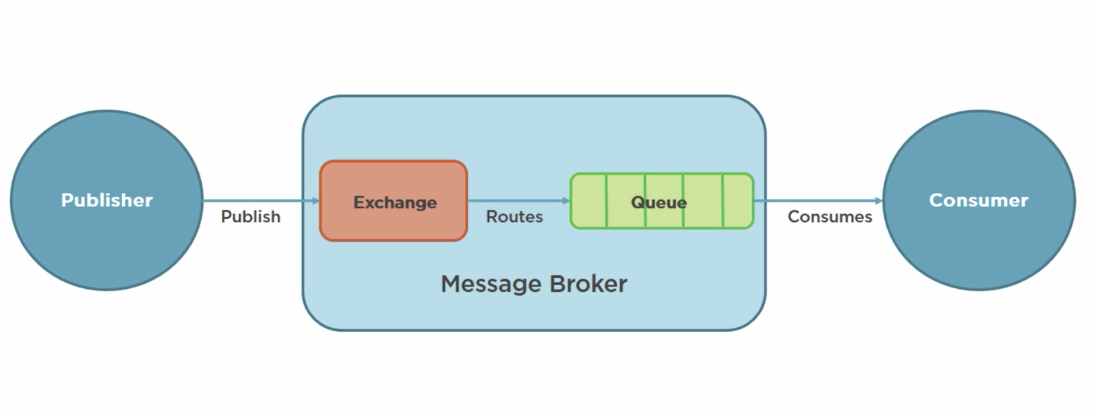
What is AMQP?
Advanced Message Queue Protocol
Network protocol to enable client apps to communicate with compatible messaging systems
AMQP was designed with the following main characteristics as goals:
Security
Reliability
Interoperability
Standard
Open
Notes:
AMQP was originated in 2003 by John O'Hara at JPMorgan Chase in London.
In 2005 JPMorgan Chase approached other firms to form a working group Cisco Systems, Red Hat, etc
RabbitMQ was developed in Erlang by Rabbit Technologies
The working group grew to 23 companies
In August 2011, the AMQP working group announced its reorganization into an OASIS member section.
RabbitMQ - primarily supports AMQP 0-9-1, with 1.0 via experimental plugin
PL – Java, .Net, Windows, and Linux.

Slide 5
AMQP Model
Exchange -> Binding ->[Queue]
Exchanges
Receives and routes messages
Binding
Defines the relationship between exchange and queue
Queues
Stores messages until they are processed
Notes:
There are four building blocks you really care about in AMQP: virtual hosts, exchanges, queues and bindings
- A virtual host holds a bundle of exchanges, queues and bindings
- Queues are where your “messages” end up. They’re message buckets
- Exchanges are routers with routing tables. Every message has what’s known as a “routing key”, which is simply a string.

Slide 6
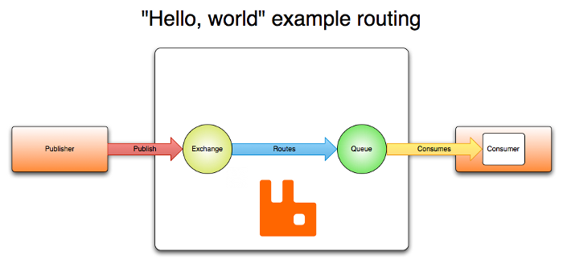
RabbitMQ Hello, world.
Notes:
docker run -d -h rabbitserver -p 15672:15672 -p 5672:5672 -p 5671:5671 --restart always rabbitmq:3-management
CloudAMQP https://www.cloudamqp.com/

Slide 7
Protolabs RabbitMQ - Early Days
P
Exchange
C
Q
Auto delete queue
Transient messages
browser
Notes:
Started with one team using it for a few high performance messaging where reliability wasn’t much concern (Single node between browser and backend server)
Historical Context - Control and standardize application integrations.
SOA
ESB
WS-*
Continuing Trends - Decentralization and team autonomy.
Interactions over HTTP or lightweight messaging
Focus on the goals, intended benefits and principles before technologies
Follow development patterns observed within numerous organizations
VM configuration deployment pipeline moving towards more optimized containers

Slide 8
Protolabs RabbitMQ – Chipping Away
RabbitMQ first used to break up Monolith
C
P/C
P/C
P/C
P
X
Q
Salesforce
Notes:
Another team spun up one instance and started using it for non critical pub sub.
(pub sub between monolith and another team)
Breaking up a monolith
Teams work in small teams organized around business domains
Teams are a combination of developers, BA, SQE, and SRE.
Notable Technologies - .NET Core, Vue.js, Docker, Linux, RabbitMQ, Chef, RavenDB
We needed messaging but unsure what topology was needed.

Slide 9
Protolabs RabbitMQ – Getting Serious
Commerce
order
C
P
X
Q
ERP
Notes:
Then new ordering system was developed to use it for submitting orders.

Slide 10
Protolabs RabbitMQ - Standardize
EasyNetQ Bunny
Cluster AMER
C
P
X
Q
Federation
Clusters EMEA
C
X
Q
Notes:
RabbitMQ moved out of Docker (QE and higher)
Deployment and configuration done via Chef.
RabbitMQ HA and clustering setup
Message topologies continue to evolve

Slide 11
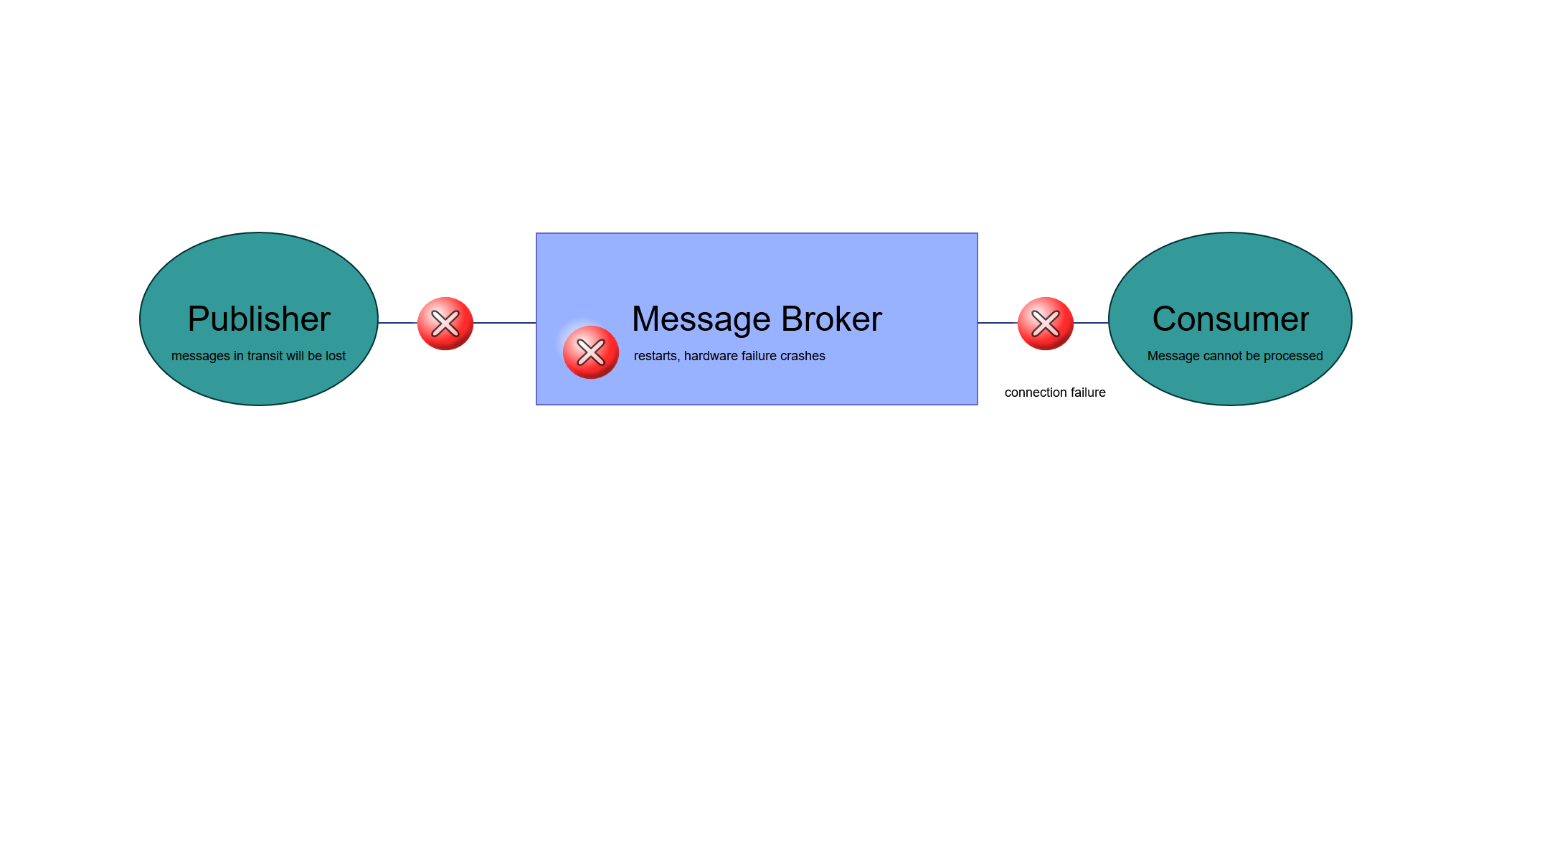
Message Durability
Publisher confirms
Durability exchanges and queues
message acknowledgements
Delivery and processing confirmation
Notes:
Distributed systems - messages sent are not guaranteed to reach the peer or be successfully processed by it
broker acknowledgements to publishers are a protocol extension called publisher confirms.
Both features build on the same idea and are inspired by TCP. They are essential for reliable delivery both from publishers to RabbitMQ nodes and from RabbitMQ nodes to consumers.
If a consumer dies (its channel is closed, connection is closed, or TCP connection is lost) without sending an ack, RabbitMQ will understand that a message wasn't processed fully and will re-queue it.
Use durable to avoid lost queues and exchanges when RabbitMQ quits or crashes.

Slide 12
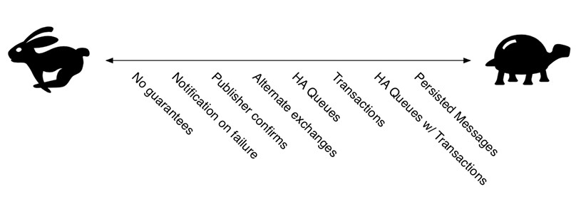
Message Publishing
Message Publishing in RabbitMQ, by Gavin M Roy
Notes:
fire-and-forget to saved to disk
As we get to safer and safer guarantees around message delivery, it gets slower.

Slide 13
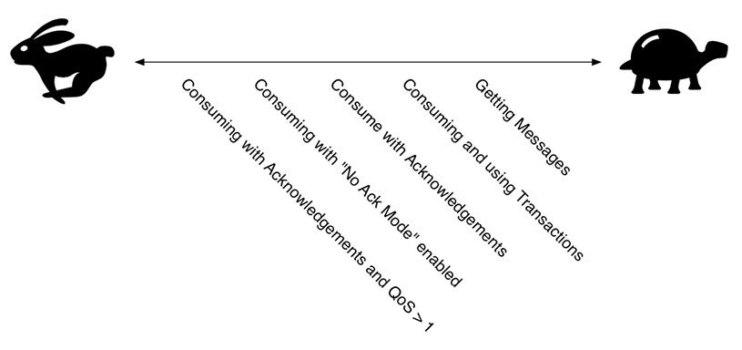
Receiving Messages
Message Publishing in RabbitMQ, by Gavin M Roy
Notes:
QoS prefetch is basically telling Rabbit how quickly can this one connection, this one channel process messages.

Slide 14
High Availability
Enable Publisher confirms
Use Durable queues, exchanges
Extensions to consider - consistently hash and sharding
Do not enable HiPE
Prefetch configuration
Multi nodes with HA policy

Slide 15
High Performance
Enable HiPE
Disable LazyQueue
Short queues
Transient Messages
Disable HA

Slide 16

My Recent RabbitMQ success story.
Refining a services boundaries and switching to RabbitMQ
Notes:
I recently took over an application that did some very heavy processing
New feature – move the processing service to 2 different data center because of ITAR regulations
Remove shared DB
Allow API to send messages to correct regional processing service

Slide 17
My Recent RabbitMQ success story.

Slide 18
Direct Exchange
Queue
Consumer
Created
Publisher
Direct exchange
Consumer
Queue
Created
Modified
Deleted
Modified
Deleted
Queue
Consumer
Routing Keys
Bindings
Notes:
Direct Exchange – Routing keys are involved. A queue binds to the exchange to request messages that match a particular routing key exactly. This is a straight match.
if the message's routing key doesn't match the binding key, none of the queues will receive the message.

Slide 19
Fan out example
C
Queue A
Fan out exchange
C
P
Queue B
C
Queue C
Notes:
Fanout Exchange – No routing keys involved. You simply bind a queue to the exchange. Any message that is sent to the exchange is sent to all queues bound to that exchange. Think of it like a subnet broadcast. Any host on the subnet gets a copy of the packet. Fanout exchanges route messages the fastest.
With a fanout exchange, there is no filtering and all messages go to all bound queues.

Slide 20
Topic exchange example
Wild card routing by routing key
* (star) can substitute for exactly one word.
# (hash) can substitute for zero or more words.
C
Q
*.mdc.*
P
Topic exchange
*.*.mdc
C
Q
mdc.#
Q
C
Bindings
Notes:
Topic Exchange – Matches routing keys against a pattern. Instead of binding with a particular routing key, the queue binds with a pattern string. The symbol # matches one or more words, and the symbol * matches any single word (no more, no less).

Slide 21
Analysis Request Example
C
Q
Analysis Archive
#
Q
C
3dp.amer
3DP America Analysis
Analysis Request
P
X
cnc.emea
C
Q
CNC UK Analysis
im.jp
Q
C
Injection Molding Japan Analysis

Slide 22

Competing Consumers Demo
Notes:
*** Reminder shut down any RabbitMQ instances running on port 15672
Reminder shut down and VS instances that have the pub or consumer app open. ***
docker-compose up --build --abort-on-container-exit

Slide 23
Rabbitmq Use Cases
Good
Event Stream
Connecting apps new and old written in different languages
When you are uncertain RabbitMQ is a certain choice
multi protocol and patterns
Federation between data centers
Bad
Large binary videos and images
Use as a data store large queues

Slide 24
Lessons Learned
Stay up to date with clients, rabbitmq, and erlang
Connections - don't open new connections with every message.
Don't let queues grow 10 000 messages is too much limit with TTL or max size
Send persistent messages and use durable queues and exchange
Use publisher confirms when it makes sense
Take a look at prefetch and adjust if needed.
Notes:
https://www.cloudamqp.com/blog/2018-01-19-part4-rabbitmq-13-common-errors.html
Story about correlation id.
“Hey, use the model. Look at the message properties. Figure out how you can combine exchanges, and routing keys, and message properties to provide the context to your messages so that the message body itself is as terse or limited to the content you actually care about at the message level and go from there.

Slide 25
Monitoring
Queue Length
Missing Consumers
How long messages have been in queue
CPU, RAM, Disk
https://www.rabbitmq.com/production-checklist.html

Slide 26
Summary
RabbitMQ is a great solution for connecting async messaging for Microservices
RabbitMQ provides options for high performance and high reliability
Messaging doesn’t need to be hard, it can be boring, and boring is good.

Slide 27

Questions?

