Slide 1
Microservice Plumbing With RabbitMQ
Smart endpoints and dumb pipes
jasonrowe@gmail.com
@jsonrow
ProtoLabs

Slide 2
ProtoLabs - Microservice and RabbitMQ
Breaking up a monilith
Teams work in small teams organized around business domains
Teams are a combination of developers, BA, SQE, and SRE.
Notable Technologies - .NET Core, Vue.js, Docker, Linux, RabbitMQ, Chef, RavenDB
RabbitMQ
3.7.7
Clusters of 2 nodes
HAProxy used as loadbalancer infront of RabbitMQ instances
HA queues synced between nodes

Slide 3
ProtoLabs RabbitMQ Evolution
Started with one team using it for a few high performance messaging where reliability wasn’t much concern (Single node between browser and backend server)
Another team spun up one instance and started using it for non critical pub sub.
(pub sub between monolith and another team)
Then new ordering system was developed to use it for submitting orders.
(As the ordering and commerce team broke up they decided to use RabbitMQ HA and clustering was added)
Then another team setup an exchange to coordinate messages from global service to regional services. Then those regional services started using it to publish messages back to global services. Complex topologies evolved with multiple clusters using federation to talk to other clusters.

Slide 4
Must Read Topics
https://www.rabbitmq.com/production-checklist.html
https://www.rabbitmq.com/confirms.html

Slide 5
Messaging topologies
Global routing to regional (federations policies)
Short lived queues for browser interactions
Private exchanges used inside teams processors Topic exchanges

Slide 6
Microservice messaging landscape
Historical Context - Control and standardize application integrations.
SOA
ESB
WS-*
Continuing Trends - Decentralization and team autonomy.
Interactions over HTTP or lightweight messaging
Focus on the goals, intended benefits and principles before technologies
Follow development patterns observed within numerous organizations (TODO RabbiMQ Examples)

Slide 7
Architecture examples?
Messaging at ProtoLabs?
Microsevice overview at ProtoLabs?
Messaging Patterns we are using.
What works?
What doesn’t work?
HA options

Slide 8
What is RabbitMQ?
AMQP Protocol "core" protocol supported by the broker
Open Source Messaging System
Reliability
Routing
Clustering and High Availability
Management UI and API
Client Libraries

Slide 9
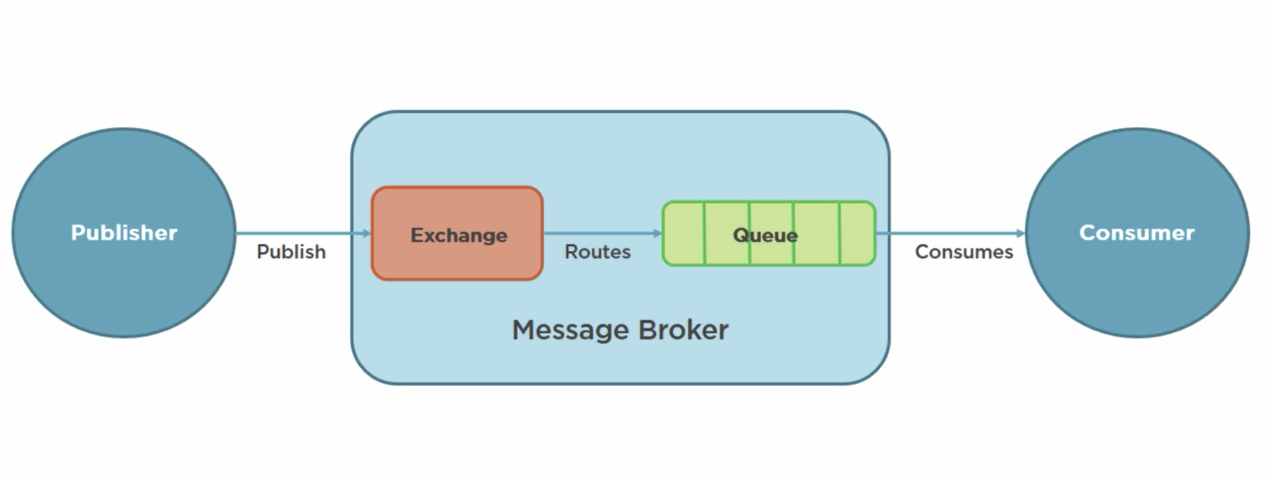
What is AMQP?
Advanced Message Queue Protocol
Network protocol to enable client apps to communicate with compatible messaging systems
AMQP was designed with the following main characteristics as goals:
Security
Reliability
Interoperability
Standard
Open

Slide 10
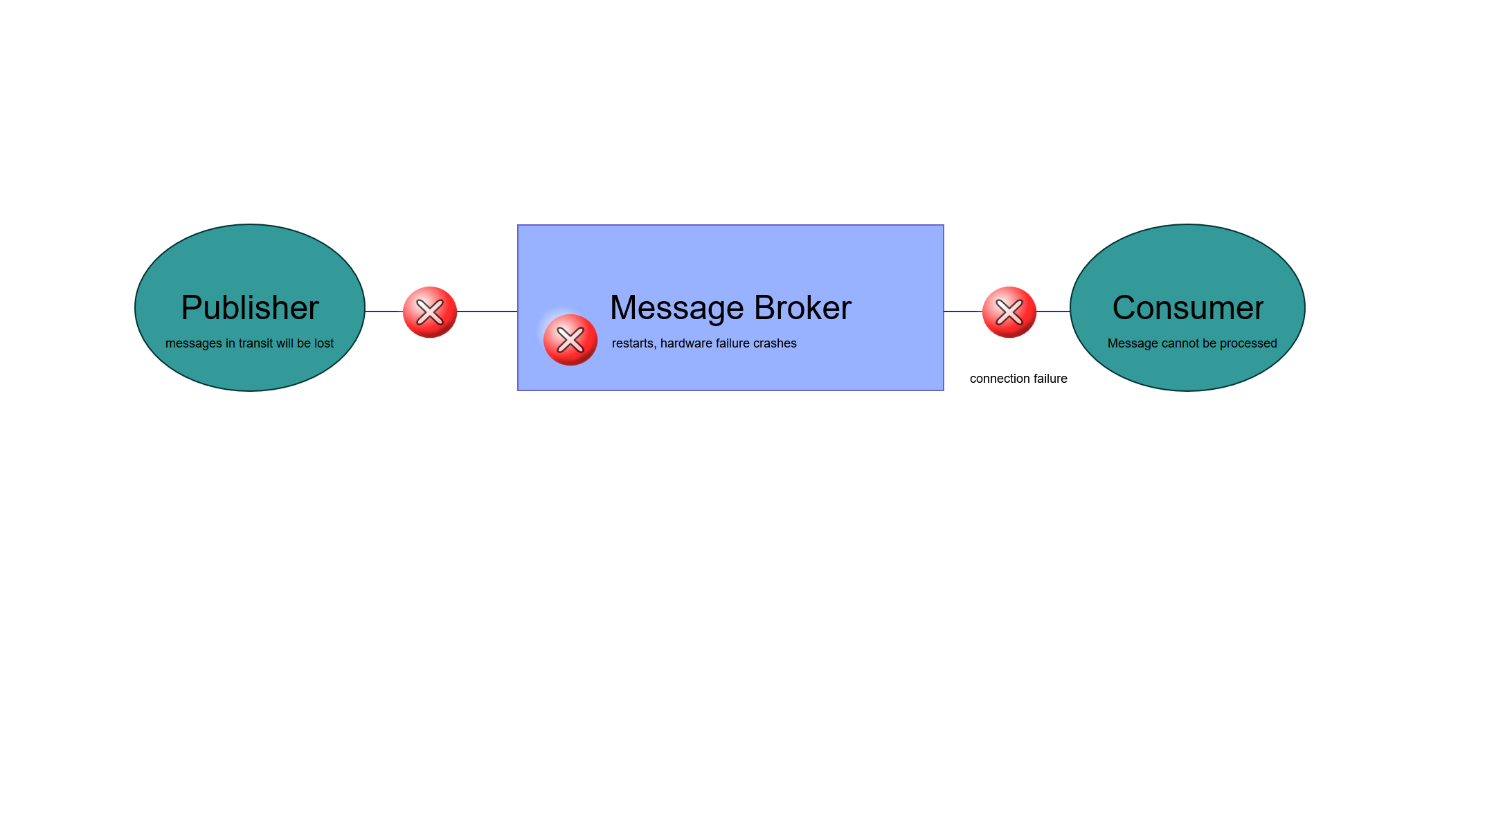
What is AMQP?
message acknowledgements
Delivery and processing confirmation
AMQP 0-9-1

Slide 11
Outline (Rough Draft)
What are the key points that my audience should take away from the talk
RabbitMQ is a great solution for connecting async messaging for Microservices
RabbitMQ provides options for high performanc and high reliability
Messaging doesn’t need to be hard, it can be boring, and boring is good.
Monitoring New Relic ?
Federation examples
Microservices connecting
How rabbitmq fits for async messaging
About rabbitmq
Overview
Amqp
Initial look mgmt. page demo
Messaging patterns
Example patterns
Example failures
Example saga?
Best practices
Example reliable messaging
HA
Connection handling
Message size
Exchange queue
Names
Routing keys
Federation policy
Add your third bullet point here

Slide 12
Title and Content Layout with Chart

Slide 13
Two Content Layout with Table
First bullet point here
Second bullet point here
Third bullet point here
Class | Group 1 | Group 2
Class 1 | 82 | 95
Class 2 | 76 | 88
Class 3 | 84 | 90

Slide 14
Two Content Layout with SmartArt
First bullet point here
Second bullet point here
Third bullet point here
Task 1
Task 2
Task 3

Slide 15
Add a Slide Title - 1

Slide 16
Add a Slide Title - 2

Slide 17
Add a Slide Title - 3

Slide 19
Add a Slide Title - 4

Slide 20
Add a Slide Title - 5

