Slide 1
Microservice Plumbing With RabbitMQ
Smart endpoints and dumb pipes
jasonrowe@gmail.com
@jsonrow
ProtoLabs

Slide 2
ProtoLabs - Microservice and RabbitMQ
Breaking up a monilith
Teams work in small teams organized around business domains
Teams are a combination of developers, BA, SQE, and SRE.
Notable Technologies - .NET Core, Vue.js, Docker, Linux, RabbitMQ, Chef, RavenDB
We needed messaging but unsure what topology was needed.
RabbitMQ
3.7.7
Clusters of 2 nodes
HAProxy used as loadbalancer infront of RabbitMQ instances
HA queues synced between nodes

Slide 3
Pre micro service architecture
Diagram showing BO and database monolith.

Slide 4
RabbitMQ Overview
Started in 2008
AMQP Protocol "core" protocol supported by the broker
Open Source Messaging System
Reliability
Developer centric API and docs are dev focused
Routing
Clustering and High Availability
Management UI and API
Client Libraries
Docs examples user group

Slide 5
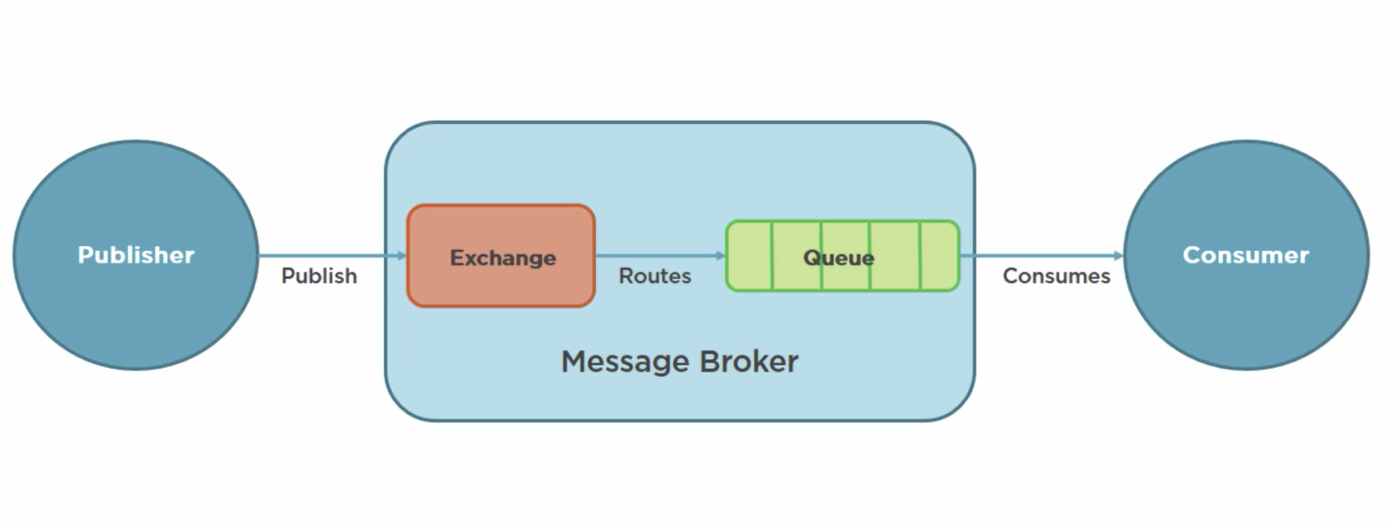
What is AMQP?
Advanced Message Queue Protocol
Network protocol to enable client apps to communicate with compatible messaging systems
AMQP was designed with the following main characteristics as goals:
Security
Reliability
Interoperability
Standard
Open

Slide 6
AMQP Model
Exchange -> Binding ->[Queue]
Exchanges
Recieves and routes messages
Binding
Defines the relationship between exchange and queue
Queues
Stores messages until they are processed

Slide 7
Microservice messaging landscape
Historical Context - Control and standardize application integrations.
SOA
ESB
WS-*
Continuing Trends - Decentralization and team autonomy.
Interactions over HTTP or lightweight messaging
Focus on the goals, intended benefits and principles before technologies
Follow development patterns observed within numerous organizations (TODO RabbiMQ Examples)
VM configuration deployment pipeline moving towards more optimized containers

Slide 8
Service Boundaries
Examples of how we determine service boundaries new architecture diagrams
Map to business domains

Slide 9
ProtoLabs RabbitMQ Evolution
Started with one team using it for a few high performance messaging where reliability wasn’t much concern (Single node between browser and backend server)
Another team spun up one instance and started using it for non critical pub sub.
(pub sub between monolith and another team)
Then new ordering system was developed to use it for submitting orders.
(As the ordering and commerce team broke up they decided to use RabbitMQ HA and clustering was added)
Then another team setup an exchange to coordinate messages from global service to regional services. Then those regional services started using it to publish messages back to global services. Complex topologies evolved with multiple clusters using federation to talk to other clusters.

Slide 10
Fan out example
Consumer
Queue A
Publisher
Fan out exchange
Consumer
Queue B
Consumer
Queue C

Slide 11
Direct Exchange
Queue with binding key Created
Consumer
Bindings
Routing Key
Peblisher
Direct exchange
Queue with Binding key Modified
Consumer
Created
Modified
Deleted
Queue with binding key Deleted
Consumer

Slide 12
Topic exchange example
Wild card routing by routing key
* = match one word
# = match multiple words

Slide 13
Competing Consumers

Slide 14
Hashing Exchange Example

Slide 15
Rabbitmq use cases
Good
Event Stream
Connecting apps new and old written in different languages
When you are uncertain Rabbitmq is a certain choice multi protocol and patterns
Locality global regional
Bad
Large binary videos and images
Use as a data store large ques

Slide 16
Lessons Learned
Don’t just use a framework without understanding the ramifications
Lots of features extensions that can be used instead recreated the wheel.
Management UI runs on same mode handling messages
Connections - dont open new connections with every message. Connections and channels are expensive. 100kb each.
Reuse connections singleton pattern
RabbitMQ is optimized for long lived connections Don't let queues grow 10 000 messages is too much limit with TTL or max sizeSend persistent messages and use durable queues and exchange
Use publisher confirms
Adjust pre fetch RMPS 3.7 has a default of 50
RabbitMQ in a containers need to persist state
Heartbeats

Slide 17
Investigate / Future 3.8 and beyond
Event Exchange
Churn Statistics
Protocol agnostic core
Native processing speed up mqtp traffic
Moving away from amqp model
Graph based queues
Quorum queues data safety replication
http 2/3
More protocols better flow control and cluster aware
Oauth 2.0 support

Slide 18
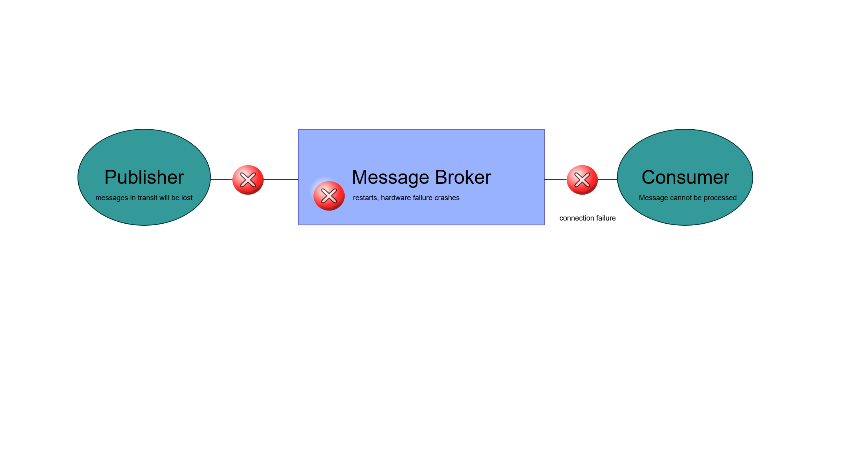
What is AMQP?
message acknowledgements
Delivery and processing confirmation
AMQP 0-9-1

Slide 19
High Availability
Extensions- consistantly hash and sharding
Do not enable HiPE
Durable queues, exchanges
Prefetch configuration
Publisher confirms
Multi nodes with HA policy

Slide 20
Monitoring
Queue Length
Missing Consumers
How long messages have been in queue
CPU, RAM, Disk

Slide 21
High Performance
Enable HiPE
Disable LazyQueue
Short queues
Avoid multiple nodes
Transient Messages
Disable Ha

Slide 22
Messaging topologies
Global routing to regional (federations policies)
Short lived queues for browser interactions
Private exchanges used inside teams processors Topic exchanges

Slide 23
Architecture examples?
Messaging at ProtoLabs?
Microsevice overview at ProtoLabs?
Messaging Patterns we are using.
What works?
What doesn’t work?
HA options

Slide 24
QUESTIONS

Slide 25
Outline (Rough Draft)
What are the key points that my audience should take away from the talk
RabbitMQ is a great solution for connecting async messaging for Microservices
RabbitMQ provides options for high performanc and high reliability
Messaging doesn’t need to be hard, it can be boring, and boring is good.
Monitoring New Relic ?
Federation examples
Microservices connecting
How rabbitmq fits for async messaging
About rabbitmq
Overview
Amqp
Initial look mgmt. page demo
Messaging patterns
Example patterns
Example failures
Example saga?
Best practices
Example reliable messaging
HA
Connection handling
Message size
Exchange queue
Names
Routing keys
Federation policy
Add your third bullet point here

Slide 26
Title and Content Layout with Chart

Slide 27
Two Content Layout with Table
First bullet point here
Second bullet point here
Third bullet point here
Class | Group 1 | Group 2
Class 1 | 82 | 95
Class 2 | 76 | 88
Class 3 | 84 | 90

Slide 28
Two Content Layout with SmartArt
First bullet point here
Second bullet point here
Third bullet point here
Task 1
Task 2
Task 3

Slide 29
Add a Slide Title - 1

Slide 30
Add a Slide Title - 2

Slide 31
Must Read Topics
https://www.rabbitmq.com/production-checklist.html
https://www.rabbitmq.com/confirms.html

Slide 32
Add a Slide Title - 3

Slide 34
Add a Slide Title - 4

Slide 36
Add a Slide Title - 5

