Slide 1
Microservice Plumbing With RabbitMQ
async messaging for Microservices
@jsonrow jasonrowe@gmail.com
https://github.com/JasonRowe/TCCC23
Notes:
About this talk
RabbitMQ as a message broker between our microservices.
Success stories, lessons learned, messaging patterns, and demos.
About me and past experience with messaging
PAST – Windows, MSMQ, NServiceBus, MassTransit and others.
Current – .NET Core, Linux, RabbitMQ, Docker
What I've found is RabbitMQ just works and is simple to use.

Slide 2
ProtoLabs Messaging Evolution
Started with one team using it for a few high performance messaging where reliability wasn’t much concern (Single node between browser and backend server)
Another team spun up one instance and started using it for non critical pub sub.
(pub sub between monolith and another team)
Then new ordering system was developed to use it for submitting orders.
(As the ordering and commerce team broke up they decided to use RabbitMQ HA and clustering was added)
Then another team setup an exchange to coordinate messages from global service to regional services. Then those regional services started using it to publish messages back to global services. Complex topologies evolved with multiple clusters using federation to talk to other clusters.
Notes:
Breaking up a monilith
Teams work in small teams organized around business domains
Teams are a combination of developers, BA, SQE, and SRE.
Notable Technologies - .NET Core, Vue.js, Docker, Linux, RabbitMQ, Chef, RavenDB
We needed messaging but unsure what topology was needed.

Slide 3
Microservice messaging landscape
Historical Context - Control and standardize application integrations.
SOA
ESB
WS-*
Continuing Trends - Decentralization and team autonomy.
Interactions over HTTP or lightweight messaging
Focus on the goals, intended benefits and principles before technologies
Follow development patterns observed within numerous organizations
VM configuration deployment pipeline moving towards more optimized containers

Slide 4

RabbitMQ Overview
What is RabbitMQ?
Notes:
Open Source Messaging System (Message Broker)
Developer centric API and docs are dev focused
Clustering and High Availability
Management UI and API
Client Libraries
Lots of useful plugins
Docs examples user group
Started in 2008
RabbitMQ is the most widely deployed open source message broker.
35,000 production deployments of RabbitMQ
AMQP 0-9-1 Protocol "core" protocol supported by the broker
What we currently use RabbitMQ
3.7.7
Clusters of 2 nodes in QE and above / just docker in lower
HAProxy used as loadbalancer infront of RabbitMQ instances
HA queues synced between nodes

Slide 5
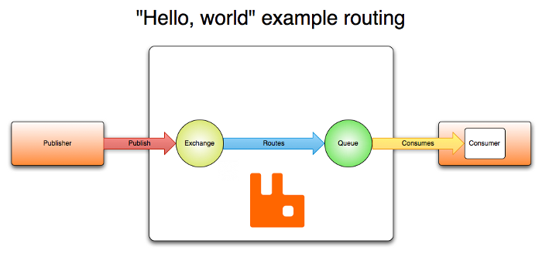
RabbitMQ Hello, world.
Notes:
docker run -d --rm -p 15672:15672 -p 5672:5672 -p 5671:5671 rabbitmq:3-management
CloudAMQP https://www.cloudamqp.com/

Slide 6
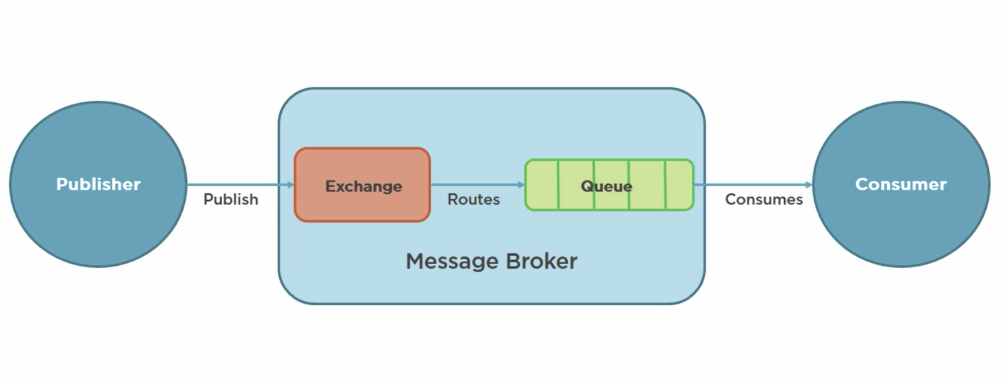
What is AMQP?
Advanced Message Queue Protocol
Network protocol to enable client apps to communicate with compatible messaging systems
AMQP was designed with the following main characteristics as goals:
Security
Reliability
Interoperability
Standard
Open
Notes:
AMQP was originated in 2003 by John O'Hara at JPMorgan Chase in London.
In 2005 JPMorgan Chase approached other firms to form a working group Cisco Systems, Red Hat, etc
RabbitMQ was developed in Erlang by Rabbit Technologies
The working group grew to 23 companies
In August 2011, the AMQP working group announced its reorganization into an OASIS member section.
RabbitMQ - primarily supports AMQP 0-9-1, with 1.0 via experimental plugin
PL – Java, .Net, Windows, and Linux.

Slide 7
AMQP Model
Exchange -> Binding ->[Queue]
Exchanges
Receives and routes messages
Binding
Defines the relationship between exchange and queue
Queues
Stores messages until they are processed

Slide 8
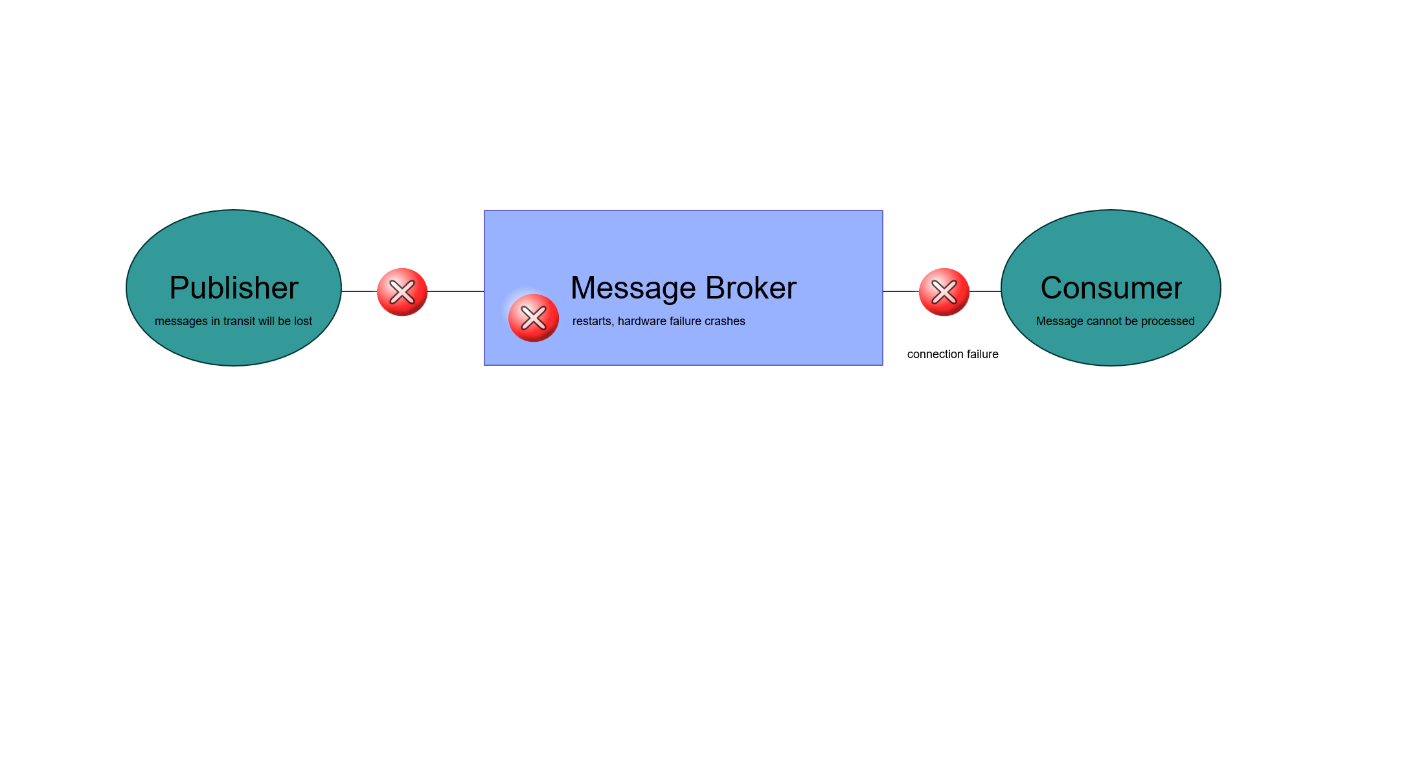
Message Durability
Publisher confirms
Durability exchanges and queues
message acknowledgements
Delivery and processing confirmation
Notes:
Distributed systems - messages sent are not guaranteed to reach the peer or be successfully processed by it
broker acknowledgements to publishers are a protocol extension called publisher confirms.
Both features build on the same idea and are inspired by TCP. They are essential for reliable delivery both from publishers to RabbitMQ nodes and from RabbitMQ nodes to consumers.
If a consumer dies (its channel is closed, connection is closed, or TCP connection is lost) without sending an ack, RabbitMQ will understand that a message wasn't processed fully and will re-queue it.
Use durable to avoid lost queues and exchanges when RabbitMQ quits or crashes.

Slide 9

My Recent RabbitMQ success story.
Refining a services boundaries and switching to RabbitMQ
Notes:
I recently took over an application that did some very heavy processing
New feature – move the processing service to 2 different data center because of ITAR regulations
Remove shared DB
Allow API to send messages to correct regional processing service

Slide 10
My Recent RabbitMQ success story.

Slide 11
Direct Exchange
Queue
Consumer
Created
Publisher
Direct exchange
Consumer
Queue
Created
Modified
Deleted
Modified
Deleted
Queue
Consumer
Routing Keys
Bindings
Notes:
if the message's routing key doesn't match the binding key, none of the queues will receive the message.

Slide 12
Topic exchange example
Wild card routing by routing key
* (star) can substitute for exactly one word.
# (hash) can substitute for zero or more words.
Consumer
Queue
*.tccc.*
Publisher
Topic exchange
Consumer
Queue
*.*.tccc.23
tccc.#
Consumer
Binding
Queue

Slide 13
Fan out example
Consumer
Queue A
Publisher
Fan out exchange
Consumer
Queue B
Consumer
Queue C
Notes:
With a fanout exchange, there is no filtering and all messages go to all bound queues.

Slide 14
Competing Consumers

Slide 15
Hashing Exchange Example

Slide 16
Rabbitmq use cases
Good
Event Stream
Connecting apps new and old written in different languages
When you are uncertain Rabbitmq is a certain choice multi protocol and patterns
Locality global regional
Bad
Large binary videos and images
Use as a data store large ques

Slide 17
Lessons Learned
Don’t just use a framework without understanding the ramifications
Lots of features extensions that can be used instead recreated the wheel.
Management UI runs on same mode handling messages
Connections - dont open new connections with every message. Connections and channels are expensive. 100kb each.
Reuse connections singleton pattern
RabbitMQ is optimized for long lived connections Don't let queues grow 10 000 messages is too much limit with TTL or max sizeSend persistent messages and use durable queues and exchange
Use publisher confirms
Adjust pre fetch RMPS 3.7 has a default of 50
RabbitMQ in a containers need to persist state
Heartbeats
Notes:
https://www.cloudamqp.com/blog/2018-01-19-part4-rabbitmq-13-common-errors.html

Slide 18
Investigate / Future 3.8 and beyond
Event Exchange
Churn Statistics
Protocol agnostic core
Native processing speed up mqtp traffic
Moving away from amqp model
Graph based queues
Quorum queues data safety replication
http 2/3
More protocols better flow control and cluster aware
Oauth 2.0 support

Slide 19
High Availability
Enable Publisher confirms
Use Durable queues, exchanges
Extensions to consider - consistently hash and sharding
Do not enable HiPE
Prefetch configuration
Multi nodes with HA policy

Slide 20
High Performance
Enable HiPE
Disable LazyQueue
Short queues
Avoid multiple nodes
Transient Messages
Disable Ha

Slide 21
Monitoring
Queue Length
Missing Consumers
How long messages have been in queue
CPU, RAM, Disk

Slide 22
Messaging topologies
Global routing to regional (federations policies)
Short lived queues for browser interactions
Private exchanges used inside teams processors Topic exchanges

Slide 23
Architecture examples?
Messaging at ProtoLabs?
Microsevice overview at ProtoLabs?
Messaging Patterns we are using.
What works?
What doesn’t work?
HA options

Slide 24
Must Read Topics
https://www.rabbitmq.com/production-checklist.html
https://www.rabbitmq.com/confirms.html

Slide 25
QUESTIONS

Slide 26
Outline (Rough Draft)
What are the key points that my audience should take away from the talk
RabbitMQ is a great solution for connecting async messaging for Microservices
RabbitMQ provides options for high performanc and high reliability
Messaging doesn’t need to be hard, it can be boring, and boring is good.
Monitoring New Relic ?
Federation examples
Microservices connecting
How rabbitmq fits for async messaging
About rabbitmq
Overview
Amqp
Initial look mgmt. page demo
Messaging patterns
Example patterns
Example failures
Example saga?
Best practices
Example reliable messaging
HA
Connection handling
Message size
Exchange queue
Names
Routing keys
Federation policy
Add your third bullet point here

Slide 27
Two Content Layout with Table
First bullet point here
Second bullet point here
Third bullet point here
Class | Group 1 | Group 2
Class 1 | 82 | 95
Class 2 | 76 | 88
Class 3 | 84 | 90

Slide 28
Two Content Layout with SmartArt
First bullet point here
Second bullet point here
Third bullet point here
Task 1
Task 2
Task 3

Slide 29
Add a Slide Title - 2

Slide 30
Add a Slide Title - 3

Slide 32
Add a Slide Title - 4

