Slide 1
Microservice Plumbing With RabbitMQ
Smart endpoints and dumb pipes
jasonrowe@gmail.com
@jsonrow
ProtoLabs

Slide 2
What is RabbitMQ?
AMQP Protocol "core" protocol supported by the broker
Open Source Messaging System
Reliability
Routing
Clustering and High Availability
Management UI and API
Client Libraries

Slide 3
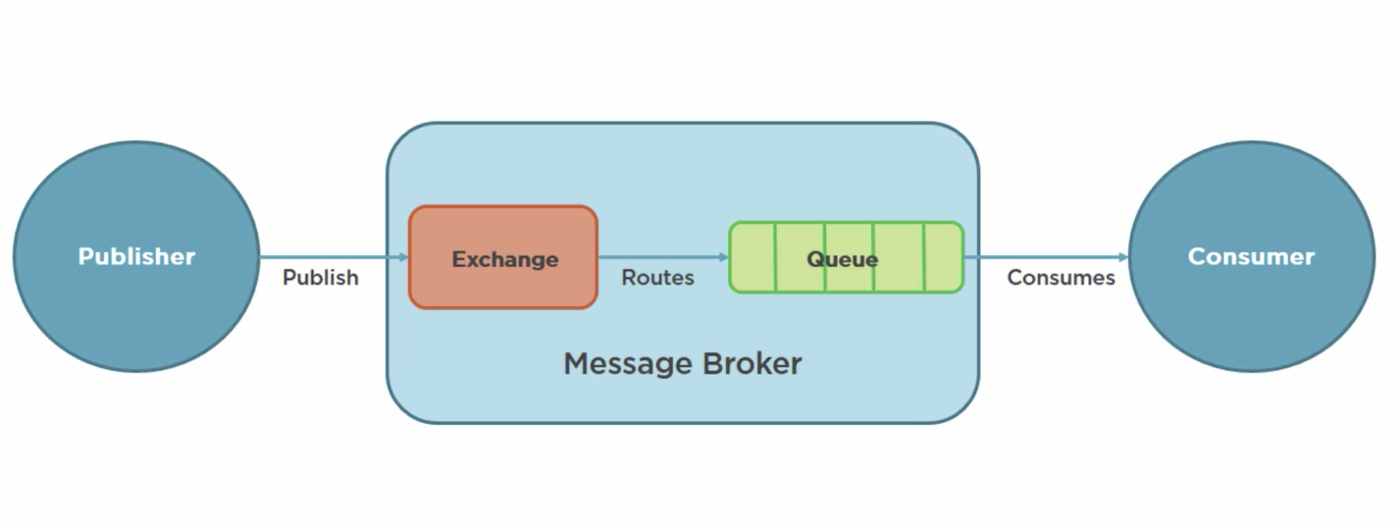
What is AMQP?
Advanced Message Queue Protocol
Network protocol to enable client apps to communicate with compatible messaging systems
AMQP was designed with the following main characteristics as goals:
Security
Reliability
Interoperability
Standard
Open

Slide 4
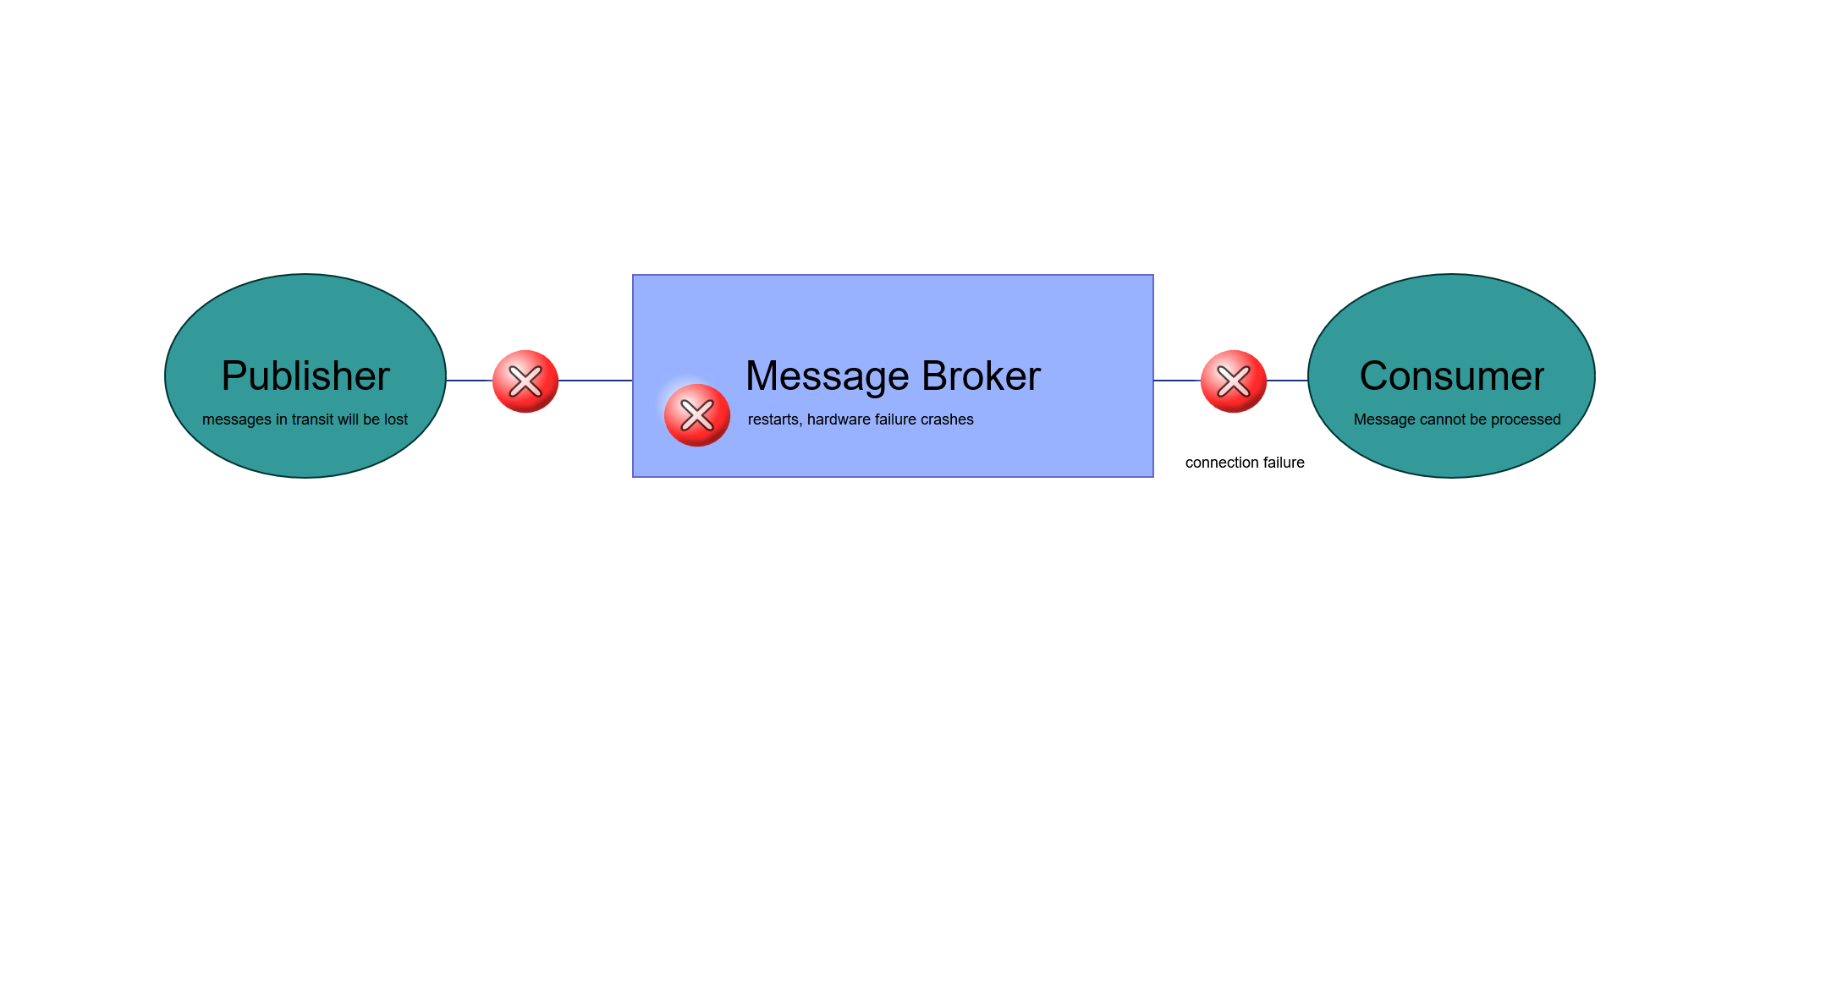
What is AMQP?
message acknowledgements
Delivery and processing confirmation
AMQP 0-9-1

Slide 5
Outline (Rough Draft)
What are the key points that my audience should take away from the talk
RabbitMQ is a great solution for connecting async messaging for Microservices
RabbitMQ provides options for high performanc and high reliability
Messaging doesn’t need to be hard, it can be boring, and boring is good.
Monitoring New Relic ?
Federation examples
Microservices connecting
How rabbitmq fits for async messaging
About rabbitmq
Overview
Amqp
Initial look mgmt. page demo
Messaging patterns
Example patterns
Example failures
Example saga?
Best practices
Example reliable messaging
HA
Connection handling
Message size
Exchange queue
Names
Routing keys
Federation policy
Add your third bullet point here

Slide 6
Title and Content Layout with Chart

Slide 7
Two Content Layout with Table
First bullet point here
Second bullet point here
Third bullet point here
Class | Group 1 | Group 2
Class 1 | 82 | 95
Class 2 | 76 | 88
Class 3 | 84 | 90

Slide 8
Two Content Layout with SmartArt
First bullet point here
Second bullet point here
Third bullet point here
Task 1
Task 2
Task 3

Slide 9
Add a Slide Title - 1

Slide 10
Add a Slide Title - 2

Slide 11
Add a Slide Title - 3

Slide 13
Add a Slide Title - 4

Slide 14
Add a Slide Title - 5

