Slide 1
claus

Slide 2

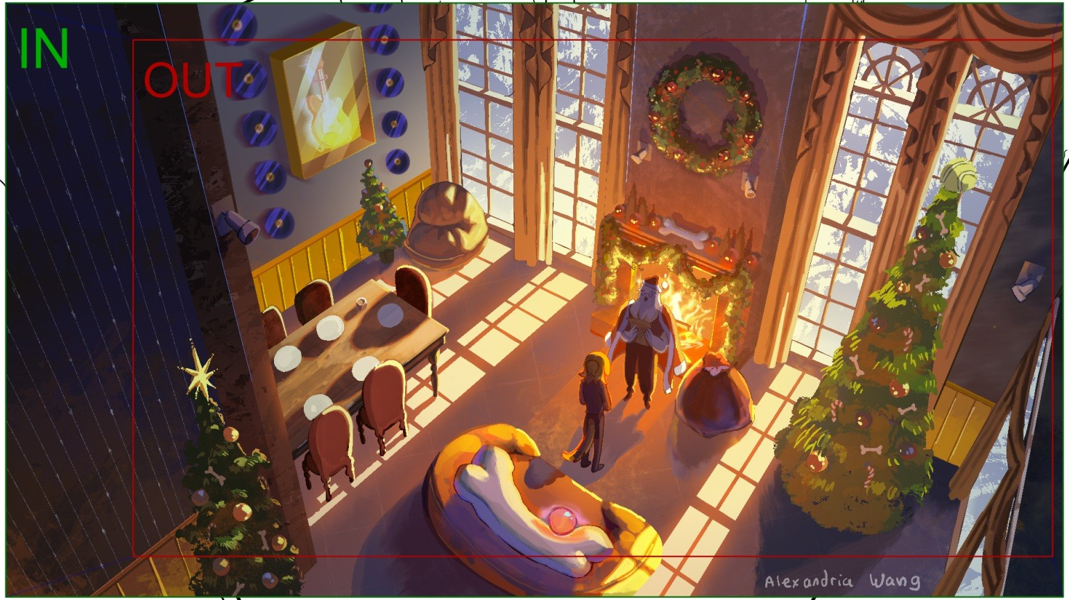
claus
Page 1/148
Scene 1 | Duration 03:21 | Panel 1 | Duration 03:21
Dialog SANTA: *clears throat* "All I want for Christmas

Slide 3
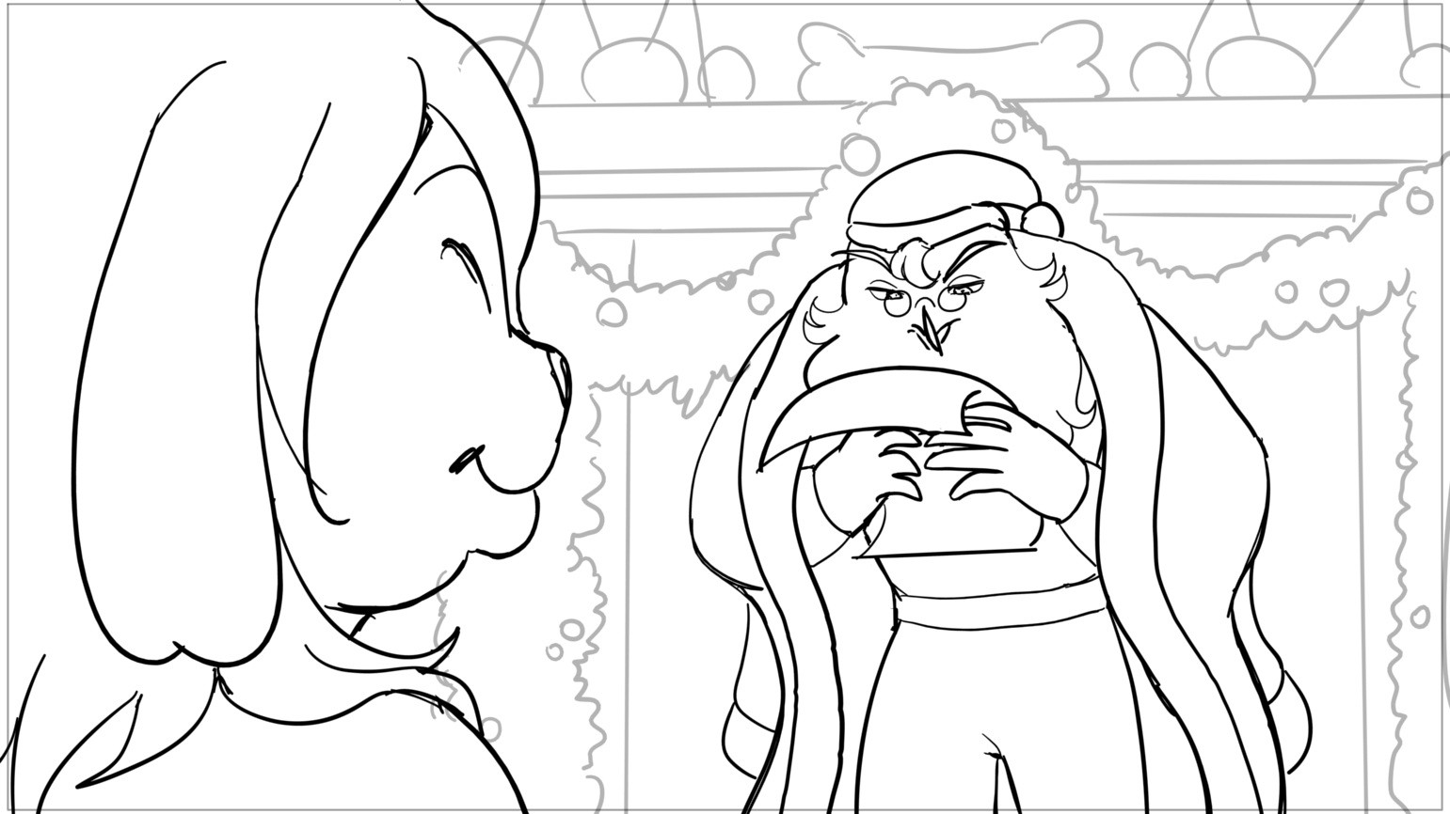
claus
Page 2/148
Scene 2 | Duration 03:17 | Panel 1 | Duration 01:06
Dialog is a kickass riff"

Slide 4
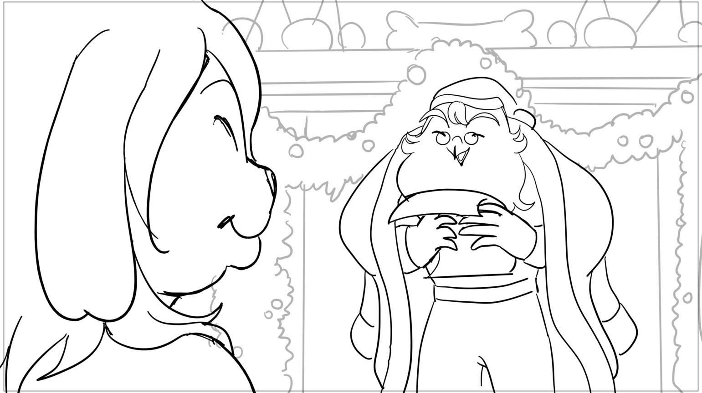
claus
Page 3/148
Scene 2 | Duration 03:17 | Panel 2 | Duration 00:20

Slide 5
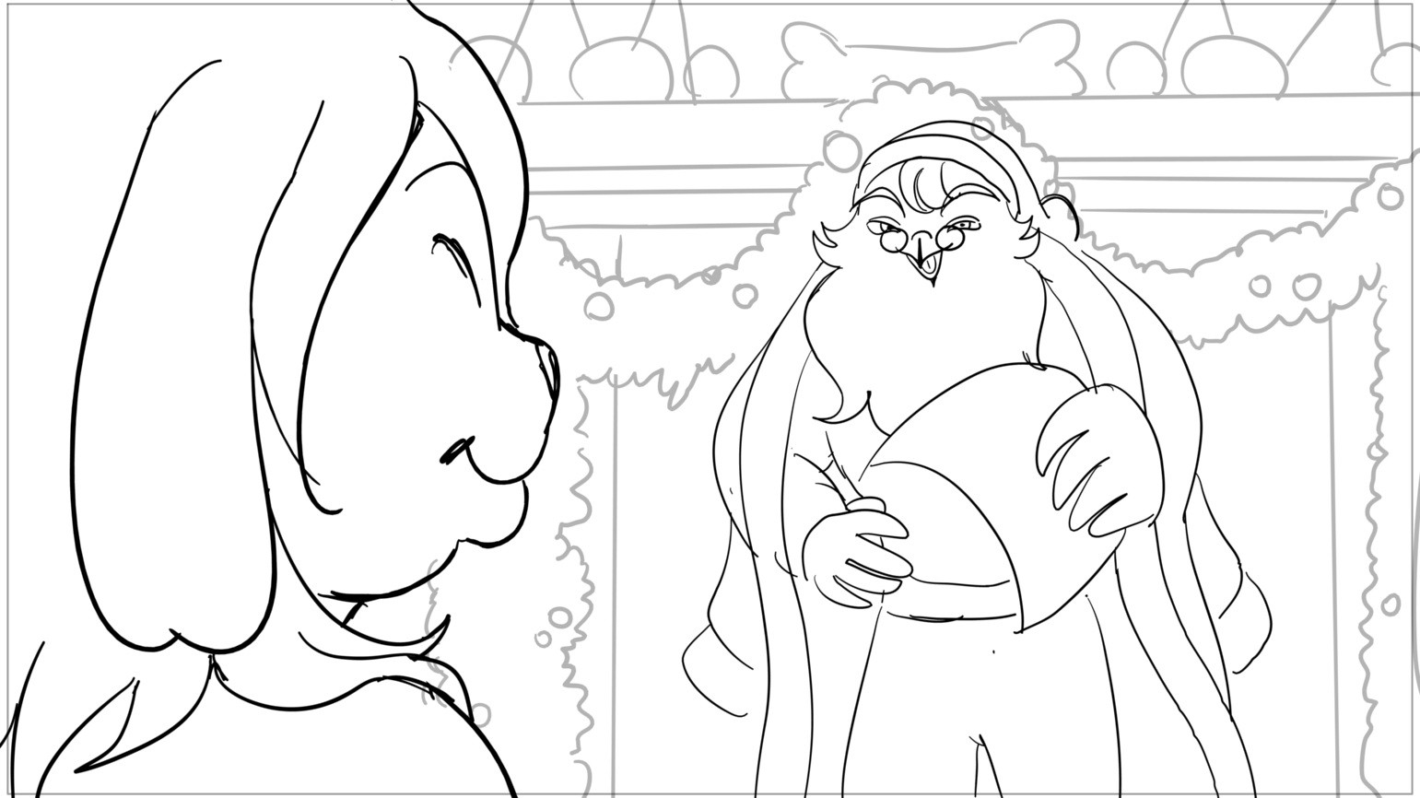
claus
Page 4/148
Scene 2 | Duration 03:17 | Panel 3 | Duration 00:09
Dialog *laughs*

Slide 6
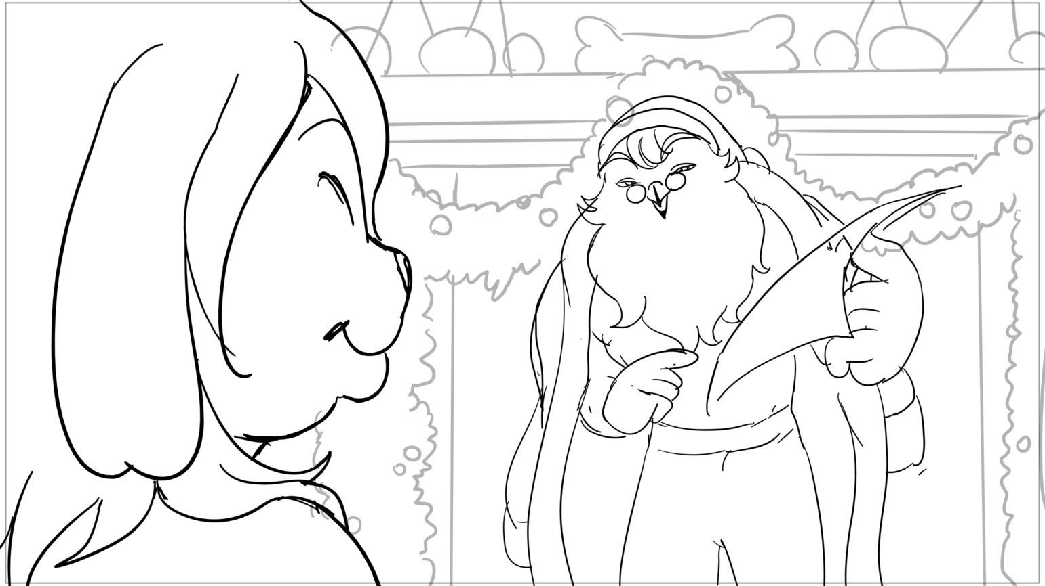
claus
Page 5/148
Scene 2 | Duration 03:17 | Panel 4 | Duration 01:06
Dialog You- you serious dawg?

Slide 7
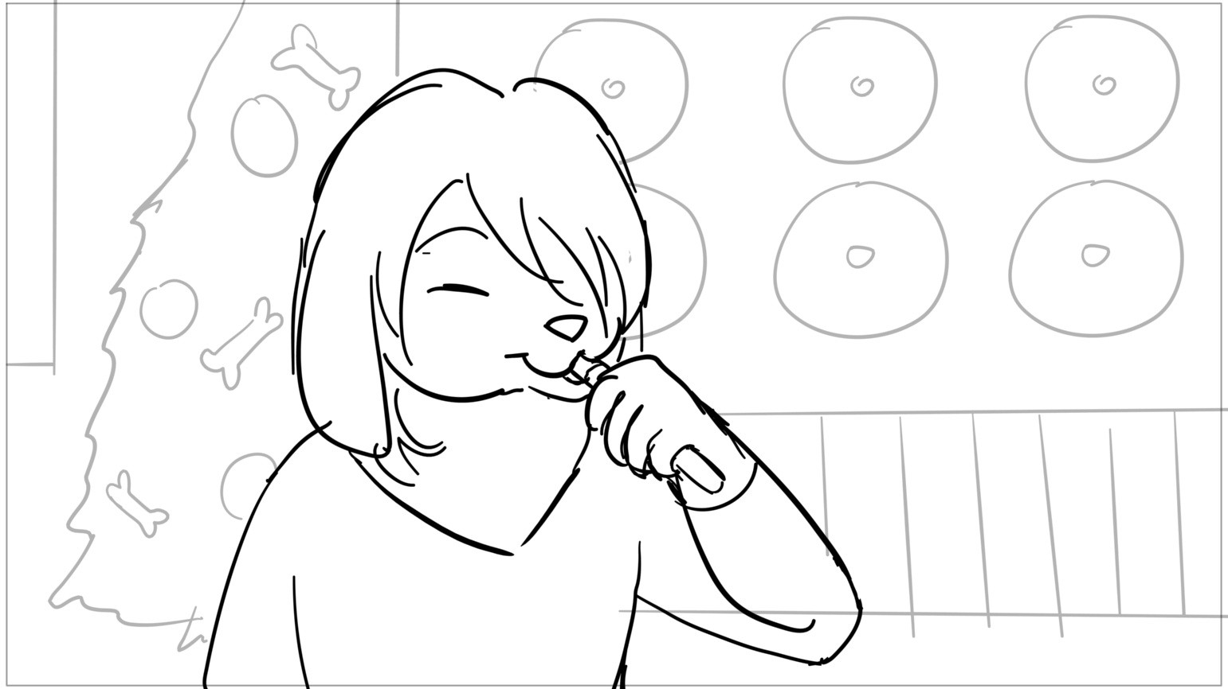
claus
Page 6/148
Scene 3 | Duration 02:04 | Panel 1 | Duration 00:06

Slide 8
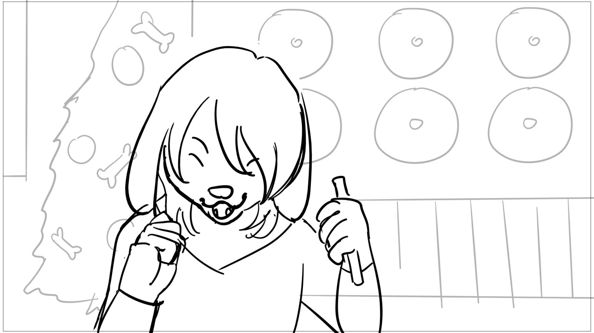
claus
Page 7/148
Scene 3 | Duration 02:04 | Panel 2 | Duration 00:08

Slide 9
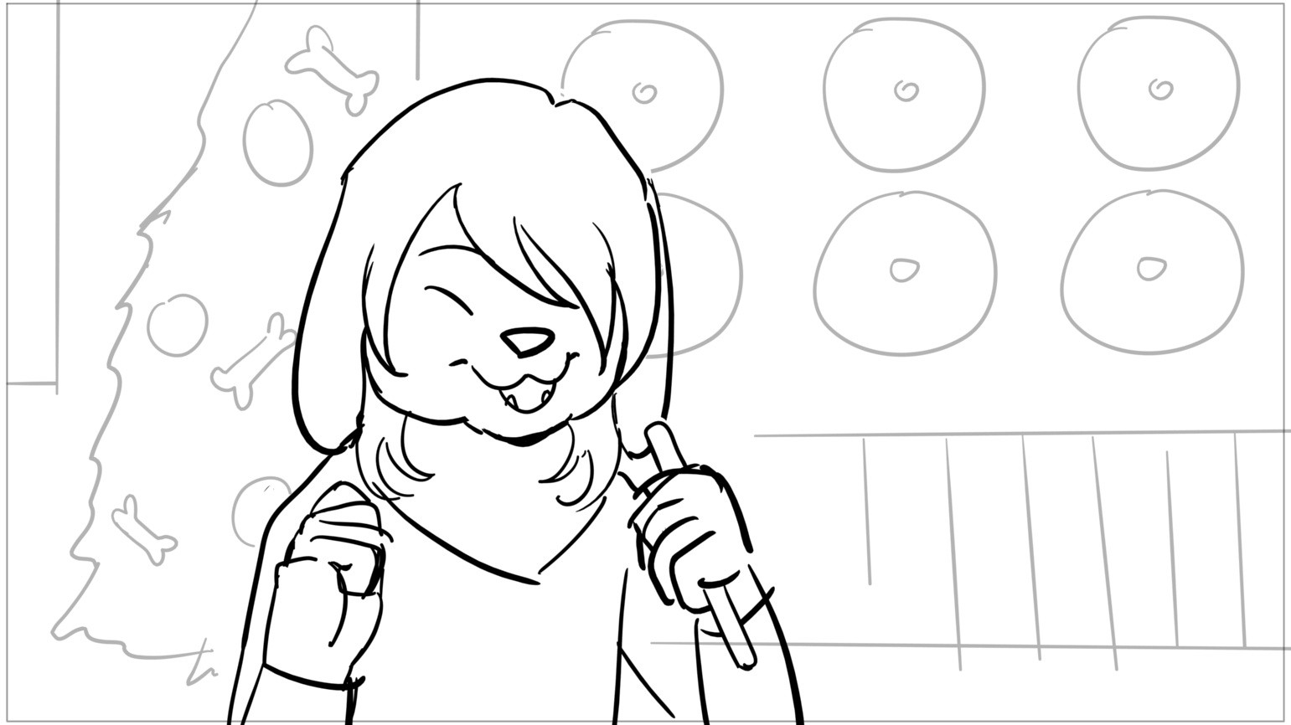
claus
Page 8/148
Scene 3 | Duration 02:04 | Panel 3 | Duration 01:14
Dialog MARSH: Yes please! SANTA: Heh, OK

Slide 10
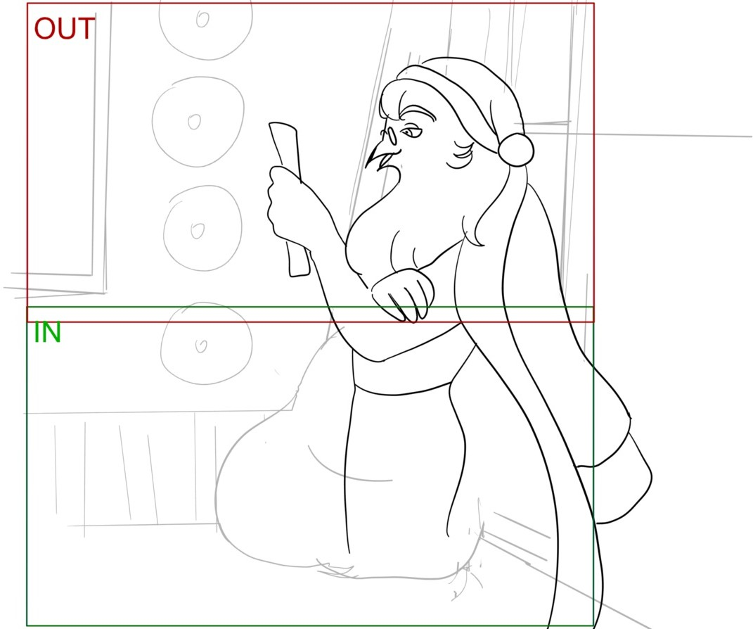
claus
Page 9/148
Scene 4 | Duration 02:17 | Panel 1 | Duration 02:17
Dialog What's wrong with the stuff I got you before?

Slide 11
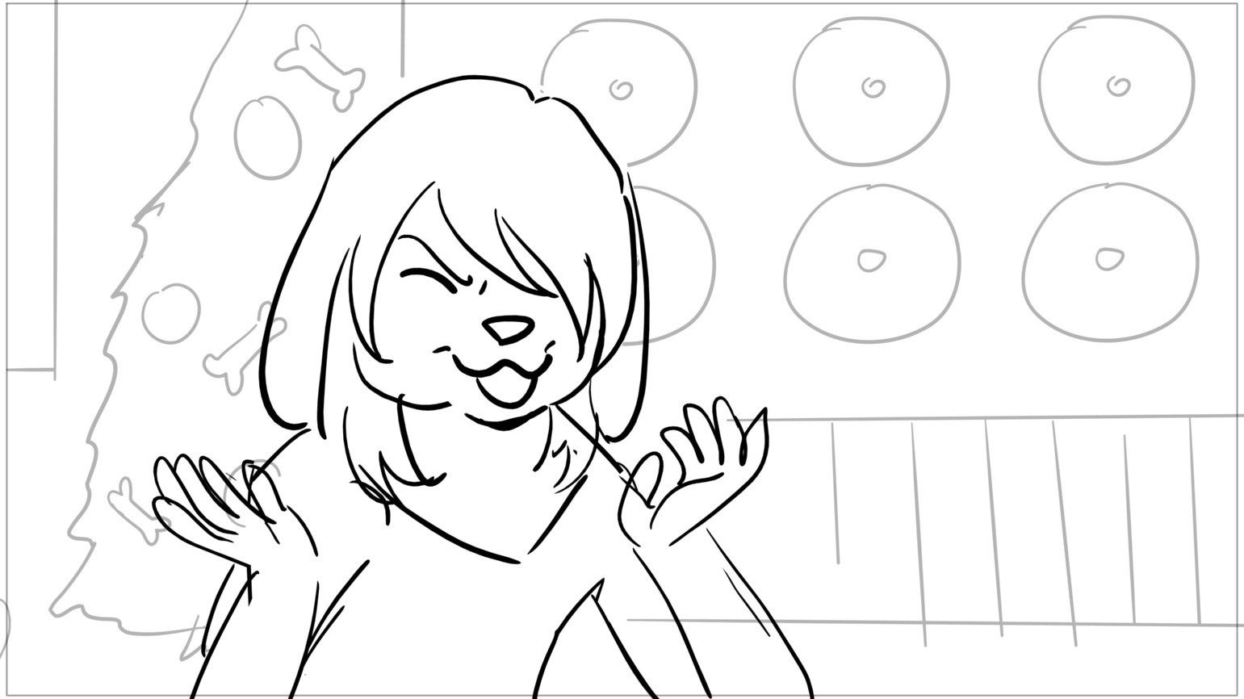
claus
Page 10/148
Scene 5 | Duration 02:06 | Panel 1 | Duration 01:01
Dialog MARSH: Ugh, I just couldn't

Slide 12
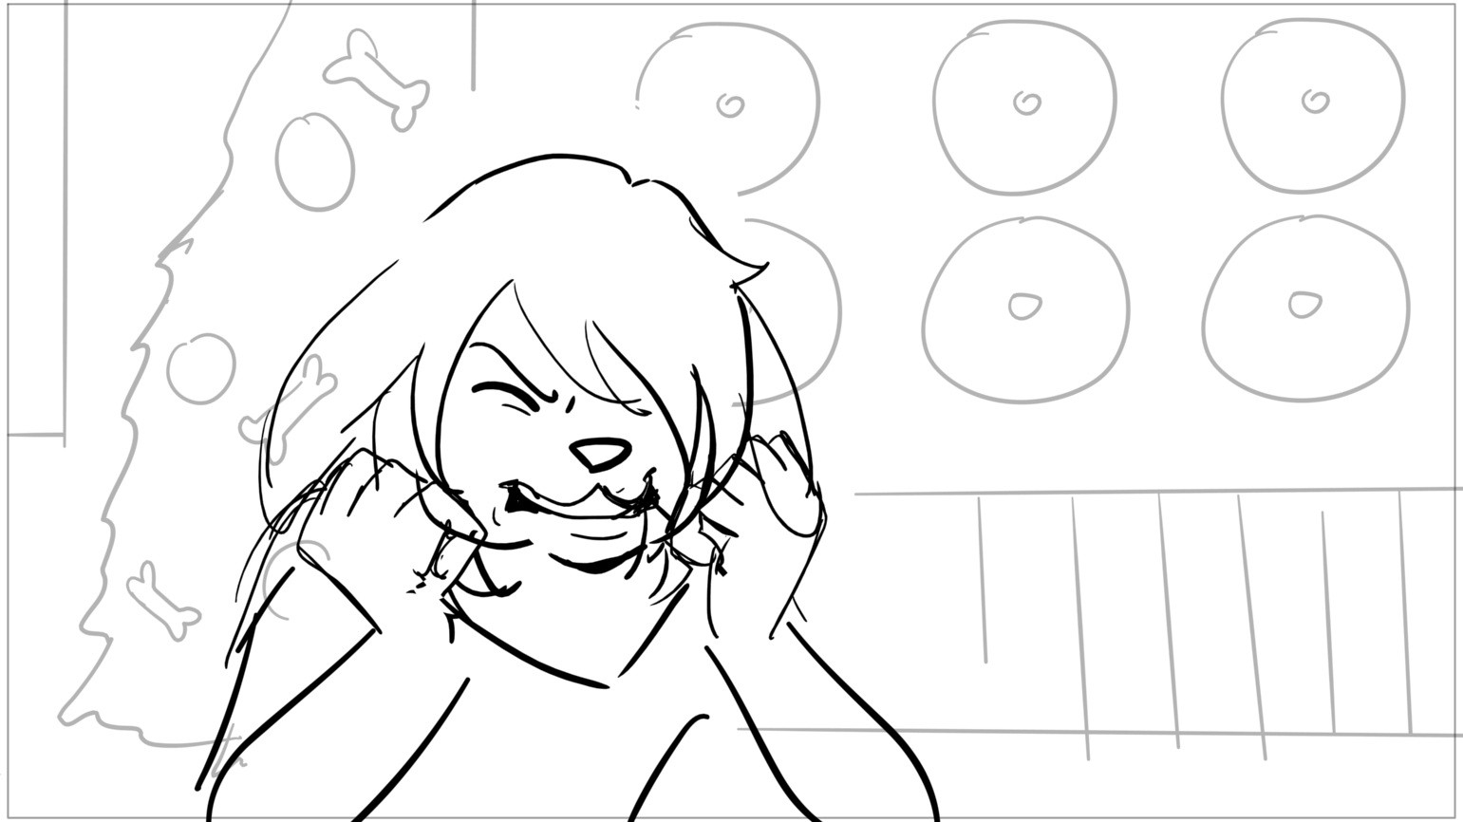
claus
Page 11/148
Scene 5 | Duration 02:06 | Panel 2 | Duration 01:05
Dialog feel the music

Slide 13
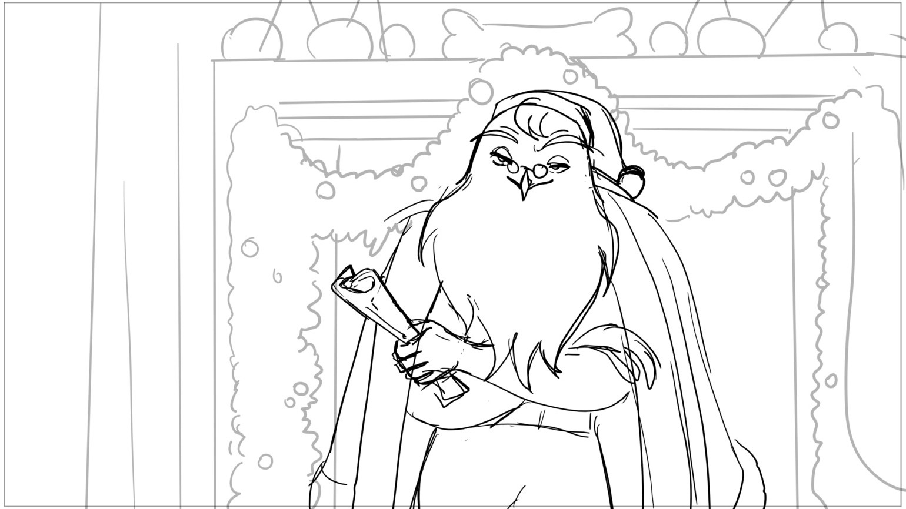
claus
Page 12/148
Scene 6 | Duration 03:06 | Panel 1 | Duration 01:06
Dialog you know what I mean?

Slide 14
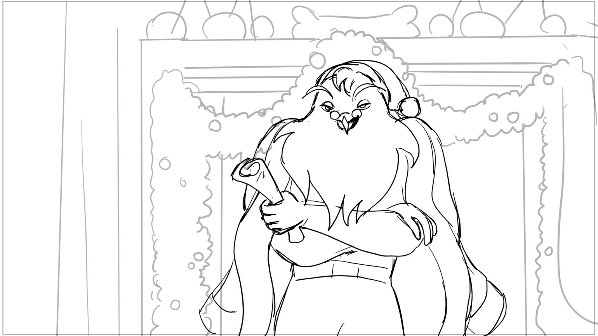
claus
Page 13/148
Scene 6 | Duration 03:06 | Panel 2 | Duration 01:00
Dialog SANTA: Alrighty,

Slide 15
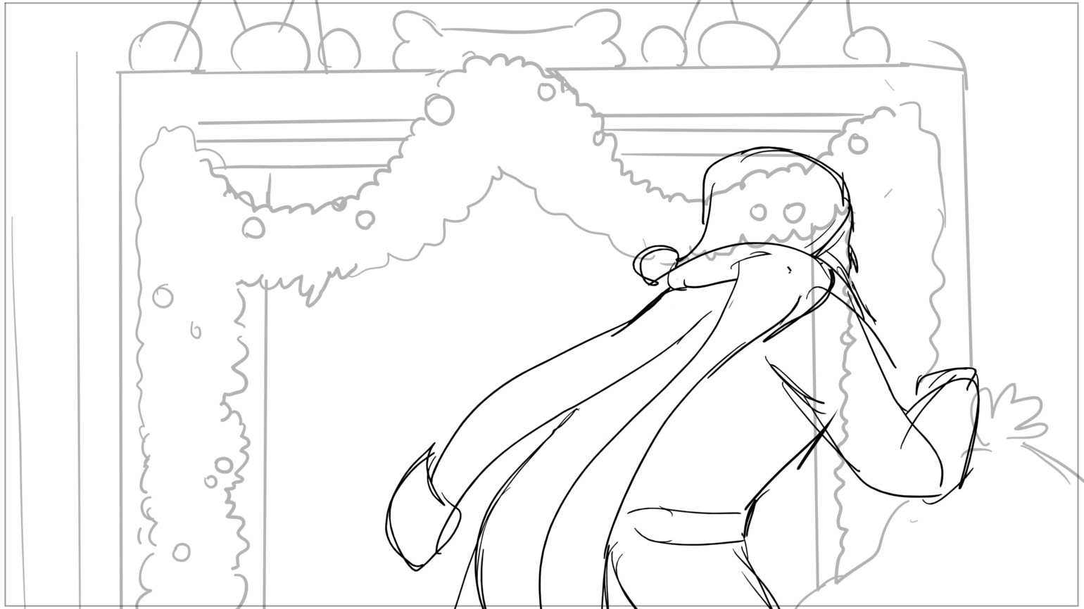
claus
Page 14/148
Scene 6 | Duration 03:06 | Panel 3 | Duration 01:00
Dialog I gotcha son.

Slide 16
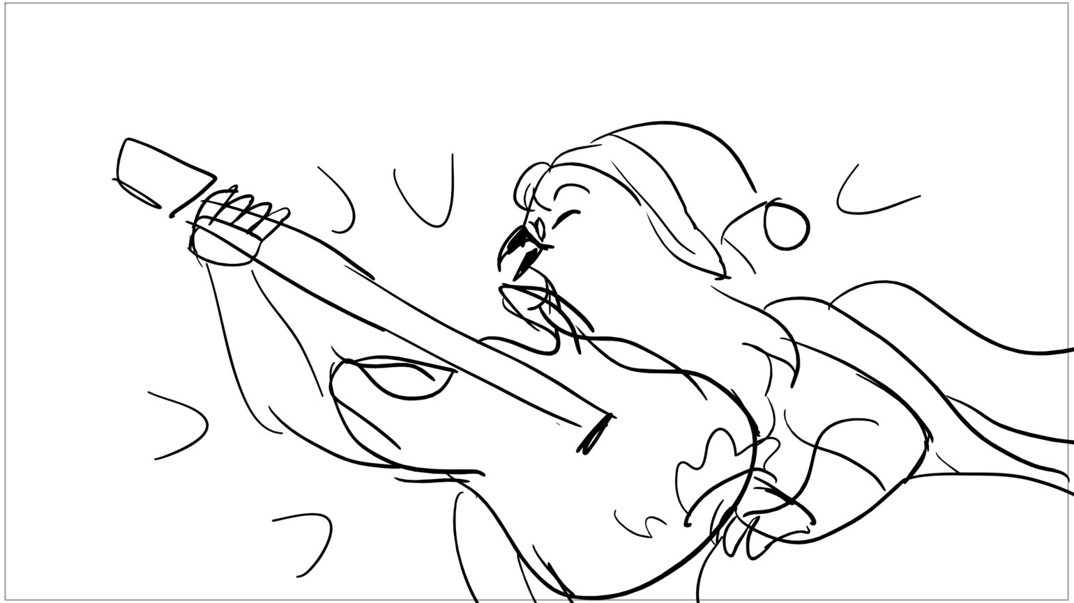
claus
Page 15/148
Scene 7 | Duration 01:06 | Panel 1 | Duration 00:06
Dialog guitar screech

Slide 17
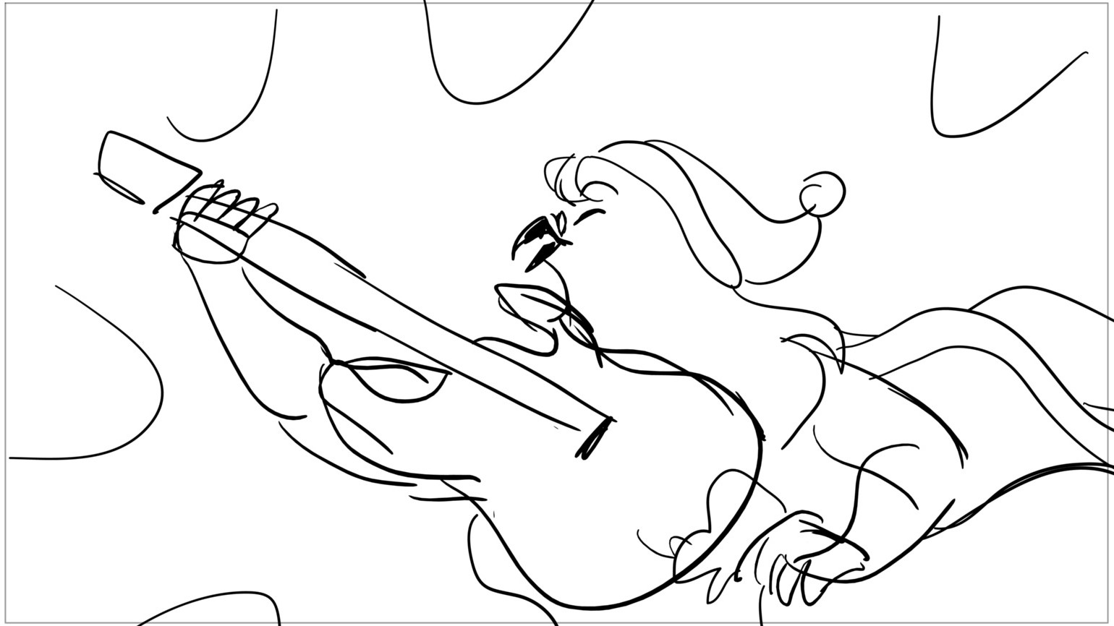
claus
Page 16/148
Scene 7 | Duration 01:06 | Panel 2 | Duration 00:07
Dialog guitar screech

Slide 18
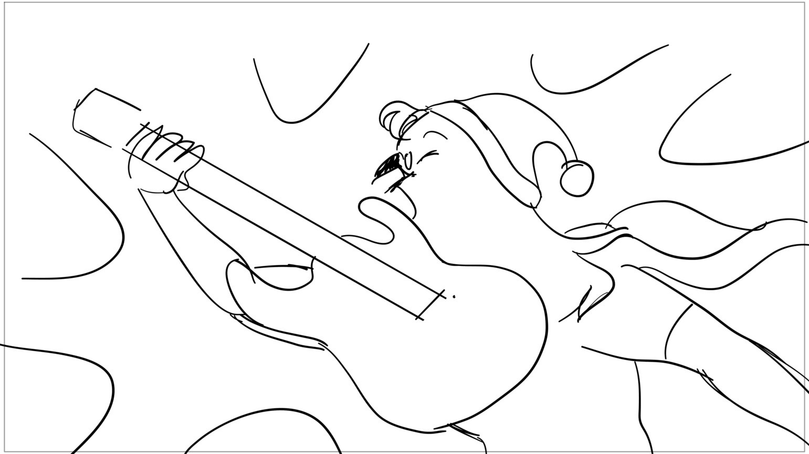
claus
Page 17/148
Scene 7 | Duration 01:06 | Panel 3 | Duration 00:08

Slide 19
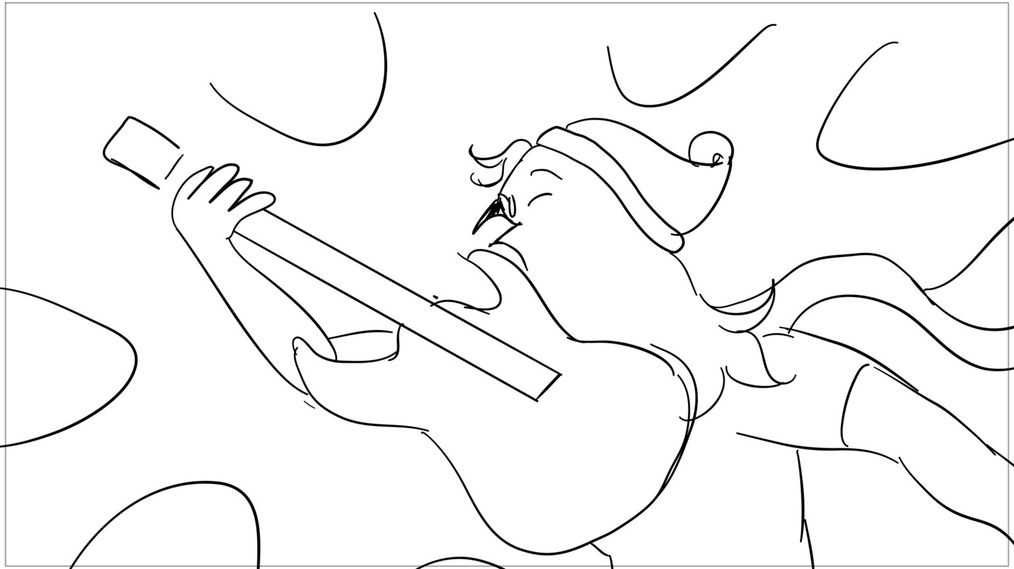
claus
Page 18/148
Scene 7 | Duration 01:06 | Panel 4 | Duration 00:09

Slide 20
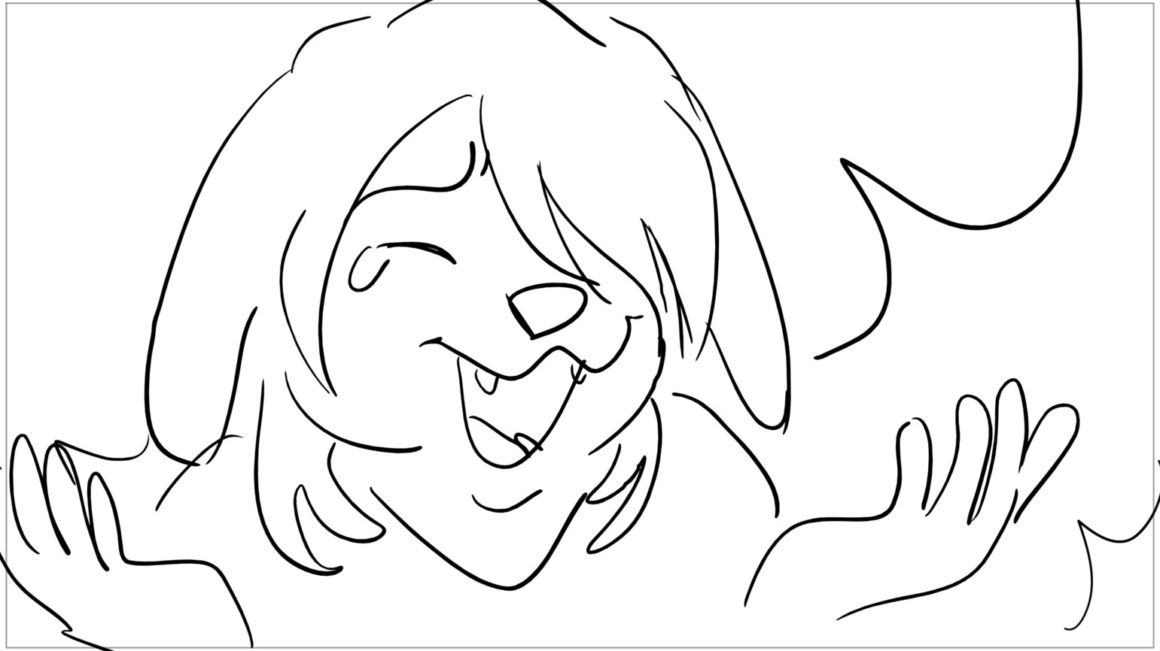
claus
Page 19/148
Scene 8 | Duration 01:21 | Panel 1 | Duration 01:00
Dialog MARSH: Aahahahaaa

Slide 21
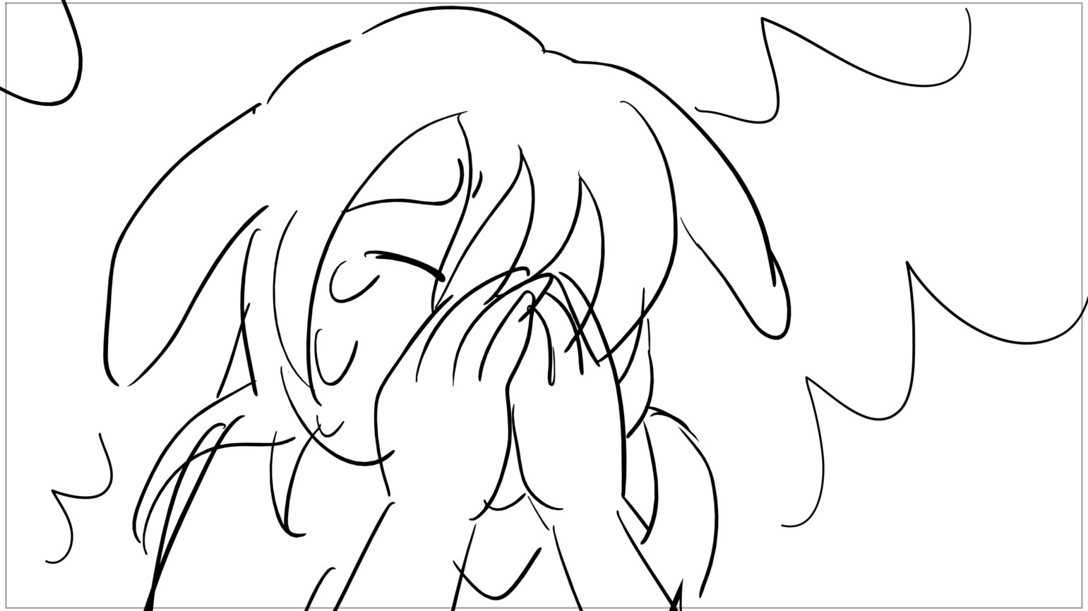
claus
Page 20/148
Scene 8 | Duration 01:21 | Panel 2 | Duration 00:21
Dialog fuck yeahhh

Slide 22
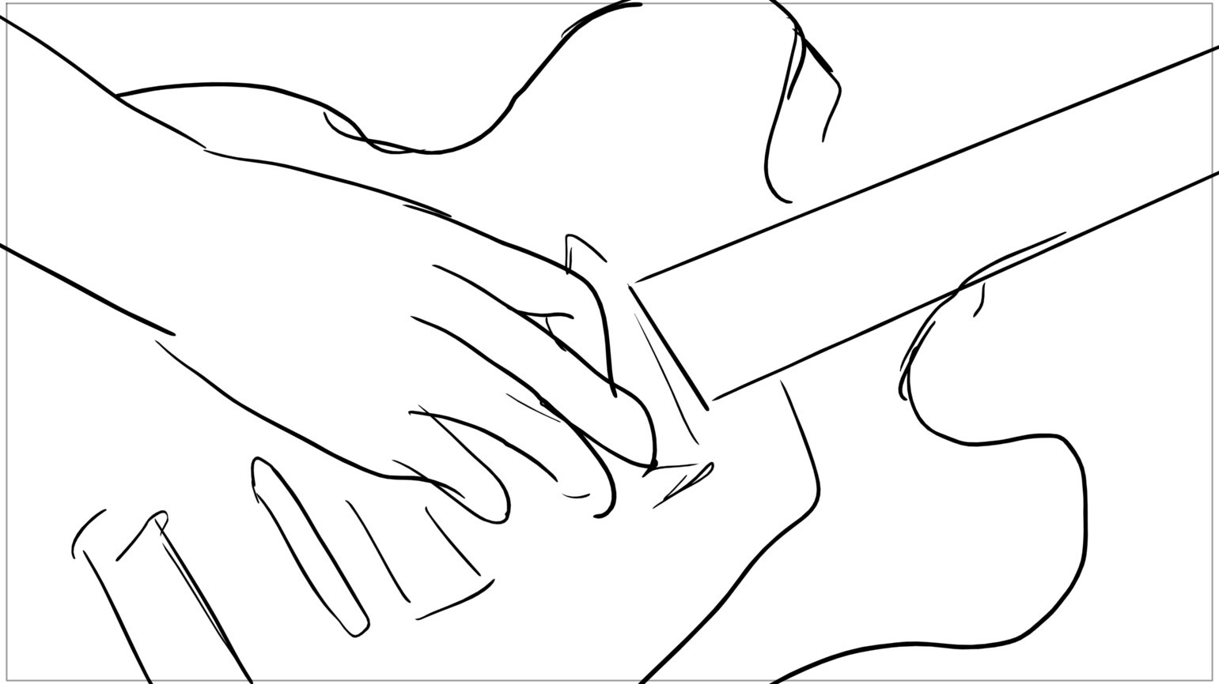
claus
Page 21/148
Scene 9 | Duration 03:08 | Panel 1 | Duration 00:03

Slide 23
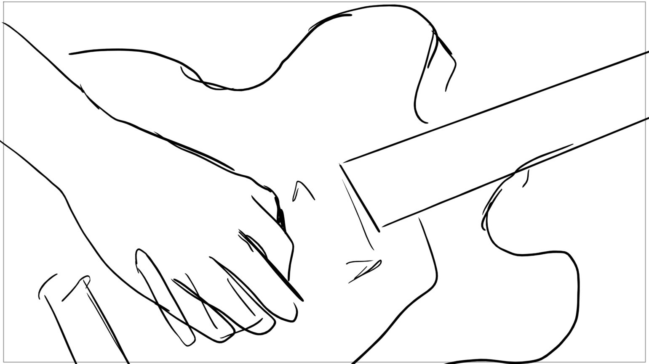
claus
Page 22/148
Scene 9 | Duration 03:08 | Panel 2 | Duration 00:03

Slide 24
claus
Page 23/148
Scene 9 | Duration 03:08 | Panel 3 | Duration 00:03

Slide 25
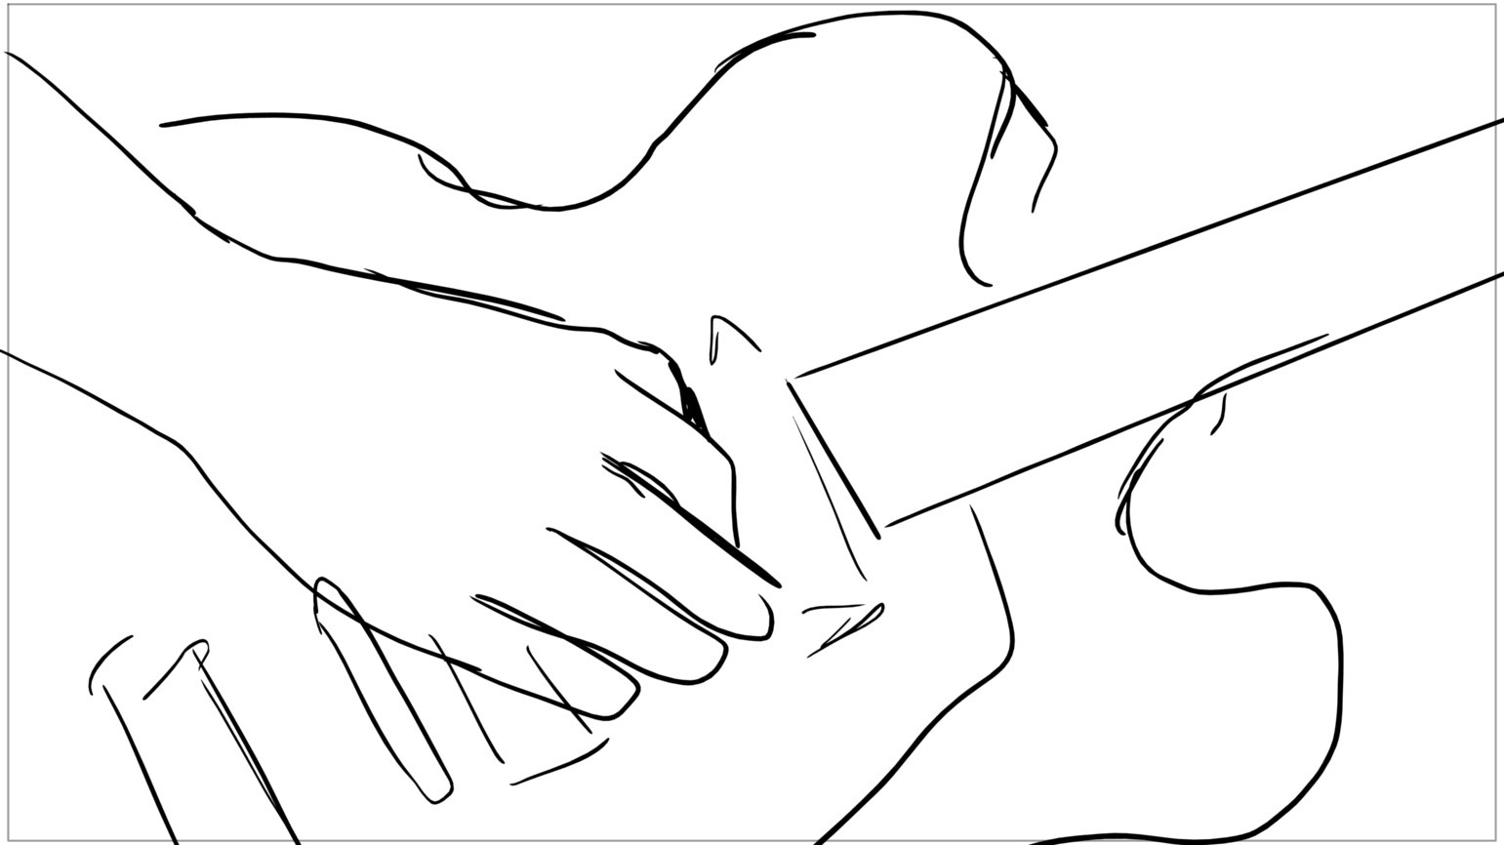
claus
Page 24/148
Scene 9 | Duration 03:08 | Panel 4 | Duration 00:03

Slide 26
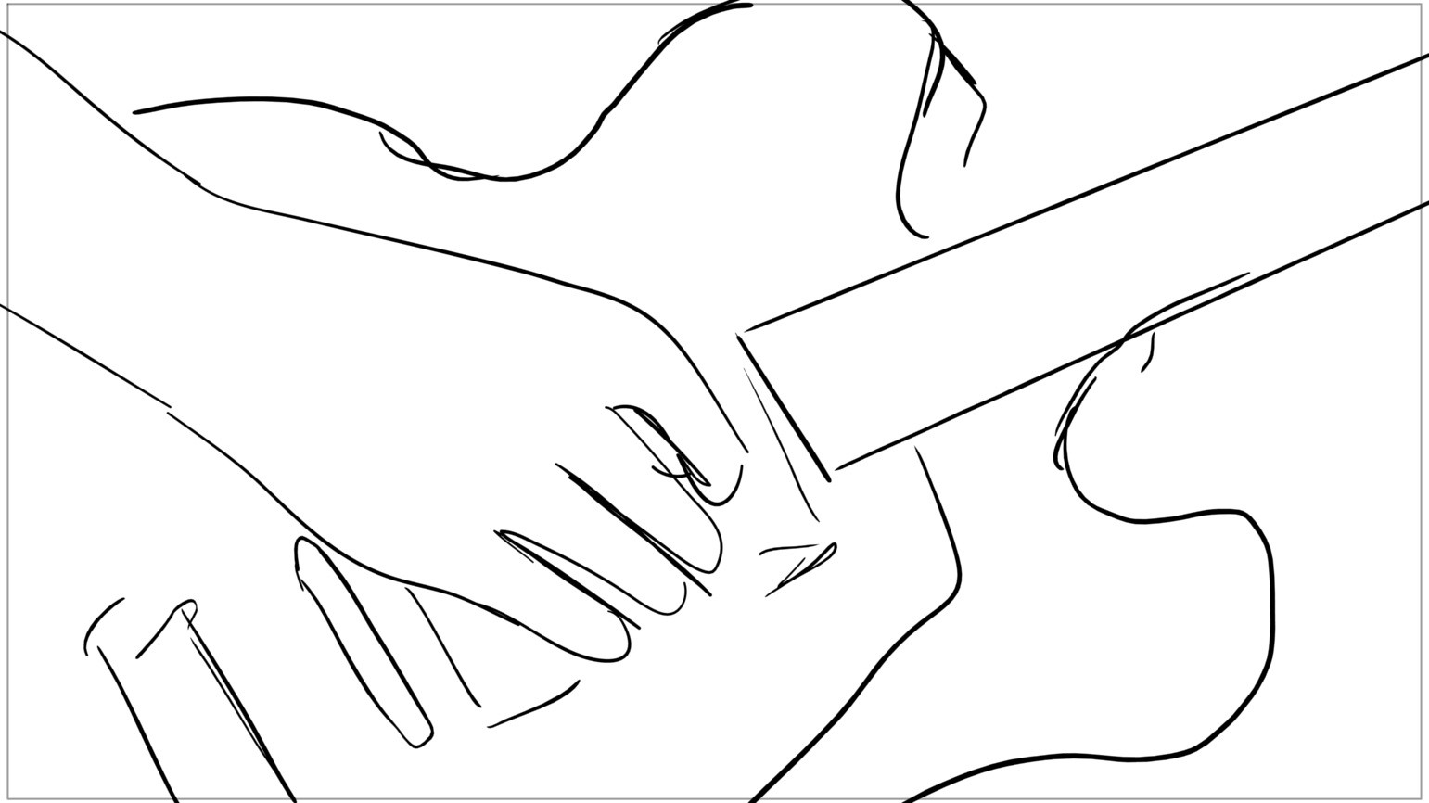
claus
Page 25/148
Scene 9 | Duration 03:08 | Panel 5 | Duration 00:12

Slide 27
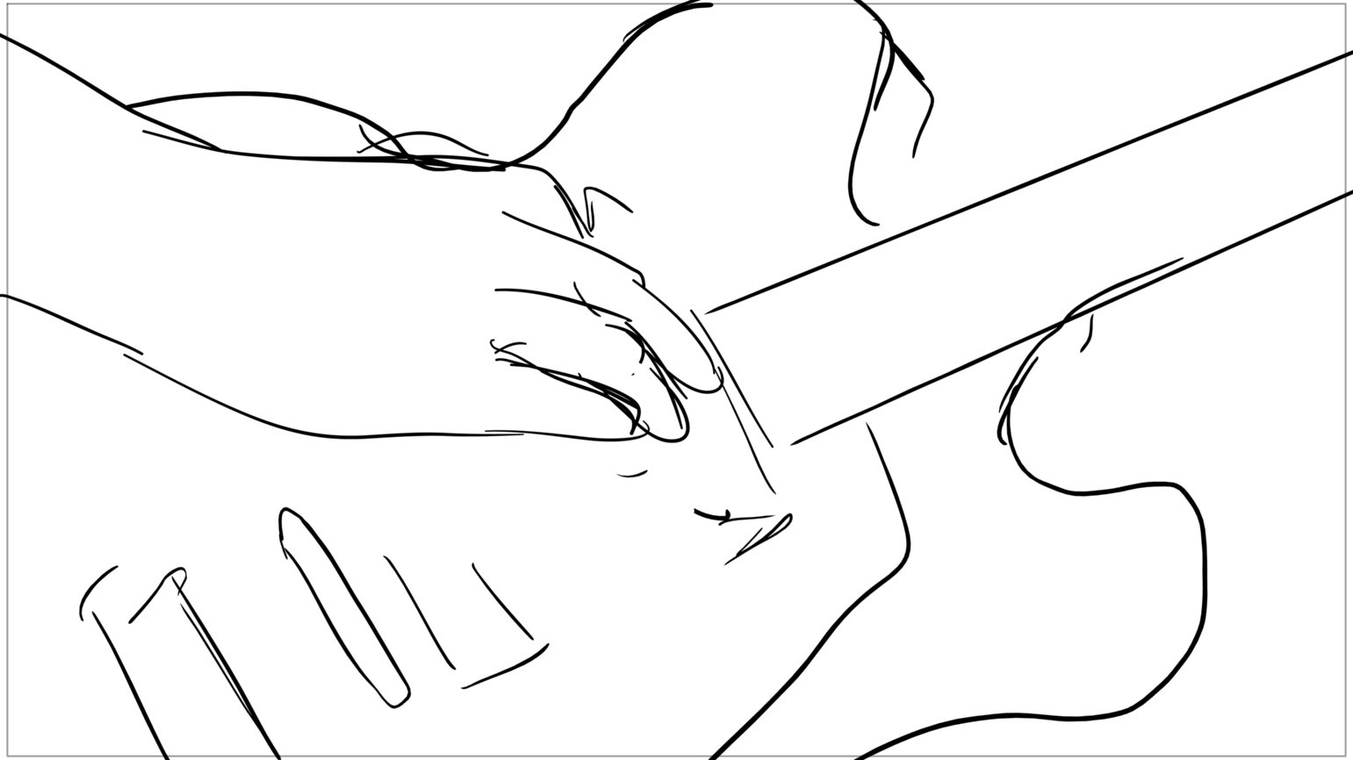
claus
Page 26/148
Scene 9 | Duration 03:08 | Panel 6 | Duration 00:03

Slide 28
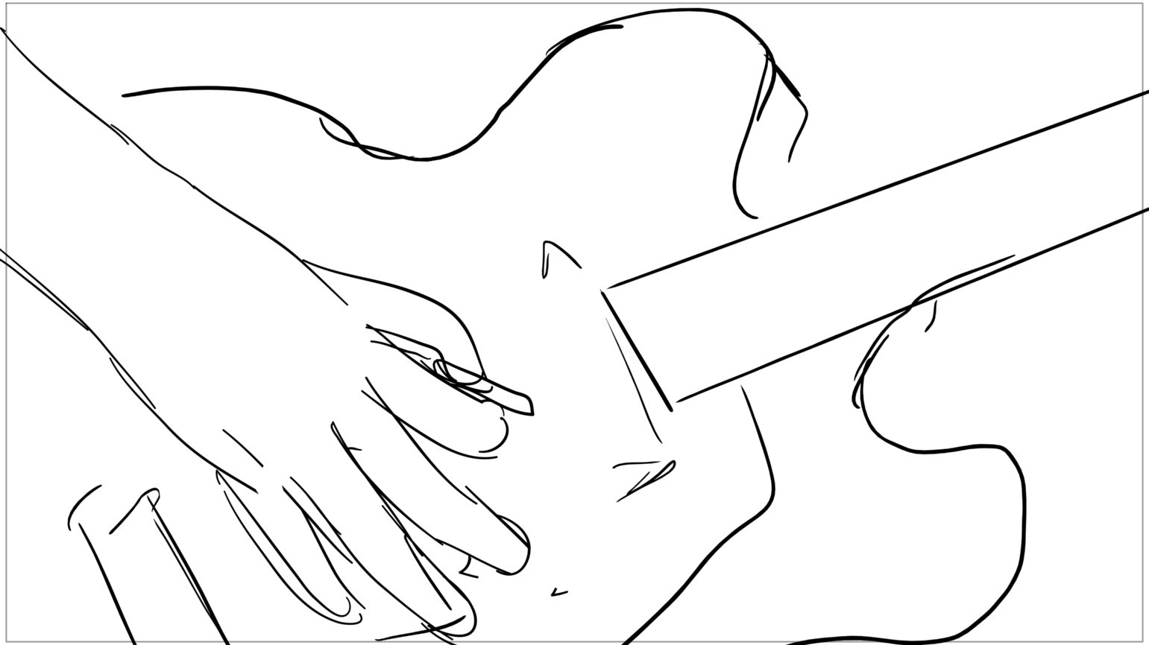
claus
Page 27/148
Scene 9 | Duration 03:08 | Panel 7 | Duration 00:03

Slide 29
claus
Page 28/148
Scene 9 | Duration 03:08 | Panel 8 | Duration 00:03

Slide 30
claus
Page 29/148
Scene 9 | Duration 03:08 | Panel 9 | Duration 00:03

Slide 31
claus
Page 30/148
Scene 9 | Duration 03:08 | Panel 10 | Duration 00:09

Slide 32
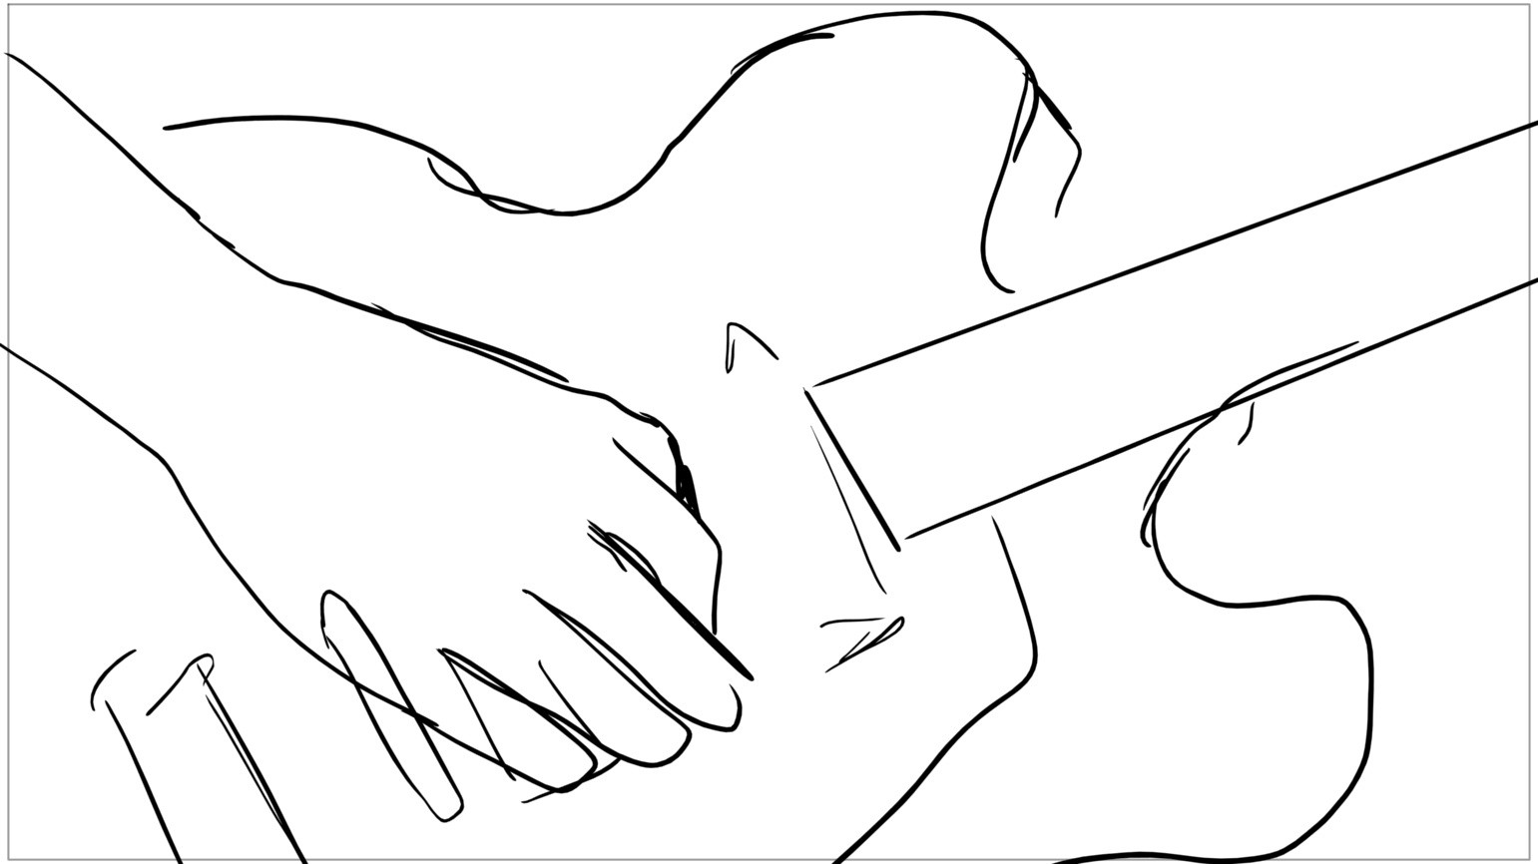
claus
Page 31/148
Scene 9 | Duration 03:08 | Panel 11 | Duration 00:03

Slide 33
claus
Page 32/148
Scene 9 | Duration 03:08 | Panel 12 | Duration 00:03

Slide 34
claus
Page 33/148
Scene 9 | Duration 03:08 | Panel 13 | Duration 00:03

Slide 35
claus
Page 34/148
Scene 9 | Duration 03:08 | Panel 14 | Duration 00:12

Slide 36
claus
Page 35/148
Scene 9 | Duration 03:08 | Panel 15 | Duration 00:05

Slide 37
claus
Page 36/148
Scene 9 | Duration 03:08 | Panel 16 | Duration 00:03

Slide 38
claus
Page 37/148
Scene 9 | Duration 03:08 | Panel 17 | Duration 00:06

Slide 39
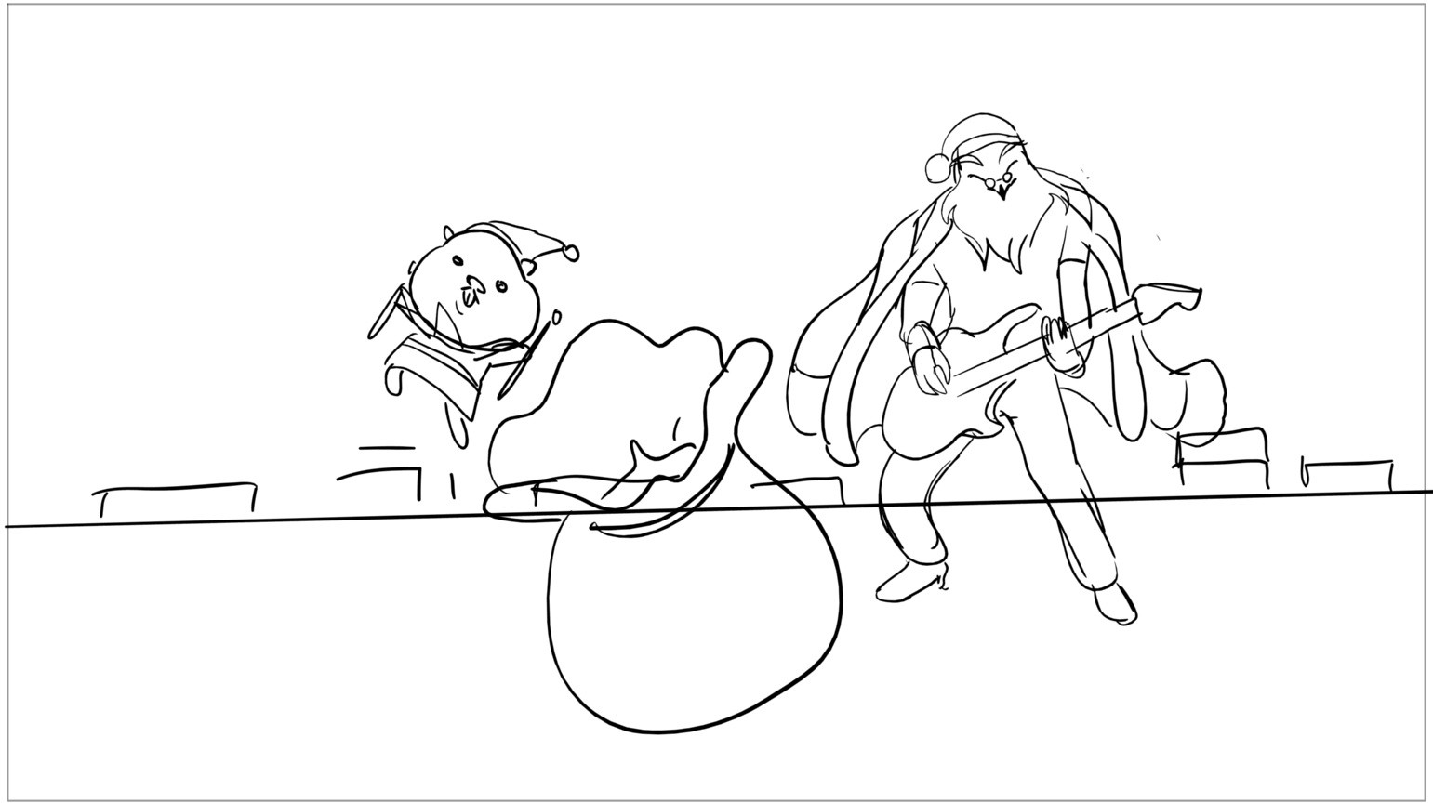
claus
Page 38/148
Scene 10 | Duration 03:18 | Panel 1 | Duration 00:09

Slide 40
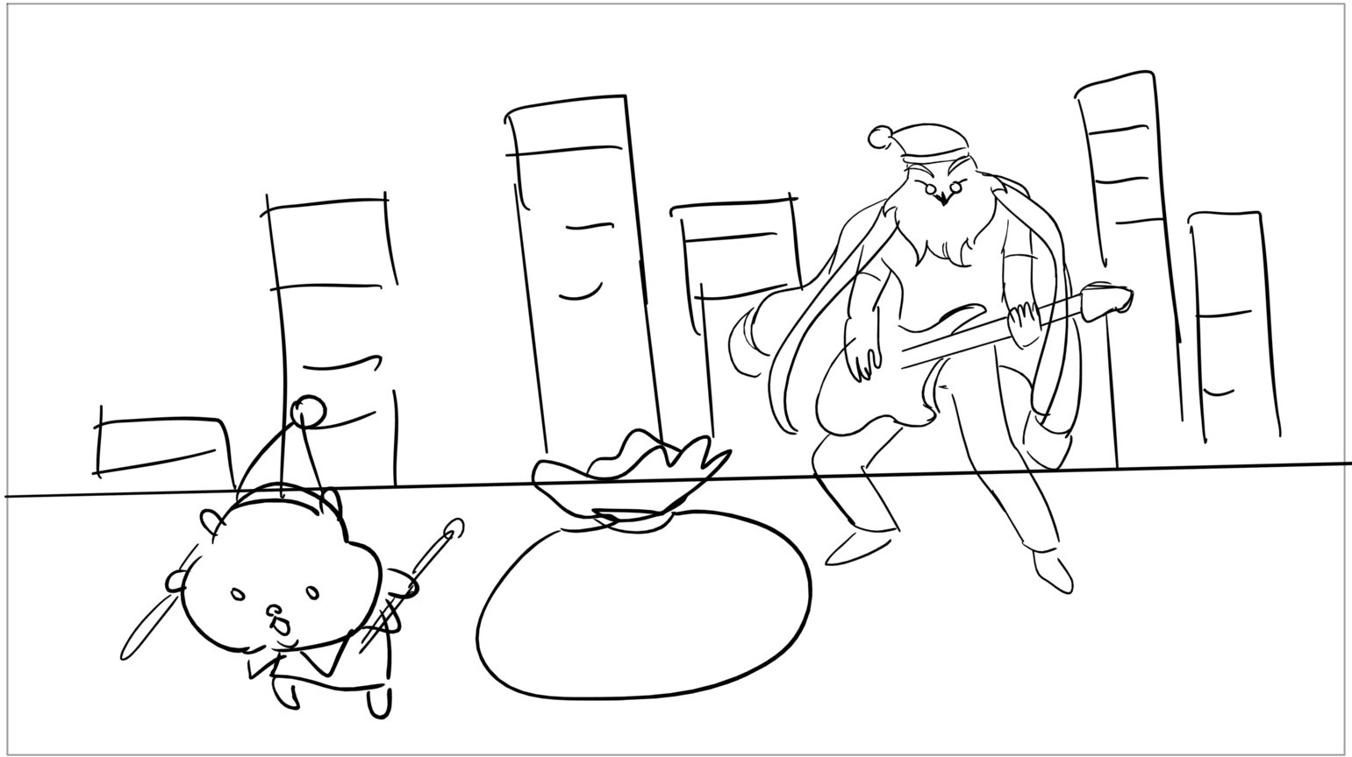
claus
Page 39/148
Scene 10 | Duration 03:18 | Panel 2 | Duration 00:10

Slide 41
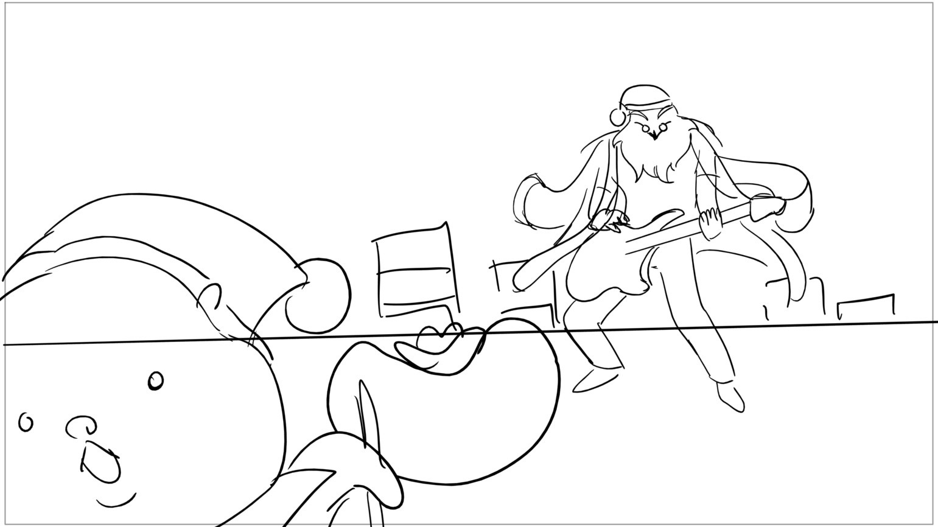
claus
Page 40/148
Scene 10 | Duration 03:18 | Panel 3 | Duration 00:04

Slide 42
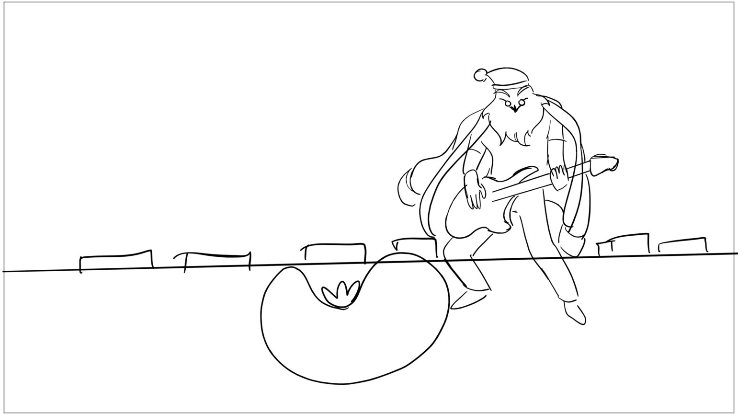
claus
Page 41/148
Scene 10 | Duration 03:18 | Panel 4 | Duration 00:04

Slide 43
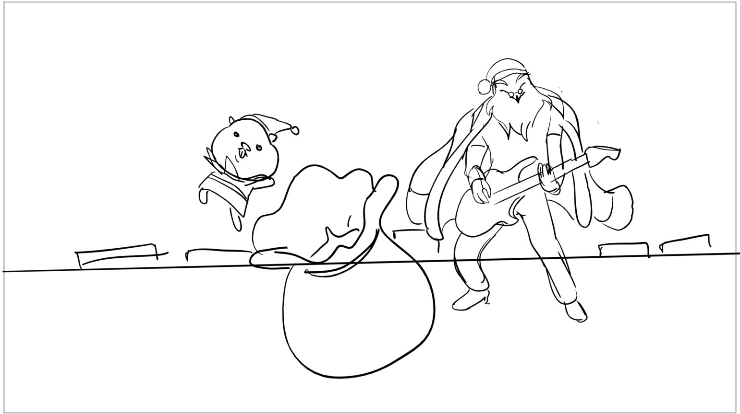
claus
Page 42/148
Scene 10 | Duration 03:18 | Panel 5 | Duration 00:06

Slide 44
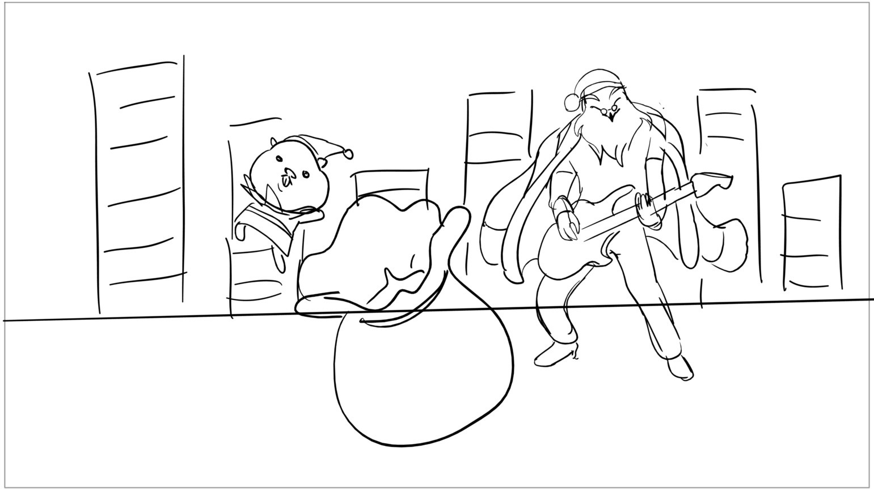
claus
Page 43/148
Scene 10 | Duration 03:18 | Panel 6 | Duration 00:06

Slide 45
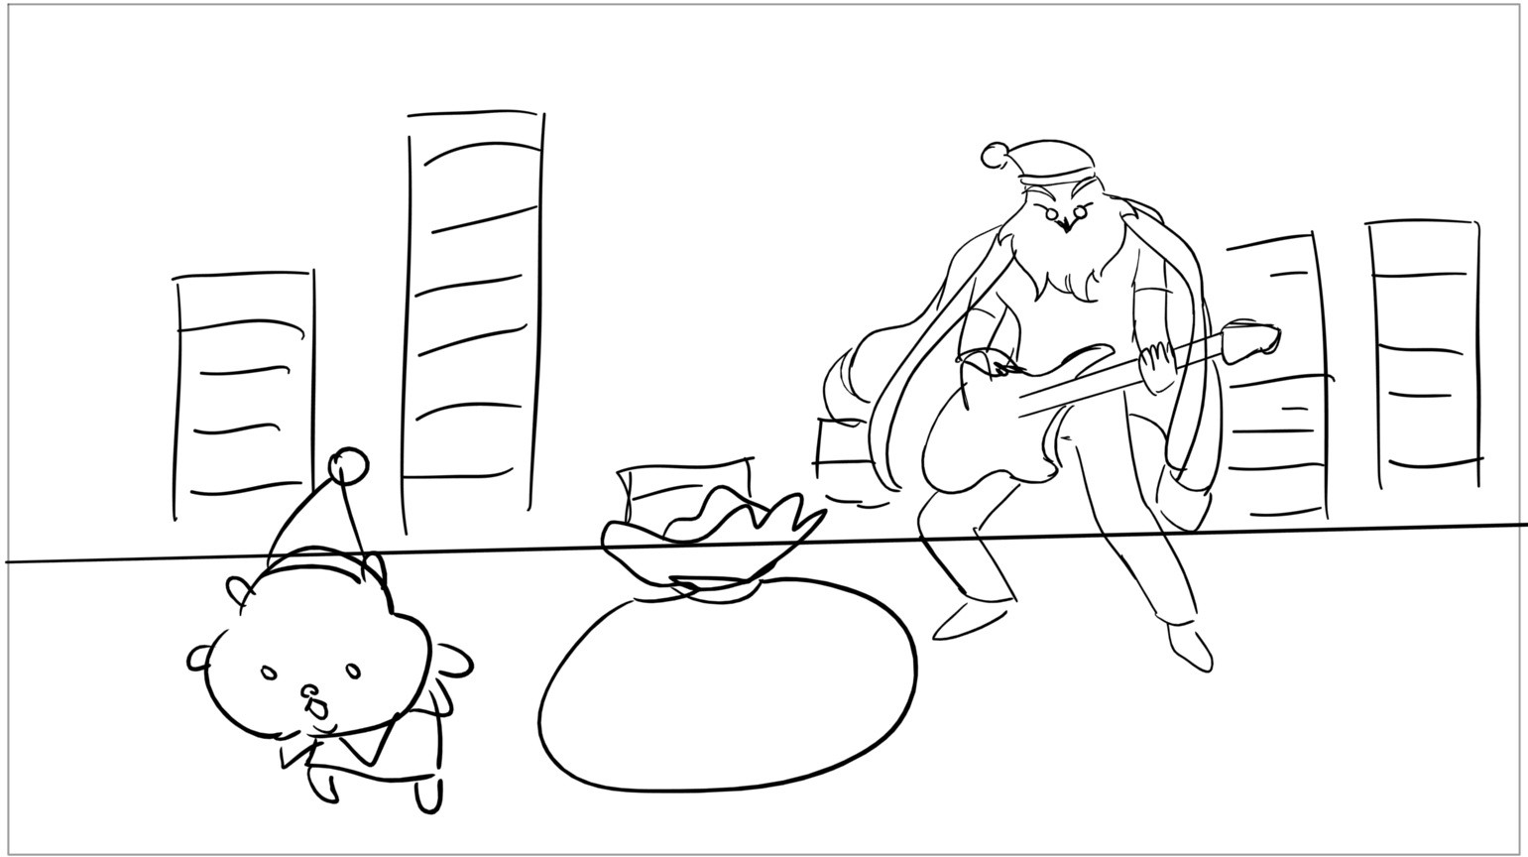
claus
Page 44/148
Scene 10 | Duration 03:18 | Panel 7 | Duration 00:08

Slide 46
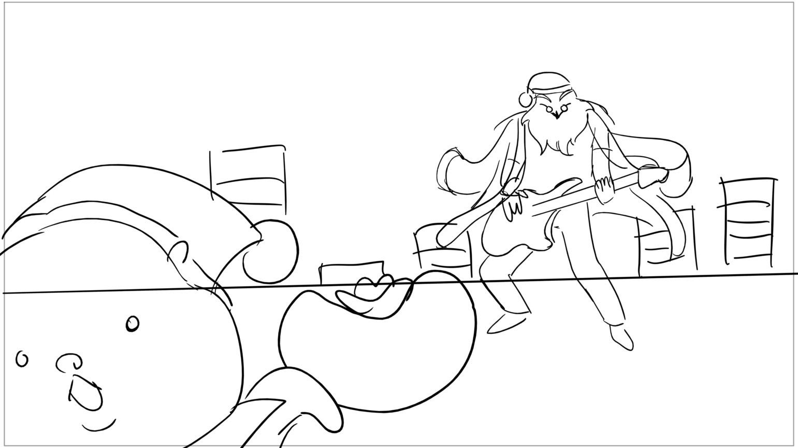
claus
Page 45/148
Scene 10 | Duration 03:18 | Panel 8 | Duration 00:04

Slide 47
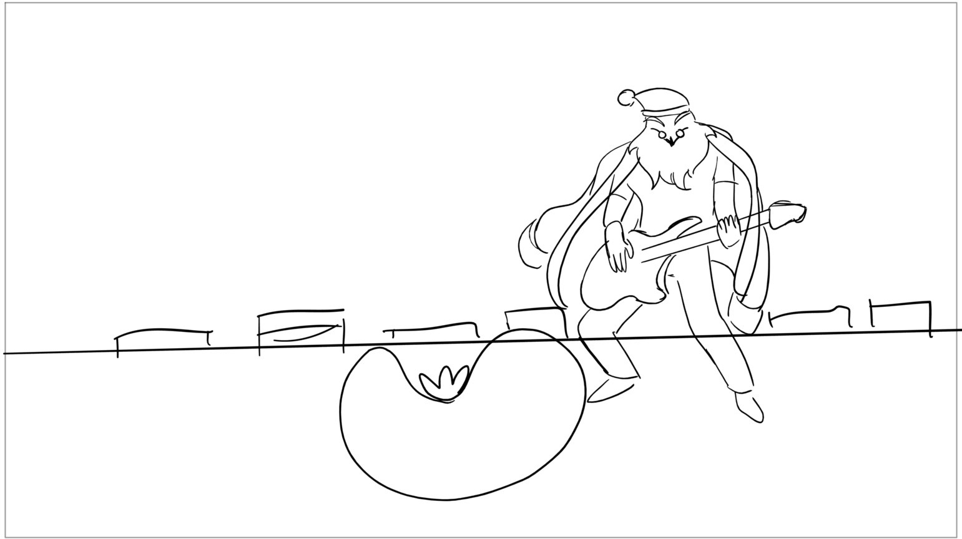
claus
Page 46/148
Scene 10 | Duration 03:18 | Panel 9 | Duration 00:04

Slide 48
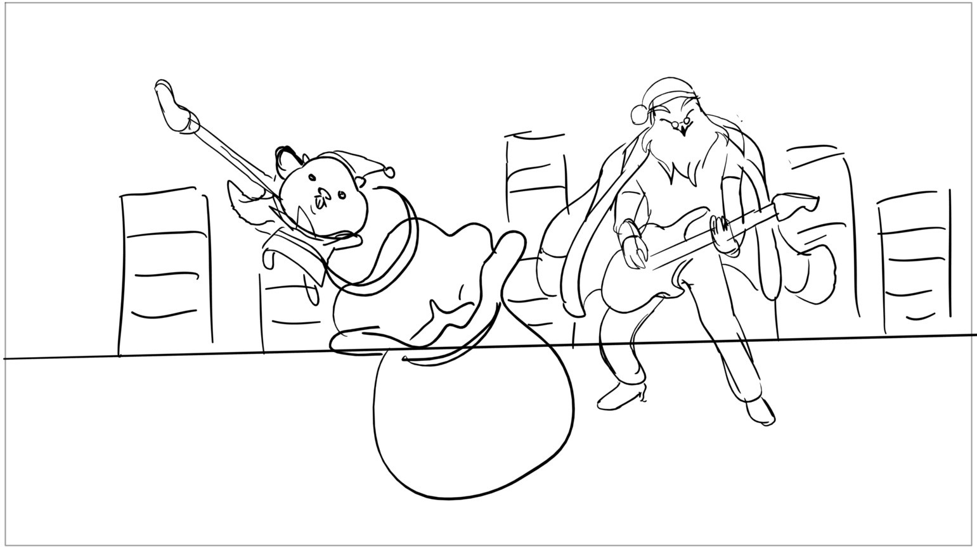
claus
Page 47/148
Scene 10 | Duration 03:18 | Panel 10 | Duration 00:09

Slide 49
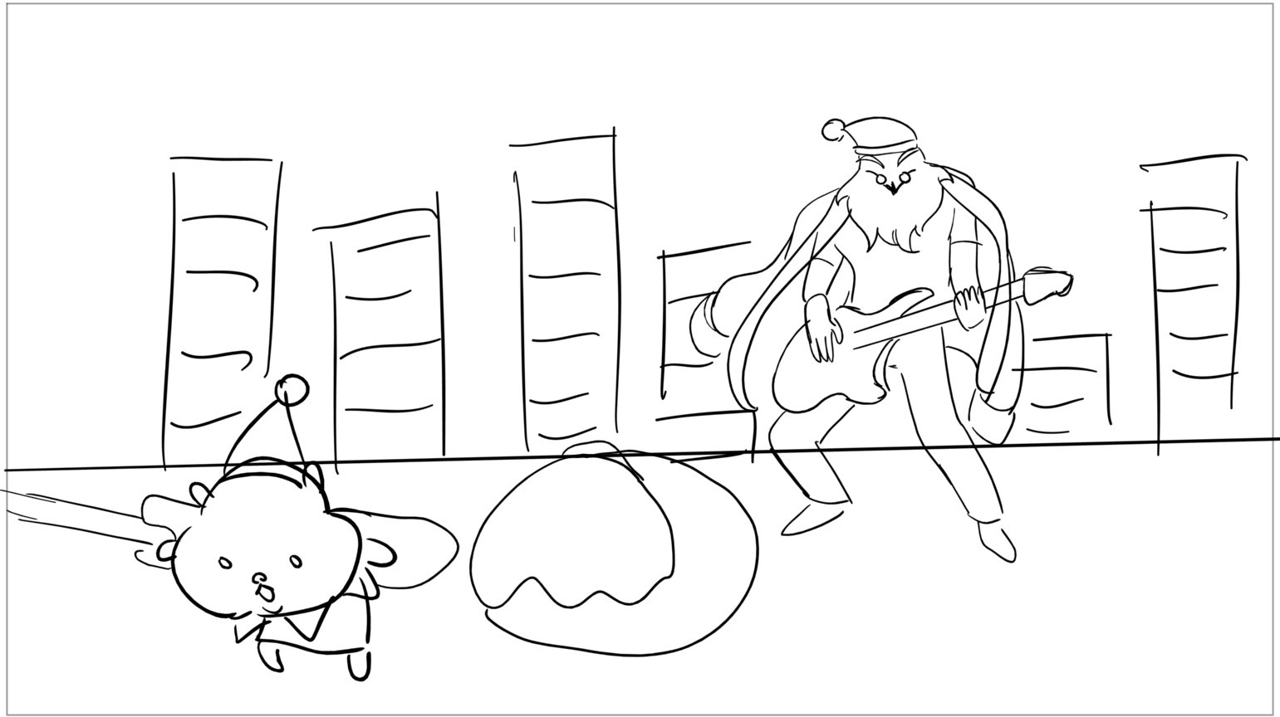
claus
Page 48/148
Scene 10 | Duration 03:18 | Panel 11 | Duration 00:07

Slide 50
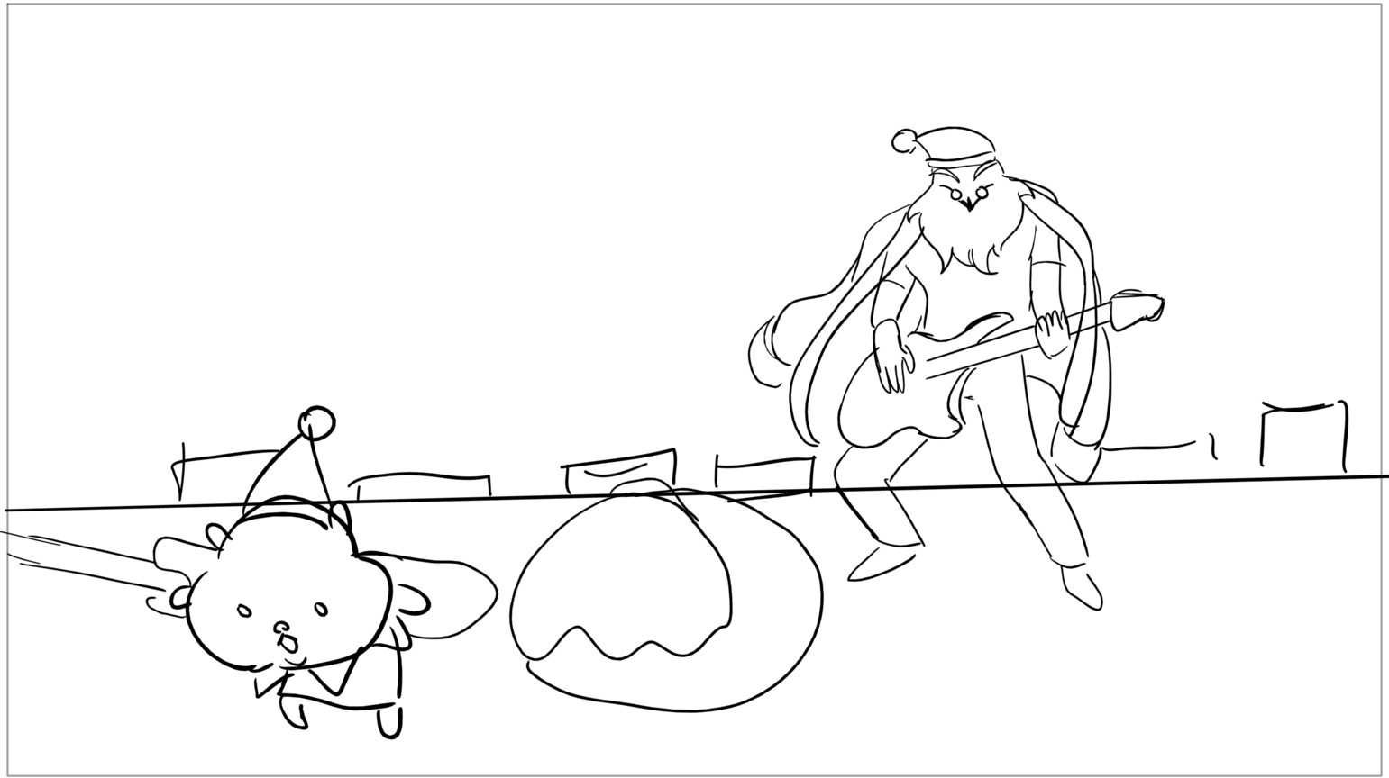
claus
Page 49/148
Scene 10 | Duration 03:18 | Panel 12 | Duration 00:03

Slide 51
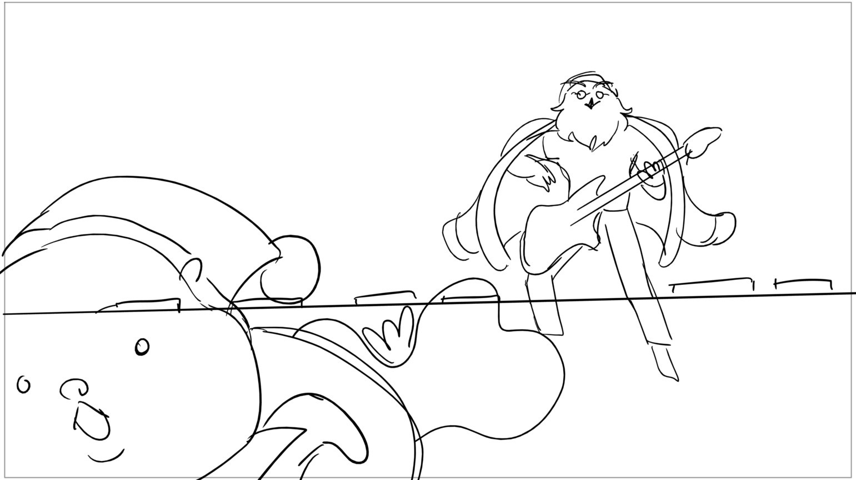
claus
Page 50/148
Scene 10 | Duration 03:18 | Panel 13 | Duration 00:04

Slide 52
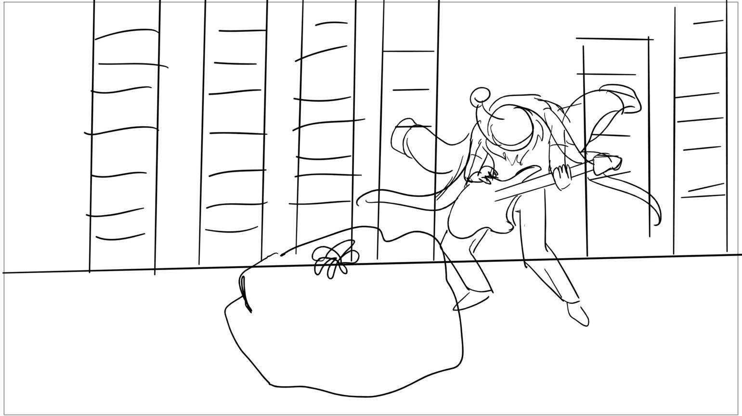
claus
Page 51/148
Scene 10 | Duration 03:18 | Panel 14 | Duration 00:04

Slide 53
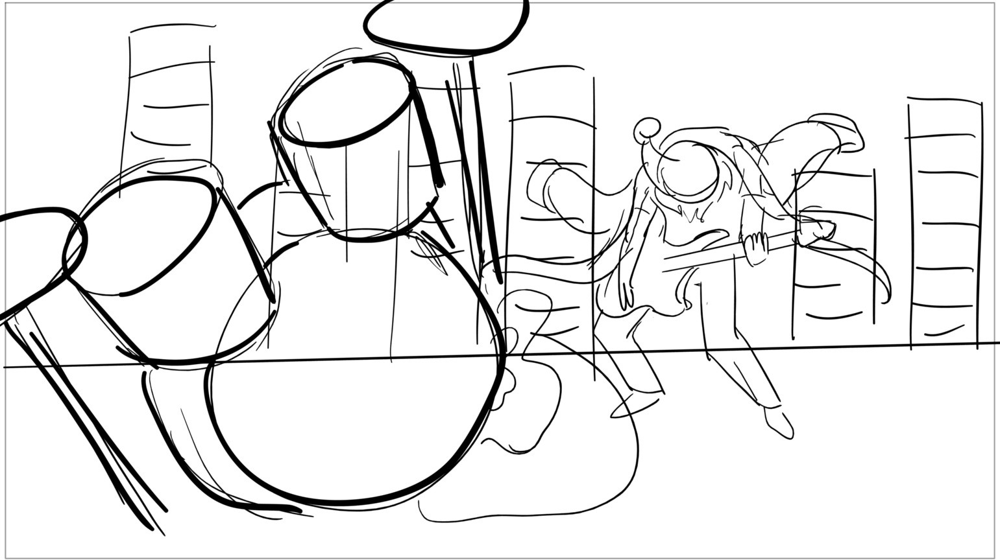
claus
Page 52/148
Scene 10 | Duration 03:18 | Panel 15 | Duration 00:08

Slide 54

claus
Page 53/148
Scene 11 | Duration 02:09 | Panel 1 | Duration 00:07

Slide 55
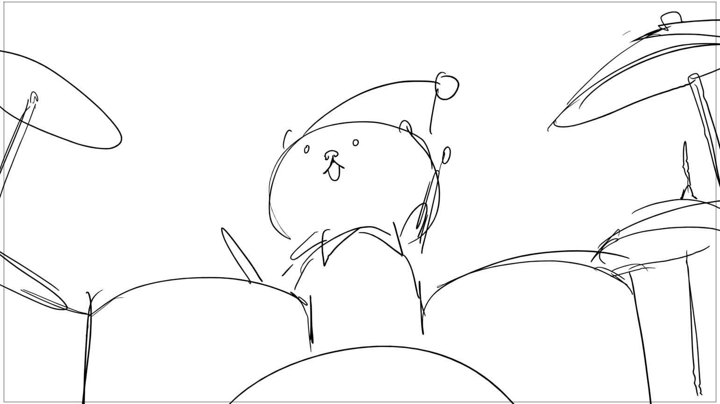
claus
Page 54/148
Scene 11 | Duration 02:09 | Panel 2 | Duration 00:05

Slide 56
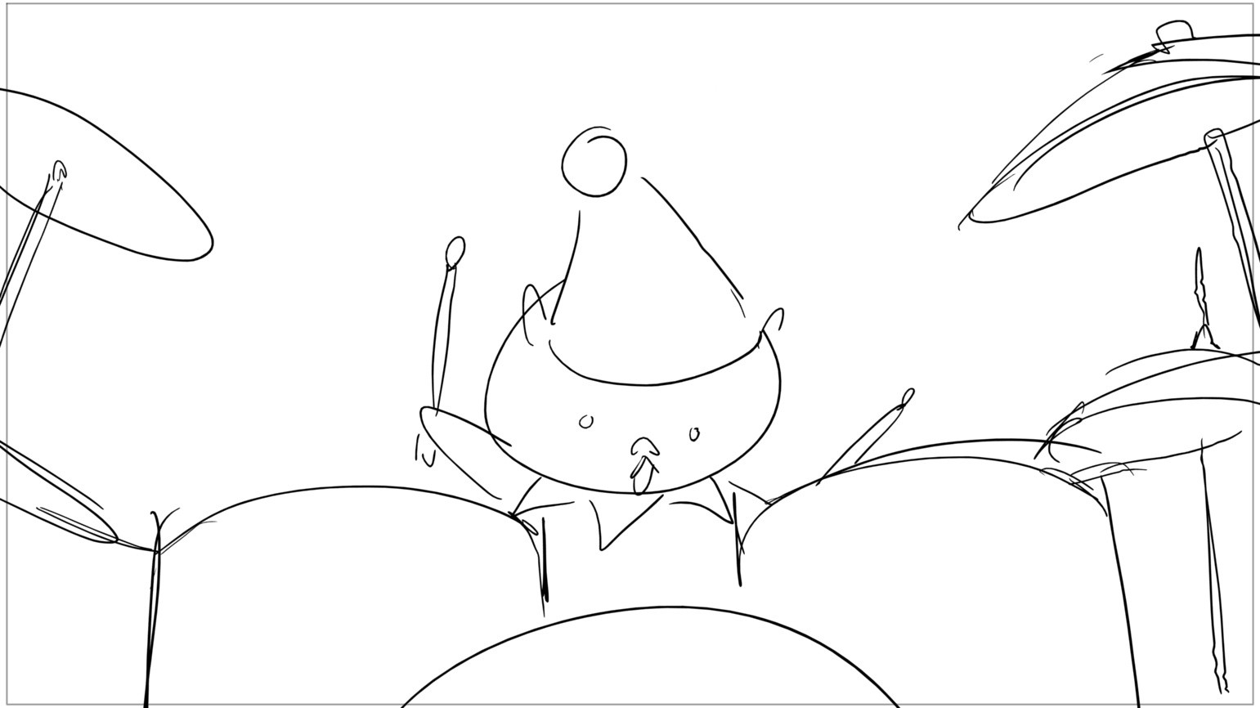
claus
Page 55/148
Scene 11 | Duration 02:09 | Panel 3 | Duration 00:05

Slide 57
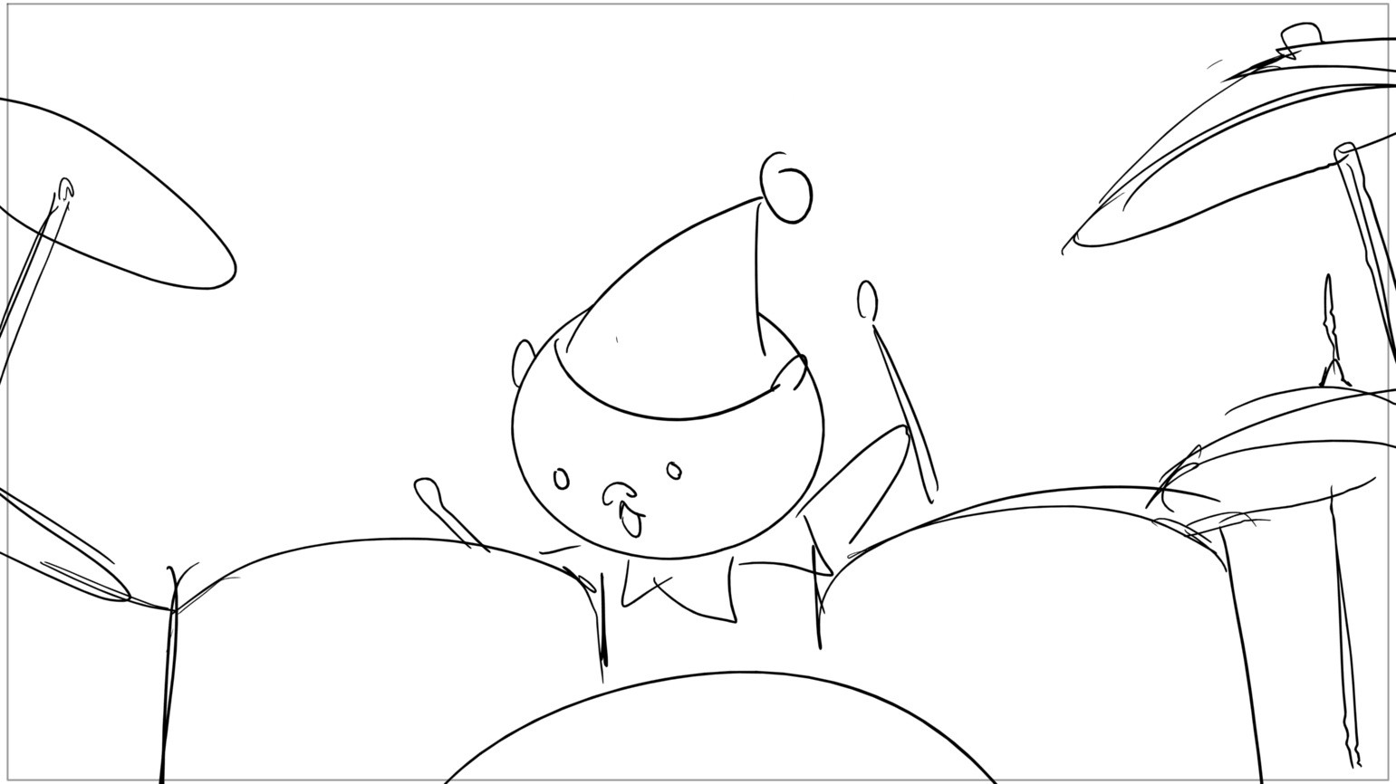
claus
Page 56/148
Scene 11 | Duration 02:09 | Panel 4 | Duration 00:04

Slide 58
claus
Page 57/148
Scene 11 | Duration 02:09 | Panel 5 | Duration 00:05

Slide 59
claus
Page 58/148
Scene 11 | Duration 02:09 | Panel 6 | Duration 00:04

Slide 60
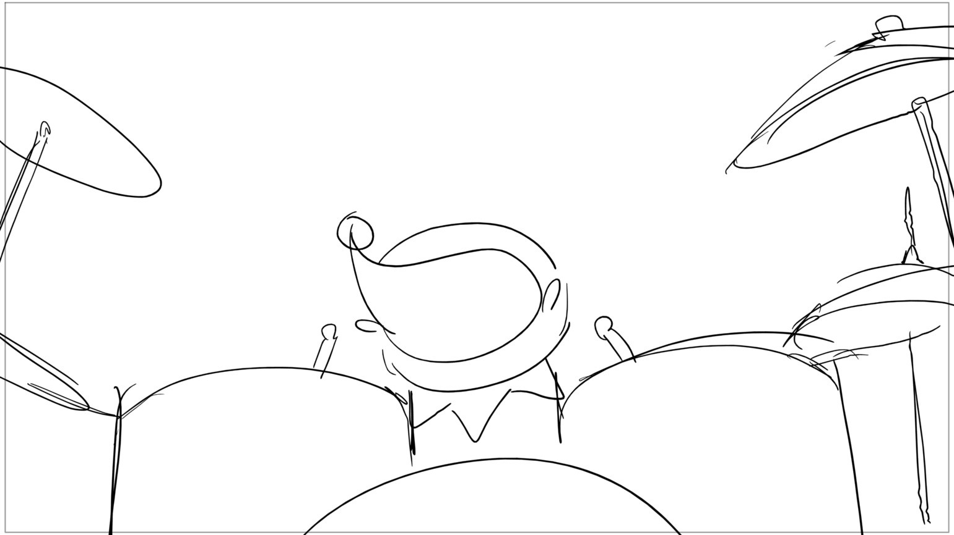
claus
Page 59/148
Scene 11 | Duration 02:09 | Panel 7 | Duration 00:05

Slide 61
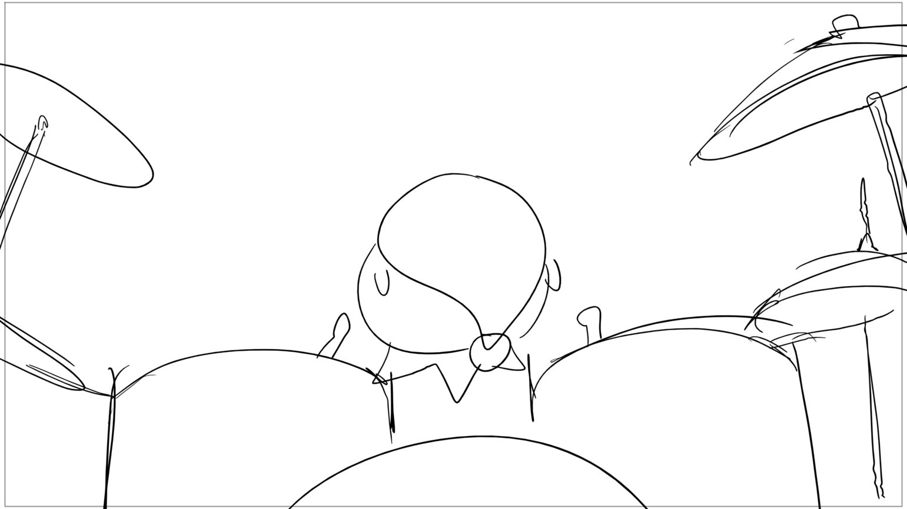
claus
Page 60/148
Scene 11 | Duration 02:09 | Panel 8 | Duration 00:05

Slide 62
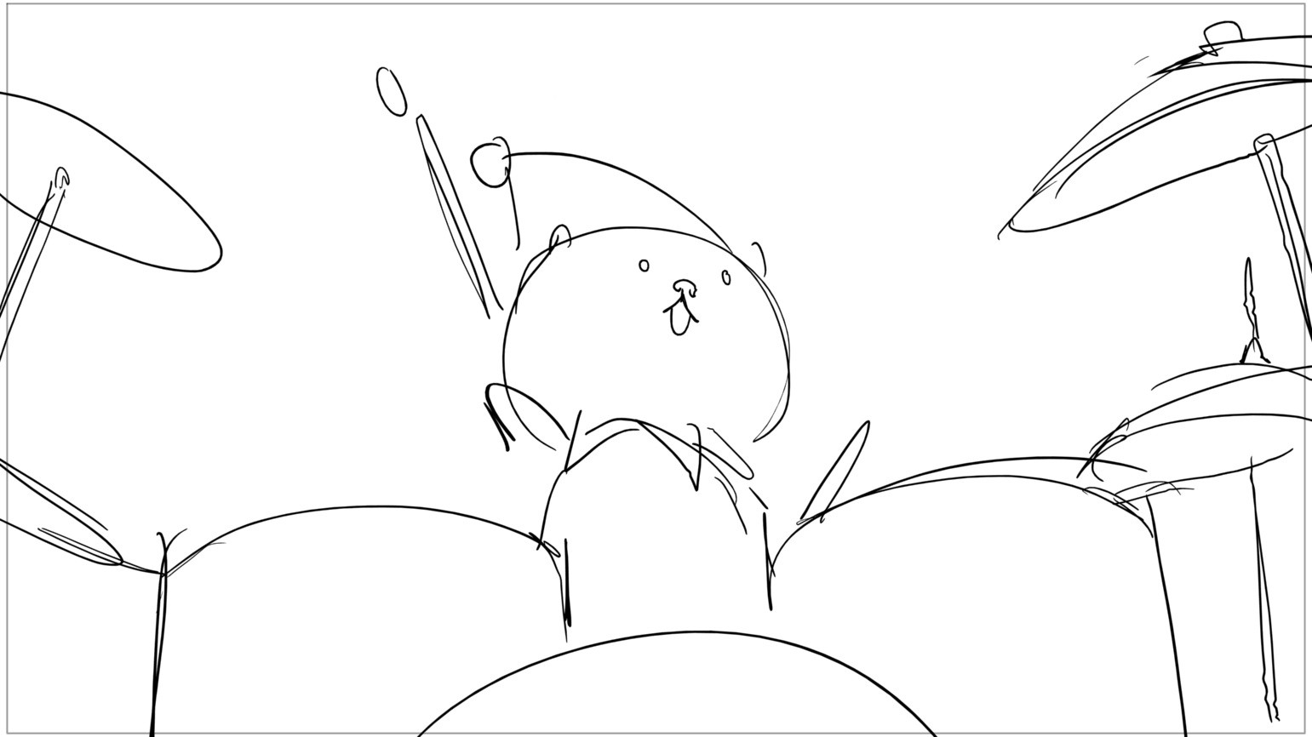
claus
Page 61/148
Scene 11 | Duration 02:09 | Panel 9 | Duration 00:04

Slide 63
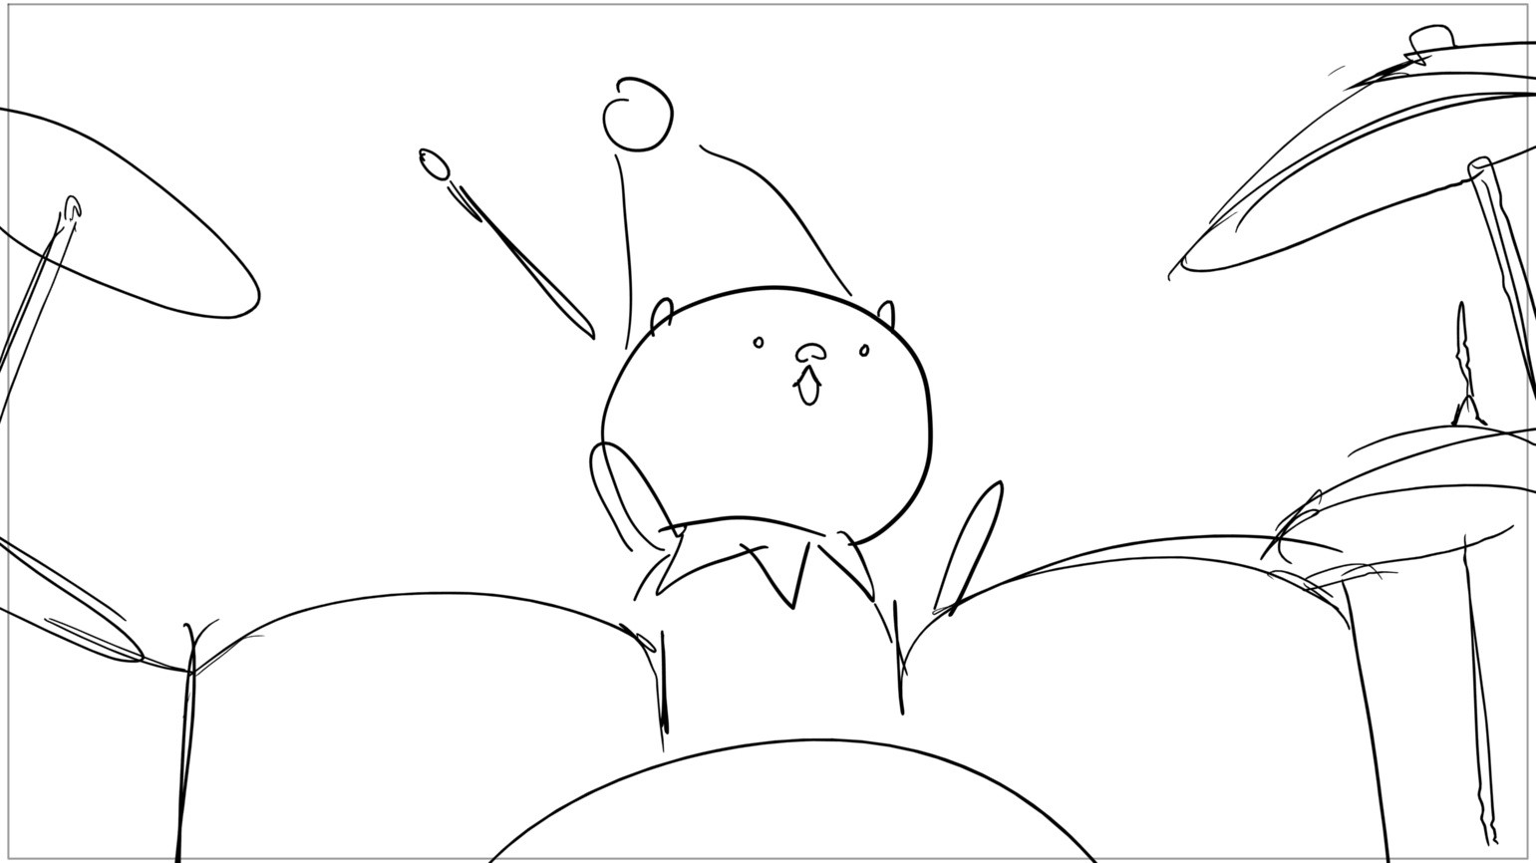
claus
Page 62/148
Scene 11 | Duration 02:09 | Panel 10 | Duration 00:04

Slide 64
claus
Page 63/148
Scene 11 | Duration 02:09 | Panel 11 | Duration 00:05

Slide 65
claus
Page 64/148
Scene 11 | Duration 02:09 | Panel 12 | Duration 00:04

Slide 66
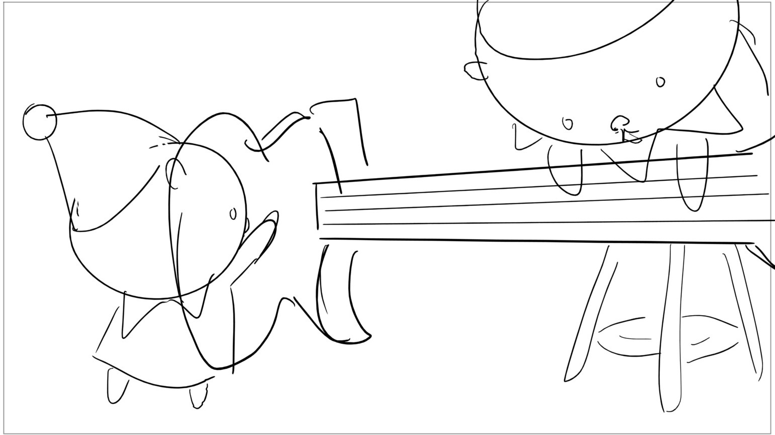
claus
Page 65/148
Scene 12 | Duration 01:18 | Panel 1 | Duration 00:05

Slide 67

claus
Page 66/148
Scene 12 | Duration 01:18 | Panel 2 | Duration 00:05

Slide 68
claus
Page 67/148
Scene 12 | Duration 01:18 | Panel 3 | Duration 00:05

Slide 69

claus
Page 68/148
Scene 12 | Duration 01:18 | Panel 4 | Duration 00:05

Slide 70

claus
Page 69/148
Scene 12 | Duration 01:18 | Panel 5 | Duration 00:06
Dialog 1s

Slide 71

claus
Page 70/148
Scene 12 | Duration 01:18 | Panel 6 | Duration 00:05
Dialog 1s

Slide 72
claus
Page 71/148
Scene 12 | Duration 01:18 | Panel 7 | Duration 00:06
Dialog 1s

Slide 73
claus
Page 72/148
Scene 12 | Duration 01:18 | Panel 8 | Duration 00:05
Dialog 1s

Slide 74

claus
Page 73/148
Scene 13 | Duration 03:11 | Panel 1 | Duration 00:21

Slide 75

claus
Page 74/148
Scene 13 | Duration 03:11 | Panel 2 | Duration 00:20

Slide 76

claus
Page 75/148
Scene 13 | Duration 03:11 | Panel 3 | Duration 00:20

Slide 77

claus
Page 76/148
Scene 13 | Duration 03:11 | Panel 4 | Duration 00:22

Slide 78

claus
Page 77/148
Scene 14 | Duration 02:19 | Panel 1 | Duration 00:16

Slide 79

claus
Page 78/148
Scene 14 | Duration 02:19 | Panel 2 | Duration 00:17

Slide 80

claus
Page 79/148
Scene 14 | Duration 02:19 | Panel 3 | Duration 00:17

Slide 81

claus
Page 80/148
Scene 14 | Duration 02:19 | Panel 4 | Duration 00:17

Slide 82

claus
Page 81/148
Scene 15 | Duration 02:15 | Panel 1 | Duration 01:00

Slide 83

claus
Page 82/148
Scene 15 | Duration 02:15 | Panel 2 | Duration 00:23

Slide 84

claus
Page 83/148
Scene 15 | Duration 02:15 | Panel 3 | Duration 00:16

Slide 85

claus
Page 84/148
Scene 16 | Duration 02:04 | Panel 1 | Duration 01:06

Slide 86

claus
Page 85/148
Scene 16 | Duration 02:04 | Panel 2 | Duration 00:22

Slide 87

claus
Page 86/148
Scene 17 | Duration 01:09 | Panel 1 | Duration 00:10

Slide 88

claus
Page 87/148
Scene 17 | Duration 01:09 | Panel 2 | Duration 00:11

Slide 89

claus
Page 88/148
Scene 17 | Duration 01:09 | Panel 3 | Duration 00:12

Slide 90

claus
Page 89/148
Scene 18 | Duration 02:07 | Panel 1 | Duration 00:08

Slide 91

claus
Page 90/148
Scene 18 | Duration 02:07 | Panel 2 | Duration 00:19

Slide 92

claus
Page 91/148
Scene 18 | Duration 02:07 | Panel 3 | Duration 00:08

Slide 93

claus
Page 92/148
Scene 18 | Duration 02:07 | Panel 4 | Duration 00:13

Slide 94

claus
Page 93/148
Scene 18 | Duration 02:07 | Panel 5 | Duration 00:07

Slide 95

claus
Page 94/148
Scene 19 | Duration 05:11 | Panel 1 | Duration 00:07

Slide 96

claus
Page 95/148
Scene 19 | Duration 05:11 | Panel 2 | Duration 00:06

Slide 97

claus
Page 96/148
Scene 19 | Duration 05:11 | Panel 3 | Duration 00:07

Slide 98

claus
Page 97/148
Scene 19 | Duration 05:11 | Panel 4 | Duration 00:12

Slide 99

claus
Page 98/148
Scene 19 | Duration 05:11 | Panel 5 | Duration 00:08

Slide 100

claus
Page 99/148
Scene 19 | Duration 05:11 | Panel 6 | Duration 00:13

Slide 101

claus
Page 100/148
Scene 19 | Duration 05:11 | Panel 7 | Duration 00:09

Slide 102

claus
Page 101/148
Scene 19 | Duration 05:11 | Panel 8 | Duration 00:12

Slide 103
claus
Page 102/148
Scene 19 | Duration 05:11 | Panel 9 | Duration 00:13

Slide 104

claus
Page 103/148
Scene 19 | Duration 05:11 | Panel 10 | Duration 00:10

Slide 105

claus
Page 104/148
Scene 19 | Duration 05:11 | Panel 11 | Duration 00:11

Slide 106

claus
Page 105/148
Scene 19 | Duration 05:11 | Panel 12 | Duration 00:07

Slide 107

claus
Page 106/148
Scene 19 | Duration 05:11 | Panel 13 | Duration 00:04

Slide 108

claus
Page 107/148
Scene 19 | Duration 05:11 | Panel 14 | Duration 00:05

Slide 109

claus
Page 108/148
Scene 19 | Duration 05:11 | Panel 15 | Duration 00:07

Slide 110

claus
Page 109/148
Scene 20 | Duration 01:09 | Panel 1 | Duration 00:04

Slide 111

claus
Page 110/148
Scene 20 | Duration 01:09 | Panel 2 | Duration 00:05

Slide 112

claus
Page 111/148
Scene 20 | Duration 01:09 | Panel 3 | Duration 00:08

Slide 113

claus
Page 112/148
Scene 20 | Duration 01:09 | Panel 4 | Duration 00:09

Slide 114

claus
Page 113/148
Scene 20 | Duration 01:09 | Panel 5 | Duration 00:07

Slide 115

claus
Page 114/148
Scene 21 | Duration 03:02 | Panel 1 | Duration 00:08

Slide 116

claus
Page 115/148
Scene 21 | Duration 03:02 | Panel 2 | Duration 00:17

Slide 117

claus
Page 116/148
Scene 21 | Duration 03:02 | Panel 3 | Duration 00:05

Slide 118

claus
Page 117/148
Scene 21 | Duration 03:02 | Panel 4 | Duration 00:04

Slide 119

claus
Page 118/148
Scene 21 | Duration 03:02 | Panel 5 | Duration 00:05

Slide 120

claus
Page 119/148
Scene 21 | Duration 03:02 | Panel 6 | Duration 00:04

Slide 121
claus
Page 120/148
Scene 21 | Duration 03:02 | Panel 7 | Duration 00:08

Slide 122
claus
Page 121/148
Scene 21 | Duration 03:02 | Panel 8 | Duration 00:04

Slide 123
claus
Page 122/148
Scene 21 | Duration 03:02 | Panel 9 | Duration 00:04

Slide 124
claus
Page 123/148
Scene 21 | Duration 03:02 | Panel 10 | Duration 00:02

Slide 125
claus
Page 124/148
Scene 21 | Duration 03:02 | Panel 11 | Duration 00:04

Slide 126
claus
Page 125/148
Scene 21 | Duration 03:02 | Panel 12 | Duration 00:03

Slide 127
claus
Page 126/148
Scene 21 | Duration 03:02 | Panel 13 | Duration 00:03

Slide 128
claus
Page 127/148
Scene 21 | Duration 03:02 | Panel 14 | Duration 00:03

Slide 129

claus
Page 128/148
Scene 22 | Duration 01:00 | Panel 1 | Duration 00:04

Slide 130

claus
Page 129/148
Scene 22 | Duration 01:00 | Panel 2 | Duration 00:02

Slide 131
claus
Page 130/148
Scene 22 | Duration 01:00 | Panel 3 | Duration 00:04

Slide 132
claus
Page 131/148
Scene 22 | Duration 01:00 | Panel 4 | Duration 00:02

Slide 133
claus
Page 132/148
Scene 22 | Duration 01:00 | Panel 5 | Duration 00:04

Slide 134
claus
Page 133/148
Scene 22 | Duration 01:00 | Panel 6 | Duration 00:02

Slide 135
claus
Page 134/148
Scene 22 | Duration 01:00 | Panel 7 | Duration 00:04

Slide 136
claus
Page 135/148
Scene 22 | Duration 01:00 | Panel 8 | Duration 00:02

Slide 137

claus
Page 136/148
Scene 23 | Duration 03:18 | Panel 1 | Duration 00:08

Slide 138

claus
Page 137/148
Scene 23 | Duration 03:18 | Panel 2 | Duration 00:06

Slide 139

claus
Page 138/148
Scene 23 | Duration 03:18 | Panel 3 | Duration 00:06

Slide 140

claus
Page 139/148
Scene 23 | Duration 03:18 | Panel 4 | Duration 00:06

Slide 141

claus
Page 140/148
Scene 23 | Duration 03:18 | Panel 5 | Duration 00:07

Slide 142

claus
Page 141/148
Scene 23 | Duration 03:18 | Panel 6 | Duration 00:08

Slide 143

claus
Page 142/148
Scene 23 | Duration 03:18 | Panel 7 | Duration 00:07

Slide 144

claus
Page 143/148
Scene 23 | Duration 03:18 | Panel 8 | Duration 00:04

Slide 145

claus
Page 144/148
Scene 23 | Duration 03:18 | Panel 9 | Duration 00:05

Slide 146

claus
Page 145/148
Scene 23 | Duration 03:18 | Panel 10 | Duration 00:04

Slide 147

claus
Page 146/148
Scene 23 | Duration 03:18 | Panel 11 | Duration 00:05

Slide 148

claus
Page 147/148
Scene 23 | Duration 03:18 | Panel 12 | Duration 01:00

Slide 149

claus
Page 148/148
Scene 24 | Duration 03:05 | Panel 1 | Duration 03:05

