Slide 1
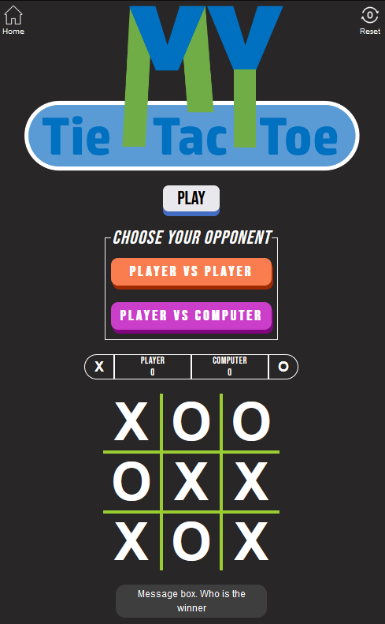
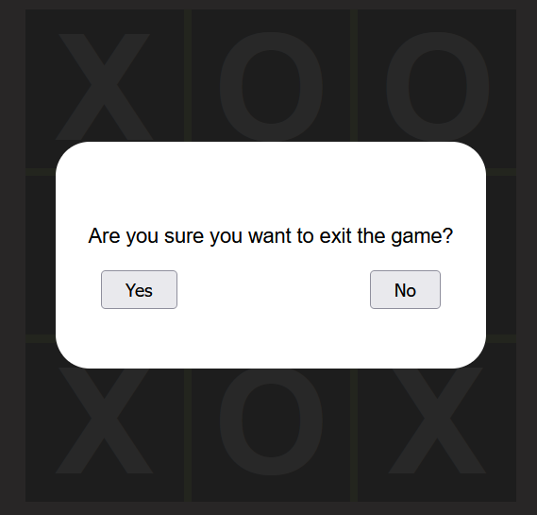











left-icon
right-icon
title-container
title-img
title-img + img-shrink
play-button
choose-container
button-2
button-1
status-container
left-player
right-player
left-score
right-score
left-corner
left-status
right-status
right-corner
game-container
grid-3X3 -> p00 - p22
x-border, y-border
style-msg
alert-msg
grid-3X3 -> blur-back
style-button
msg-container

