Slide 1
Design Studio - Straight Talk
go to “Insert” tab and select “Header & Footer” to apply audience disclosure on all pages

Slide 2
Straight Talk
John Higley - Dev
Peter Plantenberg - Marketing
Steve Anselment - Dev
Kevin Saurer - Marketing
Jason Sowers - Dev
go to “Insert” tab and select “Header & Footer” to apply audience disclosure on all pages

Slide 3
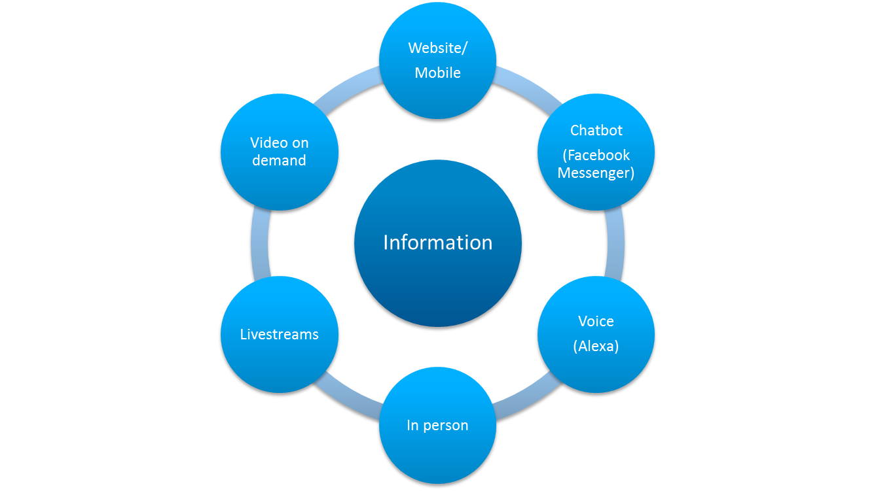
Straight Talk
Ways to interface with customers and distributors
go to “Insert” tab and select “Header & Footer” to apply audience disclosure on all pages

Slide 4

Alexa in App Card
go to “Insert” tab and select “Header & Footer” to apply audience disclosure on all pages

Slide 5
Q&A
go to “Insert” tab and select “Header & Footer” to apply audience disclosure on all pages

