Slide 1
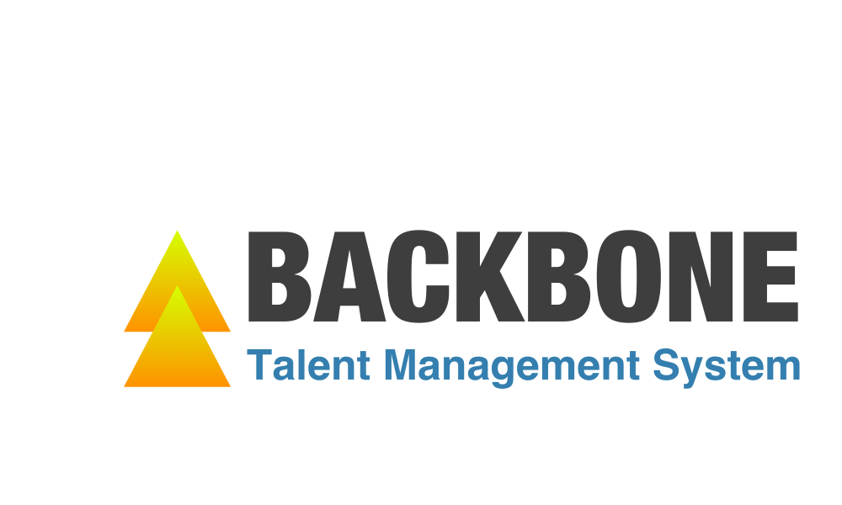
We are a new data driven service offer employer the intelligent talent management system.
Group 10
Jiexuan Sun, Chao Xu, Zhaoning Su, Congyang Wang
Notes:
Good evening everyone, good evening Dr. Paffenroth. My name is Congyang from group 10. I’m here to introducing the total new talent management system BACKBONE.
We are a new data driven service offer employer the intelligent talent management system.

Slide 2





1. THE OPPOTUNITY
Problem worth solving
Our solution
Employees are the core and soul of an organization.
The cost of talent loss is very high for each one.
So how to prevent the loss of key talent is a emergency problem to solve.
We build the total new Talent Management System the which use data analysis tech to help company prevent the loss of the key talents.
2. ABOUT THE BACKBONE
‘Gamified’ Module
‘Smile Recognize’ Module
Talent Loss Detecting
Notes:
What is the business opportunity for us, first we found the a high valued problem worth to solve: how a company can prevent the loss of key talents, nowadays, the employees are the core and soul of every single organization. And the cost of talent loss is very huge for company especially for most startups.
Then, what we do? We build one total new talent management system to help company prevent the loss of the key talents.
Inside the Backbone, we have three key modules, Gamification, Smile Recognition, and the final part: the talent loss detecting.

Slide 3


3. THE MARKET
Target Market
The value of us
There is a 74 Billion* market for the whole Talent Industry, and this is one market vacancy with a lot of imagine space.
Reliable: High accuracy based on the data science approach.
High Profit: We help you to keep potential leaving talents equals to make money for you.
Ready to go: Easy to transfer and implement.
Ready to Go
High Profit
Reliable
4. PARTNERS AND RESOURCES
OpenCV (Open Source Computer Vision Library) is an open source computer vision and machine learning software library.
Kaggle is a community of data scientists and data enthusiasts. enables you to learn from and mentor each other on your personal, academic, and professional data science journeys.
http://blog.thestarrconspiracy.com/employee-engagement-and-market-share-the-74-billion-question
Notes:
So How big this market, from the report of industry, this is a total 74 billion business, not M, B in Talent Management.
And our target market is a market vacancy in the whole market. We believe It will be the future of the Talent Management with innovation and automation.
So why you should choose us to do this, we have our nuclear weapons, 1, the system is reliable, we have high accuracy. 2, the system is high profit, we help you to keep the talents, 3, the system is ready to go, it’s easy to transfer and implement.
For our partners, we use the tech from OpenCV and data from Kaggle.
That’s the Backbone, thank you for your time.
Ok I am glad you have a question on our product, it means you are interested in the backbone system. It’s a good thing, and you are luck, we will have a long presentation can show you more detail, let’s save the best for last, ok?

