Slide 1
TAS Final Presentation
B. Kast, H. Zimmermann, M. Freundl, W. Burger
Final Report
Prof. D. Wollherr, L. Alkurdi, K. Hoang Dinh

Slide 2

Simulation
Bernd Kast
B. Kast, H. Zimmermann, M. Freundl, W. Burger
2

Slide 3
Simulator
Useful for easier development and testing
Based on gazebo simulator
Ackerman_vehicle adapted:
Wheel and chassis dimensions changed
Laser scanners, imu and magnetic added
Conversion between ackerman_msg and twist
Walls built according to map
Weights and center of masses not changed
B. Kast, H. Zimmermann, M. Freundl, W. Burger
3

Slide 4
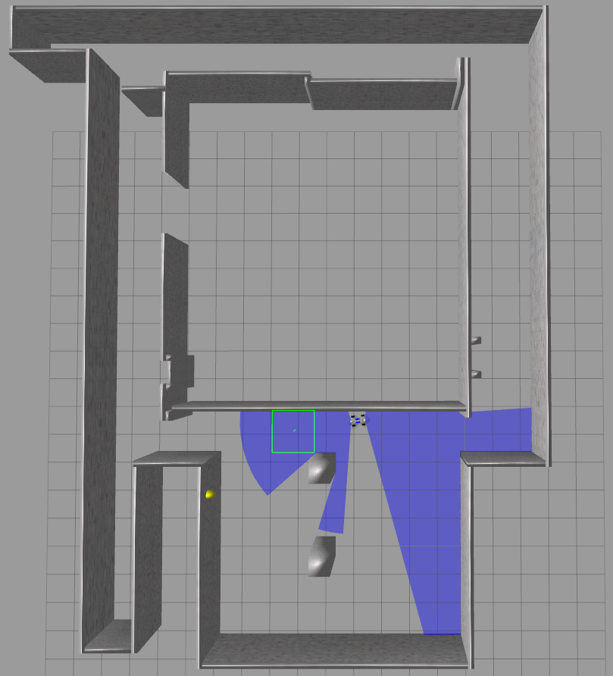
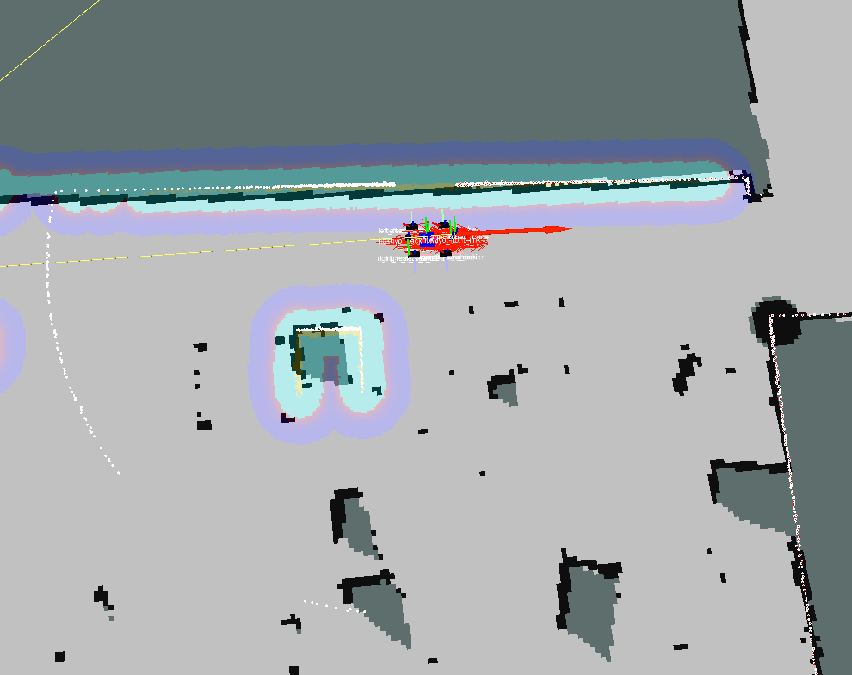
Simulator – Results
B. Kast, H. Zimmermann, M. Freundl, W. Burger
4

Slide 5
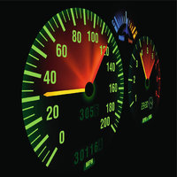
Speed Control
Hubert Zimmermann
© Roman Dekan - Fotolia.com
B. Kast, H. Zimmermann, M. Freundl, W. Burger
5

Slide 6
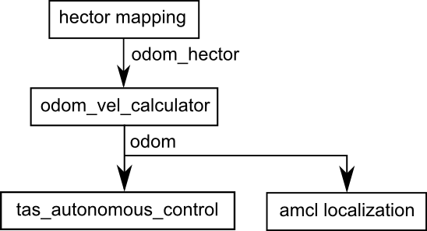
Speed Control by using Odometry
Idea:
Subscribe odometry message from hector_mapping
Calculate linear velocity and rotation angle out of elapsed time and two sampled points in the coordinate system
Reduce noise of velocity-measurement by low-pass filtering
Publish modified odom message with velocities to autonomous_control and amcl_localization
B. Kast, H. Zimmermann, M. Freundl, W. Burger
6

Slide 7
Autonomous Control Node
Determines absolute velocity and controls it with PID-Controller
PID-Controller was created with control_toolbox package for ROS
Forward- and backwards-velocity are modified by seperate PID-Controllers
Calculates the rotation velocity for controlling steering angle
Publishes PWM-control commands to servos
B. Kast, H. Zimmermann, M. Freundl, W. Burger
7

Slide 8
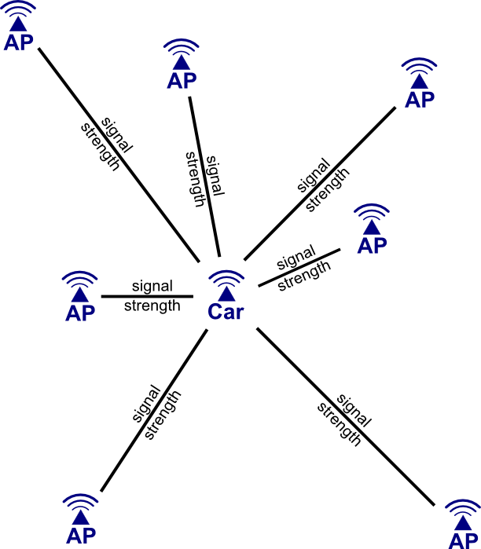
Wifi Localization
Wolfgang Burger
B. Kast, H. Zimmermann, M. Freundl, W. Burger
8

Slide 9
Localization
Idea:
Signal strengths of the detected wifi signals for localization
Collect samples when the car is located at the positions
Train a Feedforward Neural Network with this data
Used packages:
wifi_scan (https://github.com/RafBerkvens/wifi_scan)
wifi_localization (self-written)
B. Kast, H. Zimmermann, M. Freundl, W. Burger
9

Slide 10
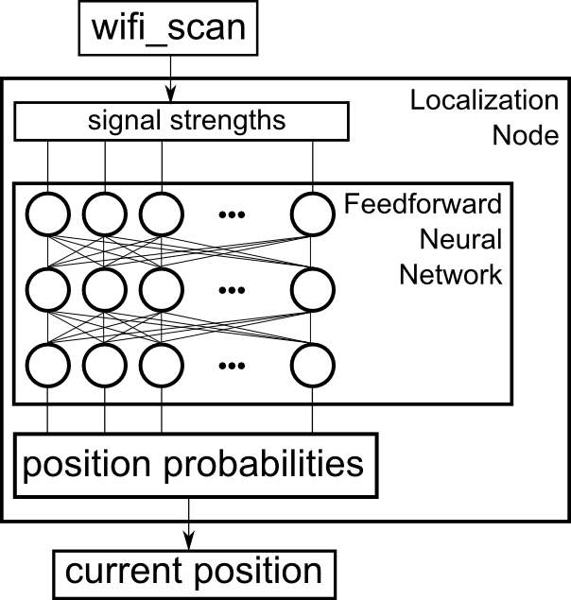
Localization
For every detected wifi we get the MAC adress of the access point and the corresponding signal strength.
Each signal strength is mapped to one input of the FFNN by using the MAC adress. If a network is not detected, the signal strength is set to a very low bottom level.
Each output of the FFNN represents the pseudo-probability that the car is in one specific position
B. Kast, H. Zimmermann, M. Freundl, W. Burger
10

Slide 11
Localization
Results:
The program is able to collect data, train the network and save it for another time so there is only need to train it once
The localization was successfully tried on different laptops using 8 positions at the LSR floor (4 corners and in between them)
It was not possible to get it running on the cars (we tried Gerty and Vettel) because of some issue with the wifi_scan package
B. Kast, H. Zimmermann, M. Freundl, W. Burger
11

Slide 12

Parking Task
Martin Freundl
B. Kast, H. Zimmermann, M. Freundl, W. Burger
12

Slide 13
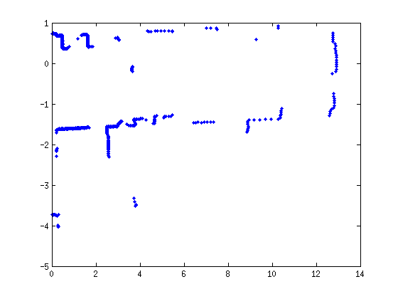
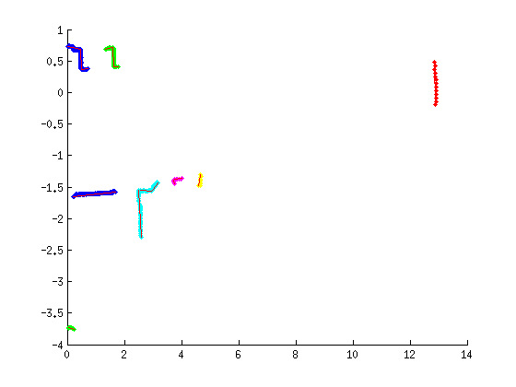
Parking – Box Recognition
Group neighbouring points of the laser scan into clusters
Only select clusters with a certain number of points
Fit lines into the remaining clusters
Choose those clusters as boxes:
Consisting of 3 lines
2 angles of about 90°
Second line is about 30 cm long (edge of DIN A4)
B. Kast, H. Zimmermann, M. Freundl, W. Burger
13

Slide 14
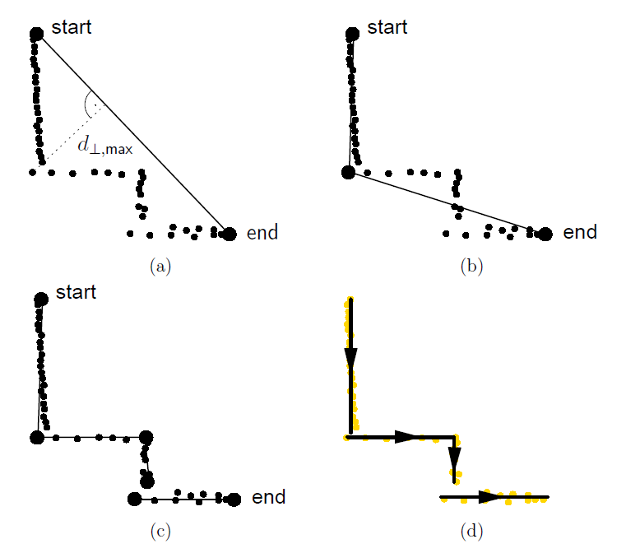
Parking – Box Recognition
Group neighbouring points of the laser scan into clusters
Only select clusters with a certain number of points
Fit lines into the remaining clusters
Choose those clusters as boxes:
Consisting of 3 lines
2 angles of about 90°
Second line is about 30 cm long (edge of DIN A4)
Line segment extraction within a group of scan points [1]
B. Kast, H. Zimmermann, M. Freundl, W. Burger
14

Slide 15
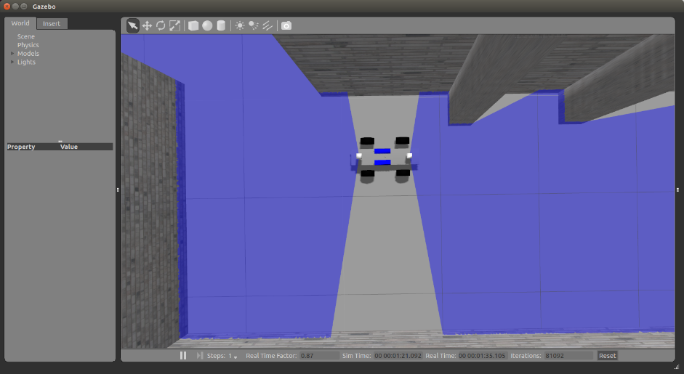
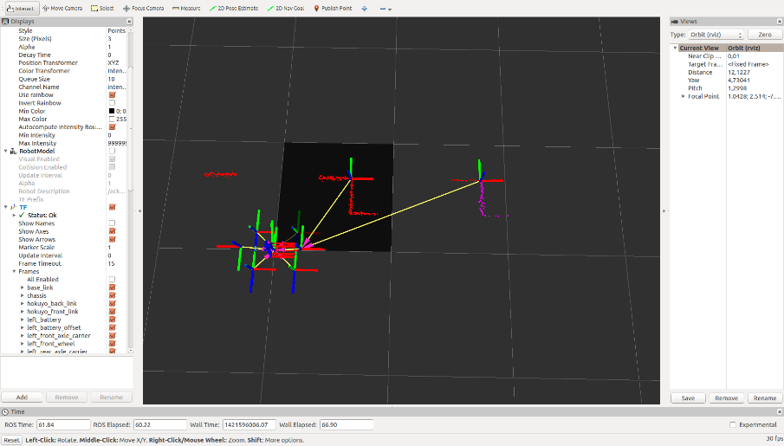
Parking – Steps
Step 1:
Detect a gap of the right length to start the parking task.
B. Kast, H. Zimmermann, M. Freundl, W. Burger
15

Slide 16
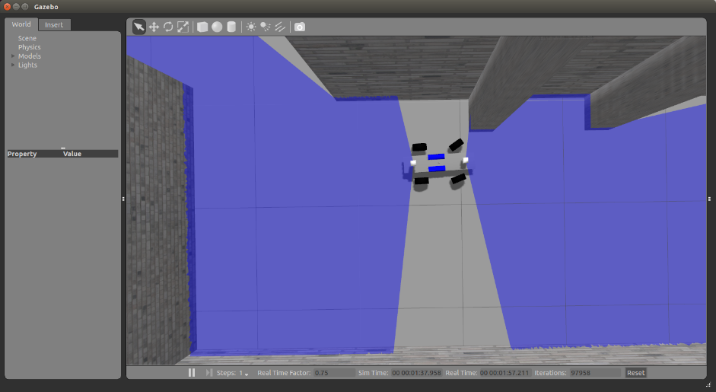
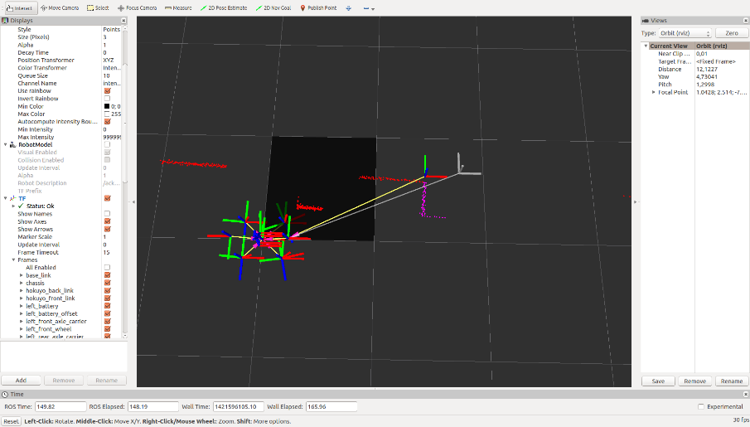
Parking – Steps
Step 2:
Move to position 2.
Control orientation and position of the car.
B. Kast, H. Zimmermann, M. Freundl, W. Burger
16

Slide 17
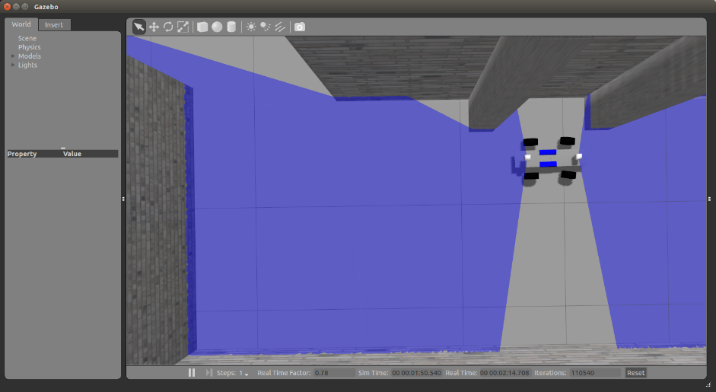
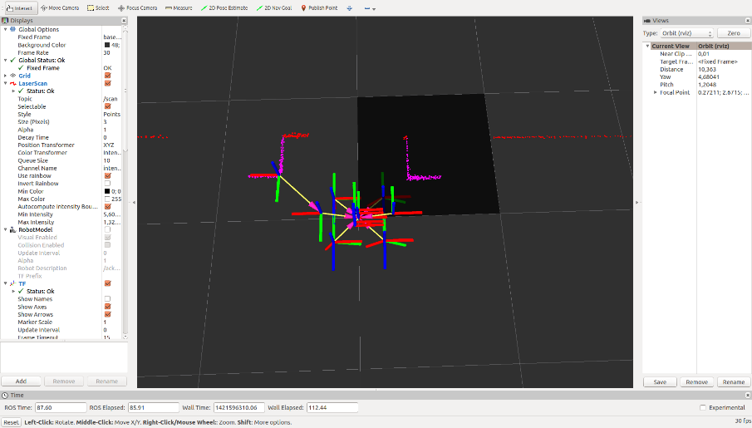
Parking – Steps
Step 2:
Move to position 2.
Switch to back-scanner when box in the front disappears.
B. Kast, H. Zimmermann, M. Freundl, W. Burger
17

Slide 18
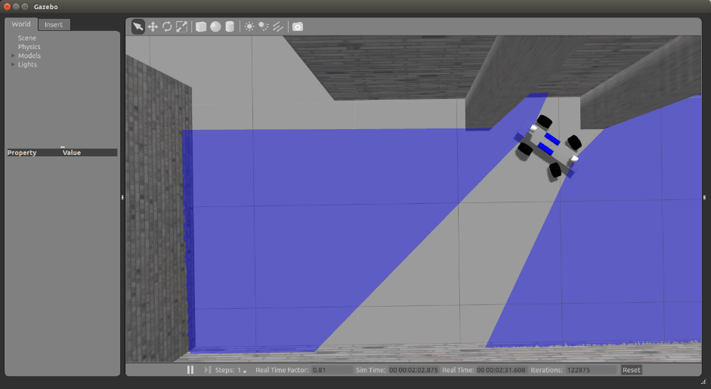
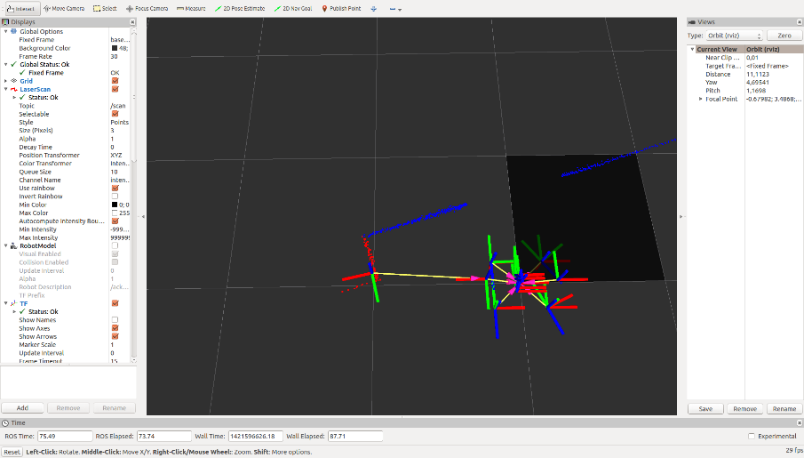
Parking – Steps
Step 3:
Move into the gap.
Steering angle is reversed
when the car has a certain orientation to the box behind it.
B. Kast, H. Zimmermann, M. Freundl, W. Burger
18

Slide 19
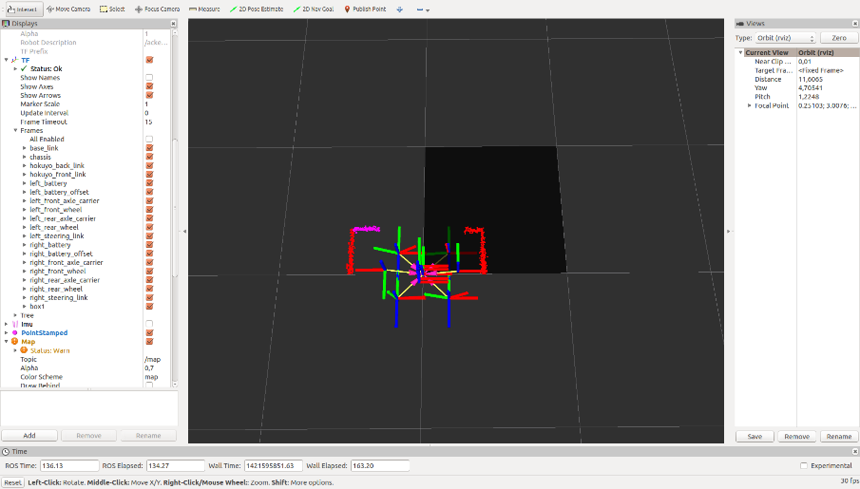
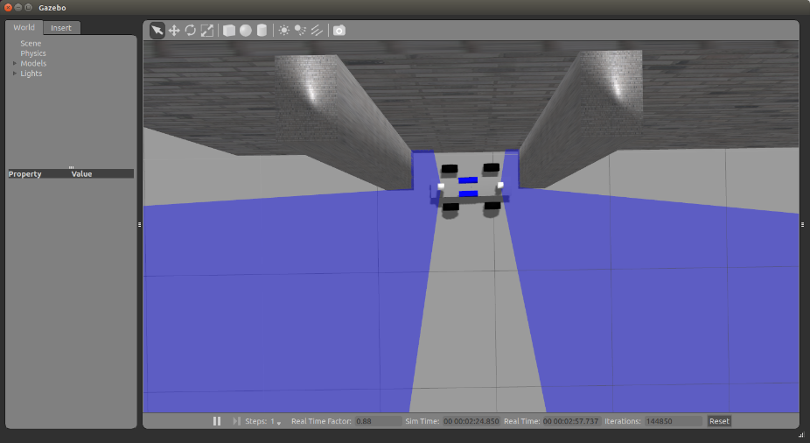
Parking – Steps
Step 4:
Do a movement for correction.
Both laser scanners are used so that the car does not touch the boxes.
B. Kast, H. Zimmermann, M. Freundl, W. Burger
19

Slide 20
Parking – Results & Conclusion
The parking task is a set of controlled movements and not just a recorded movement, so minor changes of the start position lead to the same result
Thanks to the simulation and the velocity controller, the parking task was completely developed in the simulation and then adapted to the reality by only doing little modifications on some parameters.
The second box needs to be higher otherwise it is not detected in the start position because the scanner is mounted on the car at a certain slope
B. Kast, H. Zimmermann, M. Freundl, W. Burger
20

Slide 21

Thanks!
T. Einsele Localization in Indoor Environments Using a Panoramic Laser Range Finder Dissertation
[1]
B. Kast, H. Zimmermann, M. Freundl, W. Burger
21

