Slide 1

Automation of Invoice Reporting with UiPath
Jason Teixeira
AI Automation | Project 6

Slide 2
Problem
Finance manually opens supplier invoices, copies key fields, and identifies purchases—slowing reporting and risking errors.

Slide 3
Solution
UiPath reads Drive PDFs, extracts invoice fields, flags low-confidence numbers, and generates short purchase descriptions. Eligible invoices are appended to a five-column report.

Slide 4
RPA workflow diagram
Drive PDFs → Document Understanding → Confidence warning → AI description → Due-date check → Google Sheets

Slide 5
Benefits
Less manual copying
Clear purchase context
Warnings for review

Slide 6
Challenges & improvements
Validation and future improvements
Test faint scans and the 22 September cutoff. Review low-confidence invoice numbers, handle missing fields, and prevent duplicate rows on reruns.

Slide 7
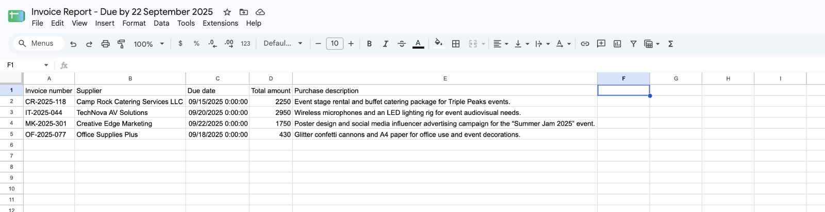
Result: four eligible invoices with all five fields populated.

Slide 8
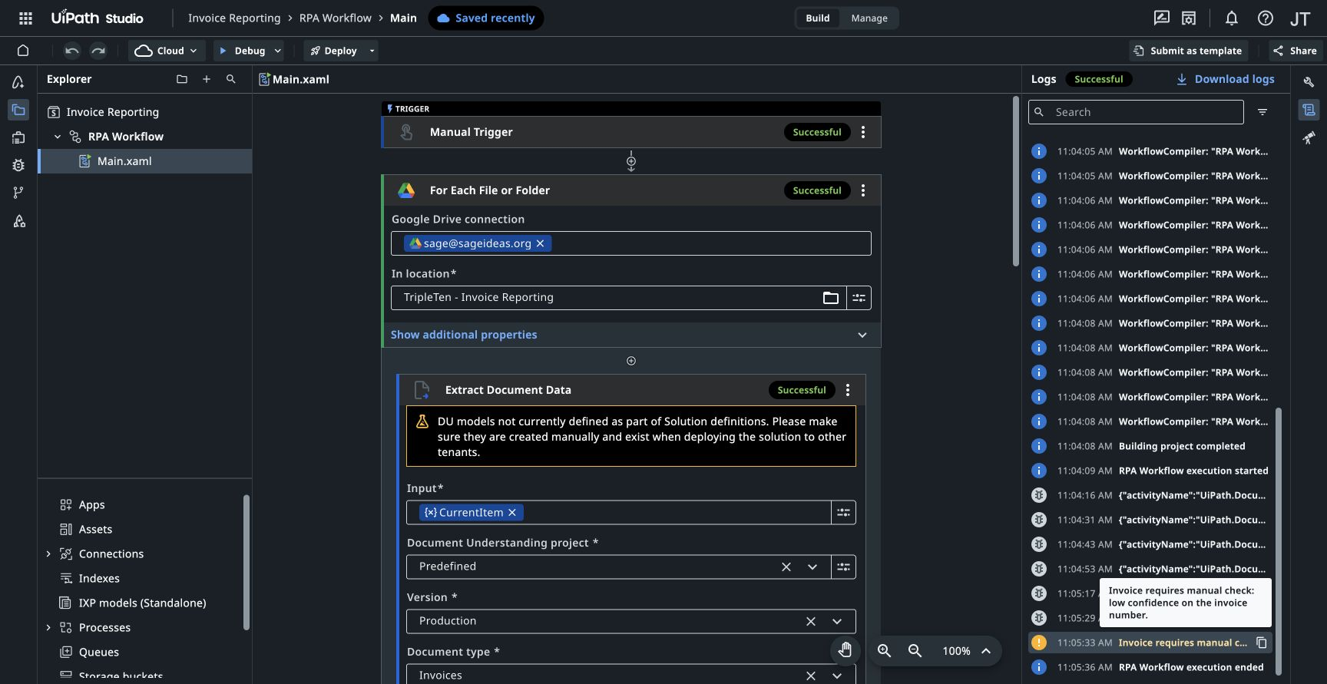

Slide 9
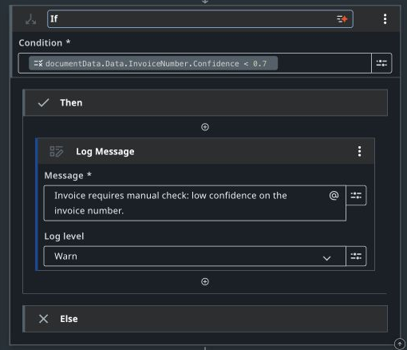
Confidence check and manual review
Invoice Number confidence below 0.7 routes to a Warn log for manual review.
UiPath Studio Web configuration capture · October 29, 2026 · Evidence 1/6

Slide 10
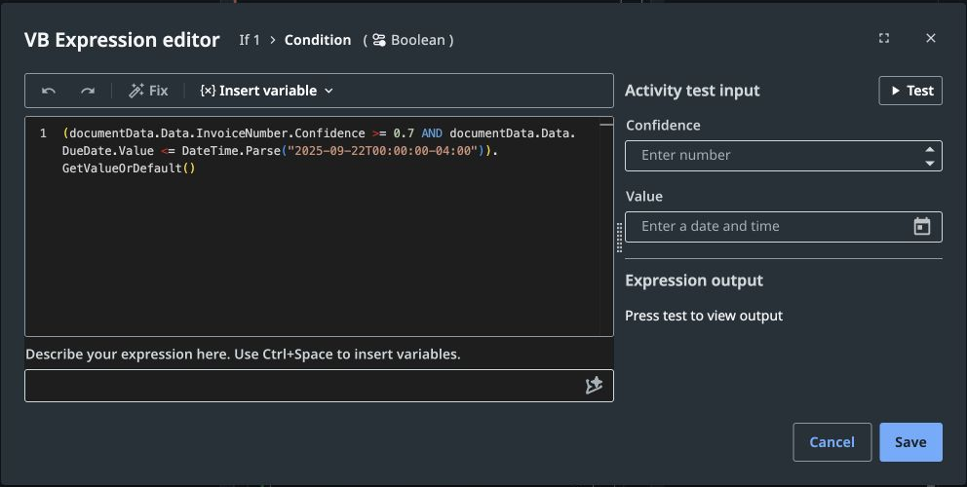
Due date filter
Both conditions must pass: confidence at least 0.7 and due date on or before September 22, 2025. The Else branch has no Write Row.
UiPath Studio Web configuration capture · October 29, 2026 · Evidence 2/6

Slide 11
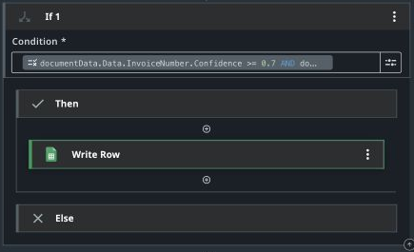
Due date filter: report path
Write Row appears only in Then. The empty Else branch skips invoices that fail the date or confidence condition.
UiPath Studio Web configuration capture · October 29, 2026 · Evidence 3/6

Slide 12
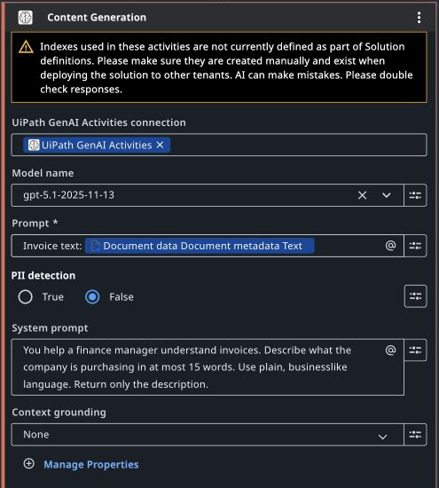
Purchase Description prompt
The system prompt limits the generated description to at most 15 words; the invoice document text is supplied as input.
UiPath Studio Web configuration capture · October 29, 2026 · Evidence 4/6

Slide 13
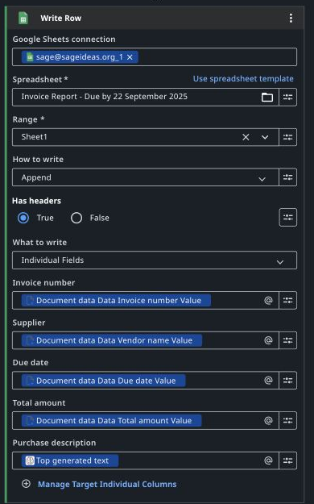
Google Sheets Write Row mappings
All five fields are mapped. Purchase description uses Top generated text.
UiPath Studio Web configuration capture · October 29, 2026 · Evidence 5/6

Slide 14
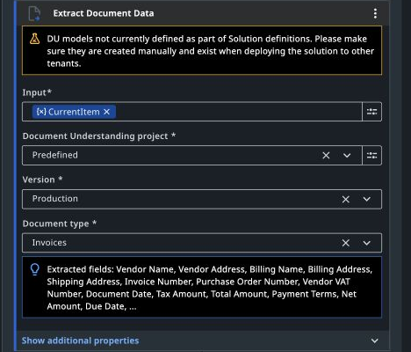
Document Understanding warning reviewed
Studio warns that the predefined Invoices model is outside the Solution definitions. The successful local run is evidenced separately; deployment to another tenant needs that model available.
UiPath Studio Web configuration capture · October 29, 2026 · Evidence 6/6

