Slide 1
Automated Customer Feedback Analysis
Raw customer feedback in, structured real-time insight out.
Nothing slips through, and unhappy customers get caught the same day.
Google Forms · Make · Gemini 2.5 Flash · Google Sheets · Gmail
Jason Teixeira · Customer Success Manager (project scenario) · TripleTen AI Automation

Slide 2
THE PROBLEM
Feedback is only useful if you actually read it — fast
As the Customer Success Manager for a small online store, feedback comes in through a form and just sits in a spreadsheet.
Slow — reading every response by hand doesn't scale, so insights arrive late, if at all.
Inconsistent — two people will grade the same message differently.
Risky — the angry responses are exactly the ones you can't afford to miss for three days. One overlooked complaint can turn into a public blow-up.
So I built a workflow that reads, classifies, and files every response automatically, and pings me the moment something goes negative.

Slide 3
WHAT I BUILT
One form in, structured insight out — no manual steps
A customer fills out one short form. Behind the scenes an AI model returns a sentiment label and a one-line summary, that lands in a spreadsheet automatically, and if it's negative I get an email.
Collect — Google Form: a satisfaction rating + free-text feedback.
Analyze — Gemini 2.5 Flash classifies sentiment and writes a 1-sentence summary.
Store — parsed results drop into Google Sheets with a timestamp.
Alert — negative feedback triggers an instant email to me.

Slide 4
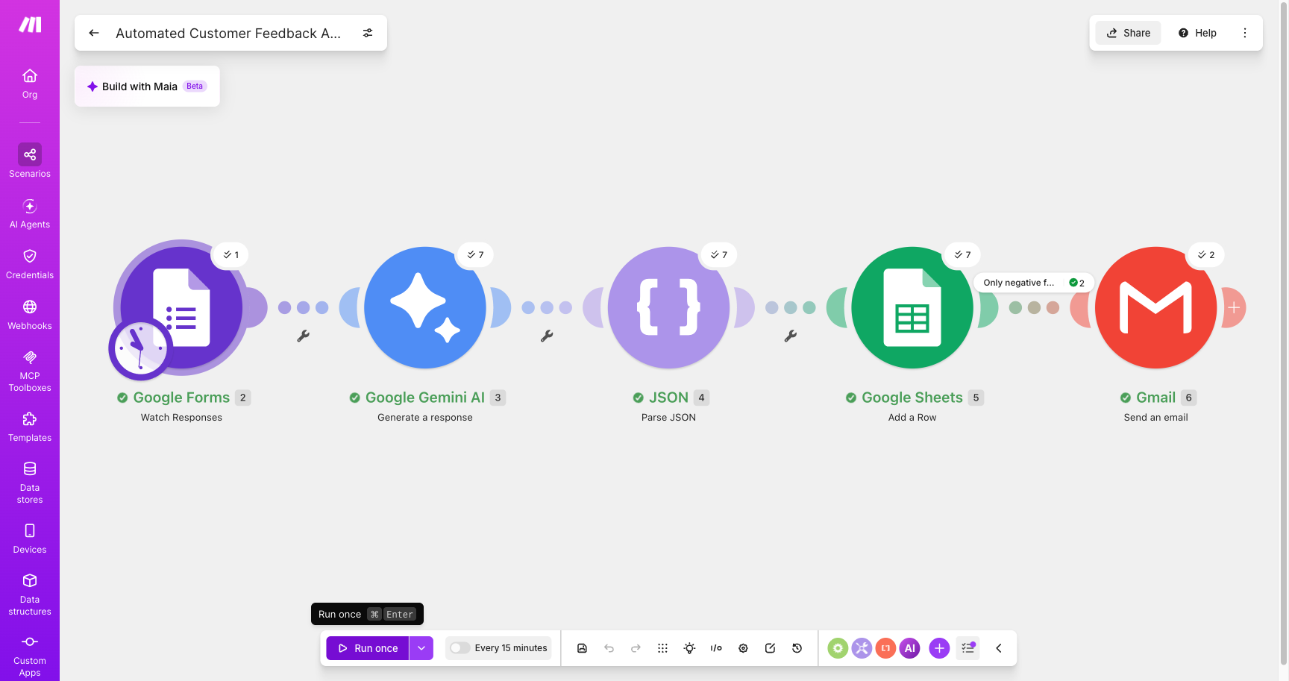
HOW IT WORKS
The workflow in Make, end to end
Google Forms (trigger) → Gemini 2.5 Flash (classify + summarize) → Parse JSON → Google Sheets (add row) → Gmail (only if Negative)
The live scenario after a real run — all 5 modules connected, 7 responses processed, filter on the email leg.

Slide 5
THE AI PART
Getting clean, consistent JSON was the real work
The starter prompt kept wrapping its answer in a Markdown code block, and sometimes added a sentence first. The JSON parser choked on both.
Fix 1 — demand raw JSON only: "return ONLY one JSON object. No Markdown, no code fences, no text before or after it."
Fix 2 — pin the two keys exactly: "sentiment" (Positive / Neutral / Negative) and "summary" (1 sentence, third person).
Fix 3 — add a fallback for empty feedback so the parser never gets a surprise shape.
Fix 4 — temperature 0.2, and explicit classification rules after a borderline comment ("packaging was excessive") flip-flopped between Neutral and Negative across runs. Mild gripes now stay Neutral; Negative is reserved for real problems that need action.
After that, every one of the responses parsed cleanly on every run.

Slide 6
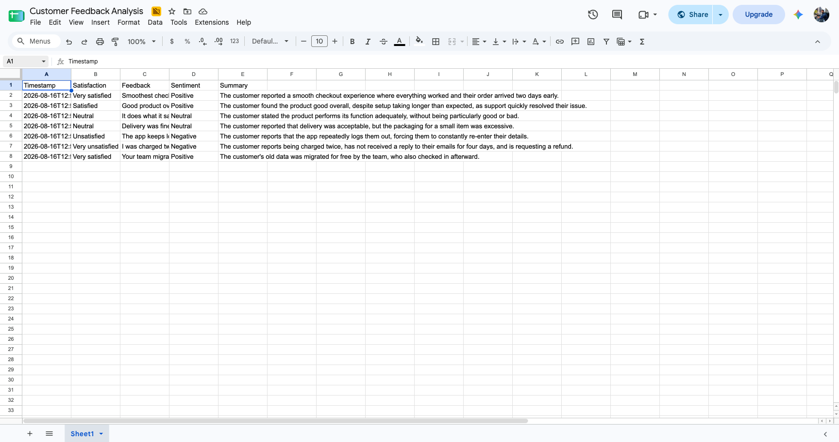
THE OUTPUT
Clean, analyzable data in Sheets
One row per response: Timestamp · Satisfaction · Feedback · Sentiment · Summary. This is the real sheet from the 7 test submissions.

Slide 7
THE INSIGHT
What the data told me
Across 7 test submissions: 3 Positive · 2 Neutral · 2 Negative.
The useful part wasn't the split. It was the pattern in the negatives: both unhappy customers were describing the same class of problem — billing and account reliability (a double-charge with no support reply, and repeated forced logouts).
That's something a team can actually go fix: improve billing response time and patch the session bug — instead of a vague "some customers are unhappy."

Slide 8
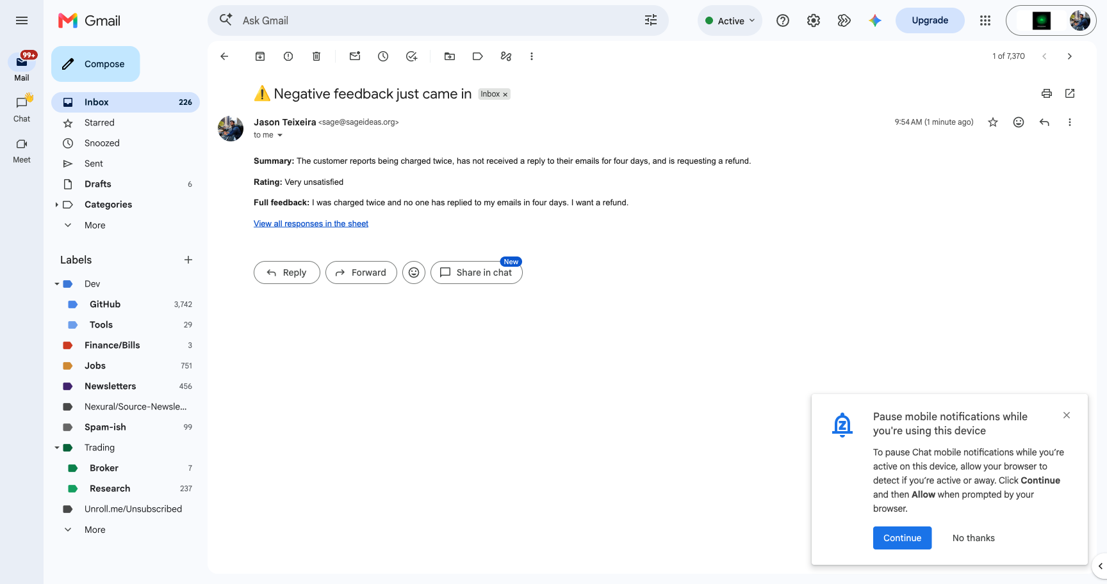
OPTIONAL — BUILT IT ANYWAY
Real-time email alerts for negative feedback
Filter: sentiment = Negative → Gmail sends the summary, rating, full feedback, and a link to the sheet.
A real alert from the live run, in my inbox the same minute the response was processed.

Slide 9
HONEST REFLECTION
What I'd improve with more time and tools
Slack alerts — post negatives into a #customer-alerts channel so the whole team sees them, with a reaction to claim each one.
Topic tags — have the AI also return a category (billing / shipping / bug / praise) so the sheet can be filtered and trended, not just read.
Fallback logic — if Gemini ever returns malformed JSON, catch it and log the row as "needs review" instead of erroring out.
A live dashboard — a Looker Studio chart on top of the sheet showing sentiment over time.
Priority scoring — flag anything that's both "Very unsatisfied" and Negative as high priority, so the loudest alarms rise to the top.

Slide 10
DELIVERABLES
Links & submission
Make scenario blueprint (exported JSON, anyone with the link can view):
https://drive.google.com/file/d/1mFRXlwrmPMcy_1W7vSgARE3hg_QLvR9J/view?usp=sharing
Google Sheet with the live test data (anyone with the link can view):
https://docs.google.com/spreadsheets/d/1L-kVnd12jnnij_LtLvnCo6Gdk9jjtZIxbvY9c5mPjNQ/edit?usp=sharing
Everything above runs hands-off. One form submission, and the insight files itself.
Thanks for reviewing — Jason Teixeira

