Slide 1

Automation of Invoice Reporting with UiPath
Jason Teixeira
AI Automation | Project 6

Slide 2
Problem
Finance manually opens supplier invoices, copies key fields, and identifies purchases—slowing reporting and risking errors.

Slide 3
Solution
UiPath reads Drive PDFs, extracts invoice fields, flags low-confidence numbers, and generates short purchase descriptions. Eligible invoices are appended to a five-column report.

Slide 4
RPA workflow diagram
Drive PDFs → Document Understanding → Confidence warning → AI description → Due-date check → Google Sheets

Slide 5
Benefits
Less manual copying
Clear purchase context
Warnings for review

Slide 6
Challenges & improvements
Validation and future improvements
Test faint scans and the 22 September cutoff. Review low-confidence invoice numbers, handle missing fields, and prevent duplicate rows on reruns.

Slide 7
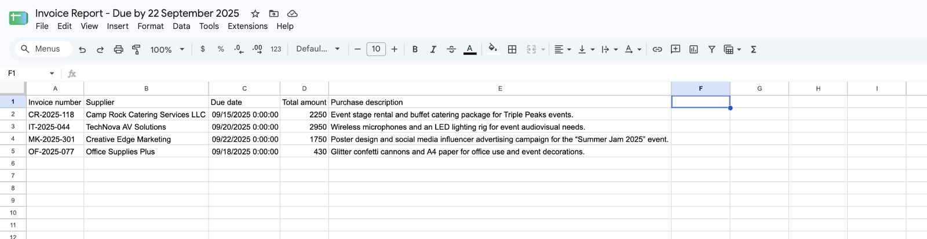
Result: four eligible invoices with all five fields populated.

Slide 8
