Slide 1
Student: Jason Thomas, s3907634 Program: Bachelor of Science (Mathematics and Statistics) (Honours) Project: Probability of extinction for pathogens transmitted between ticks during co-feeding Supervisor: Associate Professor Stephen Davis

Slide 2
Thesis seminar schedule
Introduction
Aims and research questions
Methods
Results
Discussion
References
Acknowledgements
Questions

Slide 3
Introduction: ticks
Hard-bodied ticks:
Are arachnids
Feed on the blood of vertebrate hosts
Have four life stages: (egg, larva, nymph, adult) (Johnson, 2023)
Feed once per life stage.

Slide 4
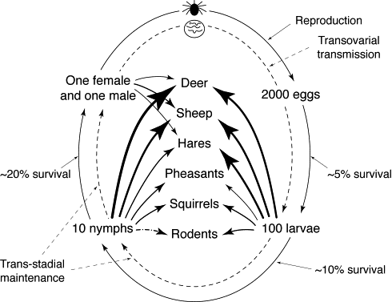
Introduction: ticks
Hard-bodied ticks:
Are arachnids
Feed on the blood of vertebrate hosts
Have four life stages: (egg, larva, nymph, adult) (Johnson, 2023)
Feed once per life stage.
Immature ticks
Are more plentiful
Frequently feed on small vertebrate hosts (Randolph, 1998)

Slide 5
Introduction: ticks
Tick-borne diseases:
Ticks spread pathogens that cause diseases.
There are three known transmission routes for pathogens:
Systemic transmission
Transovarial transmission
Co-feeding transmission (Harrison and Bennett, 2012).
Co-feeding required for some pathogens to persist in nature (Hartemink et al, 2008).
Some research shows that co-feeding transmission is sufficient for some pathogens to survive (Rosa et al, 2003).

Slide 6
Introduction: ticks
Tick-aggregation
Aggregation is where most parasites tend to attach to a subset of the available hosts. The 80:20 rule is commonly-cited and well-observed (Woolhouse et al, 1997).
The negative binomial distribution has become the de facto standard for fitting parasite aggregation data generally (Shaw et al, 1998).

Slide 7
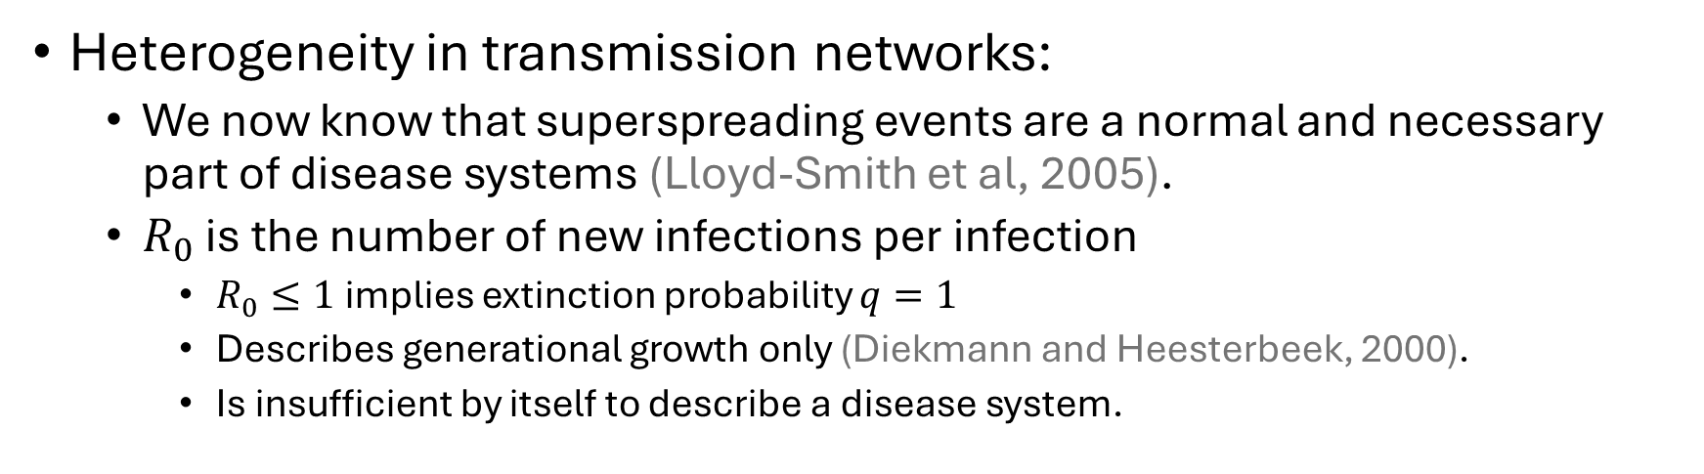
Introduction: other transmission
Heterogeneity in transmission networks:
We now know that superspreading events are a normal and necessary part of disease systems (Lloyd-Smith et al, 2005).
$R_{0}$ is the number of new infections per infection
$R_{0}≤1$ implies extinction probability $q=1$
Describes generational growth only (Diekmann and Heesterbeek, 2000).
Is insufficient by itself to describe a disease system.

Slide 8
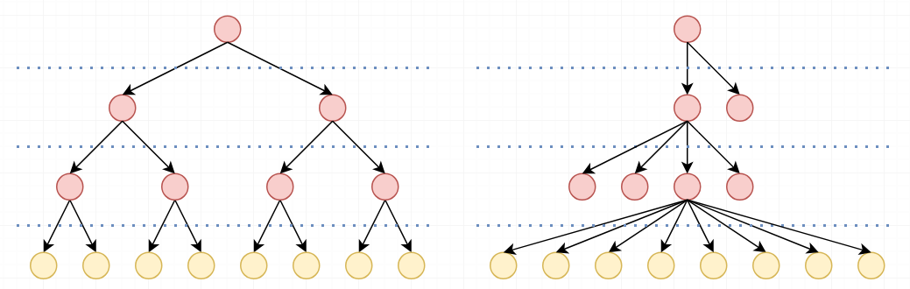
Introduction: other transmission
Heterogeneity in transmission networks:

Slide 9
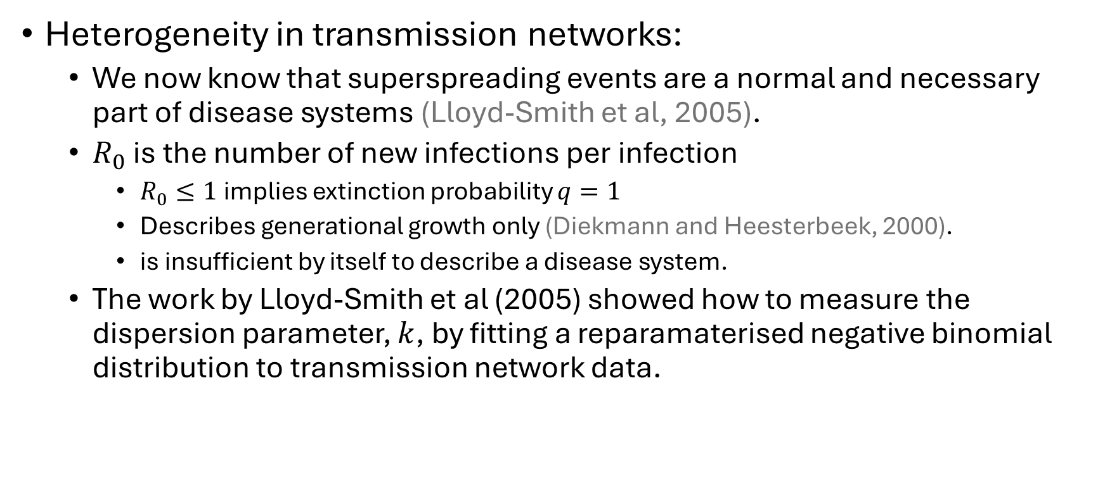
Introduction: other transmission
Heterogeneity in transmission networks:
We now know that superspreading events are a normal and necessary part of disease systems (Lloyd-Smith et al, 2005).
$R_{0}$ is the number of new infections per infection
$R_{0}≤1$ implies extinction probability $q=1$
Describes generational growth only (Diekmann and Heesterbeek, 2000).
is insufficient by itself to describe a disease system.
The work by Lloyd-Smith et al (2005) showed how to measure the dispersion parameter, $k$, by fitting a reparamaterised negative binomial distribution to transmission network data.

Slide 10

Introduction: other transmission
Probability of extinction
Lloyd-Smith et al (2005) used a single-type Galton-Watson Branching Process to predict $q$: the probability that a chain of transmissions becomes extinct.
Once you have found $R_{0},k$ you can use that to find $q$ by using a probability generating function (and some clever maths).

Slide 11
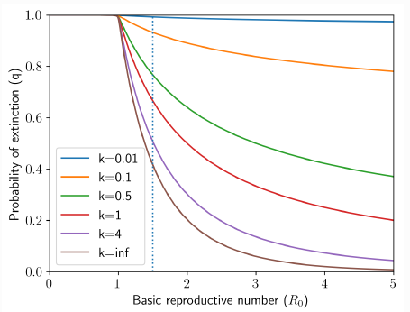
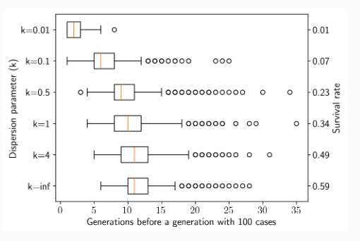
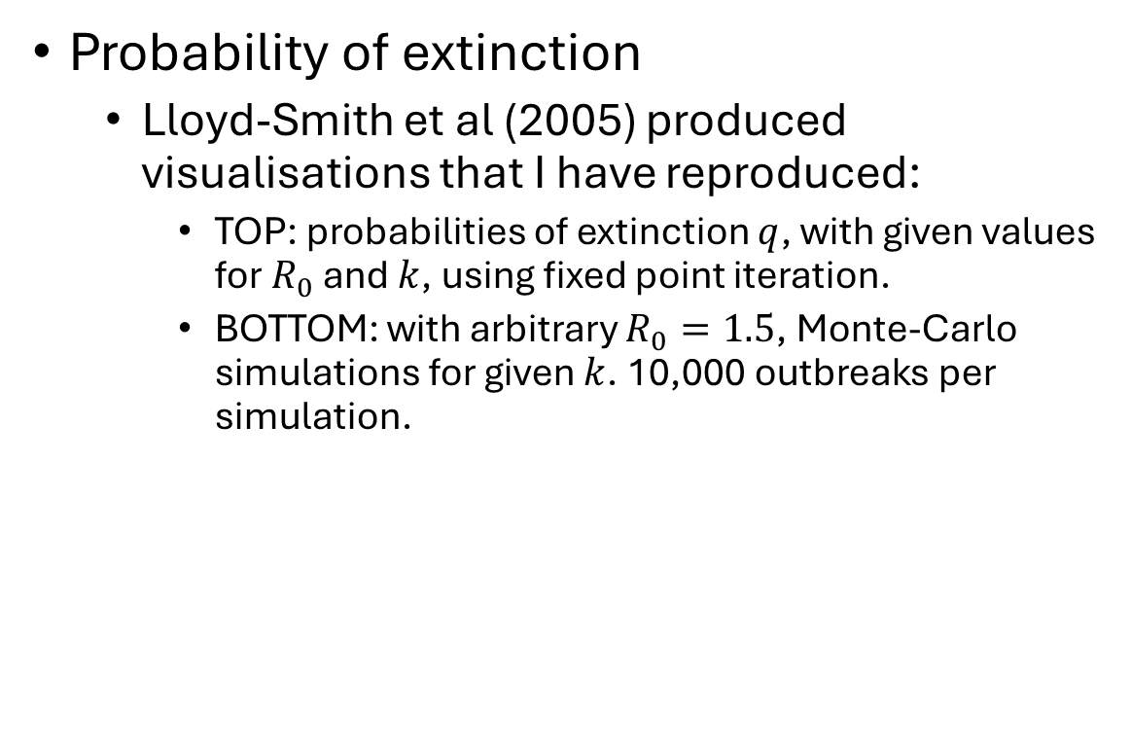
Introduction: other transmission
Probability of extinction
Lloyd-Smith et al (2005) produced visualisations that I have reproduced:
TOP: probabilities of extinction $q$, with given values for $R_{0}$ and $k$, using fixed point iteration.
BOTTOM: with arbitrary $R_{0}=1.5$, Monte-Carlo simulations for given $k$. 10,000 outbreaks per simulation.

Slide 12
Thesis seminar schedule
Introduction
Aims and research questions
Methods
Results
Discussion
References
Acknowledgements
Questions

Slide 13
Aims and research questions
Research question:
For common tick aggregation data, with numbers of larvae and nymphs recorded, can we determine the probability that a chain of transmissions becomes extinct?
Using a technique that we think is novel
Using a single-type GWBP (well-established)

Slide 14
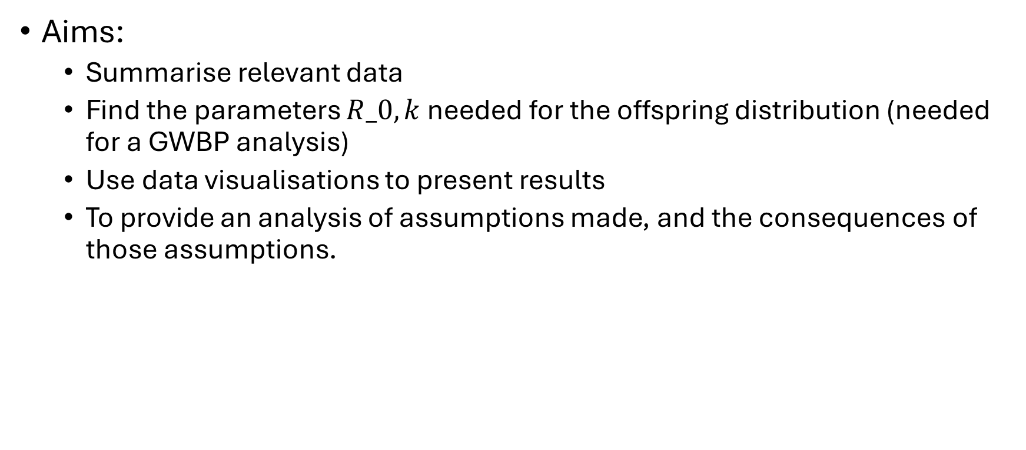
Aims and research questions
Aims:
Summarise relevant data
Find the parameters $R_0, k$needed for the offspring distribution (needed for a GWBP analysis)
Use data visualisations to present results
To provide an analysis of assumptions made, and the consequences of those assumptions.

Slide 15
Thesis seminar schedule
Introduction
Aims and research questions
Methods
Results
Discussion
References
Acknowledgements
Questions

Slide 16
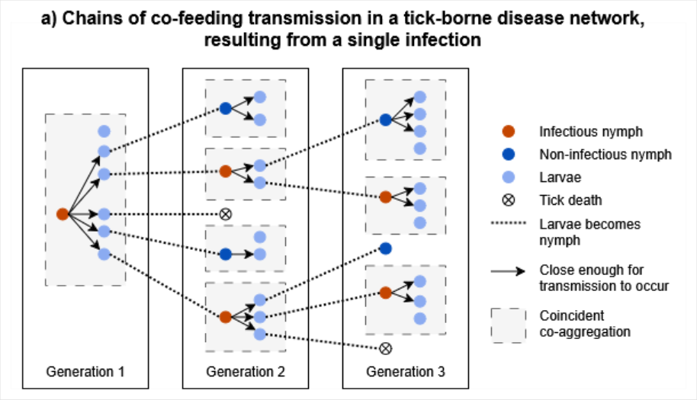
Methods: model of transmission

Slide 17
Methods: data
Basic details:
From the Kielder Forest in the north of England
Collected between 2004-2005
Tick species: Ixodes ricinus, Ixodes trianguliceps
Vertebrate host species: Common Shrew, Field Vole
Provided by Dr Kevin Bown

Slide 18
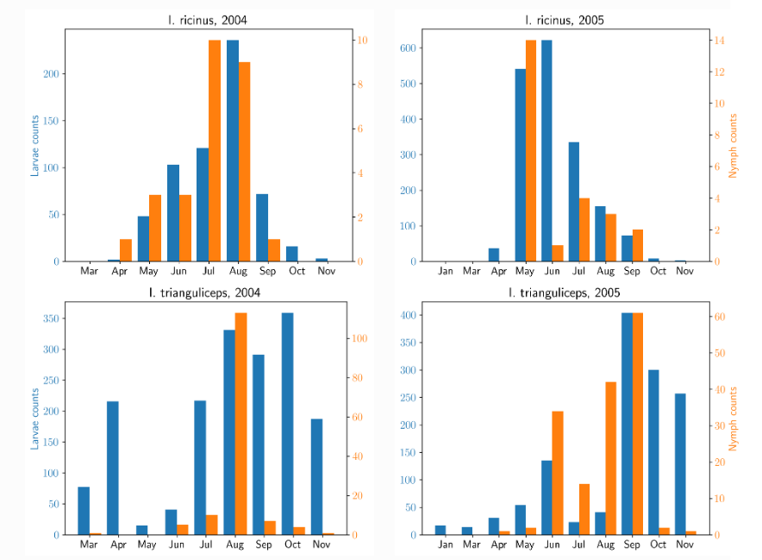
Methods: data

Slide 19
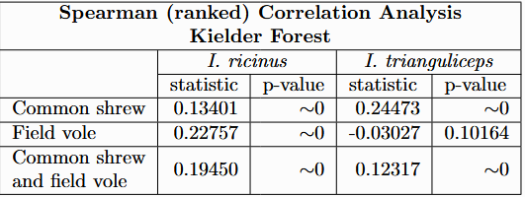
Methods: data

Slide 20
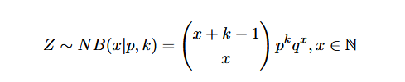


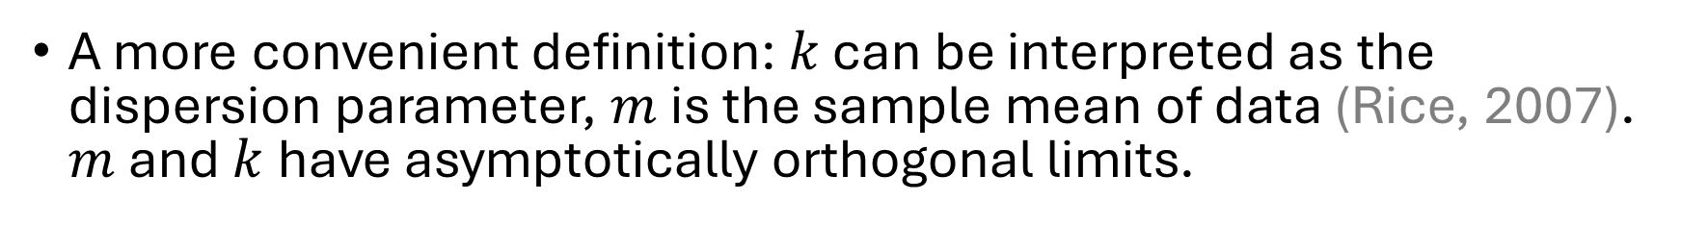
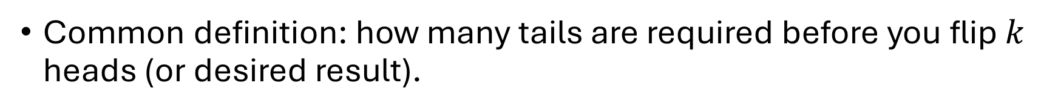
Methods: negative binomial distribution
Common definition: how many tails are required before you flip $k$ heads (or desired result).
A more convenient definition: $k$ can be interpreted as the dispersion parameter, $m$ is the sample mean of data (Rice, 2007). $m$ and $k$have asymptotically orthogonal limits.

Slide 21
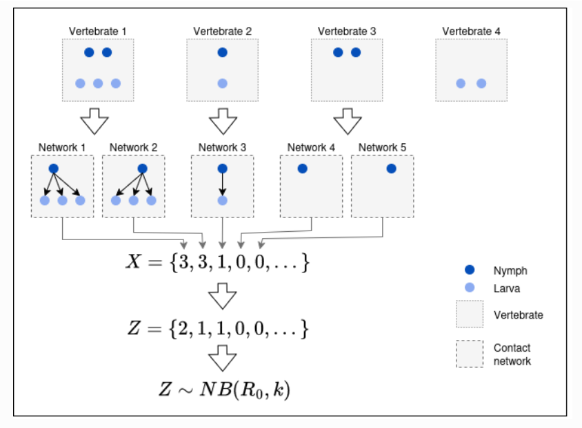

Methods: how to find values of $R_{0}$ and $k$

Slide 22
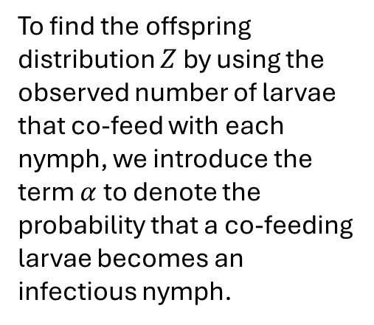
Methods: how to find values of $R_{0}$ and $k$
To find the offspring distribution $Z$ by using the observed number of larvae that co-feed with each nymph, we introduce the term $α$ to denote the probability that a co-feeding larvae becomes an infectious nymph.

Slide 23
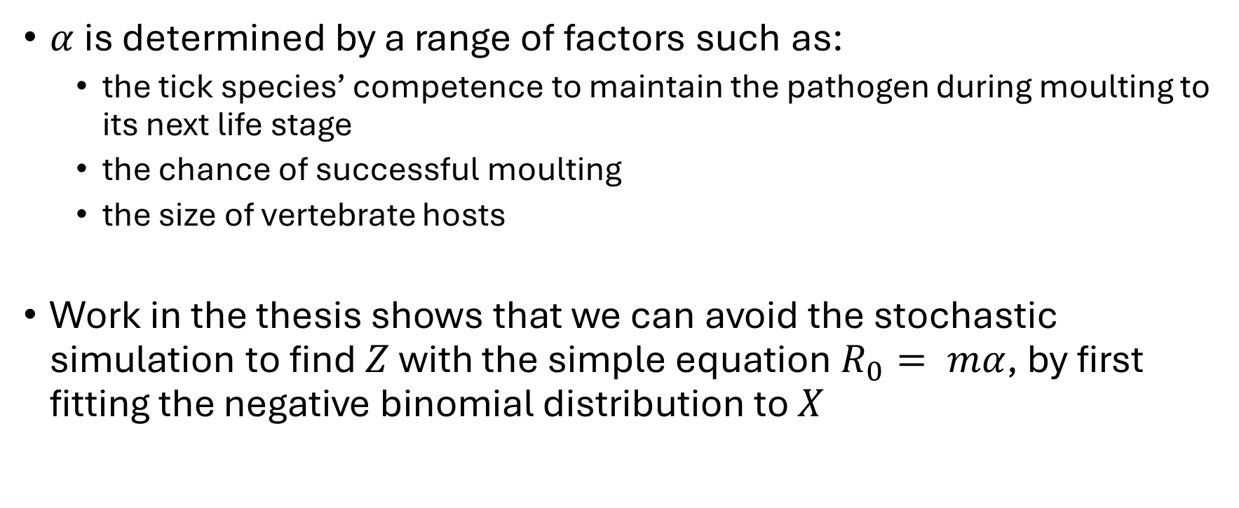
Methods: how to find values of $R_{0}$ and $k$
$α$is determined by a range of factors such as:
the tick species’ competence to maintain the pathogen during moulting to its next life stage
the chance of successful moulting
the size of vertebrate hosts
Work in the thesis shows that we can avoid the stochastic simulation to find $Z$ with the simple equation$R_{0}= mα$, by first fitting the negative binomial distribution to $X$

Slide 24

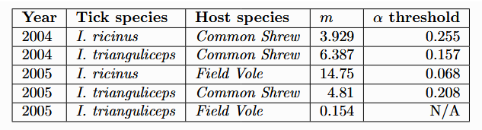

Methods: effect of $α$ on$R_{0}$
$α$ has a threshold property:

Slide 25
Methods: effect of $α$ on$R_{0}$
$α$ has a threshold property:

Slide 26
Thesis seminar schedule
Introduction
Aims and research questions
Methods
Results
Discussion
References
Acknowledgements
Questions

Slide 27
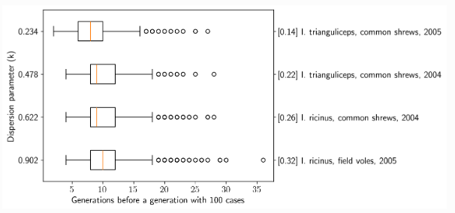

Results: probability of extinction $q$

Slide 28
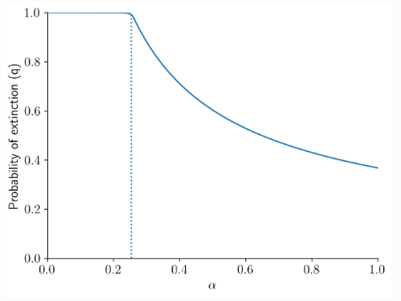
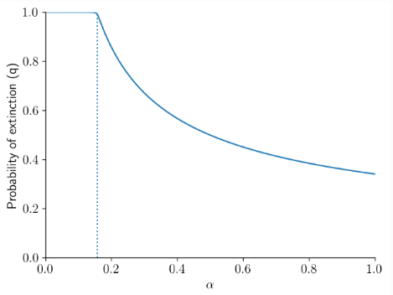
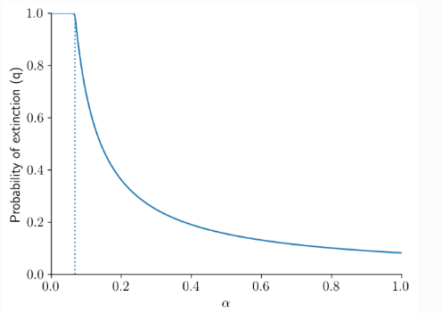
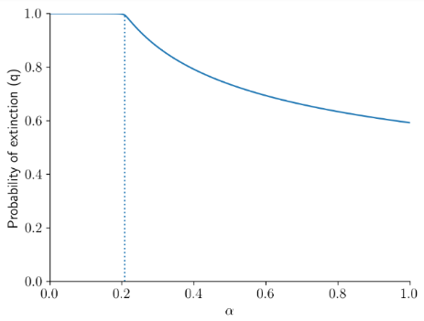
Results: probability of extinction $q$
TOP LEFT: I. ricinus found on common shrews in 2004.
TOP RIGHT: I. trianguliceps found on common shrews in 2004.
BOTTOM LEFT: I. ricinus found on field voles in 2005.
BOTTOM RIGHT: I. trianguliceps for on common shrews in 2005.

Slide 29
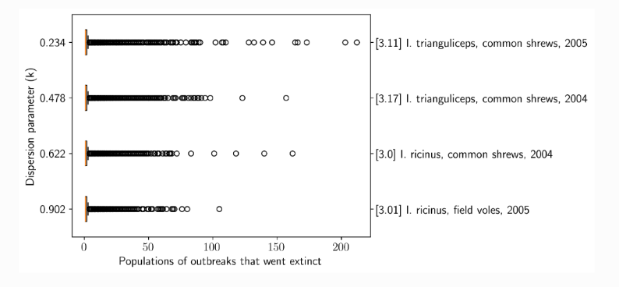
Results: probability of extinction $q$

Slide 30
Thesis seminar schedule
Introduction
Aims and research questions
Methods
Results
Discussion
References
Acknowledgements
Questions

Slide 31
Discussion
Assumptions:
Some reflect biological reality.
Some are simplifying assumptions to make the problem tractable.
All of them have consequences and limit the use of this method.
Alternative assumptions and consequences analysed in thesis.

Slide 32
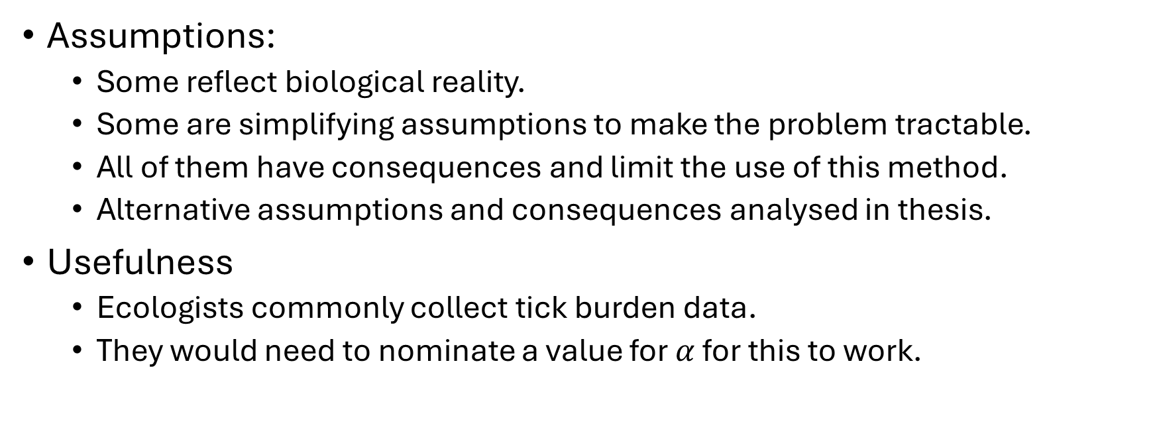
Discussion
Assumptions:
Some reflect biological reality.
Some are simplifying assumptions to make the problem tractable.
All of them have consequences and limit the use of this method.
Alternative assumptions and consequences analysed in thesis.
Usefulness
Ecologists commonly collect tick burden data.
They would need to nominate a value for $α$ for this to work.

Slide 33
Thesis seminar schedule
Introduction
Aims and research questions
Methods
Results
Discussion
References
Acknowledgements
Questions

Slide 34
References
Johnson, N. (2023b). A brief introduction to ticks. In Ticks (pp. 1–7). Elsevier. https://doi.org/10.1016/b978-0-323-91148-1.00001-0
Randolph, S. (1998). Ticks are not insects: Consequences of contrasting vector biology for transmission potential. Parasitology Today, 14 (5), 186–192. https://doi.org/10.1016/s01694758(98)01224-1
Harrison, A., & Bennett, N. C. (2012). The importance of the aggregation of ticks on small mammal hosts for the establishment and persistence of tick-borne pathogens: An investigation using the r 0 model. Parasitology, 139 (12), 1605–1613. https://doi.org/10.1017/s0031182012000893
Hartemink, N. et al., (2008). The basic reproduction number for complex disease systems: Defining r0 for tick-borne infections. The American Naturalist,171 (6), 743–754. https://doi.org/10.1086/587530
Rosa, R. et al., (2003). Thresholds for disease persistence in models for tick-borne infections including non-viraemic transmission, extended feeding and tick aggregation. Journal of Theoretical Biology, 224 (3), 359–376. https://doi.org/10.1016/s0022-5193(03)00173-5
Woolhouse, M. E. et al., (1997). Heterogeneities in the transmission of infectious agents: Implications for the design of control programs. Proceedings of the National Academy of Sciences, 94 (1), 338–342. https://doi.org/10.1073/pnas.94.1.338
Shaw, D., Grenfell, B., & Dobson, A. (1998). Patterns of macroparasite aggregation in wildlife host populations. Parasitology, 117 (6), 597–610. https://doi.org/10.1017/s0031182098003448
Lloyd-Smith, J. O. et al, (2005). Superspreading and the effect of individual variation on disease emergence. Nature, 438 (7066), 355–359. https://doi.org/10.1038/nature04153
Rice, J. A. (2007). Mathematical statistics and data analysis (3. ed., internat. student ed.) Thomson Brooks/Cole

Slide 35
Thesis seminar schedule
Introduction
Aims and research questions
Methods
Results
Discussion
References
Acknowledgements
Questions

Slide 36
Acknowledgements
Associate Professor Stephen Davis
Dr Simon Robertson-Johnstone, Dr Haydar Demirhan, Daniel Longmuir
Sarah Cowen, Amy Lambalk, Cooper Maher
Dr Kevin Bown

Slide 37
Thesis seminar schedule
Introduction
Aims and research questions
Methods
Results
Discussion
References
Acknowledgements
Questions

