Slide 2
1. How to derive the Linearisation function
2. What are some of its applications?
3. Why should we all care about this?

Slide 3
1. How to derive the Linearisation function

Slide 4
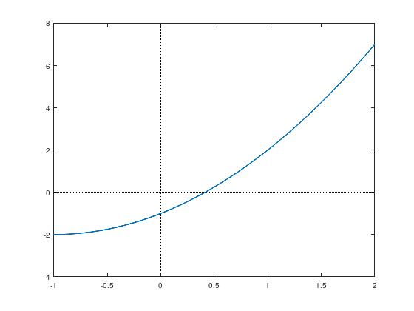
1. How to derive the Linearisation function

Slide 5
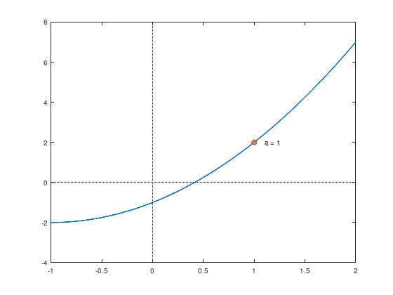
1. How to derive the Linearisation function

Slide 6
1. How to derive the Linearisation function

Slide 7
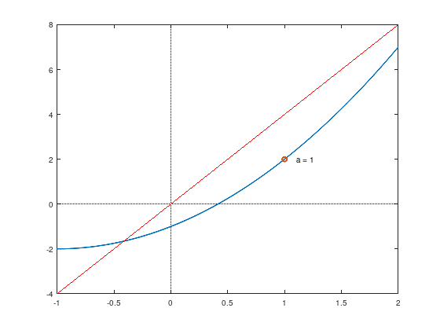
1. How to derive the Linearisation function

Slide 8
1. How to derive the Linearisation function

Slide 9
1. How to derive the Linearisation function

Slide 10
1. How to derive the Linearisation function

Slide 11
1. How to derive the Linearisation function

Slide 12
1. How to derive the Linearisation function

Slide 13
1. How to derive the Linearisation function

Slide 14
1. How to derive the Linearisation function

Slide 15
1. How to derive the Linearisation function

Slide 16
1. How to derive the Linearisation function

Slide 17
1. How to derive the Linearisation function

Slide 18
1. How to derive the Linearisation function

Slide 19
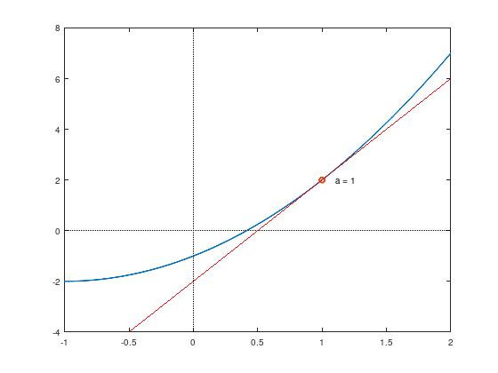
1. How to derive the Linearisation function

Slide 20
2. What are some of its applications?

Slide 21
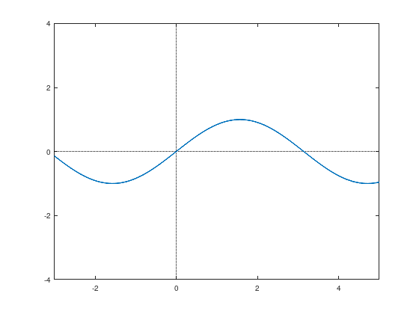
2. What are some of its applications?

Slide 22
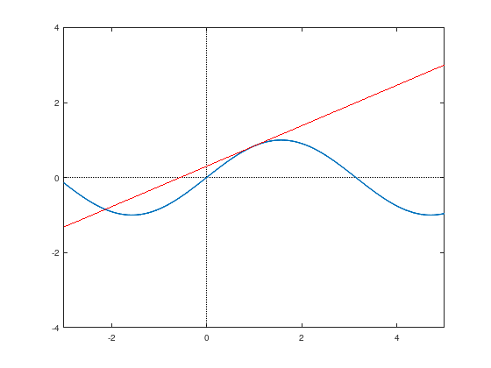
2. What are some of its applications?

Slide 23
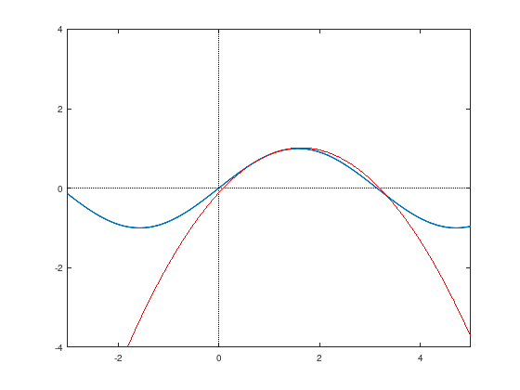
2. What are some of its applications?

Slide 24
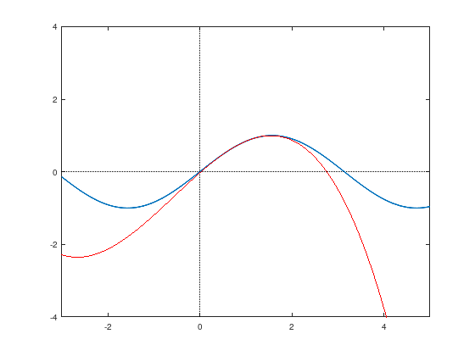
2. What are some of its applications?

Slide 25
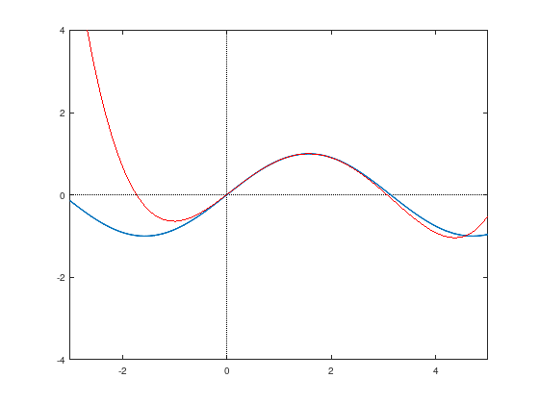
2. What are some of its applications?

Slide 26
2. What are some of its applications?

Slide 27
2. What are some of its applications?

Slide 28
2. What are some of its applications?

Slide 29
2. What are some of its applications?

Slide 30
2. What are some of its applications?

Slide 31
2. What are some of its applications?

Slide 32
2. What are some of its applications?

Slide 33
2. What are some of its applications?

Slide 34
3. Why should we all care about this?

Slide 35
3. Why should we all care about this?
I cannot imagine our world without Linearisation.

Slide 36
3. Why should we all care about this?

Slide 37
Thanks for watching
This is an entry in Swinburne University’s 2022 Mathstory competition
Slides and a Jupyter Notebook on this topic are available at: https://github.com/JasonThomasData/MathStory2022

