Slide 1

MGMT 599
M5 Demand Forecasting
A serverless analytics pipeline on AWS
59.2M rows · 3,049 products · 10 stores · 1,941 days
Jaewon Jang · Jason Tofte · Ross Roach
Summer 2026 · Supply Chain Track · Final Project
Notes:
Good afternoon. We are Group 5, Jaewon Jang, Jason Tofte and Ross Roach. Our project is a demand forecasting pipeline built on AWS using the Walmart M5 dataset. I will cover the problem, the data and the architecture. Jaewon covers the pipeline and the analytics, and Ross covers the models, the cost and the cloud trade-offs.

Slide 2
THE BUSINESS PROBLEM
The inventory decision we are supporting
Order too much
Order too little
Cash and shelf space are tied up in product that is not selling.
The sale is lost, and the customer may buy it somewhere else.
These two costs are not equal. A stockout usually costs more than the same unit of excess inventory, which is why we report forecast bias as well as error.
Stakeholder: the person who sets store-level stock levels. At the moment that decision is mostly based on judgement, and our goal is to give them a 28-day projection to work from.
Group 5 · M5 Demand Forecasting on AWS
2
Notes:
The decision we are supporting is easy to describe but hard to do at scale. A store inventory manager decides how much of each product to stock. Order too much and cash is tied up in product that is not selling. Order too little and the sale is lost. Those two costs are not equal, because a stockout usually costs more than the same unit of excess inventory, and that is why we report forecast bias and not just error. The manager makes this decision across thousands of products at once, mostly on judgement. We want to give them a 28-day projection to work from instead.

Slide 3
THE DATASET
Walmart M5 Forecasting Accuracy (Kaggle)
3,049
10
1,941
59.2M
products
stores across CA, TX, WI
days of history
item-store-day rows
Two corrections we made after validating the data
The columns are units sold
The dataset covers 10 stores
The daily columns record what sold, not what was on hand. The 68% of values that are zero are normal intermittent demand.
CA 4, TX 3, WI 3. With 3,049 items that is 30,490 separate demand series to forecast.
Group 5 · M5 Demand Forecasting on AWS
3
Notes:
The dataset is M5 Forecasting Accuracy from Kaggle, contributed by Walmart. It covers 3,049 products across 10 stores in three states, over 1,941 days. Reshaped, that is just over 59 million item, store and day rows. We made two corrections to our proposal after validating the data. First, the daily columns record units sold rather than inventory on hand, so the two thirds of values that are zero are normal intermittent demand. Second, the dataset covers ten stores rather than the three we originally wrote, which gives us 30,490 demand series.

Slide 4
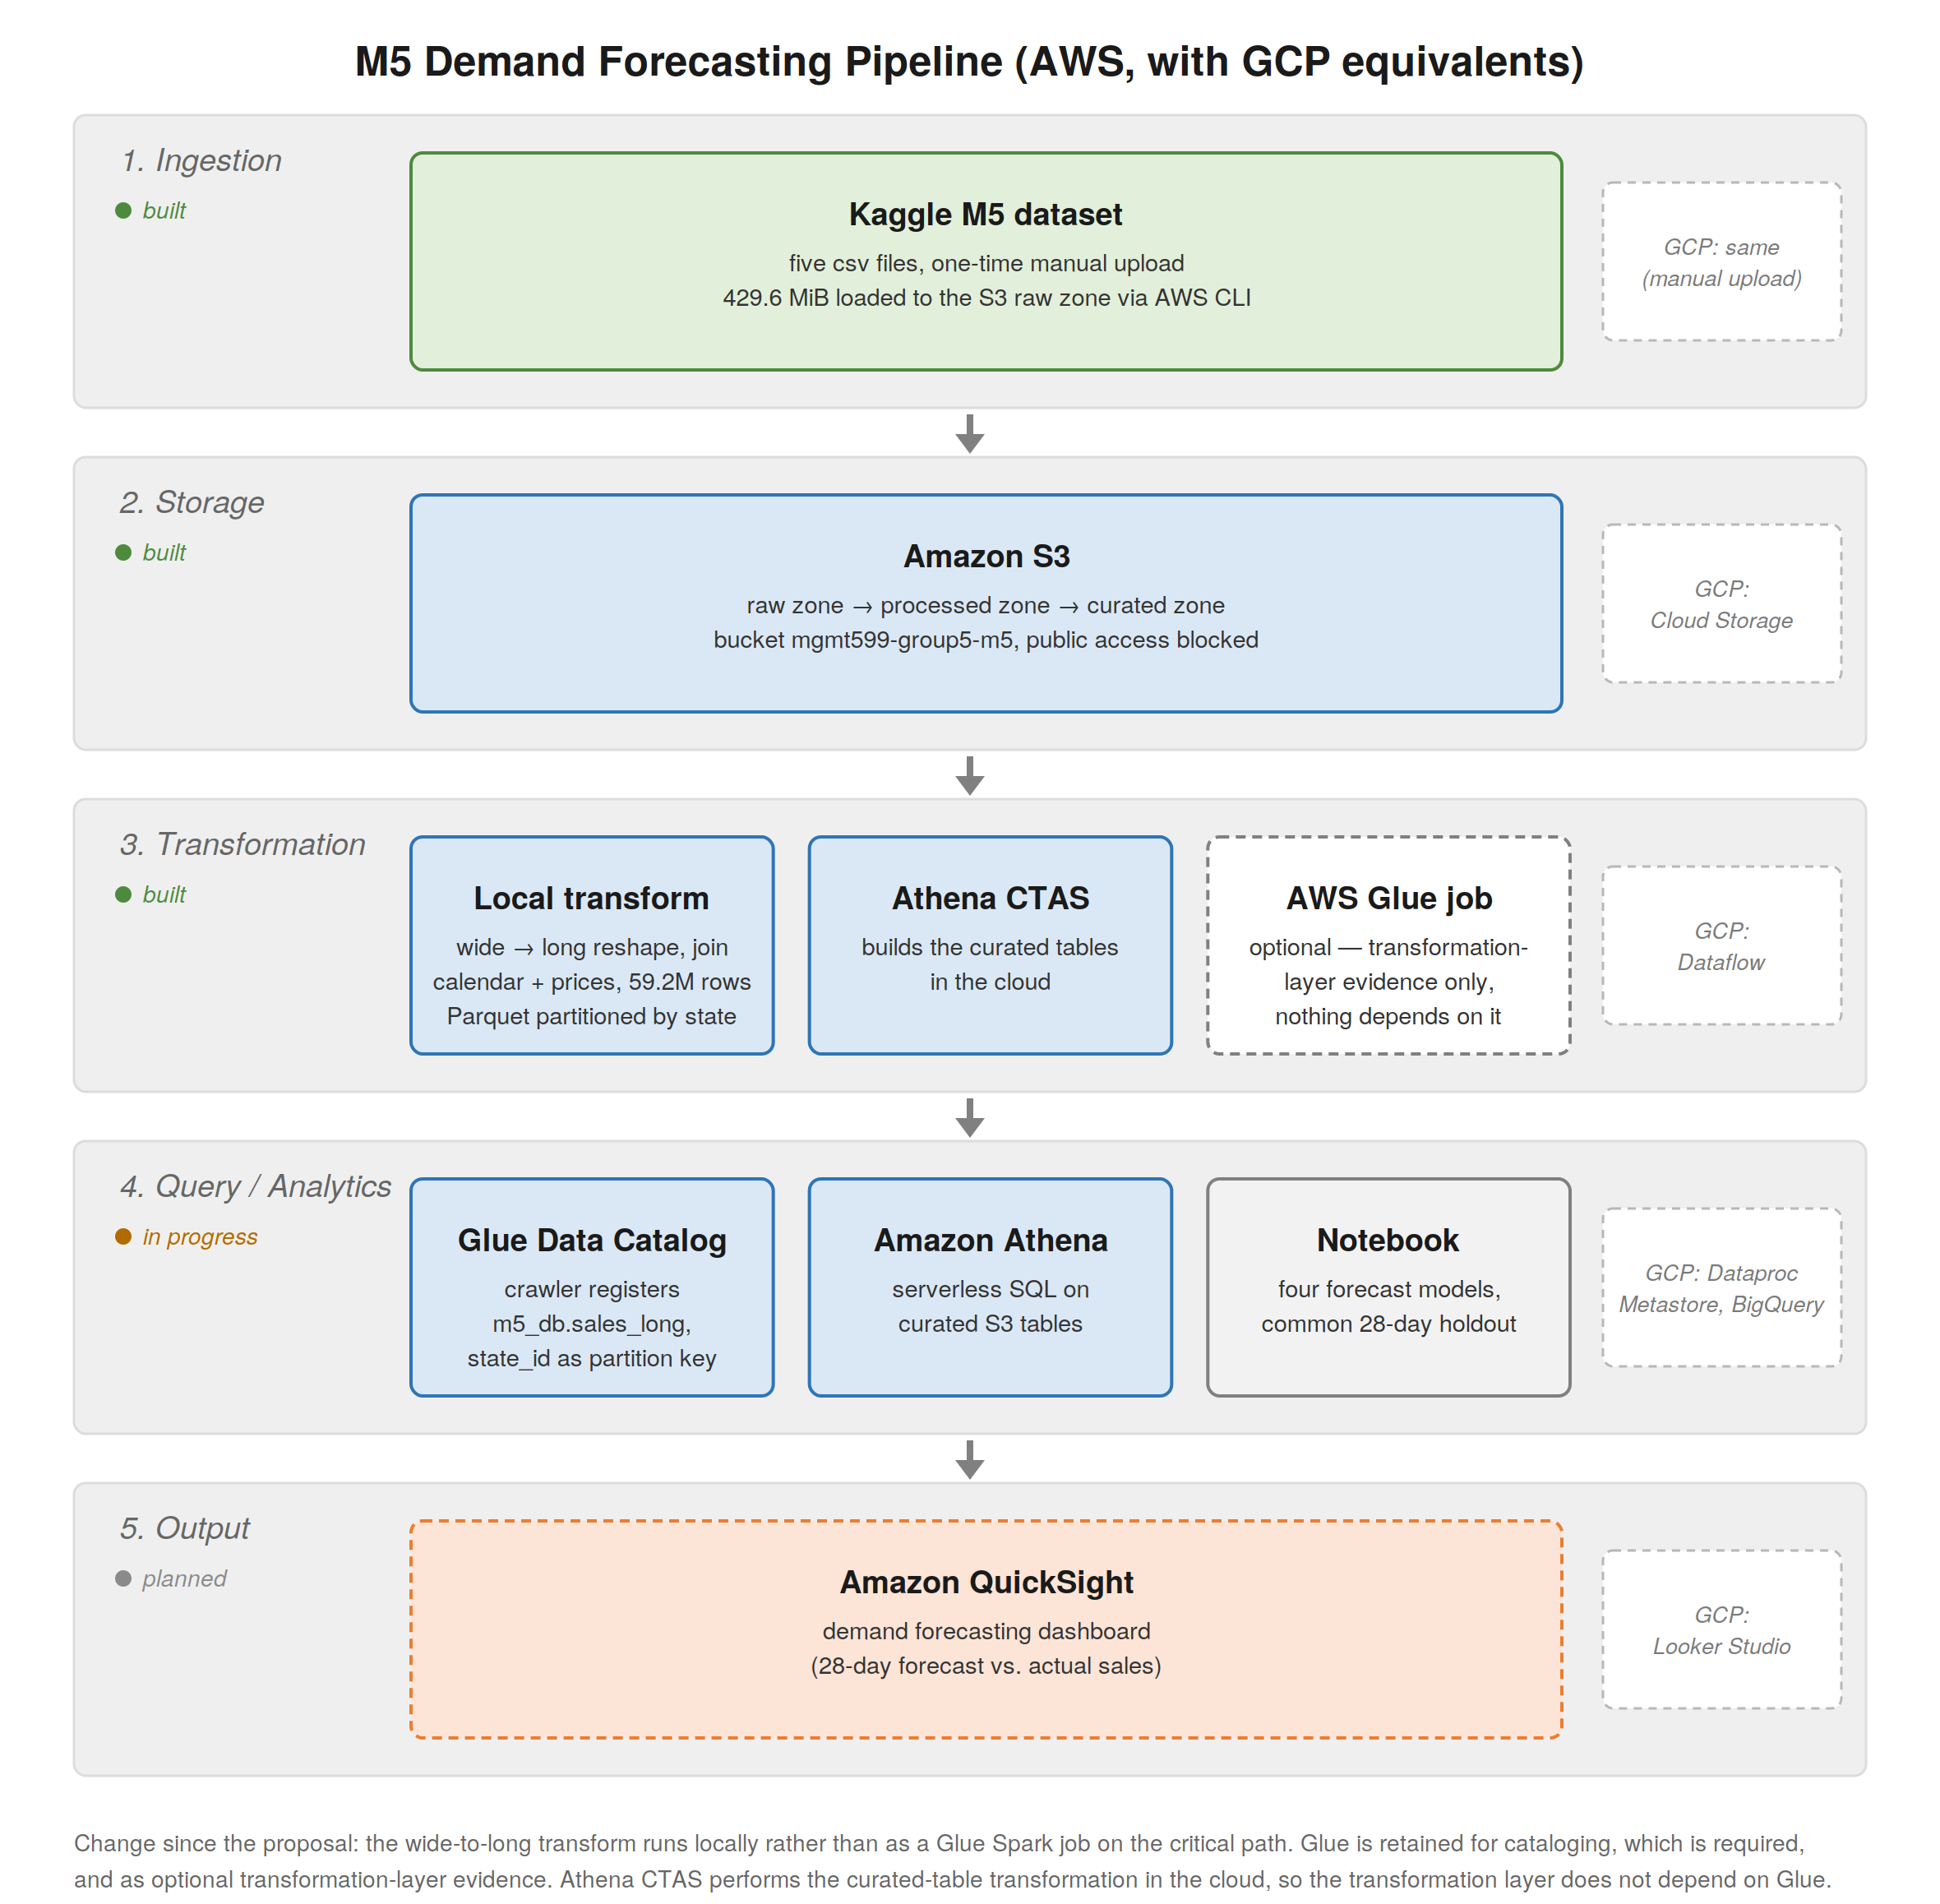
Five layers, built on AWS with GCP equivalents
1
Ingestion
CLI upload · 430 MB
2
Storage
S3 raw / processed / curated
3
Transformation
Local melt + Athena CTAS
4
Query
Glue Catalog + Athena + notebook
5
Output
QuickSight dashboard
A one-time CLI upload rather than a stream, because the dataset is fixed and never updates.
Group 5 · M5 Demand Forecasting on AWS
4
Notes:
The architecture has five layers. Ingestion is a one time upload of 430 megabytes into S3 using the CLI. We did it that way because the dataset is fixed and never updates, so a streaming service would only add complexity. S3 is the storage layer, split into raw, processed and curated zones. Transformation is a local reshape followed by Athena CTAS, with a Glue job as additional evidence. The Glue Data Catalog handles cataloging, Athena and a notebook handle the analytics, and QuickSight is the output. Every layer has a GCP equivalent, which Ross comes back to at the end.

Slide 5
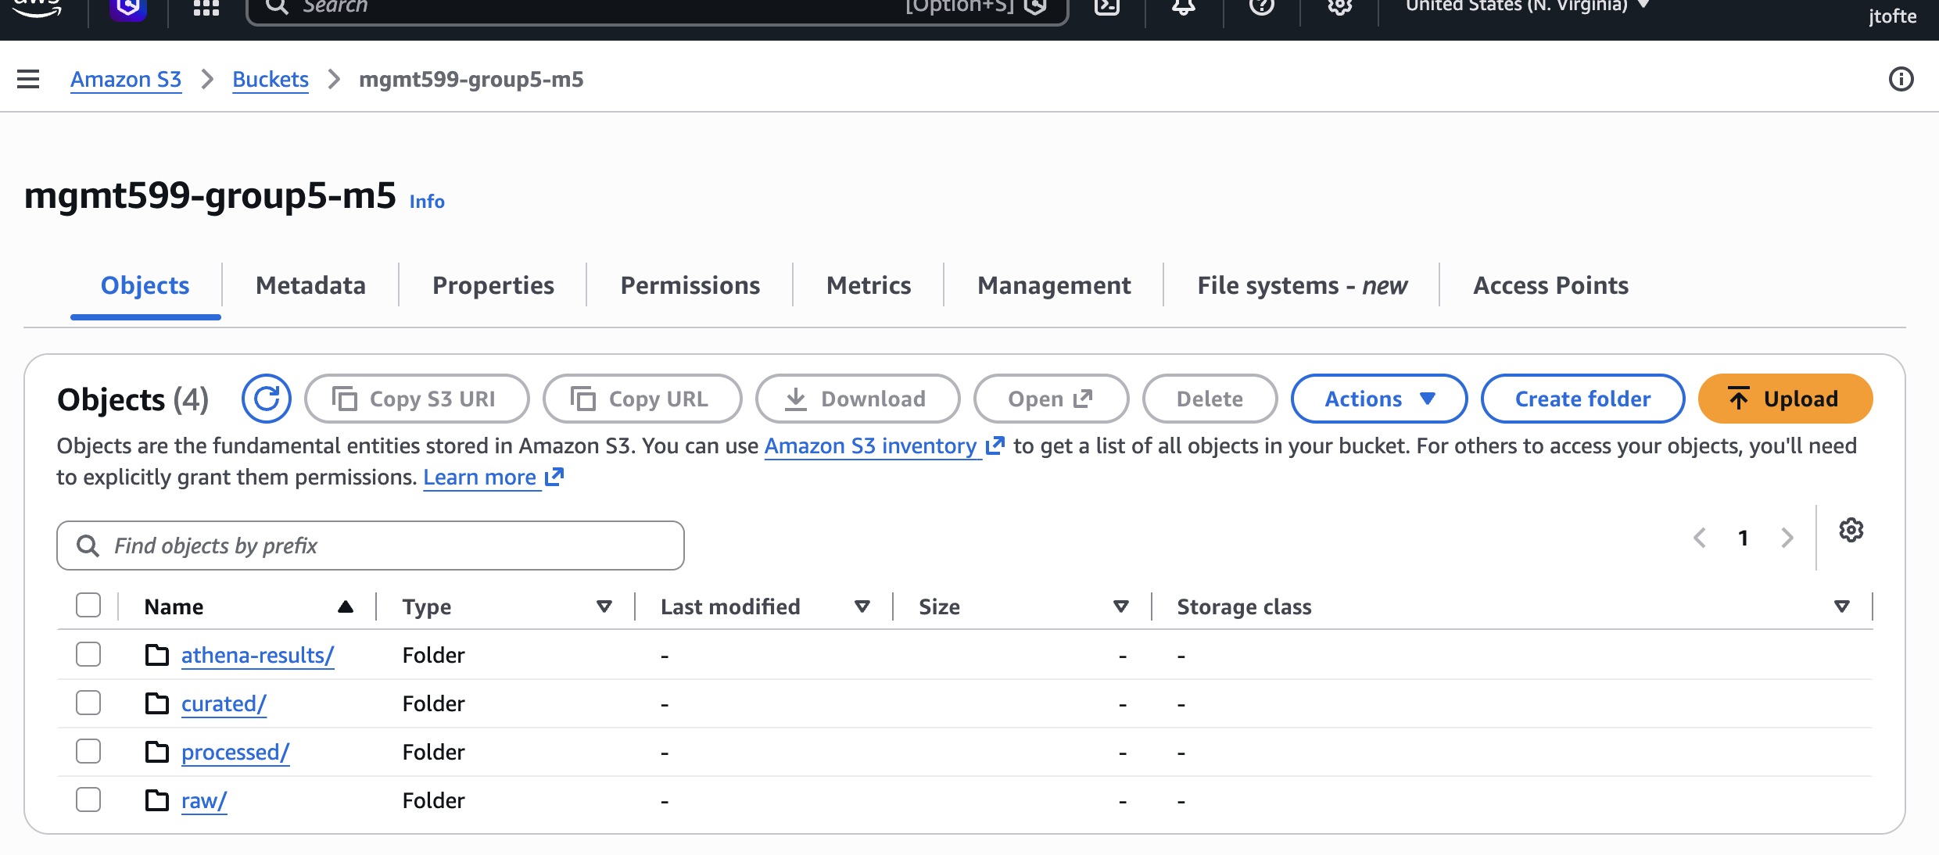
IMPLEMENTATION EVIDENCE
S3 storage zones and the raw upload
raw/
Five original CSVs, untouched
processed/
Snappy Parquet, partitioned by state
curated/
Serving tables for the dashboard
athena-results/
Query output location
Why we keep the raw files unchanged: if the transform is wrong we can start again from the original files, without downloading 430 MB from Kaggle a second time.
Group 5 · M5 Demand Forecasting on AWS
5
Notes:
This is the bucket in our account, with four prefixes: raw, processed, curated and athena-results. The raw zone holds the five original CSV files unchanged, because if we make a mistake during the transform we can start again without downloading 430 megabytes from Kaggle a second time. The processed zone holds the Parquet partitioned by state, and public access is blocked at the bucket. Jaewon will pick it up from the transform.

Slide 6
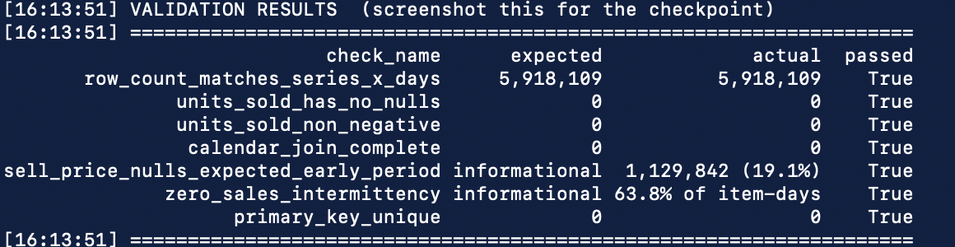
JAEWON
TRANSFORMATION
Why we moved the transform off the critical path
Proposed
Built
Glue Spark job on the critical path, so every downstream step was blocked until it succeeded.
Local reshape, then S3, crawler and Athena CTAS. Glue writes to a separate prefix as evidence.
The transform is a wide-to-long reshape of a 120 MB CSV and runs locally in 12 seconds. Glue takes the same setup at any data size, and it was the step most likely to fail. Athena CTAS is a cloud transformation, so the layer does not depend on Glue.
The transform will not write output unless these checks pass
This is the single-store run. The same checks run on all ten stores before anything is written to S3.
Group 5 · M5 Demand Forecasting on AWS
6
Notes:
Thanks Jason. The main change from our proposal is here. We originally had the transform running as a Glue Spark job on the critical path. But it is a reshape of a 120 megabyte CSV from wide to long, and it runs on a laptop in twelve seconds. Glue takes the same setup regardless of data size, and it was the step most likely to fail. So we moved it off. We transform locally, upload the Parquet, run the crawler, then use Athena CTAS for the curated tables. CTAS is a cloud transformation in its own right, so the layer does not depend on Glue. We still run the Glue job to a separate prefix as evidence. And the script will not write output unless the row count, primary key and null checks all pass.

Slide 7
JAEWON
DATA MODEL
One fact table at item × store × day
Property | Decision
Grain | One row per item, per store, per day. 59,181,090 rows
Primary key | (item_id, store_id, d). Three columns, not the two our proposal implied
Format | Snappy Parquet, partitioned by state_id (CA / TX / WI)
Price join | LEFT. The nulls mean the item was not being carried in that store yet.
A note on partitioning
Most of our queries aggregate across all three states, so partition pruning is not where the saving comes from. The cost reduction comes from columnar projection and compression, because a query that reads four of the sixteen columns only scans those four. Partitioning still helps the state-filtered queries.
Curated serving tables: daily_sales_agg · weekly_item_agg · forecast_vs_actual · data_quality_summary
Group 5 · M5 Demand Forecasting on AWS
7
Notes:
We have one fact table, at one row per item, per store, per day. The primary key is item, store and day. That is three columns rather than the two our proposal implied. The price join is a left join, and the nulls are meaningful: they tell us the item was not being carried in that store yet. One note on partitioning. We partition by state, but most of our queries aggregate across all three, so pruning is not where the saving comes from. It comes from columnar projection and compression.

Slide 8
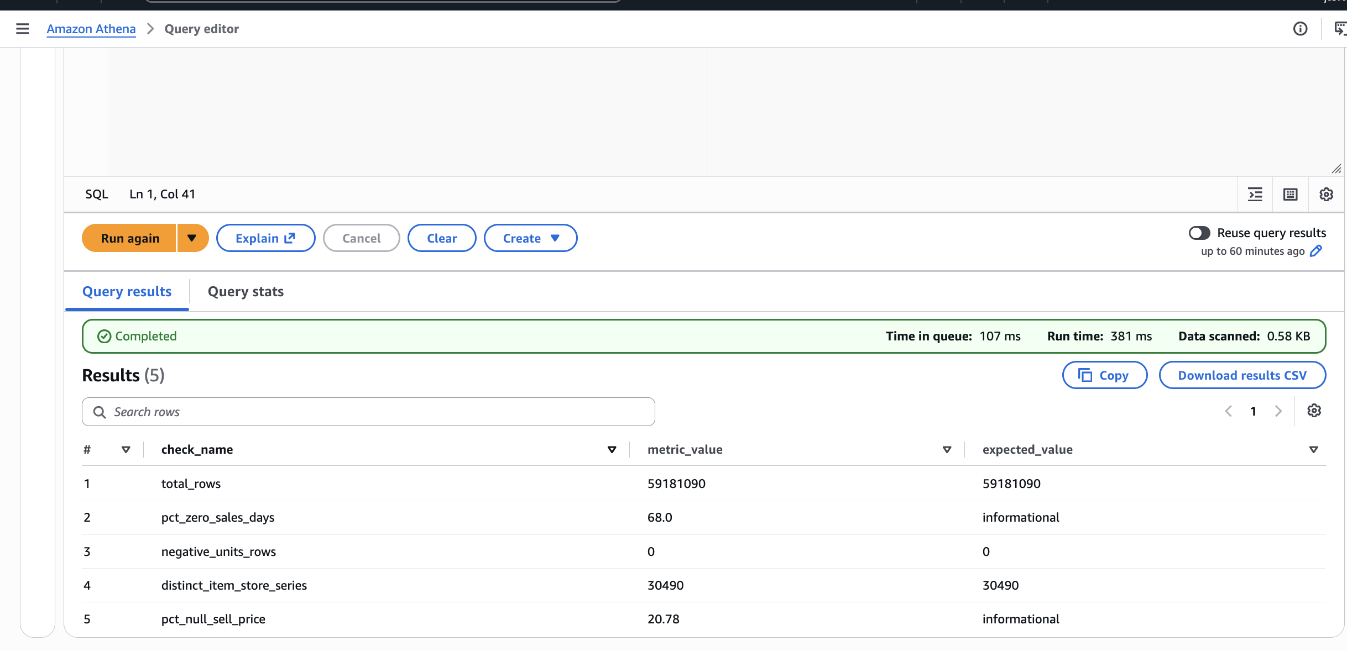
JAEWON
DATA QUALITY
Data quality checks run against the table
59,181,090
rows, matching the expected count
30,490
distinct item-store series
0
negative unit values
68.0%
zero-sales item-days, as expected
20.8%
null sell_price, item not yet carried
The last two are flagged as informational rather than as failures. Both are expected for this kind of retail data, and we would rather report them than leave them out.
Group 5 · M5 Demand Forecasting on AWS
8
Notes:
We ran the data quality checks as queries against the actual table. The row count matches exactly at 59,181,090, there are 30,490 distinct series, and no negative units. Two results are flagged informational rather than as failures. 68 percent of item days are zero, and 21 percent of rows have no price. Both are expected for this kind of retail data, and we would rather report them than leave them out.

Slide 9
JAEWON
ANALYTICS
Category volume and price sensitivity
Volume concentrates in FOODS
Demand falls slowly as price rises
FOODS is 68.6% of units but only 58% of revenue, so HOUSEHOLD is earning more per unit sold. Average daily units peak around the fourth decile and fall to 1.48 at the top, which is about 8% across the range, on nearly 1.85M observations per decile.
Group 5 · M5 Demand Forecasting on AWS
9
Notes:
Two findings. Volume is concentrated in FOODS, which is 68.6 percent of units but only 58 percent of revenue, so HOUSEHOLD earns more per unit sold. That matters because a forecast built around unit volume alone would underserve the category with the better margin. Price does affect demand, but not by much. Average daily units peak around the fourth decile then fall to 1.48, about eight percent across the range, on nearly two million observations per decile. It is a real effect but a small one.

Slide 10
JAEWON
KEY FINDING
SNAP benefit days lift FOODS demand
Why we think the effect is real
If this were just a busier day overall, all three categories would rise together.
They do not. FOODS moves 10 to 30%, while the others move very little.
SNAP dates are published in advance, so we can use this as a feature in the forecast.
% lift in average daily units on SNAP days vs. normal days
Group 5 · M5 Demand Forecasting on AWS
10
Notes:
This is the finding we would put in front of a stakeholder. On SNAP benefit days FOODS demand is 30 percent higher in Wisconsin, 15.6 percent higher in Texas and 10.2 percent higher in California. HOUSEHOLD and HOBBIES move between two and four percent. That difference tells us the effect is real rather than a busier day overall, because if it were a general increase all three categories would move together, and they do not. SNAP dates are published in advance, so we can use this as a forecast feature. Ross will take the models.

Slide 11
ROSS
FORECASTING
Four models on a common 28-day holdout
01
Naive
Carry the last observed value forward
Avoiding leakage
Lag features never go below 28 days, so no test row can see an actual value from inside the holdout window.
02
Seasonal naive
Same weekday four weeks earlier
03
Weekday mean
Per-item average for that weekday in the training period
Why we report bias
04
Gradient boosting
Calendar, price, SNAP and lag features
A model that is accurate on average but under-forecasts consistently is worse than its RMSE suggests, because a stockout costs more than the excess unit.
All four scored on the same 28-day holdout · scoped to FOODS in California
Group 5 · M5 Demand Forecasting on AWS
11
Notes:
Thanks Jaewon. We ran four models on the same 28-day holdout: a naive model carrying the last value forward, a seasonal naive using the same weekday four weeks earlier, a per item weekday mean, and gradient boosting on calendar, price, SNAP and lag features. The lag features never go below 28 days, so no test row can see an actual value from inside the holdout. And we report bias alongside RMSE, because a stockout and overstock do not cost the same.

Slide 12
ROSS
RESULTS
Gradient boosting performed best on all three measures
Model | RMSE | MAE | Bias
Naive (last value) | 3.5710 | 1.9421 | +0.466
Seasonal naive (28d) | 3.3399 | 1.7487 | -0.0855
Weekday mean | 3.1034 | 1.5828 | -0.3644
Gradient boosting | 2.6635 | 1.4674 | -0.0634
20.3%
lower RMSE than the
seasonal naive baseline
Also best on MAE, 16.1% better, and the smallest bias of the four.
Scored on the same 28-day holdout · FOODS in California · lower is better
Why we report bias
Consistent with M5
The weekday mean has the second best RMSE but under-forecasts by 0.36 units per item-day. For a manager more worried about stockouts, that makes it worse than its RMSE position suggests.
The competition winner also used gradient boosting, and the top five finishers beat the best statistical benchmark by more than 20%. Our 20.3% is in line with that.
Group 5 · M5 Demand Forecasting on AWS
12
Notes:
Gradient boosting was best on all three measures. RMSE is 2.66 against 3.34 for the seasonal naive, a 20.3 percent improvement, with the smallest bias at minus 0.06. That is in line with the M5 competition, where the winner also used gradient boosting and the top five beat the best benchmark by over 20 percent. Look at the weekday mean as well. It has the second best RMSE but under forecasts by 0.36 units per item day, which for a manager worried about stockouts makes it worse than its RMSE position suggests.

Slide 13
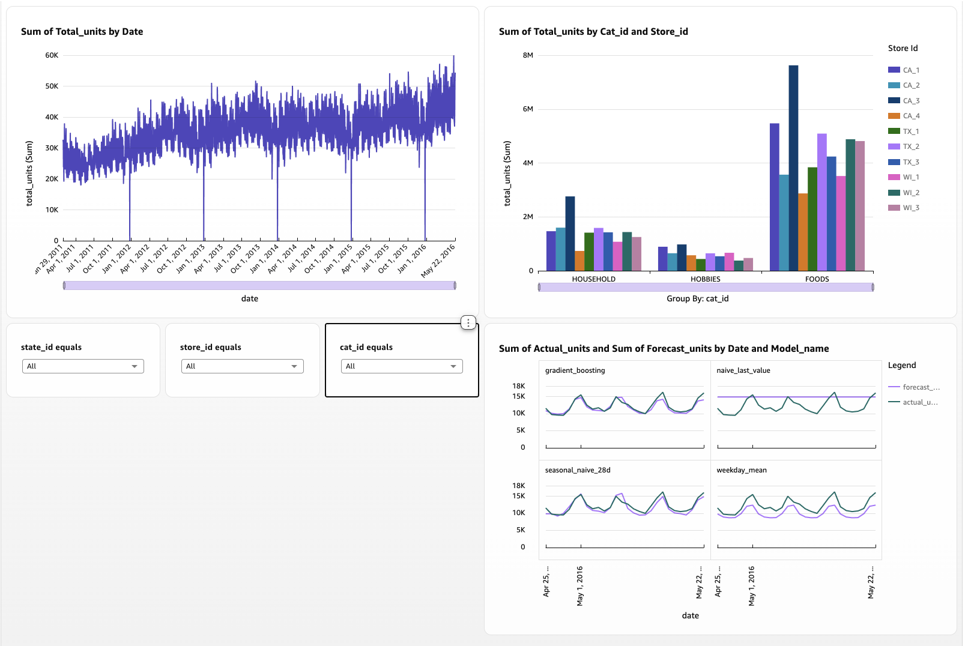
ROSS
OUTPUT LAYER
The QuickSight dashboard
Built on daily_sales_agg
135,870 rows at day, store and department grain, rather than the 59.2M-row fact table, which would rescan on every filter change.
How it gets used
Filter to a store and category, read the 28-day forecast total, compare against current stock, decide whether to order.
Group 5 · M5 Demand Forecasting on AWS
13
Notes:
This is the output layer. The dashboard is built on daily_sales_agg, 135,870 rows, rather than the 59 million row fact table, which would rescan on every filter change. You filter to a store and a category, read the 28-day forecast, compare it against stock on hand, and decide whether to order.

Slide 14
ROSS
COST
Total cost and how we controlled it
Parquet + Snappy
< $10
Our heaviest query scanned 194 MB, against Athena's charge of $5 per TB.
total project spend
Curated aggregates
budget alert set before any
resource was created
The dashboard reads 135,870 rows rather than 59.2M.
Serverless only
No always-on warehouse, and the notebook runs locally rather than on a billed instance.
Staged alerts
A $10 ceiling with $2 increments beneath it, so we could see where the spend was coming from.
Athena was not the cost risk. The risks were resources left running, such as a QuickSight subscription or a notebook instance. The teardown steps are documented.
Group 5 · M5 Demand Forecasting on AWS
14
Notes:
We spent under ten dollars. We set the budget alert before creating any resources, with two dollar increments underneath so we could see where the spend was coming from. Parquet with Snappy keeps the data Athena scans low. Our heaviest query scanned 194 megabytes, and Athena charges five dollars a terabyte. Athena was not the cost risk. The risk was resources left running, and the teardown steps are documented.

Slide 15
ROSS
TRADE-OFFS
AWS and GCP trade-offs
Layer | AWS (built) | GCP equivalent
Storage | S3, zoned | Cloud Storage
Transformation | Local melt + Athena CTAS | Dataflow
Catalog | Glue Data Catalog | Dataproc Metastore
Query | Athena | BigQuery
Output | QuickSight | Looker Studio
Athena and BigQuery
Both are serverless and both charge per query, so the cost model is very similar.
The main difference
BigQuery is a managed warehouse with its own storage, so you would normally load the data into it. Athena reads the files where they are, which suited a fixed dataset we did not want to duplicate.
Why AWS: it is the platform we used during the course. Nothing in the design is specific to AWS, and the layer boundaries would stay the same on GCP.
Group 5 · M5 Demand Forecasting on AWS
15
Notes:
The same pipeline maps onto GCP without much difficulty. Cloud Storage replaces S3, Dataflow replaces Glue, BigQuery replaces Athena, and Looker Studio replaces QuickSight. Athena and BigQuery are the closest match, because both are serverless and charge per query. The main difference is that BigQuery has its own storage, so you would load the data into it, whereas Athena reads the files where they are. That suited a fixed dataset we did not want to duplicate. We chose AWS because it is the platform we used during the course.

Slide 16
LIMITATIONS AND NEXT STEPS
Limitations and what we would do next
Scoped to one category
The models cover FOODS in California rather than all 30,490 series, because a single model covering every series runs into memory limits.
RMSE instead of WRMSSE
We used RMSE instead of the competition metric, which we think is reasonable at this scope as long as we say so.
The dataset is static
We have built a working architecture rather than something running in production.
Next: scheduled ingestion · per-store models · probabilistic rather than point forecasts
A stock decision is better served by a range than a single number.
github.com/JasonTofte/mgmt599-group5-m5-forecasting
Generative AI was used for drafting, debugging and diagram structure. All statistics come from our own queries against our own data.
Notes:
A few limitations. The models are scoped to FOODS in California rather than all 30,490 series, because a single model covering every series runs into memory limits. We used RMSE instead of the competition's WRMSSE, which is reasonable at this scope as long as we say so. And the dataset is static, so we have built a working architecture rather than something running in production. If we carried on we would add scheduled ingestion, models per store, and probabilistic forecasts, because a stock decision is better served by a range. Everything is in the repository. Thank you.

