Slide 1


A Case for Grid Computing on Virtual Machines
Renato Figueiredo
Assistant Professor
ACIS Laboratory, Dept. of ECE
University of Florida
José Fortes
ACIS Laboratory, Dept. of ECE
University of Florida
Peter Dinda
Prescience Lab, Dept. of Computer Science
Northwestern University

Slide 2
The “Grid problem”
“Flexible, secure, coordinated resource sharing among dynamic collections of individuals, institutions, and resources” ¹
¹ “The Anatomy of the Grid: Enabling Scalable Virtual Organizations”, I. Foster, C. Kesselman, S. Tuecke. International J. Supercomputer Applications, 15(3), 2001

Slide 3
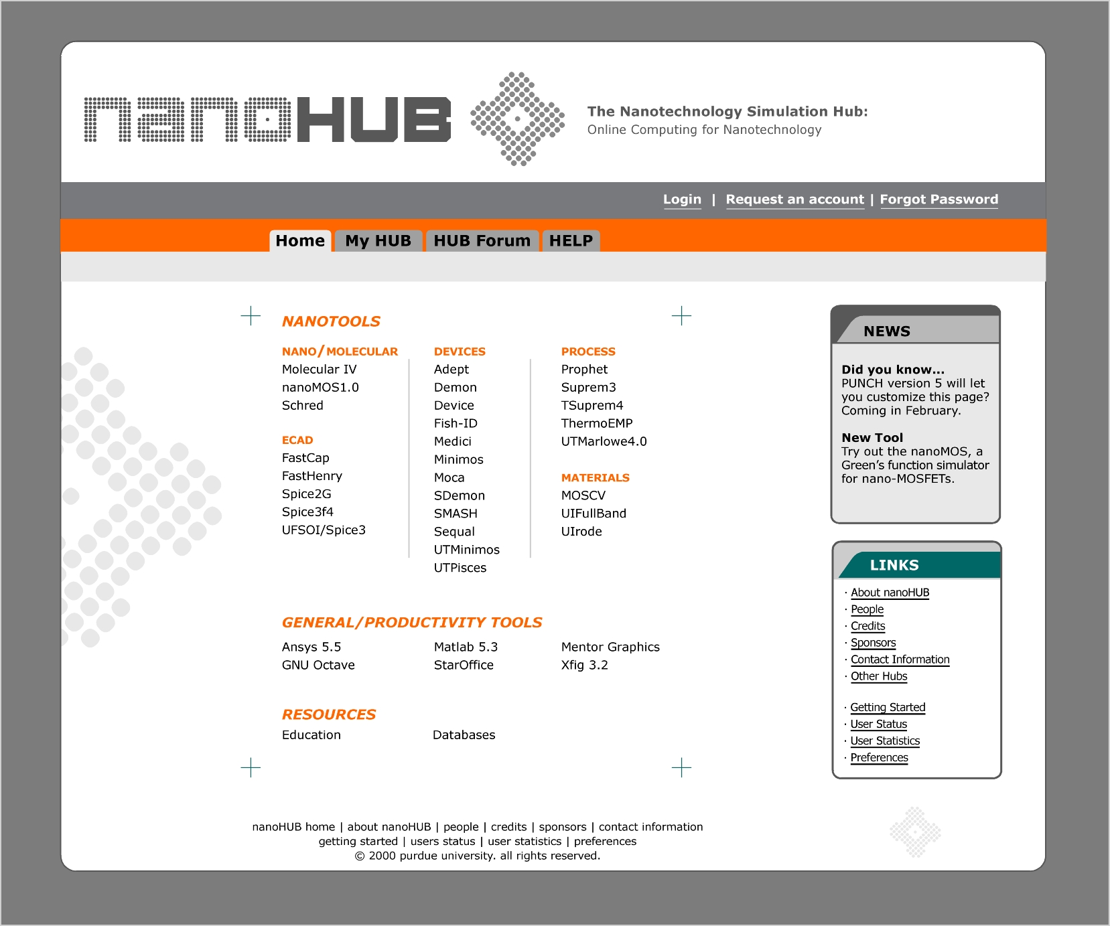
Example – PUNCH
Since 1995
>1,000 users
>100,000 jobs
Kapadia, Fortes,
Lundstrom, Adabala,
Figueiredo et al
www.punch.purdue.edu

Slide 4
Resource sharing
Traditional solutions:
  Multi-task operating systems
  User accounts
  File systems
Evolved from centrally-admin. domains
  Functionality available for reuse
    However, Grids span administrative domains

Slide 5


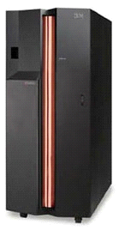
Sharing – owner’s perspective
I own a resource (e.g. cluster) and wish to sell/donate cycles to a Grid
  User “A” is trusted and uses an environment common to my cluster
  If user “B” is not to be trusted?
    May compromise resource, other users
  If user “C” has different O/S, application needs?
    Administrative overhead
    May not be possible to support “C” without dedicating resource or interfering with other users
B
C
A

Slide 6
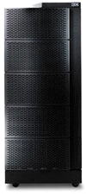
Sharing – user’s perspective
I wish to use cycles from a Grid
  I develop my apps using standard Grid interfaces, and trust users who share resource A
  If I have a grid-unaware application?
    Provider B may not support the environment my application expects: O/S, libraries, packages, …
  If I do not trust who is sharing a resource C?
    If another user compromises C’s O/S, they also compromise my work
A
B
C

Slide 7
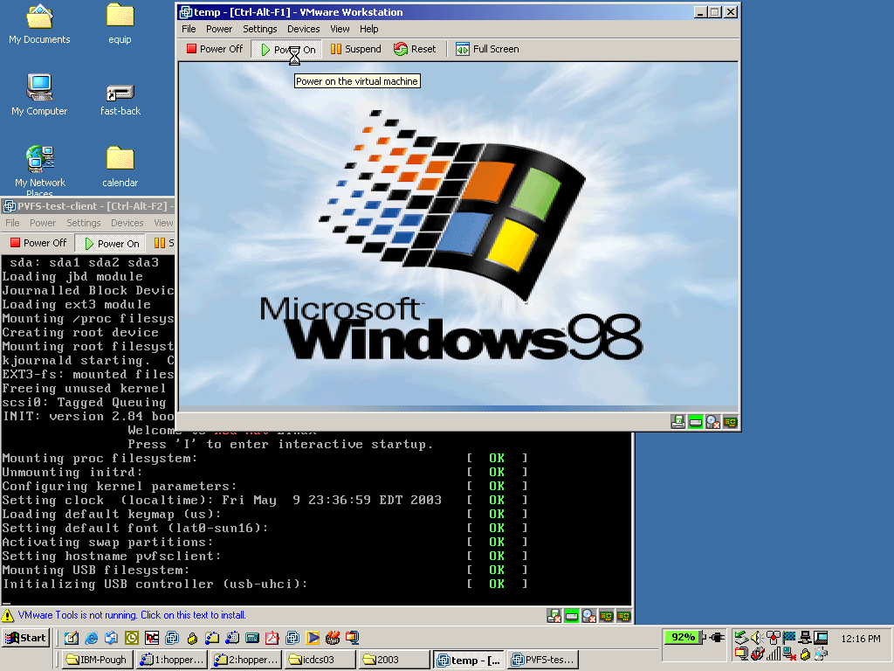
Alternatives?
“Classic” Virtual Machines (VMs)
  Virtualization of instruction sets (ISAs)
    Language-independent, binary-compatible (not JVM)
  70’s (IBM 360/370..) – 00’s (VMware, Connectix, zVM)

Slide 8
“Classic” Virtual Machines
“A virtual machine is taken to be an efficient, isolated, duplicate copy of the real machine” ²
  “A statistically dominant subset of the virtual processor’s instructions is executed directly by the real processor” ²
  “…transforms the single machine interface into the illusion of many” ³
  “Any program run under the VM has an effect identical with that demonstrated if the program had been run in the original machine directly” ²
² “Formal Requirements for Virtualizable Third-Generation Architectures”, G. Popek and R. Goldberg, Communications of the ACM, 17(7), July 1974
³ “Survey of Virtual Machine Research”, R. Goldberg, IEEE Computer, June 1974

Slide 9
VMs for Grid computing
Security
  VMs isolated from physical resource, other VMs
Flexibility/customization
  Entire environments (O/S + applications)
Site independence
  VM configuration independent of physical resource
Binary compatibility
Resource control
VM2
(Win98)
Physical
(Win2000)
VM1
(Linux RH7.3)

Slide 10
Outline
Motivations
VMs for Grid Computing
  Architecture
  Challenges
Performance analyses
Related work
Outlook and conclusions

Slide 11
How can VMs be deployed?
Statically
  Like any other node on the network, except it is virtual
  Not controlled by middleware
Dynamically
  May be created, terminated by middleware
  User-customized
    Per-user state, persistent
      A personal, virtual workspace
  One-for-many, “clonable”
    State shared across users; non-persistent
      Sandboxes; application-tailored nodes

Slide 12
Architecture – dynamic VMs
Indirection layer:
  Physical resources: where virtual machines are instantiated
  Virtual machines: where application execution takes place
Coordination: Grid middleware

Slide 13
Middleware
Abstraction: VM consists of a process (VMM) and data (system image)
  Core middleware support is available
VM-raised challenges
  Resource and information management
    How to represent VMs as resources?
    How to instantiate, configure, terminate VMMs?
  Data management
    How to provide (large) system images to VMs?
    How to access user data from within VM instances?

Slide 14
Image management
Proxy-based Grid virtual file systems
  On-demand transfers (NFS virtualization)
    RedHat 7.3: 1.3GB, <5% reboot+exec SpecSEIS
  User-level extensions for client caching/sharing
    Shareable (read) portions
NFS protocol
proxy
proxy
inter-proxy extensions
ssh tunnel
disk cache
VM image
NFS
client
NFS
server
[HPDC’2001]

Slide 15
Resource management
Extensions to Grid information services (GIS)
  VMs can be active/inactive
  VMs can be assigned to different physical resources
URGIS project
  GIS based on the relational data model
  Virtual indirection
    Virtualization table associates unique id of virtual resources with unique ids of their constituent physical resources
  Futures
    An URGIS object that does not yet exist
    Futures table of unique ids

Slide 16
GIS extensions
Compositional queries (joins)
  “Find physical machines which can instantiate a virtual machine with 1 GB of memory”
  “Find sets of four different virtual machines on the same network with a total memory between 512 MB and 1 GB”
Virtual/future nature of resource hidden unless query explicitly requests it

Slide 17
Example: In-VIGO virtual workspace
User request
Information
service
User ‘Y’
2: query
(data, image, compute server)
7: VNC X-window,
HTTP file
manager
5: copy/access
user data
V1
X
isolation
1: user request
4: start VM
3: setup
VM image
User ‘X’
6: return handler
to user (URL)
Front
end ‘F’
Y
Physical server
pool P
V2
How fast to instantiate?
Run-time overhead?
Image
Server I
Data
Server D1
Data
Server D2

Slide 18
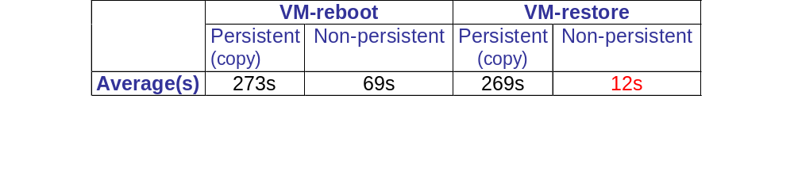
Performance – VM instantiation
Instantiate VM “clone” via Globus GRAM
  Persistent (full copy) vs. non-persistent (link to base disk, writes to separate file)
    Full state copying is expensive
  VM can be rebooted, or resumed from checkpoint
    Restoring from post-boot state has lower latency
Experimental setup: physical: dual Pentium III 933MHz, 512MB memory, RedHat 7.1, 30GB disk; virtual: Vmware Workstation 3.0a, 128MB memory, 2GB virtual disk, RedHat 2.0

Slide 19
Performance – VM instantiation
Local and mounted via virtual file system
  Disk caching – low latency
Startup | Disk | Grid Virtual FS | LAN | WAN
Reboot | 48s | Cache: cold | 121s | 434s
 |  | Cache: warm | 52s | 56s
Resume | 4s | Cache: cold | 80s | 1386s
 |  | Cache: warm | 7s | 16s
Experimental setup: Physical client is a dual Pentium-4, 1.8GHz, 1GB memory, 18GB
Disk, RedHat 7.3. Virtual client: 128MB memory, 1.3GB disk, RedHat 7.3. LAN server
is an IBM zSeries virtual machine, RedHat 7.1, 32GB disk, 256MB memory. WAN server
is a VMware virtual machine, identical configuration to virtual client. WAN GridVFS
is tunneled through ssh between UFL and NWU.

Slide 20
Performance – VM run-time
Small relative
virtualization
overhead;
compute-intensive
Application | Resource | ExecTime (10^3 s) | Overhead
SpecHPC Seismic (serial, medium) | Physical | 16.4 | N/A
 | VM, local | 16.6 | 1.2%
 | VM, Grid virtual FS | 16.8 | 2.0%
SpecHPC Climate (serial, medium) | Physical | 9.31 | N/A
 | VM, local | 9.68 | 4.0%
 | VM, Grid virtual FS | 9.70 | 4.2%
Experimental setup: physical: dual Pentium III 933MHz, 512MB memory, RedHat 7.1,
30GB disk; virtual: Vmware Workstation 3.0a, 128MB memory, 2GB virtual disk, RedHat 2.0
NFS-based grid virtual file system between UFL (client) and NWU (server)

Slide 21
Related work
Entropia virtual machines
  Application-level sandbox via Win32 binary modifications; no full O/S virtualization
Denali at U. Washington
  Light-weight virtual machines; ISA modifications
CoVirt at U. Michigan; User Mode Linux
  O/S VMMs, host extensions for efficiency
“Collective” at Stanford
  Migration and caching of personal VM workspaces
Internet Suspend/Resume at CMU/Intel
  Migration of VM environment for mobile users; explicit copy-in/copy-out of entire state files

Slide 22
Outlook
Interconnecting VMs via virtual networks
  Virtual nodes: VMs
  Virtual switches, routers, bridges: host processes
  Virtual links: tunneling through physical resources
    Layer-3 virtual networks (e.g. VPNs)
    Layer-2 virtual networks (virtual bridges)
“In-VIGO”
  On-demand virtual systems for Grid computing

Slide 23
Conclusions
VMs enable fundamentally different approach to Grid computing:
  Physical resources – Grid-managed distributed providers of virtual resources
  Virtual resources – engines where computation occurs; logically connected as virtual network domains
  Towards secure, flexible sharing of resources
Demonstrated feasibility of the architecture
  For current VM technology, compute-intensive tasks
    On-demand transfer; difference-copy, resumable clones; application-transparent image caches

Slide 24
Acknowledgments
NSF Middleware Initiative
  http://www.nsf-middleware.org
NSF Research Resources
IBM Shared University Research
VMware
Ivan Krsul, In-VIGO and Virtuoso teams at UFL/NWU
  http://www.acis.ufl.edu/vmgrid
  http://plab.cs.northwestern.edu

