Slide 1
Vectorize Me!
Case Study in Vectorization of
Technical Strategy Python Code
David Byrd (2016)
Georgia Institute of Technology

Slide 2
Assignment
Create and code:
Technical Indicator (can be compound)
Trading strategy based on the indicator
Input: date range & symbols. Output: orders file.
start_date = dt.datetime(2005,01,01)
end_date = dt.datetime(2011,12,31)
symbols = ['GOOG', 'AAPL', 'GLD', 'XOM', 'HD', ‘VZ', 'KO']
lookback = 14
build_orders(symbols, start_date, end_date, lookback)
IN
2005-01-31 AAPL SELL 100
2005-02-03 XOM SELL 100
2005-03-03 AAPL BUY 100
2005-03-09 AAPL BUY 100
2005-03-09 XOM BUY 100
OUT

Slide 3
Indicator
“Basket” indicator
Looks for divergence between stock and index
Constituents
Price/SMA ratio
Bollinger Bands® %
Relative Strength Index

Slide 4
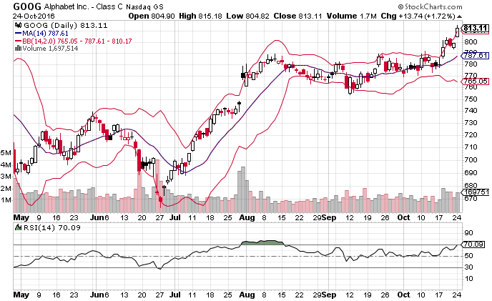

Slide 5
Strategy
Go long when:
Symbol is oversold, index is not.
Go short when:
Symbol is overbought, index is not.
Close positions when:
Symbol crosses through its SMA.
Divergence strategy

Slide 6
Indicator Details
Call symbol overbought when:
Price/SMA ratio > 1.05
Bollinger Band % > 1
RSI > 70
Call symbol oversold when:
Price/SMA ratio < 0.95
Bollinger Band % < 0
RSI < 30

Slide 7
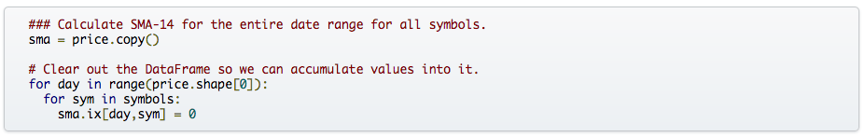
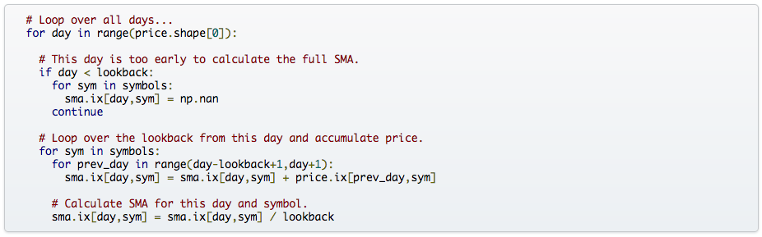
Iteration: The Easy Way
Create SMA array. Zero it out. (The copy is not the bad part of this!)
Calculate SMA in a triple-nested for loop.

Slide 8
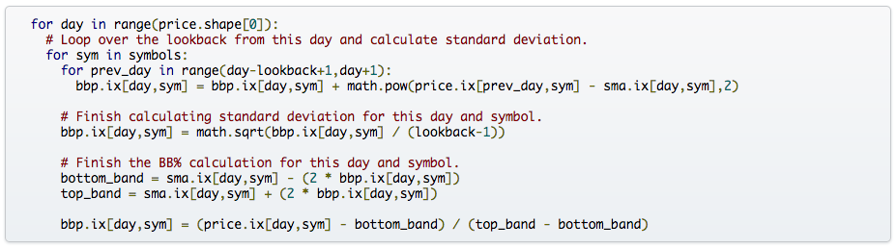
Calculate Bollinger Bands, then BB%.
Turn SMA into Price/SMA ratio.

Slide 9
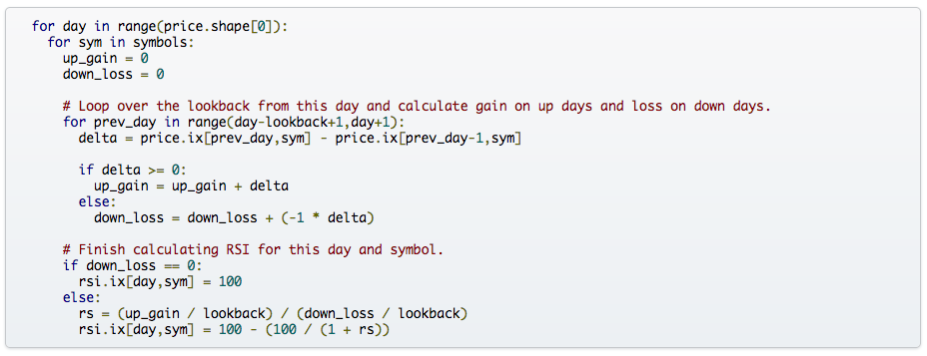
Calculate Relative Strength, then RSI.

Slide 10
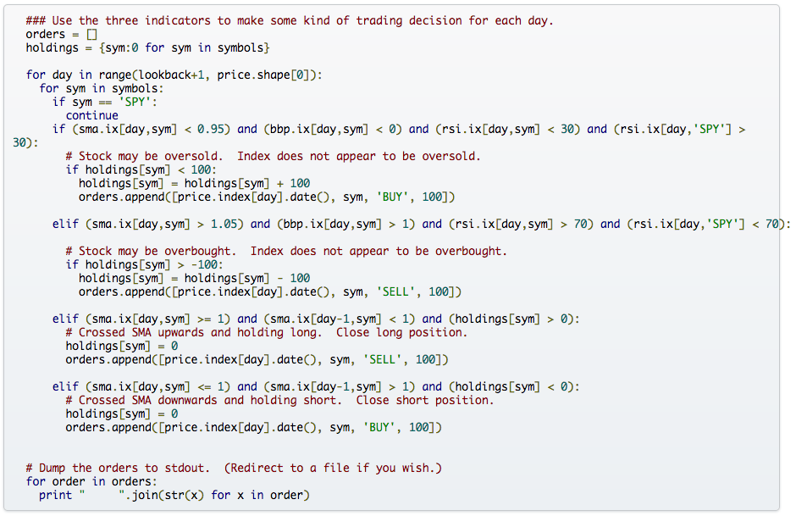
Applying the basket indicator and executing the strategy.

Slide 11
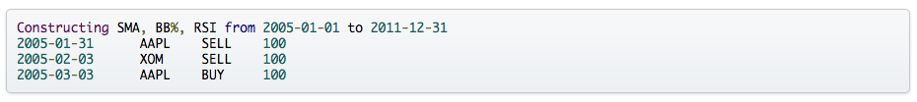
It Works!
Output contains 188 orders over the 7 years.
But S-L-O-W-L-Y…
real 5m24.461s
user 5m24.281s
sys 0m0.185s

Slide 12
What’s the problem?
We’re examining:
7 years of daily data
7 stocks
3 simple indicators
14 period lookback
It takes over 5 minutes on a Core i7 Quad
Parts of our algorithm are O(n³) at least
What happens if we want minute data? 500 stocks? 50 indicators? 60 period lookback?

Slide 13

Image from: imgflip.com

Slide 14
So: Vectorize Me!
Low hanging fruit: triple-nested loops!
real 1m50.948s
user 1m50.830s
sys 0m0.120s
66% faster!

Slide 15
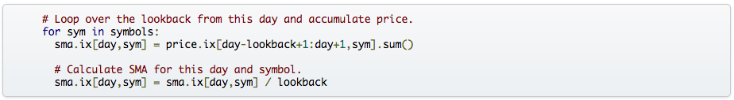
More easy fixes: clear the array with broadcasting.
Eliminate the inner for loops again!
Keep checking that your output hasn’t changed! (diff it)
real 1m11.534s
user 1m11.428s
sys 0m0.106s
35% faster!

Slide 16
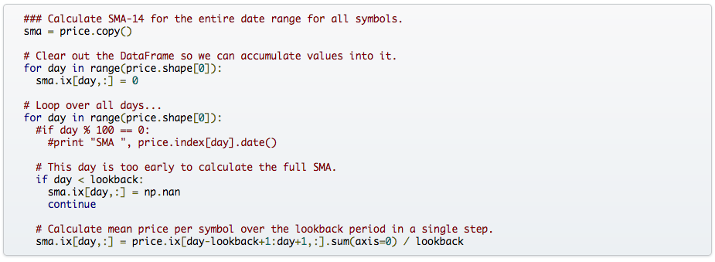
Eliminate final SMA loop: fully vectorized!
Or equivalently:

Slide 17
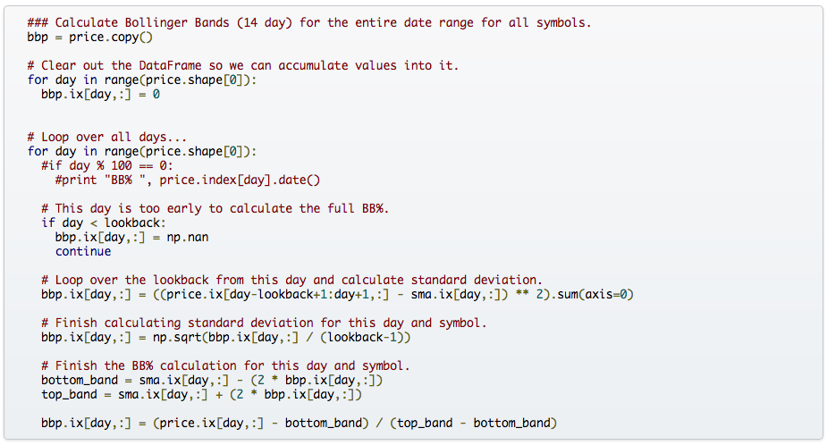
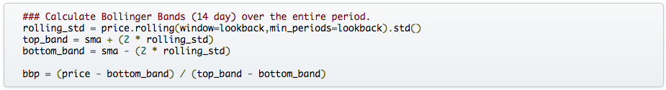
Eliminate final BB% loop: fully vectorized!

Slide 18
Vectorize the SMA -> Price/SMA calculation.
Start dealing with RSI. Terrible redundancy in inner loop.
The above requires pre-calculating “delta” (daily returns) prior to the iteration.
This is still a triple-nested loop, but:
real 0m38.587s
user 0m38.481s
sys 0m0.106s
46% faster!

Slide 19
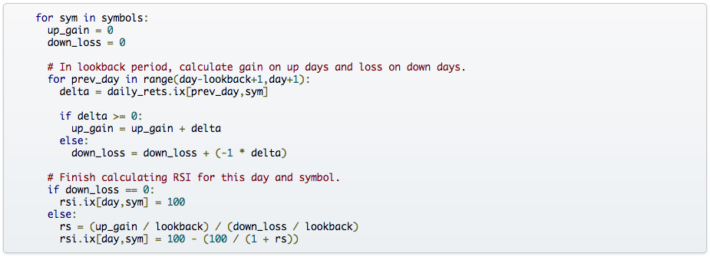
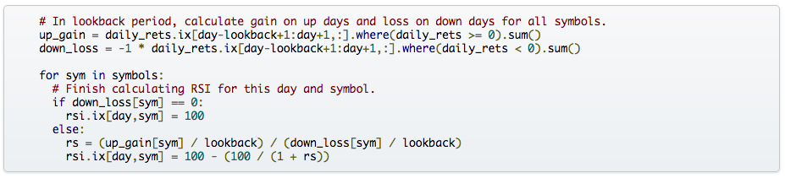
Finally: eliminate the inner RSI loop.
real 0m15.148s
user 0m15.054s
sys 0m0.091s
60% faster!

Slide 20
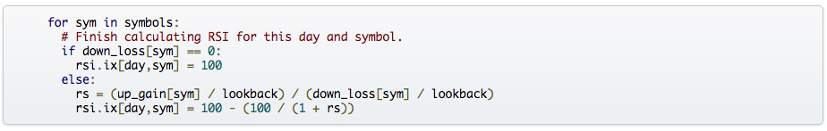
Eliminate the inner RSI loop again!
But wait! We lost the guard against dividing by zero when there are no down days.
Turns out numpy had our backs. x / 0 == Inf.
So we can just fix up the Inf values after the fact!

Slide 21
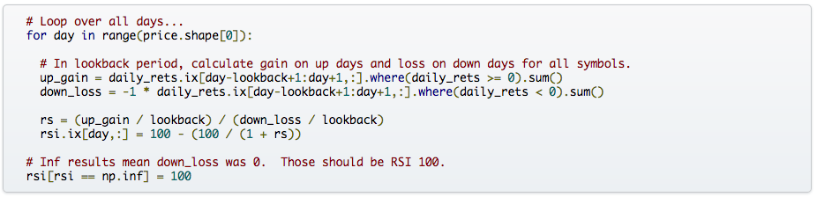
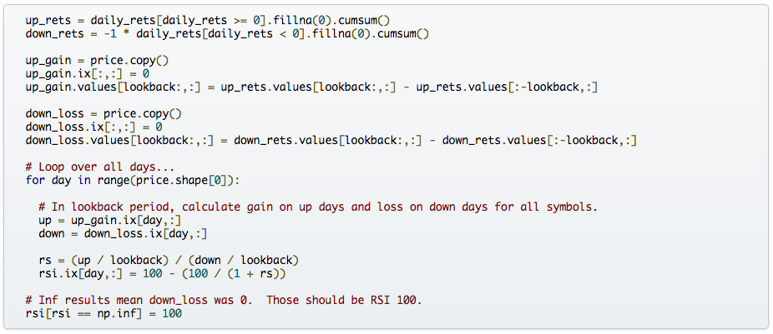
Counter-intuitive alert! We’re adding code this time.

Slide 22
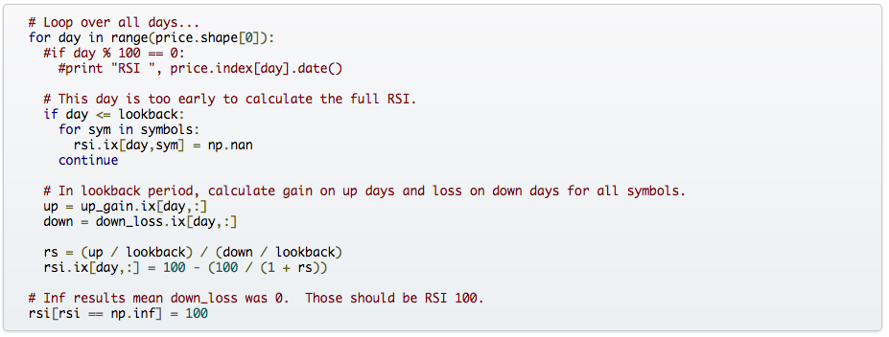
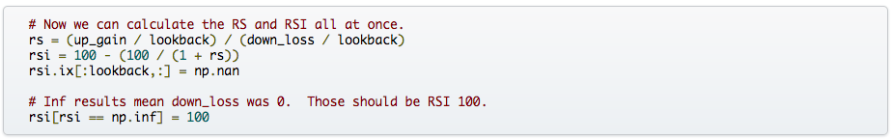
Now the RSI can be fully vectorized.
real 0m9.096s
user 0m9.000s
sys 0m0.096s
40% faster!

Slide 23
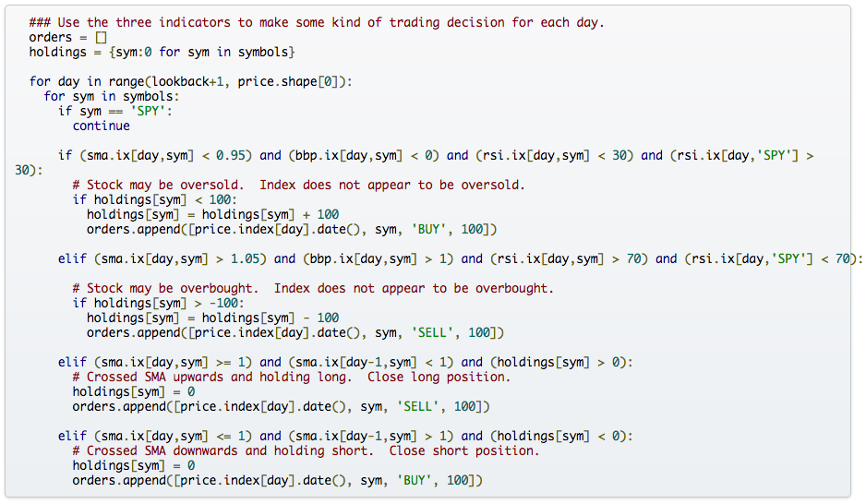
Remember This?

Slide 24
I made this hard to vectorize on purpose. *sigh*
Orders as a Python list was not going to cut it.
Traded memory for speed by filling an array with the index RSI.

Slide 25
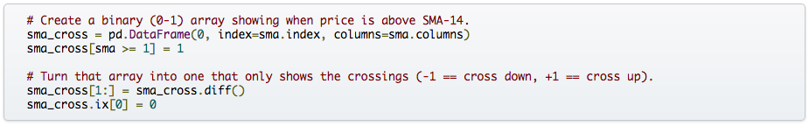
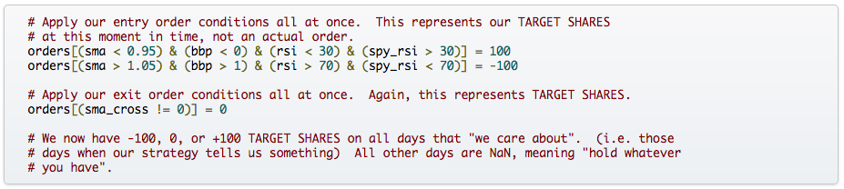
Now I have a problem! My strategy closes positions on Price-SMA Crossovers.
I don’t have a vectorized indicator for those crossovers. I need one.
Now I can calculate the results of my entire strategy at once.
Note that I did NOT calculate orders directly, but target holdings.
This type of indirect thinking can turn a hard vectorization problem into an easy one!

Slide 26
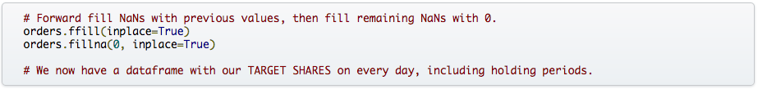
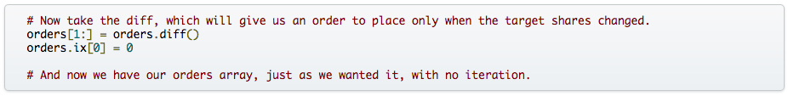
What about all those NaN days in my orders df?
NaN meant “stand pat”, so we should forward fill those.
But we wanted orders, not target holdings!
We finally bring that indirect thinking back home.
Orders are just the daily “diff” of target holdings!
real 0m3.759s
user 0m3.669s
sys 0m0.091s
60% faster!

Slide 27

Final Problem: writing out the orders file.
We don’t have a nice list to iterate through anymore.
We can’t easily use a write_csv() function due to custom format.
But at least we can minimize the output CSV iteration…

Slide 28
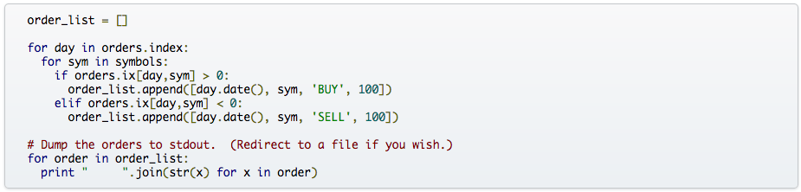
☹ Okay, some iteration. ☹
Still, that reduced the number of orders elements to consider from 14,104 to 1,197!
That’s 90% fewer elements to iterate for output, and indeed:
real 0m0.440s
user 0m0.351s
sys 0m0.092s
90% faster!

Slide 29
Final Results for Identical Output
real 5m24.461s
user 5m24.281s
sys 0m0.185s
real 0m0.440s
user 0m0.351s
sys 0m0.092s
1000 times faster!
That’s 0.1% of the original runtime for the exact same results!
Code smarter, not harder!

