Slide 1
基于深度学习的 观点抽取
1701111316 秦汉民

Slide 2

观点抽取

Slide 3
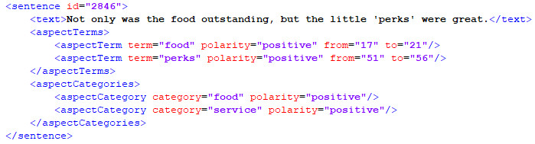
观点抽取
特征抽取与聚类
抽取对象的所有特征表达，并将同义特征表达聚类。
特征情感分类
确定观点针对每个特征的情感倾向：正面、负面、中性。
实例：SemEval-2014 Task 4

Slide 4
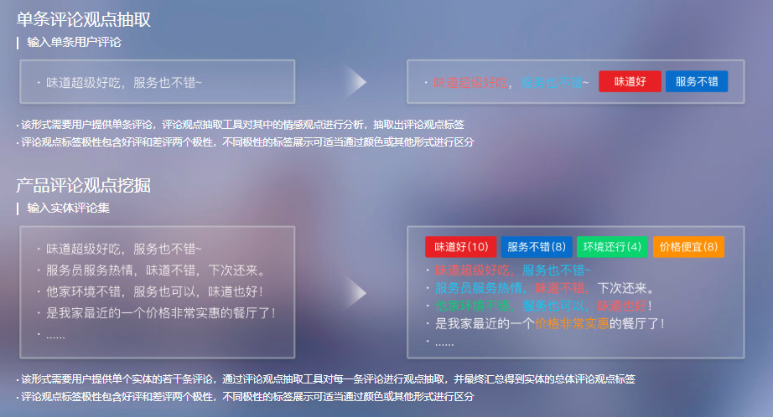
观点抽取
http://ai.baidu.com/tech/nlp/comment_tag

Slide 5
观点抽取
特征抽取与聚类
抽取对象的所有特征表达，并将同义特征表达聚类。
特征情感分类
确定观点针对每个特征的情感倾向：正面、负面、中性。
实例：SemEval-2014 Task 4

Slide 6
特征抽取（经典工作）
Unsupervised(Rule-based methods)
Frequent itemsets among noun phrases
Extraction rules based on POS tag relations
Supervised(sequence labeling task)
Hidden Markov Models
Conditional Random Fields
Mining and Summarizing Customer Reviews (2004)
Mining Opinion Features in Customer Reviews (2004)
Expanding Domain Sentiment Lexicon through Double Propagation (2009)
A novel lexicalized HMM-based learning framework for web opinion mining (2009)
Extracting Opinion Targets in a Single- and Cross-Domain Setting with Conditional Random Fields (2010)

Slide 7
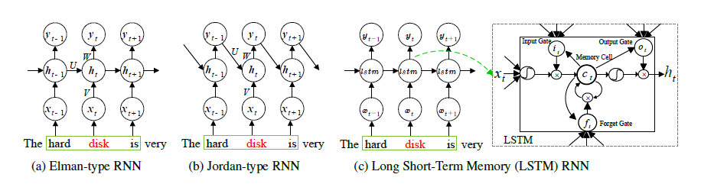
特征抽取（RNN 1）
Word embedding
pretrained embeddings from SENNA/Google
word2vec on Amazon corpus
RNN (high-level feature representation for each word)
Elman-type RNN/Jordan-type RNN/ LSTM RNN
label classification with softmax
Fine-grained Opinion Mining with Recurrent Neural Networks andWord Embeddings (2015)

Slide 8
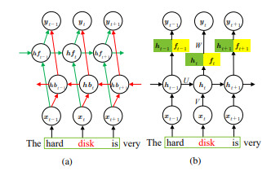
特征抽取（RNN 1）
Bidirectional RNN
capture dependencies from the future as well as from the past
Other Linguistic Features
POS tag classes/BIO-tagged chunk information
Fine-grained Opinion Mining with Recurrent Neural Networks andWord Embeddings (2015)

Slide 9
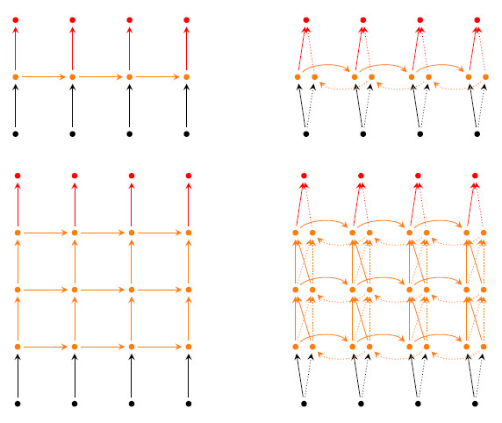
特征抽取（RNN 2）
Word embedding
word2vec on Amazon corpus
RNN (high-level feature representation for each word)
Bidirectionality/Depth in Space
label classification with softmax
Opinion Mining with Deep Recurrent Neural Networks (2014)

Slide 10
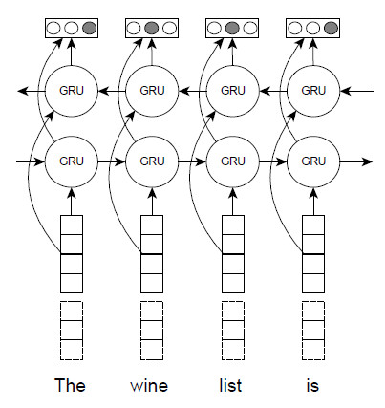
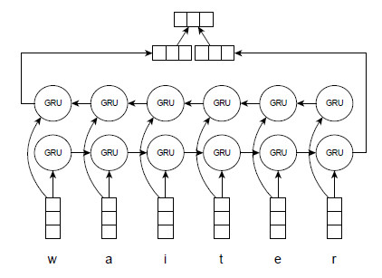
特征抽取（RNN 3）
Word embedding
word2vec on Amazon corpus
Character-level embeddings
RNN (high-level feature representation for each word)
bidirectional GRU
label classification with softmax
Improving Opinion-Target Extraction with Character-Level Word Embeddings (2017)

Slide 11
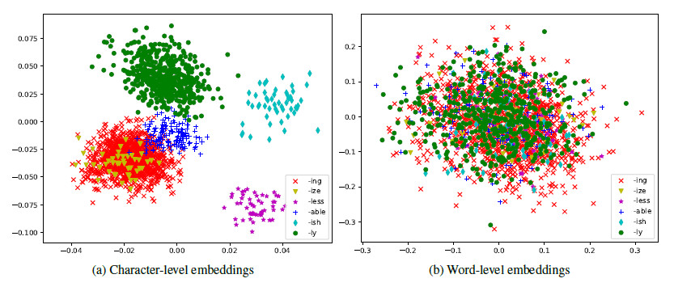
特征抽取（RNN 3）
character-level word embeddings encode morphological features of a word
Improving Opinion-Target Extraction with Character-Level Word Embeddings (2017)

Slide 12
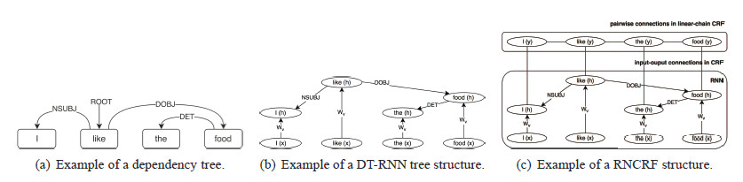
特征抽取（RNN+CRF）
Word embedding
word2vec on Yelp/Amazon corpus
RNN (high-level feature representation for each word)
Dependency-Tree RNN
CRF (mapping from high-level features to labels)
joint Training with RNN
Recursive Neural Conditional Random Fields for Aspect-based Sentiment Analysis (2016)

Slide 13
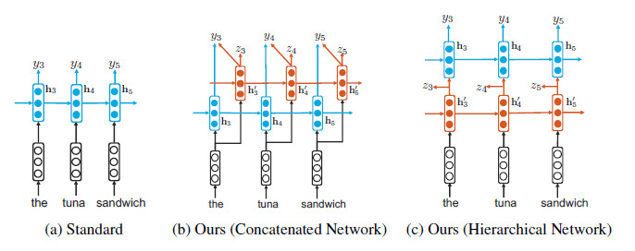
特征抽取（RNN+Rule）
Word embedding
pretrained embeddings from Google
RNN (high-level feature representation for each word)
Concatenated Network/Hierarchical Network
two parts in loss function, auxiliary labels z and true labels y
label classification with softmax
Recurrent Neural Networks with Auxiliary Labels for Cross-Domain Opinion Target Extraction (2017)

Slide 14
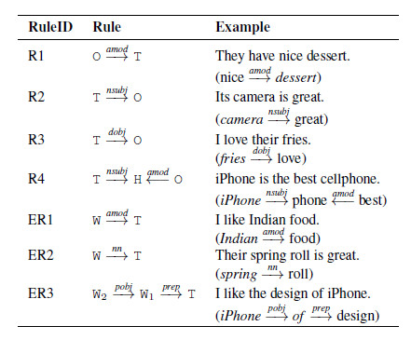
特征抽取（RNN+Rule）
Rule-based Auxiliary Labels
use syntactic patterns to detect potential opinion targets
Recurrent Neural Networks with Auxiliary Labels for Cross-Domain Opinion Target Extraction (2017)

Slide 15
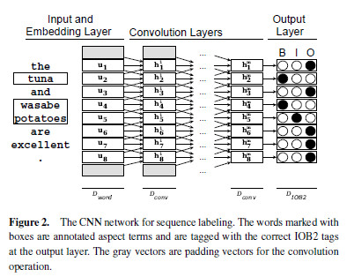
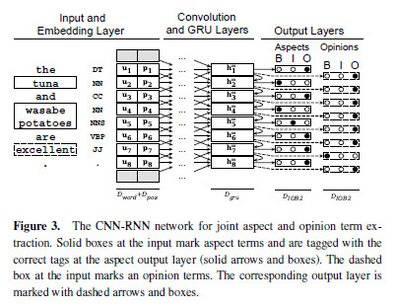
特征抽取（CNN）
Aspect extraction for opinion mining with a deep convolutional neural network (2016)
Aspect-Based Relational Sentiment Analysis Using a Stacked Neural Network Architecture (2017)

Slide 16
观点抽取
特征抽取与聚类
抽取对象的所有特征表达，并将同义特征表达聚类。
特征情感分类
确定观点针对每个特征的情感倾向：正面、负面、中性。
实例：SemEval-2014 Task 4

Slide 17
特征情感分类（经典工作）
based on orientation of the opinion words
based on topic model
feature-based SVM
Mining and Summarizing Customer Reviews (2004)
Mining Opinion Features in Customer Reviews (2004)
A Holistic Lexicon-Based Approach to Opinion Mining (2009)
Joint Sentiment Topic Model for Sentiment Analysis (2009)
Jointly Modeling Aspects and Opinions with a MaxEnt-LDA Hybrid (2010)
DCU Aspect-based Polarity Classification for SemEval Task 4 (2014)
NRC-Canada-2014: Detecting Aspects and Sentiment in Customer Reviews (2014)

Slide 18
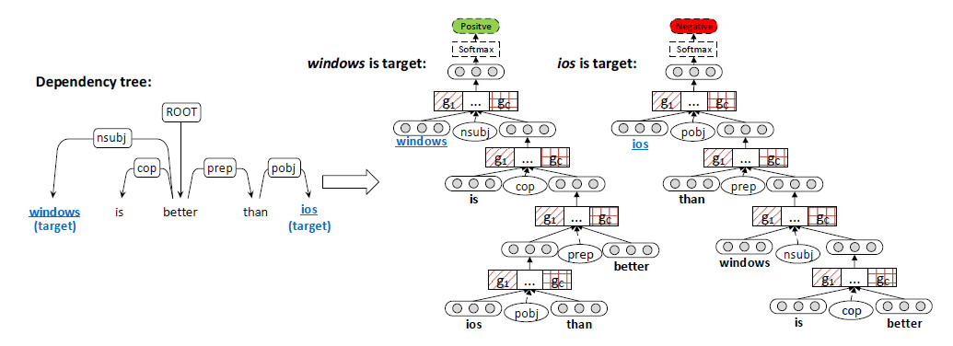
特征情感分类（RNN 1）
Word embedding
random initialization
RNN (high-level feature representation for sentence)
Adaptive Recursive Neural Network (AdaRNN)
employ more than one composition functions
classification with softmax
Adaptive Recursive Neural Network for Target-dependent Twitter Sentiment Classification (2014)

Slide 19
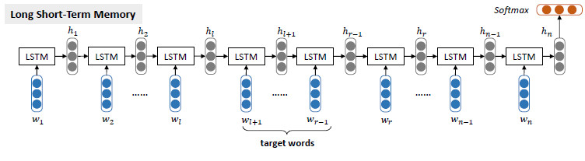
特征情感分类（RNN 2）
Word embedding
pretrained embeddings from SSWE/Glove
RNN (high-level feature representation for sentence)
Target-Dependent LSTM/Target-Connection LSTM
classification with softmax
Effective LSTMs for Target-Dependent Sentiment Classification (2015)
Target-Dependent Sentiment Classification with Long Short Term Memory (2015)

Slide 20
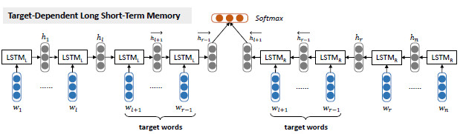
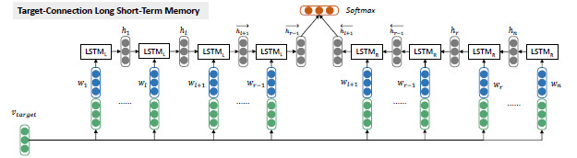
特征情感分类（RNN 2）
RNN (high-level feature representation for sentence)
Target-Dependent LSTM/Target-Connection LSTM
classification with softmax
Effective LSTMs for Target-Dependent Sentiment Classification (2015)
Target-Dependent Sentiment Classification with Long Short Term Memory (2015)

Slide 21
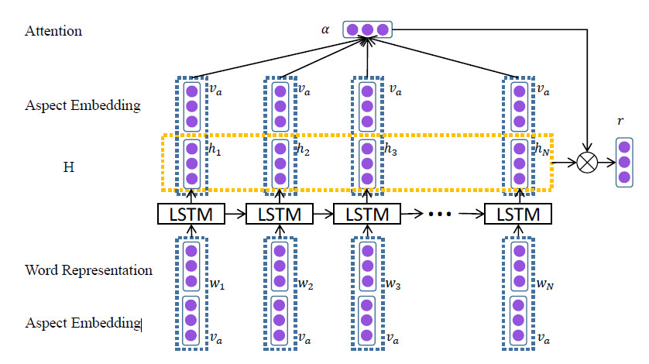
特征情感分类（RNN 3）
Word embedding
pretrained embeddings from Glove
RNN (high-level feature representation for sentence)
Attention-based LSTM (AT-LSTM)
classification with softmax
Attention-based LSTM for Aspect-level Sentiment Classification (2016)

Slide 22
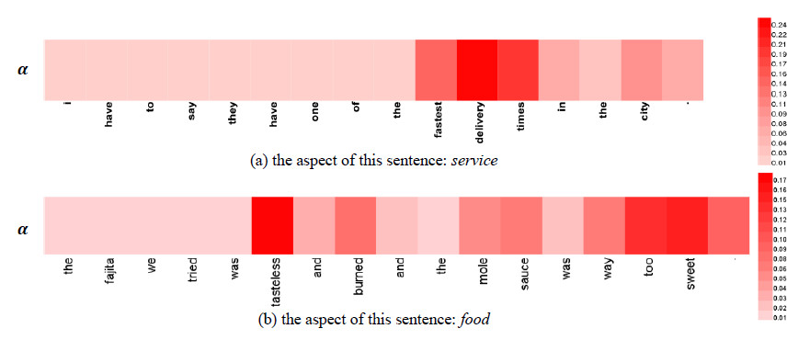
特征情感分类（RNN 3）
attention can detect important words from the whole sentence dynamically
attention can know multi-keypoints if more than one keypoint existing
Attention-based LSTM for Aspect-level Sentiment Classification (2016)

Slide 23
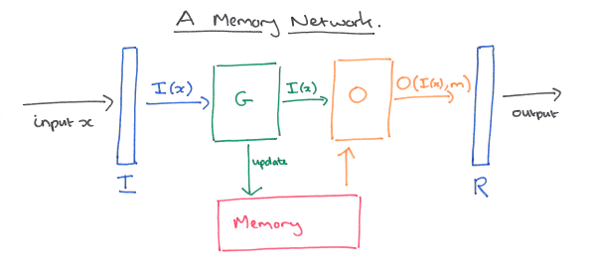
特征情感分类（Memory Network）
memory m : an indexed array of objects (e.g. vectors or arrays of strings).
Input feature map I : converts the incoming input to the internal feature representation
Generalization component G : updates old memories given the new input.
Output feature map O : produces a new output in the feature representation space given the new input and the current memory state.
Response component R : converts the output into the response format desired
Memory Networks (2015)
End-To-End Memory Networks (2015)

Slide 24
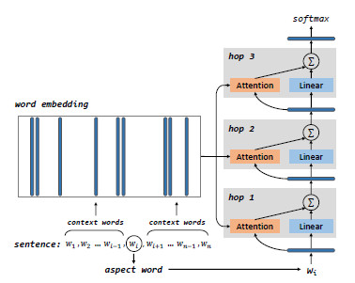
特征情感分类（Memory Network 1）
input module : pretrained embeddings from Glove
memory module : word embeddings
recurrent attention module : high-level feature representation for sentence
output module : classification with softmax
Aspect Level Sentiment Classification with Deep Memory Network (2016)

Slide 25
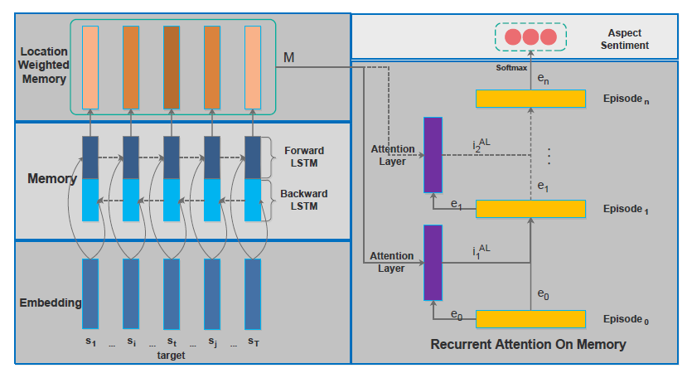
特征情感分类（Memory Network 2）
input module : pretrained embeddings from Glove
memory module : Deep Bidirectional LSTM
position-weighted memory module : based on distance from target
recurrent attention module : high-level feature representation for sentence
output module : classification with softmax
Recurrent Attention Network on Memory for Aspect Sentiment Analysis (2017)

Slide 26
谢谢
观赏

