Slide 1
Introduction to Information Retrieval
http://informationretrieval.org
IIR 2: The term vocabulary and postings lists
Hinrich Schu¨tze
Center for Information and Language Processing, University of Munich

Slide 2





Overview
1 Recap
2
Documents
Terms
General + Non-English English
Skip pointers
5
Phrase queries

Slide 3




Outline
1 Recap
2
Documents
Terms
General + Non-English English
Skip pointers
5
Phrase queries

Slide 4
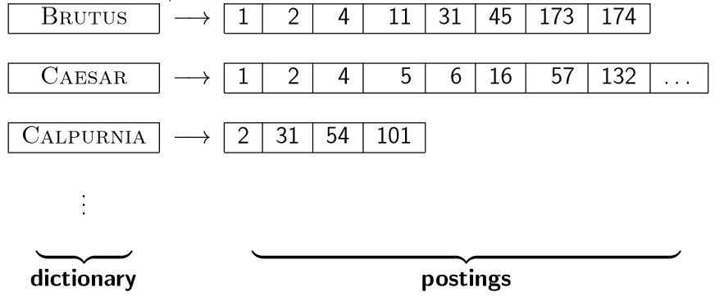
Inverted index
For each term t, we store a list of all documents that contain t.

Slide 5
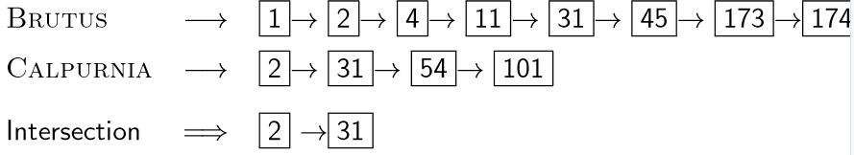
Intersecting two postings lists

Slide 6
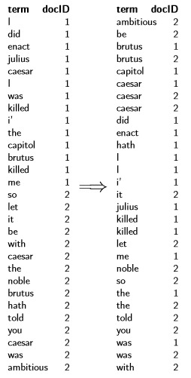
Constructing the inverted index: Sort postings

Slide 7
Westlaw: Example queries
Information need: Information on the legal theories involved in preventing the disclosure of trade secrets by employees formerly employed by a competing company Query: “trade secret” /s
disclos! /s prevent /s employe! Information need: Requirements for
disabled people to be able to access a workplace Query: disab! /p access! /s work-site work-place (employment /3 place) Information
need: Cases about a host’s responsibility for drunk guests Query:
host! /p (responsib! liab!) /p (intoxicat! drunk!) /p guest

Slide 8
Does Google use the Boolean model?
On Google, the default interpretation of a query [w₁ w₂
. . . w_{n}] is w₁ AND w₂ AND . . . AND w_{n}
Cases where you get hits that do not contain one of the w_{i} :
anchor text
page contains variant of w_{i} (morphology, spelling correction, synonym)
long queries (n large)
boolean expression generates very few hits
Simple Boolean vs. Ranking of result set
Simple Boolean retrieval returns matching documents in no particular order.
Google (and most well designed Boolean engines) rank the result set – they rank good hits (according to some estimator of relevance) higher than bad hits.

Slide 9
Take-away
Understanding of the basic unit of classical information retrieval systems: words and documents: What is a document, what is a term?
Tokenization: how to get from raw text to words (or tokens)
More complex indexes: skip pointers and phrases

Slide 10

Outline
1 Recap
2
Documents
Terms
General + Non-English English
Skip pointers
5
Phrase queries

Slide 11
Documents
Last lecture: Simple Boolean retrieval system Our assumptions were:
We know what a document is.
We can “machine-read” each document.
This can be complex in reality.

Slide 12
Parsing a document
We need to deal with format and language of each document. What format is it in? pdf, word, excel, html etc.
What language is it in? What character set is in use?
Each of these is a classification problem, which we will study later in this course (IIR 13).
Alternative: use heuristics

Slide 13
Format/Language: Complications
A single index usually contains terms of several languages. Sometimes a document or its components contain multiple
languages/formats.
French email with Spanish pdf attachment
What is the document unit for indexing? A file?
An email?
An email with 5 attachments?
A group of files (ppt or latex in HTML)?
Upshot: Answering the question “what is a document?” is not trivial and requires some design decisions.
Also: XML

Slide 14
Outline
1 Recap
2
Documents
Terms
General + Non-English English
Skip pointers
5
Phrase queries

Slide 15
Outline
1 Recap
2
Documents
Terms
General + Non-English
English
Skip pointers
5
Phrase queries

Slide 16
Definitions
Word – A delimited string of characters as it appears in the text.
Term – A “normalized” word (case, morphology, spelling etc); an equivalence class of words.
Token – An instance of a word or term occurring in a document.
Type – The same as a term in most cases: an equivalence class of tokens.

Slide 17
Normalization
Need to “normalize” words in indexed text as well as query terms into the same form.
Example: We want to match U.S.A. and USA
We most commonly implicitly define equivalence classes of terms.
Alternatively: do asymmetric expansion window → window, windows windows → Windows, windows Windows (no expansion)
More powerful, but less efficient
Why don’t you want to put window, Window, windows, and
Windows in the same equivalence class?

Slide 18
Normalization: Other languages
Normalization and language detection interact.
PETER WILL NICHT MIT. → MIT = mit
He got his PhD from MIT. → MIT /= mit

Slide 19
Tokenization: Recall construction of inverted index
Input:
Friends, Romans, countrymen.
So let it be with Caesar . . .
Output:
friend roman countryman so . . .
Each token is a candidate for a postings entry. What are valid tokens to emit?

Slide 20
Exercises
In June, the dog likes to chase the cat in the barn. – How many word tokens? How many word types? Why tokenization is difficult
– even in English. Tokenize: Mr. O’Neill thinks that the boys’ stories about Chile’s capital aren’t amusing.

Slide 21
Tokenization problems: One word or two? (or several)
Hewlett-Packard State-of-the-art co-education
the hold-him-back-and-drag-him-away maneuver data base
San Francisco
Los Angeles-based company
cheap San Francisco-Los Angeles fares York University vs. New York University

Slide 22
Numbers
3/20/91
20/3/91
Mar 20, 1991 B-52 100.2.86.144
(800) 234-2333
800.234.2333
Older IR systems may not index numbers . . .
. . . but generally it’s a useful feature. Google example

Slide 23
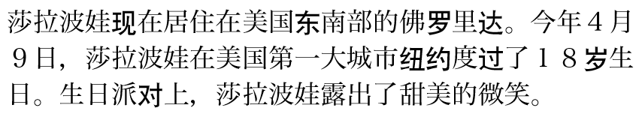
Chinese: No whitespace

Slide 24

Ambiguous segmentation in Chinese
The two
characters can be treated as one word meaning ‘monk’ or as a
sequence of two words meaning ‘and’ and ‘still’.

Slide 25
Other cases of “no whitespace”
Compounds in Dutch, German, Swedish Computerlinguistik → Computer + Linguistik Lebensversicherungsgesellschaftsangestellter
→ leben + versicherung + gesellschaft + angestellter
Inuit: tusaatsiarunnanngittualuujunga (I can’t hear very well.) Many other languages with segmentation difficulties: Finnish,
Urdu, . . .

Slide 26
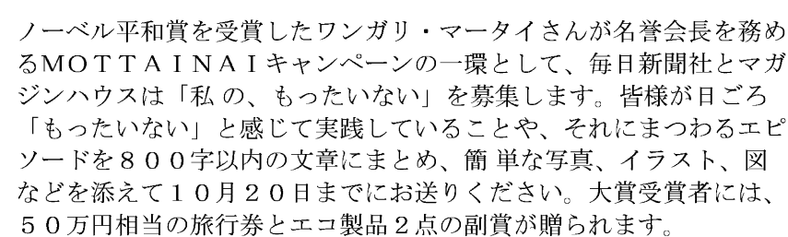
Japanese
4
different “alphabets”: Chinese characters, hiragana syllabary for inflectional endings and function words, katakana syllabary for transcription of foreign words and other uses, and latin. No spaces (as in Chinese). End user can express query entirely in hiragana!

Slide 27
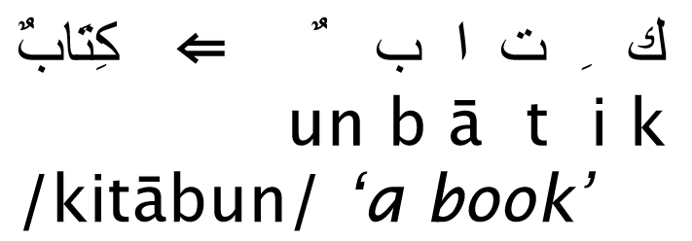
Arabic script

Slide 28

Arabic script: Bidirectionality
‘Algeria achieved its independence in 1962 after 132 years of French occupation.’
Bidirectionality is not a problem if text is coded in Unicode.

Slide 29
Accents and diacritics
Accents: r´esum´e vs. resume (simple omission of accent) Umlauts: Universit¨at vs. Universitaet (substitution with
special letter sequence “ae”)
Most important criterion: How are users likely to write their queries for these words?
Even in languages that standardly have accents, users often do not type them. (Polish?)

Slide 30
Outline
1 Recap
2
Documents
Terms
General + Non-English
English
Skip pointers
5
Phrase queries

Slide 31
Case folding
Reduce all letters to lower case
Even though case can be semantically meaningful
capitalized words in mid-sentence MIT vs. mit
Fed vs. fed
. . .
It’s often best to lowercase everything since users will use lowercase regardless of correct capitalization.

Slide 32
Stop words
stop words = extremely common words which would appear to be of little value in helping select documents matching a user need
Examples: a, an, and, are, as, at, be, by, for, from, has, he, in, is, it, its, of, on, that, the, to, was, were, will, with
Stop word elimination used to be standard in older IR systems. But you need stop words for phrase queries, e.g. “King of
Denmark”
Most web search engines index stop words.

Slide 33
More equivalence classing
Soundex: IIR 3 (phonetic equivalence, Muller = Mueller) Thesauri: IIR 9 (semantic equivalence, car = automobile)

Slide 34
Lemmatization
Reduce inflectional/variant forms to base form Example: am, are, is → be
Example: car, cars, car’s, cars’ → car
Example: the boy’s cars are different colors → the boy car be different color
Lemmatization implies doing “proper” reduction to dictionary headword form (the lemma).
Inflectional morphology (cutting → cut) vs. derivational morphology (destruction → destroy)

Slide 35
Stemming
Definition of stemming: Crude heuristic process that chops off the ends of words in the hope of achieving what “principled” lemmatization attempts to do with a lot of linguistic knowledge.
Language dependent
Often inflectional and derivational
Example for derivational: automate, automatic, automation
all reduce to automat

Slide 36
Porter algorithm
Most common algorithm for stemming English
Results suggest that it is at least as good as other stemming options
Conventions + 5 phases of reductions Phases are applied sequentially
Each phase consists of a set of commands.
Sample command: Delete final ement if what remains is longer than 1 character
replacement → replac cement → cement
Sample convention: Of the rules in a compound command, select the one that applies to the longest suffix.

Slide 37
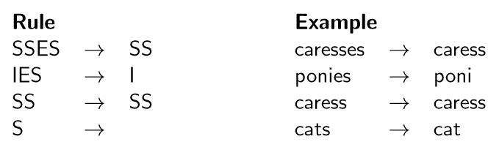
Porter stemmer: A few rules

Slide 38
Three stemmers: A comparison
Sample text: Such an analysis can reveal features that are not easily visible from the variations in the individual genes and can lead to a picture of expression that is more biologically transparent and accessible to interpretation
Porter stemmer: such an analysi can reveal featur that ar not easili visibl from the variat in the individu gene and can lead to a pictur of express that is more biolog transpar and access to interpret
Lovins stemmer: such an analys can reve featur that ar not eas vis from th vari in th individu gen and can lead to a pictur of expres that is mor biolog transpar and acces to interpres
Paice stemmer: such an analys can rev feat that are not easy vis from the vary in the individ gen and can lead to a pict of express that is mor biolog transp and access to interpret

Slide 39
Does stemming improve effectiveness?
In general, stemming increases effectiveness for some queries, and decreases effectiveness for others.
Queries where stemming is likely to help: [tartan sweaters], [sightseeing tour san francisco]
(equivalence classes: {sweater,sweaters}, {tour,tours})
Porter Stemmer equivalence class oper contains all of operate operating operates operation operative operatives operational.
Queries where stemming hurts: [operational AND research], [operating AND system], [operative AND dentistry]

Slide 40
Exercise: What does Google do?
Stop words Normalization Tokenization Lowercasing Stemming
Non-latin alphabets Umlauts Compounds Numbers

Slide 41
Outline
1 Recap
2
Documents
Terms
General + Non-English English
Skip pointers
5
Phrase queries

Slide 42
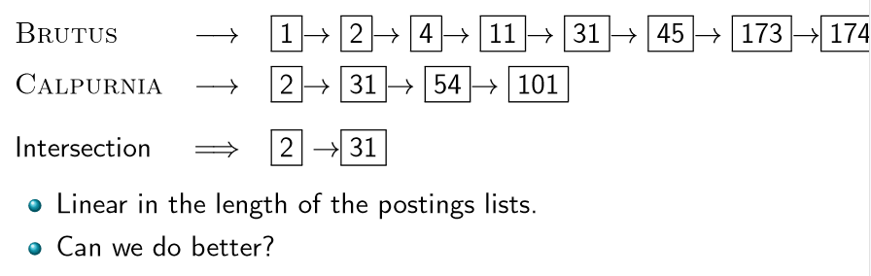
Recall basic intersection algorithm

Slide 43
Skip pointers
Skip pointers allow us to skip postings that will not figure in the search results.
This makes intersecting postings lists more efficient.
Some postings lists contain several million entries – so efficiency can be an issue even if basic intersection is linear.
Where do we put skip pointers?
How do we make sure insection results are correct?

Slide 44
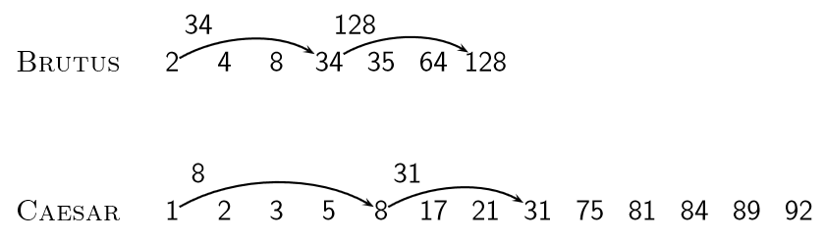
Basic idea

Slide 45
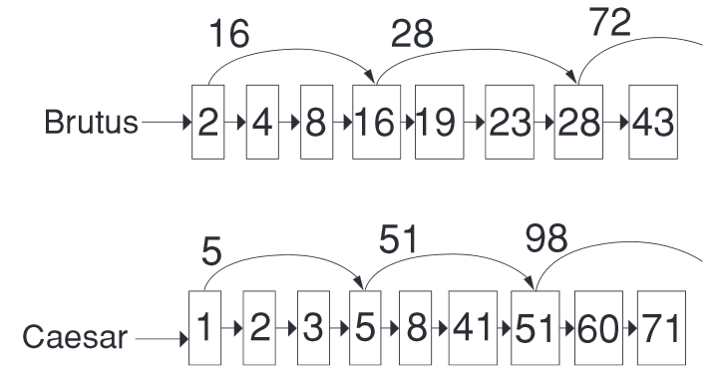
Skip lists: Larger example

Slide 46
Intersecting with skip pointers
IntersectWithSkips(p₁, p₂)
answer ← ( )
while p₁ =/ nil and p₂ =/ nil
do if docID(p₁) = docID(p₂)
then Add(answer , docID(p₁ ))
p₁ ← next(p₁)
p₂ ← next(p₂)
else if docID(p₁) < docID(p₂)
then if hasSkip(p₁) and (docID(skip(p₁)) ≤ docID(p₂))
then while hasSkip(p₁) and (docID(skip(p₁)) ≤ docID(p₂))
do p₁ ← skip(p₁)
else p₁ ← next(p₁)
else if hasSkip(p₂) and (docID(skip(p₂)) ≤ docID(p₁))
then while hasSkip(p₂) and (docID(skip(p₂)) ≤ docID(p₁))
do p₂ ← skip(p₂)
else p₂ ← next(p₂)
16
return answer

Slide 47
Where do we place skips?
Tradeoff: number of items skipped vs. frequency skip can be taken
More skips: Each skip pointer skips only a few items, but we can frequently use it.
Fewer skips: Each skip pointer skips many items, but we can not use it very often.

Slide 48

Where do we place skips? (cont)
Simple heuristic: for postings list of length P , use √
P
evenly-spaced skip pointers.
This ignores the distribution of query terms.
Easy if the index is static; harder in a dynamic environment because of updates.
How much do skip pointers help? They used to help a lot.
With today’s fast CPUs, they don’t help that much anymore.

Slide 49
Outline
1 Recap
2
Documents
Terms
General + Non-English English
Skip pointers
5
Phrase queries

Slide 50
Phrase queries
We want to answer a query such as [stanford university] – as a phrase.
Thus The inventor Stanford Ovshinsky never went to university should not be a match.
The concept of phrase query has proven easily understood by users.
Significant part of web queries are phrase queries (explicitly entered or interpreted as such)
Consequence for inverted index: it no longer suffices to store docIDs in postings lists.
Two ways of extending the inverted index:
biword index positional index

Slide 51
Biword indexes
Index every consecutive pair of terms in the text as a phrase. For example, Friends, Romans, Countrymen would generate
two biwords: “friends romans” and “romans countrymen”
Each of these biwords is now a vocabulary term. Two-word phrases can now easily be answered.

Slide 52
Longer phrase queries
A long phrase like “stanford university palo alto” can be represented as the Boolean query “stanford university” AND “university palo” AND “palo alto”
We need to do post-filtering of hits to identify subset that actually contains the 4-word phrase.

Slide 53
Issues with biword indexes
Why are biword indexes rarely used?
False positives, as noted above
Index blowup due to very large term vocabulary

Slide 54
Positional indexes
Positional indexes are a more efficient alternative to biword indexes.
Postings lists in a nonpositional index: each posting is just a docID
Postings lists in a positional index: each posting is a docID and a list of positions

Slide 55
Positional indexes: Example
Query: “to₁ be₂ or₃ not₄ to₅ be₆” to, 993427:
( 1: ( 7, 18, 33, 72, 86, 231);
2: (1, 17, 74, 222, 255);
4: ( 8, 16, 190, 429, 433);
5: (363, 367);
7: (13, 23, 191); . . . )
be, 178239:
( 1: ( 17, 25);
4: ( 17, 191, 291, 430, 434);
5: (14, 19, 101); . . . ) Document 4 is a match!

Slide 56
Proximity search
We just saw how to use a positional index for phrase searches. We can also use it for proximity search.
For example: employment /4 place
Find all documents that contain employment and place
within 4 words of each other.
Employment agencies that place healthcare workers are seeing growth is a hit.
Employment agencies that have learned to adapt now place healthcare workers is not a hit.

Slide 57
Proximity search
Use the positional index
Simplest algorithm: look at cross-product of positions of (i)
employment in document and (ii) place in document
Very inefficient for frequent words, especially stop words Note that we want to return the actual matching positions,
not just a list of documents.
This is important for dynamic summaries etc.

Slide 58
“Proximity” intersection
PositionalIntersect(p₁, p₂, k)
answer ← ( )
while p₁ =/ nil and p₂ =/ nil
do if docID(p₁) = docID(p₂)
then l ← ( )
pp₁ ← positions(p₁) 6
7
8
9
10
11
12
13
14
15
16
17
18
19
20
21
22
23
24
pp₂ ← positions(p₂) while pp₁ /= nil do while pp₂ /= nil
do if |pos(pp₁) − pos(pp₂)| ≤ k
then Add(l , pos(pp₂))
else if pos(pp₂) > pos(pp₁)
then break
pp₂ ← next(pp₂)
while l /= ( ) and |l [0] − pos(pp₁)| > k
do Delete(l [0])
for each ps ∈ l
do Add(answer , (docID(p₁ ), pos(pp₁), ps)) pp₁ ← next(pp₁)
p₁ ← next(p₁) p₂ ← next(p₂)
else if docID(p₁) < docID(p₂) then p₁ ← next(p₁) else p₂ ← next(p₂)
return answer

Slide 59
Combination scheme
Biword indexes and positional indexes can be profitably combined.
Many biwords are extremely frequent: Michael Jackson, Britney Spears etc
For these biwords, increased speed compared to positional postings intersection is substantial.
Combination scheme: Include frequent biwords as vocabulary terms in the index. Do all other phrases by positional intersection.
Williams et al. (2004) evaluate a more sophisticated mixed indexing scheme. Faster than a positional index, at a cost of 26% more space for index.

Slide 60
“Positional” queries on Google
For web search engines, positional queries are much more expensive than regular Boolean queries.
Let’s look at the example of phrase queries.
Why are they more expensive than regular Boolean queries? Can you demonstrate on Google that phrase queries are more
expensive than Boolean queries?

Slide 61
Take-away
Understanding of the basic unit of classical information retrieval systems: words and documents: What is a document, what is a term?
Tokenization: how to get from raw text to words (or tokens) More complex indexes: skip pointers and phrases

Slide 62
Resources
Chapter 2 of IIR
Resources at http://cislmu.org
Porter stemmer
A fun number search on Google

