Slide 1
Course TA F0 + F1
CST3492 Java Enterprise Application Development
Assignment A | Group B | Release 0.3.0
Full names and matriculation numbers
Name ____________________ ID ____________________
Name ____________________ ID ____________________
Name ____________________ ID ____________________
Name ____________________ ID ____________________
1
Notes:
Sources: Assignment A, F1 (page 2); output/documents/F1_Implementation_Guide.md; current release 0.3.0 source. Introduce the course assistant and the three implemented smart actions. Fill in the real team members and matriculation numbers before submission. Suggested time: 30 seconds.

Slide 2
F0 functionality
Course questions with evidence
Local lecture retrieval supplies relevant passages to a configurable LLM.
Document and page references
Course answers cite source IDs that resolve to the original document and page.
Questions about selected Java code
An editor action attaches the selected text and line range to the tool window.
2
Notes:
Implementation: src/main/java and core/src/main/java. Assignment A, CST3492, AY 2026-2027, pp. 1-3. F0 release only.

Slide 3
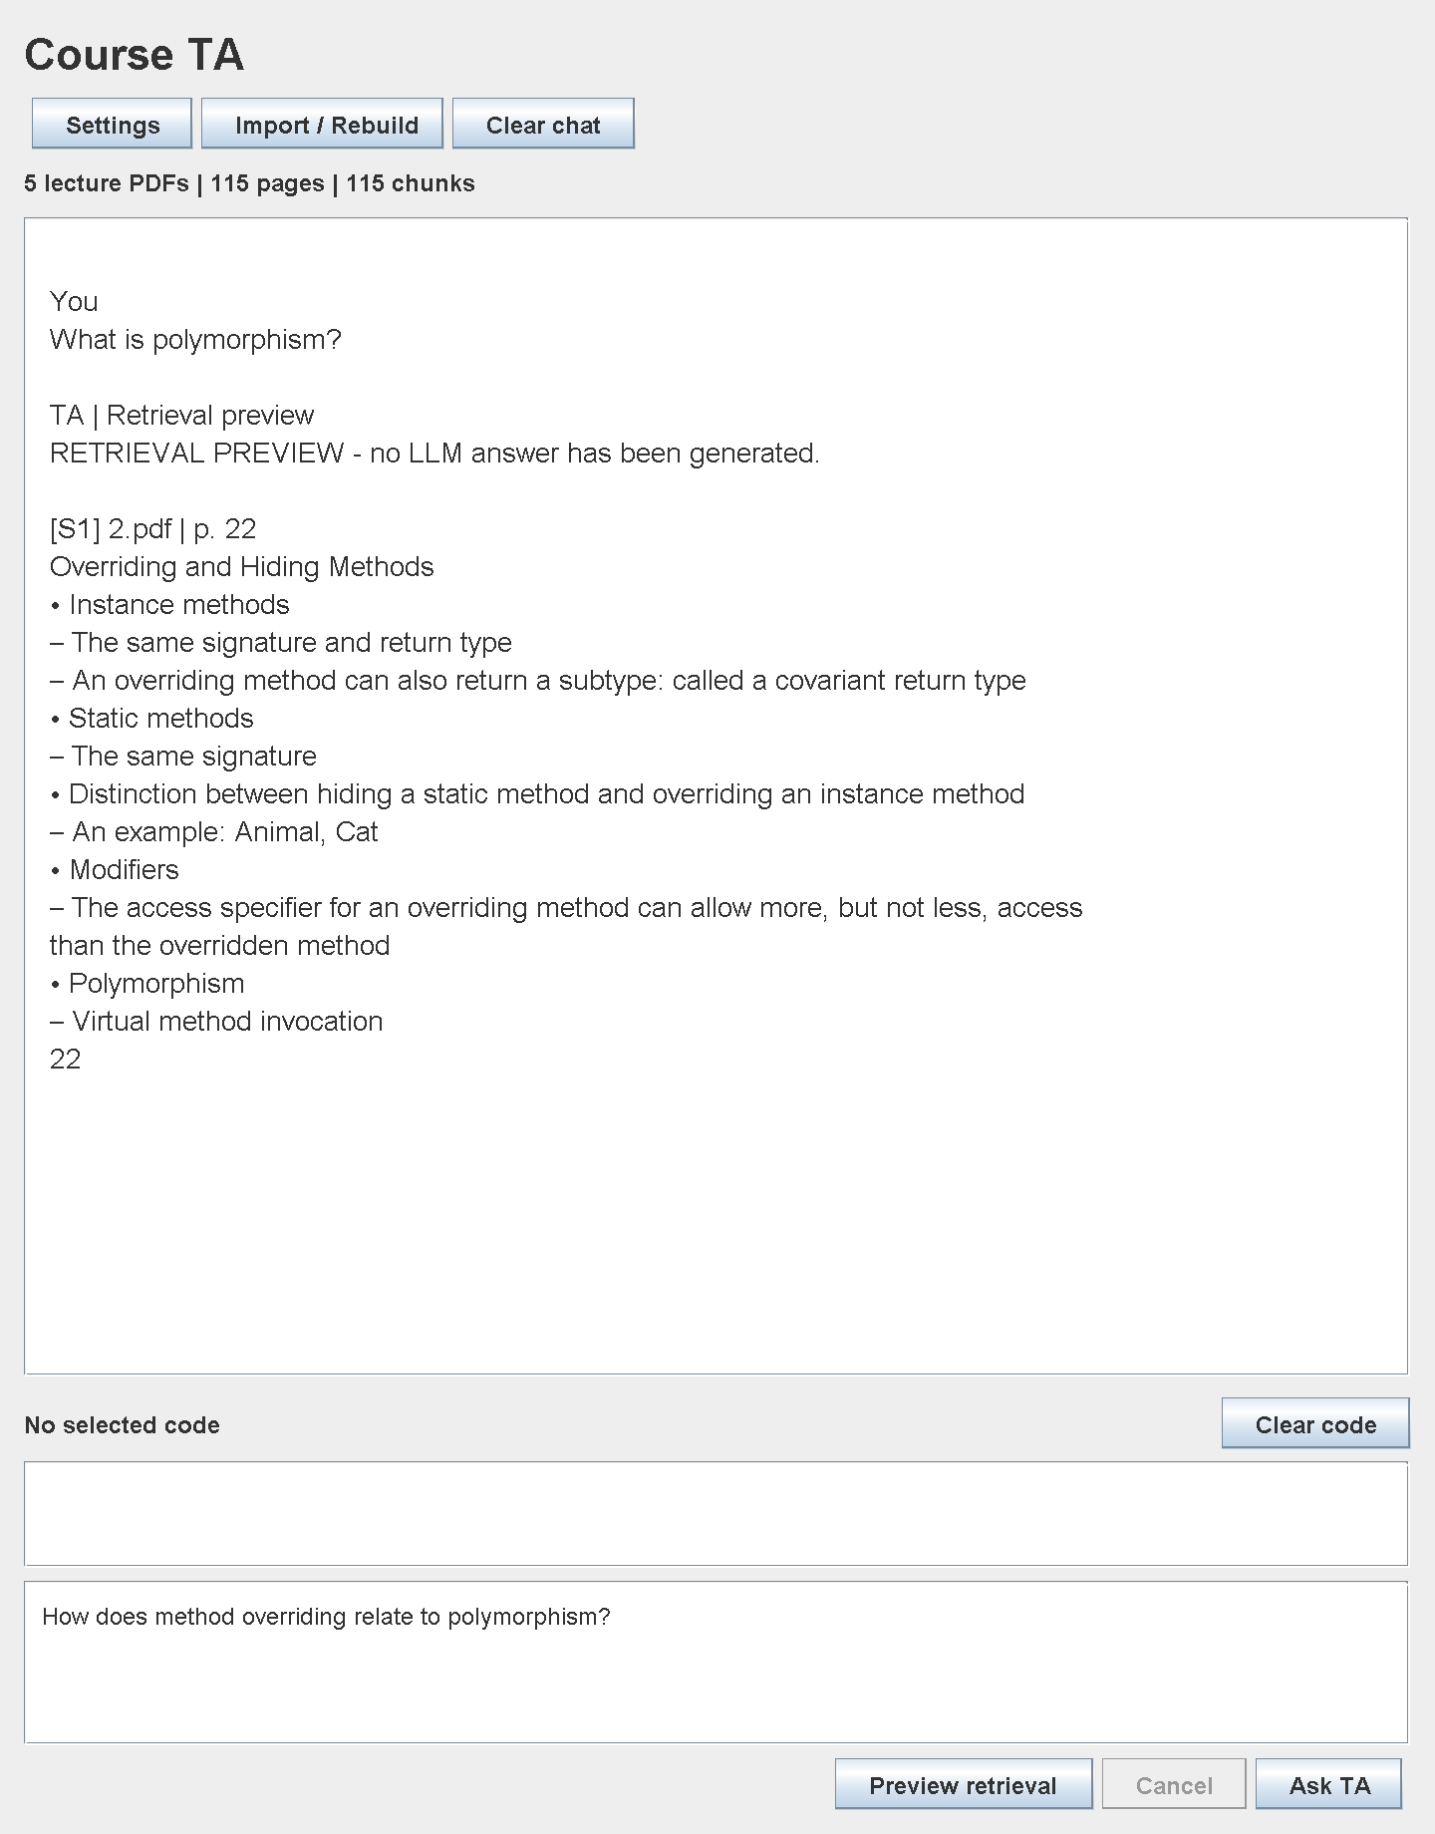
Course material retrieval
Import the five lecture PDFs.
Preview a question before configuring a model.
Inspect the source document and physical page number.
Example
Polymorphism → 2.pdf, page 22
Offscreen UI sample; no LLM call
3
Notes:
Implementation: src/main/java and core/src/main/java. Assignment A, CST3492, AY 2026-2027, pp. 1-3. F0 release only. UI: production Swing component rendered offscreen; retrieval preview, not a live LLM response.

Slide 4
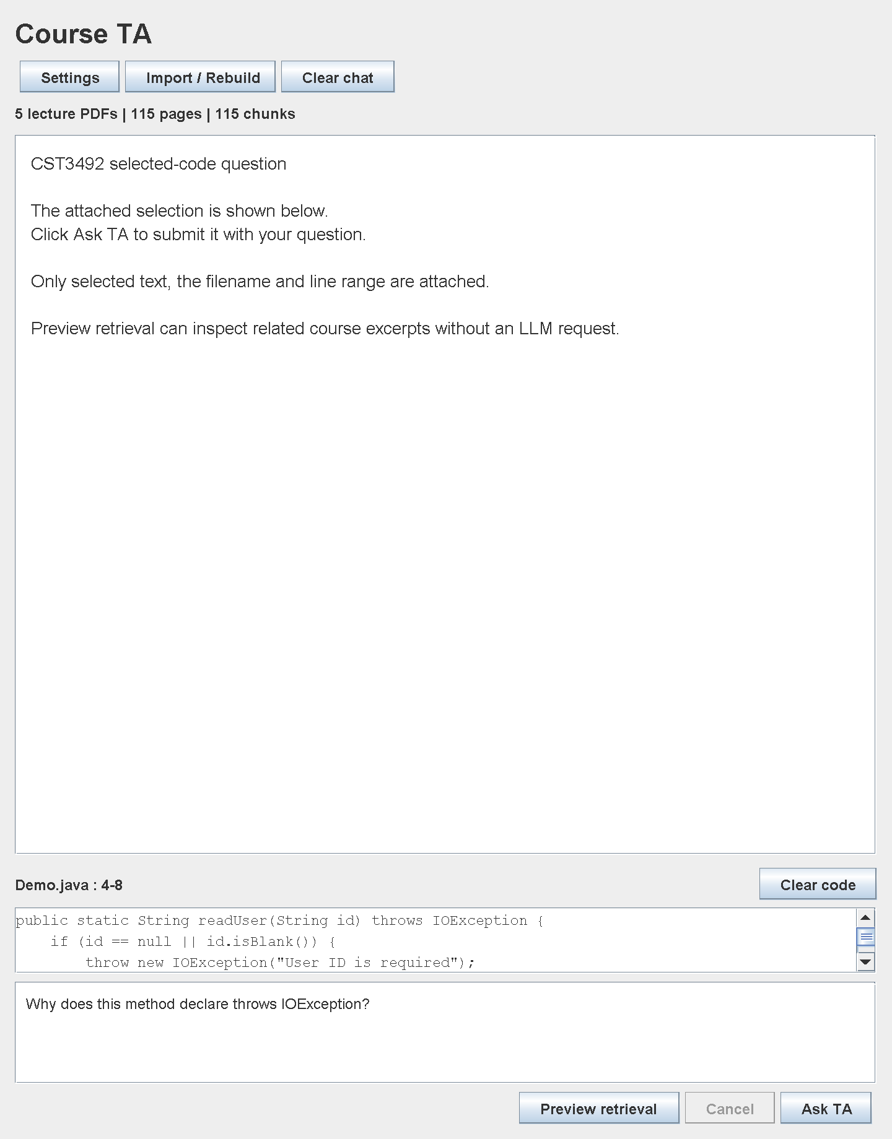
Selected code context
1 Select code in the editor.
2 Right-click Ask Course TA About Selected Code.
3 Enter a question and review the attachment.
4 Click Ask TA.
The rest of the project is not sent.
Offscreen UI component sample
4
Notes:
Implementation: src/main/java and core/src/main/java. Assignment A, CST3492, AY 2026-2027, pp. 1-3. F0 release only. UI: production Swing component rendered offscreen with Demo.java.

Slide 5
F0 architecture
IDE layer
Tool window, editor action, settings and background task control.
Local RAG layer
PDFBox extraction → page-preserving chunks → BM25 index → source IDs.
LLM layer
Question + selected code + retrieved excerpts → HTTP request → citation checks.
5
Notes:
Implementation: src/main/java and core/src/main/java. Assignment A, CST3492, AY 2026-2027, pp. 1-3. F0 release only. JetBrains tool windows: https://plugins.jetbrains.com/docs/intellij/tool-windows.html

Slide 6
Chunking and retrieval
1,400 characters per chunk
200-character target overlap
No chunk crosses a PDF page
BM25 ranks local passages using an inverted index.
The relevance gate requires score ≥ 1.0 and ≥ 20% query-term coverage.
At most four excerpts are included in each model request.
6
Notes:
Implementation: src/main/java and core/src/main/java. Assignment A, CST3492, AY 2026-2027, pp. 1-3. F0 release only. PDFBox: https://pdfbox.apache.org/3.0/migration.html

Slide 7
Citation and fallback behavior
Relevant course evidence
The prompt assigns [S1], [S2] and other IDs. The answer must cite valid IDs.
No supporting course evidence
The answer explicitly states that it is based on general knowledge.
Missing or invalid references
The application withholds the answer and asks for a retry. Semantic accuracy still requires review.
7
Notes:
Implementation: src/main/java and core/src/main/java. Assignment A, CST3492, AY 2026-2027, pp. 1-3. F0 release only. DeepSeek request schema: https://api-docs.deepseek.com/api/create-chat-completion/

Slide 8
F1 smart actions
Scenario-based JUnit tests
Selected code + a natural-language scenario produce a JUnit 5 test-class draft.
Git commit messages
The complete staged diff produces a Conventional Commit message draft.
Creative action: code comments
Selected Java lines receive Chinese or English comments for review and application.
8
Notes:
Sources: Assignment A, F1 (page 2); output/documents/F1_Implementation_Guide.md; current release 0.3.0 source. The creative action is automatic comments for selected Java code. F1 uses a fixed Java-controlled request flow rather than model-directed tool calls. Suggested time: 1 minute.

Slide 9
JUnit generation in IntelliJ
1 Select a class or method in a Java editor.
2 Right-click Generate JUnit Tests with Course TA.
3 Describe the test scenario, then click Generate.
4 Review the draft in F1 Actions. Copy result or Save test as...
Run the saved tests in the target project
Use JUnit Jupiter 5 and the correct package / class name.
Check the assertions and dependencies before running.
9
Notes:
Sources: Assignment A, F1 (page 2); output/documents/F1_Implementation_Guide.md; current release 0.3.0 source. Sources: GenerateJUnitAction.java, SmartActionPanel.java and SmartActions.java. The complete current Java file includes unsaved edits. Save test as uses a new-file-only write. Add JUnit Jupiter 5 in the target project. Generated tests are not compiled or executed by the plugin. Suggested time: 1 minute 30 seconds.

Slide 10
JUnit context and scenario
Example scenario: Demo.readUser
Reject null, empty and whitespace-only IDs.
For ID "42", return "User: 42".
Context sent to the model
Illustrative assertion excerpt
Scenario and selected code
Filename and line range
Complete current Java file
assertThrows(IOException.class,
() -> Demo.readUser(" "));
assertEquals("User: 42",
Demo.readUser("42"));
Basic output checks verify class / JUnit structure; review still determines correctness.
10
Notes:
Sources: Assignment A, F1 (page 2); output/documents/F1_Implementation_Guide.md; current release 0.3.0 source. Sources: samples/Demo.java; SmartActions.java. The assertion excerpt is illustrative, hand-authored for explanation, not captured live model output. The actual action requests one complete test class. The generator checks basic class and Jupiter structure, not compilation or scenario coverage. Suggested time: 1 minute 30 seconds.

Slide 11
Git commit messages
1 Stage the intended files or hunks
Modified files must be staged before the plugin can read them.
2 Choose the repository and preview
Preview staged diff shows all staged changes. Unstaged edits are excluded.
3 Generate, review and copy the message
Generate commit message reads a fresh snapshot for the model request.
Illustrative message: feat: add selected-code comment generation
“No staged changes” means the staging area is empty. Stage changes, then retry.
11
Notes:
Sources: Assignment A, F1 (page 2); output/documents/F1_Implementation_Guide.md; current release 0.3.0 source. Sources: GitStagedChanges.java, SmartActions.java and SmartActionPanel.java. Collection uses git diff --cached with binary/full-index/no-renames and read-only options, resolves the repository root, includes all staged files and supports initial commits. No Git staging, commit or push is executed. The message below is illustrative. Suggested time: 2 minutes including a staged/unstaged demonstration.

Slide 12
Creative action: code comments
1 Select Java code and right-click
Generate Comments with Course TA.
2 Choose Chinese or English, then Generate.
3 Review the read-only preview in F1 Actions.
4 Copy result or Apply comments to the source editor.
The applied edit uses an undoable IDE command.
If the source changes after generation, regenerate the draft before applying.
12
Notes:
Sources: Assignment A, F1 (page 2); output/documents/F1_Implementation_Guide.md; current release 0.3.0 source. Sources: GenerateCommentsAction.java and SmartActionPanel.java. Select full methods or meaningful segments. The action expands the selection to complete physical lines. Chinese is the default; English is also available. Application uses WriteCommandAction with the name Apply Course TA Comments. The command is designed to support Undo; live IDE undo has not been verified for this release. Suggested time: 1 minute 30 seconds.

Slide 13
Comment insertion design
The model proposes structured insertions
JSON contains the relative line number, comment kind and comment text.
Java validates the insertion plan
Only code-state line starts are accepted. Strings and existing comment blocks are protected.
The original code supplies the final draft
The plugin inserts comment blocks into the captured source; every original character is retained.
13
Notes:
Sources: Assignment A, F1 (page 2); output/documents/F1_Implementation_Guide.md; current release 0.3.0 source. Source: core/src/main/java/edu/groupb/courseta/core/CommentGenerator.java. The JSON schema has comments with line, kind and text. Line is 1-based relative to the selection. Kinds are javadoc and block. At most 40 unique positions, 1500 characters per comment. The complete source lexer tracks strings, characters, comments and text blocks. Comment terminators, Java Unicode escape sequences and invalid controls are rejected. Full-source equality is checked before applying the draft. Generated explanation accuracy still requires review. Suggested time: 1 minute 30 seconds.

Slide 14
Code comments: before and after
Selected Java code
Preview after insertion
public int twice(int n) {
return n * 2;
}
/**
* Returns twice the input.
* @param n input value
* @return twice n
*/
public int twice(int n) {
return n * 2;
}
Original method body preserved
Illustrative example. Review the explanation before applying it.
14
Notes:
Sources: Assignment A, F1 (page 2); output/documents/F1_Implementation_Guide.md; current release 0.3.0 source. Illustrative hand-authored example, not a real model response. It shows the insertion approach: the original method stays identical and a Javadoc block is added above it. The executable regression test compiles original and annotated fixtures and compares behavior for positive and negative inputs. That controlled test does not prove all generated prose is correct. Suggested time: 1 minute.

Slide 15
F1 architecture
IDE entry points
GenerateJUnitAction / GenerateCommitAction / GenerateCommentsAction
Shared interaction
SmartActionPanel: input, preview, background work, export and apply
Core implementation
SmartActions: tests / commit prompts GitStagedChanges: staged snapshot
CommentGenerator: insertion plan and source-preserving draft
LlmClient and PasswordSafe settings are shared with F0.
Fixed Java-controlled flow. Oversize requests are rejected without partial context.
15
Notes:
Sources: Assignment A, F1 (page 2); output/documents/F1_Implementation_Guide.md; current release 0.3.0 source. Sources: src/main/java/edu/groupb/courseta/ide/GenerateJUnitAction.java, GenerateCommitAction.java, GenerateCommentsAction.java, SmartActionPanel.java, TaProjectService.java; core/src/main/java/edu/groupb/courseta/core/SmartActions.java, CommentGenerator.java, GitStagedChanges.java and LlmClient.java. F1 does not use BM25 retrieval or model-directed tool calling. Shared configuration is under Course Q&A > Settings. Git/HTTP/export run in background tasks; stale/cancelled responses do not update the panel. Context limits: scenario 6000 chars, selected code 12000, full file 60000, staged diff 120000. Over-limit context is rejected without truncation. Suggested time: 1 minute 30 seconds.

Slide 16
Validation results
5 lecture PDFs | 115 pages | 115 chunks
53 automated tests passed
21 F0 | 10 test / commit | 7 Git | 15 comments
Plugin ZIP built against IntelliJ IDEA 2026.1.1.
Local HTTP stubs and controlled Java fixtures were tested.
Live provider calls and interactive IDE / Undo checks remain pending.
16
Notes:
Evidence: output/evidence/core-tests.xml, f1-actions-tests.xml, f1-git-tests.xml, f1-comments-tests.xml and course-audit.json. Counts are 21 + 10 + 7 + 15 = 53, with zero failures/errors/skips. Git tests use real temporary repositories. Comment tests include original/annotated Java compilation and behavior matching. HTTP tests use a local stub. No real provider credential was supplied. Interactive clicks and IDE Undo have not been verified for 0.3.0. Suggested time: 1 minute.

Slide 17
Team demonstration
F0 demonstration
F1 demonstration
Course question and page citation
Selected-code question
General-knowledge fallback
Architecture and design limits
Scenario-based JUnit draft
Staged-diff commit message
Comments: preview and apply
Actual team roles and collaboration evidence: __________________________
17
Notes:
Sources: Assignment A, F1 (page 2); output/documents/F1_Implementation_Guide.md; current release 0.3.0 source. Use the live plugin only after configuring a provider and rehearsing. For F0, ask a course question, inspect the physical page citation, attach selected code and show the general-knowledge fallback. For F1, use samples/Demo.java, stage an intended Git edit and preview its exact snapshot, then generate comments, review, apply and test Undo. Suggested schedule: 5 minutes for slides 1-7; 11.5 minutes for slides 8-15 including short demonstrations; 1 minute for slide 16; 2.5 minutes for this final demonstration / questions, total 20 minutes. Replace the roles placeholder with actual collaboration evidence; do not invent team contributions.

