Slide 1
Course TA F0
CST3492 Java Enterprise Application Development
Assignment A | Group B | Release 0.1.0
Full names and matriculation numbers
Name ____________________ ID ____________________
Name ____________________ ID ____________________
Name ____________________ ID ____________________
Name ____________________ ID ____________________
1
Notes:
Implementation: src/main/java and core/src/main/java. Assignment A, CST3492, AY 2026-2027, pp. 1-3. F0 release only.

Slide 2
F0 functionality
Course questions with evidence
Local lecture retrieval supplies relevant passages to a configurable LLM.
Document and page references
Course answers cite source IDs that resolve to the original document and page.
Questions about selected Java code
An editor action attaches the selected text and line range to the tool window.
2
Notes:
Implementation: src/main/java and core/src/main/java. Assignment A, CST3492, AY 2026-2027, pp. 1-3. F0 release only.

Slide 3
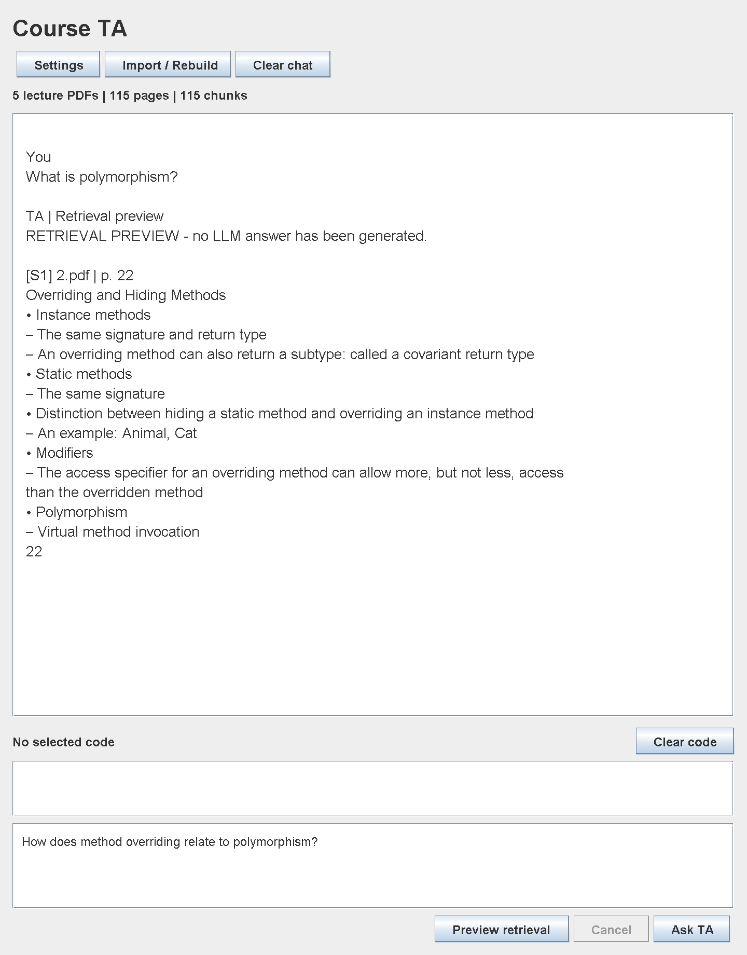
Course material retrieval
Import the five lecture PDFs.
Preview a question before configuring a model.
Inspect the source document and physical page number.
Example
Polymorphism → 2.pdf, page 22
Offscreen UI sample; no LLM call
3
Notes:
Implementation: src/main/java and core/src/main/java. Assignment A, CST3492, AY 2026-2027, pp. 1-3. F0 release only. UI: production Swing component rendered offscreen; retrieval preview, not a live LLM response.

Slide 4
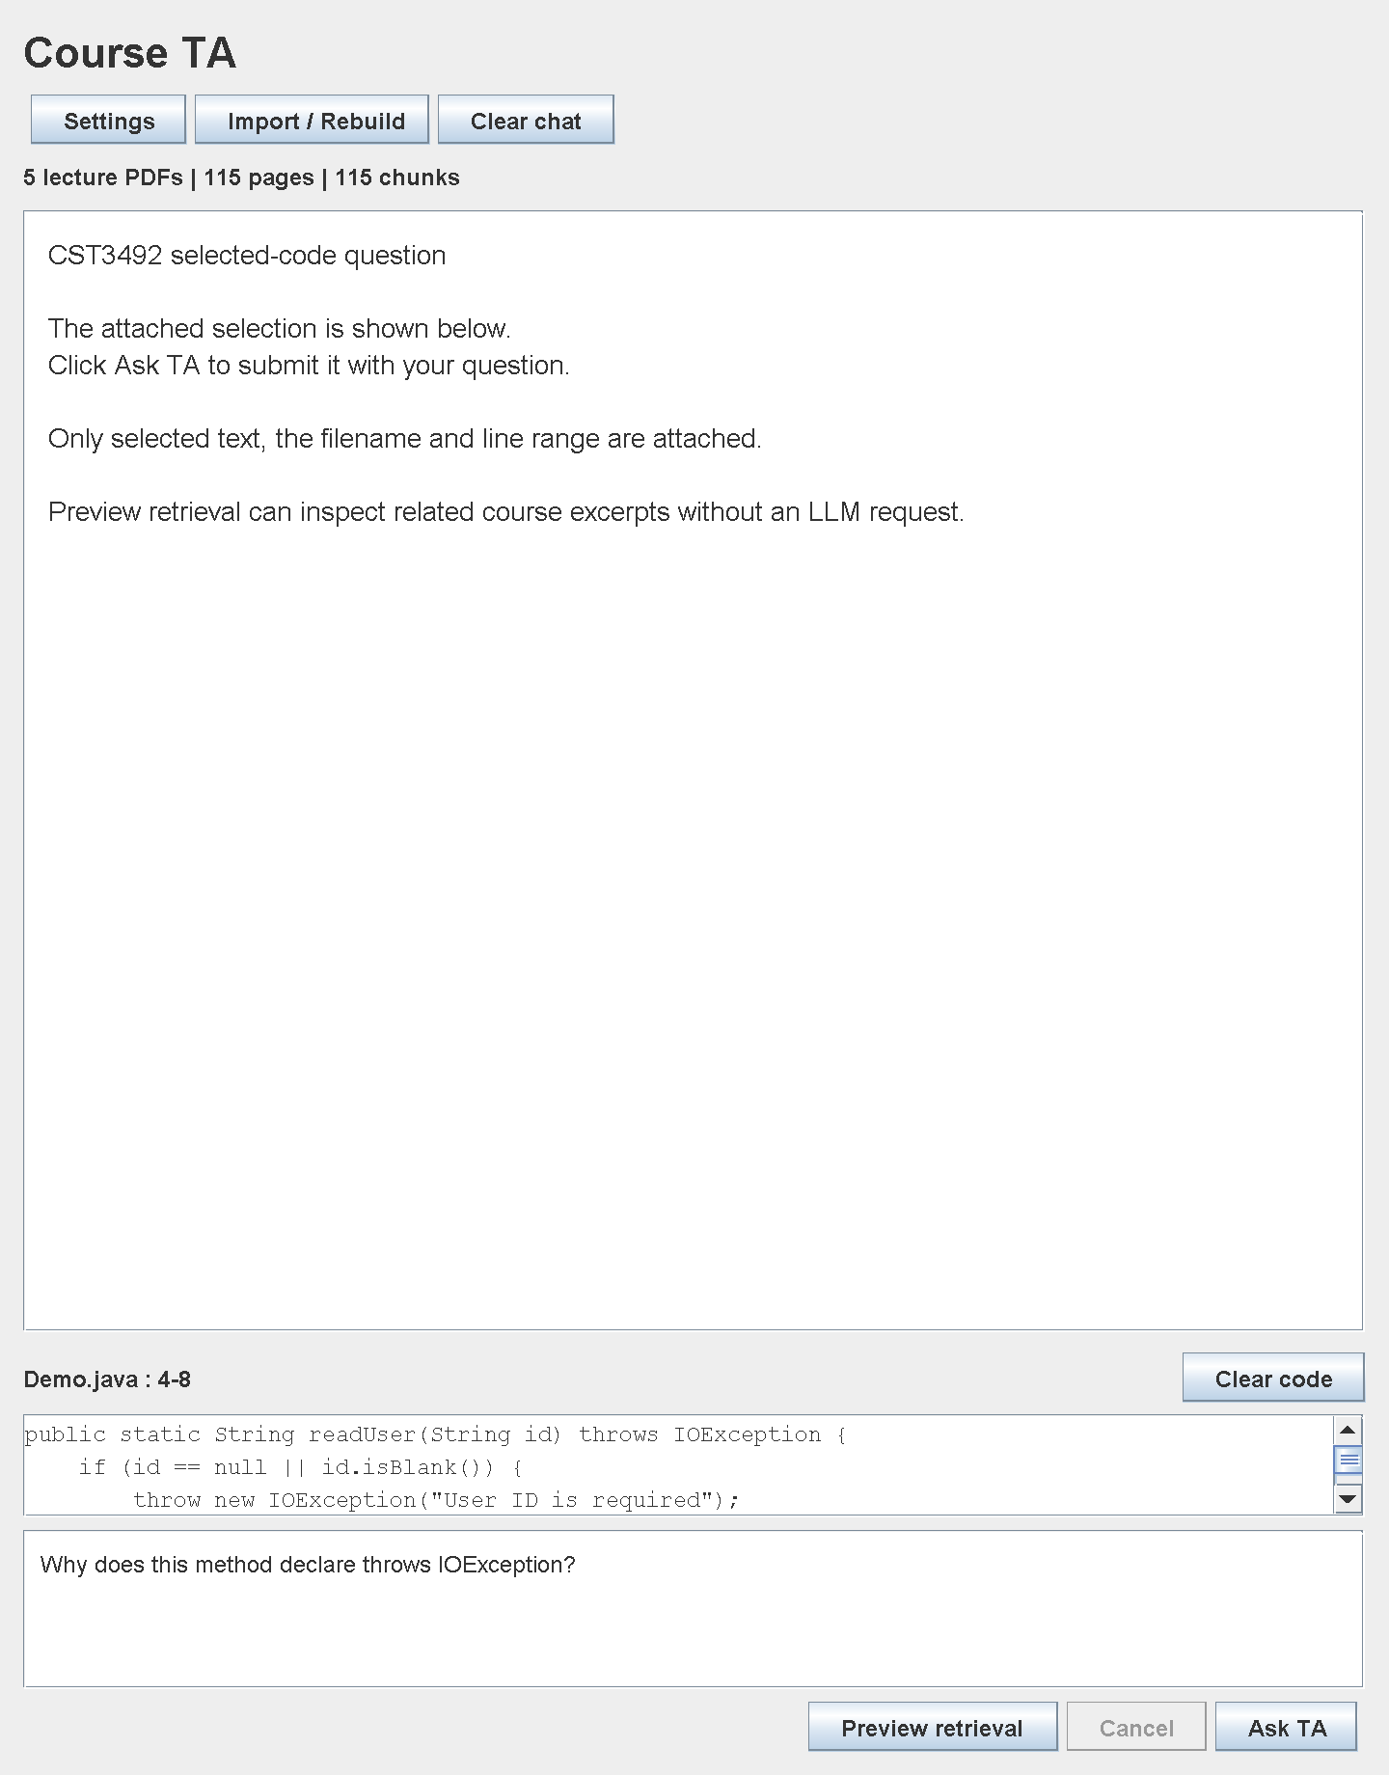
Selected code context
1 Select code in the editor.
2 Right-click Ask Course TA About Selected Code.
3 Enter a question and review the attachment.
4 Click Ask TA.
The rest of the project is not sent.
Offscreen UI component sample
4
Notes:
Implementation: src/main/java and core/src/main/java. Assignment A, CST3492, AY 2026-2027, pp. 1-3. F0 release only. UI: production Swing component rendered offscreen with Demo.java.

Slide 5
Architecture
IDE layer
Tool window, editor action, settings and background task control.
Local RAG layer
PDFBox extraction → page-preserving chunks → BM25 index → source IDs.
LLM layer
Question + selected code + retrieved excerpts → HTTP request → citation checks.
5
Notes:
Implementation: src/main/java and core/src/main/java. Assignment A, CST3492, AY 2026-2027, pp. 1-3. F0 release only. JetBrains tool windows: https://plugins.jetbrains.com/docs/intellij/tool-windows.html

Slide 6
Chunking and retrieval
1,400 characters per chunk
200-character target overlap
No chunk crosses a PDF page
BM25 ranks local passages using an inverted index.
The relevance gate requires score ≥ 1.0 and ≥ 20% query-term coverage.
At most four excerpts are included in each model request.
6
Notes:
Implementation: src/main/java and core/src/main/java. Assignment A, CST3492, AY 2026-2027, pp. 1-3. F0 release only. PDFBox: https://pdfbox.apache.org/3.0/migration.html

Slide 7
Citation and fallback behavior
Relevant course evidence
The prompt assigns [S1], [S2] and other IDs. The answer must cite valid IDs.
No supporting course evidence
The answer explicitly states that it is based on general knowledge.
Missing or invalid references
The application withholds the answer and asks for a retry. Semantic accuracy still requires review.
7
Notes:
Implementation: src/main/java and core/src/main/java. Assignment A, CST3492, AY 2026-2027, pp. 1-3. F0 release only. DeepSeek request schema: https://api-docs.deepseek.com/api/create-chat-completion/

Slide 8
Validation results
5 lecture PDFs | 115 pages | 115 chunks
18 automated tests passed
PDF provenance, retrieval, persistence, prompt limits, citation gates and HTTP handling are covered.
Plugin ZIP built against IntelliJ IDEA 2026.1.1.
Live provider and interactive IDE demonstration remain to be checked by the team.
8
Notes:
Evidence: core/build/test-results/test/TEST-edu.groupb.courseta.core.CoreTest.xml and build/audit/course-audit.json. Tests use a local HTTP stub; no real provider credential was supplied.

Slide 9
Team demonstration and F1 milestone
F0 demonstration
Group B next milestone
Course question and page citation
Selected-code question
General-knowledge fallback
Architecture and design limits
Scenario-based JUnit tests
Staged-diff commit messages
One creative smart action
Actual team roles and collaboration evidence: __________________________
9
Notes:
Implementation: src/main/java and core/src/main/java. Assignment A, CST3492, AY 2026-2027, pp. 1-3. F0 release only.

