Slide 1
TCP RST Diagnostic Payload draft-boucadair-tcpm-rst-diagnostic-payload/
IETF#122, TCPM WG, Bangkok
M. Boucadair , T. Reddy, & J. Xing

Slide 2
The Problem
TCP connections can be reset by a peer for various reasons
TCP connections may also be reset by on-path devices (NATs, Firewalls, etc.)
However, the receiver has no hint about the reasons why the connection was reset
Troubleshooting and diagnostic may be complicated
It is not always possible to have a contact for (real) problems such as receiving unusual number of RSTs from peers in a given network

Slide 3
Design Rationale
Leverage an existing provision in the base TCP specifications (now consolidated in RFC 9293)
Ease deployability by avoiding any negotiation during 3WHS
Compact encoding by signaling only a reason code on the wire for registered reasons
Accommodate proprietary reasons, when needed:
Include a brief human-readable description
Include a vendor-specific code and its PEN
Does not change any other parts of RST handling
It is harmless, RST with/without reason code can be sent (allowed by 9293)
| "TCP implementations SHOULD allow a received RST segment to
| include data (SHLD-2)."

Slide 4
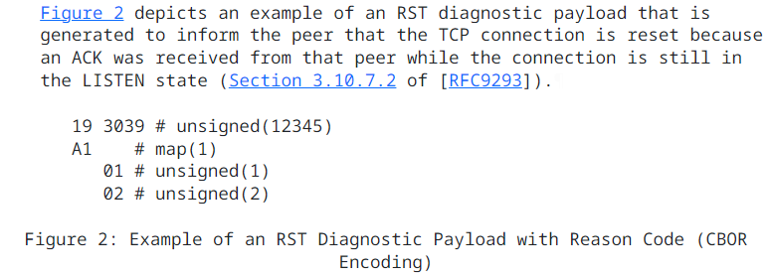
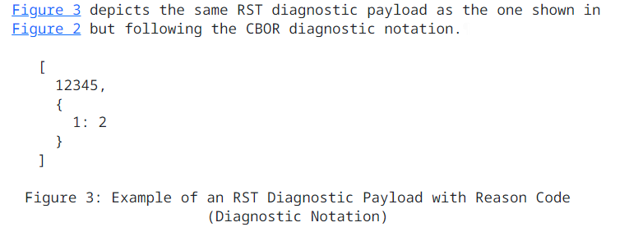
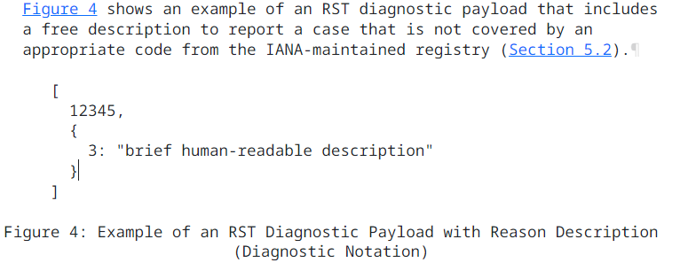
Examples

Slide 5
The Encoding is not Frozen, though
Other alternate encoding designs can be considered. For example:
TLV
Plain text
Etc.
Each has their own pros and cons, mainly:
Amplification impact
Need or not of a kernel library and availability of such library (if needed)
Impact of conversion on CPU
Integration with traffic visualisation tools

Slide 6
Next Steps
Request WG Adoption
Linux maintainers require an IETF document to consider including it
… Which is fair and reasonable
Jason commit to complete it in the Linux kernel

