Slide 1
AMICA:Alleviating Misinformation for Chinese Americans

Slide 2
Abstract
The increasing popularity of social media promotes proliferation of misinformation
Most of the existing efforts on misinformation mitigation focuses on other language makes Chinese vulnerable to online disinformation campaigns.
AMICA:information retrieval system for alleviating misinformation for Chinese
Dynamically collects data from popular social media platforms,the data are stored and indexed in Elasticsearch to provide advanced search functionalities.
Given a user query,the ranking of social media posts consider topical relevance and likelihood of being misinformation

Slide 3
Introduction
Chinese Americans rely heavily on information in native language.But Chinese media sphere in the US has been neglected and questionable content has gained popularity among Chinese-speaking immigrants.The distribution and consumption of misinformation are further complicated by difference in values,interests,etc.
AMICA:Repository and monitor that stores and ranks Chinese language posts from social media and websites,easier to search misinformation&disinformation.
AMICA can add newsrooms,journalists and anti-disinformation initiatives to capture disinformation topics and propagation patterns for further reports.
The system can be used as training data for disinformation researches.

Slide 4
Related Works
18 Chinese-based propaganda techniques,some techniques can be effective for general misinformation propagation
Wechat provides key clues to how misinformation constructed and distributed among Chinese-American community.
Many studies reveals unique propagation patterns of misinformation in online social media but few for Chinese context.
Limited datasets contains fine-grained information to show dynamic evolution
Ongoing efforts from practitioners.(Google Fact Check Explorer,Piyaoba)

Slide 5
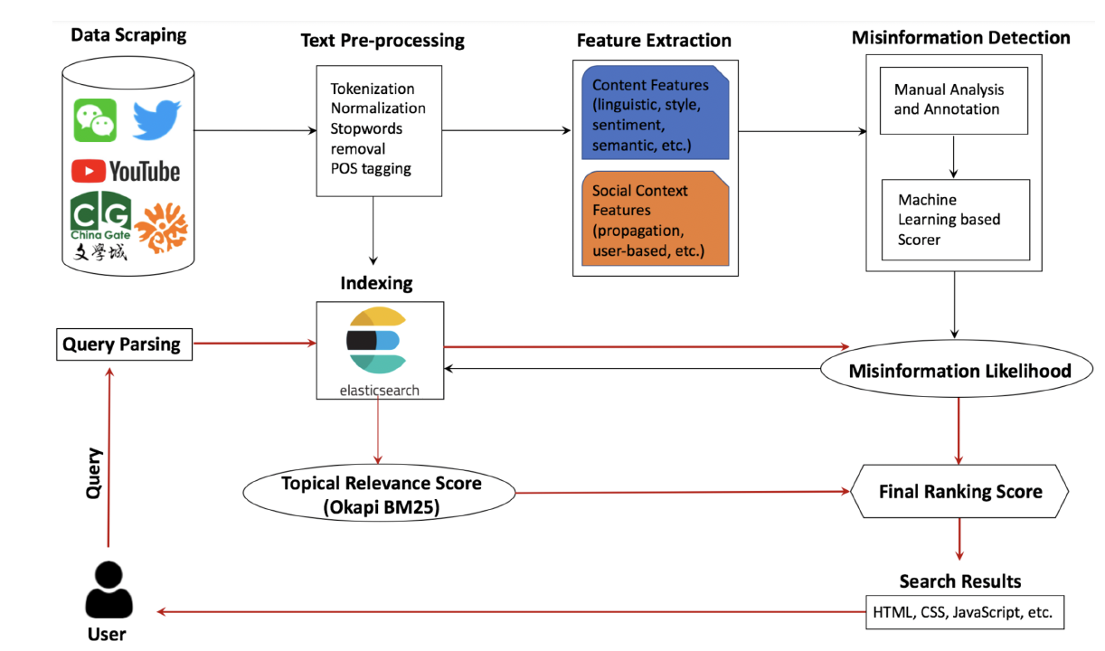
System Design
Overview:
web-based search engine allows user to search for information by entering keywords and phrases.
Returns a list of relevant results ranked by relevance,sentiment,propagation data.
Backend:crawlers to collect data,Elasticsearch to storage,2 ranking scores(topical relevance and machine learning based misinformation likelihood)

Slide 6
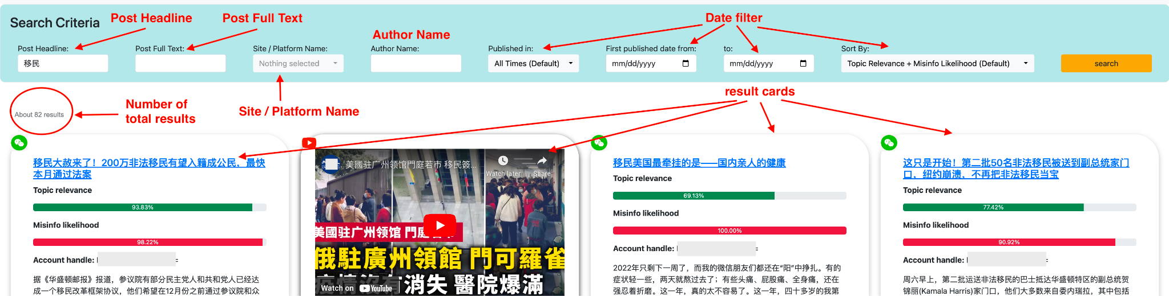
User Interface
Frontend is a web search page built with Flask.User interface is built with HTML,CSS,JavaScript.
Secure login system allows authorized users to access the search engine and conduct search.
Enter queries get results which include essential information about the post along with a preview on the page.

Slide 7
Data Scraping
Collect articles,posts and transcripts and obtain propagation data to analyze
Using 4 crawler instances and stores data in Elasticsearch.
Twitter:official API
Youtube:Google developer accounts and Youtube API V3
Wechat:closed system,Used an open source program “Wechat Spider”
Bulletin-based Chinese Forums:WenXue City,Huaren.us using web crawler
Dynamic Crawling:balance accuracy and collection costs,use a dynamic crawling window with high frequency in the first 24 hours and low frequency from 24 to 72 hours

Slide 8
Text Preprocessing
Text normalization,tokenization,part-of-speech(POS) tagging to assign labels.
Remove stopwords to improve the efficiency and reduce noise.
Analyzers used in the process:
Smart Chinese Analysis plugin(smartcn):used in Elasticsearch built-in ranking system to enhance the performance on Chinese texts.
Jieba:a Chinese text analysis package in Python,uses a dictionary-based approach to tokenize Chinese text into words and phrases.Also supports POS tagging and keyword extraction
After preprocessing,Elasticsearch indexes each post to a predefined mapping property which specifies the structure of data and how it will be stored and searched for fast and efficient retrieval when queried

Slide 9
Feature Extraction
Content Features:measures textual characteristics of the content:
1.min-max normalize length of the post
2.number of question marks
3.number of exclamation marks
4.strong attempts to gather attention by using language stokes fear,anxiety,worry or shock.
5.sentiment of a post
Social Context Features:measures social characteristics of the post:
1.where the post was originally published
2.how the post has spread or propagated
3.sharing evidence or references to supports claims by citing other sources

Slide 10
Misinformation Detection
Using logistic regression model by taking features as input and generating a score by the Sigmoid function indicating the probability of being misinformation.
Two domain experts manually labeled posts from the social media platforms and randomly sampled posts from the entire corpus and treated as non-misinfo.
Utilizing the known misinfo posts manually identified by Chinese fact-checking websites as part of the training data.
The misinfo likelihood is query independent.
Calculating the misinfo likelihood for all the posts in the corpus offline and store in the database after training.

Slide 11
Ranking
Combining topical relevance(query-dependent) with misinformation likelihood.
Using Elasticsearch built-in Okapi BM25 to measure the topical relevance,factoring in term frequency and document length.
To make all the scores comparable,using min-max normalization to normalize the scores within each respective social platform.
Ranking based on the descending order of the sum of BM25 and misinformation likelihood scores then render the page on the frontend

Slide 12
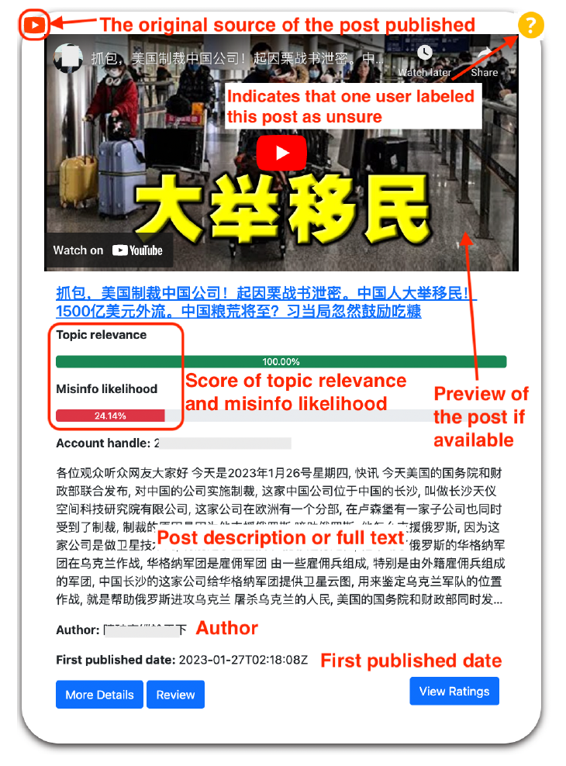
Demonstration
The search criteria bar located at the top of the page,user can refine results based on the publication date of posts.
Result cards contains basic information about a post as well as topical relevance score and misinfo likelihood,with a logo indicating platform.
“More Details” button:opens a pop-up window displaying a line chart for propagation data, showing how post has spread over time.
“Review” button:allows users submit a review form to determine misinfo or not.Helps improve the accuracy of misinfo likelihood score.

Slide 13
Conclusion
AMICA is a search engine designed to counter misinformation
Backend system:Web crawler,database,machine learning model to score data and provide users with relevant search results.
Frontend:Web search page built with Flask and features with a secure login system for authorized users.

Slide 14
Strengths and Weaknesses
Strengths:
1.Focus on Chinese-speaking diaspora
2.Collect data from various platforms
3.Combine topical relevance with misinformation likelihood
4.Dynamic Crawling
5.Human feedbacks

Slide 15
Weaknesses:
1.Relying on manually labeled data
2.Dependent on some official APIs
3.Limited focus on real-time propagation patterns
4.Some unconsidered variables

Slide 16
Improvement
1.Using advanced NLP techniques:Trying to use transformer-based models to see if enhancing the performance.
2.Collaborating with more fact-check organizations
3.Using the reviews given by the user to modify the ranking results
4.Enlarging the datasets,Crawling more data.

