Slide 1
Lab B: DFT
110061519 楊博舜

Slide 2
Outline
Briefly introduction to the algorithm or overall system
Explain the original code/system/pragmas and how you implement it
Analyze the timing/performance/utilization
Explain what you observed and learned
Explain what problem you encountered and how you solved it
Two questions to test the key learning

Slide 3
Briefly Introduction to the Algorithm or Overall System

Slide 4
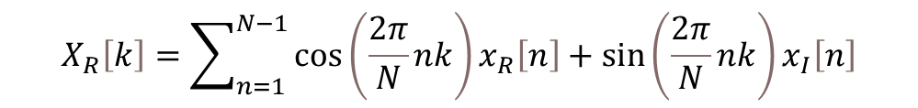
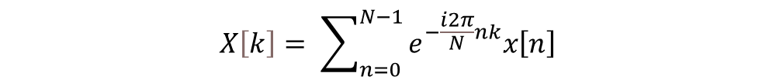
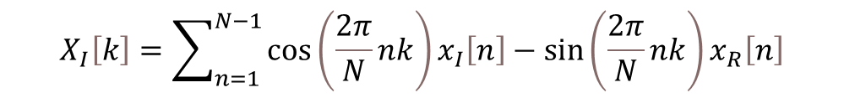
Briefly introduction to the algorithm or overall system
In this lab, we are required to do a discrete Fourier transform (DFT) kernel, and implemented it in PYNQ. The algorithm is shown in the formula below.
We perform the real part and imaginary part separately, so the formula can be rewritten in this way.
$$X\left[k\right]= \sum_{n=0}^{N−1}{e^{−\frac{i2π}{N}nk}x\left[n\right]}$$
$$X_{R}\left[k\right]=\sum_{n=1}^{N−1}{\cos\left(\frac{2π}{N}nk\right)x_{R}\left[n\right]+\sin\left(\frac{2π}{N}nk\right)x_{I}\left[n\right]}$$
$$X_{I}\left[k\right]=\sum_{n=1}^{N−1}{\cos\left(\frac{2π}{N}nk\right)x_{I}\left[n\right]−\sin\left(\frac{2π}{N}nk\right)x_{R}\left[n\right]}$$

Slide 5
Explain the Original Code/System/Pragmas and How You Implement It

Slide 6
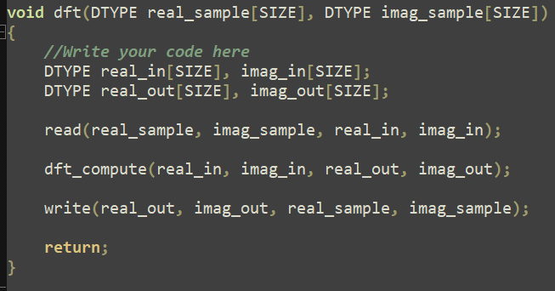
Explain the Original Code/System/Pragmas and How You Implement It
Here, I will show the baseline code. In the next section, I will implement optimization step by step following the questions of the guide.
This is the top function, and 3 functions are called here.

Slide 7
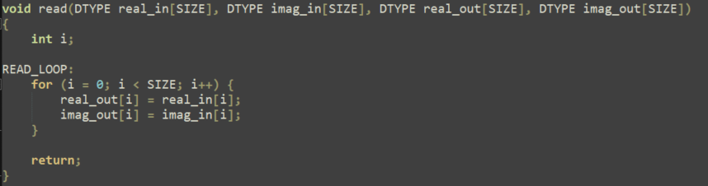
Explain the Original Code/System/Pragmas and How You Implement It
The function in the above figure is used to read the input.

Slide 8
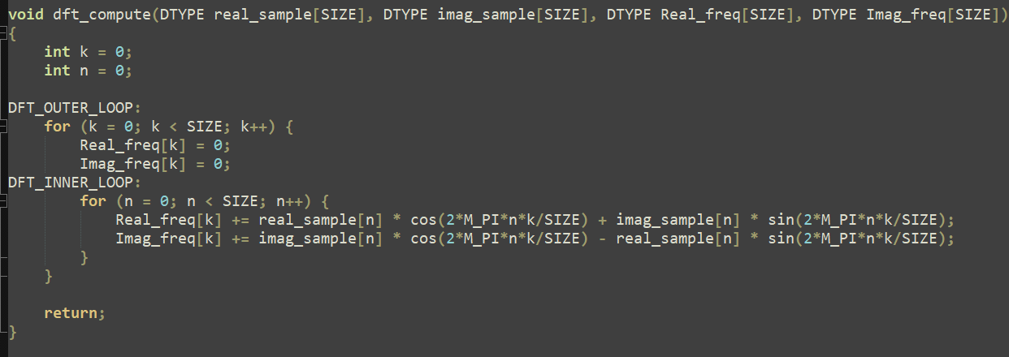
Explain the Original Code/System/Pragmas and How You Implement It
The function in the above figure is used to compute DFT.

Slide 9
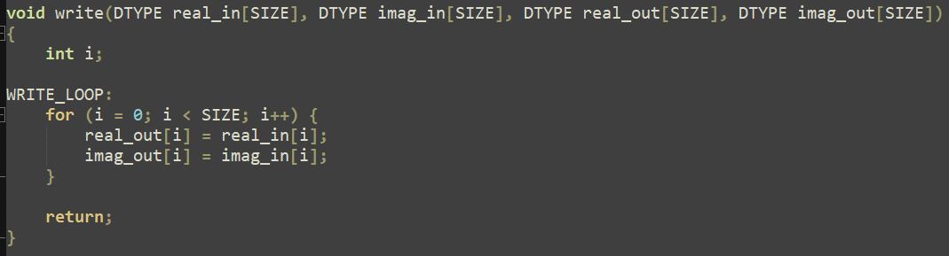
Explain the Original Code/System/Pragmas and How You Implement It
The function in the figure above is used to output the result.

Slide 10
Analyze the Timing/Performance/Utilization

Slide 11
1. lookup table
The inner loop is modified in this way so that we don’t need to calculate cos and sin functions.

Slide 12
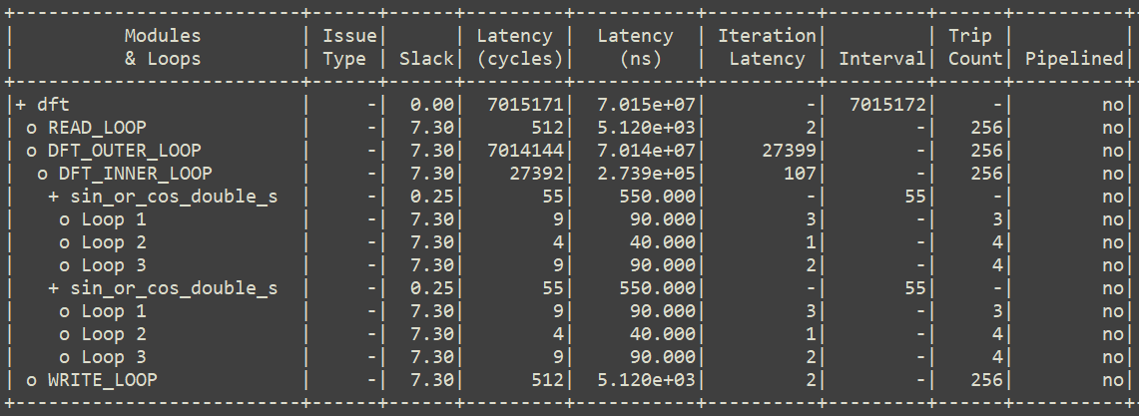
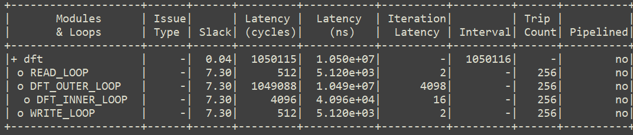
How does this change the throughput and resource utilization?
Throughput
Baseline
Lookup table
$$1÷\left(7015172×10ns\right)=14.25$$
$$1÷\left(1050116×10ns\right)=95.22$$

Slide 13
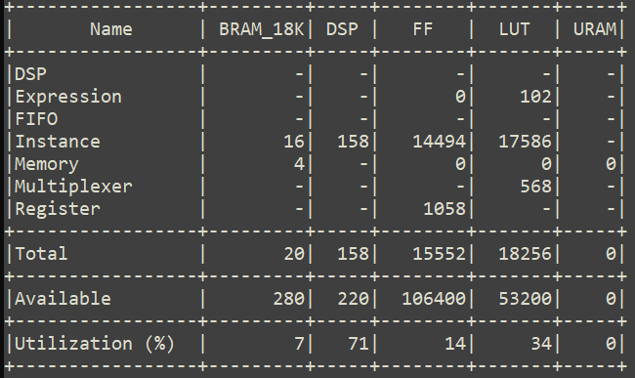
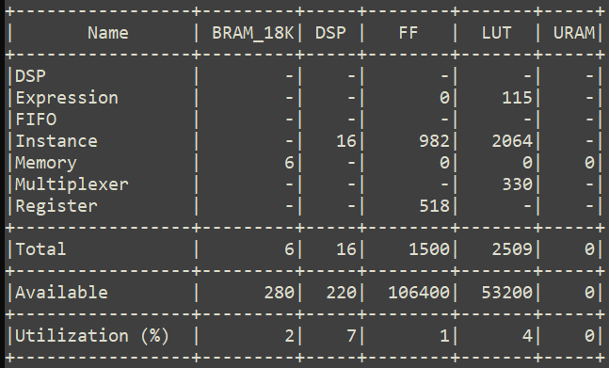
How does this change the throughput and resource utilization?
Baseline
Lookup table
From the above result, we can see that the throughput is greatly increased. Besides, the resource utilization also decreases a lot. Therefore, lookup table is very helpful for DFT.

Slide 14
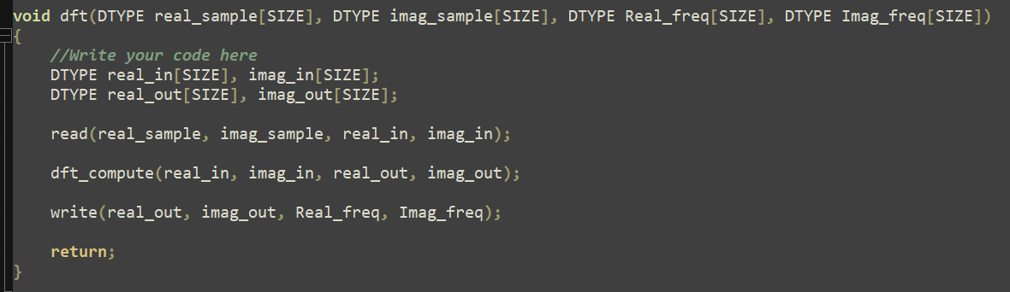
2. I/O Array
Original
New

Slide 15

How does it change the performance?
The throughput is 1÷(1050116×10ns)=95.22. Compared to the throughput of the last question, 95.22, it doesn’t change. It is reasonable since the difference between them is where to output the new array.

Slide 16
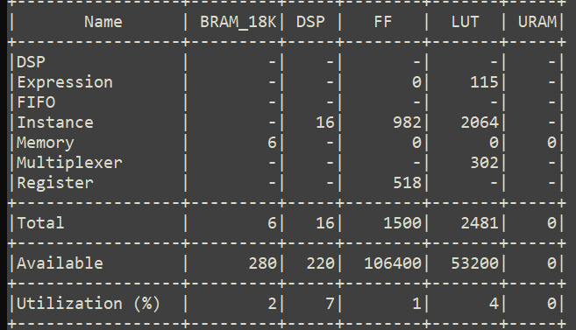
How does the resource usage change?
Lookup table
I/O Array
From the above tables, we can see that the LUT of multiplexer becomes smaller. Take a look at their tables.

Slide 17
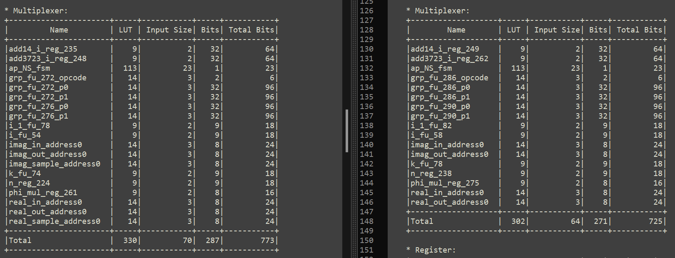
How does the resource usage change?
Lookup table
I/O Array
We can see that real_sample_address0 and imag_sample_address0 are gone. I think that it is because we write output to another array in this case, we don’t need to access the address based on the read/write state.

Slide 18
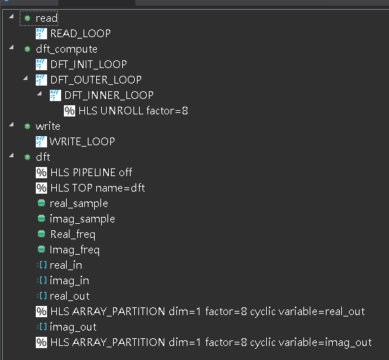
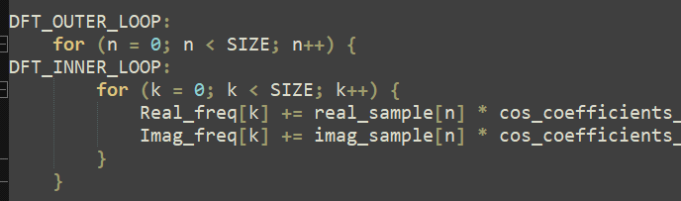
3. Loop optimization
To apply loop unroll and array partition, I exchange the outer loop and inner loop so that the inner loop can write to different element if unrolled.

Slide 19
Plot the performance in terms of number of DFT operations per second (throughput) versus the unroll and array partitioning factor.

Slide 20
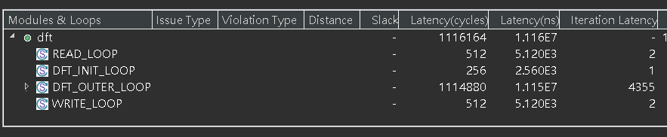
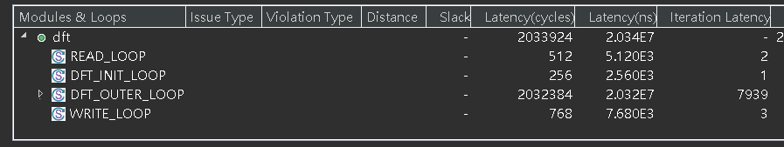
There are two things I want to discuss about array partitioning.
The first thing is that the iteration latency of WRITE_LOOP. We can see that after array partitioning is set, the iteration increases from 2 to 3.

Slide 21
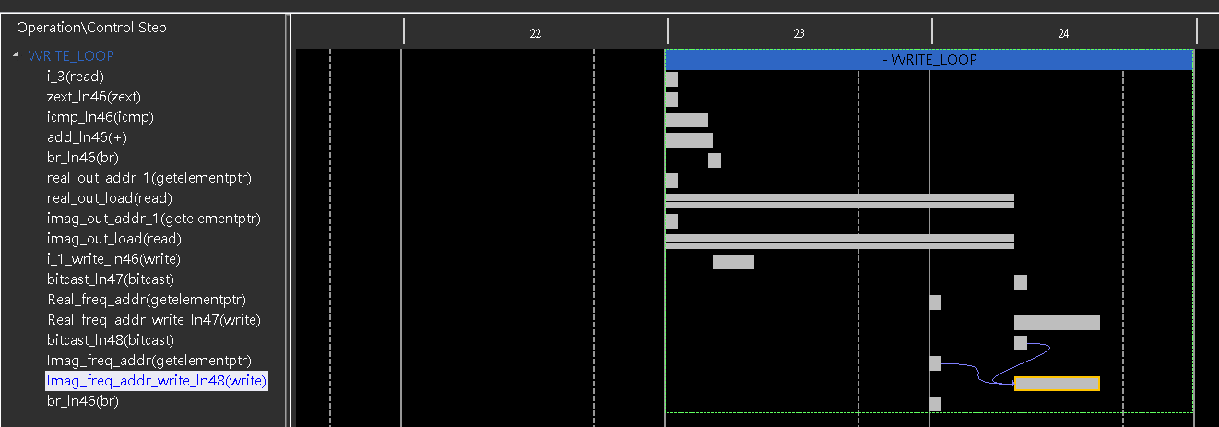
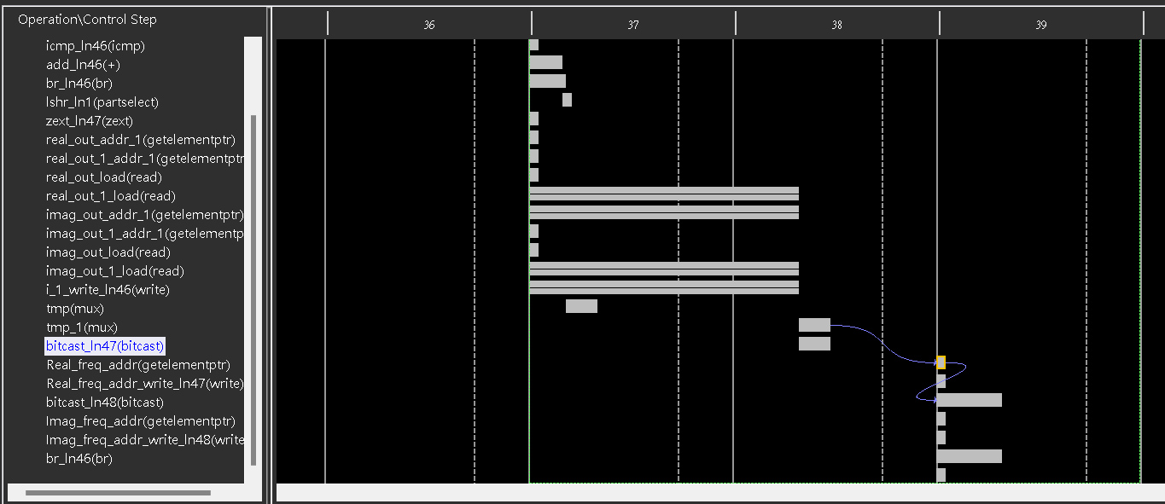

Slide 22

The second thing is that the latency of factor 2 is twice larger than that of factor 4.

Slide 23
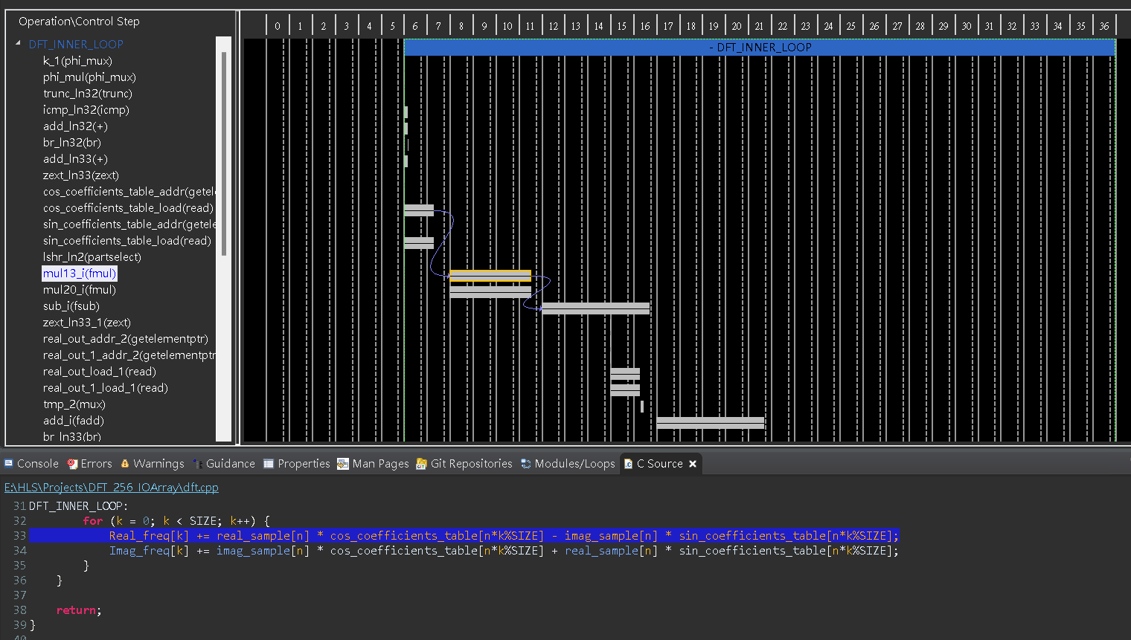
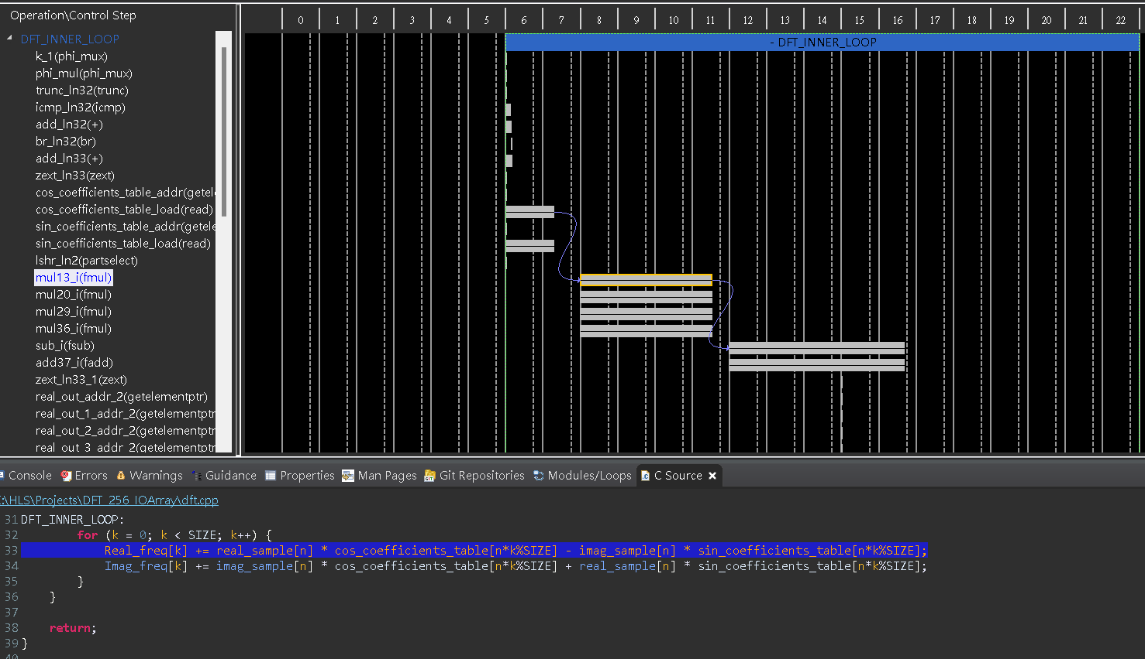

Slide 24
Now, I want to discuss the performance of “loop unrolling” and “both”.
We can see that the “loop unrolling” result of factor 2 is a bit better than the result of “both”. However, it is not the case in factor 4 and 8.

Slide 25
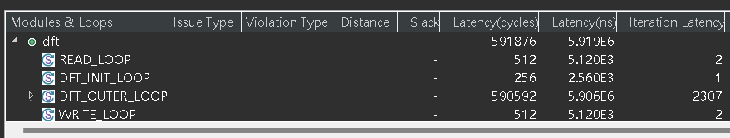

Let’s take a look at the performance tables of factor 2
From this table, we can see that the only difference is the WRITE_LOOP. The latency of DFT_OUTER_LOOP is the same. I guess it is because the memory is 2-port, the data can be written at the same time.

Slide 26
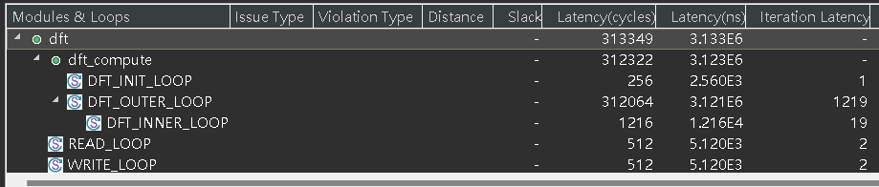
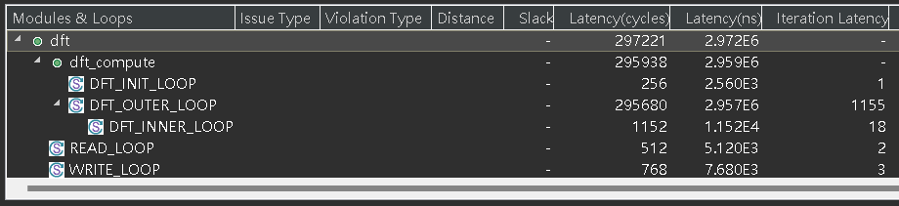
Let’s take a look at the performance tables of factor 4
From this table, we can see that the decrease in dft_compute is larger than the increase in WRITE_LOOP. Therefore, the overall latency is decreased.

Slide 27
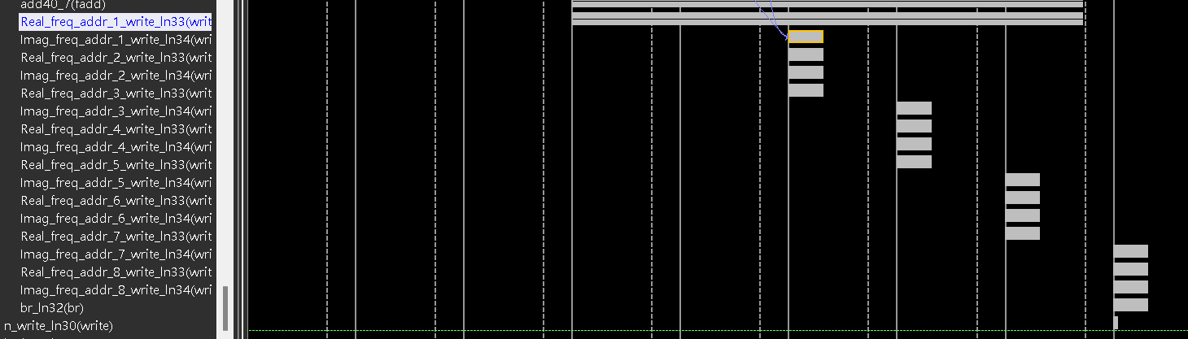
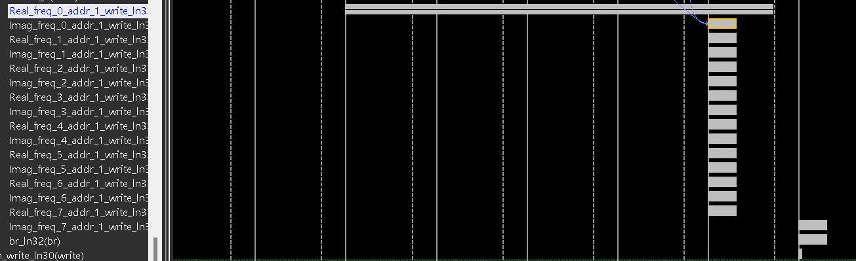
To know where the improvement comes from, let’s take a look at the schedule viewer of factor 8.
We can see that write operation with array partitioning is done in parallel, so the latency is reduced.

Slide 28
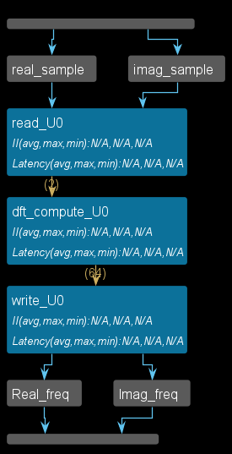
4. Dataflow
I apply the dataflow pragma to my top function. The top function includes read, dft_compute, and write functions. I encountered a problem when doing co-simulation on the synthesized result without pipeline, so I enable pipeline at first.
Now, let’s compare the performance with and without dataflow.

Slide 29
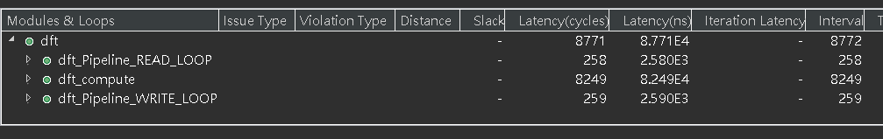
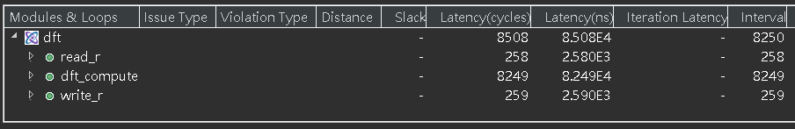
4. Dataflow
We can see that although the latency of 3 submodules is the same, the total latency is different. Besides, the interval is smaller.

Slide 30
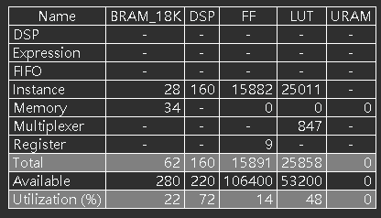
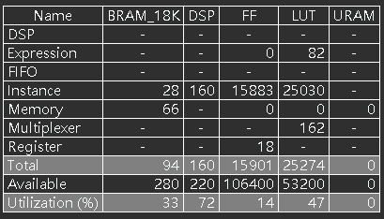
4. Dataflow
without dataflow
with dataflow
We can see that with dataflow, we will need more BRAM.
I also have tried to change my code into more submodules, but end up less efficient.

Slide 31
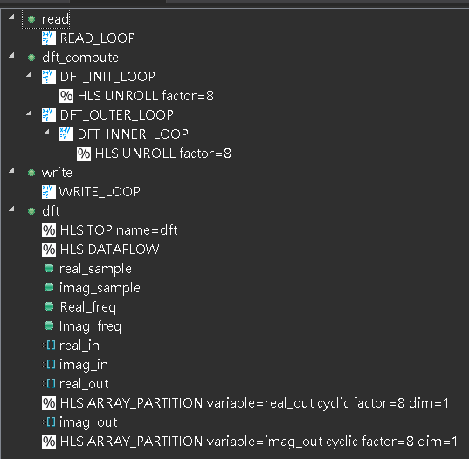
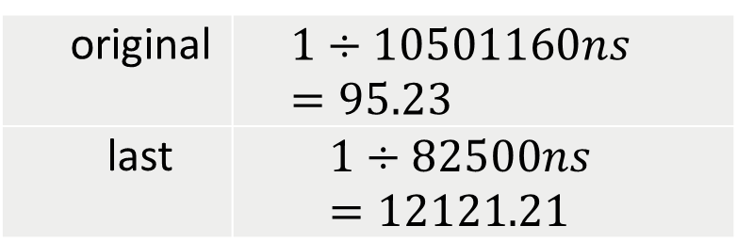
5. Best architecture
The best architecture of mine is the one with smallest interval, that is the result with dataflow in the previous question.
Throughput
original | $$1÷10501160ns=95.23$$
last | $$1÷82500ns=12121.21$$

Slide 32
5. Best architecture
The best architecture of mine is the one with smallest interval, that is the result with dataflow in the previous question.
Throughput
original | $$1÷10501160ns=95.23$$
last | $$1÷82500ns=12121.21$$

Slide 33
5. Best architecture
original
last
We can see that the throughput increases a lot, but the resource utilization also increases about 10 times of the original usage.

Slide 34
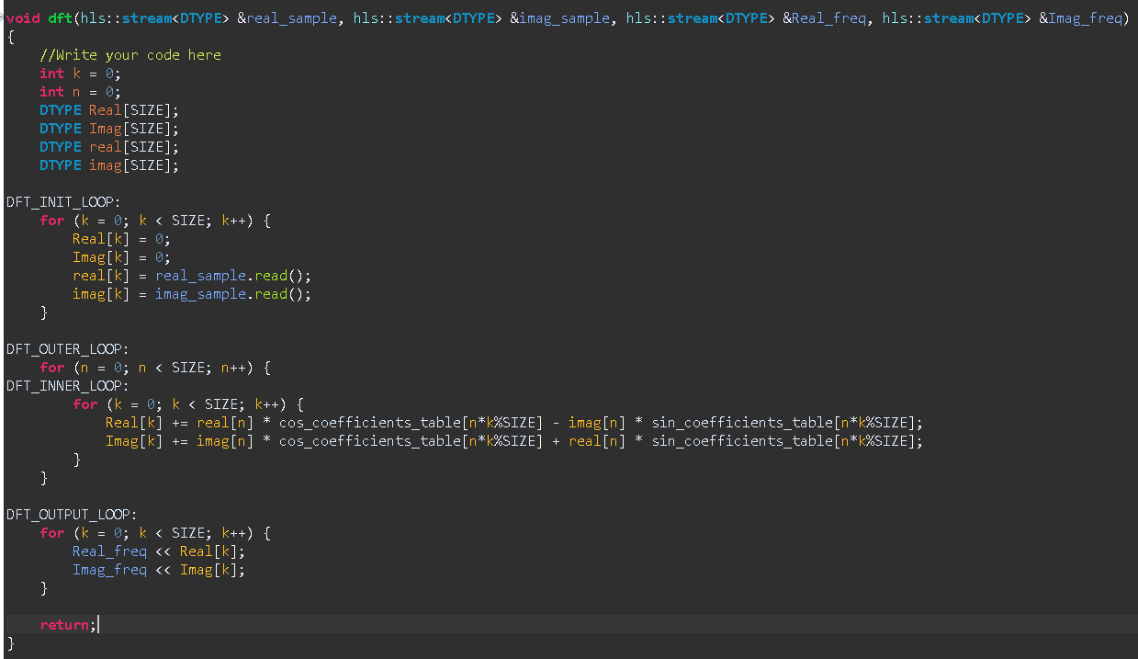
6. Streaming interface synthesis

Slide 35
Describe the major changes that you made to your code to implement the streaming interface. What benefits does the streaming interface provide? What are the drawbacks?
I use 4 arrays to store the input streams and output streams.
We must finish calculating a value before writing it into stream, so I use arrays to store the temporary value.
real and imag must be loaded first. Otherwise, they need to be read in the DFT_OUTER_LOOP, and we cannot perform pipeline to lower the latency.

Slide 36
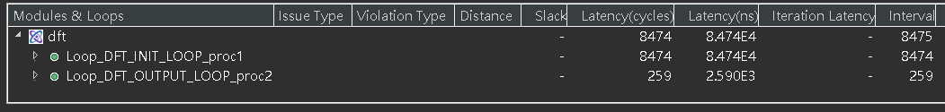
Describe the major changes that you made to your code to implement the streaming interface. What benefits does the streaming interface provide? What are the drawbacks?
We can see that the total latency decreases. However, the interval increases. Since we can’t start a new computation when output the values.

Slide 37
Explain What You Observed and Learned

Slide 38
Explain What You Observed and Learned
In this lab, I learned to optimize a design in several ways, including lookup table, array partition, unroll, pipeline, and dataflow.
I also learned how to transmit float data through streams.

Slide 39
Explain what problem you encountered and how you solved it

Slide 40
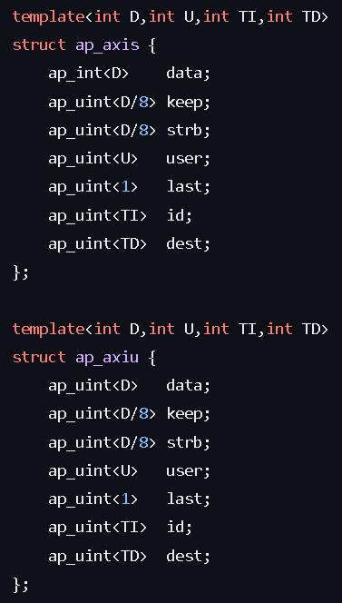
PYNQ Demo failed for 1.5 days
In the PYNQ Demo section, we are required to
implement the result of streaming interface in the last question,
change the streaming data type
increase the problem size from 256 to 1024.
The reason of changing data type is that to send a stream of elements, we need to use specific structures for the elements. The structures are shown in the figure.

Slide 41
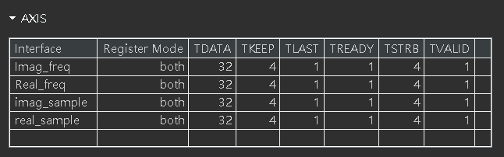
PYNQ Demo failed for 1.5 days
In this way, the stream signals can be synthesized as shown in the figure below.
It contains necessary signals to use DMA. TLAST is a key signal that tells if the stream finishes sending or receiving elements.
“last” of the last output element should be set to 1, others are set to 0.

Slide 42
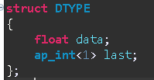
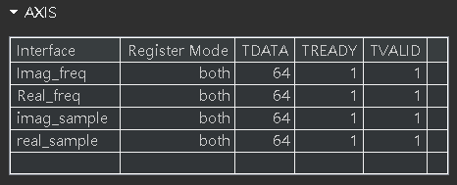
PYNQ Demo failed for 1.5 days
However, in this lab, we need to transfer float data rather than integer through the stream, so the tutorial asks us to construct a structure as shown in the figure. After synthesis, the stream signals are shown in the table below.

Slide 43
PYNQ Demo failed for 1.5 days
We can see that even though we have added “last” in the struct, TLAST is still gone.
What would happen if TLAST is gone? After we export IP, add it in the block diagram of Vivado, and then create wrapper, it will raise critical warning that TLAST in the DMA is not connected. If we run the bit file on Jupyter, the stream will get stuck there, since it doesn’t know if the stream is done.
After I tried several methods and searched on the internet, I found nothing helpful. In the end, when I was writing this report, I found that the size of TDATA in the above figure becomes 64, which means that the “last” is inside it.

Slide 44
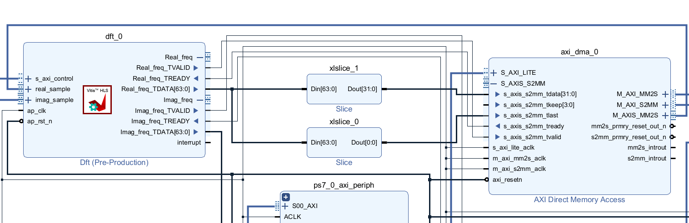
PYNQ Demo failed for 1.5 days
Therefore, when I connect the block diagram in Vivado, I split the TDATA[64:0] into TDATA[32] and TDATA[31:0], corresponding to “last” and “data” respectively (variables in a structure are arranged from lower bit field to higher bit filed). In this way, we can get the correct bit file.

Slide 45
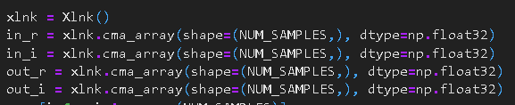

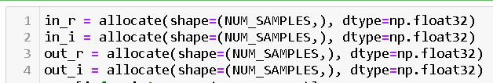
The python code they provide is too old

Slide 46
Two questions to test the key learning

Slide 47
Two questions to test the key learning
What is the relationship between array partitioning and loop unrolling?
How to construct a float stream?

Slide 48
END

