Slide 1
Image Inpainting for Irregular Holes Using Partial Convolutions
7109053122 于凡淵

Slide 2


Partial Convolutional
W: convolution filter weights
b: corresponding bias.
X: feature values for the current convolution window
M: corresponding binary mask

Slide 3
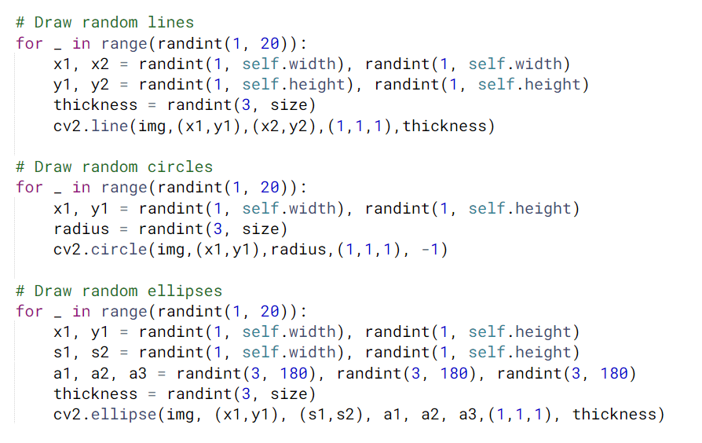
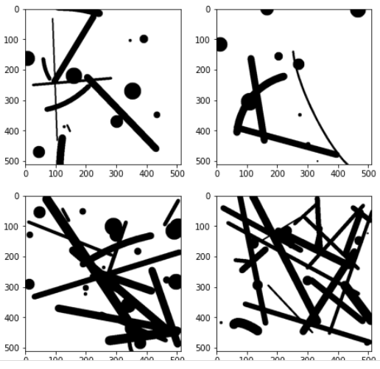

Mask

Slide 4
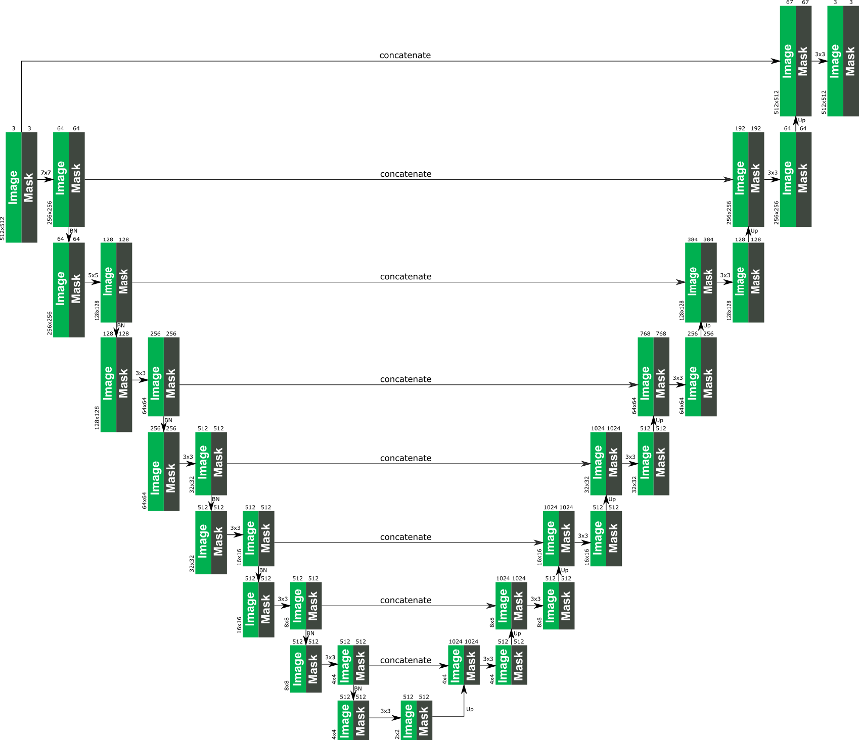
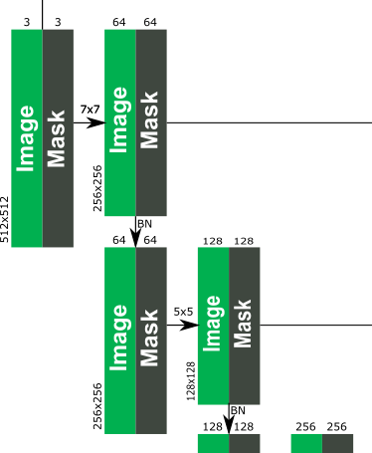
Unet Architecture

Slide 5
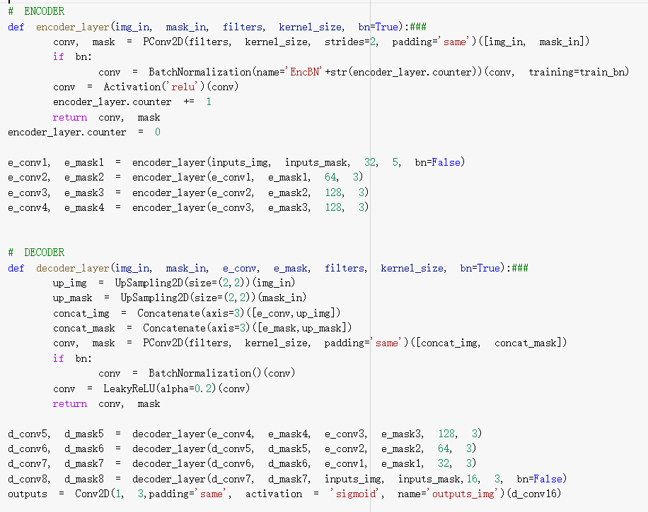
model

Slide 6
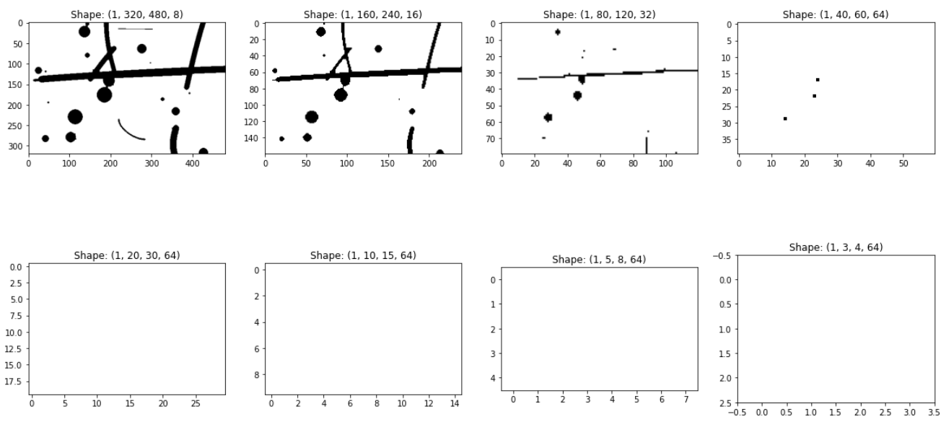
M:3*3 sliding window

Slide 7
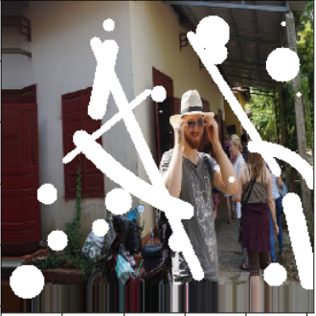
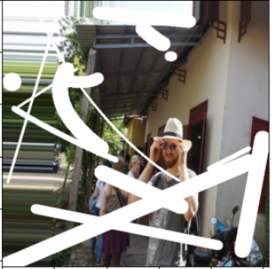
實作:單一照片
先擴增資料
…

Slide 8
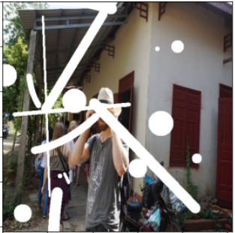

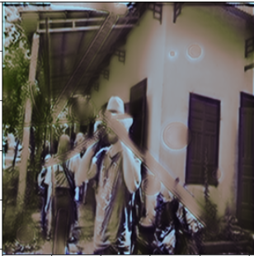
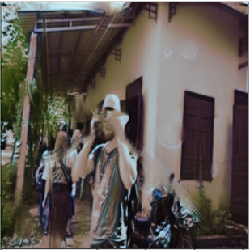
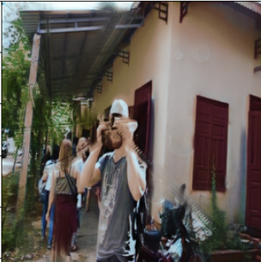
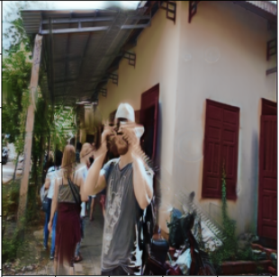
結果
Epoch:3 Epoch:5 Epoch:7 Epoch:9

Slide 9
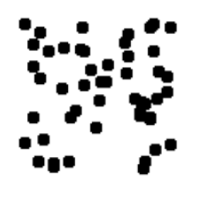
實作:數字
Mask:
Model:
Loss: Binary cross entropy

Slide 10

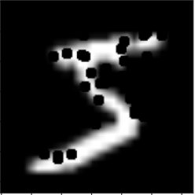
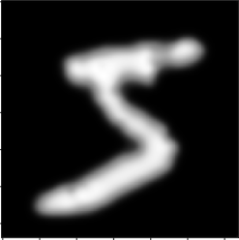
結果
原圖 mask+原圖 結果

