Slide 1
V-Rep Showcase
Jason Zhang

Slide 2
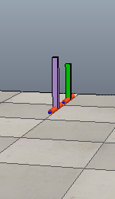
A simple self-made clock model The purple bar is the second hand and the green bar is the minute hand (no hour hand for it takes a long time to observe angle change of it ) simulation in the real-time mode

Slide 3


The minute_joint and second_joint are revolute joints in order to control the minute_hand and second_hand separately, with saperate non-threaded scripts. The is the invisible body of the clock, in order to support other visible parts (2 joints and 2 hands) of the model.

Slide 4
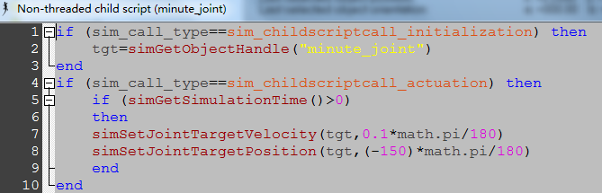
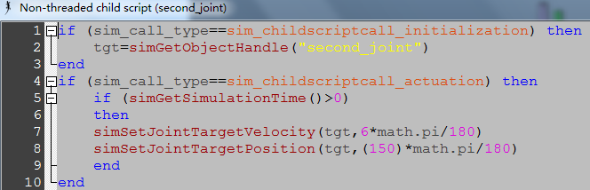
The 2 scripts are very similar, the main difference is as arrows shown.

Slide 5
Line 2 is used to determine the control target Line 5 is used to determine the start time of the control, if we change 0 to 3, the control of velocity or position will start from 3 seconds after the simulation start. Line 7 is used to control the velocity of the second_joint, while line 8 is used to control the position of it. But these two lines cannot work simultaneously!

Slide 6
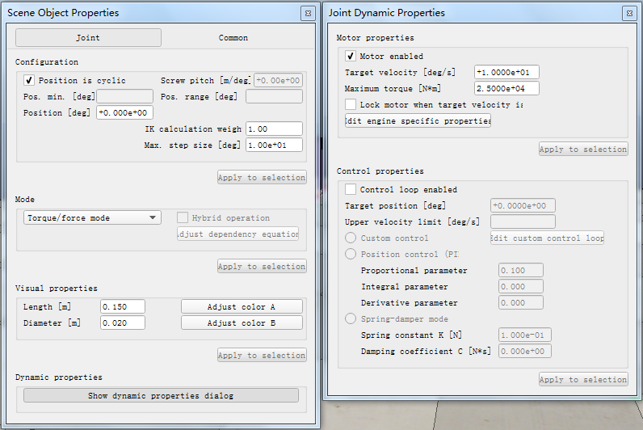
Velocity Control – set the joints
only check this

Slide 7
This line sets the velocity of the second_joint. The velocity is set to 6 degree per second. After 60 seconds, the second_joint will go 60*6=360 degrees, which is equal to 1 cycle (1 min = 60 sec).
This line sets the velocity of the minute_joint. The velocity is set to 0.1 degree per second. After 60 seconds, the second_joint will go 60*0.1=6 degrees, which is equal to 1/60 cycle (1 hour = 60 min).

Slide 8

If we change the number in purple, we can change the speed of the joint and hand, then the clock will malfunction. ☺
Before the simulation start, make sure you press the real-time mode button , then the simulation will follow the real-time. Otherwise, the simulation will have its own time speed (often faster).

Slide 9

Velocity Control makes the model work as a real clock

Slide 10
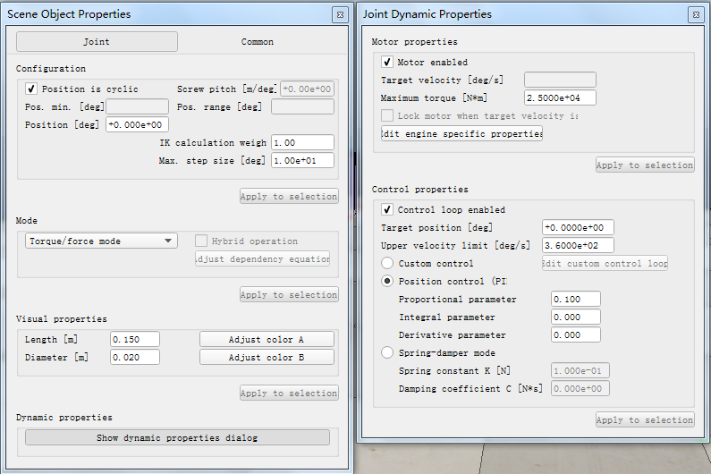
Position Control – set the joints
Also check this and
select position control

Slide 11


These lines set the position of the joints. The positions are set to 150 (second_joint) degree and -150 (minute_joint) degree (these 2 angles are randomly given☺). When the simulation start, two clock hands will move to new positions soon, as shown in the graph.
initial positions new positions 150 degree for second_hand
-150 degree for minute_hand

Slide 12
Maybe you have already noticed the Trick
The viewing angles in these 2 control modes are different
For the velocity control, the second_hand is the front hand.
For the position control, the second_hand is the behind hand.
And the direction of rotation is clockwise in v control.
The direction of rotation is anticlockwise in p control.
v-control p-control

Slide 13
In fact, it always obey the mathematics rules
Given a positive angle change, it will always rotate anticlockwise as often the case in math.
Given a positive speed, it will always rotate anticlockwise as often the case in math.
In v control, I just reversed the viewing angle to make it look more like a real clock!☺

Slide 14
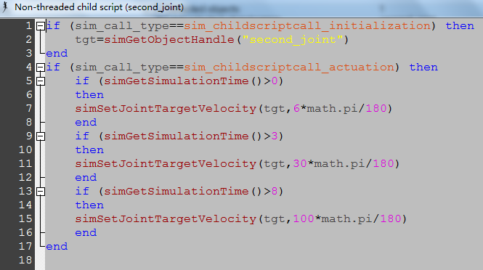
What’s more
You can also control the model based on time.
e.g.

Slide 15
You can modify the script by simple copy&paste based on the former script. Don’t forget to set the time range. You are controlling the second_joint. Then after the modification, the seond_hand will move in 6 d/s for 3 sec, then 30 d/s for 5 sec and finally 100 d/s for the rest of simulation time.

Slide 16
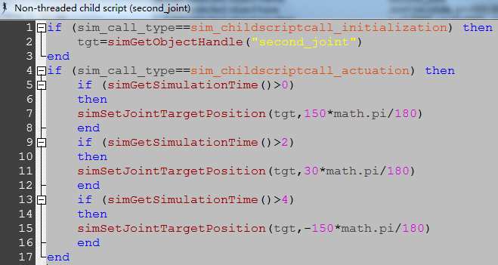
Similarly you can do this in p control

Slide 17




You are controlling the second_joint. Then after the modification, the seond_hand will move to 150 degree soon, then to 30 degree soon after 2 seconds and finally -150 degree soon after 4 seconds. The angle change in p control is the relative angle change between the final position to the initial position. No matter how many steps of moves, the angle change is always with respect to the initial position!!!!
Watch this slide!
Initial soon 2s later 2s later
0d 150d 30d -150d

Slide 18
Thank you!
An appendix with any useful notes-----To Be Continued☺

