Slide 1
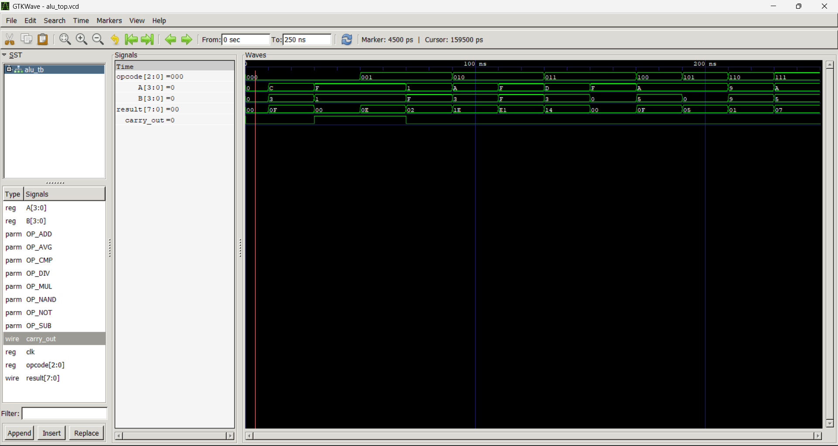
Opcode: 000 (Addition)

Slide 2
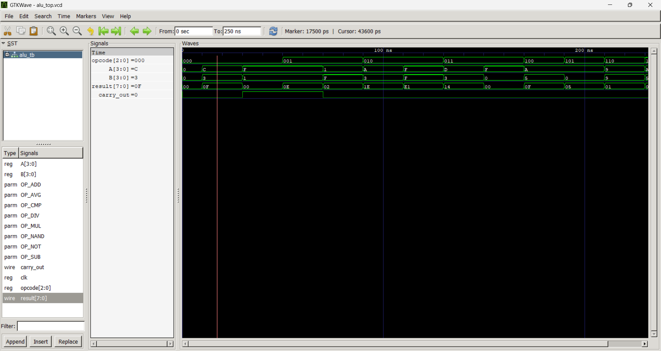
Opcode: 000 (Addition)

Slide 3
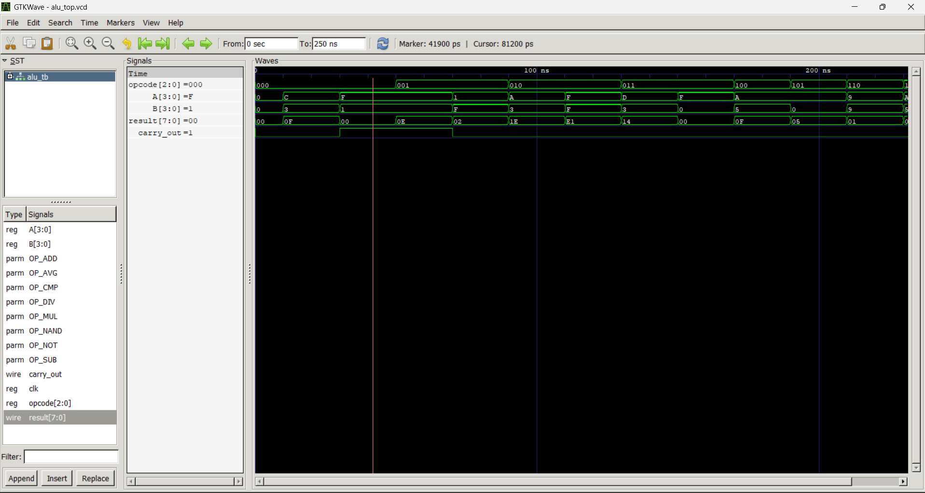
Opcode: 000 (Addition)

Slide 4
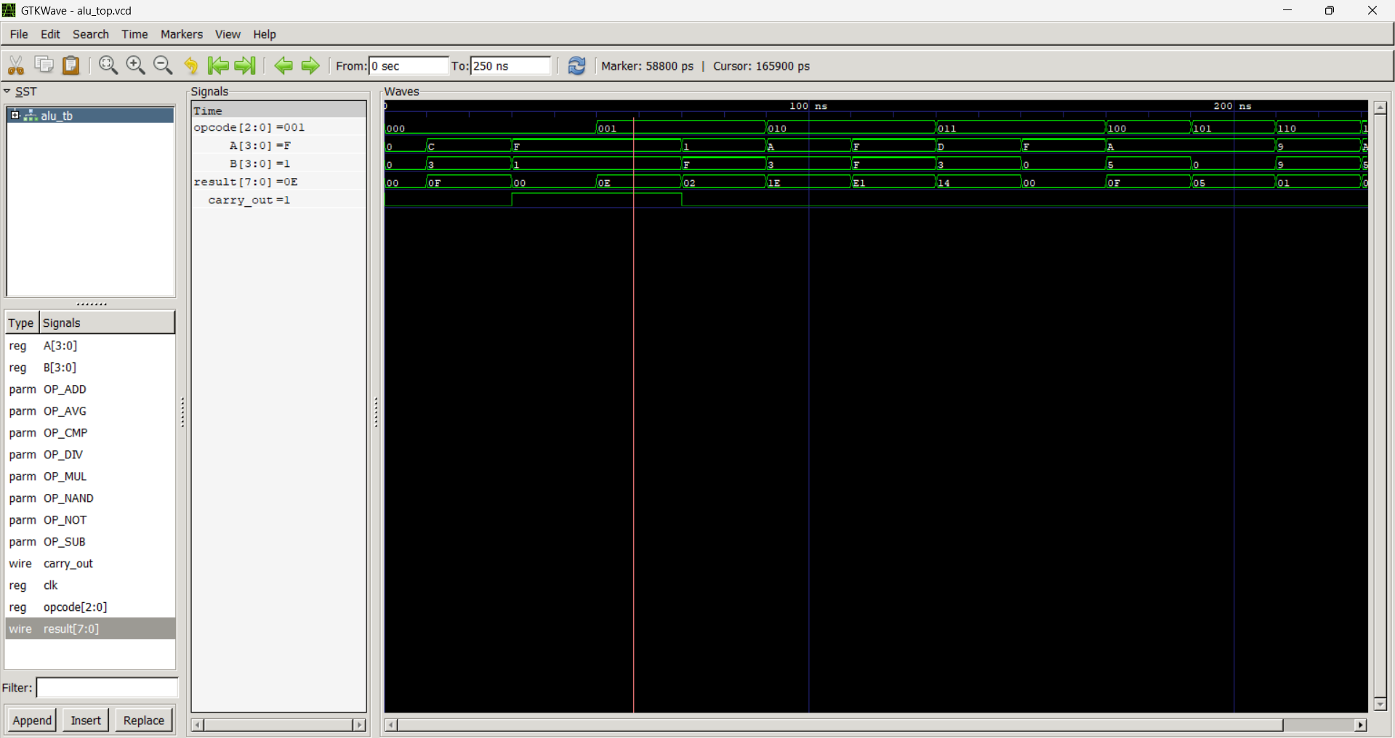
Opcode: 001 (Subtraction)

Slide 5

Opcode: 001 (Subtraction)

Slide 6
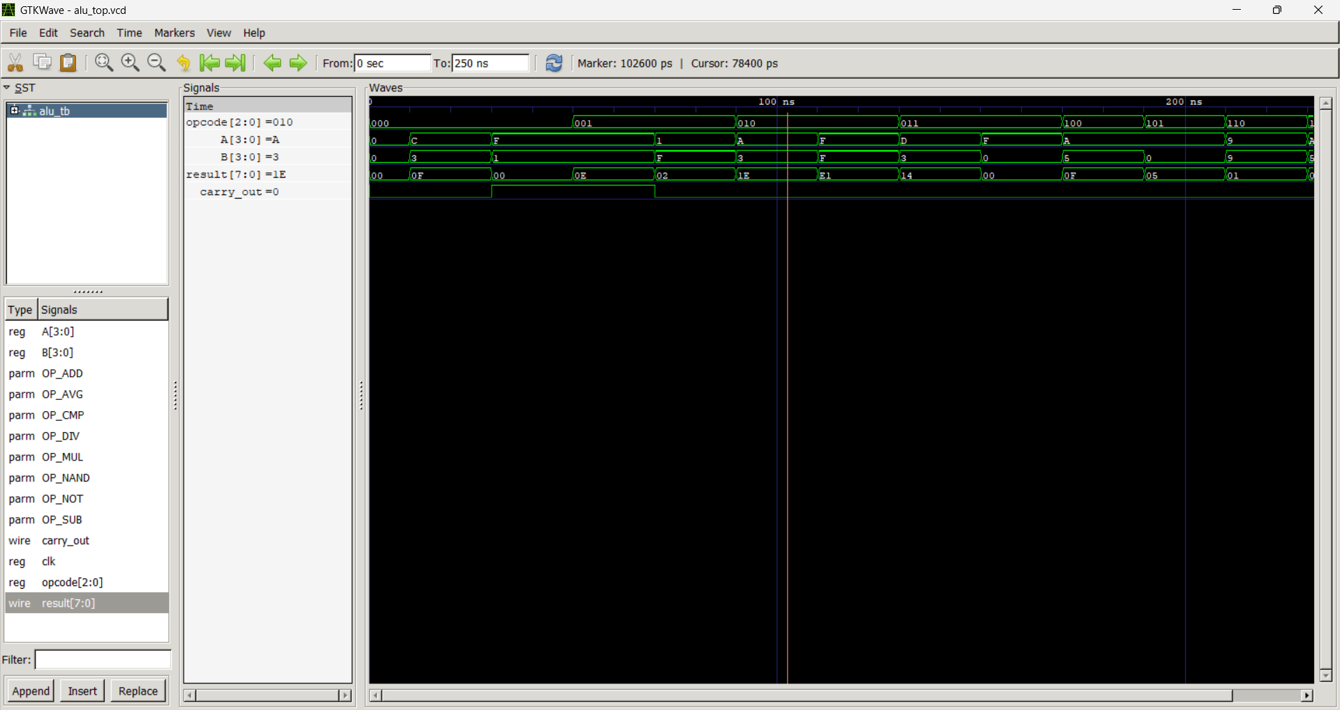
Opcode: 010 (Multiplication)

Slide 7

Opcode: 010 (Multiplication)

Slide 8
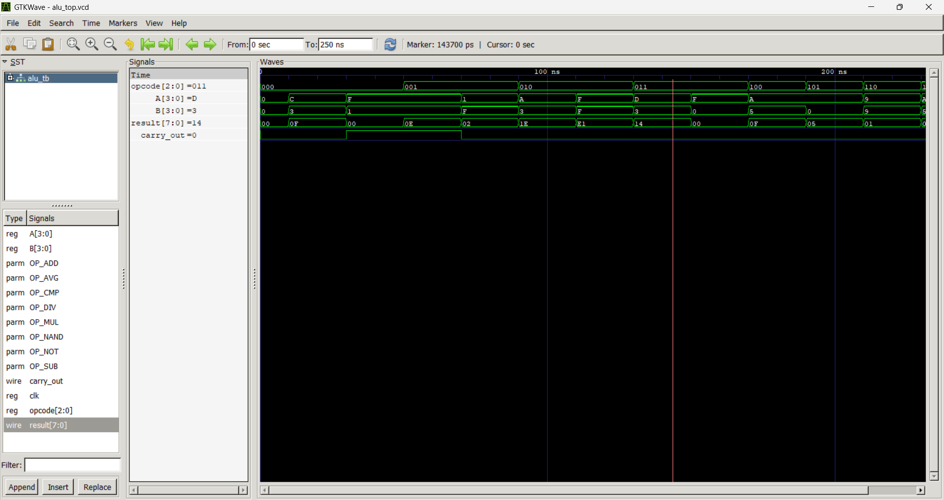
Opcode: 011 (Division)

Slide 9

Opcode: 011 (Division)

Slide 10

Opcode: 100 (NAND)

Slide 11

Opcode: 101 (NOT)

Slide 12

Opcode : 110 (Compare)

Slide 13

Opcode: 111 (Average)

Slide 14
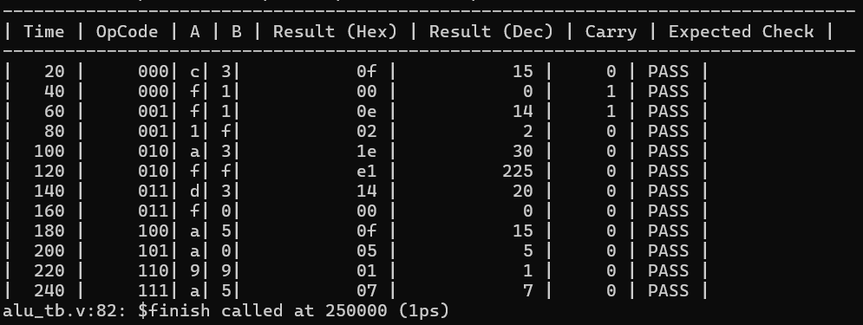
Summary

