Slide 1
EVENT EMITTERS
Aakar Mutha
Jason Carter

Slide 2
What is Event Emitter?
Node.js uses events module to create and handle custom events. The EventEmitter class can be used to create and handle custom events module.
All EventEmitters emit the event newListener when new listeners are added and removeListener when existing listeners are removed.
Syntax:
const EventEmitter = require('events');
eventEmitter.addListener(event, listener)
eventEmitter.on(event, listener)
eventEmitter.emit(event, [arg1], [arg2], [...])

Slide 3
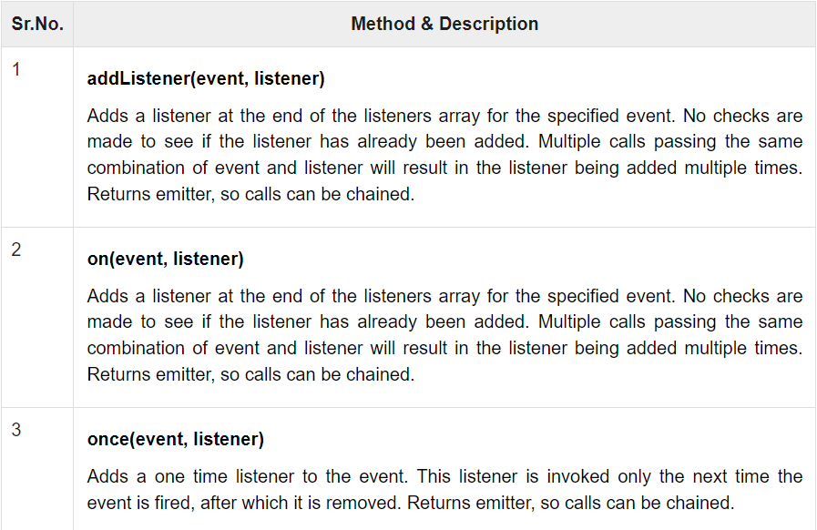
Methods & Description

Slide 4
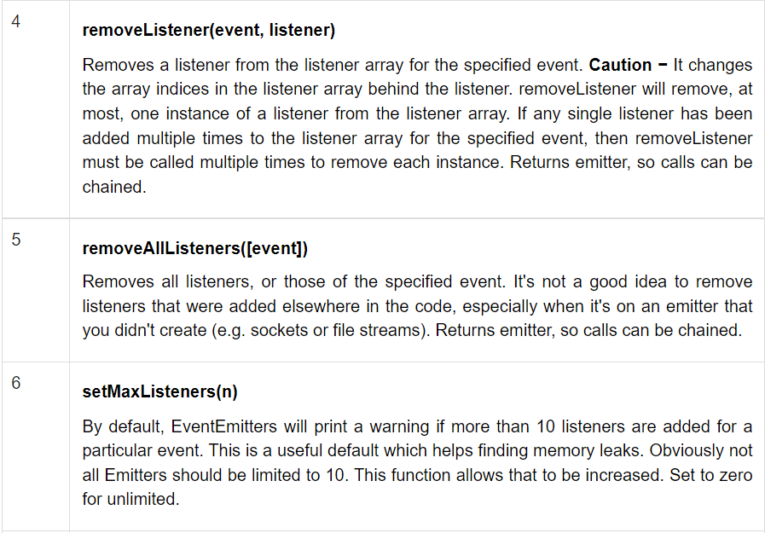

Slide 5
