Slide 1

MACRO-TO-MARKETS
How Inflation & Interest Rates Shape S&P 500 Performance (2016–2026)
Independent Data Analytics Project | 2026
Presented by: Jason Daou

Slide 2

The Question We're Answering
“Rate hikes are bad for stocks.” Repeated constantly — but how strong is that, really?
How have inflation (CPI) and the effective federal funds rate been associated with S&P 500 performance and volatility between July 2016 and mid-2026?
Near-zero rate era (2016–21) → Hiking cycle (2022–24) → Easing cycle (2024–26)
2 / 8

Slide 3




Official Data
S&P 500
CPI (Inflation)
Fed Funds Rate
Daily · S&P Dow Jones Indices
Monthly · U.S. Bureau of Labor Statistics
Monthly · Federal Reserve Board
Python
Wrangling & statistics
3 / 8

Slide 4
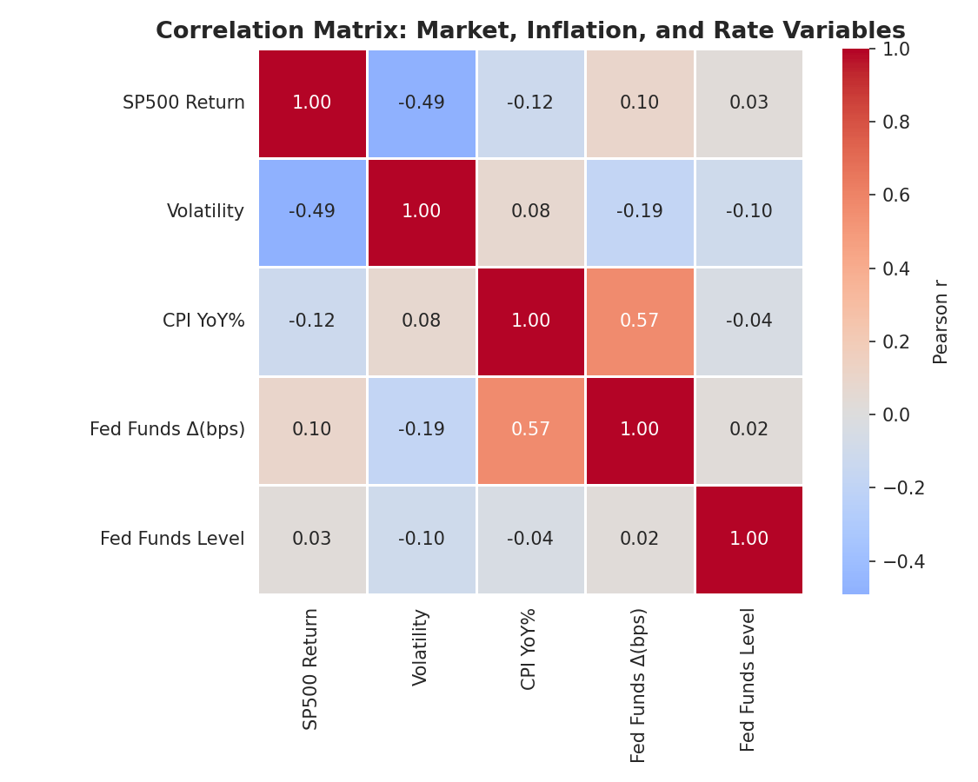
Where the Relationships Actually Are
r = -0.49
Volatility ↔ Returns
Moderate negative
r = 0.57
Fed Funds Δ ↔ Inflation
Fed reacts to inflation
r = -0.12
Inflation ↔ Returns
Weak
4 / 8

Slide 5

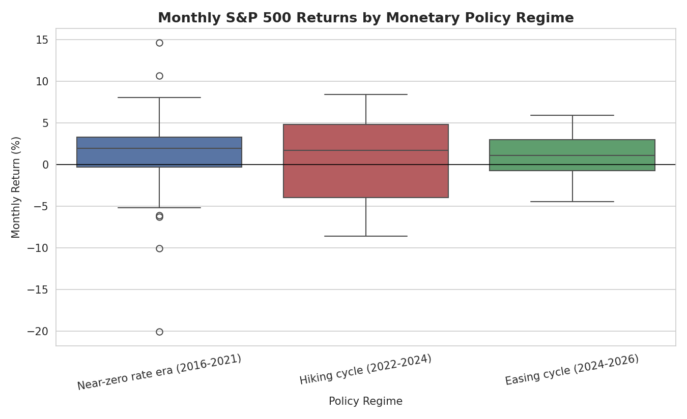
The Hiking Cycle Was Rougher — But...
14.3%
Avg. volatility, near-zero era
16.6%
Avg. volatility, hiking cycle
Direction matches theory — but the difference is NOT statistically significant (Welch's t-test, p = 0.203).
5 / 8

Slide 6

The Honest Answer
p = 0.207
NOT statistically significant at the 5% level
Inflation explains only 1.5% of monthly return variance (R² = 0.015)
Direction matches financial theory — strength does not
Real shocks (COVID-19, 2025 tariff episode) drove more volatility than rates alone
6 / 8

Slide 7

What This Means in Practice
01
Don't time markets on inflation/rate correlation alone
The relationship is too weak and uncertain to drive allocation by itself
02
Track volatility regime and shock events — not just rate direction
COVID-19 and the 2025 tariff episode moved markets more than rates did
03
Extend the model before relying on it
Add earnings, GDP, and geopolitical risk indicators for real investment decisions
7 / 8

Slide 8

Direction confirms theory.
Strength does not.
Honest evidence beats a convenient narrative.
Questions?
8 / 8

