Slide 1
UCF Dollar Value Menu
The Dollar Store of Fast Food

Slide 2
The team
Brady - Mobile App + Backend + Swagger
Alejandro Zamora - Frontend
Nav - Frontend
Jason - Backend + Swagger

Slide 3

MERN
Went well last time
Mlab
Heroku
React Native + Expo

Slide 4
Functionality
Our service will display a menu from restaurants in the UCF area, being a 3 mile radius, that will show all the dollar menu items from these restaurants. Students, professors, and anyone in the UCF area can find items that are cheap, fast, varied and very close.

Slide 5
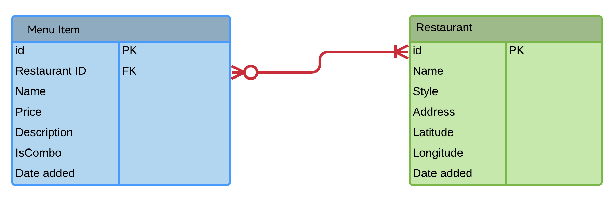
ERD

Slide 6
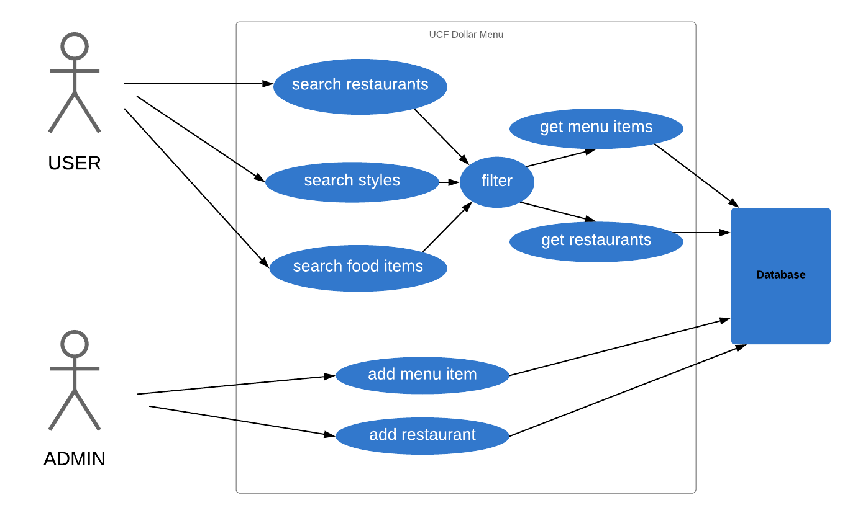
Use Case

Slide 7
Endpoint | Description
POST /menu | Submit a new menu item | Menu item populated under new restaurant | PASS
GET /menu | List menu items | No menu items missing | PASS
POST /restaurant | Submit new restaurant | Restaurant is populated on map | PASS
GET /restaurant | List restaurants | No missing restaurants on map | PASS
POST /getMenu | Get entire menu from restaurant | Menu displayed upon clicking restaurant on map | PASS

Slide 8
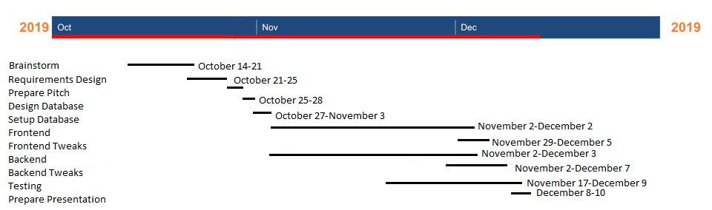
Gantt Chart

Slide 9
How things went overall
Had a lot of time because of presenting last
Same stack so was easier than before
Split the workload of web app and mobile app to organize development
Used To do list to keep track of pending task within the project

Slide 10
Demo
https://ucfdollarmenu.herokuapp.com/#

Slide 11
Swagger
https://app.swaggerhub.com/apis/cop4331/dollar-store/1.0.0#/

Slide 12
Questions?

