Slide 1
Using Machine Learning to Analyze and Predict Malicious Darknet Traffic
Department of Engineering, Computing, and Cybersecurity
Jacob Lavenant
Jason Lavenant
Professor: Dr. Gonzalo D. Parra

Slide 2
Outline
Why this project?
Objective
Timeline
Management System
Project Milestones
Dataset Analysis
Machine Learning Model
Challenges and Limitations
Conclusion
Resources

Slide 3
Why this project?
Acquire a deeper understanding on darknet traffic
Develop an autonomous Darknet traffic detection system
Analyze who is using the darknet
Monitor what they're using the darknet for

Slide 4
Objective

Slide 5
Objective
Develop a deeper understanding on what's going on behind the curtains of the internet, known as the darknet. We will analyze the CIC-Darknet 2020 dataset from the Canadian Institute of Cybersecurity. Also, create a machine learning model to help in early monitoring of malware before malicious activities happen.

Slide 6
Timeline

Slide 7
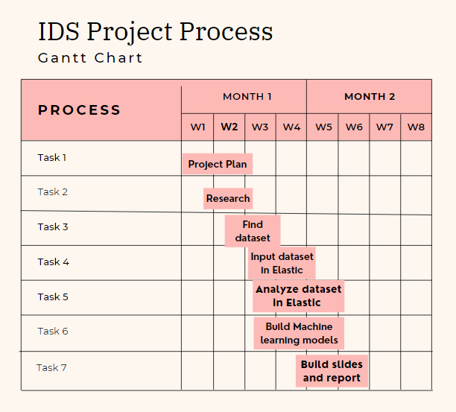

Slide 8
Management System

Slide 9
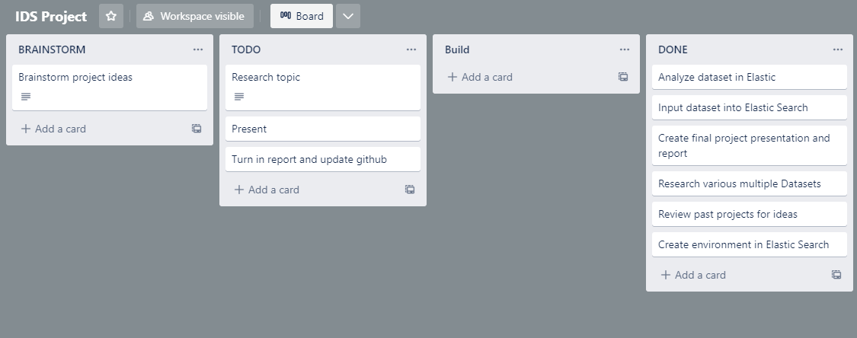

Slide 10
Project Milestones
Milestone 1. Find and research dataset
Milestone 2. Import dataset into Elastic
Milestone 3. Analyze Data and Create ML Model
Milestone 4. Finalize presentation and report

Slide 11
Dataset Analysis

Slide 12
Dataset Analysis
This dataset was Created by the Canadian Institute for Cybersecurity at the University of New Brunswick.
CIC-Darknet2020 dataset is used to mimic network traffic on the dark web to assist in monitoring of malware attacks before malicious activities are detected.

Slide 13
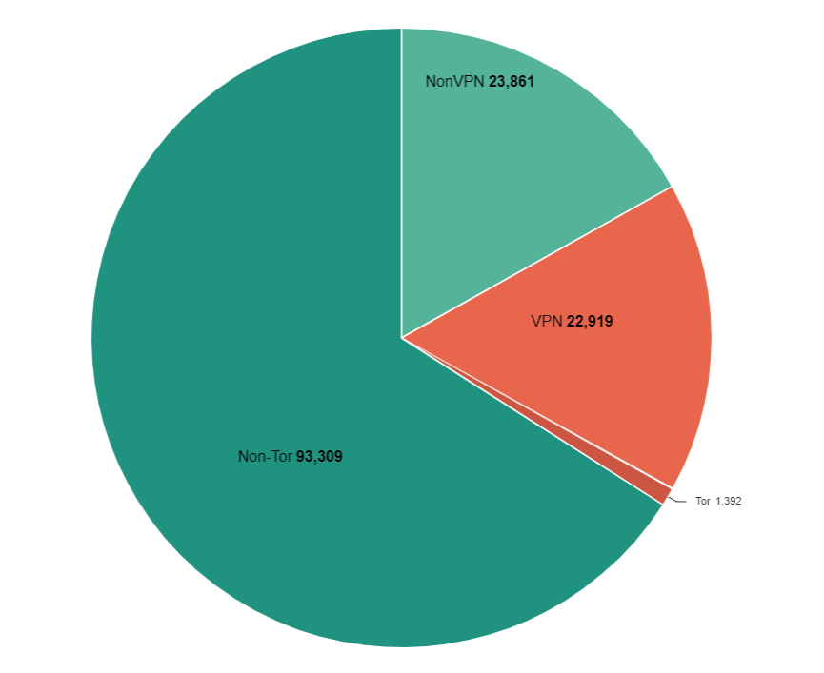
Dataset Analysis
This Dataset classifies each IP Address that either use VPN, Tor, Non-VPN, or Non-Tor in the network traffic.
The dataset showed that each IP address was used to
do different activities such as video streaming,
chat, email, and audio stream.

Slide 14
Machine Learning Model

Slide 15
Creating the Model
Model creation took place in Elastic Search
We went to the Data frame Analytics tab in machine learning and used Classification as the job type
We then selected our fields and created the model

Slide 16
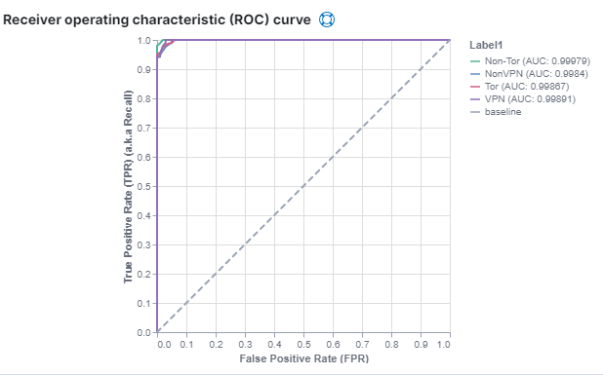
Model Results
This is the Receiver Operating Characteristic, here it compares the true positive against the false positive rate at different classification thresholds.

Slide 17
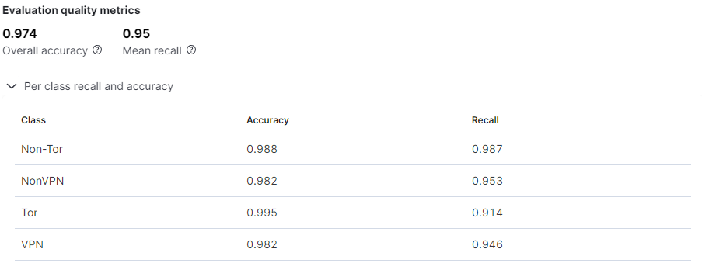
Model Results
Our model came out with 97% as the overall accuracy. The chart below breaks down the accuracy by classification.

Slide 18
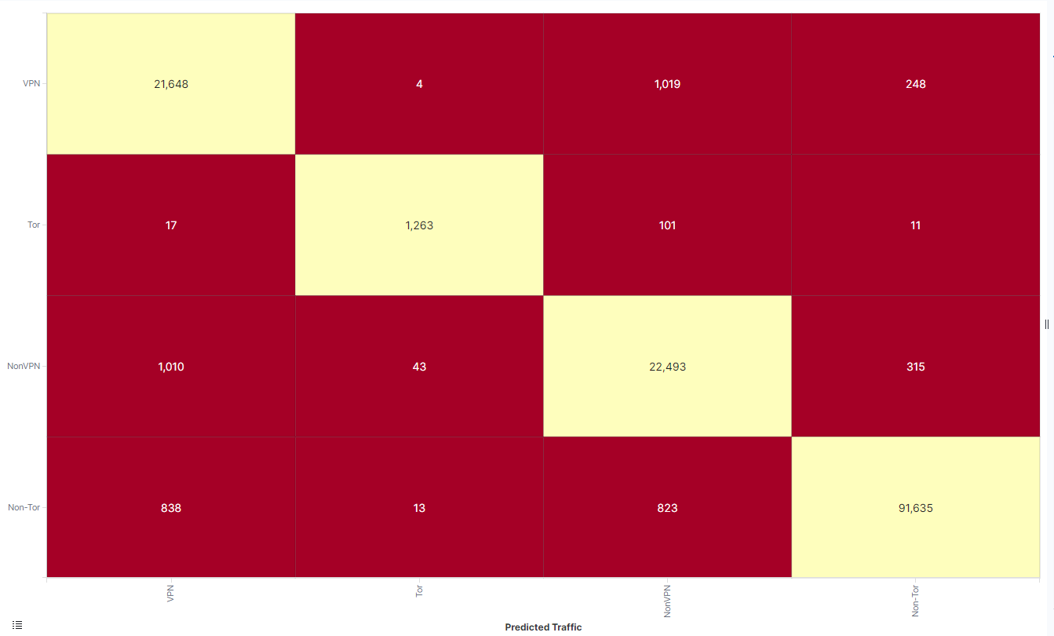
Model Results
Here is the confusion matrix of the model. The upper right quadrant is the false positives, and the bottom left quadrant is the false negatives.

Slide 19
Challenges and Limitations

Slide 20
Challenges
Setting up machine learning models
Picking fields to be included in the analysis for the models
Picking a dataset that we wanted to use

Slide 21
Limitations
If selected too many fields while creating the machine learning model it will generate an error stating model_memory_limit must be less than the value. This caused us to only select fields that were the most useful.

Slide 22
Conclusion

Slide 23
Conclusion
We built and modeled a Darknet traffic Detection System in Elastic Search. Useful to help in early monitoring of potential malware before any malicious activities occur.
For more details everything can be found at out repository: https://github.com/Jasonlavaa/IDSProject2022

Slide 24
Resources

Slide 25
Resources
Arash Habibi Lashkari, Gurdip Kaur, and Abir Rahali, “DIDarknet: A Contemporary Approach to Detect and Characterize the Darknet Traffic using Deep Image Learning”, 10th International Conference on Communication and Network Security, Tokyo, Japan, November 2020.
https://www.unb.ca/cic/datasets/darknet2020.html

Slide 26
Questions

