Slide 1
Adapter Design Pattern
Match interfaces of different classes Jing li

Slide 2
Structure Of Poster
Adapter :
Transform the interface of one class into another interface that the client expects.
Objectives
Adapter Design Patterns make development more efficiently .
To understand why Adapter is used frequently and how to use it in different applied fields.
Abstract :
Adapter is an object of a class that implements the Abstract class or the Adapter interface .
Using software development with C# and mobile development with Java as examples to understand more about the design pattern.

Slide 3
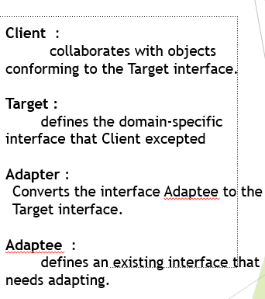
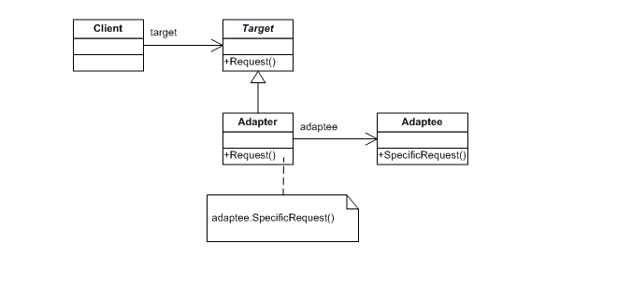
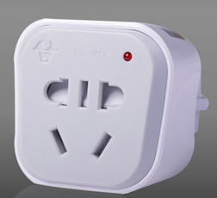
Discussion

Slide 4

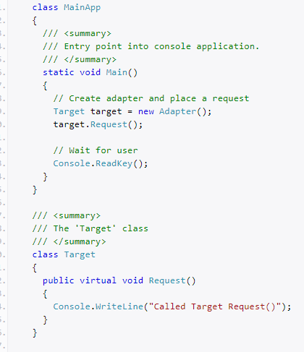
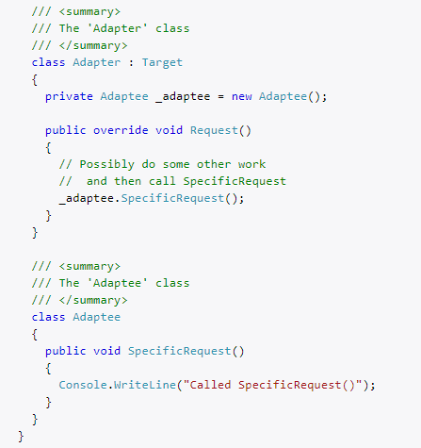
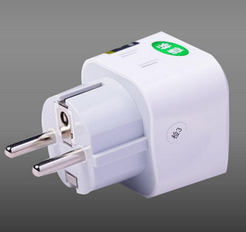
Discussion
This C# structural code demonstrates the Adapter pattern which maps the interface of one class onto another so that they can work together. These incompatible classes may come from different libraries or frameworks.
Example:
Run right code
The output is
“Called
SpecificRequest()”.

Slide 5
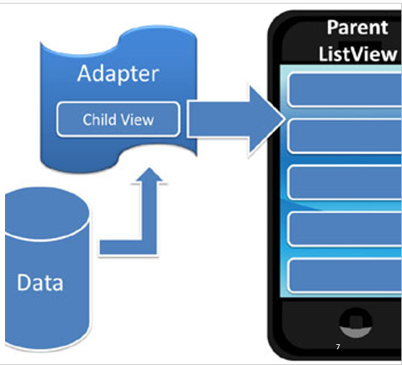
Research and Analysis
Impact of Adapter on Mobile development :
Adapters are the link between a set of data and the Adapter View (an object of a class that extends the abstract AdapterView class) that displays the data.
Adapters are responsible for supplying the
data and creating the views representing each item.
AdapterViews are ViewGroups that display child views given to it by an adapter (e.g., ListView,GridView)
Adapters get the data and pass it, along with child view, to the parent AdapterView which displays the child view and the data.
Data
sets
Adapter
Adapter View (UI Component)
ListView
GridView
Spinner

Slide 6
Conclusion
Adapter design pattern says the right one is the best .
Freuently guided with Adapter pattern In Mobile development ,Adapter is responsible for retrieving data from the data set and for generating View objects based on the data. The generated View objects are then used to populate any adapter view that is bound to the adapter.
References
Adapter(n.d.).Retrieved September 19,2019, from https://www.dofactory.com/net/adapter-design-pattern
Android From Scratch: Understanding Adapters and Adapter Views.(2016-11-02) .Retrieved September 19,2019, from http://esolution-inc.com/blog/android-from-scratch-understanding-adapters-and-adapter-views--cms-26646.html

Slide 7
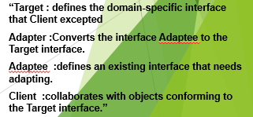
Adapter pattern -Match interfaces of different classes Author: Jing Li I D: 21902204 Whitireia Polytechnic
Abstract
Objectives
Discussions
Adapter is an object of a class that implements the Abstract class or the Adapter interface .Using C# and Java as examples to understand more about the design pattern.
To understand why Adapter pattern is used frequently and how to use it in different applied fields.
“Adapter Definition :Convert the interface of a class into another interface clients expect.”
Point one
Second conclusion
Sub point
Next interesting point
Sub point
Last point of interest
Sub point
Research and Analysis
Impact of Adapter on Mobile development :
“Adapters are the link between a set of data and the Adapter View (an object of a class that extends the abstract AdapterView class) that displays the data.
Adapter is an object of a class that implements the Adapter interface.”
Adapters are responsible for providing the data and creating the views representing each item.
Example
Run the above C# code ,the output is “Called SpecificRequest()”.
Conclusion
Data
sets
Adapter
Adapter View (UI Component)
Adapter design pattern says the right one is the best .
References
ListView
GridView
Spinner
Adapter(n.d.).Retrieved September 19,2019, from https://www.dofactory.com/net/adapter-design-pattern
Android From Scratch: Understanding Adapters and Adapter Views(2016-11-02) Retrieved September 19,2019, from http://esolution-inc.com/blog/android-from-scratch-understanding-adapters-and-adapter-views--cms-26646.html

