Slide 1
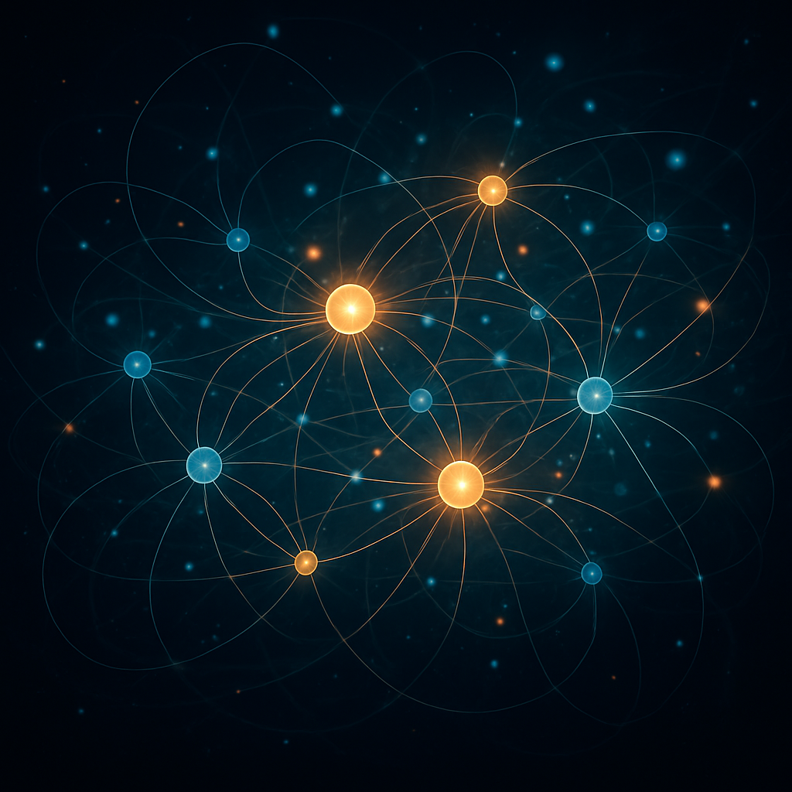
Scaling: Physics vs Plain English
ZeroDrift™ Self-Organizing Neural Engine
September 4, 2025
[1] [2]

Slide 2




Physics-Grade Scaling
Energy Conservation
Stability & Coherence
Energy Invariant
Stability
ΔH_rel = O(ε_mach) ∀ N,T
λ ≤ 0 under Koopman dynamics
Coherence
Replay
R̄ ≈ 0.962 (+5.4%) persistent
ψ-replay error = 0.0 for any N,T
[2] [3]

Slide 3
Scaling: Plain English
Energy stays constant
ΔEnergy_rel remains ~1e-16 regardless of steps or nodes.
Perturbations shrink
Negative λ means stability grows as the system scales.
Order prevails
Coherence (+5.4% ordering) persists at large scale.
Reversible by design
ψ-replay error remains zero for any N,T.
It scales by physics, not by accident.
[1] [3]

