Slide 1
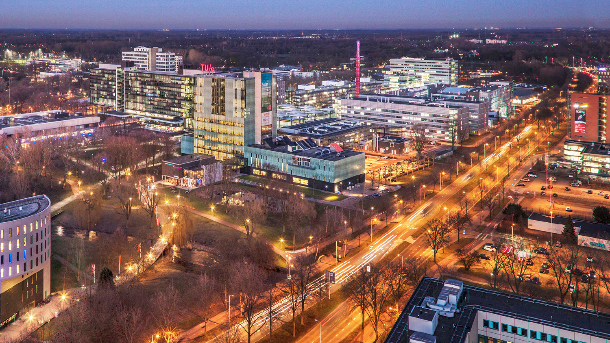
Dynamic Graph Visualization on WebGL
21/03/2025
Guangyu Li
Visualization Group

Slide 2
Dynamic Graph Visualization
Evolution of relationships between entities.
A temporal graph is used to store events between entities.
Entities are encoded as node in a static graph
Events between entities are encoded as undirected edges
An offline dynamic graph has complete knowledge of all event details in advance.

Slide 3
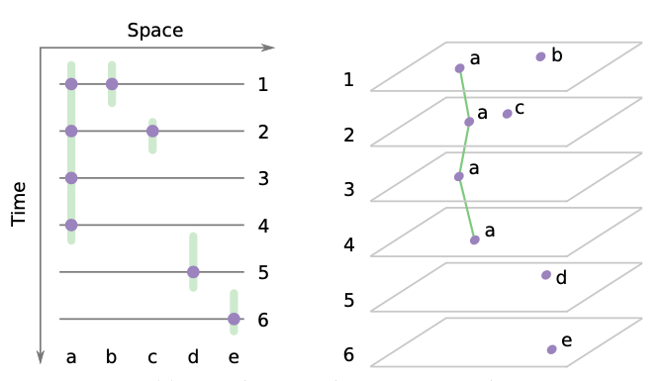
Dynamic Graph Approaches
Time-sliced Graph
Static graph in every snapshot
Advantage in structured data
Loss of information about potential events
Difficult to determine slicing criteria

Slide 4
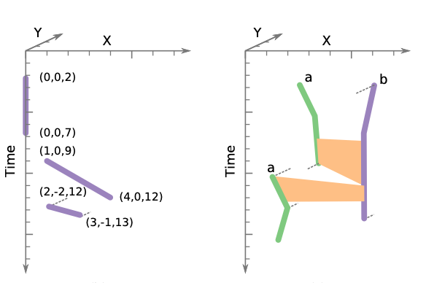
Event-based graph layout
Integrated Graph
Convert time into distance in 3D space
Preserve all details of temporal network
Visualization in Time-Space cube
node -> trajectory
edge -> connection surface

Slide 5
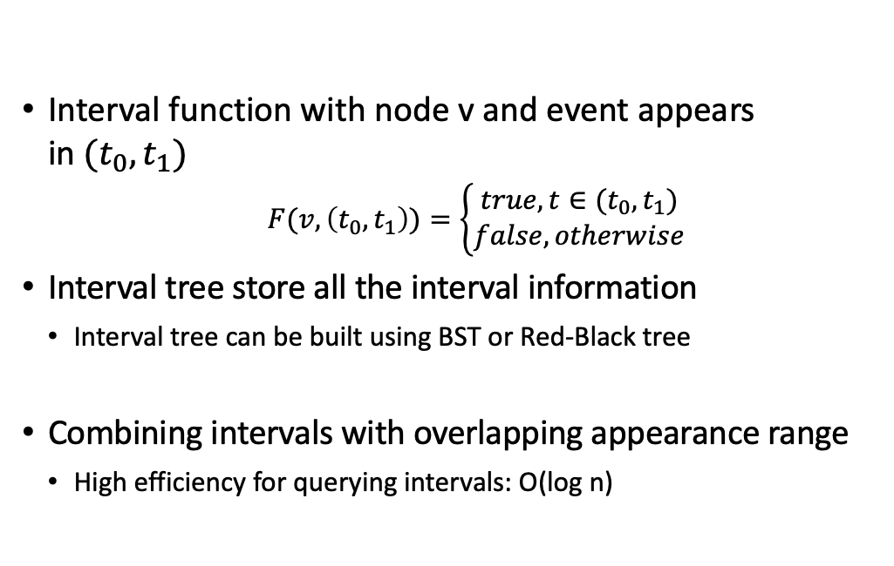
Modelling events using interval function
Interval function with node v and event appears in$(t_{0},t_{1})$
$$F(v,\left(t_{0},t_{1}\right))=\left\{\begin{aligned}true, t∈(t_{0},t_{1}) \\ false,otherwise\end{aligned}\right.$$
Interval tree store all the interval information
Interval tree can be built using BST or Red-Black tree
Combining intervals with overlapping appearance range
High efficiency for querying intervals: O(log n)

Slide 6
Challenges for Event-based Graph
Measuring relative position of entities
Real-world network don’t have explicit coordinate at 3D space
Event Modeling with edges
Modelling event using nodes distance
Force Directed Layout
Reveal underline graph structure
Without explicit positioning

Slide 7
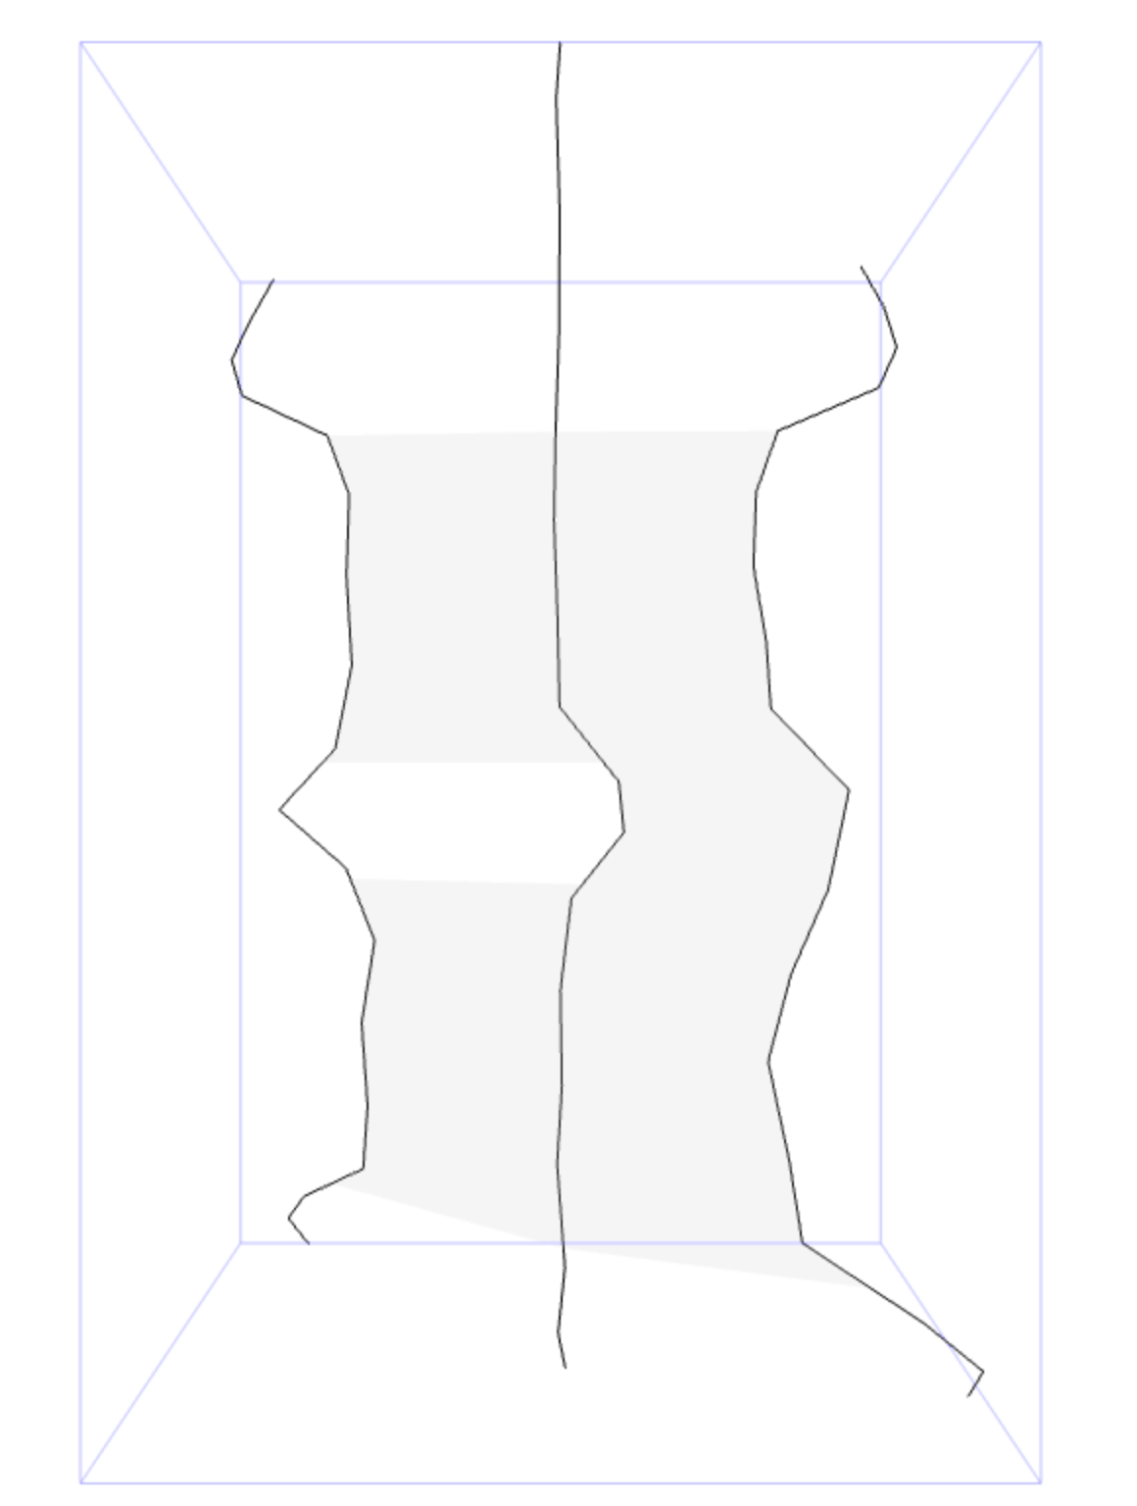
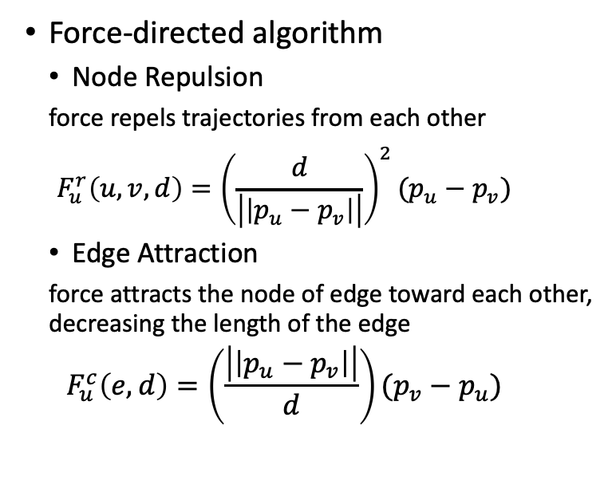
Dynamic Graph Computation
Force-directed algorithm
Node Repulsion
force repels trajectories from each other
$$F_{u}^{r}\left(u,v,d\right)={\left(\frac{d}{\left|\left|p_{u}−p_{v}\right|\right|}\right)}^{2}(p_{u}−p_{v})$$
Edge Attraction
force attracts the node of edge toward each other, decreasing the length of the edge
$$F_{u}^{c}\left(e,d\right)=\left(\frac{\left|\left|p_{u}−p_{v}\right|\right|}{d}\right)(p_{v}−p_{u})$$

Slide 8
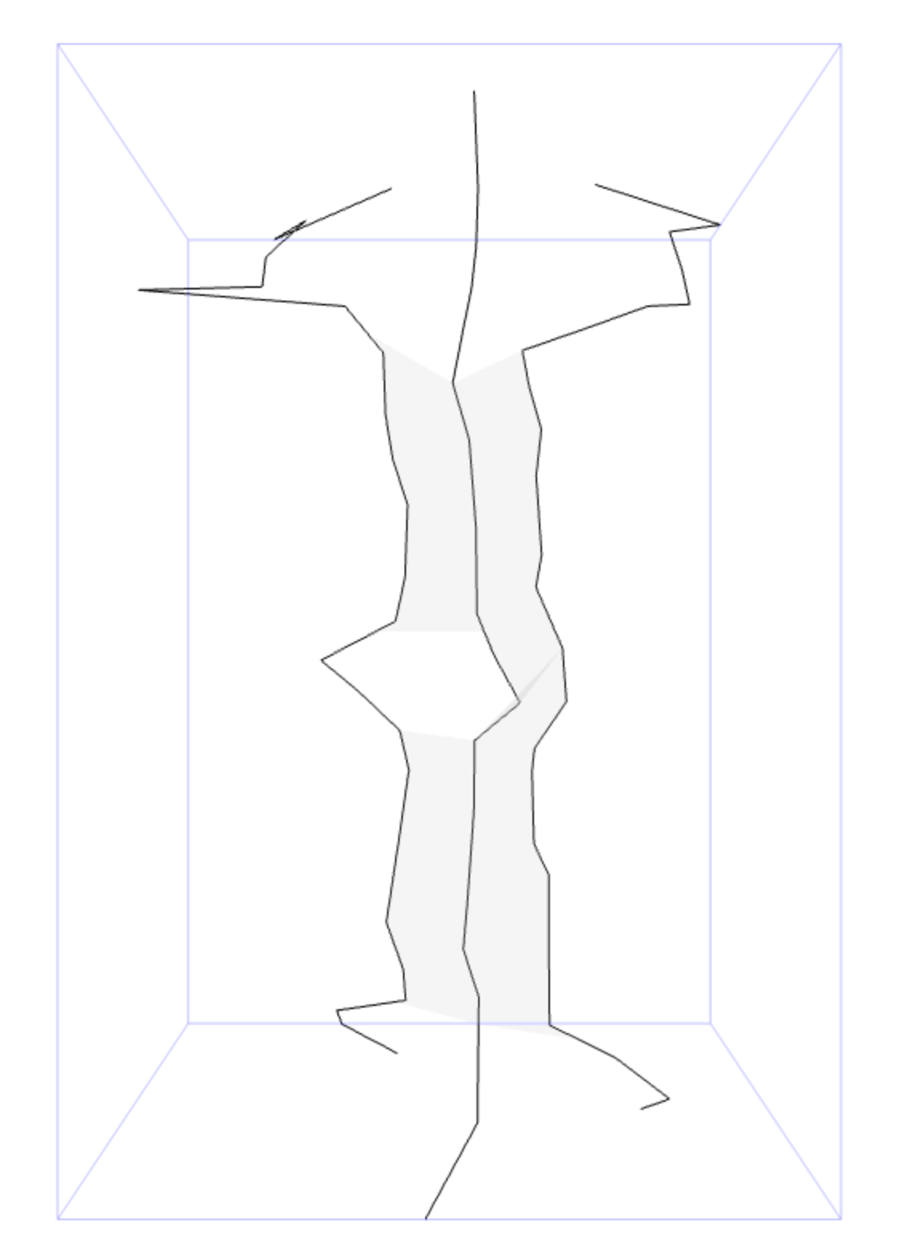
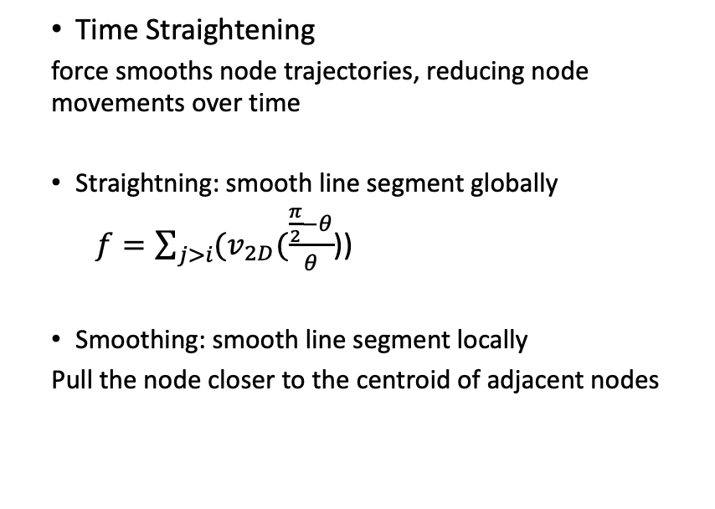
Dynamic Graph Computation
Time Straightening
force smooths node trajectories, reducing node movements over time
Straightning: smooth line segment globally
$f=\sum_{j>i}{(v_{2D}(\frac{\frac{π}{2}−θ}{θ}}$))
Smoothing: smooth line segment locally
Pull the node closer to the centroid of adjacent nodes

Slide 9
Model Framework --- Data Structure
Computation units for nodes and connections in Time-Space Cube.
Allowing potential improvement in parallel force computation.
Iteratively computes the forces until convergence
Adds or removes bends in the node trajectory during each cycle
Imposes constraints on maximum movement and acceleration
Corrects the time coordinate with real dataset

Slide 10
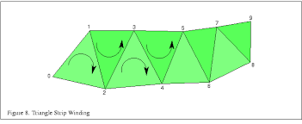
Model Framework --- Visualization
WebGL
high-performance rendering 3D graphics on GPU
Advantages on animation of graph evolution
Renders surfaces using triangle strips
Serializes the node coordinates into the vertex shader
Server-Client environment accelerating the computation speed

Slide 11
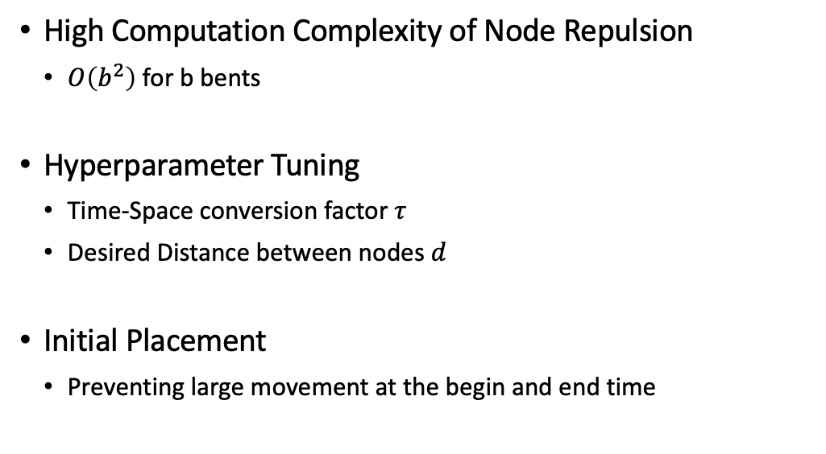
Challenges
High Computation Complexity of Node Repulsion
$O\left(b^{2}\right)$ for b bents
Hyperparameter Tuning
Time-Space conversion factor $τ$
Desired Distance between nodes $d$
Initial Placement
Preventing large movement at the begin and end time

Slide 12
Improvement
Exploiting Parallel Computation on Node Repulsion
Splits force calculations among nodes and computes them in parallel
Hyperparameter Tuning
AutoTau
Initial Placement
Pre-computes the average node connections to initialize clusters.
Testing Based on Graph Measurement Metrics
Both discrete and continuous dataset computed

Slide 13
Measurement Metrics
Crowding
The number of times nodes pass close to each other in animation.
Movement
The average 2D movements of nodes.
Stress
Measures how well the Euclidean distances in the graph layout preserve the shortest path distances in the original graph.

Slide 14
Dataset
Vandebunt: Student relationship across seven different timeframes.
Time-sliced
32 nodes and 49 connections
Rugby: Competition news of rugby teams on Twitter (X) over a year.
Continous
12 nodes and 888 connections(merged repeated news)
Dialog: Dialog from all chapters of book “Pride and Prejudice”
Continous
118 nodes and 3481 connections

Slide 15
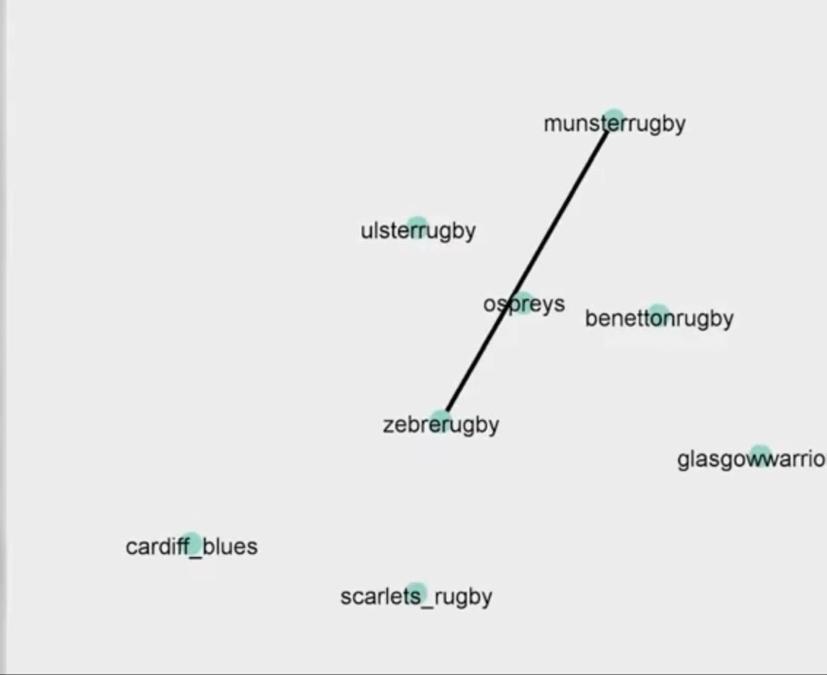
Dynamic Graph Visualization Demo
Rugby teams' competition network

Slide 16
Demo

Slide 17
Q&A

