Slide 1
BRPT
16 Jul 2026
Rp 1,752
Current Price
PT Barito Pacific Tbk
IDX Broker Flow Intelligence · AVCO Analysis
Strategic Block (≥5%)
Broker-Tracked Float
Named <5% Holders
71.4%
19.8%
7.4%
AVCO Realized P&L
AVCO Combined P&L
Profitable Brokers
+Rp6.1T
+Rp12.5T
84/88
IDX Broker Analysis · 16 Jul 2026
1

Slide 2
Executive Summary
Key Metrics
Key Findings
Metric | Value
Market Price | Rp 1,752
Strategic Block (≥5%) | 71.4%
Named <5% Holders | 7.4%
Broker-Tracked Float | 19.8%
Untracked | 1.36%
AVCO Median | Rp 1,600
Overhead Supply? | NO
AVCO Realized P&L | +Rp6.1T
AVCO Unrealized P&L | +Rp6.4T
AVCO Combined P&L | +Rp12.5T
Profitable Brokers | 84 / 88
Top 5 Concentration | 11.0%
Top 10 Concentration | 15.1%
Trading Days | 2530
Data Range | 2016-01-04 → 2026-07-15
Median broker cost Rp 1,600 vs market Rp 1,752 — price is above average break-even.
3-tier ownership: 71.4% strategic (KSEI direct), 7.4% named <5%, 19.8% broker-tracked float.
AVCO combined P&L: +Rp12.5T — 84 of 88 brokers profitable at current price.
Realized P&L: +Rp6.1T banked — provides cushion against paper losses.
Top 10 brokers hold 15.1% of exchange float — moderately concentrated.
Largest holder: GR at 3.40%, AVCO Rp 1,462, unrealized +Rp924.12B.
Price controllers (last 6m): CC · YP · PD — CC (Rp1,600 σ592, lead r=+0.01, Structural) | YP (Rp1,674 σ993, lead r=-0.11, Structural). Identified via buy-lead correlation with next-day price returns.
IDX Broker Analysis · 16 Jul 2026
2

Slide 3
Market Maker Identification — CC · YP · PD
Identification Methodology — Last 6 Months
Candidate Comparison — sorted by MM Score · Lead ≥ 0.12 or Floor ≥ 55% or Buy% ≥ 75% = threshold
Signal 1 — Gross Flow Value (50%)
Broker | Type | Lead r | Contemp r | Buy% | Gross | Net Pos | Net/Gross | Score | Status
AK | Asing | -0.019 | -0.388 | 100% | 7.24B | 29.5M | 0.004 | 80.0 | —
CC | Pemerintah | +0.011 | -0.158 | 100% | 5.21B | 196.5M | 0.038 | 66.0 | Selected
YP | Asing | -0.107 | -0.005 | 100% | 4.07B | 338.8M | 0.083 | 58.1 | Selected
PD | Lokal | -0.149 | +0.265 | 100% | 2.47B | 259.3M | 0.105 | 52.1 | Selected
ZP | Asing | +0.037 | +0.258 | 100% | 2.32B | 1.76B | 0.758★ | 50.7 | —
LG | Lokal | +0.139 | +0.433 | 94% | 1.49B | 21.5M | 0.014 | 47.2 | —
YU | Asing | +0.051 | +0.362 | 91% | 1.57B | 85.3M | 0.054 | 45.5 | —
CP | Asing | +0.054 | +0.077 | 99% | 2.22B | 85.1M | 0.038 | 45.0 | —
NI | Pemerintah | -0.181 | +0.086 | 99% | 1.30B | 19.1M | 0.015 | 38.7 | —
SQ | Lokal | -0.352 | -0.171 | 100% | 1.20B | 85.9M | 0.072 | 38.3 | —
MG | Lokal | +0.200 | +0.059 | 86% | 2.57B | 145.3M | 0.056 | 45.9 | Operator
XL | Lokal | -0.249 | -0.227 | 100% | 8.21B | 332.9M | 0.019 | 0.0 | Excluded
XC | Lokal | -0.309 | -0.254 | 100% | 2.90B | 73.2M | 0.015 | 0.0 | Excluded
broker gross_vol ÷ max broker gross_vol in same window. The broker that transacts the most total value (buy + sell) is the price-setter on IDX — MMs dominate volume, not just direction. Top traders by value score highest.
Signal 2 — Daily Consistency (30%)
buy_presence = buy_days ÷ total trading days in 6m window. Real MMs show up almost every session. ≥ 50% gate to enter top-3 selection.
Signal 3 — Price Correlation (20%)
Max(lead_corr, contemp_corr) t-stat weighted. Confirms the MM is actually moving price, not just providing neutral liquidity. Distributor penalty: zeroed if lead < −0.15 (buying before own price drops = distribution).
★ Net/Gross Ratio — Insider Signal
Net shares held ÷ 6-month gross flow. High ratio (>0.30) = broker accumulates quietly without churning — classic informed-money pattern. Purple-tinted rows in table — NOT selected as MM but flagged as potential insiders. Note: numerator is all-time, denominator is 6m.
XC/XL — Retail Aggregators, NOT Excluded from Intelligence
XL (Stockbit) and XC (Ajaib) are excluded from MM SCORING only — their gross volume is retail aggregation, not structural price control. However they are NOT excluded from VWAP Alpha or correlation analysis (slide 17). The XC/XL correlation pair should be treated as ambiguous: could be retail co-movement or same beneficial owner routing through two platforms. Cannot be ruled out as insiders without KSEI account-level data.
Selected: CC · YP · PD — top 3 by MM Score
Green = Selected MM (biggest gross flow + daily presence) | Purple tint ★ = Quiet Accumulator (high Net/Gross, insider-like) | Amber = P&D Operator | Tan = Retail Aggregator (excl.)
IDX Broker Analysis · 16 Jul 2026
3

Slide 4
Market Maker Deep Dive — CC · YP · PD
Price controllers identified via buy-lead correlation with next-day price (last 6m) · Tight zone = month with lowest buy-price σ · Distribution = sell-dominant periods (≥3% net sold)
CC Pemerintah | 196.5M (0.21%)
PEAK HOLDINGS (200d)
Peak Shares | 303.6M (0.32%)
Peak Date | Jan 2026
vs Current | +107M shares vs now
ACCUMULATION ZONE
Tightest Month | Feb '26 (recent)
Avg Buy Price | Rp2,034
σ at Tightest | 110.3
Price Range ±1σ | Rp1,924 – Rp2,144
DISTRIBUTION ZONE
Avg Sell Price | Rp1,936
σ at Distribution | 386.7
Price Range ±1σ | Rp1,549 – Rp2,323
LAST 5d ACTION
Direction | NET SELLING
Net Volume | -22.4M
% of Holdings | -11.38%
Avg Price | Rp1,726
Conviction σ | σ23.0 — Moderate
YP Asing | 338.8M (0.36%)
PEAK HOLDINGS (200d)
Peak Shares | 392.9M (0.42%)
Peak Date | May 2026
vs Current | +54M shares vs now
ACCUMULATION ZONE
Tightest Month | Feb '26 (recent)
Avg Buy Price | Rp2,079
σ at Tightest | 109.2
Price Range ±1σ | Rp1,970 – Rp2,188
DISTRIBUTION ZONE
Avg Sell Price | Rp1,879
σ at Distribution | 378.5
Price Range ±1σ | Rp1,500 – Rp2,258
LAST 5d ACTION
Direction | NET SELLING
Net Volume | -5.3M
% of Holdings | -1.55%
Avg Price | Rp1,724
Conviction σ | σ22.6 — Moderate
PD Lokal | 259.3M (0.28%)
PEAK HOLDINGS (200d)
Peak Shares | 327.8M (0.35%)
Peak Date | Jun 2026
vs Current | +69M shares vs now
ACCUMULATION ZONE
Tightest Month | Feb '26 (recent)
Avg Buy Price | Rp2,093
σ at Tightest | 108.2
Price Range ±1σ | Rp1,985 – Rp2,201
DISTRIBUTION ZONE
Avg Sell Price | Rp1,854
σ at Distribution | 415.7
Price Range ±1σ | Rp1,438 – Rp2,270
LAST 5d ACTION
Direction | NET SELLING
Net Volume | -1.2M
% of Holdings | -0.47%
Avg Price | Rp1,721
Conviction σ | σ20.3 — Moderate
IDX Broker Analysis · 16 Jul 2026
4

Slide 5
Pre-Move Accumulation — Insider Confidence Signal
Who loaded up 1–3 weeks before price surged ≥15% · last 12 months · min 5M shares · min 5 active days · Hit% = surges front-ran ÷ total surges detected
Week End | Surge | VWAP Rp | Pre-Buyers (21d) | Day 1 Entry | Pos%
2026-07-07 | +17% | 1,333→1,560 | YU(52.5M) · XL*(42.2M) · OD(20.5 | CC(15.2M) · TP(10.8M) | New
2026-06-02 | +30% | 1,546→2,010 | OD(68.0M) · XL*(56.0M) · CC(52.7 | AK(57.8M) · CC(24.3M) | +32%
2026-05-07 | +16% | 1,961→2,269 | HP(46.2M) · AZ(42.9M) · PD(39.3M | AK(6.9M) · AZ(3.9M) | +2%
2026-04-14 | +69% | 1,399→2,369 | SS(17.3M) · HP(11.2M) · XA(10.9M | AZ(9.2M) · SS(7.2M) | +661%
2025-09-24 | +50% | 2,426→3,641 | BB(52.7M) · TP(40.1M) · LG(32.2M | CC(34.4M) · PD(23.0M) | New
2025-07-30 | +23% | 2,157→2,650 | ZP(58.6M) · BB(47.0M) · HP(43.3M | RF(11.9M) · TP(4.6M) | +4%
TOP 3 SIGNAL BROKERS
Broker | N | Hit% | Pre Vol | Avg Pos%
BB | 3 | 50% | 125M | +110%
OD | 3 | 50% | 124M | +20%
HP | 3 | 50% | 101M | +2%
ACCUMULATION RANKING
Broker | N | Hit% | Pre Vol | Avg Pos% | Class
XL | 4 | 67% | 139M | +24% | Retail Flow
BB | 3 | 50% | 125M | +110% | INSIDER-LIKE
OD | 3 | 50% | 124M | +20% | INSIDER-LIKE
HP | 3 | 50% | 101M | +2% | INSIDER-LIKE
PD | 4 | 67% | 99M | +11% | INSIDER-LIKE
POST-SURGE DISTRIBUTORS
Surge End | Broker | Net Sold
2026-07-07 | CC | -38.2M
 | AZ | -28.4M
2026-06-02 | LG | -75.0M
 | ZP | -43.0M
2026-05-07 | YP | -49.1M
 | NI | -44.3M
* retail aggregator (Ajaib/Stockbit) — volume is real but not coordinated · Pos% uses first signal broker
IDX Broker Analysis · 16 Jul 2026
5

Slide 6
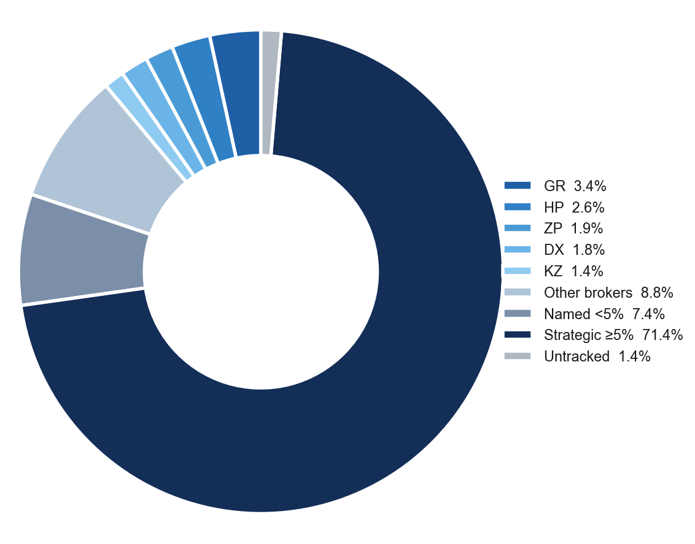
Ownership Structure
Shareholder Breakdown — 3-Tier Structure
Named Shareholders >1%
Holder | Shares | % | Tier
Prajogo Pangestu | 66.91B | 71.41% | ≥5%
Bangkok Bank Public Company | 4.68B | 4.99% | <5%
Anbo Holdings | 1.23B | 1.31% | <5%
Standard Chartered Bank | 1.04B | 1.11% | <5%
IDX Broker Analysis · 16 Jul 2026
6

Slide 7
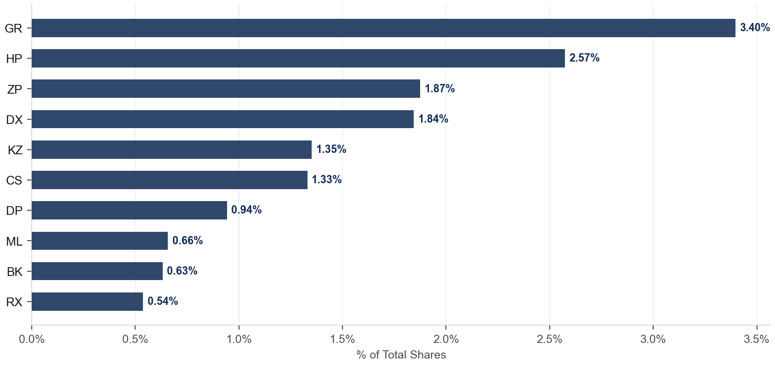
Broker Holdings — Top 10
Exchange Float · Top 10 Brokers · 19.8% of total shares
Detail
Broker | Type | Shares | %Co
GR | Lokal | 3.18B | 3.40%
HP | Lokal | 2.41B | 2.57%
ZP | Asing | 1.76B | 1.87%
DX | Pemerintah | 1.73B | 1.84%
KZ | Asing | 1.27B | 1.35%
CS | Asing | 1.25B | 1.33%
DP | Asing | 882.7M | 0.94%
ML | Asing | 616.5M | 0.66%
BK | Asing | 591.5M | 0.63%
RX | Asing | 504.3M | 0.54%
IDX Broker Analysis · 16 Jul 2026
7

Slide 8
AVCO Cost Basis — Top 20 Brokers
AVCO · Price-correlated lot matching (sell at P → consume lot nearest to P) · 88 brokers total · Current price Rp 1,752
Broker | Type | Shares | %Co | AVCO | Realized | Unrealized | Combined
GR | Lokal | 3.18B | 3.40% | Rp1,462 | -Rp66.55B | +Rp924.12B | +Rp857.57B
HP | Lokal | 2.41B | 2.57% | Rp1,394 | +Rp101.33B | +Rp863.64B | +Rp964.97B
ZP | Asing | 1.76B | 1.87% | Rp1,960 | +Rp91.65B | -Rp365.53B | -Rp273.88B
DX | Pemerintah | 1.73B | 1.84% | Rp918 | +Rp140.63B | +Rp1.4T | +Rp1.6T
KZ | Asing | 1.27B | 1.35% | Rp978 | +Rp41.39B | +Rp980.49B | +Rp1.0T
CS | Asing | 1.25B | 1.33% | Rp946 | +Rp12.37B | +Rp1.0T | +Rp1.0T
DP | Asing | 882.7M | 0.94% | Rp1,120 | +Rp267.67B | +Rp558.47B | +Rp826.14B
ML | Asing | 616.5M | 0.66% | Rp732 | +Rp4.42B | +Rp629.31B | +Rp633.72B
BK | Asing | 591.5M | 0.63% | Rp1,957 | +Rp221.52B | -Rp120.95B | +Rp100.57B
RX | Asing | 504.3M | 0.54% | Rp1,213 | +Rp128.04B | +Rp271.75B | +Rp399.79B
OD | Pemerintah | 352.1M | 0.38% | Rp2,003 | +Rp219.45B | -Rp88.33B | +Rp131.12B
YP | Asing | 338.8M | 0.36% | Rp1,674 | +Rp154.01B | +Rp26.49B | +Rp180.50B
XL | Lokal | 332.9M | 0.36% | Rp1,620 | +Rp35.10B | +Rp43.96B | +Rp79.06B
BB | Lokal | 295.6M | 0.32% | Rp2,762 | +Rp29.08B | -Rp298.47B | -Rp269.39B
DR | Asing | 273.8M | 0.29% | Rp1,895 | +Rp73.66B | -Rp39.15B | +Rp34.51B
PD | Lokal | 259.3M | 0.28% | Rp1,725 | +Rp156.23B | +Rp7.18B | +Rp163.41B
CG | Asing | 227.9M | 0.24% | Rp932 | +Rp1.14B | +Rp187.01B | +Rp188.15B
CC | Pemerintah | 196.5M | 0.21% | Rp1,600 | +Rp745.53B | +Rp29.99B | +Rp775.52B
TP | Asing | 185.7M | 0.20% | Rp2,244 | +Rp32.27B | -Rp91.27B | -Rp59.01B
MG | Lokal | 145.3M | 0.15% | Rp1,745 | +Rp96.86B | +Rp1.11B | +Rp97.98B
IDX Broker Analysis · 16 Jul 2026
8

Slide 9
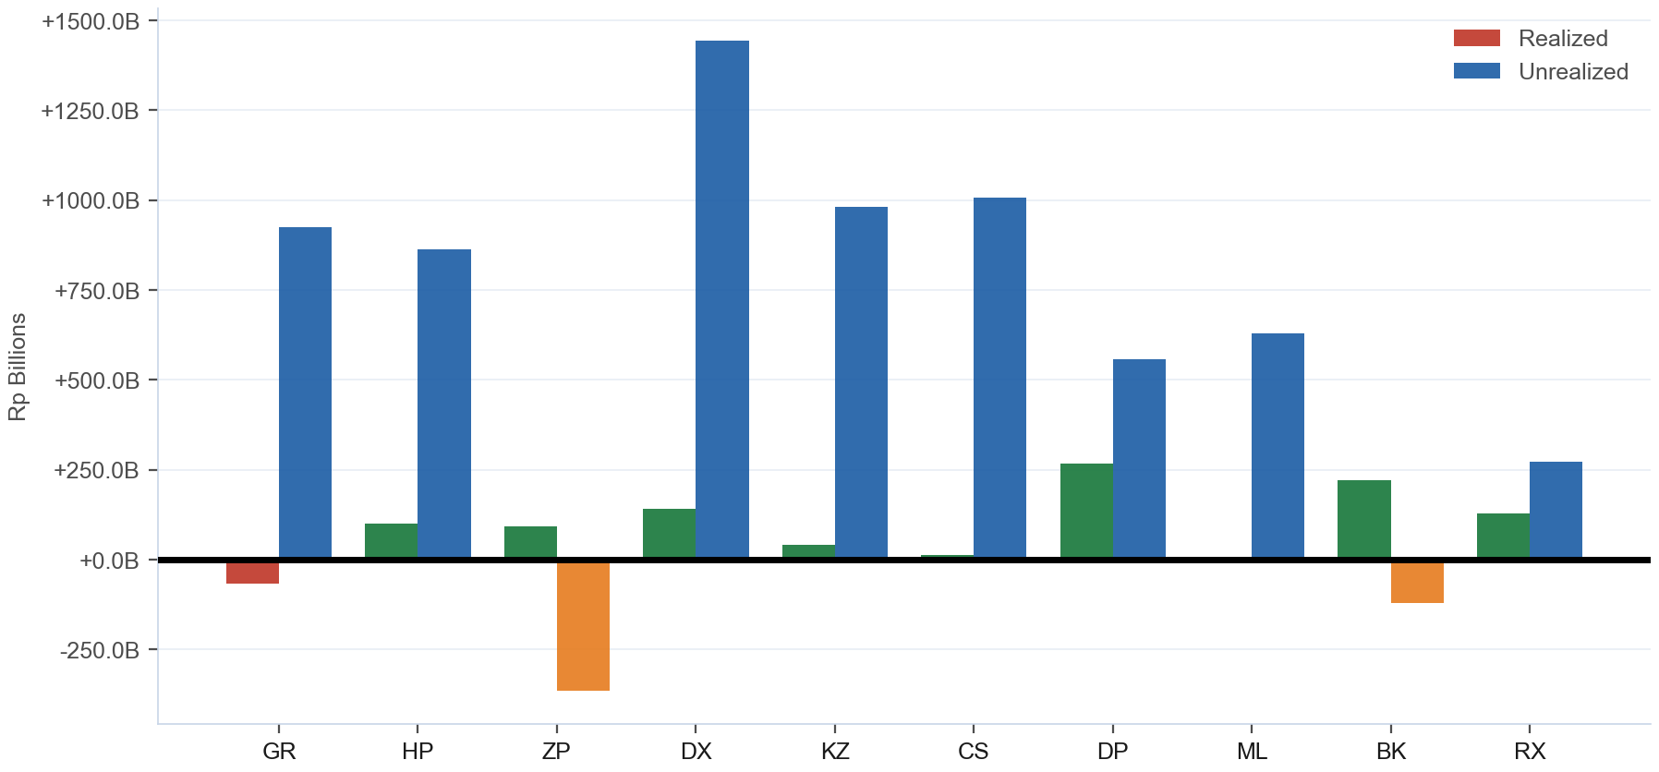
Combined P&L — Realized + Unrealized
Realized: +Rp6.1T · Unrealized: +Rp6.4T · Combined: +Rp12.5T · 84/88 profitable
IDX Broker Analysis · 16 Jul 2026
9

Slide 10
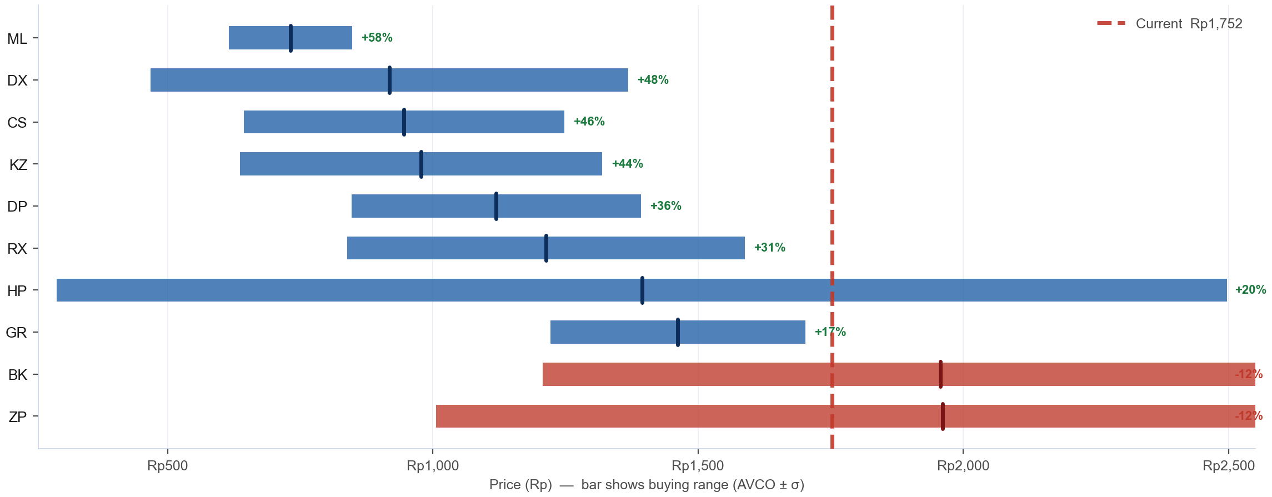
AVCO Distribution — Where Did the Top 10 Buy?
Top 10 by shares · Bar = buying range (AVCO ± 1σ) · Tick = average cost (AVCO) · Blue = in profit (AVCO below Rp 1,752) · Red = underwater · % = unrealized profit or loss vs current price
IDX Broker Analysis · 16 Jul 2026
10

Slide 11
SD / Conviction Analysis — Accumulation Behaviour
σ ≤ 15 = disciplined zone buyers · σ > 25 = price-chasers · Tightest = within last 6 months (bullish) · Rel σ (σ÷market σ) on Bell Curve slide — <1.0 = tighter than market
TIGHT σ ≤ 15
MODERATE σ 16-25
WIDE / EXTREME σ>25
Broker | AVCO | σ | Shares | Tightest | Range
TS | Rp1,654 | 4.3 | 17.1M | — | 1650–1658
SM | Rp96 | 4.3 | 4.5M | — | 91–100
LH | Rp824 | 14.8 | 2.0M | — | 809–838
CD | Rp1,786 | 0.1 | 1.4M | May '26 (R) | 1786–1787
AH | Rp883 | 2.0 | 515K | — | 880–885
Broker | AVCO | σ | Shares | Tightest | Range
SF | Rp974 | 23.1 | 2.6M | — | 951–997
Broker | AVCO | σ | Shares | Tightest | Range
GR | Rp1,462 | 240.1 | 3.18B | Feb '26 (R) | 1222–1702
HP | Rp1,394 | 1102.9 | 2.41B | Mar '26 (R) | 292–2497
ZP | Rp1,960 | 953.9 | 1.76B | Feb '26 (R) | 1007–2914
DX | Rp918 | 450.1 | 1.73B | Feb '26 (R) | 468–1368
KZ | Rp978 | 341.5 | 1.27B | Jun '26 (R) | 636–1319
CS | Rp946 | 302.1 | 1.25B | — | 643–1248
DP | Rp1,120 | 272.2 | 882.7M | — | 847–1392
ML | Rp732 | 116.1 | 616.5M | — | 616–848
BK | Rp1,957 | 749.9 | 591.5M | Feb '26 (R) | 1207–2707
RX | Rp1,213 | 374.4 | 504.3M | Feb '26 (R) | 839–1588
…+65 more
IDX Broker Analysis · 16 Jul 2026
11

Slide 12
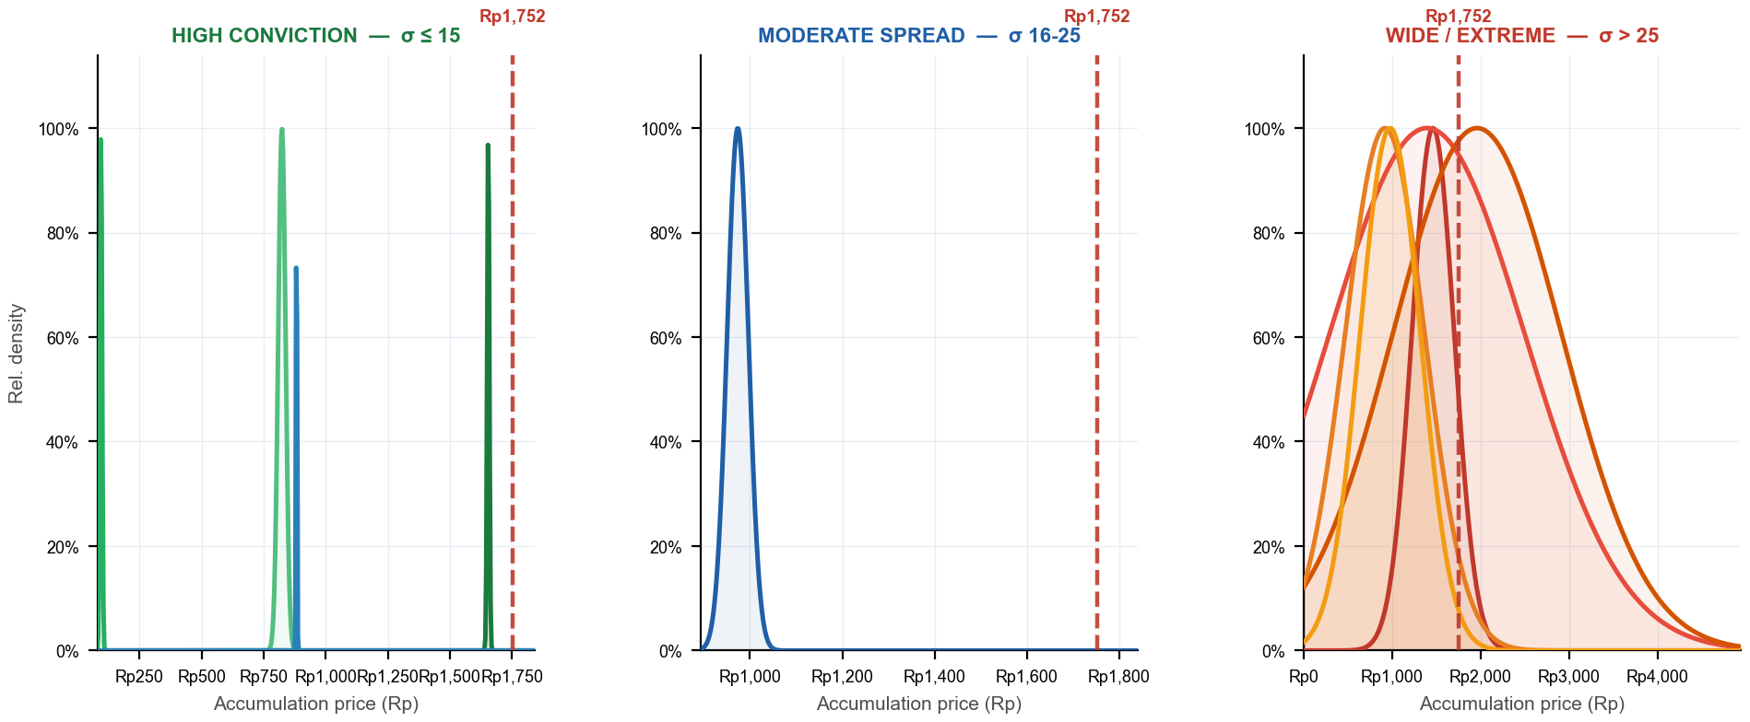
Bell Curves — Accumulation Distribution by Conviction Tier
Narrow peak = disciplined buyer (high conviction) · Flat curve = no price discipline · 3 panels — one per σ tier · Each panel has its own zoomed x-axis · Red dashed = current price · Curve normalized to peak = 1.0
TS σ4 · SM σ4 · LH σ15 · CD σ0 · AH σ2
SF σ23
GR σ240 · HP σ1103 · ZP σ954 · DX σ450 · KZ σ341
σ Evolution — Top 5 by Shares · σ = buy-price std deviation (lower = more focused zone buying) · Trend = σ 30d vs σ 180d (Tightening = buying more focused recently)
Broker | Shares | σ All-time | σ 30d | σ 90d | σ 180d | Rel σ 30d | Trend (30d vs 180d)
GR | 3.18B | 240.1 | 139.4 | 277.6 | 339.3 | 1.21 | Tightening
HP | 2.41B | 1102.9 | 107.4 | 257.3 | 306.6 | 0.94 | Tightening
ZP | 1.76B | 953.9 | 116.4 | 257.3 | 321.7 | 1.01 | Tightening
DX | 1.73B | 450.1 | 67.8 | 241.2 | 355.8 | 0.59 | Tightening
KZ | 1.27B | 341.5 | 23.1 | 252.1 | 312.3 | 0.20 | Tightening
IDX Broker Analysis · 16 Jul 2026
12

Slide 13
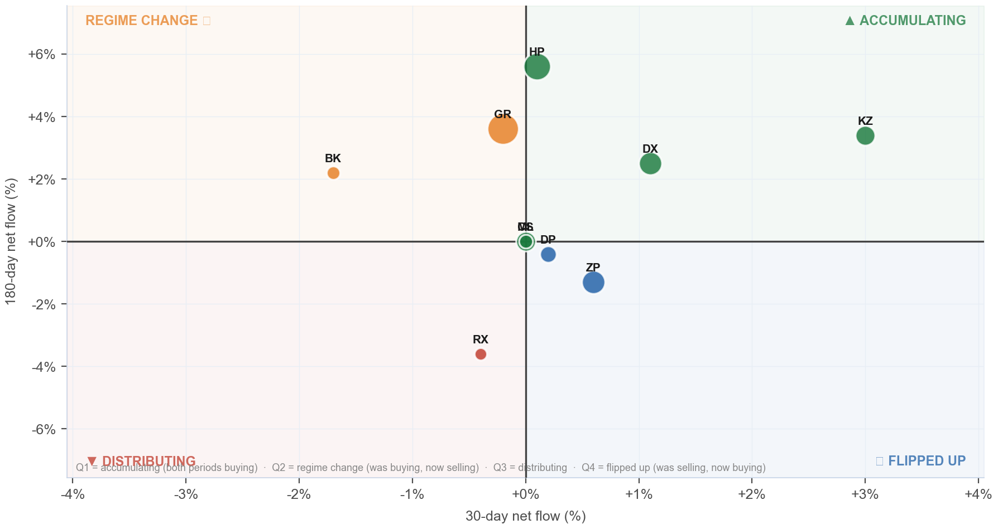
Broker Regime Map — 30d vs 180d Net Flow
X = 30d net flow % · Y = 180d net flow % · Bubble ∝ ownership % · Green=Accumulating · Orange=Regime Change · Red=Distributing · Blue=Flipped Up
Detail
Broker | 30d | 180d
GR | -0.2% | +3.6%
HP | +0.1% | +5.6%
ZP | +0.6% | -1.3%
DX | +1.1% | +2.5%
KZ | +3.0% | +3.4%
CS | +0.0% | +0.0%
DP | +0.2% | -0.4%
ML | +0.0% | +0.0%
BK | -1.7% | +2.2%
RX | -0.4% | -3.6%
IDX Broker Analysis · 16 Jul 2026
13

Slide 14
Investment Thesis — BRPT at Rp 1,752
Bullish Signals
Tactical Caution
AVCO median Rp 1,600 — price is ABOVE median broker cost.
Named <5% holders (7.4%) = direct KSEI holders (creditor conversions, IPO allotments, or pre-IPO investors — entry price varies) — exit adds unexpected supply.
Net unrealized gain +Rp6.4T — broker float predominantly profitable.
Realized armor: +Rp6.1T banked profit provides buffer.
Top 10 brokers hold 15.1% of total shares — concentrated, large incremental moves possible.
84/88 brokers profitable — majority positioned to hold.
IDX Broker Analysis · 16 Jul 2026
14

Slide 15
Ownership Reconciliation & Methodology
Share Count Reconciliation — 3-Tier Ownership Model
Category | Shares | % | Notes
Strategic ≥5% (founders/pre-IPO) | 66.91B | 71.41% | KSEI direct — never in broker flow, zero overlap
Named <5% (direct KSEI — creditor/allotment/pre-IPO) | 6.95B | 7.42% | May overlap broker float — entry cost varies by holder type (shown gross)
Broker-tracked float | 18.57B | 19.81% | Raw broker flow data — may overlap with named <5% holders
Untracked (KSEI, unidentified) | 1.28B | 1.36% | Not in named list or broker data
TOTAL SHARES OUTSTANDING | 93.70B | 100.00% | Fully reconciled
Methodology
AVCO: price-correlated lot matching — on SELL at price P, consume the lot with min |buy_price − P|. Correct for aggregate broker data; raw FIFO and equal-weight AVCO both produce incorrect basis.
Gross flows: Stockbit Net-OFF — separate BUY/SELL rows per broker per day. Data: 2016-01-04 → 2026-07-15 (2530 days).
Corporate actions: applied in-queue on recording date. Forward splits/bonus: lots ×multiplier, prices ×(1/multiplier). Reverse splits: lots ÷multiplier, prices ×multiplier. No post-hoc factor.
Realized P&L: realized_pnl_rp from holdings_final.csv (LotQueue). NOT avco_realized — can differ by billions on high-volume brokers.
IDX Broker Analysis · 16 Jul 2026
15

Slide 16
Broker Intelligence — VWAP Alpha & Ownership Clustering
VWAP alpha < 0 = broker buys cheaper than market average · r > 0.50 shown · r ≥ 0.70 + both non-MM = amber (strong same-owner signal) · Negative r = counterparty/transfer behavior, not co-ownership
BUY VWAP ALPHA vs market (all history)
CORRELATED BROKER PAIRS (same owner signal)
Broker | Mean α | Days<Mkt | t-stat | Buy days
II PPE | -1.120% | 53% | -1.8 | 19
ID PPE | -0.989% | 81% | -2.2 | 16
SM PPE | -0.960% | 62% | -2.6 | 39
PI PPE | -0.775% | 52% | -1.5 | 23
BF PPE | -0.677% | 73% | -2.3 | 15
HP ACC | -0.397% | 59% | -4.3 | 818
SS CHN | -0.296% | 56% | -1.5 | 125
MU PPE | -0.248% | 61% | -1.0 | 23
KI PPE | -0.213% | 59% | -4.6 | 763
GW MM | -0.169% | 63% | -0.6 | 19
RO MM | -0.164% | 54% | -2.6 | 395
IF MM | -0.151% | 60% | -2.3 | 294
PF MM | -0.150% | 51% | -1.8 | 271
YJ MM | -0.144% | 56% | -2.8 | 667
SQ PPE | -0.143% | 65% | -4.5 | 1143
Pair | r | Overlap | Roles
XC/XL | +0.625 | 726d | STR|ACC
BK/RX | -0.549 | 622d | STR|STR
AF/DP | -0.629 | 89d | DIS|ACC
AI/GR | -0.975 | 665d | DIS|ACC
★ AMBER = r ≥ 0.70 + both non-MM roles = likely single owner
IDX Broker Analysis · 16 Jul 2026
16

