Slide 1
MEJA
16 Jul 2026
Rp 80
Current Price
PT Harta Djaya Karya Tbk
IDX Broker Flow Intelligence · AVCO Analysis
Strategic Block (≥5%)
Broker-Tracked Float
Named <5% Holders
39.3%
58.6%
9.4%
AVCO Realized P&L
AVCO Combined P&L
Profitable Brokers
-Rp6.72B
-Rp27.85B
40/72
IDX Broker Analysis · 16 Jul 2026
1

Slide 2
Executive Summary
Key Metrics
Key Findings
Metric | Value
Market Price | Rp 80
Strategic Block (≥5%) | 39.3%
Named <5% Holders | 9.4%
Broker-Tracked Float | 58.6%
Untracked | 0.00%
AVCO Median | Rp 94
Overhead Supply? | YES
AVCO Realized P&L | -Rp6.72B
AVCO Unrealized P&L | -Rp21.13B
AVCO Combined P&L | -Rp27.85B
Profitable Brokers | 40 / 72
Top 5 Concentration | 37.5%
Top 10 Concentration | 47.1%
Trading Days | 495
Data Range | 2024-02-12 → 2026-07-16
Median broker cost Rp 94 vs market Rp 80 — price is below average break-even.
3-tier ownership: 39.3% strategic (KSEI direct), 9.4% named <5%, 58.6% broker-tracked float.
AVCO combined P&L: -Rp27.85B — 40 of 72 brokers profitable at current price.
Realized P&L: -Rp6.72B banked — provides cushion against paper losses.
Top 10 brokers hold 47.1% of exchange float — moderately concentrated.
Largest holder: XL at 14.42%, AVCO Rp 92, unrealized -Rp4.64B.
Price controllers (last 6m): CC · YP · YJ — CC (Rp91 σ26, lead r=+0.07, Directional / no clear signal) | YP (Rp93 σ71, lead r=+0.10, Support). Identified via buy-lead correlation with next-day price returns.
IDX Broker Analysis · 16 Jul 2026
2

Slide 3
Market Maker Identification — CC · YP · YJ
Identification Methodology — Last 6 Months
Candidate Comparison — sorted by MM Score · Lead ≥ 0.12 or Floor ≥ 55% or Buy% ≥ 75% = threshold
Signal 1 — Gross Flow Value (50%)
Broker | Type | Lead r | Contemp r | Buy% | Gross | Net Pos | Net/Gross | Score | Status
CC | Pemerintah | +0.074 | -0.111 | 76% | 703.6M | 170.9M | 0.243 | 72.8 | Selected
YP | Asing | +0.095 | -0.124 | 68% | 502.6M | 166.9M | 0.332 | 56.1 | Selected
YJ | Lokal | +0.121 | +0.159 | 66% | 362.8M | 168.0M | 0.463 | 46.5 | Selected
CP |  | +0.088 | +0.100 | 66% | 180.8M | 1 | 0.000 | 32.8 | —
AK | Asing | +0.093 | +0.071 | 45% | 259.3M | 2.9M | 0.011 | 32.0 | —
KK | Asing | -0.275 | -0.164 | 67% | 135.1M | 82.8M | 0.613★ | 29.8 | —
NI | Pemerintah | -0.090 | -0.008 | 68% | 128.8M | 53.8M | 0.418★ | 29.6 | —
OD | Pemerintah | -0.164 | -0.082 | 76% | 71.9M | 23.0M | 0.320★ | 27.9 | —
SQ | Lokal | -0.125 | -0.023 | 64% | 119.6M | 20.9M | 0.174 | 27.6 | —
LG | Lokal | -0.045 | +0.066 | 59% | 136.8M | 37.0M | 0.271 | 27.5 | —
MG | Lokal | +0.181 | +0.259 | 40% | 137.8M | 9.9M | 0.072 | 26.4 | Operator
XL | Lokal | +0.088 | +0.047 | 67% | 1.84B | 376.1M | 0.035 | 0.0 | Excluded
XC | Lokal | -0.197 | +0.007 | 65% | 340.2M | 96.5M | 0.000 | 0.0 | Excluded
broker gross_vol ÷ max broker gross_vol in same window. The broker that transacts the most total value (buy + sell) is the price-setter on IDX — MMs dominate volume, not just direction. Top traders by value score highest.
Signal 2 — Daily Consistency (30%)
buy_presence = buy_days ÷ total trading days in 6m window. Real MMs show up almost every session. ≥ 50% gate to enter top-3 selection.
Signal 3 — Price Correlation (20%)
Max(lead_corr, contemp_corr) t-stat weighted. Confirms the MM is actually moving price, not just providing neutral liquidity. Distributor penalty: zeroed if lead < −0.15 (buying before own price drops = distribution).
★ Net/Gross Ratio — Insider Signal
Net shares held ÷ 6-month gross flow. High ratio (>0.30) = broker accumulates quietly without churning — classic informed-money pattern. Purple-tinted rows in table — NOT selected as MM but flagged as potential insiders. Note: numerator is all-time, denominator is 6m.
XC/XL — Retail Aggregators, NOT Excluded from Intelligence
XL (Stockbit) and XC (Ajaib) are excluded from MM SCORING only — their gross volume is retail aggregation, not structural price control. However they are NOT excluded from VWAP Alpha or correlation analysis (slide 17). The XC/XL correlation pair should be treated as ambiguous: could be retail co-movement or same beneficial owner routing through two platforms. Cannot be ruled out as insiders without KSEI account-level data.
Selected: CC · YP · YJ — top 3 by MM Score
Green = Selected MM (biggest gross flow + daily presence) | Purple tint ★ = Quiet Accumulator (high Net/Gross, insider-like) | Amber = P&D Operator | Tan = Retail Aggregator (excl.)
IDX Broker Analysis · 16 Jul 2026
3

Slide 4
Market Maker Deep Dive — CC · YP · YJ
Price controllers identified via buy-lead correlation with next-day price (last 6m) · Tight zone = month with lowest buy-price σ · Distribution = sell-dominant periods (≥3% net sold)
CC Pemerintah | 170.9M (6.55%)
PEAK HOLDINGS (200d)
Peak Shares | 170.9M (6.55%)
Peak Date | Jul 2026
vs Current | +0M shares vs now
ACCUMULATION ZONE
Tightest Month | Jul '26 (recent)
Avg Buy Price | Rp84
σ at Tightest | 2.8
Price Range ±1σ | Rp81 – Rp87
DISTRIBUTION ZONE
Avg Sell Price | Rp131
σ at Distribution | 27.9
Price Range ±1σ | Rp103 – Rp159
LAST 5d ACTION
Direction | NET BUYING
Net Volume | +3.0M
% of Holdings | +1.75%
Avg Price | Rp81
Conviction σ | σ1.5 — Tight
YP Asing | 166.9M (6.40%)
PEAK HOLDINGS (200d)
Peak Shares | 269.5M (10.33%)
Peak Date | Jan 2026
vs Current | +103M shares vs now
ACCUMULATION ZONE
Tightest Month | Jul '26 (recent)
Avg Buy Price | Rp85
σ at Tightest | 3.5
Price Range ±1σ | Rp82 – Rp88
DISTRIBUTION ZONE
Avg Sell Price | Rp120
σ at Distribution | 29.3
Price Range ±1σ | Rp91 – Rp149
LAST 5d ACTION
Direction | NET SELLING
Net Volume | -0.3M
% of Holdings | -0.20%
Avg Price | Rp80
Conviction σ | σ1.2 — Tight
YJ Lokal | 168.0M (6.44%)
PEAK HOLDINGS (200d)
Peak Shares | 168.0M (6.44%)
Peak Date | Jul 2026
vs Current | +0M shares vs now
ACCUMULATION ZONE
Tightest Month | Jul '26 (recent)
Avg Buy Price | Rp85
σ at Tightest | 2.7
Price Range ±1σ | Rp82 – Rp88
DISTRIBUTION ZONE
Avg Sell Price | Rp111
σ at Distribution | 19.6
Price Range ±1σ | Rp91 – Rp131
LAST 5d ACTION
Direction | NET BUYING
Net Volume | +0.2M
% of Holdings | +0.12%
Avg Price | Rp81
Conviction σ | σ1.0 — Tight
IDX Broker Analysis · 16 Jul 2026
4

Slide 5
Pre-Move Accumulation — Insider Confidence Signal
Who loaded up 1–3 weeks before price surged ≥15% · last 12 months · min 5M shares · min 5 active days · Hit% = surges front-ran ÷ total surges detected
Week End | Surge | VWAP Rp | Pre-Buyers (21d) | Day 1 Entry | Pos%
2026-04-15 | +36% | 77→104 | CC(6.2M) | XL*(10.2M) · CC(5.4M) | +5%
2026-02-18 | +38% | 75→103 | CC(56.7M) · XC*(20.7M) · NI(16.7 | XL*(22.0M) · YP(17.6M) | New
2026-01-05 | +58% | 76→121 | XC*(64.1M) · YJ(29.5M) · YP(27.6 | XL*(48.9M) · YP(16.0M) | New
2025-10-13 | +30% | 105→137 | YP(52.9M) · CP(45.7M) · MG(29.8M | AI(3.5M) | +157%
2025-09-25 | +61% | 77→125 | XL*(86.5M) · YU(68.0M) · YP(50.4 | YP(16.8M) · AT(12.9M) | New
2025-09-02 | +59% | 48→77 | XL*(185.4M) · YP(92.1M) · CC(52. | YU(53.0M) · YP(2.9M) | New
2025-08-13 | +53% | 29→45 | YU(81.4M) · XL*(27.5M) · YP(12.8 | XL*(2.8M) | New
TOP 3 SIGNAL BROKERS
Broker | N | Hit% | Pre Vol | Avg Pos%
YP | 6 | 86% | 241M | +121%
YU | 2 | 29% | 149M | New
CC | 4 | 57% | 122M | +404%
ACCUMULATION RANKING
Broker | N | Hit% | Pre Vol | Avg Pos% | Class
XL | 4 | 57% | 322M | +321% | Retail Flow
YP | 6 | 86% | 241M | +121% | INSIDER-LIKE
YU | 2 | 29% | 149M | New | INSIDER-LIKE
XC | 5 | 71% | 144M | +56% | Retail Flow
CC | 4 | 57% | 122M | +404% | INSIDER-LIKE
POST-SURGE DISTRIBUTORS
Surge End | Broker | Net Sold
2026-04-15 | CC | -22.2M
 | BR | -8.6M
2026-02-18 | YP | -69.2M
 | BR | -12.9M
2026-01-05 | CC | -182.8M
 | AK | -51.4M
* retail aggregator (Ajaib/Stockbit) — volume is real but not coordinated · Pos% uses first signal broker
IDX Broker Analysis · 16 Jul 2026
5

Slide 6
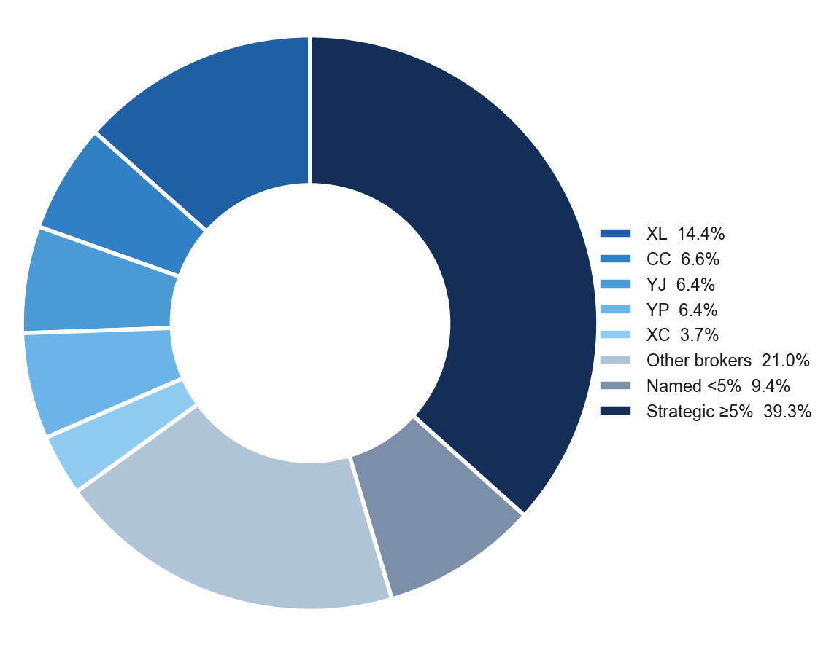
Ownership Structure
Shareholder Breakdown — 3-Tier Structure
Named Shareholders >1%
Holder | Shares | % | Tier
PT Triple Berkah Bersama | 1.03B | 39.31% | ≥5%
Donny Hartanto | 89.8M | 3.44% | <5%
William Febrian Adianto | 36.8M | 1.41% | <5%
Maria Christina S | 29.3M | 1.12% | <5%
Evan Iskandar | 27.7M | 1.06% | <5%
Haskojaya Abadi | 27.3M | 1.05% | <5%
Supian | 26.8M | 1.03% | <5%
Richie Adrian Hartanto S | 7.6M | 0.29% | <5%
IDX Broker Analysis · 16 Jul 2026
6

Slide 7
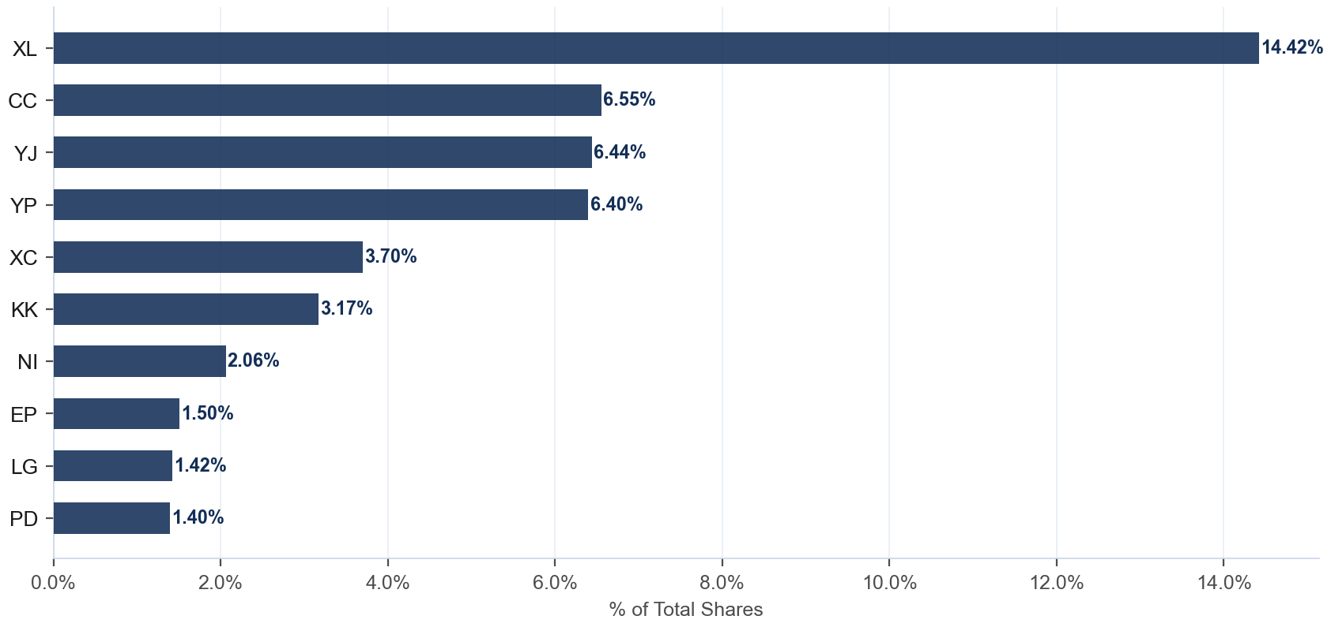
Broker Holdings — Top 10
Exchange Float · Top 10 Brokers · 58.6% of total shares
Detail
Broker | Type | Shares | %Co
XL | Lokal | 376.1M | 14.42%
CC | Pemerintah | 170.9M | 6.55%
YJ | Lokal | 168.0M | 6.44%
YP | Asing | 166.9M | 6.40%
XC | Lokal | 96.5M | 3.70%
KK | Asing | 82.8M | 3.17%
NI | Pemerintah | 53.8M | 2.06%
EP | Lokal | 39.2M | 1.50%
LG | Lokal | 37.0M | 1.42%
PD | Lokal | 36.4M | 1.40%
IDX Broker Analysis · 16 Jul 2026
7

Slide 8
AVCO Cost Basis — Top 20 Brokers
AVCO · Price-correlated lot matching (sell at P → consume lot nearest to P) · 72 brokers total · Current price Rp 80
Broker | Type | Shares | %Co | AVCO | Realized | Unrealized | Combined
XL | Lokal | 376.1M | 14.42% | Rp92 | -Rp0.80B | -Rp4.64B | -Rp5.45B
CC | Pemerintah | 170.9M | 6.55% | Rp91 | +Rp2.83B | -Rp1.81B | +Rp1.02B
YJ | Lokal | 168.0M | 6.44% | Rp93 | +Rp1.92B | -Rp2.13B | -Rp0.20B
YP | Asing | 166.9M | 6.40% | Rp93 | +Rp0.38B | -Rp2.15B | -Rp1.77B
XC | Lokal | 96.5M | 3.70% | Rp94 | +Rp0.04B | -Rp1.34B | -Rp1.31B
KK | Asing | 82.8M | 3.17% | Rp92 | +Rp0.29B | -Rp1.01B | -Rp0.72B
NI | Pemerintah | 53.8M | 2.06% | Rp97 | +Rp0.21B | -Rp0.92B | -Rp0.71B
EP | Lokal | 39.2M | 1.50% | Rp93 | +Rp0.87B | -Rp0.50B | +Rp0.37B
LG | Lokal | 37.0M | 1.42% | Rp89 | +Rp1.22B | -Rp0.32B | +Rp0.90B
PD | Lokal | 36.4M | 1.40% | Rp92 | -Rp0.68B | -Rp0.45B | -Rp1.13B
AT | Lokal | 32.3M | 1.24% | Rp145 | +Rp0.89B | -Rp2.11B | -Rp1.23B
TP | Asing | 24.5M | 0.94% | Rp82 | +Rp0.01B | -Rp0.06B | -Rp0.05B
OD | Pemerintah | 23.0M | 0.88% | Rp94 | -Rp2.17B | -Rp0.31B | -Rp2.48B
SQ | Lokal | 20.9M | 0.80% | Rp90 | +Rp0.02B | -Rp0.22B | -Rp0.20B
DR | Asing | 20.4M | 0.78% | Rp88 | +Rp0.75B | -Rp0.16B | +Rp0.59B
GR | Lokal | 20.4M | 0.78% | Rp96 | +Rp0.47B | -Rp0.32B | +Rp0.15B
CD | Lokal | 18.0M | 0.69% | Rp117 | +Rp0.02B | -Rp0.66B | -Rp0.64B
DH | Lokal | 15.5M | 0.59% | Rp94 | +Rp0.18B | -Rp0.21B | -Rp0.03B
BQ | Asing | 14.8M | 0.57% | Rp87 | +Rp1.12B | -Rp0.10B | +Rp1.01B
TS | Lokal | 10.4M | 0.40% | Rp117 | +Rp0.00B | -Rp0.39B | -Rp0.39B
IDX Broker Analysis · 16 Jul 2026
8

Slide 9
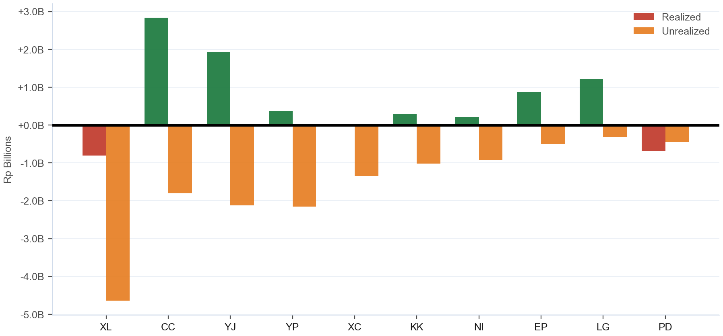
Combined P&L — Realized + Unrealized
Realized: -Rp6.72B · Unrealized: -Rp21.13B · Combined: -Rp27.85B · 40/72 profitable
IDX Broker Analysis · 16 Jul 2026
9

Slide 10
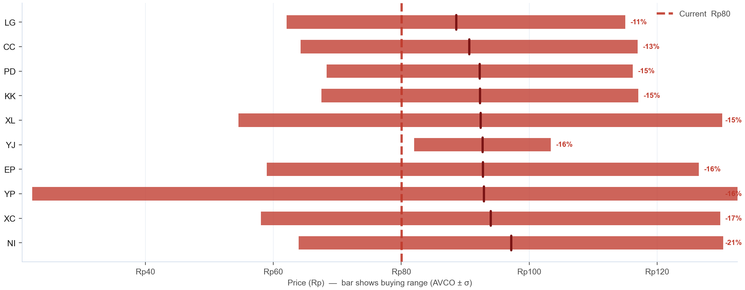
AVCO Distribution — Where Did the Top 10 Buy?
Top 10 by shares · Bar = buying range (AVCO ± 1σ) · Tick = average cost (AVCO) · Blue = in profit (AVCO below Rp 80) · Red = underwater · % = unrealized profit or loss vs current price
IDX Broker Analysis · 16 Jul 2026
10

Slide 11
SD / Conviction Analysis — Accumulation Behaviour
σ ≤ 15 = disciplined zone buyers · σ > 25 = price-chasers · Tightest = within last 6 months (bullish) · Rel σ (σ÷market σ) on Bell Curve slide — <1.0 = tighter than market
TIGHT σ ≤ 15
MODERATE σ 16-25
WIDE / EXTREME σ>25
Broker | AVCO | σ | Shares | Tightest | Range
YJ | Rp93 | 10.7 | 168.0M | Jul '26 (R) | 82–103
CD | Rp117 | 9.6 | 18.0M | Mar '26 (R) | 107–126
SS | Rp95 | 11.6 | 6.7M | Jan '26 | 83–106
AI | Rp90 | 5.5 | 6.2M | Feb '26 (R) | 85–96
AZ | Rp84 | 8.2 | 4.9M | Jul '26 (R) | 76–92
IN | Rp81 | 5.4 | 3.0M | Apr '26 (R) | 76–87
PG | Rp96 | 6.2 | 2.9M | — | 89–102
LS | Rp70 | 5.6 | 2.8M | Mar '26 (R) | 65–76
RB | Rp97 | 12.4 | 2.5M | May '26 (R) | 85–109
EL | Rp95 | 5.6 | 2.5M | Apr '26 (R) | 89–100
…+17 more
Broker | AVCO | σ | Shares | Tightest | Range
KK | Rp92 | 24.8 | 82.8M | Jul '26 (R) | 68–117
PD | Rp92 | 23.9 | 36.4M | Jul '26 (R) | 68–116
TP | Rp82 | 23.7 | 24.5M | Mar '26 (R) | 59–106
BQ | Rp87 | 19.3 | 14.8M | Jul '26 (R) | 68–106
TS | Rp117 | 16.0 | 10.4M | — | 101–133
YB | Rp90 | 23.3 | 8.0M | Jul '26 (R) | 67–114
AG | Rp96 | 24.6 | 3.1M | Mar '26 (R) | 72–121
AK | Rp83 | 23.4 | 2.9M | Jun '26 (R) | 59–106
OK | Rp93 | 19.2 | 2.7M | Feb '26 (R) | 73–112
IF | Rp99 | 18.4 | 2.6M | May '26 (R) | 81–117
…+2 more
Broker | AVCO | σ | Shares | Tightest | Range
XL | Rp92 | 37.8 | 376.1M | Jul '26 (R) | 55–130
CC | Rp91 | 26.3 | 170.9M | Jul '26 (R) | 64–117
YP | Rp93 | 70.6 | 166.9M | Jul '26 (R) | 22–164
XC | Rp94 | 35.9 | 96.5M | Jul '26 (R) | 58–130
NI | Rp97 | 33.2 | 53.8M | Jul '26 (R) | 64–130
EP | Rp93 | 33.8 | 39.2M | Jul '26 (R) | 59–127
LG | Rp89 | 26.5 | 37.0M | Jul '26 (R) | 62–115
AT | Rp145 | 50.0 | 32.3M | Jul '26 (R) | 95–195
OD | Rp94 | 98.3 | 23.0M | Jul '26 (R) | 0–192
SQ | Rp90 | 49.1 | 20.9M | Jul '26 (R) | 41–140
…+14 more
IDX Broker Analysis · 16 Jul 2026
11

Slide 12
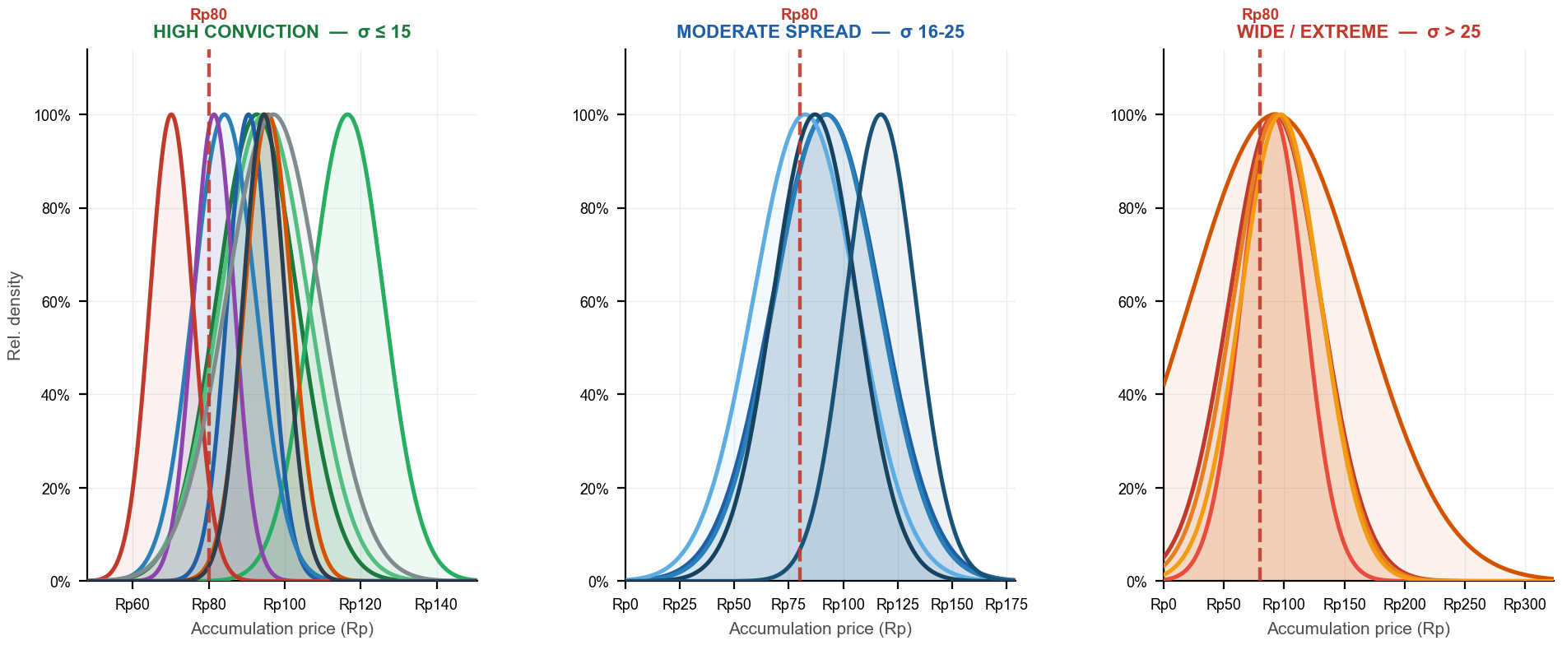
Bell Curves — Accumulation Distribution by Conviction Tier
Narrow peak = disciplined buyer (high conviction) · Flat curve = no price discipline · 3 panels — one per σ tier · Each panel has its own zoomed x-axis · Red dashed = current price · Curve normalized to peak = 1.0
YJ σ11 · CD σ10 · SS σ12 · AI σ6 · AZ σ8 · IN σ5 · PG σ6 · LS σ6 · RB σ12 · EL σ6
KK σ25 · PD σ24 · TP σ24 · BQ σ19 · TS σ16
XL σ38 · CC σ26 · YP σ71 · XC σ36 · NI σ33
σ Evolution — Top 5 by Shares · σ = buy-price std deviation (lower = more focused zone buying) · Trend = σ 30d vs σ 180d (Tightening = buying more focused recently)
Broker | Shares | σ All-time | σ 30d | σ 90d | σ 180d | Rel σ 30d | Trend (30d vs 180d)
XL | 376.1M | 37.8 | 4.4 | 14.3 | 13.9 | 1.06 | Tightening
CC | 170.9M | 26.3 | 4.8 | 14.2 | 14.4 | 1.16 | Tightening
YJ | 168.0M | 10.7 | 6.2 | 11.7 | 10.4 | 1.51 | Tightening
YP | 166.9M | 70.6 | 3.9 | 16.4 | 16.6 | 0.95 | Tightening
XC | 96.5M | 35.9 | 4.2 | 14.2 | 17.9 | 1.02 | Tightening
IDX Broker Analysis · 16 Jul 2026
12

Slide 13
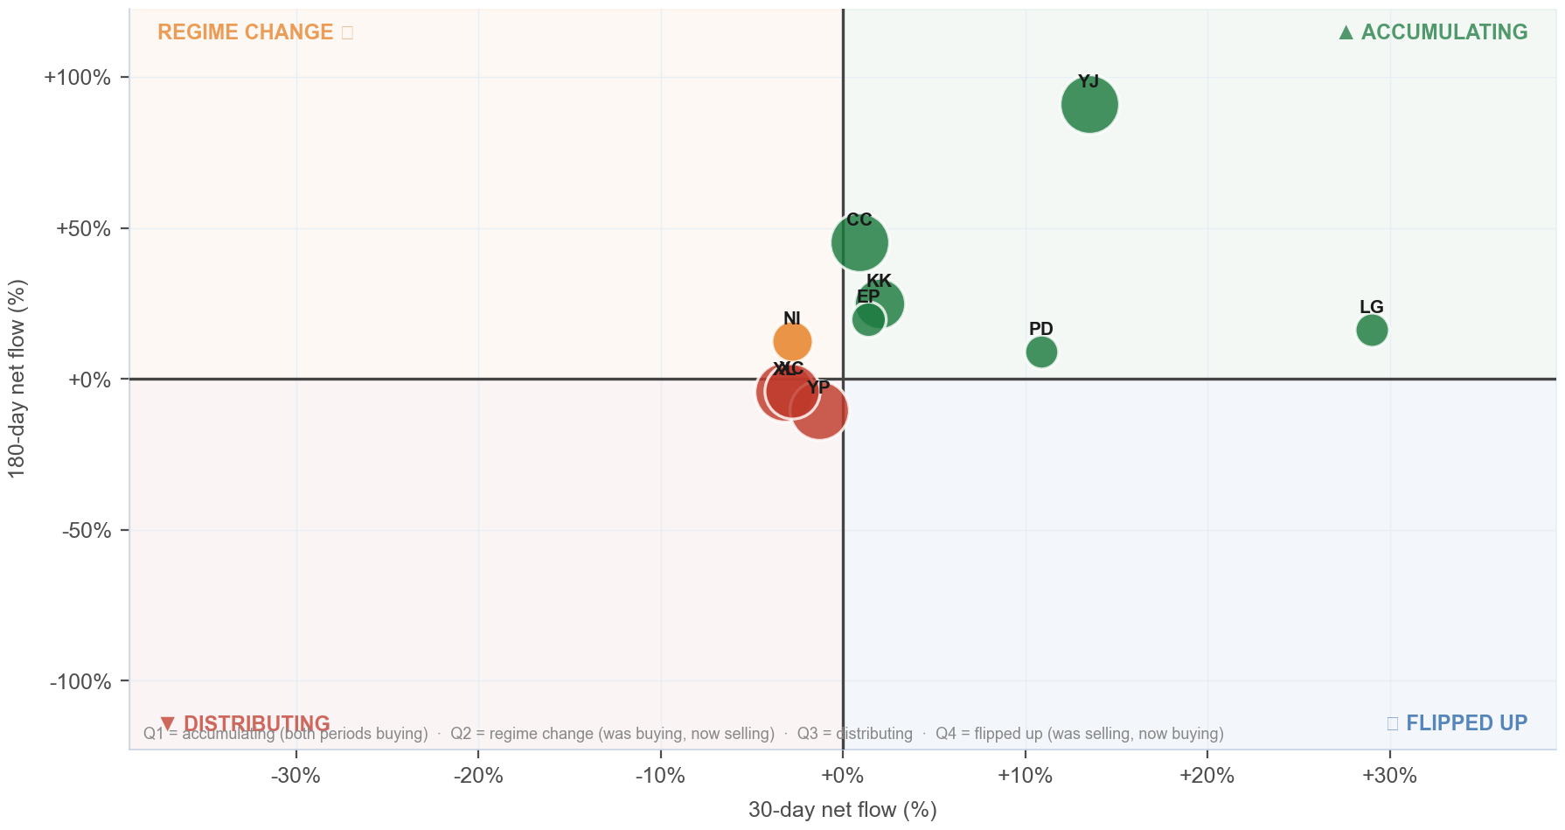
Broker Regime Map — 30d vs 180d Net Flow
X = 30d net flow % · Y = 180d net flow % · Bubble ∝ ownership % · Green=Accumulating · Orange=Regime Change · Red=Distributing · Blue=Flipped Up
Detail
Broker | 30d | 180d
XL | -3.2% | -4.2%
CC | +0.9% | +45.2%
YJ | +13.5% | +90.9%
YP | -1.3% | -10.3%
XC | -2.8% | -4.1%
KK | +2.0% | +25.0%
NI | -2.8% | +12.4%
EP | +1.4% | +19.7%
LG | +29.0% | +16.4%
PD | +10.9% | +8.9%
IDX Broker Analysis · 16 Jul 2026
13

Slide 14
Investment Thesis — MEJA at Rp 80
Bullish Signals
Tactical Caution
AVCO median Rp 94 — price is BELOW median broker cost.
Net unrealized loss -Rp21.13B — underwater positions create exit pressure on rallies.
Top 10 brokers hold 47.1% of total shares — concentrated, large incremental moves possible.
Only 40/72 brokers profitable — elevated distribution risk.
Named <5% holders (9.4%) = direct KSEI holders (creditor conversions, IPO allotments, or pre-IPO investors — entry price varies) — exit adds unexpected supply.
IDX Broker Analysis · 16 Jul 2026
14

Slide 15
Ownership Reconciliation & Methodology
Share Count Reconciliation — 3-Tier Ownership Model
Category | Shares | % | Notes
Strategic ≥5% (founders/pre-IPO) | 1.03B | 39.31% | KSEI direct — never in broker flow, zero overlap
Named <5% (direct KSEI — creditor/allotment/pre-IPO) | 245.2M | 9.40% | May overlap broker float — entry cost varies by holder type (shown gross)
Broker-tracked float | 1.53B | 58.56% | Raw broker flow data — may overlap with named <5% holders
Untracked (KSEI, unidentified) | 0 | 0.00% | Not in named list or broker data
TOTAL SHARES OUTSTANDING | 2.61B | 100.00% | Fully reconciled
Methodology
AVCO: price-correlated lot matching — on SELL at price P, consume the lot with min |buy_price − P|. Correct for aggregate broker data; raw FIFO and equal-weight AVCO both produce incorrect basis.
Gross flows: Stockbit Net-OFF — separate BUY/SELL rows per broker per day. Data: 2024-02-12 → 2026-07-16 (495 days).
Corporate actions: applied in-queue on recording date. Forward splits/bonus: lots ×multiplier, prices ×(1/multiplier). Reverse splits: lots ÷multiplier, prices ×multiplier. No post-hoc factor.
Realized P&L: realized_pnl_rp from holdings_final.csv (LotQueue). NOT avco_realized — can differ by billions on high-volume brokers.
IDX Broker Analysis · 16 Jul 2026
15

Slide 16
Broker Intelligence — VWAP Alpha & Ownership Clustering
VWAP alpha < 0 = broker buys cheaper than market average · r > 0.50 shown · r ≥ 0.70 + both non-MM = amber (strong same-owner signal) · Negative r = counterparty/transfer behavior, not co-ownership
BUY VWAP ALPHA vs market (all history)
CORRELATED BROKER PAIRS (same owner signal)
Broker | Mean α | Days<Mkt | t-stat | Buy days
PS MM | -19.467% | 68% | -2.4 | 71
CP MM | -13.549% | 61% | -4.7 | 271
AR MM | +0.901% | 55% | +0.1 | 60
BQ MM | +14.519% | 51% | +1.5 | 241
SA MM | +25.042% | 47% | +1.0 | 38
IH MM | +31.499% | 64% | +1.1 | 154
IN PPE | +41.289% | 30% | +3.5 | 61
QA | +63.557% | 19% | +6.0 | 58
SF PPE | +65.686% | 34% | +2.6 | 35
RS MM | +83.855% | 32% | +3.6 | 19
HP | +85.367% | 26% | +6.6 | 165
MG MM | +88.601% | 50% | +3.2 | 208
XA PPE | +90.118% | 35% | +3.9 | 226
EP MM | +90.969% | 44% | +3.7 | 279
YJ CHN | +96.765% | 54% | +1.5 | 228
Pair | r | Overlap | Roles
AI/AO | +0.567 | 104d | DIS|DIS
CD/IF | +0.561 | 68d | TRA|MAR
SQ/XC | +0.511 | 405d | MAR|STR
★ AMBER = r ≥ 0.70 + both non-MM roles = likely single owner
IDX Broker Analysis · 16 Jul 2026
16

