Slide 1
PPGL
16 Jul 2026
Rp 208
Current Price
PT Prima Globalindo Logistik Tbk
IDX Broker Flow Intelligence · AVCO Analysis
Strategic Block (≥5%)
Broker-Tracked Float
Named <5% Holders
75.9%
36.3%
7.2%
AVCO Realized P&L
AVCO Combined P&L
Profitable Brokers
+Rp4.57B
+Rp16.49B
56/72
IDX Broker Analysis · 16 Jul 2026
1

Slide 2
Executive Summary
Key Metrics
Key Findings
Metric | Value
Market Price | Rp 208
Strategic Block (≥5%) | 75.9%
Named <5% Holders | 7.2%
Broker-Tracked Float | 36.3%
Untracked | 0.00%
AVCO Median | Rp 185
Overhead Supply? | NO
AVCO Realized P&L | +Rp4.57B
AVCO Unrealized P&L | +Rp11.92B
AVCO Combined P&L | +Rp16.49B
Profitable Brokers | 56 / 72
Top 5 Concentration | 20.9%
Top 10 Concentration | 26.6%
Trading Days | 1418
Data Range | 2020-07-20 → 2026-07-15
Median broker cost Rp 185 vs market Rp 208 — price is above average break-even.
3-tier ownership: 75.9% strategic (KSEI direct), 7.2% named <5%, 36.3% broker-tracked float.
AVCO combined P&L: +Rp16.49B — 56 of 72 brokers profitable at current price.
Realized P&L: +Rp4.57B banked — provides cushion against paper losses.
Top 10 brokers hold 26.6% of exchange float — moderately concentrated.
Largest holder: YP at 6.46%, AVCO Rp 131, unrealized +Rp3.85B.
Price controllers (last 6m): YP · CC · CP — YP (Rp131 σ54, lead r=+0.18, Structural) | CC (Rp218 σ35, lead r=-0.05, Structural). Identified via buy-lead correlation with next-day price returns.
IDX Broker Analysis · 16 Jul 2026
2

Slide 3
Market Maker Identification — YP · CC · CP
Identification Methodology — Last 6 Months
Candidate Comparison — sorted by MM Score · Lead ≥ 0.12 or Floor ≥ 55% or Buy% ≥ 75% = threshold
Signal 1 — Gross Flow Value (50%)
Broker | Type | Lead r | Contemp r | Buy% | Gross | Net Pos | Net/Gross | Score | Status
YP | Asing | +0.180 | -0.079 | 97% | 86.0M | 49.9M | 0.579 | 80.6 | Selected
CC | Pemerintah | -0.051 | -0.002 | 98% | 51.7M | 9.5M | 0.184 | 59.5 | Selected
CP | Asing | -0.034 | +0.025 | 53% | 67.6M | 34.3M | 0.507 | 55.2 | Selected
KK | Asing | +0.025 | -0.024 | 61% | 25.8M | 13.6M | 0.528★ | 33.2 | —
PD | Lokal | +0.014 | -0.011 | 64% | 22.1M | 11.9M | 0.537★ | 32.0 | —
NI | Pemerintah | -0.068 | +0.014 | 74% | 15.8M | 8.3M | 0.526★ | 31.2 | —
DH | Lokal | -0.005 | -0.201 | 91% | 4.4M | 2.2M | 0.489★ | 29.9 | —
OD | Pemerintah | -0.014 | +0.047 | 62% | 16.5M | 31.0M | 1.878★ | 28.1 | —
AZ | Lokal | +0.026 | -0.012 | 53% | 11.7M | 3.9M | 0.332★ | 22.7 | —
BQ | Asing | -0.037 | -0.015 | 49% | 8.1M | 2.1M | 0.259 | 19.4 | —
MG | Lokal | +0.113 | -0.015 | 40% | 23.7M | 7.6M | 0.320★ | 26.0 | Operator
XL | Lokal | -0.025 | -0.002 | 100% | 185.0M | 32.8M | 0.060 | 0.0 | Excluded
XC | Lokal | -0.094 | +0.066 | 98% | 33.6M | 6.1M | 0.057 | 0.0 | Excluded
broker gross_vol ÷ max broker gross_vol in same window. The broker that transacts the most total value (buy + sell) is the price-setter on IDX — MMs dominate volume, not just direction. Top traders by value score highest.
Signal 2 — Daily Consistency (30%)
buy_presence = buy_days ÷ total trading days in 6m window. Real MMs show up almost every session. ≥ 50% gate to enter top-3 selection.
Signal 3 — Price Correlation (20%)
Max(lead_corr, contemp_corr) t-stat weighted. Confirms the MM is actually moving price, not just providing neutral liquidity. Distributor penalty: zeroed if lead < −0.15 (buying before own price drops = distribution).
★ Net/Gross Ratio — Insider Signal
Net shares held ÷ 6-month gross flow. High ratio (>0.30) = broker accumulates quietly without churning — classic informed-money pattern. Purple-tinted rows in table — NOT selected as MM but flagged as potential insiders. Note: numerator is all-time, denominator is 6m.
XC/XL — Retail Aggregators, NOT Excluded from Intelligence
XL (Stockbit) and XC (Ajaib) are excluded from MM SCORING only — their gross volume is retail aggregation, not structural price control. However they are NOT excluded from VWAP Alpha or correlation analysis (slide 17). The XC/XL correlation pair should be treated as ambiguous: could be retail co-movement or same beneficial owner routing through two platforms. Cannot be ruled out as insiders without KSEI account-level data.
Selected: YP · CC · CP — top 3 by MM Score
Green = Selected MM (biggest gross flow + daily presence) | Purple tint ★ = Quiet Accumulator (high Net/Gross, insider-like) | Amber = P&D Operator | Tan = Retail Aggregator (excl.)
IDX Broker Analysis · 16 Jul 2026
3

Slide 4
Market Maker Deep Dive — YP · CC · CP
Price controllers identified via buy-lead correlation with next-day price (last 6m) · Tight zone = month with lowest buy-price σ · Distribution = sell-dominant periods (≥3% net sold)
YP Asing | 49.9M (6.46%)
PEAK HOLDINGS (200d)
Peak Shares | 57.0M (7.39%)
Peak Date | Jan 2026
vs Current | +7M shares vs now
ACCUMULATION ZONE
Tightest Month | Mar '26 (recent)
Avg Buy Price | Rp197
σ at Tightest | 6.6
Price Range ±1σ | Rp190 – Rp204
DISTRIBUTION ZONE
Avg Sell Price | Rp216
σ at Distribution | 25.3
Price Range ±1σ | Rp191 – Rp241
LAST 5d ACTION
Direction | NET SELLING
Net Volume | -0.8M
% of Holdings | -1.60%
Avg Price | Rp202
Conviction σ | σ3.0 — Tight
CC Pemerintah | 9.5M (1.23%)
PEAK HOLDINGS (200d)
Peak Shares | 10.2M (1.32%)
Peak Date | Jul 2026
vs Current | +1M shares vs now
ACCUMULATION ZONE
Tightest Month | Jul '26 (recent)
Avg Buy Price | Rp215
σ at Tightest | 6.8
Price Range ±1σ | Rp208 – Rp222
DISTRIBUTION ZONE
Avg Sell Price | Rp216
σ at Distribution | 30.1
Price Range ±1σ | Rp186 – Rp246
LAST 5d ACTION
Direction | NET SELLING
Net Volume | -0.4M
% of Holdings | -4.07%
Avg Price | Rp206
Conviction σ | σ1.7 — Tight
CP Asing | 34.3M (4.44%)
PEAK HOLDINGS (200d)
Peak Shares | 37.4M (4.85%)
Peak Date | Jun 2026
vs Current | +3M shares vs now
ACCUMULATION ZONE
Tightest Month | Mar '26 (recent)
Avg Buy Price | Rp194
σ at Tightest | 8.5
Price Range ±1σ | Rp186 – Rp202
DISTRIBUTION ZONE
Avg Sell Price | Rp203
σ at Distribution | 26.2
Price Range ±1σ | Rp177 – Rp229
LAST 5d ACTION
Direction | NET SELLING
Net Volume | -0.2M
% of Holdings | -0.70%
Avg Price | Rp205
Conviction σ | —
IDX Broker Analysis · 16 Jul 2026
4

Slide 5
Pre-Move Accumulation — Insider Confidence Signal
Who loaded up 1–3 weeks before price surged ≥15% · last 12 months · min 5M shares · min 5 active days · Hit% = surges front-ran ÷ total surges detected
Week End | Surge | VWAP Rp | Pre-Buyers (21d) | Day 1 Entry | Pos%
2026-06-17 | +22% | 143→175 | CP(12.8M) · NI(5.7M) | CP(2.2M) · YP(2.1M) | +62%
2026-01-12 | +57% | 190→298 | KK(6.3M) | AO(3.0M) · AZ(1.4M) | +52%
2025-12-11 | +37% | 116→160 | LG(6.3M) | SQ(3.7M) | +924%
2025-11-26 | +38% | 132→183 | XL*(5.5M) | MG(1.2M) | +37%
2025-10-09 | +16% | 108→125 | GR(5.8M) | — | +755%
TOP 3 SIGNAL BROKERS
Broker | N | Hit% | Pre Vol | Avg Pos%
CP | 1 | 10% | 13M | +62%
LG | 1 | 10% | 6M | +924%
KK | 1 | 10% | 6M | +52%
ACCUMULATION RANKING
Broker | N | Hit% | Pre Vol | Avg Pos% | Class
CP | 1 | 10% | 13M | +62% | INFORMED
LG | 1 | 10% | 6M | +924% | INFORMED
KK | 1 | 10% | 6M | +52% | INFORMED
GR | 1 | 10% | 6M | +755% | INFORMED
NI | 1 | 10% | 6M | +308% | INFORMED
POST-SURGE DISTRIBUTORS
Surge End | Broker | Net Sold
2026-05-18 | KK | -8.2M
 | LG | -8.1M
* retail aggregator (Ajaib/Stockbit) — volume is real but not coordinated · Pos% uses first signal broker
IDX Broker Analysis · 16 Jul 2026
5

Slide 6
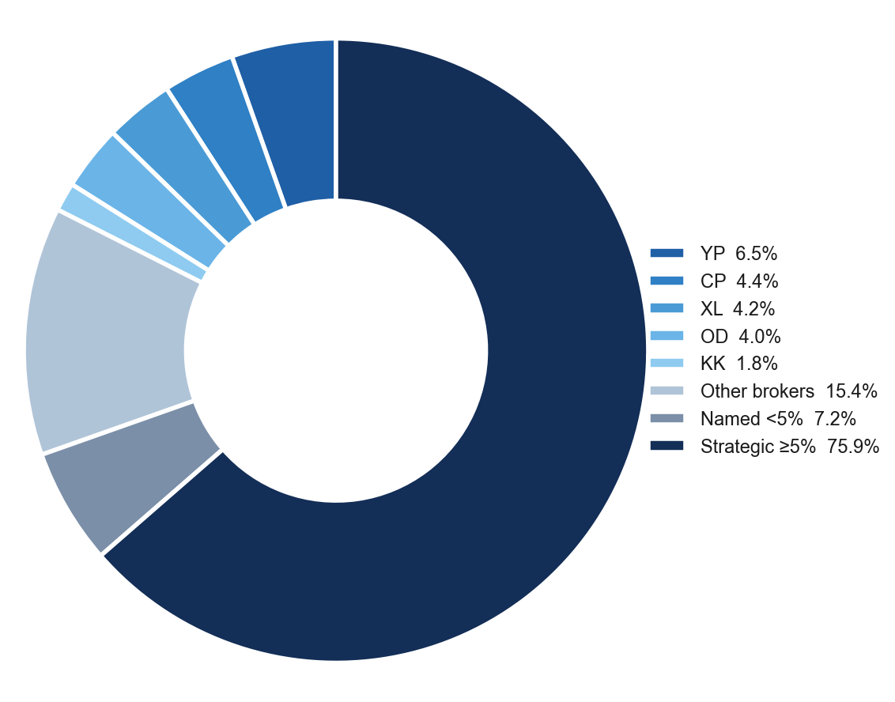
Ownership Structure
Shareholder Breakdown — 3-Tier Structure
Named Shareholders >1%
Holder | Shares | % | Tier
Darmawan Suryadi SM | 409.6M | 53.12% | ≥5%
Jap Astrid Patricia | 175.8M | 22.80% | ≥5%
Suryawarni Surli | 14.7M | 1.91% | <5%
Hengky Adinata | 11.9M | 1.54% | <5%
William Febrian Adianto | 10.7M | 1.39% | <5%
Surya Jaya | 10.0M | 1.30% | <5%
Sinyo Kalangi | 8.0M | 1.04% | <5%
IDX Broker Analysis · 16 Jul 2026
6

Slide 7
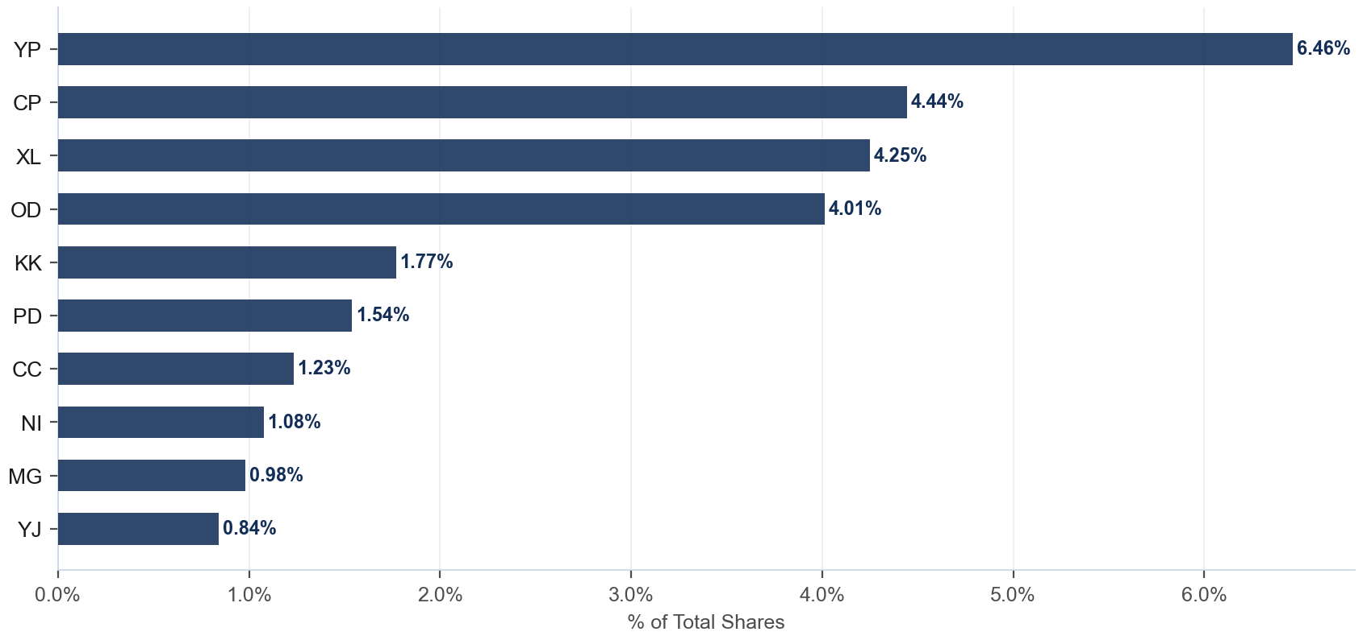
Broker Holdings — Top 10
Exchange Float · Top 10 Brokers · 36.3% of total shares
Detail
Broker | Type | Shares | %Co
YP | Asing | 49.9M | 6.46%
CP | Asing | 34.3M | 4.44%
XL | Lokal | 32.8M | 4.25%
OD | Pemerintah | 31.0M | 4.01%
KK | Asing | 13.6M | 1.77%
PD | Lokal | 11.9M | 1.54%
CC | Pemerintah | 9.5M | 1.23%
NI | Pemerintah | 8.3M | 1.08%
MG | Lokal | 7.6M | 0.98%
YJ | Lokal | 6.5M | 0.84%
IDX Broker Analysis · 16 Jul 2026
7

Slide 8
AVCO Cost Basis — Top 20 Brokers
AVCO · Price-correlated lot matching (sell at P → consume lot nearest to P) · 72 brokers total · Current price Rp 208
Broker | Type | Shares | %Co | AVCO | Realized | Unrealized | Combined
YP | Asing | 49.9M | 6.46% | Rp131 | +Rp3.30B | +Rp3.85B | +Rp7.15B
CP | Asing | 34.3M | 4.44% | Rp196 | +Rp0.21B | +Rp0.42B | +Rp0.64B
XL | Lokal | 32.8M | 4.25% | Rp215 | +Rp0.44B | -Rp0.23B | +Rp0.21B
OD | Pemerintah | 31.0M | 4.01% | Rp128 | +Rp0.12B | +Rp2.49B | +Rp2.61B
KK | Asing | 13.6M | 1.77% | Rp182 | +Rp0.40B | +Rp0.35B | +Rp0.75B
PD | Lokal | 11.9M | 1.54% | Rp174 | +Rp0.74B | +Rp0.40B | +Rp1.14B
CC | Pemerintah | 9.5M | 1.23% | Rp218 | +Rp0.05B | -Rp0.10B | -Rp0.05B
NI | Pemerintah | 8.3M | 1.08% | Rp219 | +Rp0.07B | -Rp0.09B | -Rp0.02B
MG | Lokal | 7.6M | 0.98% | Rp190 | -Rp0.11B | +Rp0.14B | +Rp0.03B
YJ | Lokal | 6.5M | 0.84% | Rp95 | -Rp0.34B | +Rp0.73B | +Rp0.39B
XC | Lokal | 6.1M | 0.79% | Rp212 | +Rp0.09B | -Rp0.03B | +Rp0.06B
SQ | Lokal | 5.3M | 0.69% | Rp171 | +Rp0.71B | +Rp0.20B | +Rp0.91B
IH | Lokal | 5.0M | 0.65% | Rp121 | -Rp0.03B | +Rp0.43B | +Rp0.41B
XA | Asing | 4.5M | 0.58% | Rp203 | -Rp0.02B | +Rp0.02B | +Rp0.00B
AZ | Lokal | 3.9M | 0.50% | Rp201 | +Rp0.06B | +Rp0.03B | +Rp0.09B
FZ | Lokal | 3.2M | 0.41% | Rp77 | +Rp0.22B | +Rp0.42B | +Rp0.64B
SH | Lokal | 3.0M | 0.39% | Rp196 | +Rp0.43B | +Rp0.04B | +Rp0.47B
RG | Lokal | 2.8M | 0.36% | Rp82 | +Rp0.20B | +Rp0.35B | +Rp0.55B
SA | Lokal | 2.7M | 0.35% | Rp93 | -Rp0.21B | +Rp0.31B | +Rp0.11B
LG | Lokal | 2.7M | 0.35% | Rp186 | +Rp0.24B | +Rp0.06B | +Rp0.30B
IDX Broker Analysis · 16 Jul 2026
8

Slide 9
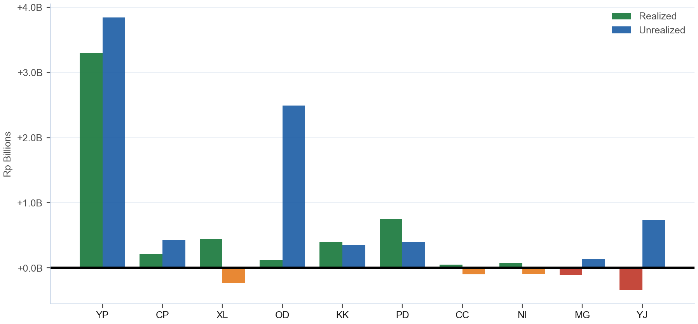
Combined P&L — Realized + Unrealized
Realized: +Rp4.57B · Unrealized: +Rp11.92B · Combined: +Rp16.49B · 56/72 profitable
IDX Broker Analysis · 16 Jul 2026
9

Slide 10
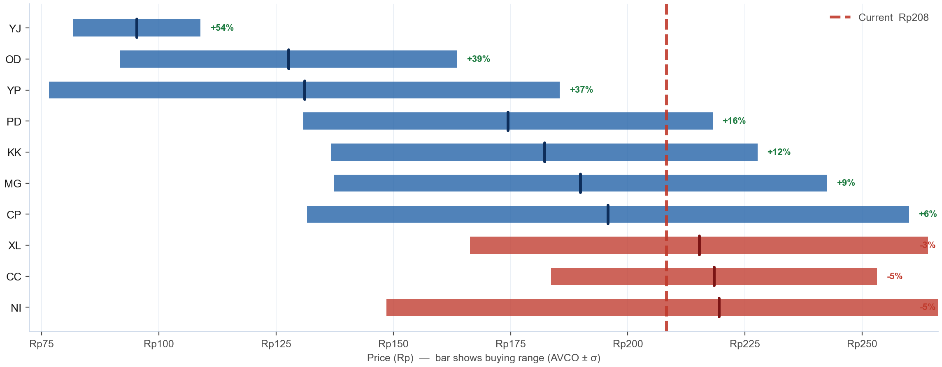
AVCO Distribution — Where Did the Top 10 Buy?
Top 10 by shares · Bar = buying range (AVCO ± 1σ) · Tick = average cost (AVCO) · Blue = in profit (AVCO below Rp 208) · Red = underwater · % = unrealized profit or loss vs current price
IDX Broker Analysis · 16 Jul 2026
10

Slide 11
SD / Conviction Analysis — Accumulation Behaviour
σ ≤ 15 = disciplined zone buyers · σ > 25 = price-chasers · Tightest = within last 6 months (bullish) · Rel σ (σ÷market σ) on Bell Curve slide — <1.0 = tighter than market
TIGHT σ ≤ 15
MODERATE σ 16-25
WIDE / EXTREME σ>25
Broker | AVCO | σ | Shares | Tightest | Range
YJ | Rp95 | 13.6 | 6.5M | — | 82–109
FZ | Rp77 | 9.2 | 3.2M | — | 68–86
SA | Rp93 | 0.5 | 2.7M | — | 93–94
AG | Rp145 | 7.7 | 2.7M | Jun '26 (R) | 137–153
ZR | Rp93 | 13.5 | 2.6M | Mar '26 (R) | 80–107
EL | Rp91 | 5.4 | 2.4M | — | 85–96
PC | Rp144 | 10.3 | 2.3M | Apr '26 (R) | 133–154
PF | Rp80 | 7.8 | 1.6M | — | 73–88
PS | Rp76 | 4.8 | 675K | — | 72–81
AF | Rp214 | 3.8 | 504K | — | 211–218
…+7 more
Broker | AVCO | σ | Shares | Tightest | Range
IH | Rp121 | 22.7 | 5.0M | Mar '26 (R) | 99–144
LG | Rp186 | 18.7 | 2.7M | Jun '26 (R) | 167–204
YU | Rp192 | 24.2 | 813K | May '26 (R) | 168–216
PO | Rp82 | 21.4 | 544K | — | 60–103
SS | Rp231 | 22.7 | 38K | — | 208–254
KI | Rp211 | 20.6 | 15K | Mar '26 (R) | 191–232
Broker | AVCO | σ | Shares | Tightest | Range
YP | Rp131 | 54.5 | 49.9M | Mar '26 (R) | 77–186
CP | Rp196 | 64.2 | 34.3M | Mar '26 (R) | 132–260
XL | Rp215 | 48.8 | 32.8M | Mar '26 (R) | 166–264
OD | Rp128 | 35.9 | 31.0M | Mar '26 (R) | 92–164
KK | Rp182 | 45.4 | 13.6M | Jul '26 (R) | 137–228
PD | Rp174 | 43.7 | 11.9M | Apr '26 (R) | 131–218
CC | Rp218 | 34.8 | 9.5M | Jul '26 (R) | 184–253
NI | Rp219 | 71.0 | 8.3M | Mar '26 (R) | 149–290
MG | Rp190 | 52.6 | 7.6M | Jan '26 | 137–242
XC | Rp212 | 41.2 | 6.1M | Mar '26 (R) | 171–254
…+31 more
IDX Broker Analysis · 16 Jul 2026
11

Slide 12
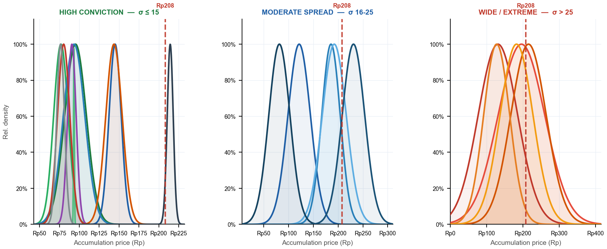
Bell Curves — Accumulation Distribution by Conviction Tier
Narrow peak = disciplined buyer (high conviction) · Flat curve = no price discipline · 3 panels — one per σ tier · Each panel has its own zoomed x-axis · Red dashed = current price · Curve normalized to peak = 1.0
YJ σ14 · FZ σ9 · SA σ1 · AG σ8 · ZR σ13 · EL σ5 · PC σ10 · PF σ8 · PS σ5 · AF σ4
IH σ23 · LG σ19 · YU σ24 · PO σ21 · SS σ23
YP σ54 · CP σ64 · XL σ49 · OD σ36 · KK σ45
σ Evolution — Top 5 by Shares · σ = buy-price std deviation (lower = more focused zone buying) · Trend = σ 30d vs σ 180d (Tightening = buying more focused recently)
Broker | Shares | σ All-time | σ 30d | σ 90d | σ 180d | Rel σ 30d | Trend (30d vs 180d)
YP | 49.9M | 54.5 | 16.7 | 71.0 | 76.1 | 0.83 | Tightening
CP | 34.3M | 64.2 | 19.7 | 38.1 | 36.1 | 0.98 | Tightening
XL | 32.8M | 48.8 | 17.0 | 27.5 | 26.3 | 0.84 | Tightening
OD | 31.0M | 35.9 | 16.0 | 19.1 | 22.2 | 0.80 | Tightening
KK | 13.6M | 45.4 | 4.5 | 30.1 | 27.2 | 0.22 | Tightening
IDX Broker Analysis · 16 Jul 2026
12

Slide 13
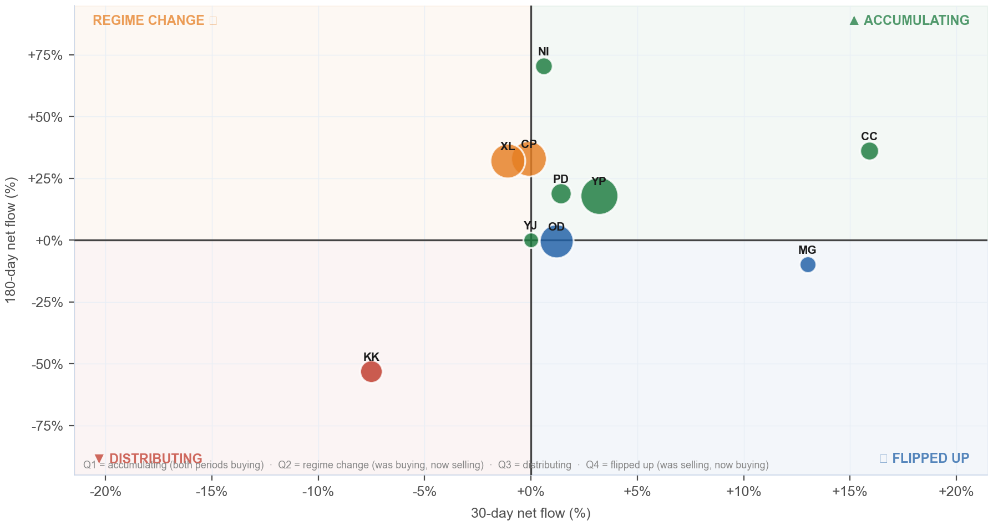
Broker Regime Map — 30d vs 180d Net Flow
X = 30d net flow % · Y = 180d net flow % · Bubble ∝ ownership % · Green=Accumulating · Orange=Regime Change · Red=Distributing · Blue=Flipped Up
Detail
Broker | 30d | 180d
YP | +3.2% | +18.0%
CP | -0.1% | +33.0%
XL | -1.1% | +32.2%
OD | +1.2% | -0.3%
KK | -7.5% | -53.1%
PD | +1.4% | +18.8%
CC | +15.9% | +36.2%
NI | +0.6% | +70.4%
MG | +13.0% | -9.9%
YJ | +0.0% | +0.0%
IDX Broker Analysis · 16 Jul 2026
13

Slide 14
Investment Thesis — PPGL at Rp 208
Bullish Signals
Tactical Caution
AVCO median Rp 185 — price is ABOVE median broker cost.
Named <5% holders (7.2%) = direct KSEI holders (creditor conversions, IPO allotments, or pre-IPO investors — entry price varies) — exit adds unexpected supply.
Net unrealized gain +Rp11.92B — broker float predominantly profitable.
Realized armor: +Rp4.57B banked profit provides buffer.
Top 10 brokers hold 26.6% of total shares — concentrated, large incremental moves possible.
56/72 brokers profitable — majority positioned to hold.
IDX Broker Analysis · 16 Jul 2026
14

Slide 15
Ownership Reconciliation & Methodology
Share Count Reconciliation — 3-Tier Ownership Model
Category | Shares | % | Notes
Strategic ≥5% (founders/pre-IPO) | 585.5M | 75.92% | KSEI direct — never in broker flow, zero overlap
Named <5% (direct KSEI — creditor/allotment/pre-IPO) | 55.3M | 7.17% | May overlap broker float — entry cost varies by holder type (shown gross)
Broker-tracked float | 280.0M | 36.30% | Raw broker flow data — may overlap with named <5% holders
Untracked (KSEI, unidentified) | 0 | 0.00% | Not in named list or broker data
TOTAL SHARES OUTSTANDING | 771.2M | 100.00% | Fully reconciled
Methodology
AVCO: price-correlated lot matching — on SELL at price P, consume the lot with min |buy_price − P|. Correct for aggregate broker data; raw FIFO and equal-weight AVCO both produce incorrect basis.
Gross flows: Stockbit Net-OFF — separate BUY/SELL rows per broker per day. Data: 2020-07-20 → 2026-07-15 (1418 days).
Corporate actions: applied in-queue on recording date. Forward splits/bonus: lots ×multiplier, prices ×(1/multiplier). Reverse splits: lots ÷multiplier, prices ×multiplier. No post-hoc factor.
Realized P&L: realized_pnl_rp from holdings_final.csv (LotQueue). NOT avco_realized — can differ by billions on high-volume brokers.
IDX Broker Analysis · 16 Jul 2026
15

Slide 16
Broker Intelligence — VWAP Alpha & Ownership Clustering
VWAP alpha < 0 = broker buys cheaper than market average · r > 0.50 shown · r ≥ 0.70 + both non-MM = amber (strong same-owner signal) · Negative r = counterparty/transfer behavior, not co-ownership
BUY VWAP ALPHA vs market (all history)
CORRELATED BROKER PAIRS (same owner signal)
Broker | Mean α | Days<Mkt | t-stat | Buy days
MI | -1.354% | 83% | -3.1 | 12
BK | -1.224% | 60% | -1.8 | 10
SF MM | -1.196% | 68% | -3.8 | 59
ZP MM | -0.557% | 61% | -4.0 | 190
MU | -0.481% | 46% | -1.1 | 35
AI PPE | -0.348% | 56% | -1.9 | 127
LS MM | -0.344% | 62% | -1.9 | 50
RF MM | -0.344% | 61% | -1.7 | 57
KI | -0.296% | 58% | -1.7 | 148
XA PPE | -0.289% | 59% | -3.4 | 396
TP MM | -0.243% | 56% | -1.5 | 121
SQ MM | -0.230% | 58% | -4.1 | 760
FS PPE | -0.223% | 46% | -1.3 | 65
DH MM | -0.220% | 64% | -0.8 | 892
AZ MM | -0.217% | 58% | -3.1 | 539
Pair | r | Overlap | Roles
OD/XA | -0.910 | 366d | ACC|DIS
★ AMBER = r ≥ 0.70 + both non-MM roles = likely single owner
IDX Broker Analysis · 16 Jul 2026
16

