Slide 1
PTRO
16 Jul 2026
Rp 4,125
Current Price
PT Petrosea Tbk
IDX Broker Flow Intelligence · AVCO Analysis
Strategic Block (≥5%)
Broker-Tracked Float
Named <5% Holders
69.8%
100.7%
7.3%
AVCO Realized P&L
AVCO Combined P&L
Profitable Brokers
+Rp7.3T
+Rp19.0T
80/96
IDX Broker Analysis · 16 Jul 2026
1

Slide 2
Executive Summary
Key Metrics
Key Findings
Metric | Value
Market Price | Rp 4,125
Strategic Block (≥5%) | 69.8%
Named <5% Holders | 7.3%
Broker-Tracked Float | 100.7%
Untracked | 0.00%
AVCO Median | Rp 4,054
Overhead Supply? | NO
AVCO Realized P&L | +Rp7.3T
AVCO Unrealized P&L | +Rp11.8T
AVCO Combined P&L | +Rp19.0T
Profitable Brokers | 80 / 96
Top 5 Concentration | 76.1%
Top 10 Concentration | 85.6%
Trading Days | 2538
Data Range | 2016-01-04 → 2026-07-15
Median broker cost Rp 4,054 vs market Rp 4,125 — price is above average break-even.
3-tier ownership: 69.8% strategic (KSEI direct), 7.3% named <5%, 100.7% broker-tracked float.
AVCO combined P&L: +Rp19.0T — 80 of 96 brokers profitable at current price.
Realized P&L: +Rp7.3T banked — provides cushion against paper losses.
Top 10 brokers hold 85.6% of exchange float — highly concentrated.
Largest holder: CC at 60.97%, AVCO Rp 2,016, unrealized +Rp13.0T.
Price controllers (last 6m): AK · YP · PD — AK (Rp3,937 σ161, lead r=+0.17, Structural) | YP (Rp4,555 σ3392, lead r=-0.28, Structural). Identified via buy-lead correlation with next-day price returns.
IDX Broker Analysis · 16 Jul 2026
2

Slide 3
Market Maker Identification — AK · YP · PD
Identification Methodology — Last 6 Months
Candidate Comparison — sorted by MM Score · Lead ≥ 0.12 or Floor ≥ 55% or Buy% ≥ 75% = threshold
Signal 1 — Gross Flow Value (50%)
Broker | Type | Lead r | Contemp r | Buy% | Gross | Net Pos | Net/Gross | Score | Status
AK | Asing | +0.170 | -0.047 | 100% | 2.12B | 9.9M | 0.005 | 81.4 | Selected
CC | Pemerintah | -0.009 | -0.531 | 100% | 1.80B | 6.15B | 3.418★ | 72.3 | —
YP | Asing | -0.282 | -0.090 | 100% | 1.36B | 118.4M | 0.087 | 61.9 | Selected
PD | Lokal | +0.018 | +0.371 | 100% | 1.03B | 229.9M | 0.223 | 61.6 | Selected
CP | Asing | -0.010 | +0.324 | 99% | 820.5M | 54.5M | 0.066 | 55.5 | —
LG | Lokal | +0.106 | +0.508 | 96% | 424.7M | 102.2M | 0.241 | 48.8 | —
YU | Asing | +0.027 | +0.307 | 93% | 508.7M | 6.6M | 0.013 | 46.0 | —
AZ | Lokal | +0.036 | +0.249 | 94% | 512.2M | 27.4M | 0.054 | 44.5 | —
SQ | Lokal | -0.287 | -0.333 | 99% | 507.1M | 61.0M | 0.120 | 41.7 | —
ZP | Asing | -0.025 | +0.027 | 96% | 517.9M | 520.5M | 1.005★ | 41.1 | —
MG | Lokal | -0.178 | -0.055 | 92% | 838.4M | 69.8M | 0.083 | 47.4 | Operator
XL | Lokal | -0.321 | -0.185 | 100% | 3.58B | 222.7M | 0.051 | 0.0 | Excluded
XC | Lokal | -0.477 | -0.091 | 100% | 1.01B | 15.1M | 0.005 | 0.0 | Excluded
broker gross_vol ÷ max broker gross_vol in same window. The broker that transacts the most total value (buy + sell) is the price-setter on IDX — MMs dominate volume, not just direction. Top traders by value score highest.
Signal 2 — Daily Consistency (30%)
buy_presence = buy_days ÷ total trading days in 6m window. Real MMs show up almost every session. ≥ 50% gate to enter top-3 selection.
Signal 3 — Price Correlation (20%)
Max(lead_corr, contemp_corr) t-stat weighted. Confirms the MM is actually moving price, not just providing neutral liquidity. Distributor penalty: zeroed if lead < −0.15 (buying before own price drops = distribution).
★ Net/Gross Ratio — Insider Signal
Net shares held ÷ 6-month gross flow. High ratio (>0.30) = broker accumulates quietly without churning — classic informed-money pattern. Purple-tinted rows in table — NOT selected as MM but flagged as potential insiders. Note: numerator is all-time, denominator is 6m.
XC/XL — Retail Aggregators, NOT Excluded from Intelligence
XL (Stockbit) and XC (Ajaib) are excluded from MM SCORING only — their gross volume is retail aggregation, not structural price control. However they are NOT excluded from VWAP Alpha or correlation analysis (slide 17). The XC/XL correlation pair should be treated as ambiguous: could be retail co-movement or same beneficial owner routing through two platforms. Cannot be ruled out as insiders without KSEI account-level data.
Selected: AK · YP · PD — top 3 by MM Score
Green = Selected MM (biggest gross flow + daily presence) | Purple tint ★ = Quiet Accumulator (high Net/Gross, insider-like) | Amber = P&D Operator | Tan = Retail Aggregator (excl.)
IDX Broker Analysis · 16 Jul 2026
3

Slide 4
Market Maker Deep Dive — AK · YP · PD
Price controllers identified via buy-lead correlation with next-day price (last 6m) · Tight zone = month with lowest buy-price σ · Distribution = sell-dominant periods (≥3% net sold)
AK Asing | 9.9M (0.10%)
PEAK HOLDINGS (200d)
Peak Shares | 93.8M (0.93%)
Peak Date | Feb 2026
vs Current | +84M shares vs now
ACCUMULATION ZONE
Tightest Month | Jul '26 (recent)
Avg Buy Price | Rp3,942
σ at Tightest | 87.6
Price Range ±1σ | Rp3,854 – Rp4,030
DISTRIBUTION ZONE
Avg Sell Price | Rp5,675
σ at Distribution | 1463.9
Price Range ±1σ | Rp4,211 – Rp7,139
LAST 5d ACTION
Direction | NET BUYING
Net Volume | +0.9M
% of Holdings | +9.13%
Avg Price | Rp4,056
Conviction σ | σ51.0 — Wide
YP Asing | 118.4M (1.17%)
PEAK HOLDINGS (200d)
Peak Shares | 119.4M (1.18%)
Peak Date | May 2026
vs Current | +1M shares vs now
ACCUMULATION ZONE
Tightest Month | Jul '26 (recent)
Avg Buy Price | Rp3,957
σ at Tightest | 89.1
Price Range ±1σ | Rp3,868 – Rp4,046
DISTRIBUTION ZONE
Avg Sell Price | Rp5,988
σ at Distribution | 2201.9
Price Range ±1σ | Rp3,786 – Rp8,190
LAST 5d ACTION
Direction | NET SELLING
Net Volume | -0.4M
% of Holdings | -0.30%
Avg Price | Rp4,036
Conviction σ | σ51.7 — Wide
PD Lokal | 229.9M (2.28%)
PEAK HOLDINGS (200d)
Peak Shares | 277.3M (2.75%)
Peak Date | Jan 2026
vs Current | +47M shares vs now
ACCUMULATION ZONE
Tightest Month | Jul '26 (recent)
Avg Buy Price | Rp3,967
σ at Tightest | 90.1
Price Range ±1σ | Rp3,877 – Rp4,057
DISTRIBUTION ZONE
Avg Sell Price | Rp6,438
σ at Distribution | 2848.8
Price Range ±1σ | Rp3,589 – Rp9,287
LAST 5d ACTION
Direction | NET BUYING
Net Volume | +2.6M
% of Holdings | +1.12%
Avg Price | Rp4,046
Conviction σ | σ49.3 — Wide
IDX Broker Analysis · 16 Jul 2026
4

Slide 5
Pre-Move Accumulation — Insider Confidence Signal
Who loaded up 1–3 weeks before price surged ≥15% · last 12 months · min 5M shares · min 5 active days · Hit% = surges front-ran ÷ total surges detected
Week End | Surge | VWAP Rp | Pre-Buyers (21d) | Day 1 Entry | Pos%
2026-06-02 | +39% | 3,643→5,059 | CC(21.2M) · XL*(18.6M) · SQ(8.6M | CC(6.4M) · BK(3.3M) | +0%
2026-04-14 | +45% | 4,536→6,569 | OD(44.4M) · ZP(12.4M) · SQ(8.3M) | AZ(2.2M) · YP(1.5M) | +78%
2026-02-18 | +32% | 5,863→7,741 | XL*(65.5M) · NI(55.9M) · HP(29.3 | MG(3.5M) · CC(2.8M) | +22%
2025-12-24 | +30% | 7,860→10,206 | HP(37.2M) · BK(16.8M) · TP(12.8M | HP(11.4M) · TP(3.1M) | New
2025-11-10 | +24% | 7,154→8,843 | XL*(24.4M) · HP(23.7M) · YP(22.3 | AK(8.1M) · YU(3.1M) | New
2025-09-29 | +28% | 5,470→7,022 | HP(35.4M) · MG(27.9M) · CC(23.2M | XA(5.4M) · AK(5.3M) | New
2025-09-24 | +48% | 4,408→6,502 | HP(18.3M) · BB(17.7M) · MG(8.8M) | HP(11.4M) · CC(11.4M) | New
2025-08-20 | +27% | 3,223→4,105 | XA(14.0M) · YP(9.5M) · NI(8.7M) | AK(4.6M) · MG(3.7M) | +54%
TOP 3 SIGNAL BROKERS
Broker | N | Hit% | Pre Vol | Avg Pos%
HP | 5 | 62% | 144M | +152%
NI | 3 | 38% | 71M | +9%
OD | 3 | 38% | 60M | +42%
ACCUMULATION RANKING
Broker | N | Hit% | Pre Vol | Avg Pos% | Class
HP | 5 | 62% | 144M | +152% | INSIDER-LIKE
XL | 3 | 38% | 108M | +67% | Retail Flow
NI | 3 | 38% | 71M | +9% | INSIDER-LIKE
OD | 3 | 38% | 60M | +42% | INSIDER-LIKE
BB | 3 | 38% | 52M | New | INSIDER-LIKE
POST-SURGE DISTRIBUTORS
Surge End | Broker | Net Sold
2026-06-02 | AZ | -10.7M
 | PD | -9.4M
2026-04-14 | TP | -90.0M
 | CC | -16.1M
2026-02-18 | TP | -48.7M
 | YU | -32.3M
* retail aggregator (Ajaib/Stockbit) — volume is real but not coordinated · Pos% uses first signal broker
IDX Broker Analysis · 16 Jul 2026
5

Slide 6
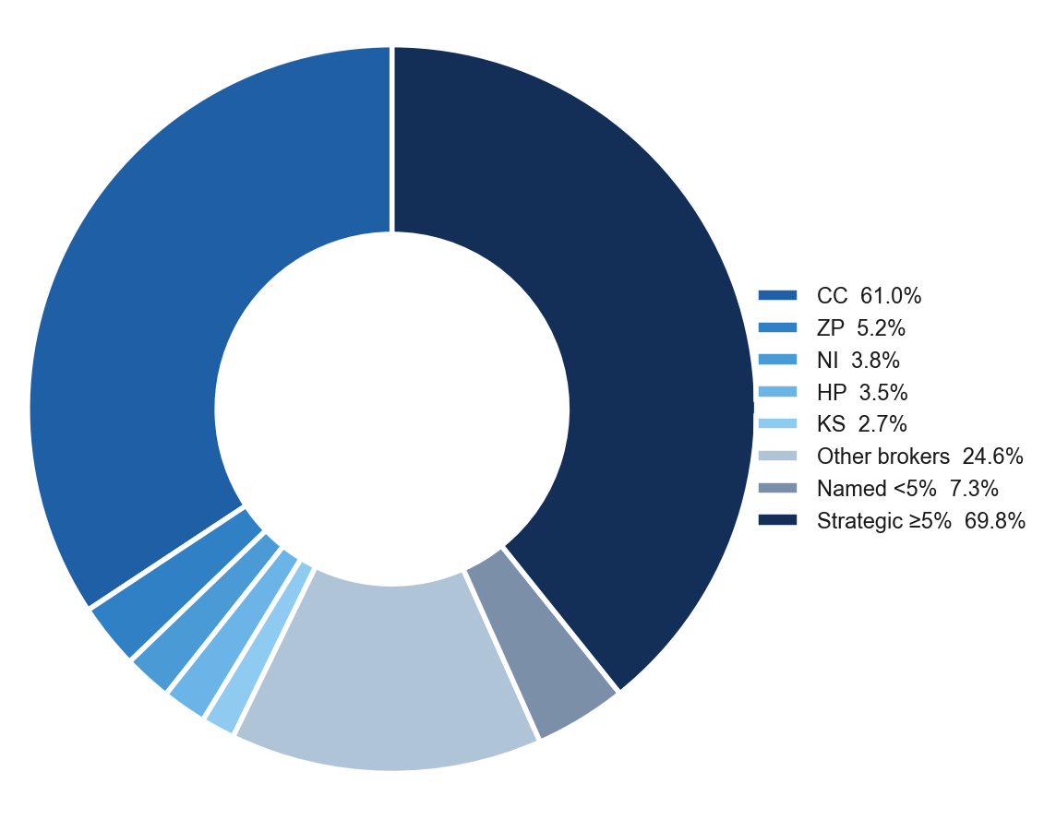
Ownership Structure
Shareholder Breakdown — 3-Tier Structure
Named Shareholders >1%
Holder | Shares | % | Tier
Kreasi Jasa Persada | 4.57B | 45.33% | ≥5%
Caraka Reksa Optima | 2.47B | 24.45% | ≥5%
Sentosa Bersama Mitra | 256.9M | 2.55% | <5%
OCBC Securities Private | 170.6M | 1.69% | <5%
Morgan Stanley International | 166.2M | 1.65% | <5%
Petrindo Jaya Kreasi | 138.9M | 1.38% | <5%
IDX Broker Analysis · 16 Jul 2026
6

Slide 7
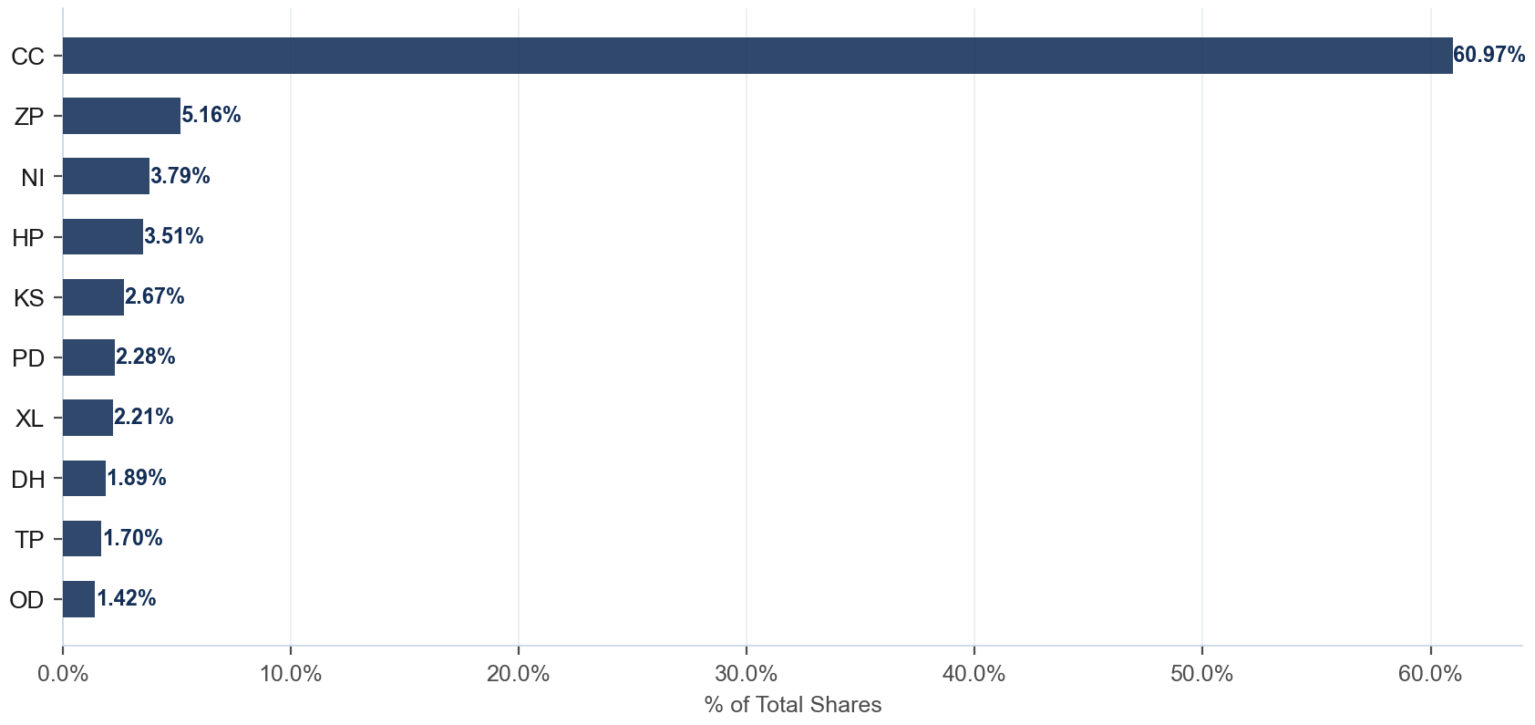
Broker Holdings — Top 10
Exchange Float · Top 10 Brokers · 100.7% of total shares
Detail
Broker | Type | Shares | %Co
CC | Pemerintah | 6.15B | 60.97%
ZP | Asing | 520.5M | 5.16%
NI | Pemerintah | 382.3M | 3.79%
HP | Lokal | 354.1M | 3.51%
KS | Lokal | 269.6M | 2.67%
PD | Lokal | 229.9M | 2.28%
XL | Lokal | 222.7M | 2.21%
DH | Lokal | 190.5M | 1.89%
TP | Asing | 171.2M | 1.70%
OD | Pemerintah | 142.7M | 1.42%
IDX Broker Analysis · 16 Jul 2026
7

Slide 8
AVCO Cost Basis — Top 20 Brokers
AVCO · Price-correlated lot matching (sell at P → consume lot nearest to P) · 96 brokers total · Current price Rp 4,125
Broker | Type | Shares | %Co | AVCO | Realized | Unrealized | Combined
CC | Pemerintah | 6.15B | 60.97% | Rp2,016 | +Rp580.56B | +Rp13.0T | +Rp13.6T
ZP | Asing | 520.5M | 5.16% | Rp4,954 | +Rp319.87B | -Rp431.64B | -Rp111.77B
NI | Pemerintah | 382.3M | 3.79% | Rp4,955 | +Rp147.79B | -Rp317.45B | -Rp169.65B
HP | Lokal | 354.1M | 3.51% | Rp8,225 | +Rp541.00B | -Rp1.5T | -Rp911.06B
KS | Lokal | 269.6M | 2.67% | Rp166 | +Rp0.28B | +Rp1.1T | +Rp1.1T
PD | Lokal | 229.9M | 2.28% | Rp5,292 | +Rp399.98B | -Rp268.34B | +Rp131.64B
XL | Lokal | 222.7M | 2.21% | Rp4,272 | +Rp142.66B | -Rp32.74B | +Rp109.93B
DH | Lokal | 190.5M | 1.89% | Rp2,112 | +Rp125.59B | +Rp383.46B | +Rp509.05B
TP | Asing | 171.2M | 1.70% | Rp5,348 | +Rp509.32B | -Rp209.41B | +Rp299.91B
OD | Pemerintah | 142.7M | 1.42% | Rp5,010 | +Rp110.29B | -Rp126.29B | -Rp16.00B
IT | Lokal | 123.8M | 1.23% | Rp279 | +Rp4.93B | +Rp476.26B | +Rp481.18B
YP | Asing | 118.4M | 1.17% | Rp4,555 | +Rp292.32B | -Rp50.99B | +Rp241.33B
LG | Lokal | 102.2M | 1.01% | Rp5,356 | +Rp439.67B | -Rp125.87B | +Rp313.80B
DR | Asing | 84.3M | 0.84% | Rp4,946 | +Rp126.69B | -Rp69.23B | +Rp57.46B
SA | Lokal | 79.5M | 0.79% | Rp380 | +Rp28.25B | +Rp297.78B | +Rp326.04B
AO | Lokal | 78.3M | 0.78% | Rp2,390 | +Rp24.35B | +Rp135.85B | +Rp160.20B
MG | Lokal | 69.8M | 0.69% | Rp4,930 | +Rp175.68B | -Rp56.16B | +Rp119.52B
IN | Lokal | 62.0M | 0.61% | Rp3,305 | +Rp54.67B | +Rp50.82B | +Rp105.49B
SQ | Lokal | 61.0M | 0.60% | Rp4,446 | +Rp74.14B | -Rp19.62B | +Rp54.52B
CP | Asing | 54.5M | 0.54% | Rp4,563 | +Rp173.95B | -Rp23.88B | +Rp150.07B
IDX Broker Analysis · 16 Jul 2026
8

Slide 9
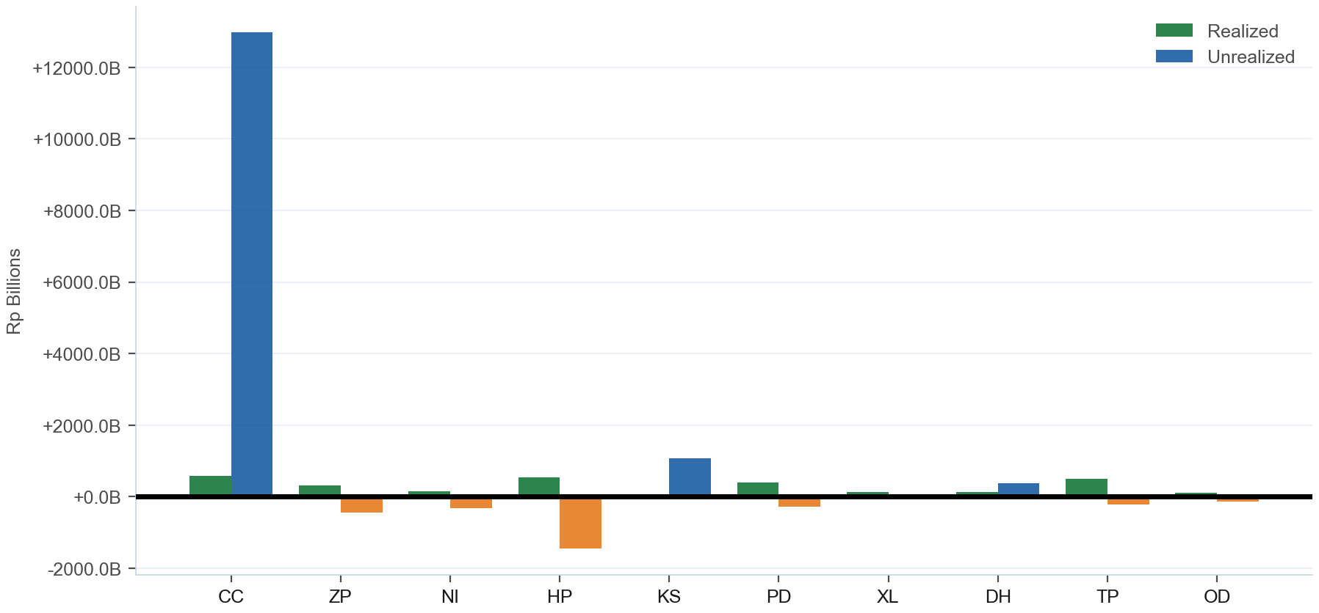
Combined P&L — Realized + Unrealized
Realized: +Rp7.3T · Unrealized: +Rp11.8T · Combined: +Rp19.0T · 80/96 profitable
IDX Broker Analysis · 16 Jul 2026
9

Slide 10
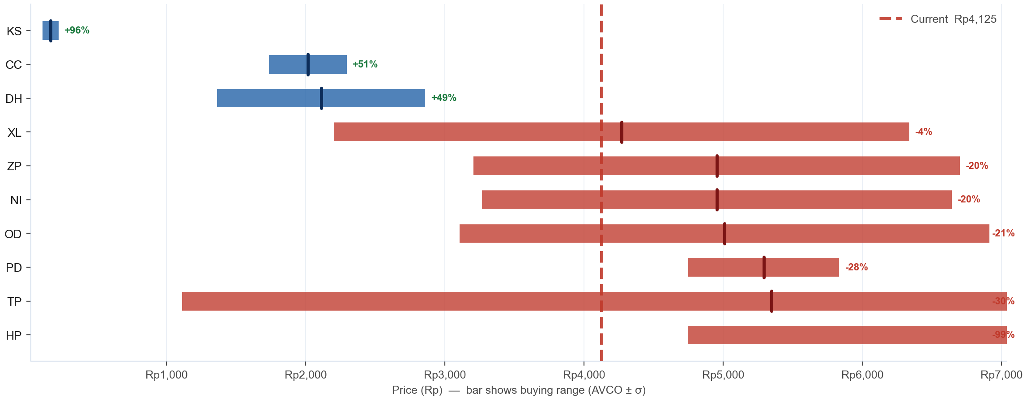
AVCO Distribution — Where Did the Top 10 Buy?
Top 10 by shares · Bar = buying range (AVCO ± 1σ) · Tick = average cost (AVCO) · Blue = in profit (AVCO below Rp 4,125) · Red = underwater · % = unrealized profit or loss vs current price
IDX Broker Analysis · 16 Jul 2026
10

Slide 11
SD / Conviction Analysis — Accumulation Behaviour
σ ≤ 15 = disciplined zone buyers · σ > 25 = price-chasers · Tightest = within last 6 months (bullish) · Rel σ (σ÷market σ) on Bell Curve slide — <1.0 = tighter than market
TIGHT σ ≤ 15
MODERATE σ 16-25
WIDE / EXTREME σ>25
Broker | AVCO | σ | Shares | Tightest | Range
GW | Rp185 | 12.2 | 35.8M | — | 173–197
SM | Rp61 | 2.4 | 5.8M | — | 59–64
GI | Rp272 | 0.8 | 1.0M | — | 271–272
PI | Rp84 | 7.6 | 783K | — | 77–92
LK | Rp54 | 0.9 | 600K | — | 53–55
OK | Rp296 | 8.2 | 413K | — | 287–304
DM | Rp163 | 4.2 | 300K | — | 159–168
DD | Rp320 | 2.5 | 144K | — | 317–322
Broker | AVCO | σ | Shares | Tightest | Range
SA | Rp380 | 22.5 | 79.5M | — | 358–403
IP | Rp220 | 15.0 | 3.6M | — | 205–235
BZ | Rp139 | 19.6 | 540K | — | 119–158
Broker | AVCO | σ | Shares | Tightest | Range
CC | Rp2,016 | 279.3 | 6.15B | Jul '26 (R) | 1736–2295
ZP | Rp4,954 | 1747.9 | 520.5M | Jul '26 (R) | 3206–6702
NI | Rp4,955 | 1686.9 | 382.3M | Jul '26 (R) | 3268–6642
HP | Rp8,225 | 3480.0 | 354.1M | Jul '26 (R) | 4745–11705
KS | Rp166 | 57.8 | 269.6M | — | 108–223
PD | Rp5,292 | 542.6 | 229.9M | Jul '26 (R) | 4749–5835
XL | Rp4,272 | 2067.3 | 222.7M | Jul '26 (R) | 2204–6339
DH | Rp2,112 | 748.1 | 190.5M | Jul '26 (R) | 1364–2860
TP | Rp5,348 | 4235.8 | 171.2M | Jun '26 (R) | 1112–9584
OD | Rp5,010 | 1904.3 | 142.7M | Jul '26 (R) | 3105–6914
…+66 more
IDX Broker Analysis · 16 Jul 2026
11

Slide 12
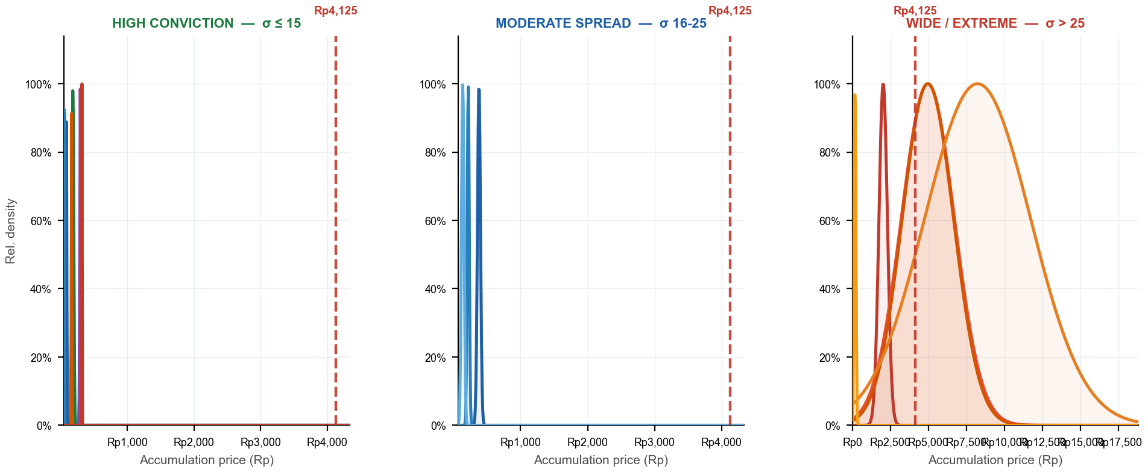
Bell Curves — Accumulation Distribution by Conviction Tier
Narrow peak = disciplined buyer (high conviction) · Flat curve = no price discipline · 3 panels — one per σ tier · Each panel has its own zoomed x-axis · Red dashed = current price · Curve normalized to peak = 1.0
GW σ12 · SM σ2 · GI σ1 · PI σ8 · LK σ1 · OK σ8 · DM σ4 · DD σ2
SA σ22 · IP σ15 · BZ σ20
CC σ279 · ZP σ1748 · NI σ1687 · HP σ3480 · KS σ58
σ Evolution — Top 5 by Shares · σ = buy-price std deviation (lower = more focused zone buying) · Trend = σ 30d vs σ 180d (Tightening = buying more focused recently)
Broker | Shares | σ All-time | σ 30d | σ 90d | σ 180d | Rel σ 30d | Trend (30d vs 180d)
CC | 6.15B | 279.3 | 130.1 | 763.9 | 1461.1 | 0.98 | Tightening
ZP | 520.5M | 1747.9 | 177.2 | 778.6 | 1659.3 | 1.33 | Tightening
NI | 382.3M | 1686.9 | 149.5 | 789.3 | 1316.3 | 1.13 | Tightening
HP | 354.1M | 3480.0 | 171.1 | 759.3 | 2569.9 | 1.29 | Tightening
KS | 269.6M | 57.8 | — | — | — | — | N/A
IDX Broker Analysis · 16 Jul 2026
12

Slide 13
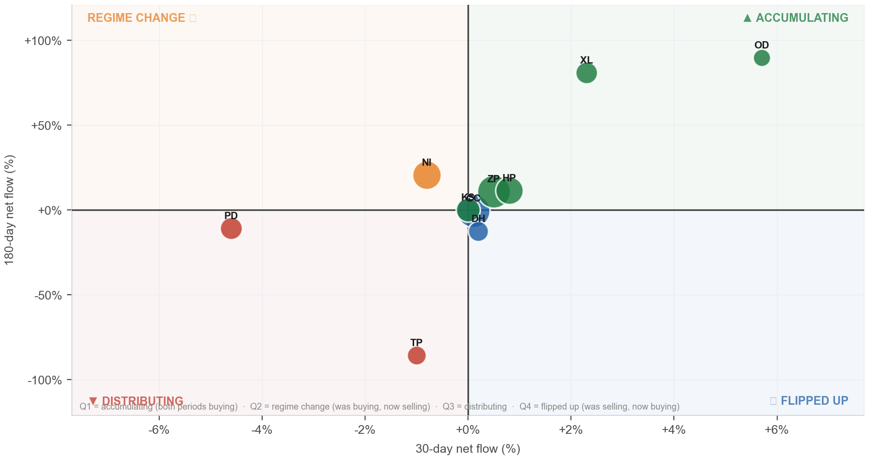
Broker Regime Map — 30d vs 180d Net Flow
X = 30d net flow % · Y = 180d net flow % · Bubble ∝ ownership % · Green=Accumulating · Orange=Regime Change · Red=Distributing · Blue=Flipped Up
Detail
Broker | 30d | 180d
CC | +0.1% | -0.4%
ZP | +0.5% | +10.9%
NI | -0.8% | +20.7%
HP | +0.8% | +11.6%
KS | +0.0% | +0.0%
PD | -4.6% | -10.7%
XL | +2.3% | +80.9%
DH | +0.2% | -12.5%
TP | -1.0% | -85.7%
OD | +5.7% | +89.7%
IDX Broker Analysis · 16 Jul 2026
13

Slide 14
Investment Thesis — PTRO at Rp 4,125
Bullish Signals
Tactical Caution
AVCO median Rp 4,054 — price is ABOVE median broker cost.
Named <5% holders (7.3%) = direct KSEI holders (creditor conversions, IPO allotments, or pre-IPO investors — entry price varies) — exit adds unexpected supply.
Net unrealized gain +Rp11.8T — broker float predominantly profitable.
Realized armor: +Rp7.3T banked profit provides buffer.
Top 10 brokers hold 85.6% of total shares — concentrated, large incremental moves possible.
80/96 brokers profitable — majority positioned to hold.
IDX Broker Analysis · 16 Jul 2026
14

Slide 15
Ownership Reconciliation & Methodology
Share Count Reconciliation — 3-Tier Ownership Model
Category | Shares | % | Notes
Strategic ≥5% (founders/pre-IPO) | 7.04B | 69.78% | KSEI direct — never in broker flow, zero overlap
Named <5% (direct KSEI — creditor/allotment/pre-IPO) | 732.6M | 7.26% | May overlap broker float — entry cost varies by holder type (shown gross)
Broker-tracked float | 10.16B | 100.71% | Raw broker flow data — may overlap with named <5% holders
Untracked (KSEI, unidentified) | 0 | 0.00% | Not in named list or broker data
TOTAL SHARES OUTSTANDING | 10.09B | 100.00% | Fully reconciled
Methodology
AVCO: price-correlated lot matching — on SELL at price P, consume the lot with min |buy_price − P|. Correct for aggregate broker data; raw FIFO and equal-weight AVCO both produce incorrect basis.
Gross flows: Stockbit Net-OFF — separate BUY/SELL rows per broker per day. Data: 2016-01-04 → 2026-07-15 (2538 days).
Corporate actions: applied in-queue on recording date. Forward splits/bonus: lots ×multiplier, prices ×(1/multiplier). Reverse splits: lots ÷multiplier, prices ×multiplier. No post-hoc factor.
Realized P&L: realized_pnl_rp from holdings_final.csv (LotQueue). NOT avco_realized — can differ by billions on high-volume brokers.
IDX Broker Analysis · 16 Jul 2026
15

Slide 16
Broker Intelligence — VWAP Alpha & Ownership Clustering
VWAP alpha < 0 = broker buys cheaper than market average · r > 0.50 shown · r ≥ 0.70 + both non-MM = amber (strong same-owner signal) · Negative r = counterparty/transfer behavior, not co-ownership
BUY VWAP ALPHA vs market (all history)
CORRELATED BROKER PAIRS (same owner signal)
Broker | Mean α | Days<Mkt | t-stat | Buy days
DU | -1.037% | 90% | -2.0 | 10
AF MM | -0.902% | 62% | -1.4 | 72
DM | -0.543% | 60% | -0.7 | 10
AN MM | -0.502% | 60% | -2.7 | 57
BF MM | -0.479% | 68% | -2.7 | 41
DD MM | -0.447% | 58% | -0.6 | 12
OK PPE | -0.441% | 57% | -2.5 | 49
IT ACC | -0.435% | 77% | -9.1 | 385
RB PPE | -0.407% | 56% | -0.9 | 64
IP MM | -0.395% | 69% | -4.6 | 365
PG PPE | -0.380% | 64% | -3.9 | 115
BS PPE | -0.220% | 59% | -1.8 | 86
EL PPE | -0.219% | 72% | -0.3 | 18
HP CHN | -0.203% | 55% | -1.9 | 1335
LS MM | -0.148% | 58% | -2.7 | 517
Pair | r | Overlap | Roles
AO/PG | -0.507 | 69d | STR|DIS
HP/ZP | -0.512 | 1286d | STR|STR
BB/CC | -0.996 | 153d | DIS|ACC
★ AMBER = r ≥ 0.70 + both non-MM roles = likely single owner
IDX Broker Analysis · 16 Jul 2026
16

