Slide 1
SINI
16 Jul 2026
Rp 5,842
Current Price
PT Singaraja Putra Tbk
IDX Broker Flow Intelligence · AVCO Analysis
Strategic Block (≥5%)
Broker-Tracked Float
Named <5% Holders
74.2%
27.6%
4.1%
AVCO Realized P&L
AVCO Combined P&L
Profitable Brokers
+Rp525.18B
+Rp169.33B
29/69
IDX Broker Analysis · 16 Jul 2026
1

Slide 2
Executive Summary
Key Metrics
Key Findings
Metric | Value
Market Price | Rp 5,842
Strategic Block (≥5%) | 74.2%
Named <5% Holders | 4.1%
Broker-Tracked Float | 27.6%
Untracked | 0.00%
AVCO Median | Rp 9,500
Overhead Supply? | YES
AVCO Realized P&L | +Rp525.18B
AVCO Unrealized P&L | -Rp355.85B
AVCO Combined P&L | +Rp169.33B
Profitable Brokers | 29 / 69
Top 5 Concentration | 16.5%
Top 10 Concentration | 21.7%
Trading Days | 1498
Data Range | 2019-11-08 → 2026-07-15
Median broker cost Rp 9,500 vs market Rp 5,842 — price is below average break-even.
3-tier ownership: 74.2% strategic (KSEI direct), 4.1% named <5%, 27.6% broker-tracked float.
AVCO combined P&L: +Rp169.33B — 29 of 69 brokers profitable at current price.
Realized P&L: +Rp525.18B banked — provides cushion against paper losses.
Top 10 brokers hold 21.7% of exchange float — moderately concentrated.
Largest holder: XL at 4.42%, AVCO Rp 11,296, unrealized -Rp116.09B.
Price controllers (last 6m): LG · HP · AZ — LG (Rp6,635 σ2160, lead r=+0.32, Structural) | HP (Rp5,271 σ2878, lead r=-0.00, Support). Identified via buy-lead correlation with next-day price returns.
IDX Broker Analysis · 16 Jul 2026
2

Slide 3
Market Maker Identification — LG · HP · AZ
Identification Methodology — Last 6 Months
Candidate Comparison — sorted by MM Score · Lead ≥ 0.12 or Floor ≥ 55% or Buy% ≥ 75% = threshold
Signal 1 — Gross Flow Value (50%)
Broker | Type | Lead r | Contemp r | Buy% | Gross | Net Pos | Net/Gross | Score | Status
LG | Lokal | +0.323 | -0.139 | 84% | 113.1M | 14.4M | 0.127 | 81.8 | Selected
HP | Lokal | -0.002 | -0.010 | 64% | 100.1M | 2.0M | 0.020 | 63.3 | Selected
AZ | Lokal | +0.041 | -0.005 | 88% | 31.9M | 12.0M | 0.376 | 40.6 | Selected
CP | Asing | +0.032 | +0.003 | 93% | 26.0M | 4.9M | 0.189 | 39.3 | —
YP | Asing | +0.061 | -0.163 | 88% | 11.1M | 7.5M | 0.678★ | 31.4 | —
PD | Lokal | -0.064 | +0.165 | 84% | 9.6M | 10.7M | 1.110★ | 30.8 | —
CC | Pemerintah | +0.014 | -0.134 | 87% | 10.3M | 4.1M | 0.402★ | 30.7 | —
GR | Lokal | -0.113 | +0.040 | 82% | 7.5M | 893K | 0.119 | 27.9 | —
OD | Pemerintah | -0.073 | +0.081 | 80% | 4.5M | 622K | 0.139 | 26.0 | —
SQ | Lokal | -0.089 | -0.106 | 83% | 2.3M | 1.4M | 0.615★ | 25.8 | —
MG | Lokal | +0.149 | +0.043 | 89% | 47.3M | 1.9M | 0.040 | 48.4 | Operator
XC | Lokal | +0.102 | -0.048 | 92% | 5.5M | 3.1M | 0.318 | 0.0 | Excluded
XL | Lokal | -0.158 | +0.118 | 96% | 56.8M | 21.3M | 0.326 | 0.0 | Excluded
broker gross_vol ÷ max broker gross_vol in same window. The broker that transacts the most total value (buy + sell) is the price-setter on IDX — MMs dominate volume, not just direction. Top traders by value score highest.
Signal 2 — Daily Consistency (30%)
buy_presence = buy_days ÷ total trading days in 6m window. Real MMs show up almost every session. ≥ 50% gate to enter top-3 selection.
Signal 3 — Price Correlation (20%)
Max(lead_corr, contemp_corr) t-stat weighted. Confirms the MM is actually moving price, not just providing neutral liquidity. Distributor penalty: zeroed if lead < −0.15 (buying before own price drops = distribution).
★ Net/Gross Ratio — Insider Signal
Net shares held ÷ 6-month gross flow. High ratio (>0.30) = broker accumulates quietly without churning — classic informed-money pattern. Purple-tinted rows in table — NOT selected as MM but flagged as potential insiders. Note: numerator is all-time, denominator is 6m.
XC/XL — Retail Aggregators, NOT Excluded from Intelligence
XL (Stockbit) and XC (Ajaib) are excluded from MM SCORING only — their gross volume is retail aggregation, not structural price control. However they are NOT excluded from VWAP Alpha or correlation analysis (slide 17). The XC/XL correlation pair should be treated as ambiguous: could be retail co-movement or same beneficial owner routing through two platforms. Cannot be ruled out as insiders without KSEI account-level data.
Selected: LG · HP · AZ — top 3 by MM Score
Green = Selected MM (biggest gross flow + daily presence) | Purple tint ★ = Quiet Accumulator (high Net/Gross, insider-like) | Amber = P&D Operator | Tan = Retail Aggregator (excl.)
IDX Broker Analysis · 16 Jul 2026
3

Slide 4
Market Maker Deep Dive — LG · HP · AZ
Price controllers identified via buy-lead correlation with next-day price (last 6m) · Tight zone = month with lowest buy-price σ · Distribution = sell-dominant periods (≥3% net sold)
LG Lokal | 14.4M (3.00%)
PEAK HOLDINGS (200d)
Peak Shares | 14.8M (3.08%)
Peak Date | Jun 2026
vs Current | +0M shares vs now
ACCUMULATION ZONE
Tightest Month | Jul '26 (recent)
Avg Buy Price | Rp5,115
σ at Tightest | 455.3
Price Range ±1σ | Rp4,660 – Rp5,570
DISTRIBUTION ZONE
Avg Sell Price | Rp12,467
σ at Distribution | 2975.2
Price Range ±1σ | Rp9,492 – Rp15,442
LAST 5d ACTION
Direction | NET BUYING
Net Volume | +0.3M
% of Holdings | +2.00%
Avg Price | Rp5,113
Conviction σ | σ444.3 — Wide
HP Lokal | 2.0M (0.41%)
PEAK HOLDINGS (200d)
Peak Shares | 18.4M (3.82%)
Peak Date | Jan 2026
vs Current | +16M shares vs now
ACCUMULATION ZONE
Tightest Month | Jul '26 (recent)
Avg Buy Price | Rp5,002
σ at Tightest | 59.6
Price Range ±1σ | Rp4,942 – Rp5,062
DISTRIBUTION ZONE
Avg Sell Price | Rp7,216
σ at Distribution | 3773.1
Price Range ±1σ | Rp3,443 – Rp10,989
LAST 5d ACTION
Direction | NET SELLING
Net Volume | -0.0M
% of Holdings | -0.67%
Avg Price | Rp5,002
Conviction σ | σ51.7 — Wide
AZ Lokal | 12.0M (2.50%)
PEAK HOLDINGS (200d)
Peak Shares | 25.8M (5.37%)
Peak Date | Feb 2026
vs Current | +14M shares vs now
ACCUMULATION ZONE
Tightest Month | Jul '26 (recent)
Avg Buy Price | Rp6,427
σ at Tightest | 766.8
Price Range ±1σ | Rp5,660 – Rp7,194
DISTRIBUTION ZONE
Avg Sell Price | Rp9,312
σ at Distribution | 4309.0
Price Range ±1σ | Rp5,003 – Rp13,621
LAST 5d ACTION
Direction | NET SELLING
Net Volume | -7.3M
% of Holdings | -60.62%
Avg Price | Rp5,827
Conviction σ | σ506.6 — Wide
IDX Broker Analysis · 16 Jul 2026
4

Slide 5
Pre-Move Accumulation — Insider Confidence Signal
Who loaded up 1–3 weeks before price surged ≥15% · last 12 months · min 5M shares · min 5 active days · Hit% = surges front-ran ÷ total surges detected
Week End | Surge | VWAP Rp | Pre-Buyers (21d) | Day 1 Entry | Pos%
2026-02-02 | +33% | 14,045→18,700 | LG(11.9M) | — | +662%
2026-01-15 | +48% | 12,000→17,715 | NI(19.4M) · HP(8.6M) · LG(5.9M) | LG(2.8M) | >999%
2026-01-06 | +187% | 4,917→14,130 | HP(9.0M) | NI(19.2M) · HP(9.2M) | New
TOP 3 SIGNAL BROKERS
Broker | N | Hit% | Pre Vol | Avg Pos%
NI | 1 | 8% | 19M | +1839%
LG | 2 | 15% | 18M | +3262%
HP | 2 | 15% | 18M | New
ACCUMULATION RANKING
Broker | N | Hit% | Pre Vol | Avg Pos% | Class
NI | 1 | 8% | 19M | +1839% | INFORMED
LG | 2 | 15% | 18M | +3262% | INSIDER-LIKE
HP | 2 | 15% | 18M | New | INSIDER-LIKE
POST-SURGE DISTRIBUTORS
No significant distribution detected post-surge.
* retail aggregator (Ajaib/Stockbit) — volume is real but not coordinated · Pos% uses first signal broker
IDX Broker Analysis · 16 Jul 2026
5

Slide 6
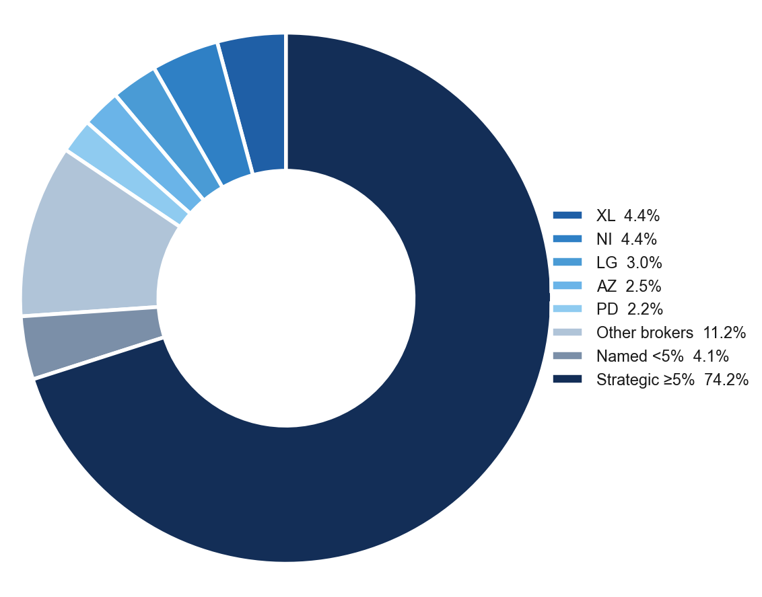
Ownership Structure
Shareholder Breakdown — 3-Tier Structure
Named Shareholders >1%
Holder | Shares | % | Tier
PT Autum Prima Indonesia | 144.3M | 30.00% | ≥5%
PT Kreasi Jasa Persada | 94.9M | 19.74% | ≥5%
Batubara Development Pte Ltd | 74.5M | 15.49% | ≥5%
Hapsoro | 43.3M | 9.00% | ≥5%
Susan Hioe | 14.4M | 3.00% | <5%
Albert Kurniawan Budi S | 5.2M | 1.08% | <5%
IDX Broker Analysis · 16 Jul 2026
6

Slide 7
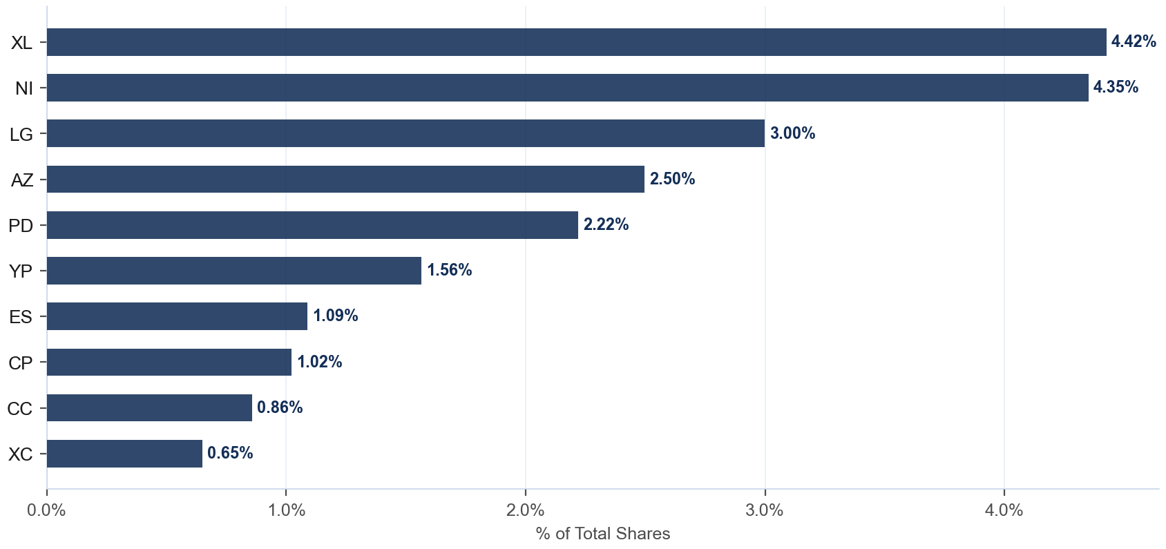
Broker Holdings — Top 10
Exchange Float · Top 10 Brokers · 27.6% of total shares
Detail
Broker | Type | Shares | %Co
XL | Lokal | 21.3M | 4.42%
NI | Pemerintah | 20.9M | 4.35%
LG | Lokal | 14.4M | 3.00%
AZ | Lokal | 12.0M | 2.50%
PD | Lokal | 10.7M | 2.22%
YP | Asing | 7.5M | 1.56%
ES | Lokal | 5.2M | 1.09%
CP | Asing | 4.9M | 1.02%
CC | Pemerintah | 4.1M | 0.86%
XC | Lokal | 3.1M | 0.65%
IDX Broker Analysis · 16 Jul 2026
7

Slide 8
AVCO Cost Basis — Top 20 Brokers
AVCO · Price-correlated lot matching (sell at P → consume lot nearest to P) · 69 brokers total · Current price Rp 5,842
Broker | Type | Shares | %Co | AVCO | Realized | Unrealized | Combined
XL | Lokal | 21.3M | 4.42% | Rp11,296 | +Rp2.32B | -Rp116.09B | -Rp113.77B
NI | Pemerintah | 20.9M | 4.35% | Rp5,109 | +Rp4.10B | +Rp15.32B | +Rp19.42B
LG | Lokal | 14.4M | 3.00% | Rp6,635 | +Rp1.15B | -Rp11.44B | -Rp10.29B
AZ | Lokal | 12.0M | 2.50% | Rp6,382 | +Rp26.99B | -Rp6.49B | +Rp20.50B
PD | Lokal | 10.7M | 2.22% | Rp7,996 | -Rp3.64B | -Rp23.01B | -Rp26.65B
YP | Asing | 7.5M | 1.56% | Rp10,459 | +Rp3.08B | -Rp34.75B | -Rp31.67B
ES | Lokal | 5.2M | 1.09% | Rp11,967 | +Rp0.15B | -Rp32.10B | -Rp31.95B
CP | Asing | 4.9M | 1.02% | Rp10,020 | -Rp0.53B | -Rp20.57B | -Rp21.10B
CC | Pemerintah | 4.1M | 0.86% | Rp8,962 | +Rp2.99B | -Rp12.85B | -Rp9.86B
XC | Lokal | 3.1M | 0.65% | Rp10,897 | +Rp0.82B | -Rp15.79B | -Rp14.96B
AN | Lokal | 2.4M | 0.49% | Rp2,613 | +Rp1.32B | +Rp7.64B | +Rp8.96B
XA | Asing | 2.2M | 0.47% | Rp11,756 | +Rp43.94B | -Rp13.23B | +Rp30.71B
AI | Asing | 2.1M | 0.44% | Rp11,775 | +Rp2.98B | -Rp12.45B | -Rp9.47B
HP | Lokal | 2.0M | 0.41% | Rp5,271 | +Rp94.28B | +Rp1.14B | +Rp95.42B
ZP | Asing | 1.9M | 0.40% | Rp13,689 | +Rp1.11B | -Rp14.96B | -Rp13.85B
MG | Lokal | 1.9M | 0.39% | Rp9,832 | -Rp2.22B | -Rp7.56B | -Rp9.78B
BQ | Asing | 1.8M | 0.37% | Rp4,929 | +Rp27.46B | +Rp1.65B | +Rp29.10B
EP | Lokal | 1.4M | 0.30% | Rp8,702 | +Rp0.10B | -Rp4.10B | -Rp4.00B
SQ | Lokal | 1.4M | 0.29% | Rp10,047 | +Rp1.81B | -Rp5.93B | -Rp4.12B
IF | Lokal | 1.3M | 0.27% | Rp9,701 | +Rp0.21B | -Rp5.07B | -Rp4.86B
IDX Broker Analysis · 16 Jul 2026
8

Slide 9
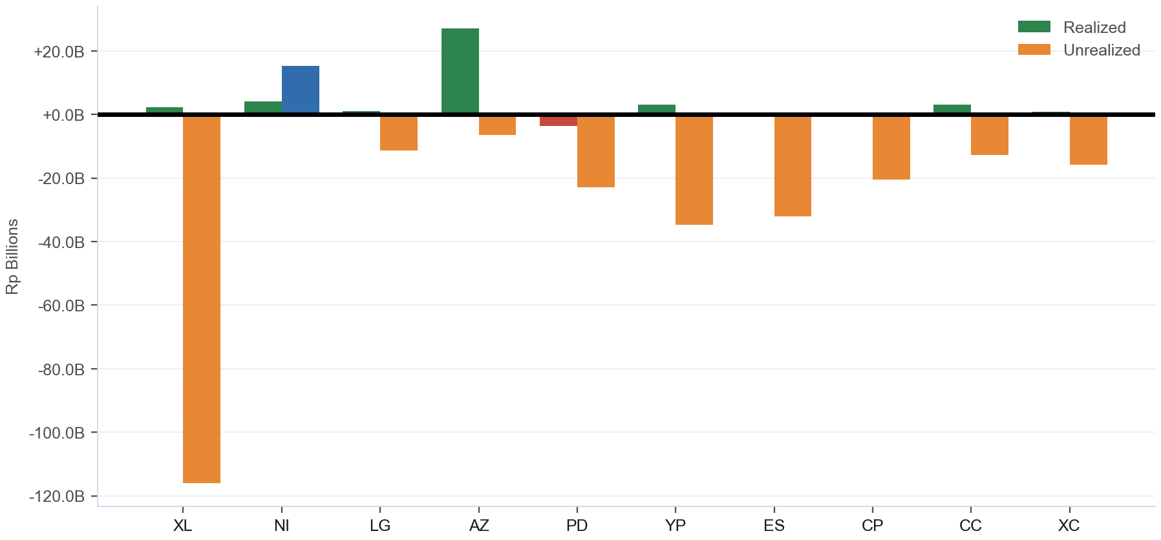
Combined P&L — Realized + Unrealized
Realized: +Rp525.18B · Unrealized: -Rp355.85B · Combined: +Rp169.33B · 29/69 profitable
IDX Broker Analysis · 16 Jul 2026
9

Slide 10
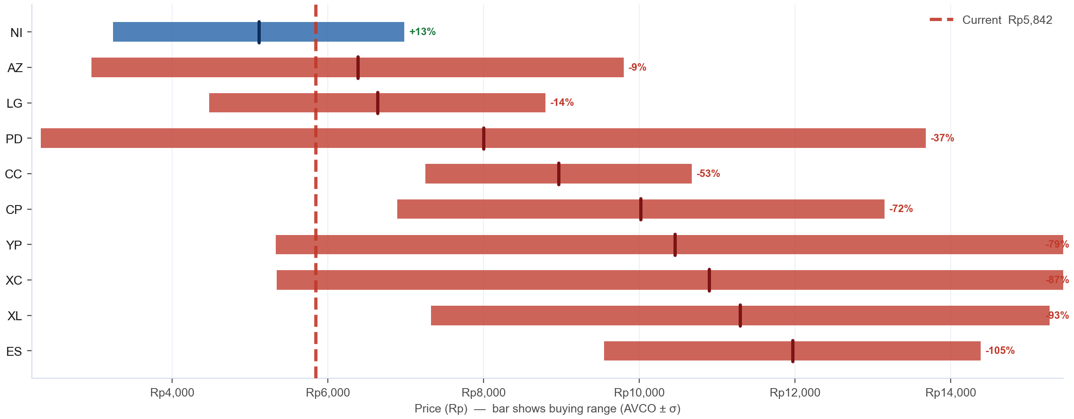
AVCO Distribution — Where Did the Top 10 Buy?
Top 10 by shares · Bar = buying range (AVCO ± 1σ) · Tick = average cost (AVCO) · Blue = in profit (AVCO below Rp 5,842) · Red = underwater · % = unrealized profit or loss vs current price
IDX Broker Analysis · 16 Jul 2026
10

Slide 11
SD / Conviction Analysis — Accumulation Behaviour
σ ≤ 15 = disciplined zone buyers · σ > 25 = price-chasers · Tightest = within last 6 months (bullish) · Rel σ (σ÷market σ) on Bell Curve slide — <1.0 = tighter than market
TIGHT σ ≤ 15
MODERATE σ 16-25
WIDE / EXTREME σ>25
Broker | AVCO | σ | Shares | Tightest | Range
SF | Rp876 | 10.1 | 45K | — | 865–886
MU | Rp793 | 6.8 | 31K | — | 786–800
Broker | AVCO | σ | Shares | Tightest | Range
— | — | — | — | — | —
Broker | AVCO | σ | Shares | Tightest | Range
XL | Rp11,296 | 3974.2 | 21.3M | Jun '26 (R) | 7322–15270
NI | Rp5,109 | 1872.4 | 20.9M | Feb '26 (R) | 3237–6982
LG | Rp6,635 | 2160.1 | 14.4M | Jul '26 (R) | 4474–8795
AZ | Rp6,382 | 3420.3 | 12.0M | Jul '26 (R) | 2962–9802
PD | Rp7,996 | 5685.2 | 10.7M | Mar '26 (R) | 2311–13681
YP | Rp10,459 | 5131.7 | 7.5M | Jun '26 (R) | 5328–15591
ES | Rp11,967 | 2418.7 | 5.2M | Mar '26 (R) | 9548–14385
CP | Rp10,020 | 3129.9 | 4.9M | Jun '26 (R) | 6890–13150
CC | Rp8,962 | 1712.2 | 4.1M | Jan '26 | 7250–10674
XC | Rp10,897 | 5556.8 | 3.1M | Jul '26 (R) | 5341–16454
…+46 more
IDX Broker Analysis · 16 Jul 2026
11

Slide 12
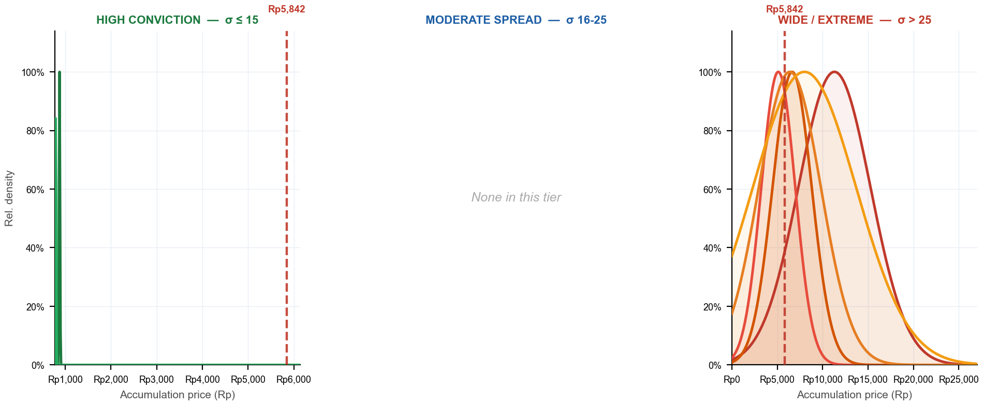
Bell Curves — Accumulation Distribution by Conviction Tier
Narrow peak = disciplined buyer (high conviction) · Flat curve = no price discipline · 3 panels — one per σ tier · Each panel has its own zoomed x-axis · Red dashed = current price · Curve normalized to peak = 1.0
SF σ10 · MU σ7
XL σ3974 · NI σ1872 · LG σ2160 · AZ σ3420 · PD σ5685
σ Evolution — Top 5 by Shares · σ = buy-price std deviation (lower = more focused zone buying) · Trend = σ 30d vs σ 180d (Tightening = buying more focused recently)
Broker | Shares | σ All-time | σ 30d | σ 90d | σ 180d | Rel σ 30d | Trend (30d vs 180d)
XL | 21.3M | 3974.2 | 1624.9 | 3180.6 | 3620.8 | 0.86 | Tightening
NI | 20.9M | 1872.4 | 1668.6 | 3260.6 | 3219.8 | 0.88 | Tightening
LG | 14.4M | 2160.1 | 509.9 | 1420.8 | 2402.6 | 0.27 | Tightening
AZ | 12.0M | 3420.3 | 1077.1 | 3509.5 | 5083.5 | 0.57 | Tightening
PD | 10.7M | 5685.2 | 1680.8 | 3266.3 | 4032.0 | 0.89 | Tightening
IDX Broker Analysis · 16 Jul 2026
12

Slide 13
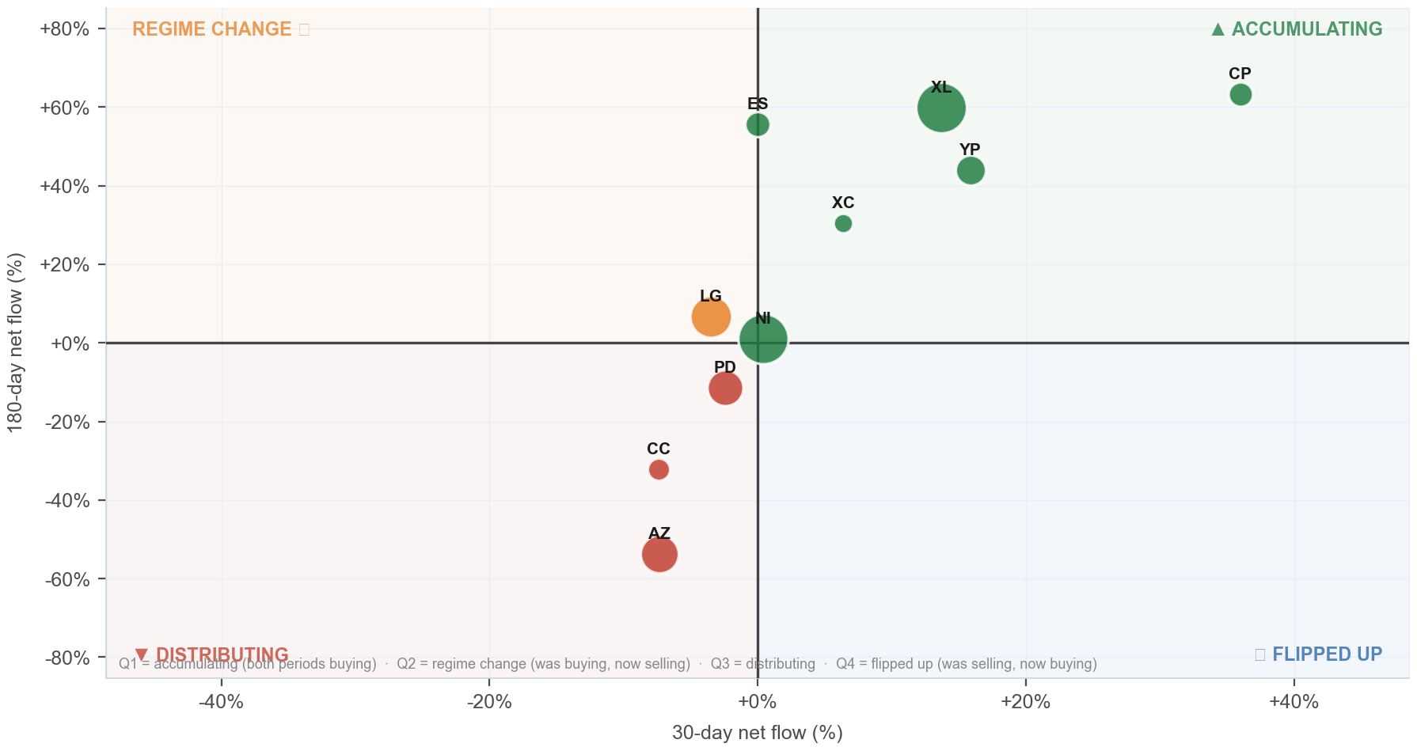
Broker Regime Map — 30d vs 180d Net Flow
X = 30d net flow % · Y = 180d net flow % · Bubble ∝ ownership % · Green=Accumulating · Orange=Regime Change · Red=Distributing · Blue=Flipped Up
Detail
Broker | 30d | 180d
XL | +13.7% | +59.9%
NI | +0.4% | +1.1%
LG | -3.5% | +6.7%
AZ | -7.3% | -53.8%
PD | -2.4% | -11.5%
YP | +15.9% | +44.0%
ES | +0.0% | +55.6%
CP | +36.0% | +63.2%
CC | -7.4% | -32.1%
XC | +6.4% | +30.5%
IDX Broker Analysis · 16 Jul 2026
13

Slide 14
Investment Thesis — SINI at Rp 5,842
Bullish Signals
Tactical Caution
AVCO median Rp 9,500 — price is BELOW median broker cost.
Net unrealized loss -Rp355.85B — underwater positions create exit pressure on rallies.
Realized armor: +Rp525.18B banked profit provides buffer.
Only 29/69 brokers profitable — elevated distribution risk.
Top 10 brokers hold 21.7% of total shares — concentrated, large incremental moves possible.
Named <5% holders (4.1%) = direct KSEI holders (creditor conversions, IPO allotments, or pre-IPO investors — entry price varies) — exit adds unexpected supply.
IDX Broker Analysis · 16 Jul 2026
14

Slide 15
Ownership Reconciliation & Methodology
Share Count Reconciliation — 3-Tier Ownership Model
Category | Shares | % | Notes
Strategic ≥5% (founders/pre-IPO) | 357.1M | 74.23% | KSEI direct — never in broker flow, zero overlap
Named <5% (direct KSEI — creditor/allotment/pre-IPO) | 19.6M | 4.08% | May overlap broker float — entry cost varies by holder type (shown gross)
Broker-tracked float | 133.0M | 27.65% | Raw broker flow data — may overlap with named <5% holders
Untracked (KSEI, unidentified) | 0 | 0.00% | Not in named list or broker data
TOTAL SHARES OUTSTANDING | 481.0M | 100.00% | Fully reconciled
Methodology
AVCO: price-correlated lot matching — on SELL at price P, consume the lot with min |buy_price − P|. Correct for aggregate broker data; raw FIFO and equal-weight AVCO both produce incorrect basis.
Gross flows: Stockbit Net-OFF — separate BUY/SELL rows per broker per day. Data: 2019-11-08 → 2026-07-15 (1498 days).
Corporate actions: applied in-queue on recording date. Forward splits/bonus: lots ×multiplier, prices ×(1/multiplier). Reverse splits: lots ÷multiplier, prices ×multiplier. No post-hoc factor.
Realized P&L: realized_pnl_rp from holdings_final.csv (LotQueue). NOT avco_realized — can differ by billions on high-volume brokers.
IDX Broker Analysis · 16 Jul 2026
15

Slide 16
Broker Intelligence — VWAP Alpha & Ownership Clustering
VWAP alpha < 0 = broker buys cheaper than market average · r > 0.50 shown · r ≥ 0.70 + both non-MM = amber (strong same-owner signal) · Negative r = counterparty/transfer behavior, not co-ownership
BUY VWAP ALPHA vs market (all history)
CORRELATED BROKER PAIRS (same owner signal)
Broker | Mean α | Days<Mkt | t-stat | Buy days
AD PPE | -2.097% | 63% | -1.9 | 19
RB MM | -1.606% | 57% | -2.4 | 47
ES | -0.721% | 76% | -2.2 | 25
CD MM | -0.692% | 53% | -1.0 | 17
IT | -0.631% | 40% | -0.3 | 10
IU MM | -0.516% | 67% | -1.2 | 27
AN | -0.173% | 48% | -0.3 | 60
BK | -0.127% | 49% | -0.6 | 39
PG | -0.102% | 60% | -0.2 | 284
BR | -0.019% | 25% | -0.0 | 16
SH MM | +0.068% | 52% | +0.1 | 139
PC PPE | +0.086% | 65% | +0.1 | 48
KI | +0.108% | 43% | +0.1 | 35
DX MM | +0.233% | 49% | +0.7 | 116
SA PPE | +0.562% | 29% | +0.6 | 17
Pair | r | Overlap | Roles
BQ/YU | +0.903 | 225d | MAR|TRA
HP/TP | -0.663 | 78d | MAR|TRA
NI/PG | -0.786 | 309d | ACC|TRA
CP/XA | -0.828 | 314d | DIS|MAR
★ AMBER = r ≥ 0.70 + both non-MM roles = likely single owner
IDX Broker Analysis · 16 Jul 2026
16

