Slide 1
COS426 Final Project: Sandstorm.mp3 Examples
Savannah Du
Jason Kim
Michael Zhang

Slide 2
Code Excerpts

Slide 3
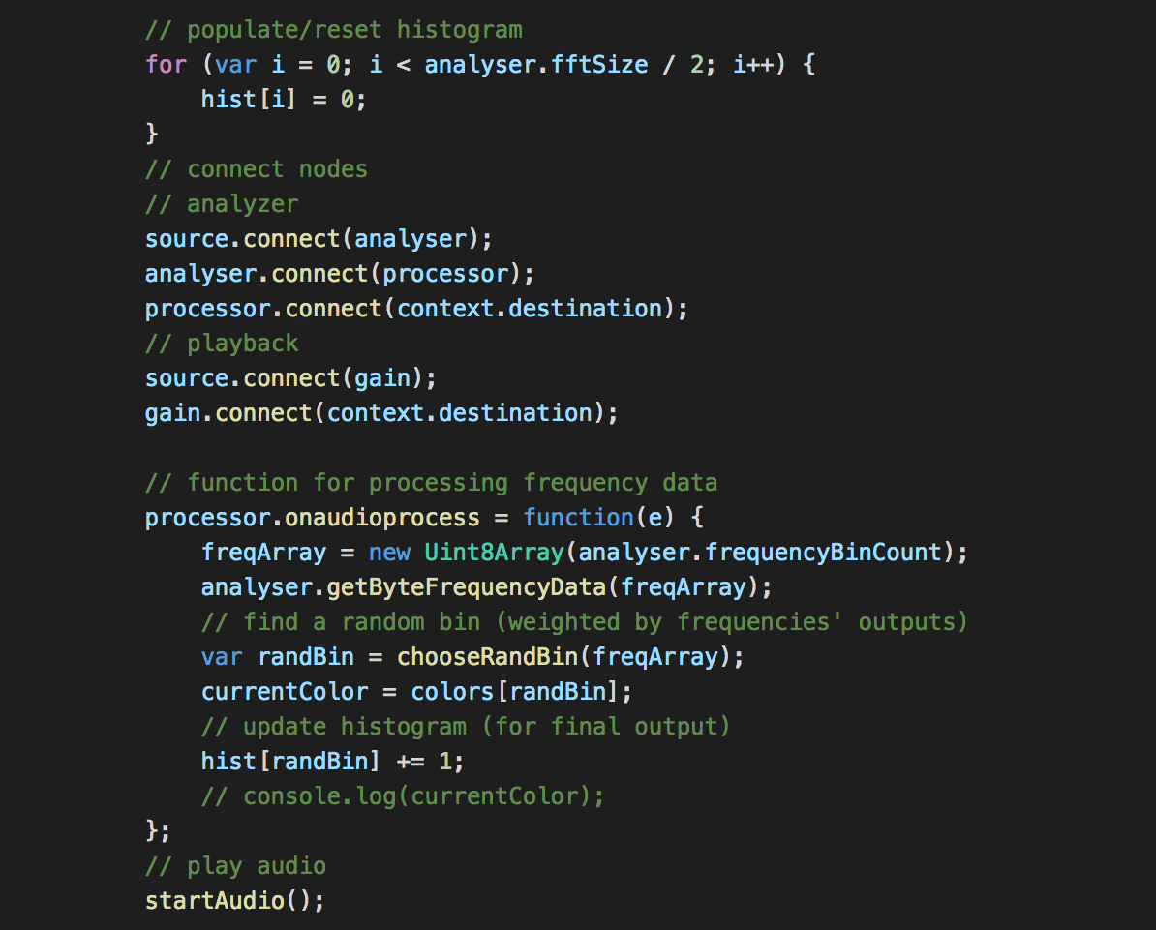
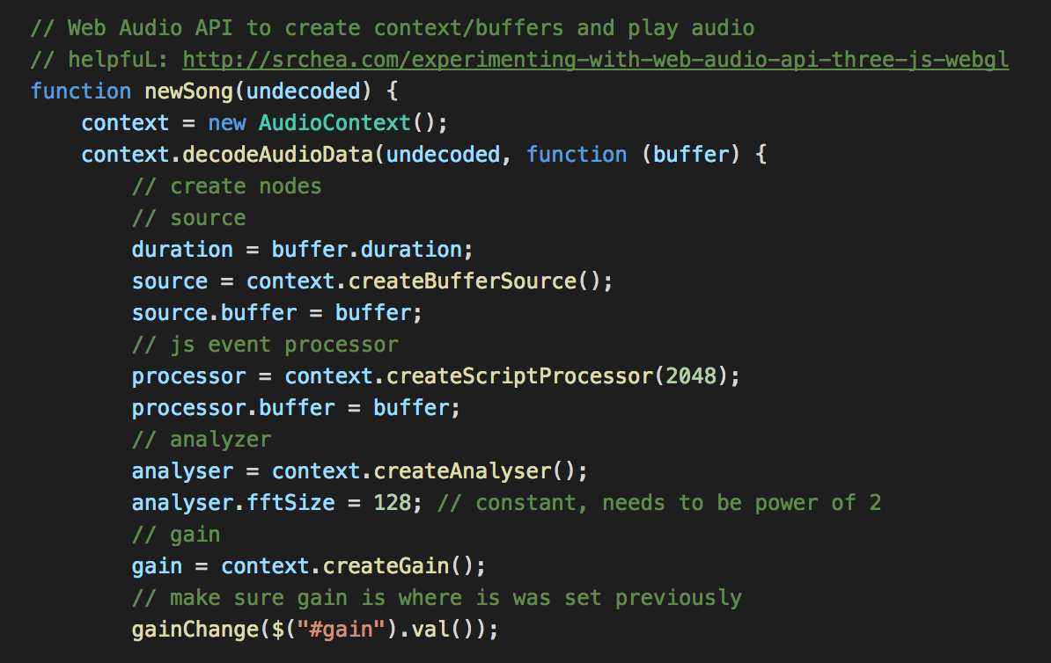
Audio Processing

Slide 4
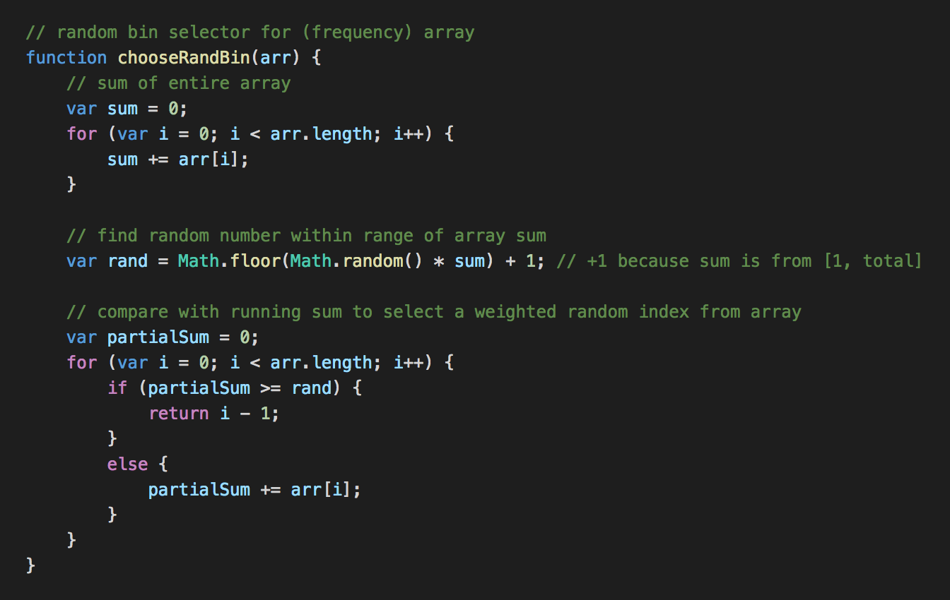
Choose Random Bin

Slide 5
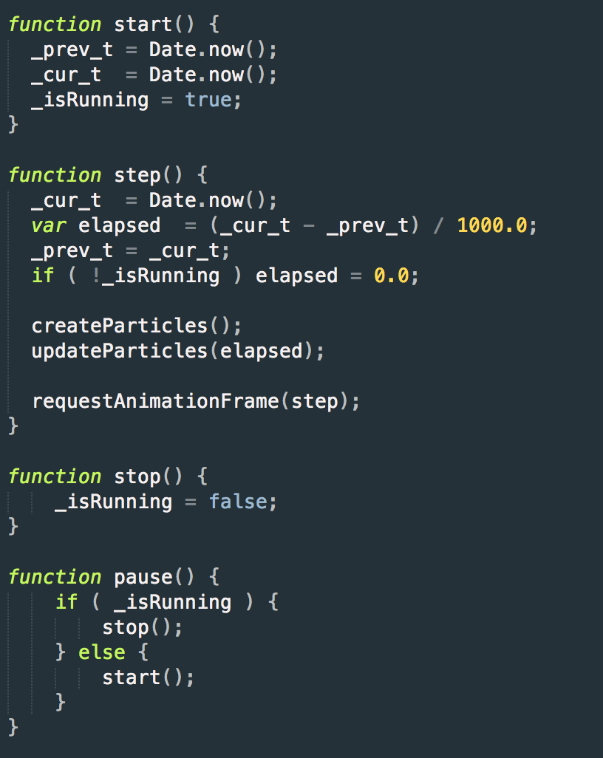
Animation

Slide 6
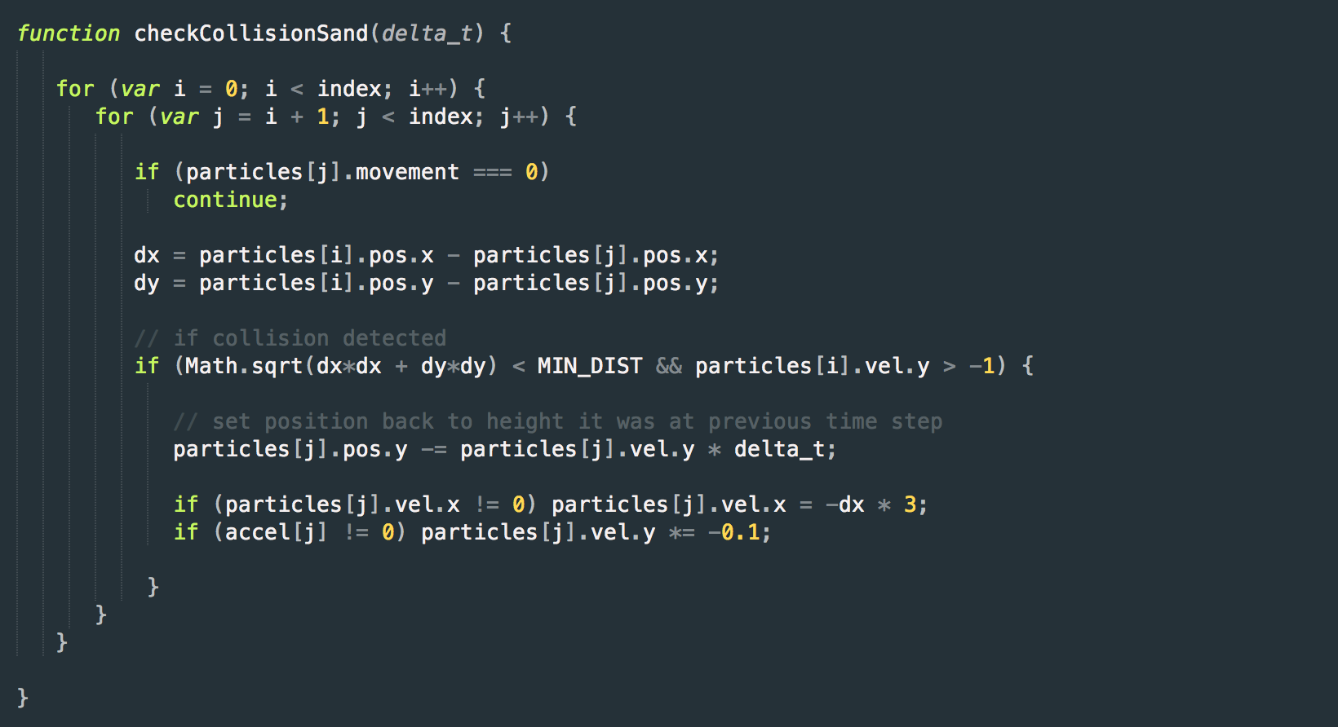
Collisions

Slide 7
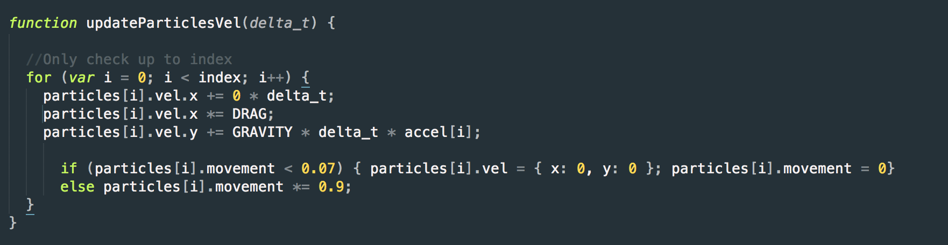
Vibration Reduction

Slide 8
Basic Examples

Slide 9

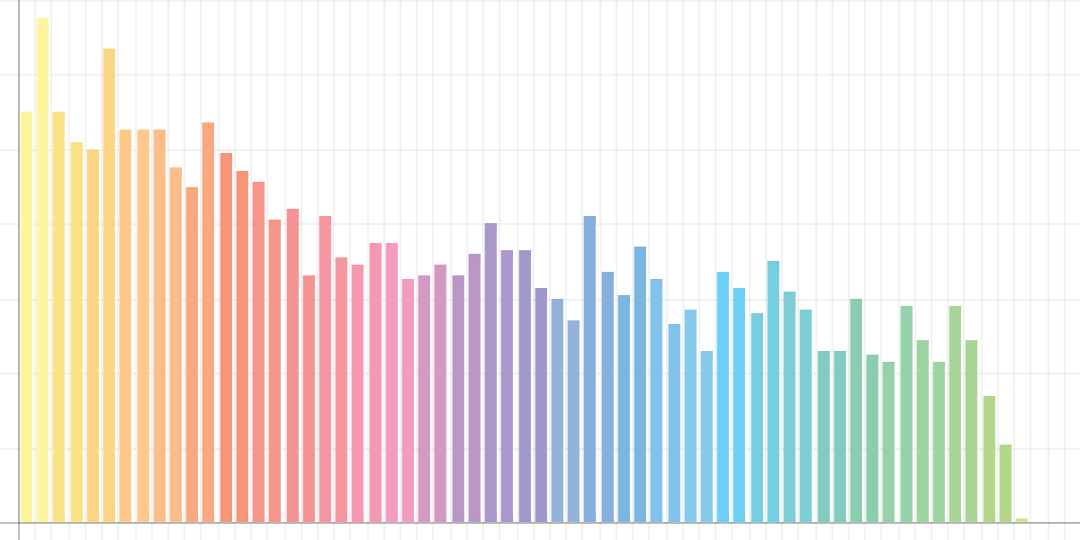
Miley Cyrus – “Party in the U.S.A.”

Slide 10

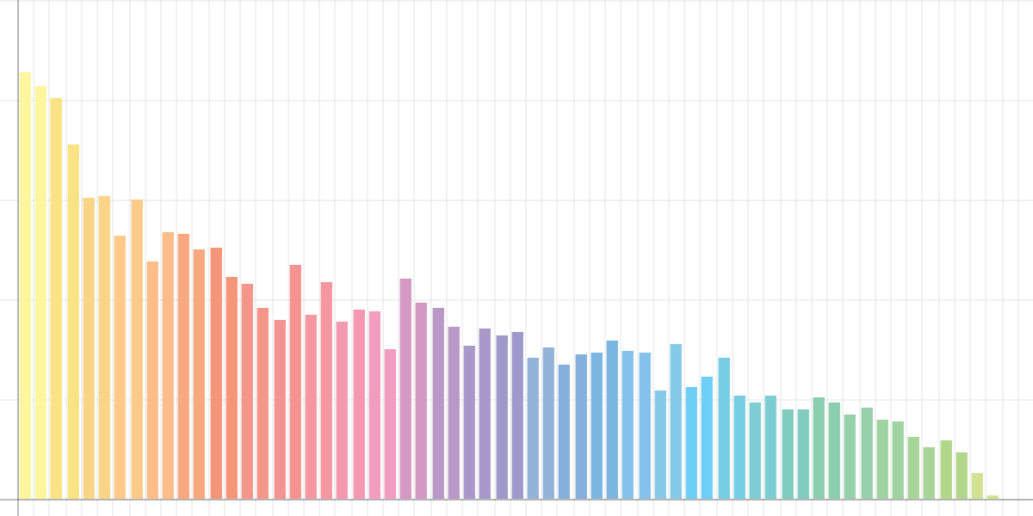
Lido – “Citi Bike”

Slide 11
Examples of Skew

Slide 12

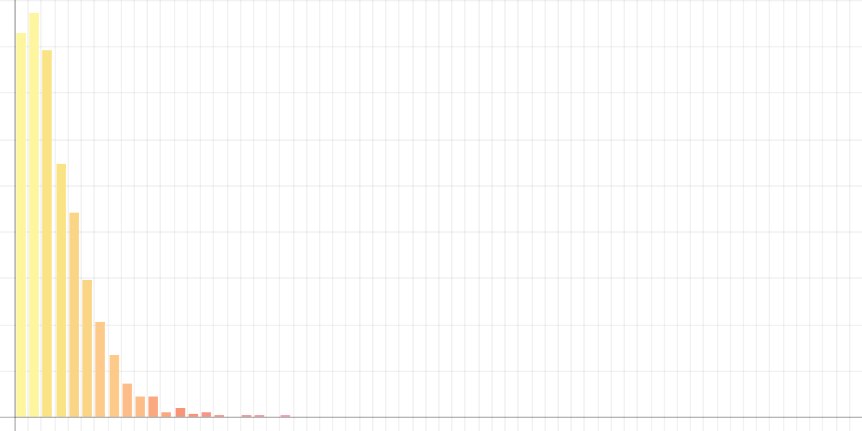
Chopin – “Prelude #4”

Slide 13

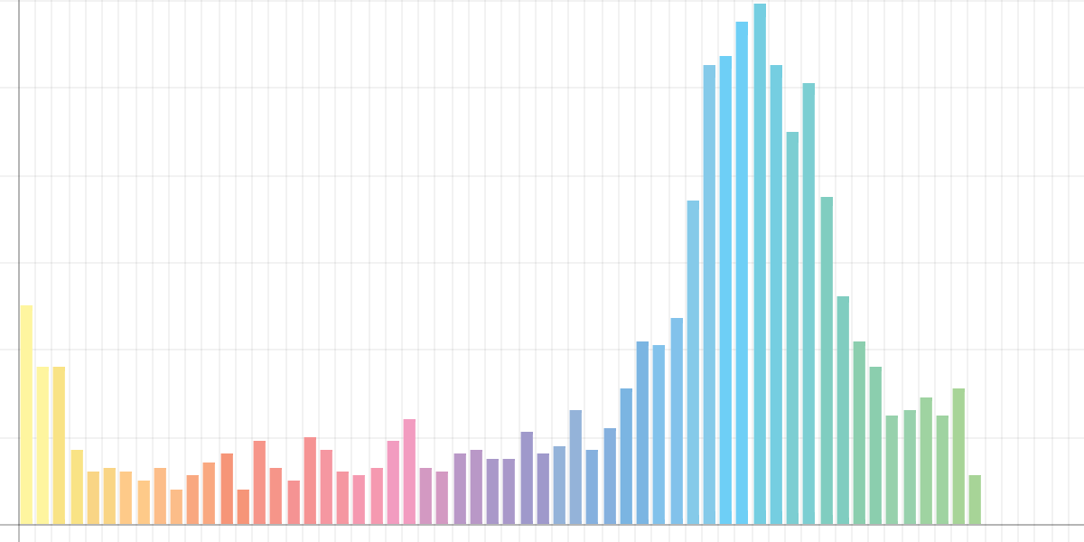
Ryoji Ikeda – “data.convex”

Slide 14
Tests

Slide 15

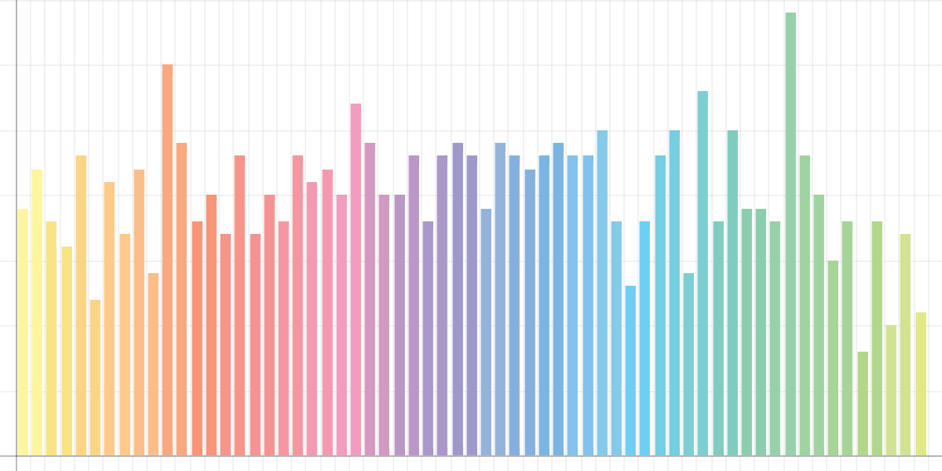
White Noise

Slide 16
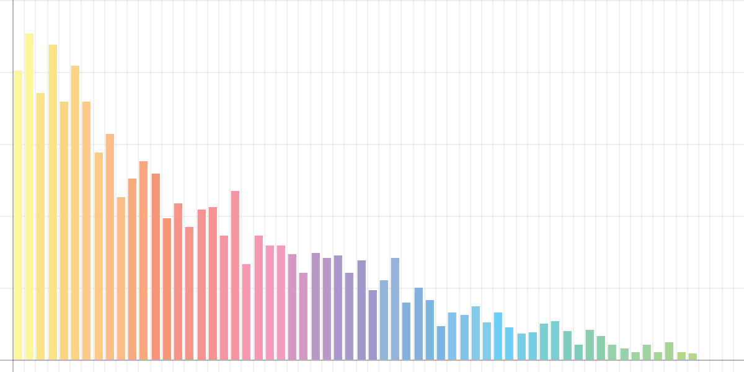
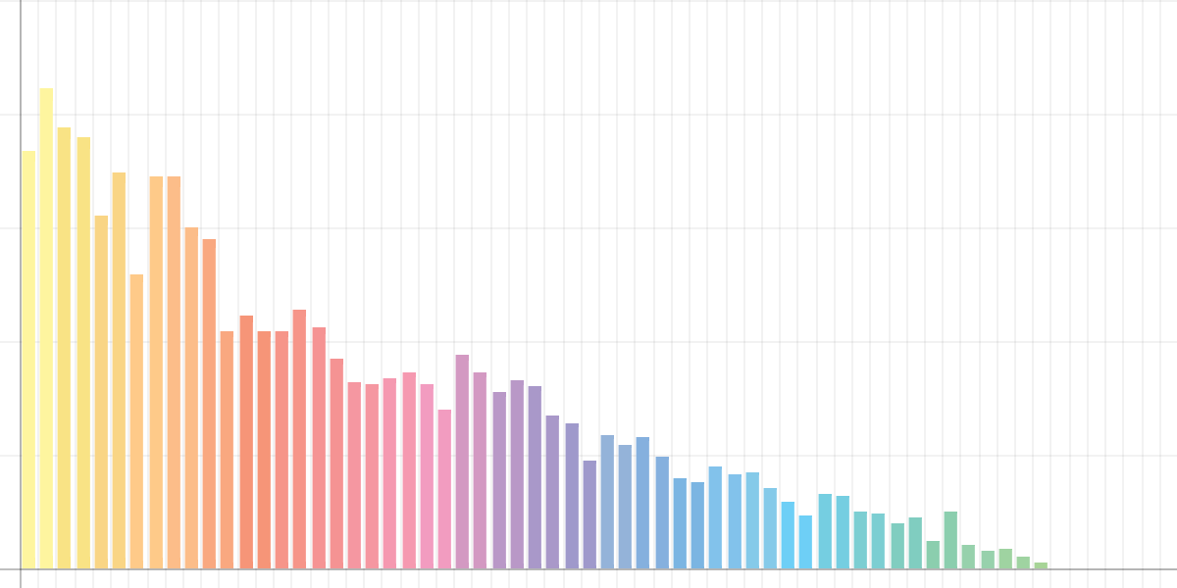
CD vs. Vinyl - Histogram (Pink Floyd - “Any Colour You Like”)
CD
Vinyl

Slide 17


CD vs. Vinyl - Bottle (Pink Floyd - “Any Colour You Like”)
CD
Vinyl

