Slide 1
COS426 Final Project: Sandstorm.mp3 Examples
Savannah Du
Jason Kim
Michael Zhang

Slide 2
https://jasonmk47.github.io/Graphics-Final/

Slide 3
Code Excerpts

Slide 4
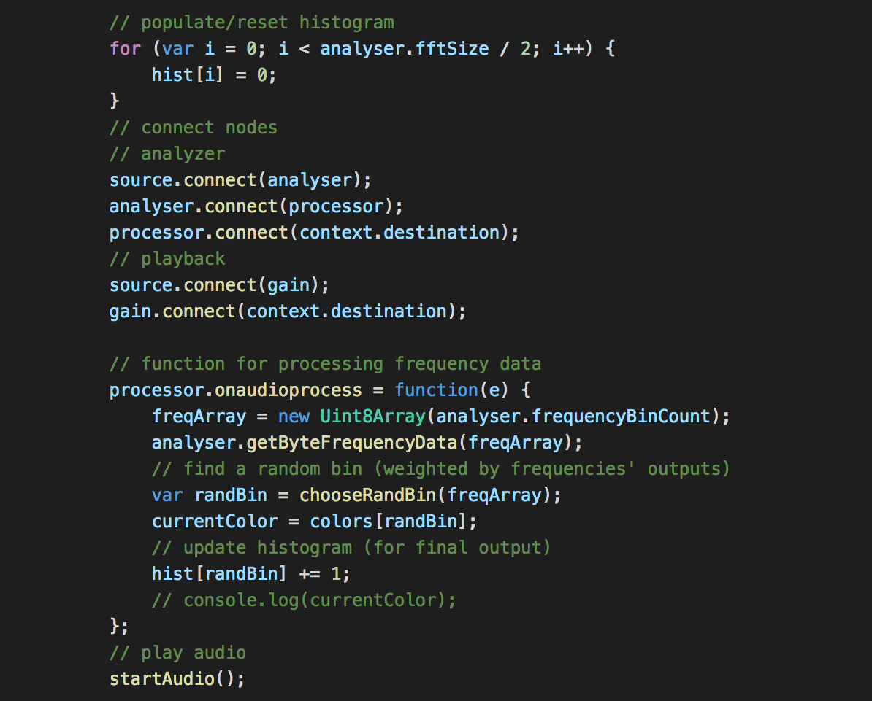
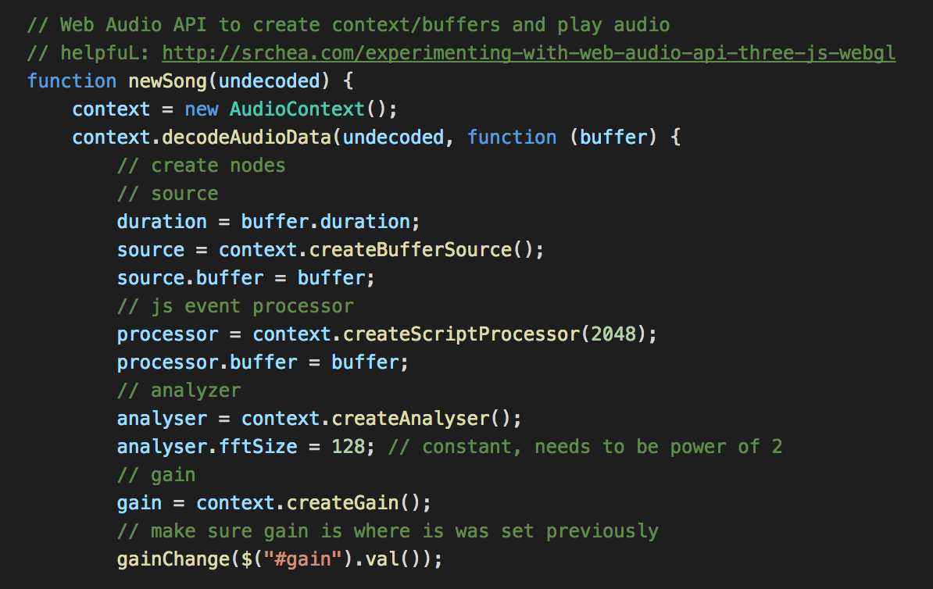
Audio Processing

Slide 5
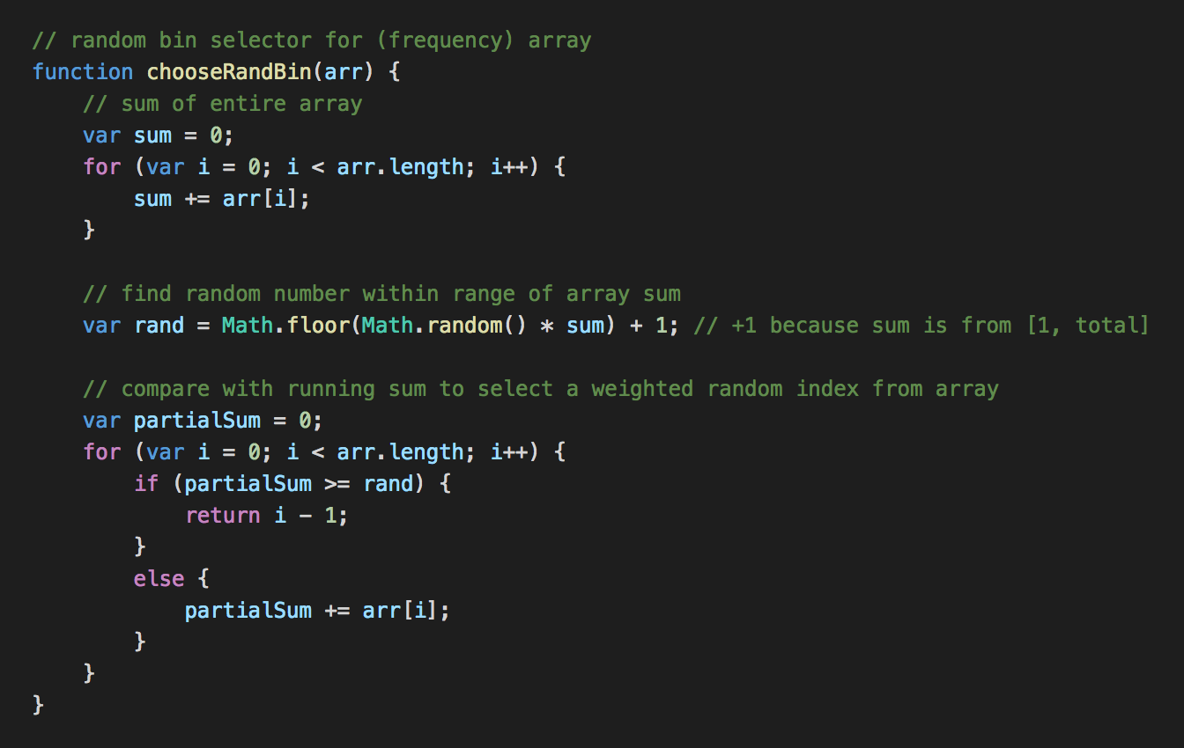
Choose Random Bin

Slide 6
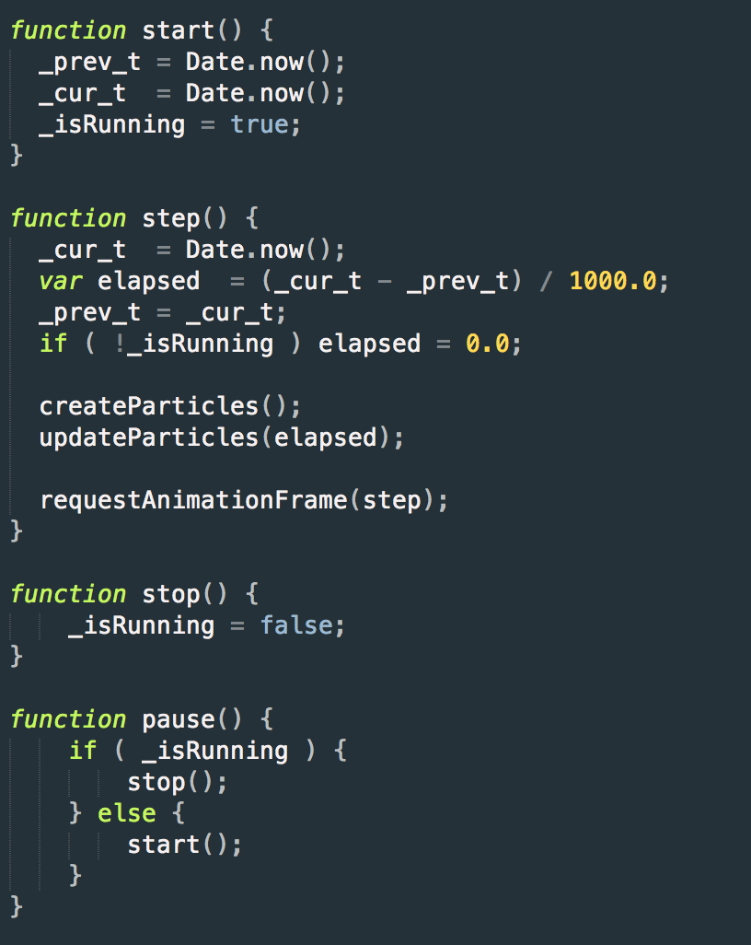
Animation

Slide 7
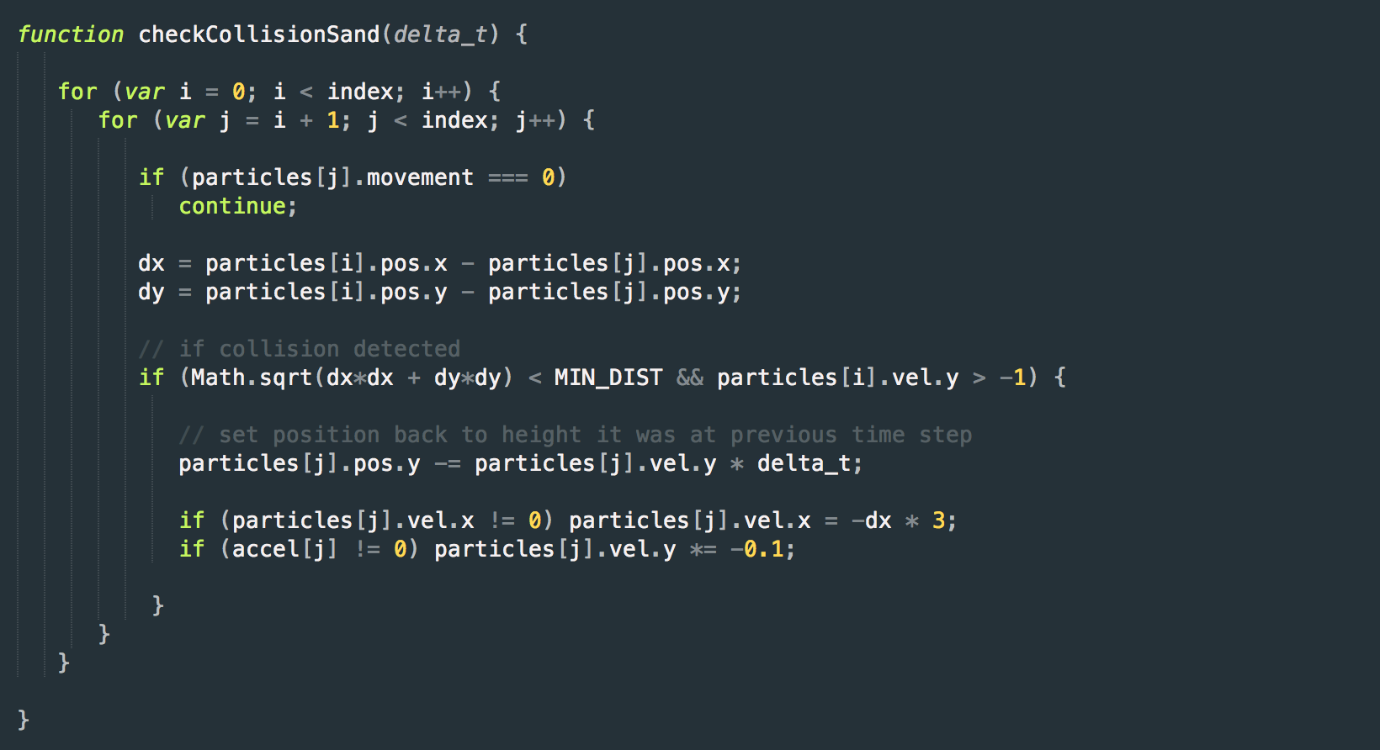
Collisions

Slide 8
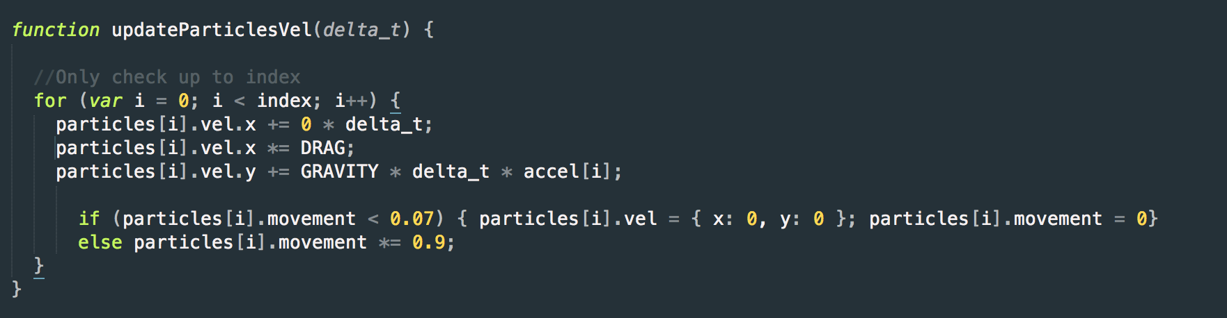
Vibration Reduction

Slide 9
Basic Examples

Slide 10

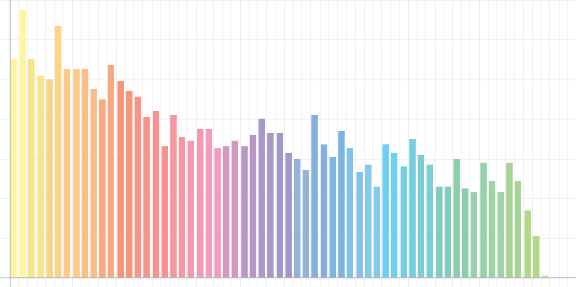
Miley Cyrus – “Party in the U.S.A.”

Slide 11

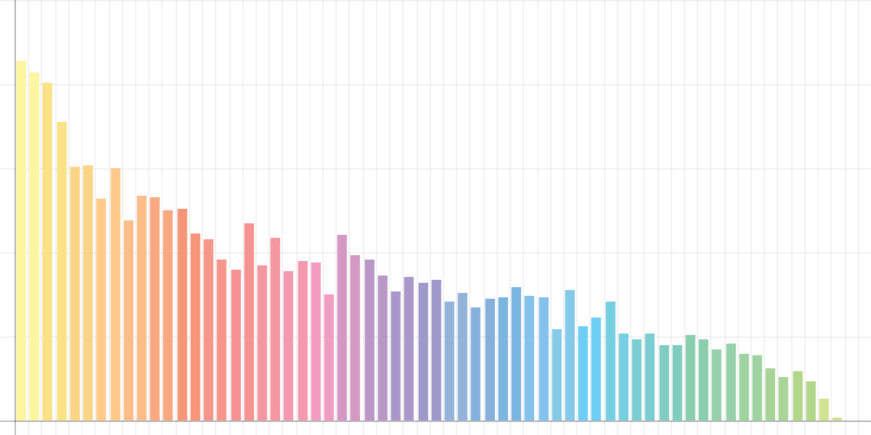
Lido – “Citi Bike”

Slide 12
Examples of Skew

Slide 13

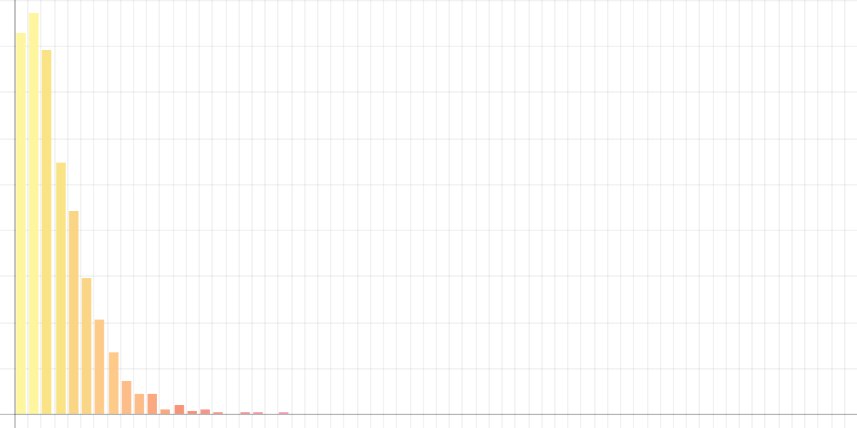
Chopin – “Prelude #4”

Slide 14

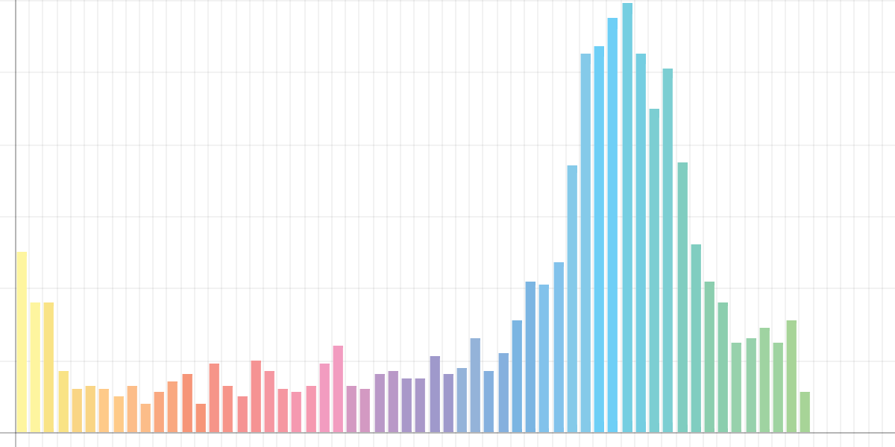
Ryoji Ikeda – “data.convex”

Slide 15
Tests

Slide 16

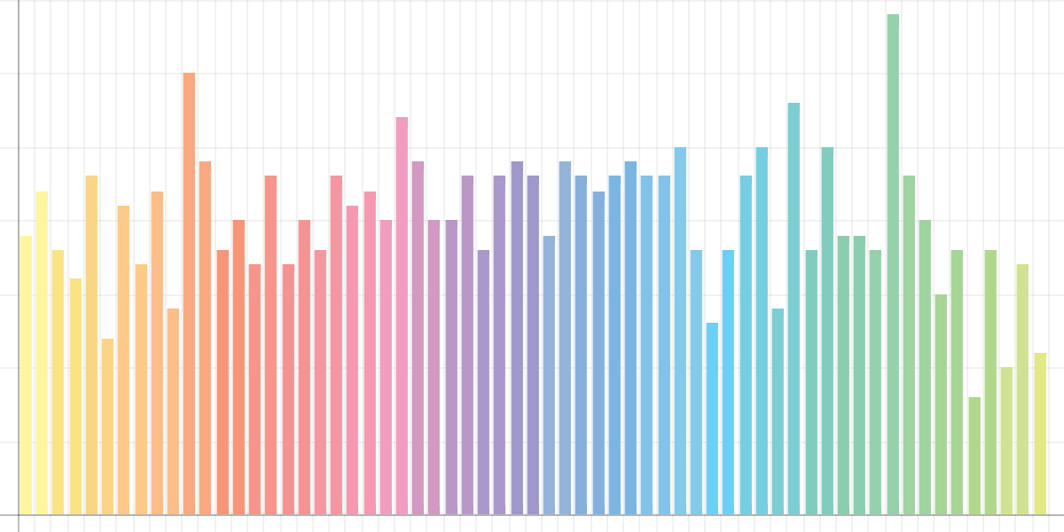
White Noise

Slide 17
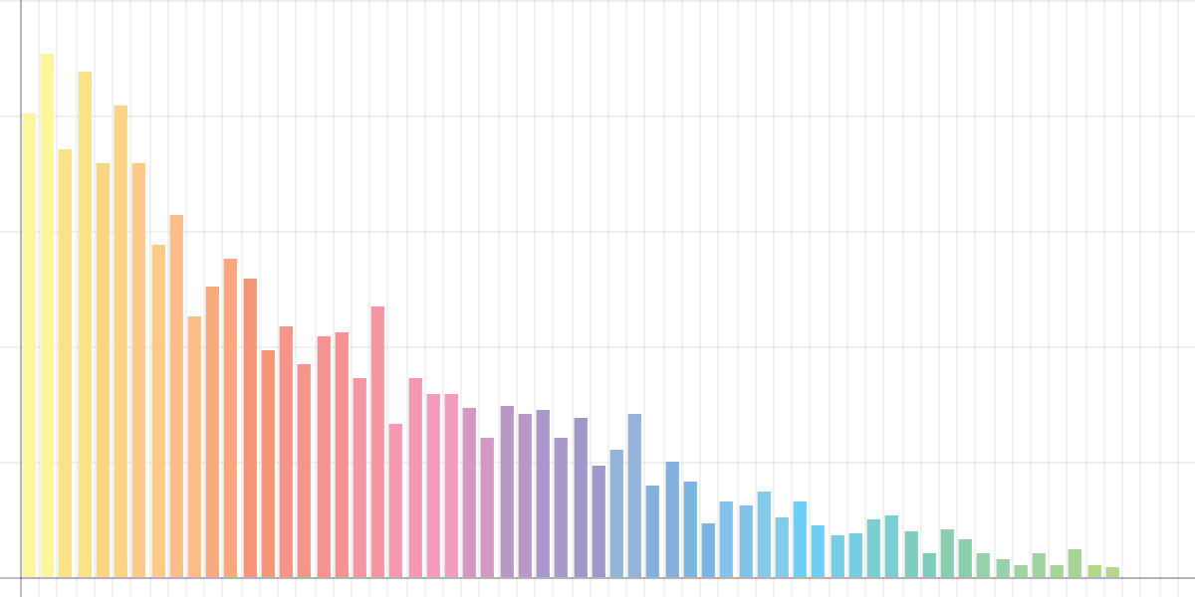
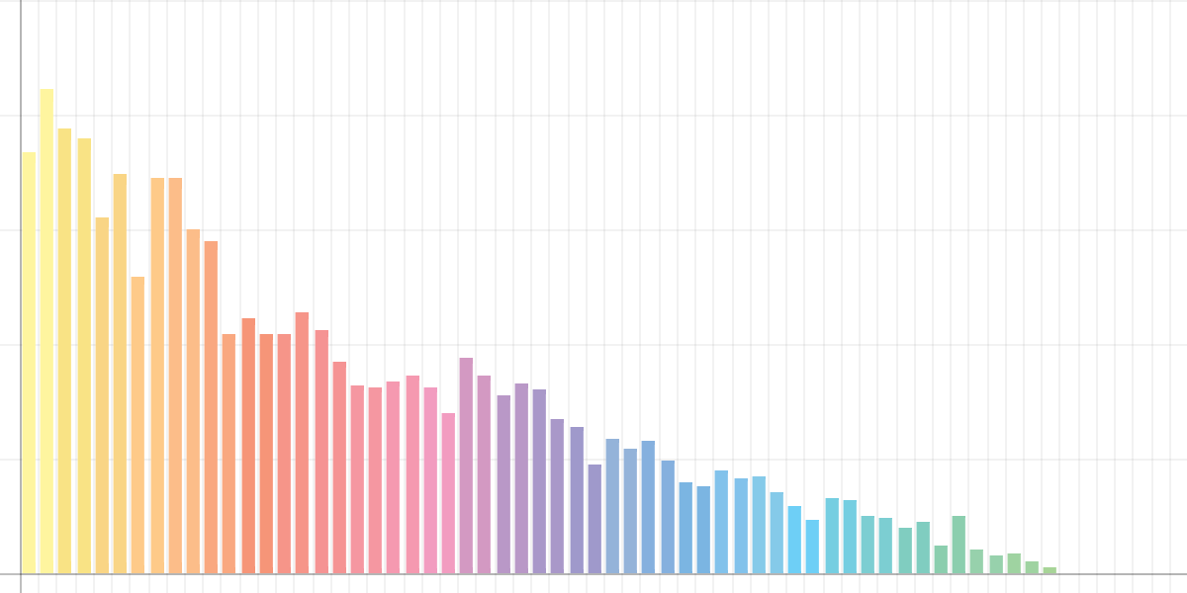
CD vs. Vinyl - Histogram (Pink Floyd - “Any Colour You Like”)
CD
Vinyl

Slide 18


CD vs. Vinyl - Bottle (Pink Floyd - “Any Colour You Like”)
CD
Vinyl

