Slide 1
COS426 Final Project: Sandstorm.mp3 Examples
Savannah Du
Jason Kim
Michael Zhang

Slide 2
Basic Examples

Slide 3

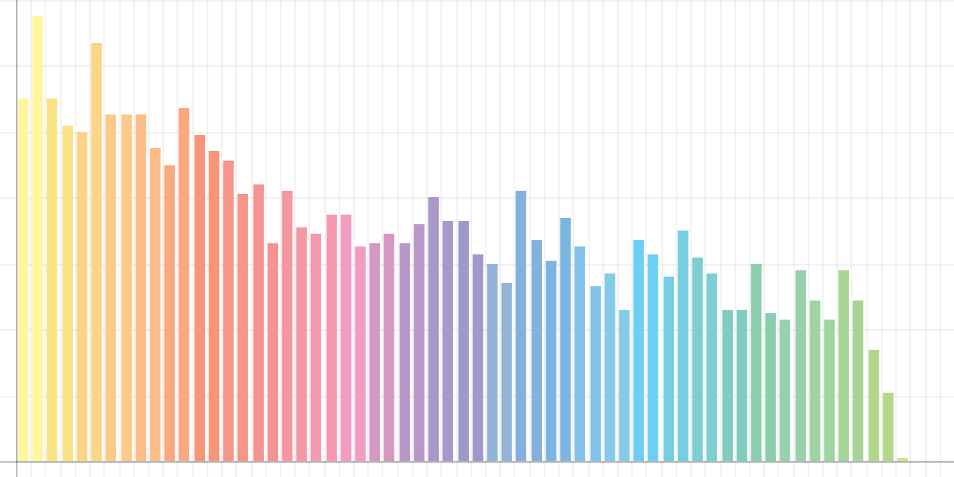
Miley Cyrus – “Party in the U.S.A.”

Slide 4

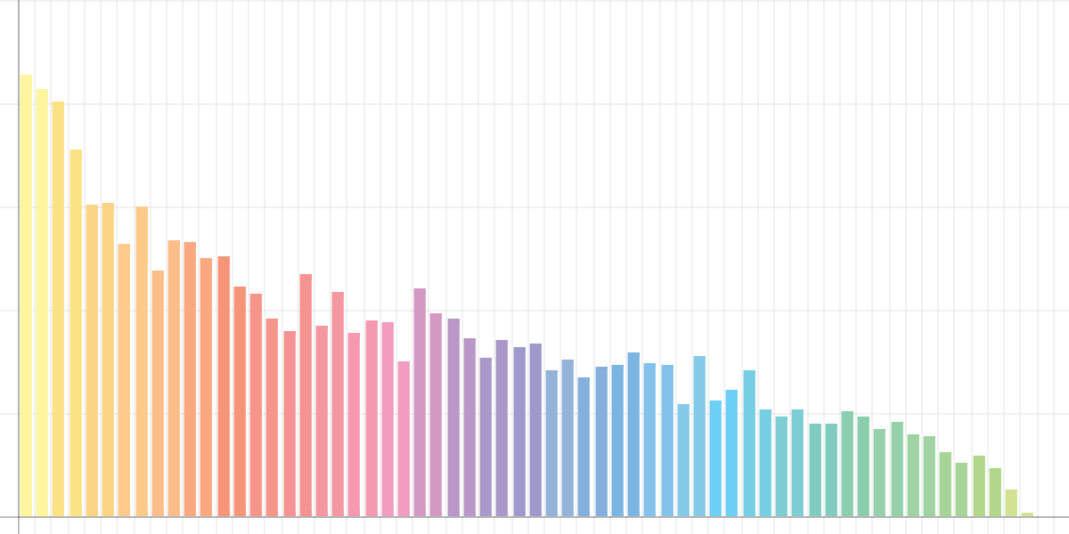
Lido – “Citi Bike”

Slide 5
Examples of Skew

Slide 6

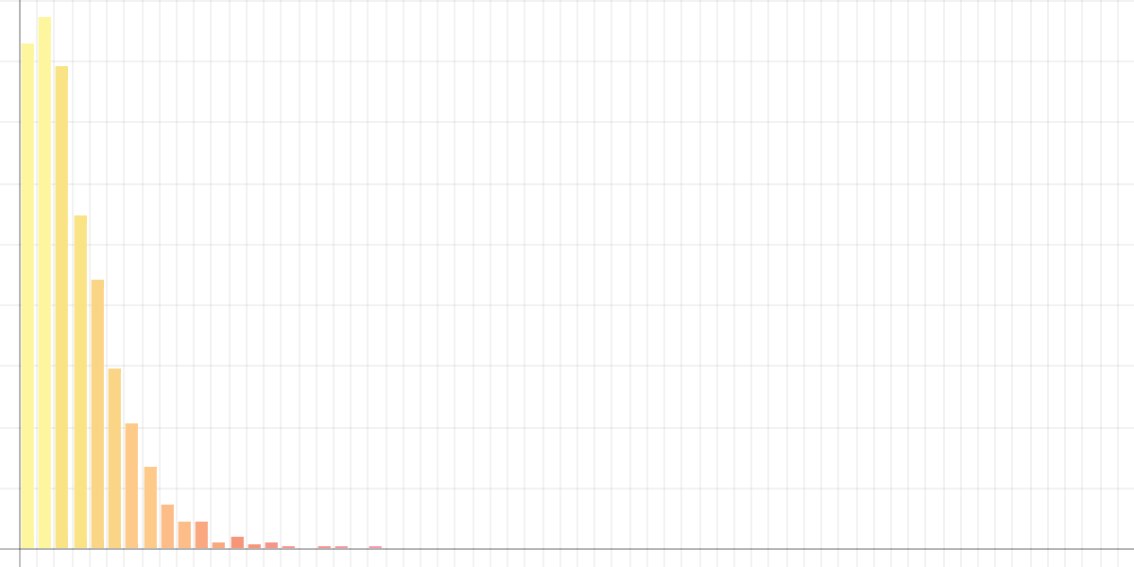
Chopin – “Prelude #4”

Slide 7

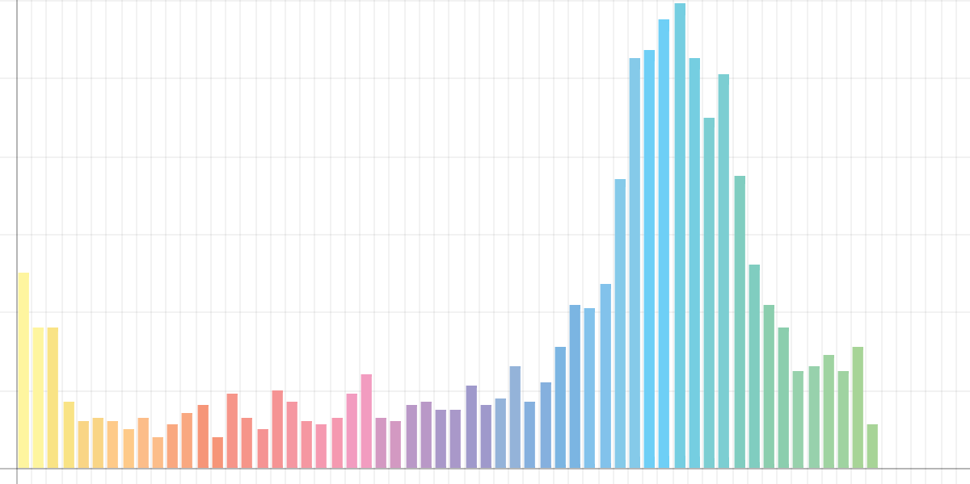
Ryoji Ikeda – “data.convex”

Slide 8
Tests

Slide 9

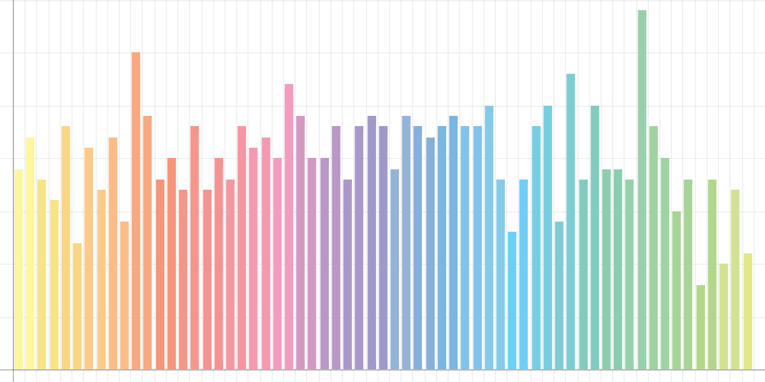
White Noise

Slide 10
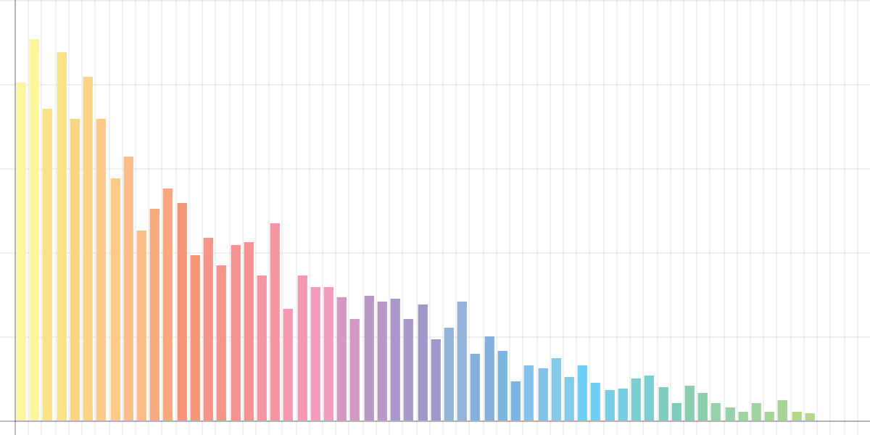
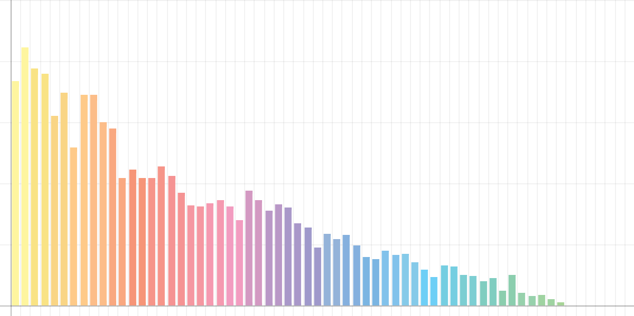
CD vs. Vinyl - Histogram (Pink Floyd - “Any Colour You Like”)
CD
Vinyl

Slide 11


CD vs. Vinyl - Bottle (Pink Floyd - “Any Colour You Like”)
CD
Vinyl

