Slide 1


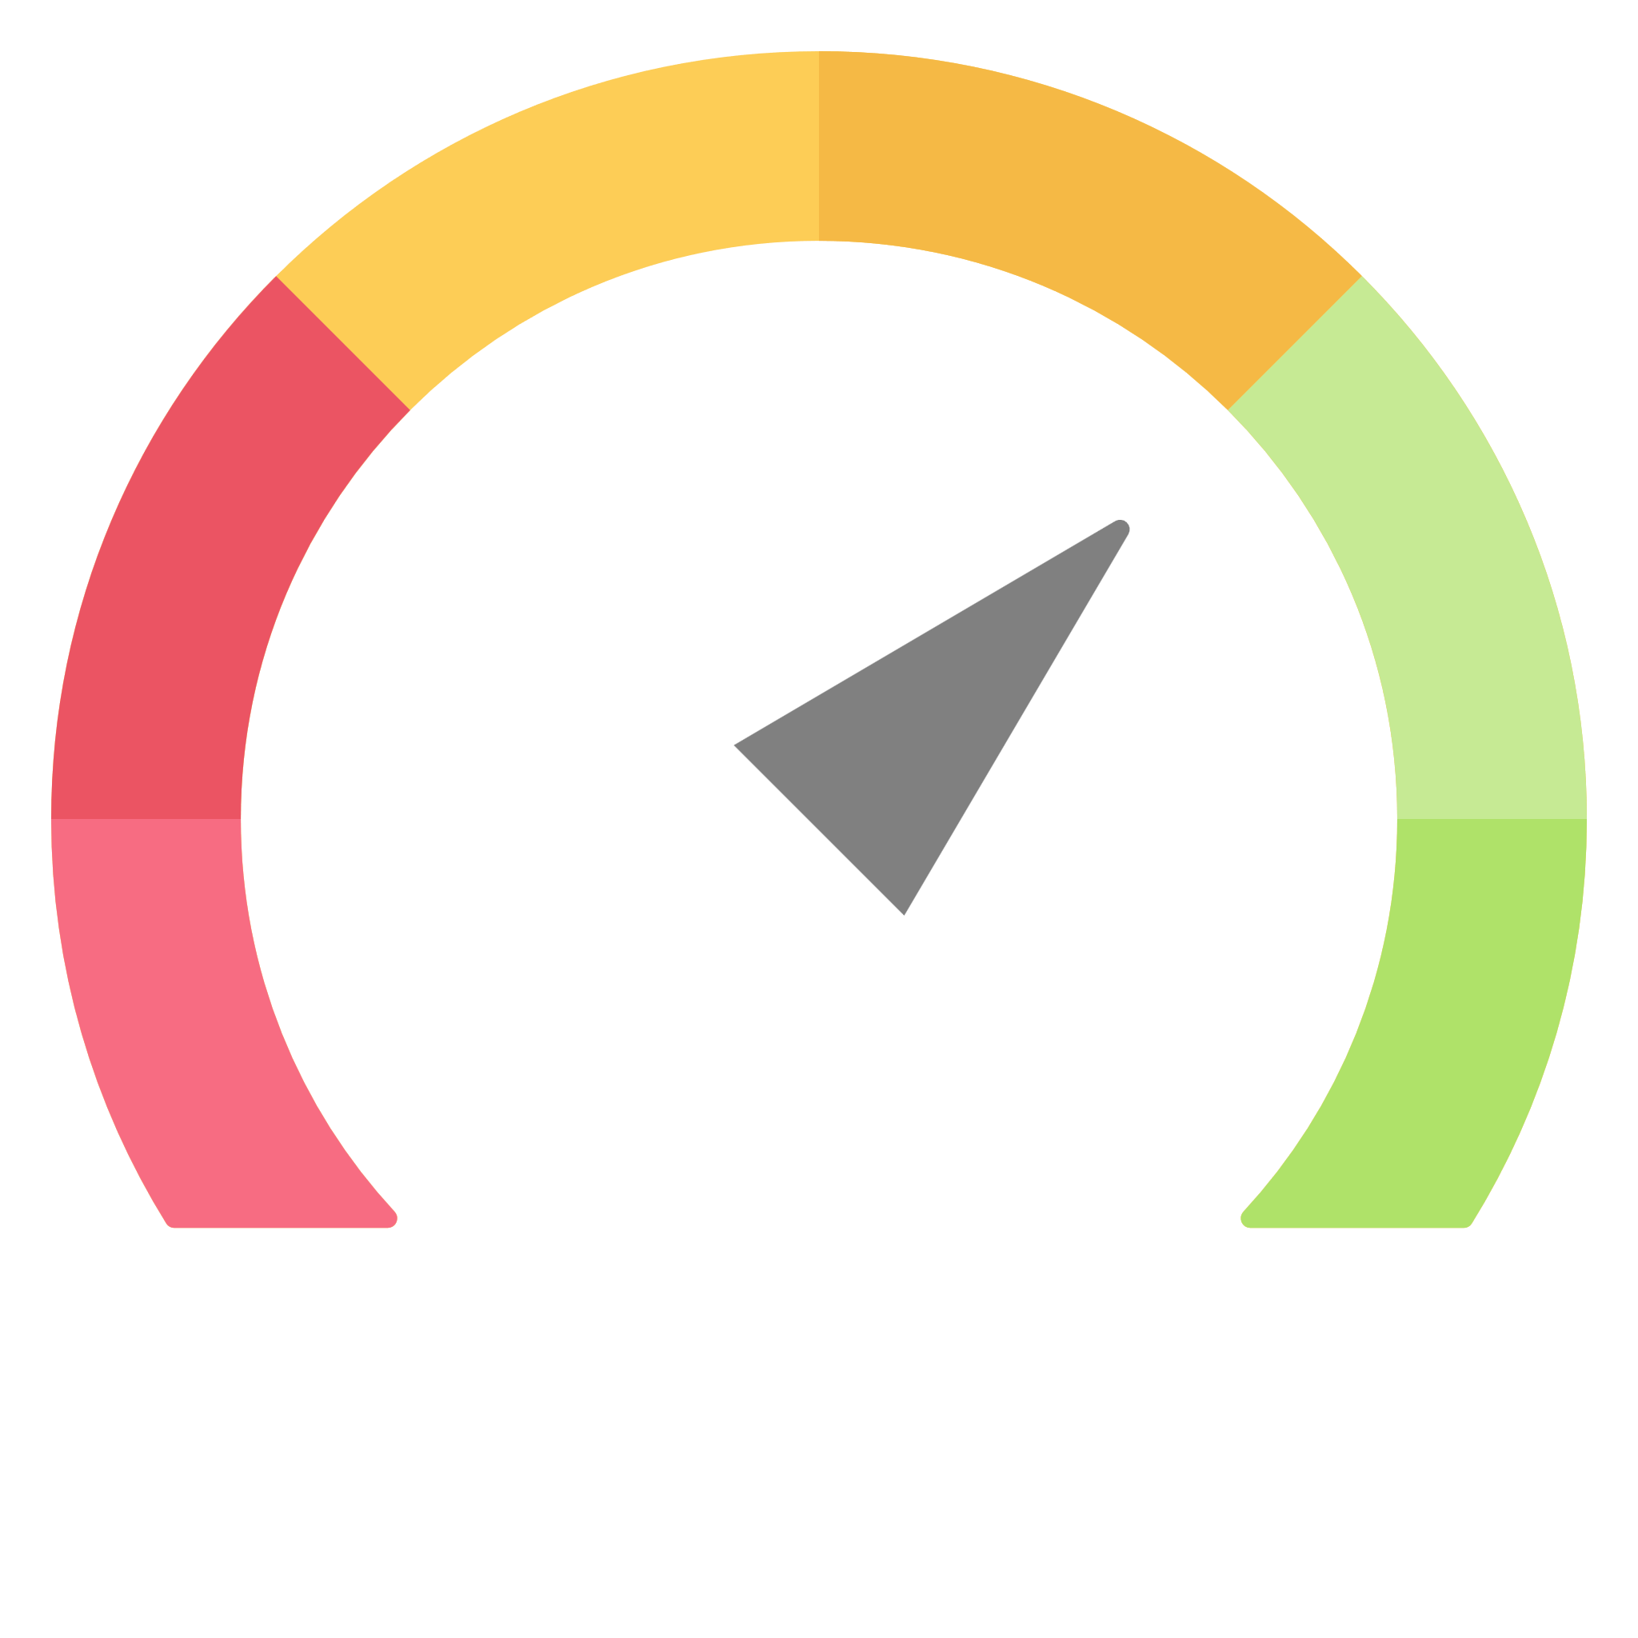
Maximizing C#
C# 12
C# Next
Performance
Notes:
Icon: https://www.flaticon.com/free-icon/coding_10728539
Icon: https://www.flaticon.com/free-icon/time_12270943

Slide 2

HELLO
Scott Kay
scott@syntaxnode.com

Slide 3
AGENDA
Everything New In C# 12
9:00am
Coming Soon To C# 13
9:45am
Break
10:30am
C# Performance Tuning
10:35am
Lunch (Jersey Mike’s)
12:00pm

Slide 4
Everything New In C# 12
Notes:
Icon: https://www.flaticon.com/free-icon/coding_10728539

Slide 5

DOCS
learn.microsoft.com/en-us/dotnet/csharp/whats-new/csharp-12

Slide 6
C# 12
REQUIRES .NET 8

Slide 7
CODE

Slide 8
Coming Soon To C# 13
Notes:
Icon: https://www.flaticon.com/free-icon/time_12270943

Slide 9

Compiler Source Code
github.com/dotnet/roslyn

Slide 10
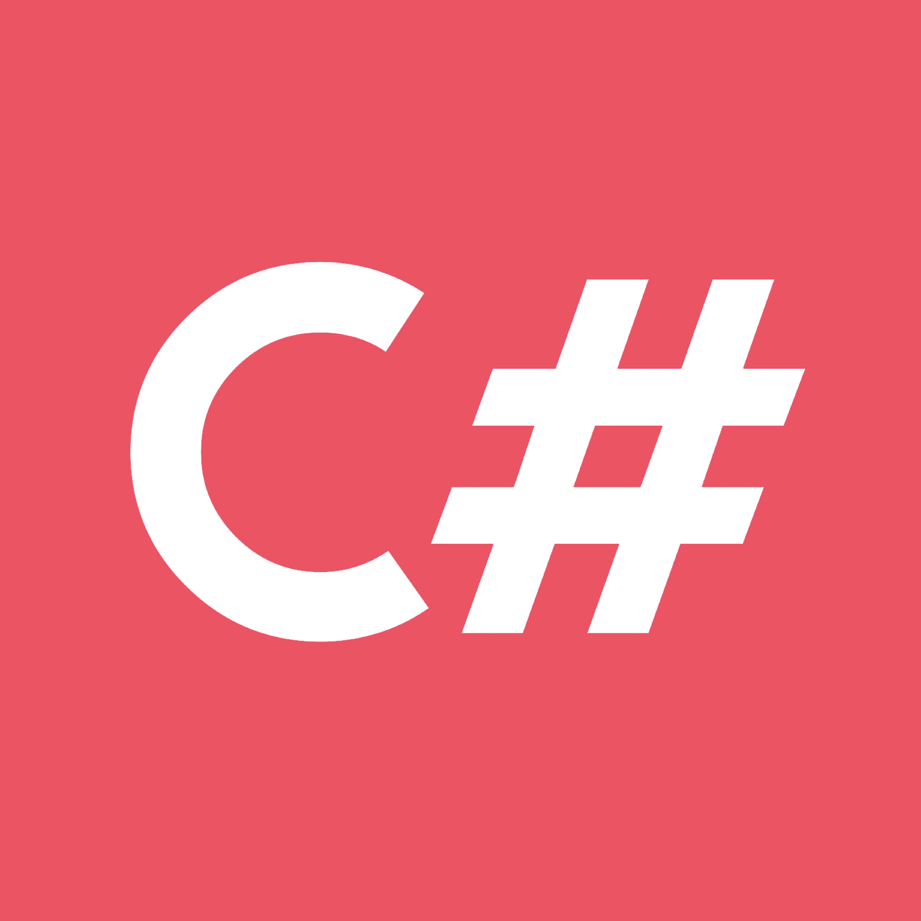
Language Design
github.com/dotnet/csharplang

Slide 11
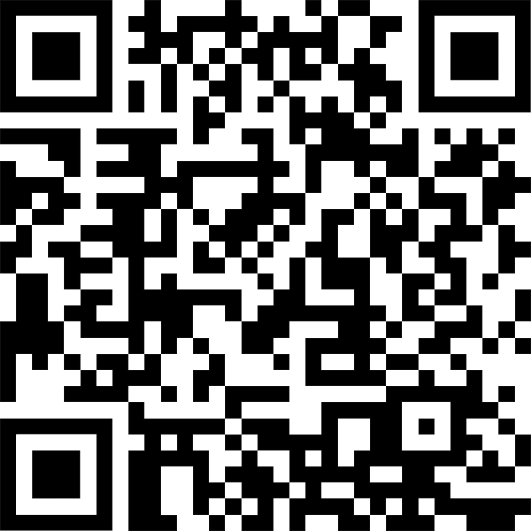
DOCS
learn.microsoft.com/en-us/dotnet/csharp/whats-new/csharp-13

Slide 12
CODE

Slide 13
C# Performance Tuning

Slide 14
TAKEAWAY #1
Don’t
Prematurely
Optimize

Slide 15
TAKEAWAY #2
Sacrifice
Readability

Slide 16
TAKEAWAY #3
Measure

Slide 17
MEASURE
Production Metrics
QPS / Throughput / Latency
Performance Metrics
CPU
Memory (Allocations & Heap Size)

Slide 18
MEASURE
Accuracy
Depends on measurement approach.
Depends on sampling window.
Depends on traffic.
Depends on hardware.
Depends on operating system.
Depends on .NET version.

Slide 19
Measure / Set A Goal
Deploy
Optimize
Measure Change

Slide 20
AGENDA
AGENDA
Profiling
Benchmarking
What Do We Optimize?
Did We Make It Better?
C# Tips & Tricks

Slide 21

AGENDA
TIPS & TRICKS
https://www.bytehide.com/blog/performance-optimization-tips-csharp

Slide 22
CODE

