Slide 1
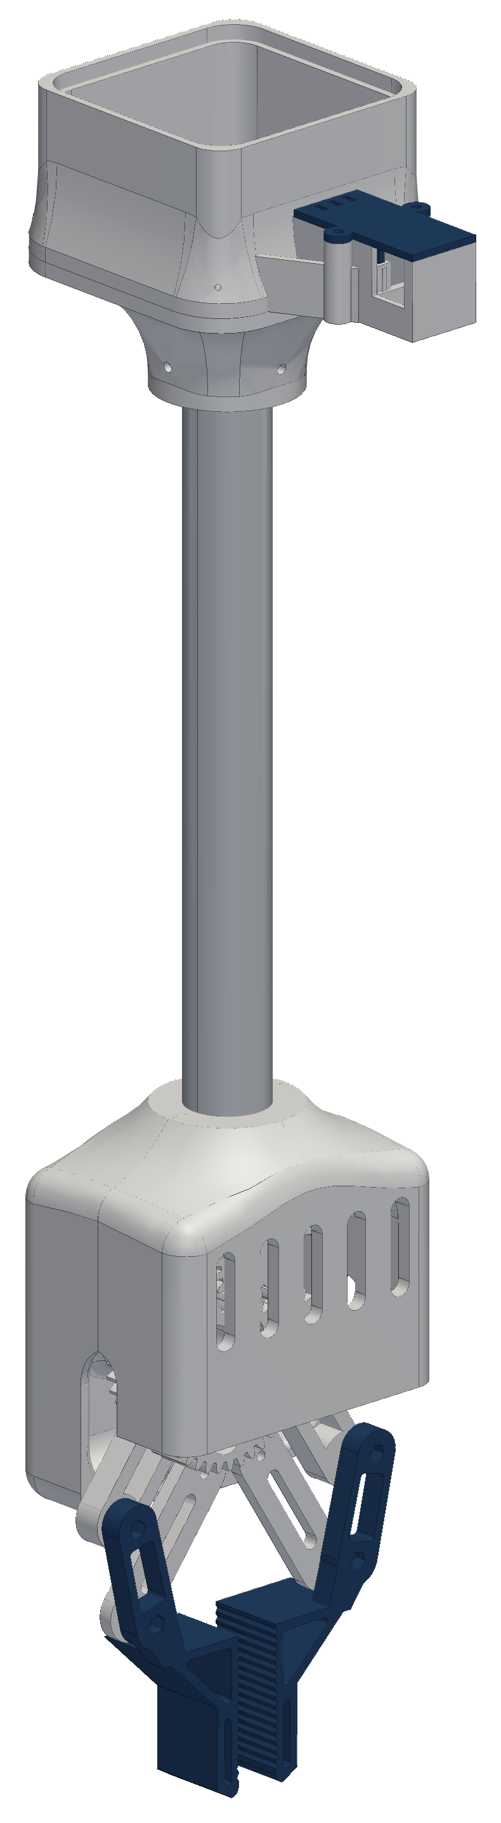

RoomCleaner
A four-cable ceiling robot that picks laundry off the floor
Jasper Buntinx
Technical presentation · October 27, 2026
Notes:
One sentence: a cable robot whose four winches sit in the ceiling corners and move one claw anywhere over the floor.

Slide 2
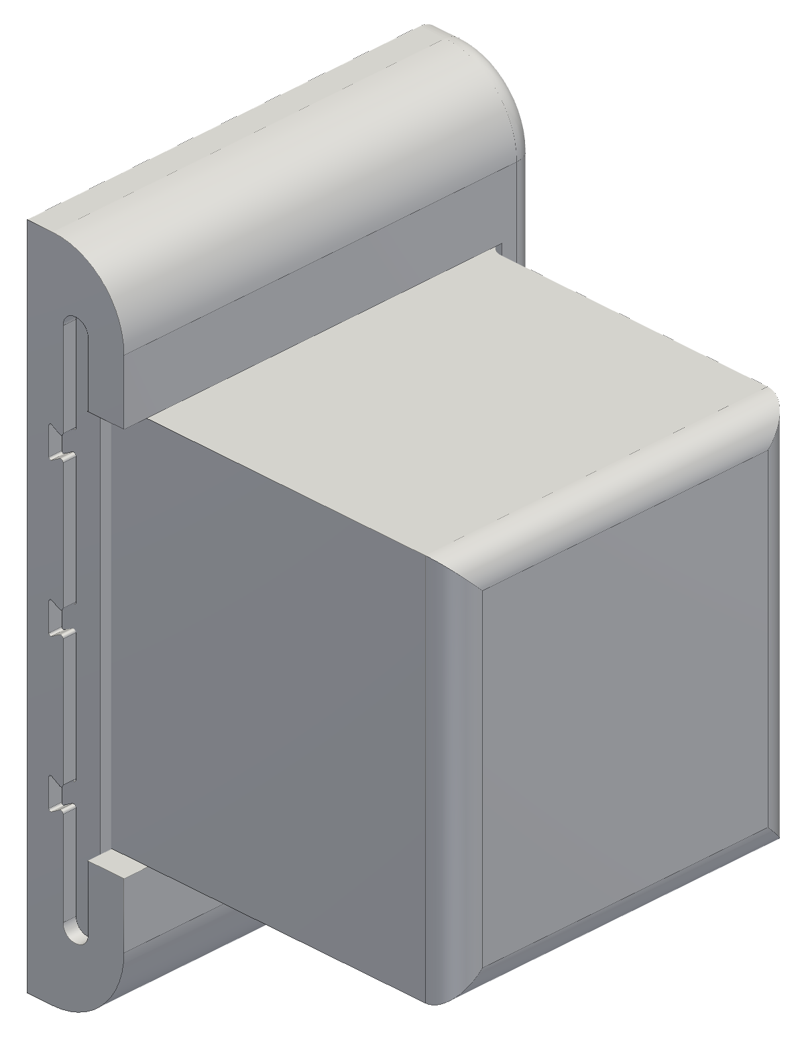
OPENING
Goal and constraints
Pick clothes off the floor and drop them in a hamper, from anywhere in the room
Four winches near the ceiling corners hold one claw on four cables
Room 11 × 9 ft with a 9 ft ceiling
Working load: a pair of jeans (0.9 kg) with 2 m/s² of acceleration; first test load 1 lb
3D-printed in PETG on a hobby budget, from parts I can buy and fix myself
Safety: anchors in studs, one hard stop (the switched power strip), nobody under the robot
One of the four winch stations (CAD)
Notes:
Requirements first: where it works, what it lifts, what it costs, and how it stays safe.

Slide 3
OPENING
Outline
1
How a cable robot works
Position vectors, statics, the winch
2
From one box to modular stations
Wiring, a controller per winch, the slide-in housing, plug-in power, cooling
3
Homing and calibration
Bead homing, why it limited the motion, the camera-based method
4
The claw
Gripper evolution, the four-bar hands, the camera, weight vs lift
5
Electronics and software
Station board, bring-up, control and the phone app
6
Status and next steps
What is built, what is tested next, what I learned
Notes:
The talk follows the order the problems appeared in.

Slide 4
01
How a cable robot works
Four cables, one point, and the vectors that connect them
Notes:
Four cables, one point, and the vectors that connect them

Slide 5
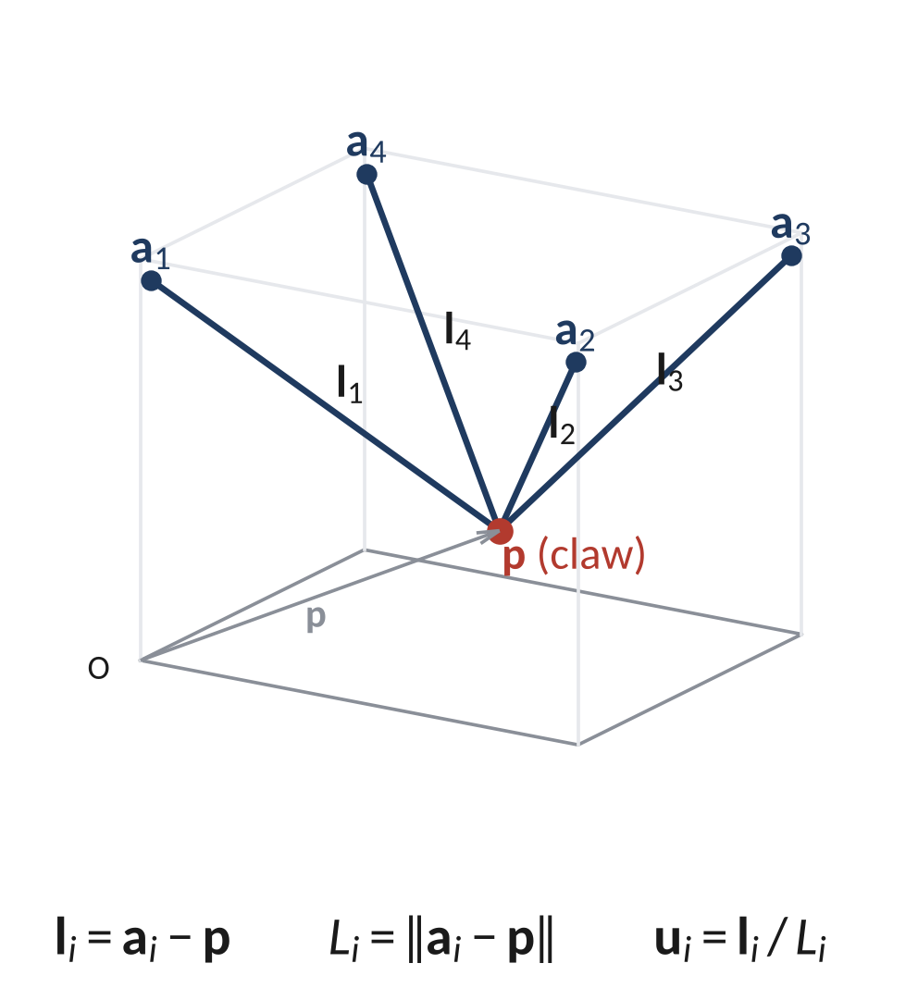
HOW A CABLE ROBOT WORKS
Position vectors
Room frame at a floor corner; anchor i (the pulley exit) at position vector a_{i}, claw at p
Cable vector l_{i} = a_{i} − p
Cable length L_{i} = ‖a_{i} − p‖, direction u_{i} = l_{i} / L_{i}
To move: for every point p(t) on the path, compute the four lengths L_{i}(t)
Spool turn: Δθ_{i} = ΔL_{i} / r, with r the spool radius including the wound line
Closed form: no iteration is needed to command a move
Notes:
Inverse kinematics of a cable robot is just vector subtraction and a norm, done for each cable at every step.

Slide 6
HOW A CABLE ROBOT WORKS
Statics: why cable angle matters
Force balance on the claw: Σ T_{i} u_{i} + m(g + a) = 0
Cables only pull, so every T_{i} must stay positive
Centred claw, equal share: T = W / (4 sin φ), φ = cable angle above horizontal
1 lb + 0.45 kg claw: 32.1 N per cable 0.15 m below the anchors, 8.3 N at 0.6 m, 4.6 N at 1.2 m
Flat cables near the ceiling or a wall need large tension
So the robot keeps margins: 0.4 m below the anchors, 0.2 m from the walls
Notes:
Numbers: W = (0.454 + 0.45) kg × 9.81 = 8.86 N, D_h = 2.17 m from the room centre to a corner. The tension doubles each time the depth halves near the ceiling.

Slide 7
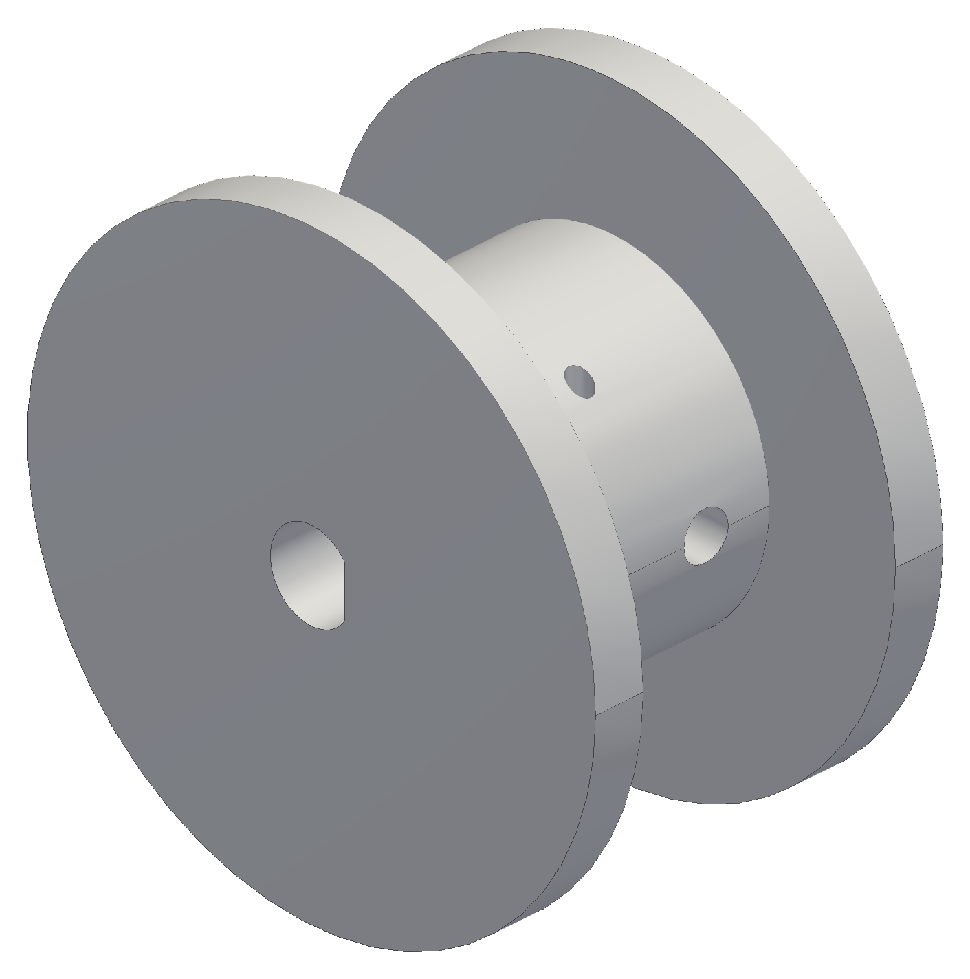


HOW A CABLE ROBOT WORKS
The winch
NEMA 17 stepper, printed spool and a bearing pulley at the outlet, one per corner
Pull from torque: T = τ / r
  smaller spool radius → more pull per amp, more turns per metre
Spool v1 → v3: Ø20 → Ø15 core with a 16 mm drum
  the first print's bore was too tight on the shaft: opened from Ø5.2 to Ø5.45
Steps open loop; an encoder at the spool checks for lost steps
Spool v1, v2, v3
Notes:
Running torque is lower than holding torque; the pull test will measure the real value.

Slide 8
02
From one box to modular stations
How adding safety features changed the whole architecture
Notes:
How adding safety features changed the whole architecture

Slide 9

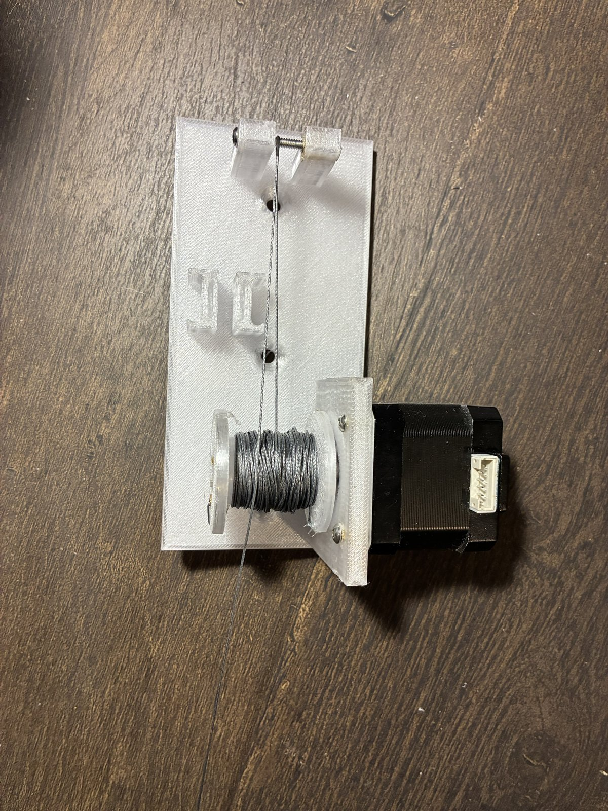
FROM ONE BOX TO MODULAR STATIONS
First idea: one central controller
One Arduino Uno and a CNC shield with four A4988 drivers, in a single box
The computer sends moves; the shield steps all four motors from one clock, so sync is free
Each motor gets a long 4-wire cable from the box to its corner
It worked on the bench: a gen-1 station lifted a test weight
Gen 1: central shield with four drivers; spool plate on the wall
Notes:
Simple and synchronised by design. It only stopped working once I wanted more than a motor at each corner.

Slide 10
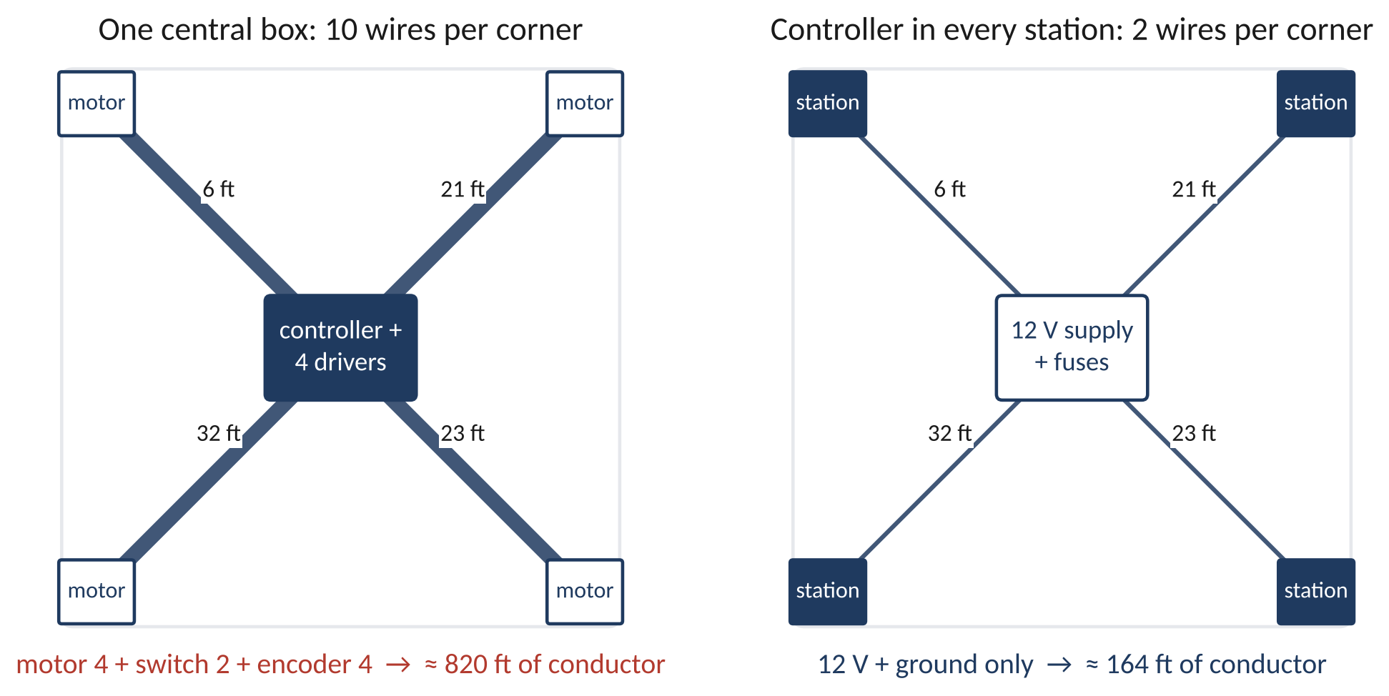
FROM ONE BOX TO MODULAR STATIONS
Why it did not scale: the wiring
I wanted more safety: a homing switch and an encoder at every winch, plus fault detection
Per corner: motor 4 + switch 2 + encoder 4 = 10 conductors, not 4
Real cable routes are 6, 21, 23 and 32 ft (82 ft)
  ≈ 820 ft of conductor, against ≈ 164 ft for power only
The encoder's I²C bus is meant for centimetres, not 10 m runs
Motor phase currents in long cables also radiate noise into the sensor lines
Notes:
The wire count, not the motors, was the problem. 16 AWG over 32 ft at 2 A drops 0.51 V; 18 AWG 0.82 V.

Slide 11


FROM ONE BOX TO MODULAR STATIONS
Decision: a controller in every winch
Each station: XIAO ESP32-C3 + A4988 driver + 5 V buck; only 12 V power travels, on 2 wires
Switch and encoder wires stay inside the station, a few centimetres long
The host computer plans the path and sends each station timed segments over Wi-Fi
Each station runs its segments on its own clock; any lost link → hold position
Cost: a 50 ms timing skew at 50 mm/s is 2.5 mm of cable mismatch, so segments are time-stamped
Benefit: about 5× less wire, and every station can be built and tested alone
Gen 2: the station carries its own controller, driver and buck
Notes:
Sync moved from wiring into software: time-stamped segments and a host that keeps every station's clock.

Slide 12
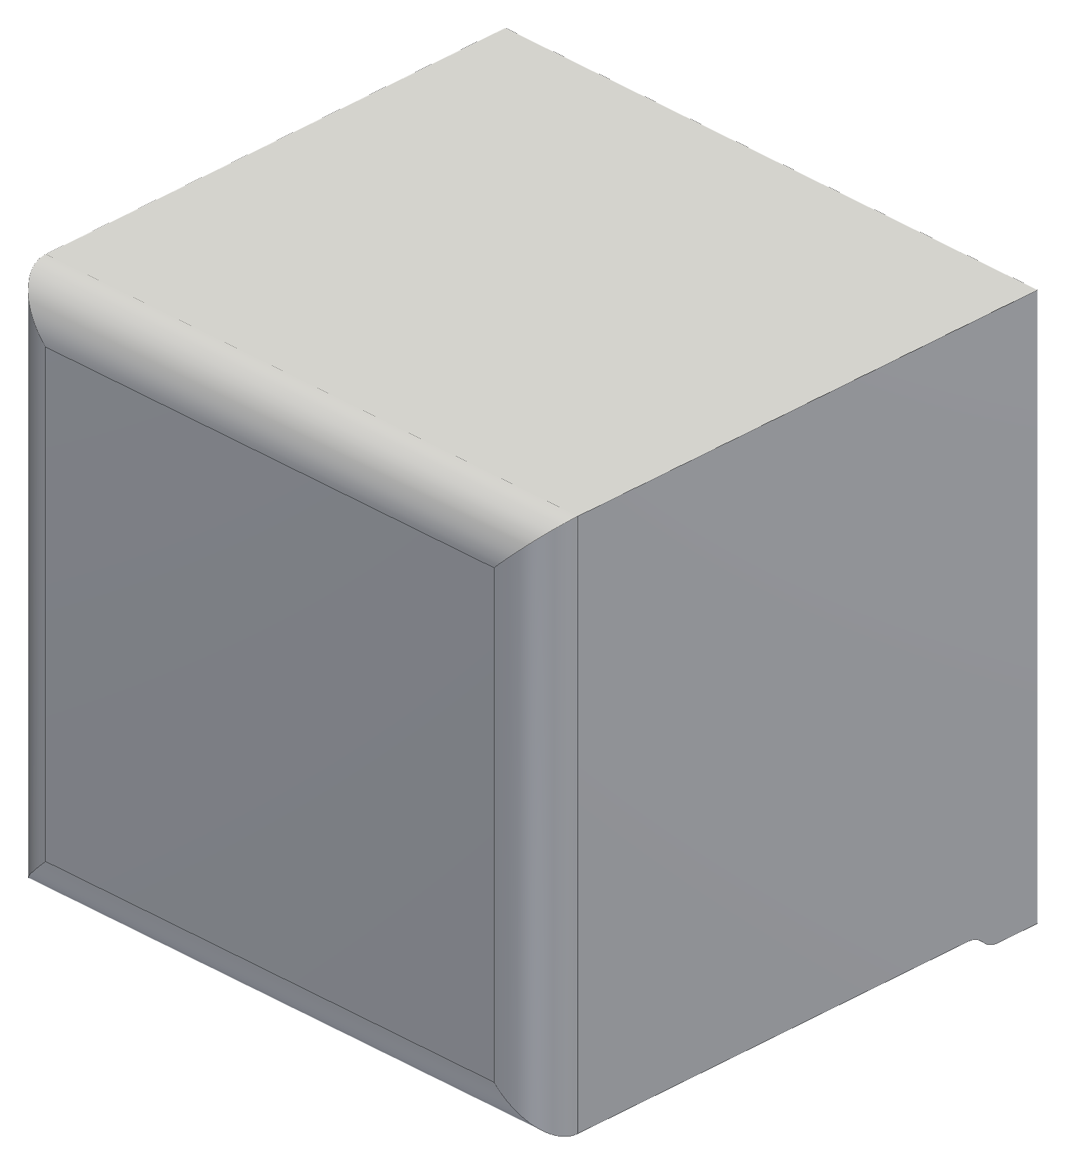
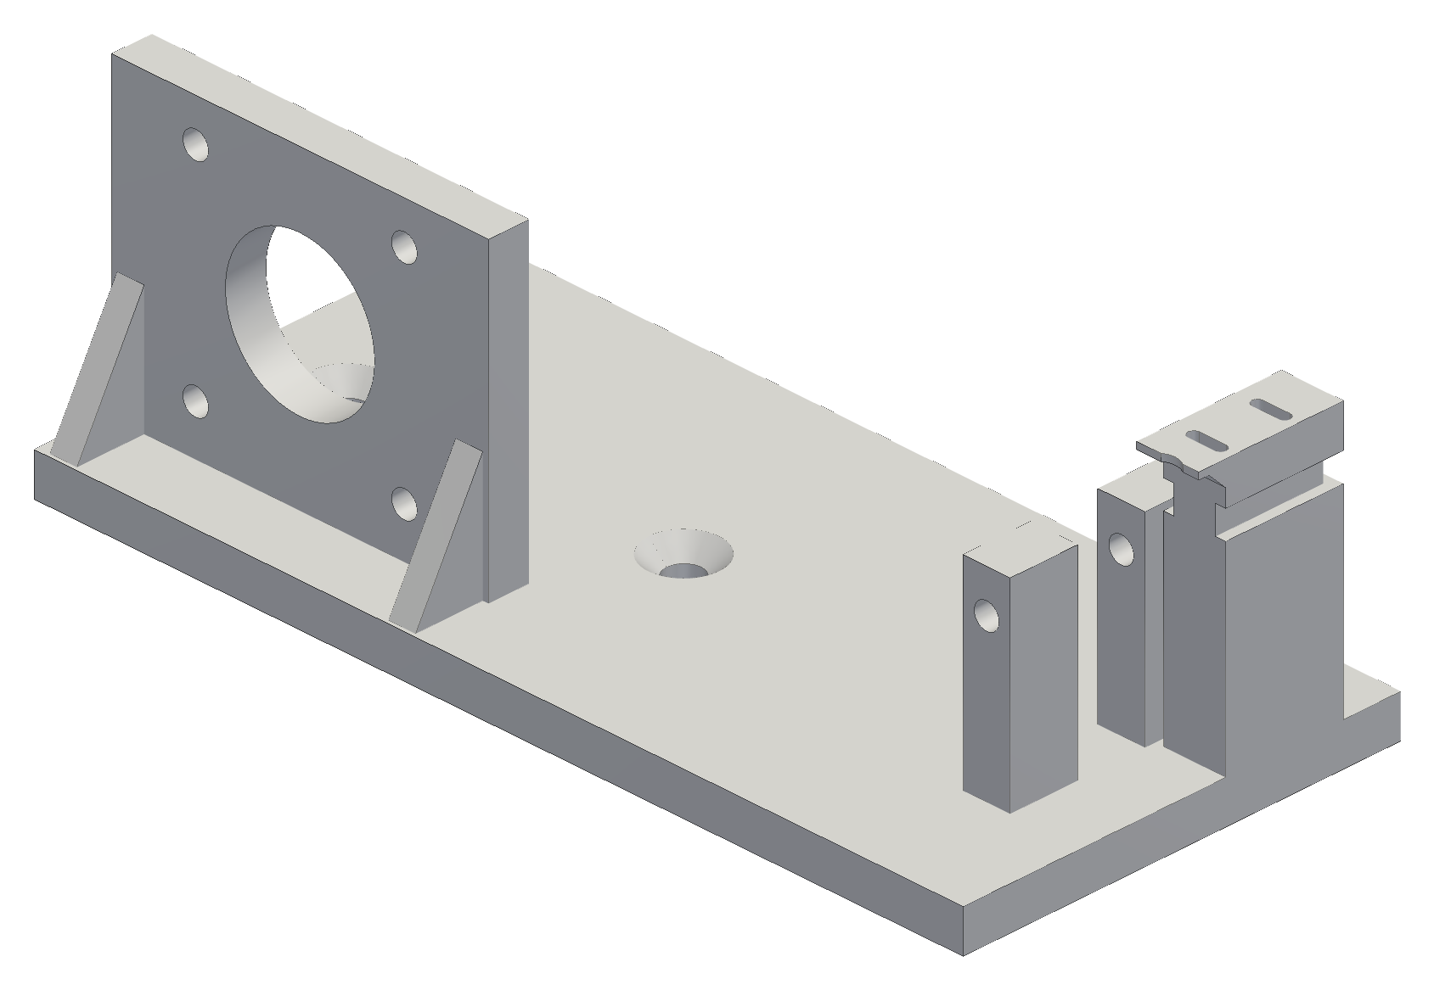
FROM ONE BOX TO MODULAR STATIONS
Making the units modular
Gen 1 was a plate screwed into the wall: fine for a bare motor
Each corner now carries a controller, driver, buck, switch and encoder
  they need protection, a clean look and a path for heat
So each station became a housing: motor, spool, pulley and electronics in one unit
Same unit in all four corners: build one, test one, copy it
Gen-1 corner plate (left) vs the gen-2 station housing (right)
Notes:
Once there are electronics in every corner, the wall plate becomes a product housing.

Slide 13
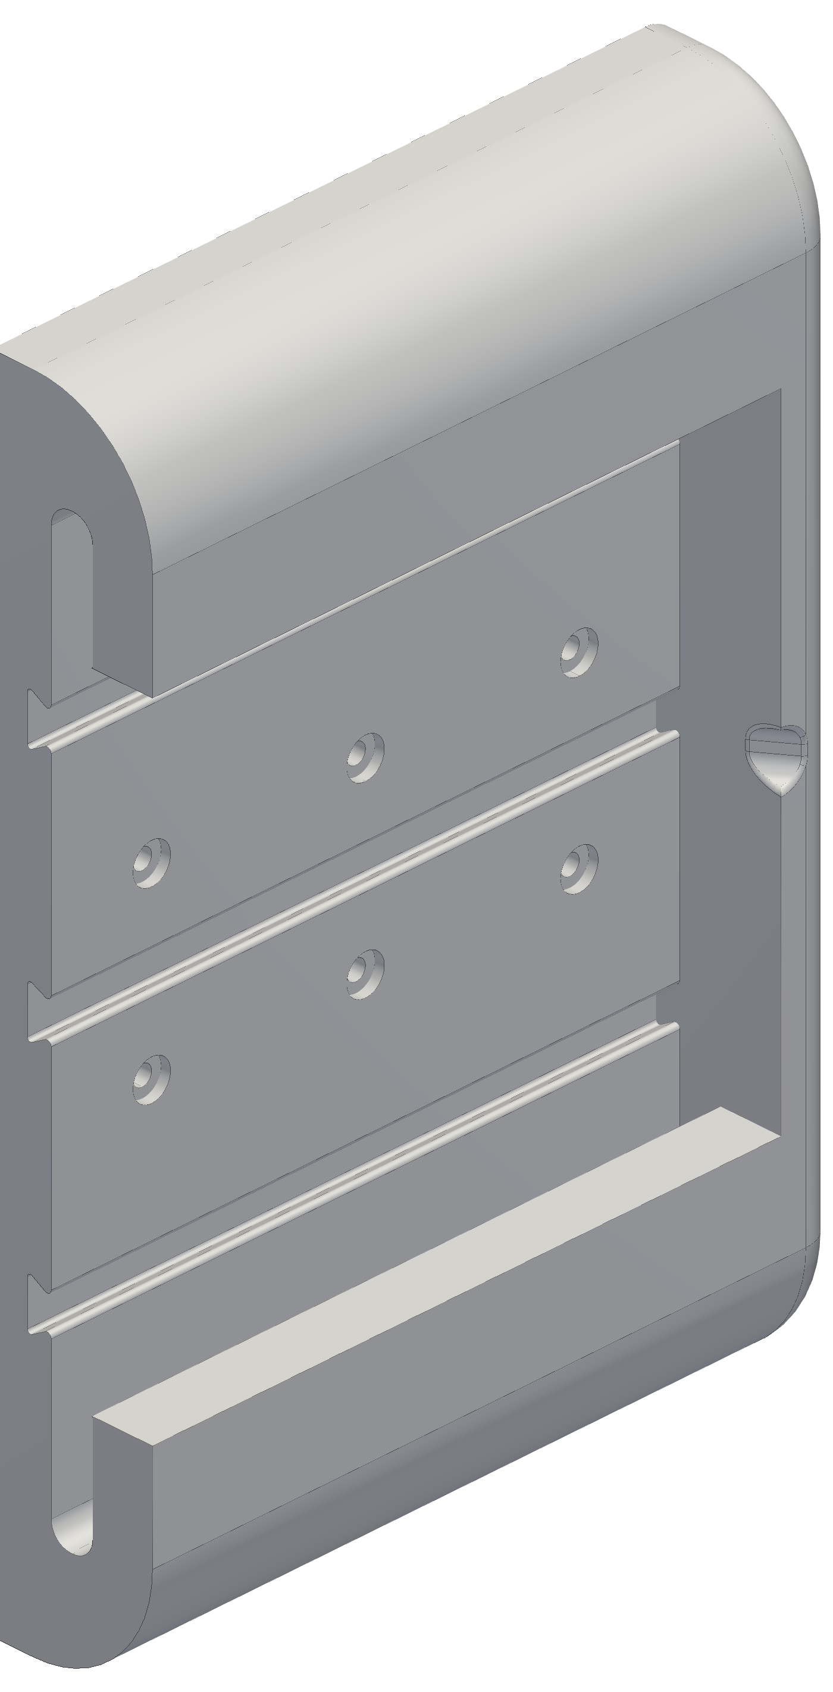
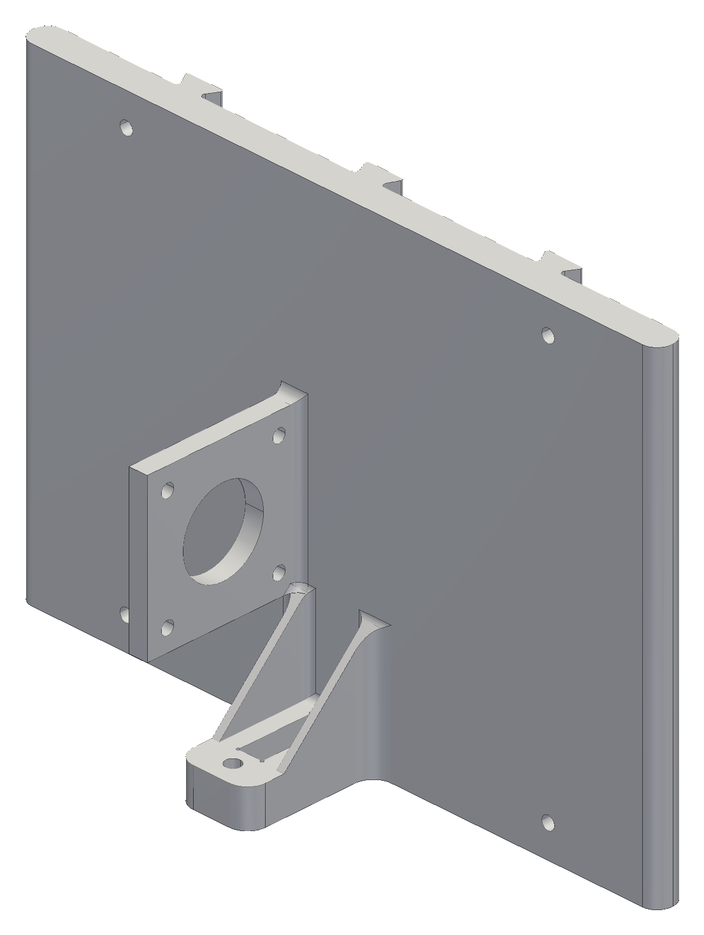
FROM ONE BOX TO MODULAR STATIONS
Slide-in mount
I take stations down often: to test, rework, repair or modify them
Drilling in and out each time damages the wall and moves the anchor point
A fixed wall frame goes into a stud once; the station slides in and locks
Pull it out, rework it, slide it back: the frame keeps the anchor position
Load: the line pulls the station away from the wall (pull-out and prying)
  design target: safety factor 3 at 34 N; SolidWorks static study planned
Fixed wall frame (left) and the slide-in piece (right)
Notes:
34 N is the snag case: holding torque at the empty spool. The study checks stress below 8.3 MPa (derated PETG / 3) and deflection at the cable exit.

Slide 14
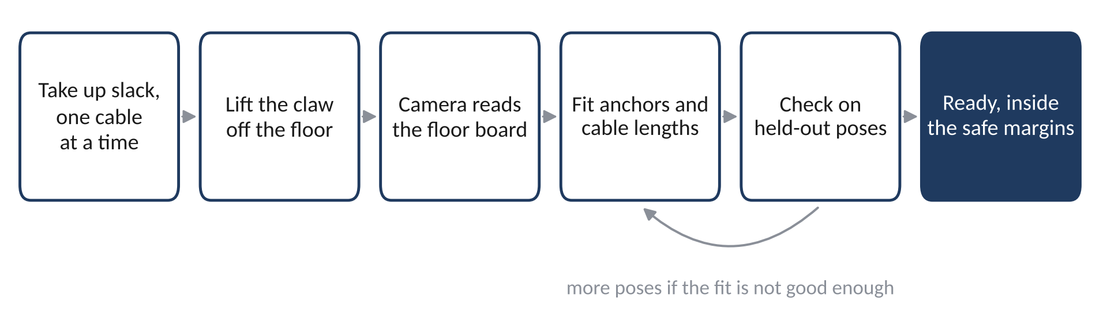
FROM ONE BOX TO MODULAR STATIONS
Self-calibration: set it up anywhere
Every time the stations go back up, the robot measures its own geometry
  no tape measure, no numbers typed in, nothing for a user to get wrong
The claw camera reads a printed floor board (a grid of tags) to get the claw's pose
The robot moves through a set of poses and fits the anchor positions and cable lengths by least squares
Works in any room the cables can reach, so it can become a consumer product
Startup calibration loop; the claw camera looks straight down
Notes:
Simulated so far; the hardware run comes after the four-station lift test.

Slide 15
FROM ONE BOX TO MODULAR STATIONS
Plug-in power
Each station has one cable: a 16 AWG pair from a fused 12 V supply
Plug in to use; unplug and store the cables when the robot is not needed
Stations slide off the wall frames if wanted
Runs cut at 9, 24, 26 and 35 ft (94 ft of a 100 ft roll), a fuse per branch at the supply
The motor stays wired inside the station, so it is never unplugged under power
The switched power strip is the one hard stop
Only power reaches the stations
Notes:
Unplugging a motor from an energised A4988 can kill the driver, so the plug carries only 12 V.

Slide 16

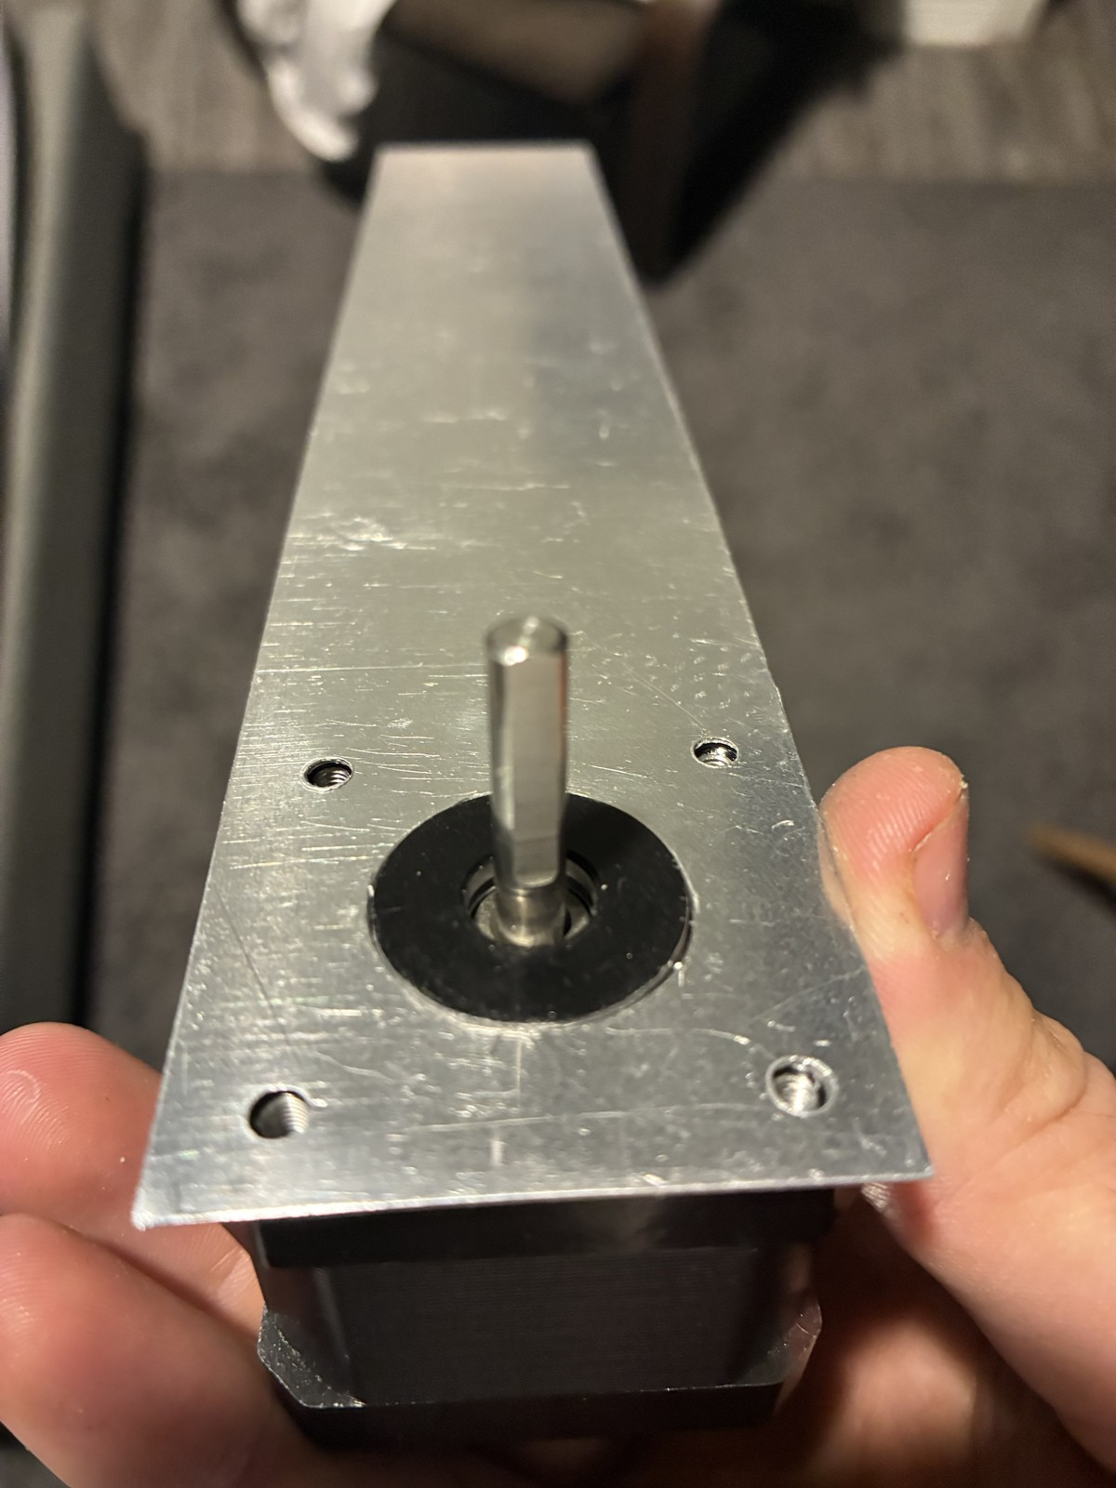
FROM ONE BOX TO MODULAR STATIONS
Cooling
In a sealed printed housing the motor's heat has nowhere to go
  PETG next to the loaded motor mount softens and creeps
Fix: an aluminium fin from the motor face up through the shell, plus vents
Fin efficiency η = tanh(mL) / (mL), with m = √(2h / (k t))
Built from 0.019 in sheet: η ≈ 37 % (74 % for the 1/8 in plate drawn)
Calculated at 1.06 A: sealed 64 °C without the fin, 46 °C with it; a 90-min hold test is planned
The fin as built and on the motor
Notes:
Fin carries about half the heat in the sealed case. 60 °C is the limit used for loaded printed parts; PETG softens near 80 °C.

Slide 17
03
Homing and calibration
Why the first homing plan limited the robot, and what replaced it
Notes:
Why the first homing plan limited the robot, and what replaced it

Slide 18
HOMING AND CALIBRATION
First plan: bead homing
A bead on each cable trips a switch at the outlet → a known cable length
The robot zeroes itself from that: set it up anywhere
I expected that to be enough, possibly even without encoders
Detail fixed early: the switch moved below the pulley, so the bead never rides over the pulley groove
KW12-3 homing switch on the bench
Notes:
The idea was a cheap absolute reference per cable.

Slide 19
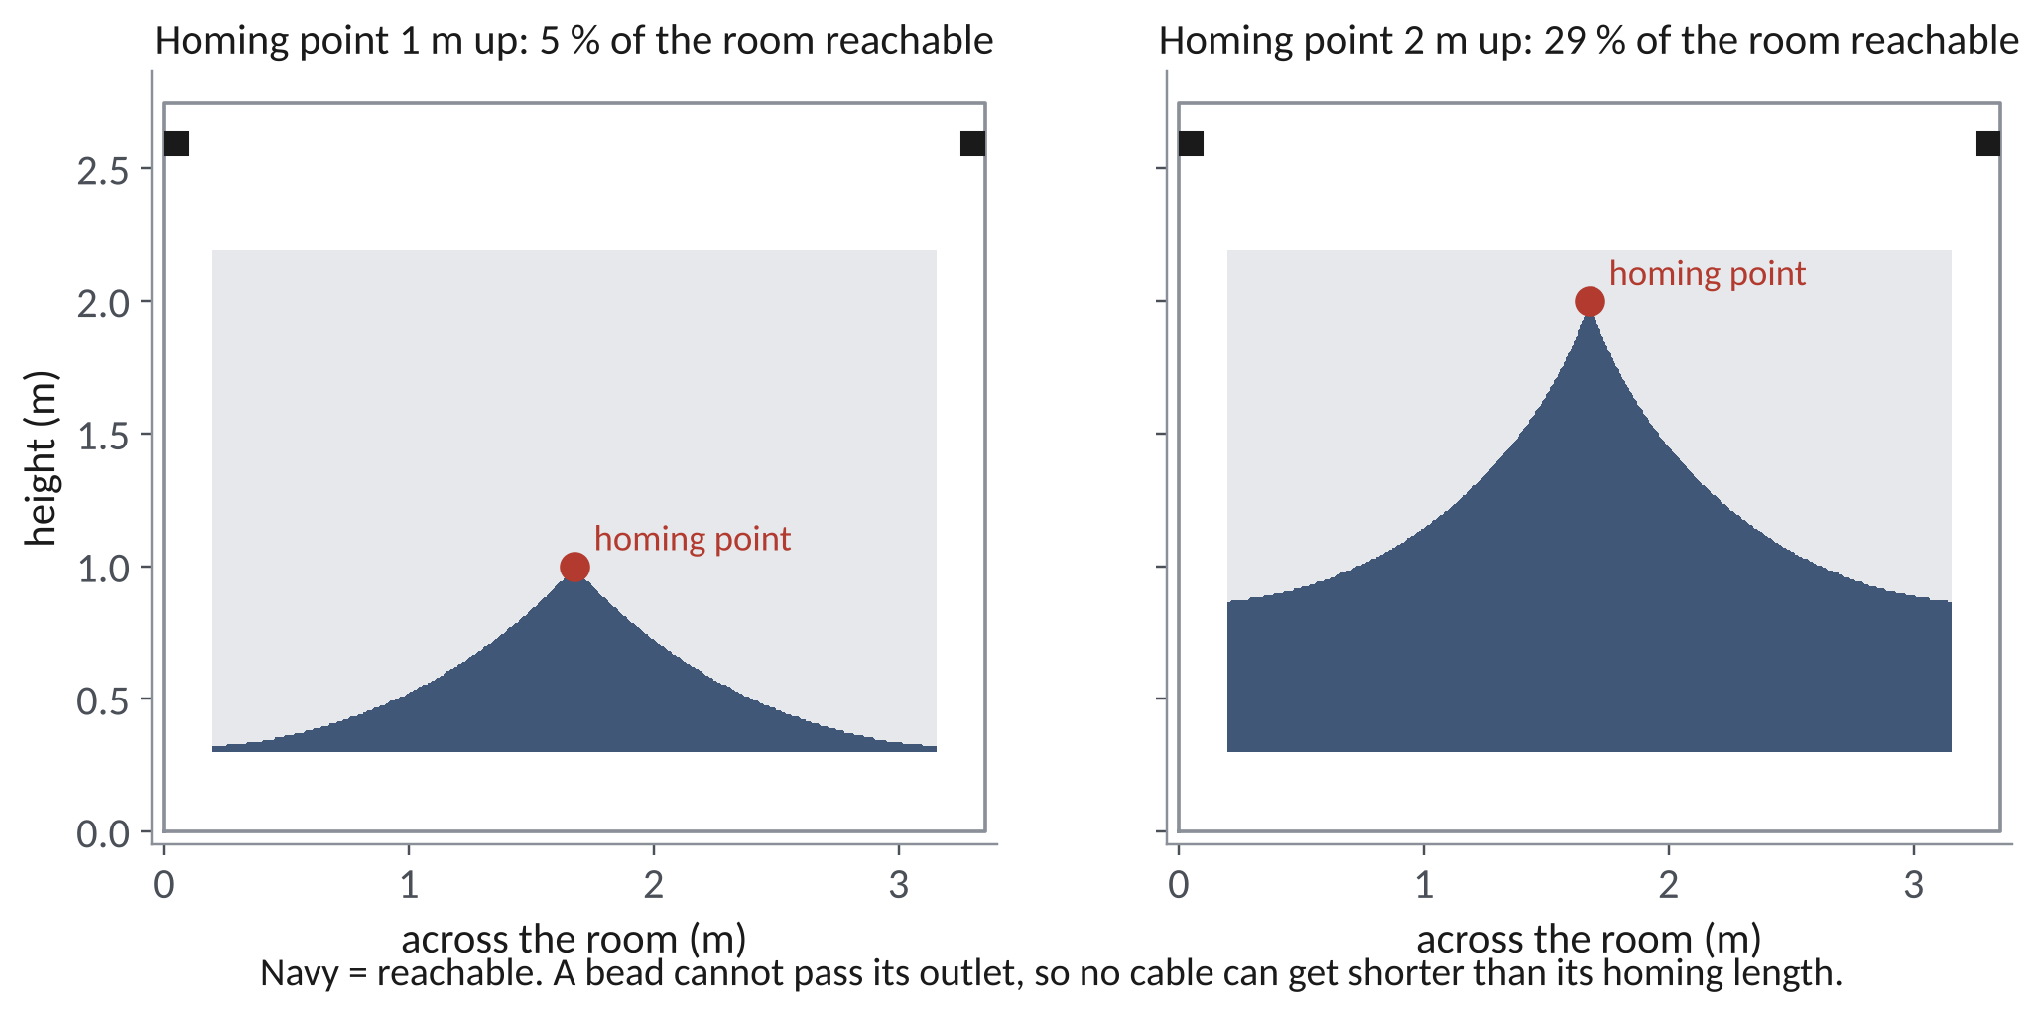
HOMING AND CALIBRATION
The problem: beads limit the motion
A bead cannot pass the outlet, so a cable can never be shorter than its homing length
To home all four at one point, each bead sits at that point's length
  then the claw can never move closer to any anchor than from that point
Home at the room centre 1 m up → about 5 % of the working volume reachable; 2 m up → about 29 %
And vision alone knows cable length to ~20–25 mm, while a bead allows ~12 mm of overtravel
  a bead search was not safe either
Notes:
Calculated over the working volume with 0.2 m wall and 0.4 m ceiling margins. This tradeoff is physical: software cannot remove it.

Slide 20
HOMING AND CALIBRATION
New calibration: camera, floor board and margins
Startup: take up slack one cable at a time, lift, then look at the floor board from several poses
Least-squares fit of the anchor positions and cable zero lengths; held-out poses check the fit
Safety comes from margins, not precision
  0.4 m below the anchors and 0.2 m inside the walls unless the error bars allow more
Beads stay as end-of-travel safety switches; encoders watch for lost steps
Simulated so far; the hardware run follows the four-station lift
Notes:
The robot only unlocks the full workspace when k × σ fits inside the margin; otherwise it stays local.

Slide 21
HOMING AND CALIBRATION
Why a floor board
Angle error becomes position error through the lever arm: δx = σ_θ · L
One tag: 12.9 mrad × 0.51 m ≈ 6.6 mm per frame
Four tags in view: about 0.7 mm
The board is a printed grid at 250 mm pitch: cheap, and it works in any room
Averaging frames helps only with random noise, not with a fixed bias
Notes:
Two tags: 4.85 mrad → 2.5 mm. Noise model: 0.3 px corner noise, 520 px focal length (camera not yet calibrated).

Slide 22
04
The claw
From fingers to a parallel-jaw gripper
Notes:
From fingers to a parallel-jaw gripper

Slide 23

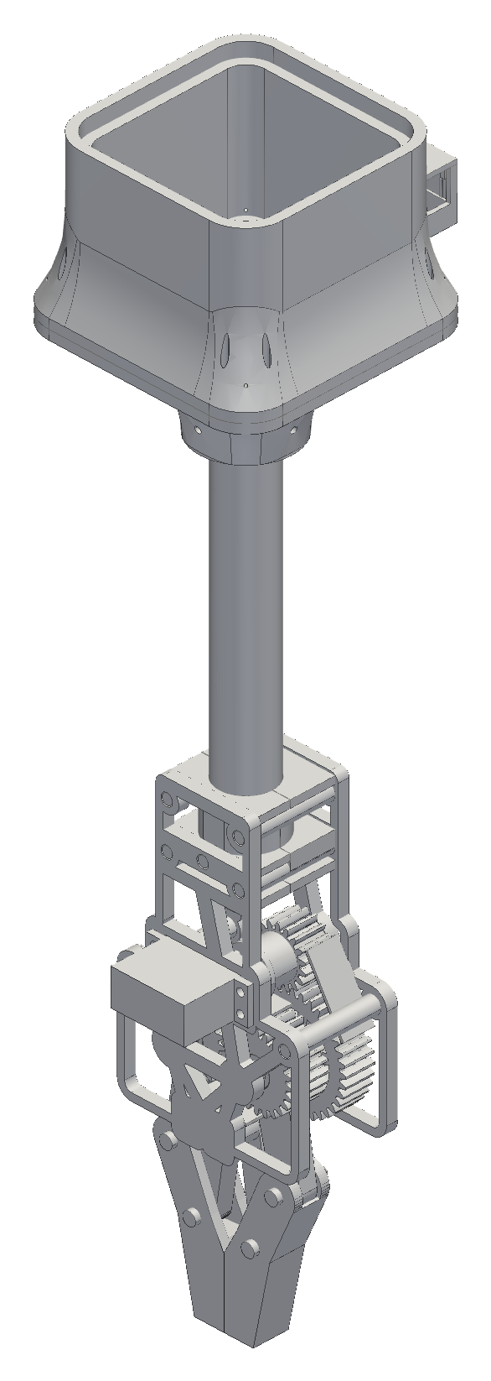


THE CLAW
Claw evolution
Five tendon-driven TPU fingers → a geared clamp → a lighter open frame → the final parallel-jaw gripper
Each step fixed a problem I found:
  the first clamp's jaws could not pinch thin fabric
  the v6 clamp was about 4.6× its mass budget
  v7 cut the gearbox frame to 143 g
Final: my gear housing and arms, with hands designed to fit them
Fingers, v6 clamp, v7 open frame, final gripper
Notes:
Mass drove most of the changes; every gram of claw is a gram of laundry the winches cannot lift.

Slide 24
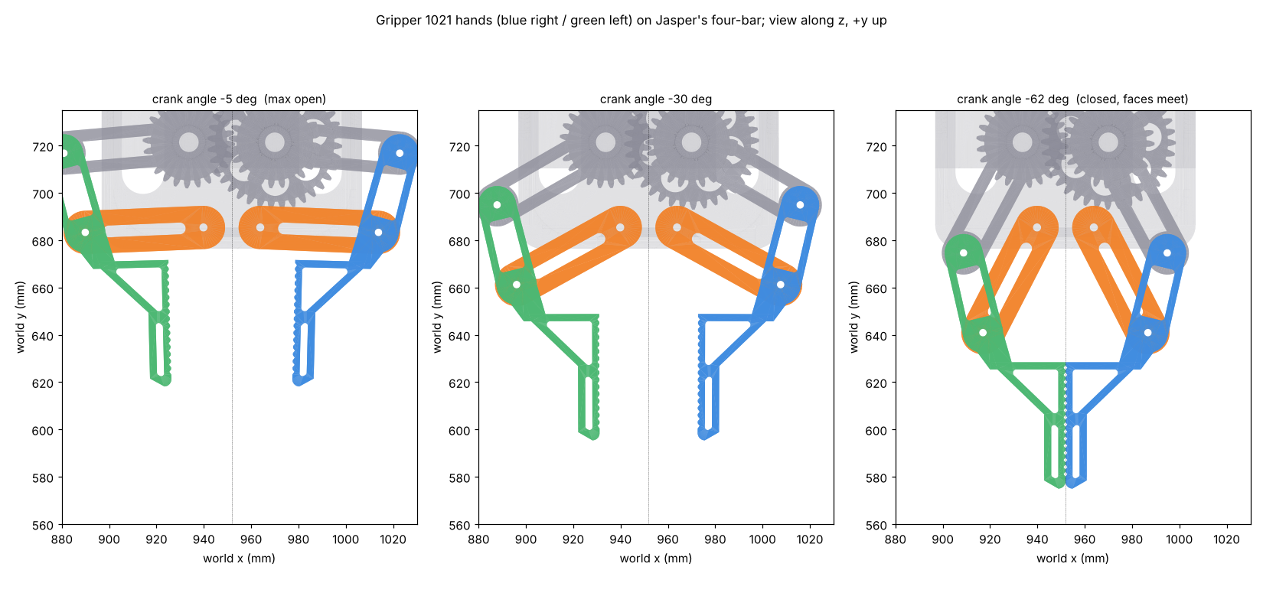
THE CLAW
Final gripper: gears and four-bar hands
Servo → 18T pinion → 36T/24T compound (2:1) → 24T sync gear: the jaws move as mirror images
Each hand joins a gear crank (53 mm) to a swing arm (50 mm): a near-parallelogram four-bar
  the jaws stay parallel within about 1° over the stroke
53 mm opening; closing also moves the tips down ~38 mm, a scoop that lifts fabric
Gear teeth checked with the Lewis equation: safety factor about 2 at servo stall
Full motion swept in CAD: no collisions from open to closed
Hands on the linkage: open, mid, closed
Notes:
Four-bar: ground 36.5, crank 53, rocker 50, coupler 34.7 mm. Lewis: σ = F_t / (b m Y).

Slide 25
THE CLAW
Camera on the claw
XIAO ESP32-S3 Sense camera in a bay built into the electronics housing
It looks straight down along the tube at the grasp spot
Sees the spot from about 17 cm above it; at contact the jaws hide it, so the last view guides the final approach
The same camera reads the floor board for calibration
One printed part: the bay is part of the housing, with a screwed cover
Camera bay on the electronics housing (cover in navy)
Notes:
Lens position kept from the studied design, so the view study still applies.

Slide 26
THE CLAW
Weight vs lift: where it stands
The driver boards top out at Vref 0.85 V → about 1.06 A per motor
Running pull ≈ 18–24 N per winch (full vs empty spool)
  about 1.1 kg total lift at the worst point in the room
The claw is not weighed yet: CAD says ~0.8 kg printed (1.2 kg solid), plus a 0.1 kg battery
With jeans that is above the capacity today: this is the open problem
Options: lighten the claw, a 3:1 winch reduction (~2.7× pull), or a lighter demo load
  next step: a luggage-scale pull test on one station decides
Notes:
Honest status: the numbers say the current claw plus jeans is too heavy. The pull test turns the 0.7 running-torque assumption into a measurement.

Slide 27
05
Electronics and software
The station board, a bring-up lesson, and how the robot is controlled
Notes:
The station board, a bring-up lesson, and how the robot is controlled

Slide 28
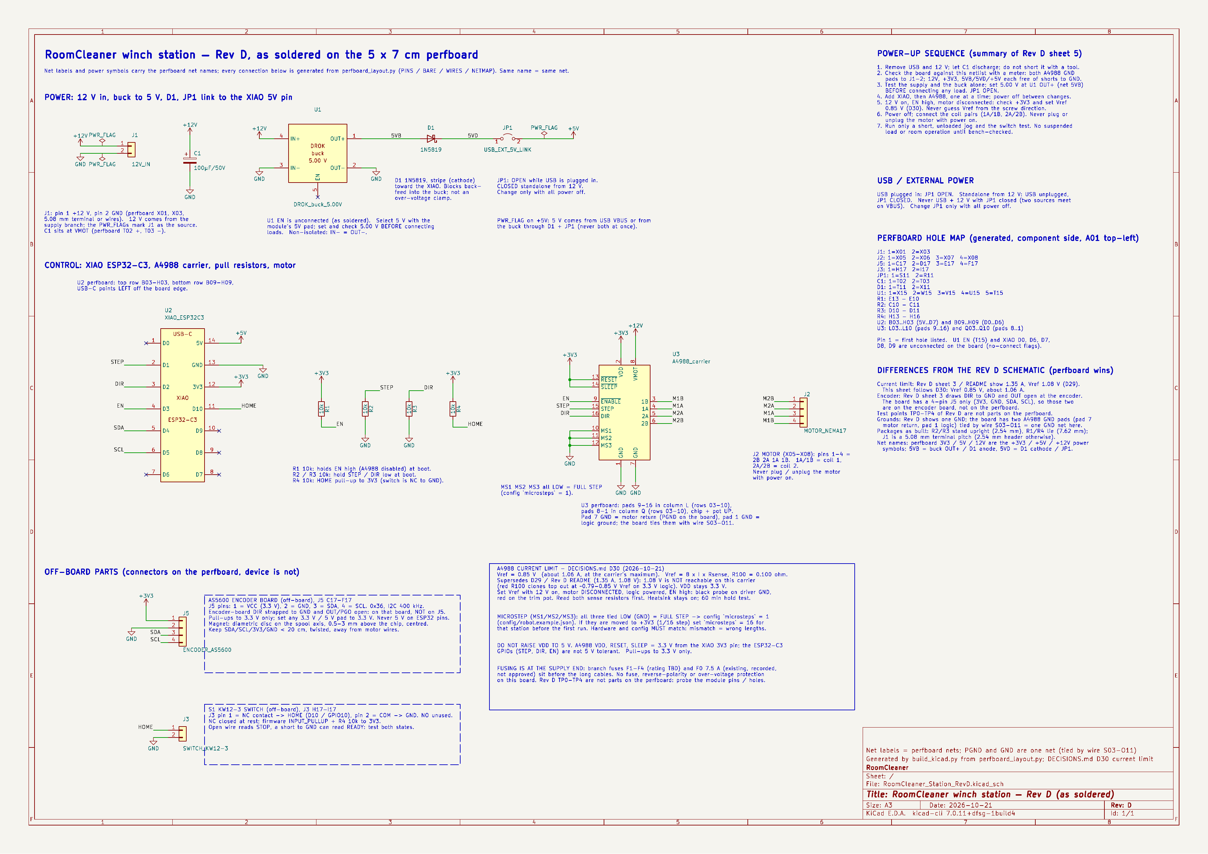
ELECTRONICS AND SOFTWARE
Station board
The driver boots disabled (EN pull-up): a reset never steps the motor
USB and the 5 V buck cannot back-feed each other: a link jumper plus a Schottky diode
100 µF at the driver's motor supply
Connectors for the motor, homing switch, encoder and 12 V
The KiCad schematic is generated from the soldered board's net list, so the two cannot disagree
Station schematic (KiCad), checked net by net against the board
Notes:
Rules check: 0 errors. 16 nets, 55 pins match the perfboard.

Slide 29
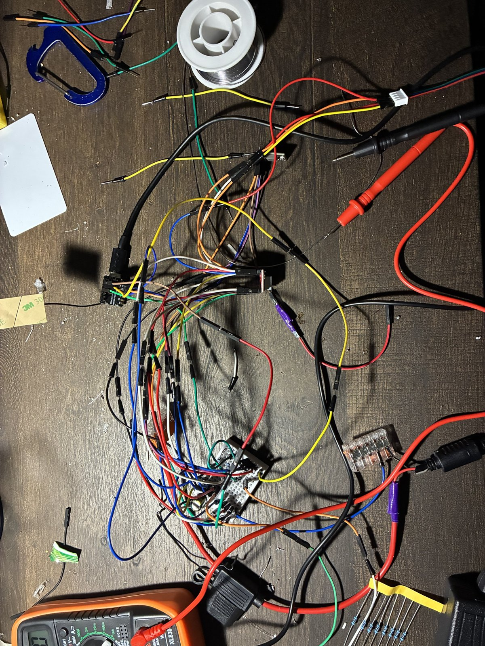

ELECTRONICS AND SOFTWARE
A motor that would not move
The log said it was stepping; the shaft did not turn
The meter said the logic rail was 1.14 V instead of 3.3 V: a bad connection
After the fix it moved
Since then: a meter checklist before any code
  VDD, SLEEP, ENABLE and the buck output, every new board
Bench wiring and bring-up
Notes:
Lesson: measure before trusting the software's view of the hardware.

Slide 30



ELECTRONICS AND SOFTWARE
Control software and phone app
The host plans paths; the stations execute timed segments; a lost link means hold
Stop never disables: there is no brake, so faults and pause keep holding torque
Phone app over home Wi-Fi: robot status, live claw camera, guided setup, chat
  anything that moves the robot asks “yes” first; pause runs at once
Tested in a full simulator of the four stations and the claw
Phone app: home, camera, chat
Notes:
The software was built against a simulator first, so faults like lost messages and reboots were exercised before hardware.

Slide 31
06
Status and next steps
Notes:
Status and next steps

Slide 32
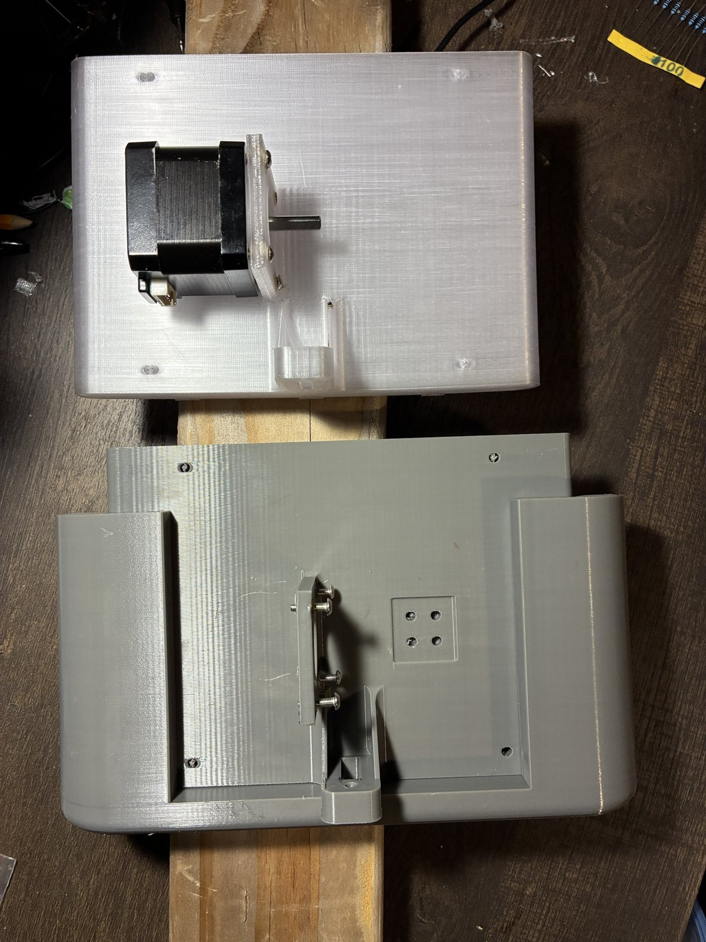
STATUS AND NEXT STEPS
Status and next steps
Built: stations, station boards, heat fins, gripper parts
Designed and checked in CAD: the hands and the camera housing
Calibration and control: simulated
Next tests, with pass limits written first:
  winch pull test (decides the capacity fix)
  90-min hold test: motor and printed mount under 60 °C
  SolidWorks static and thermal studies of the station
  first four-station lift: 1 lb, 300 mm at 50 mm/s, within 2 mm per cable
Gen-2 station shells
Notes:
Everything that is calculated or simulated is called that; the test list is what turns it into measurements.

Slide 33
STATUS AND NEXT STEPS
What I learned
Measure before trusting a margin: the driver limit and the 1.14 V rail
Print the test coupon before the part: the spool bore
Design for the worst case: stall, the corner of the room, the hottest hour
Modularity paid for itself: every station can be pulled, fixed and put back
Question each requirement and delete parts: the IMU, the five-finger hand (now two jaws), the long motor harnesses
Notes:
If I did it again: buy the pulleys and couplers sooner, and build one complete station to test before building four.

Slide 34
Questions
Jasper Buntinx · jasper_buntinx@tamu.edu
Notes:
Backups follow: schematics, gear strength, thermal network, safety.

Slide 35

BACKUP
Backup: claw electrical
One protected 2S pack (7.4 V, 2200 mAh), 5 A fuse, main switch
6 V regulator for the servo only; separate 5 V buck and Schottky diode for the controller
Battery read through 200k / 100k: 8.4 V → 2.80 V at the ADC
Peak ≈ 2.8–3.1 A against a ≈ 3 A pack rating: stalls must stay short
Charged on the claw only with the switch off, attended, at ≤ 1 A
Notes:
Rules check 0 errors; 9 nets match the specification.

Slide 36
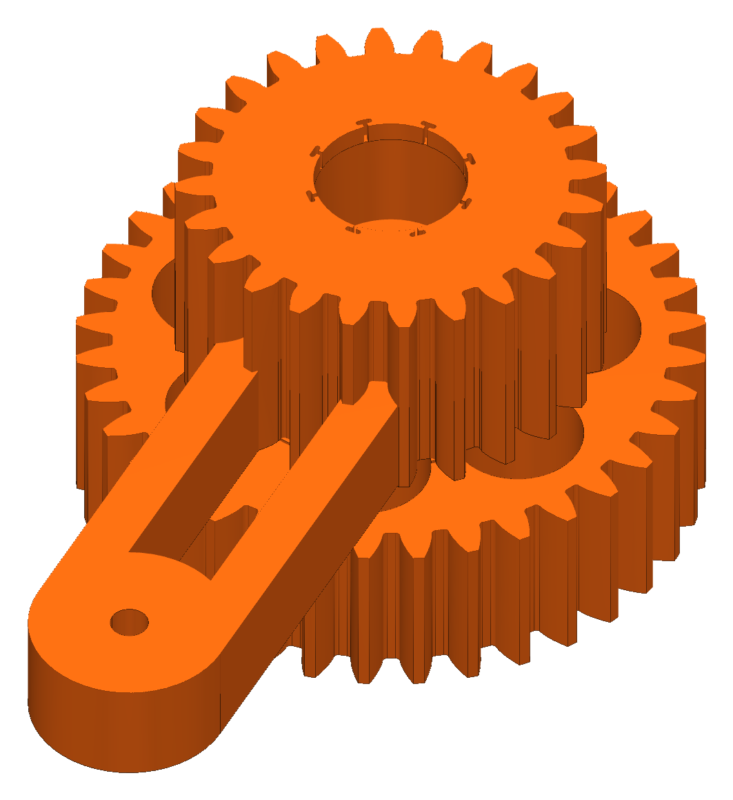
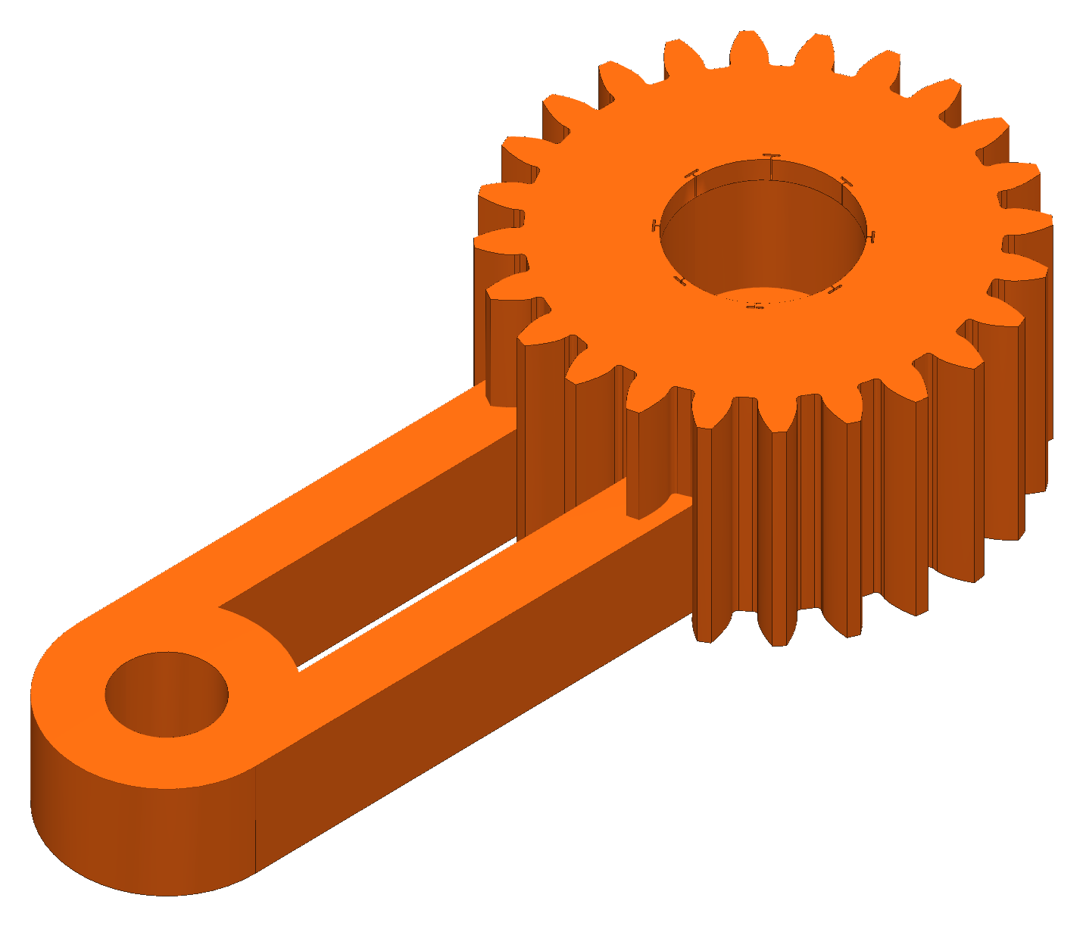
BACKUP
Backup: gear strength (Lewis)
σ = F_{t} / (b m Y), F_{t} = 2τ / d
Module 1.5, PETG allowable 22.5 MPa
At 6 V servo stall: pinion SF 2.05, 36T gear 2.50, sync gear 2.00 (one jaw carrying the load)
Module 1 was screened first: SF 0.35–0.41, so the module went up
Notes:
Stall torque 1.08 N·m at 6 V (servo rating, not measured).

Slide 37
BACKUP
Backup: safety
One hard stop: the switched power strip; faults and pause hold torque
Stations anchor into studs; the line load is mostly pull-out and prying
Nobody stands under the robot while it moves
Claw battery: protected pack, charged with the switch off and attended
No safety-rated function is claimed

