Slide 1

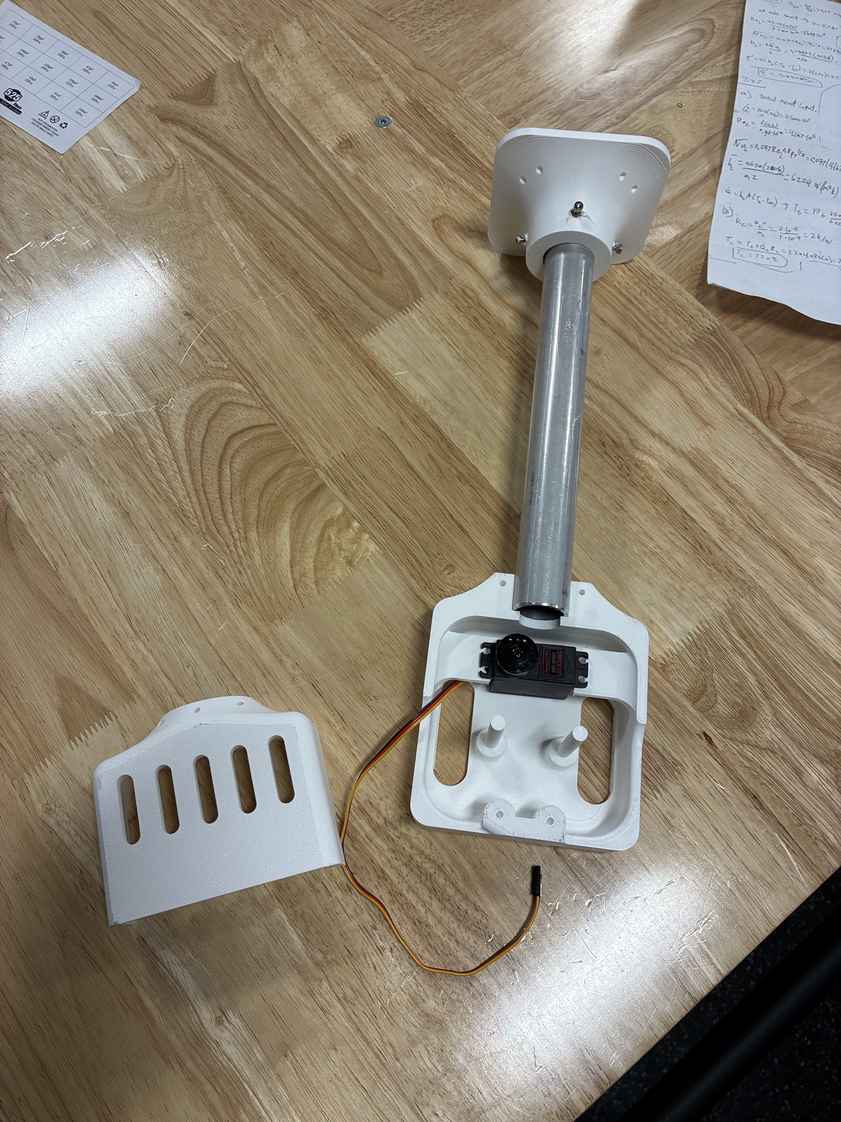
RoomCleaner
A cable-driven robot that picks laundry up off the floor
Jasper Buntinx
Mechanical Engineering, Texas A&M University
October 27, 2026
Notes:
One sentence: four winches near the ceiling corners hold one claw on cables; it picks clothes off the floor and drops them in a hamper. Then straight to who I am.

Slide 2
About Me
B.S. Mechanical Engineering, Texas A&M University, [graduation month and year]
Built EcoFil, a filament recycler with a shredder, dryer and extruder
Metal sculptures for the Austin Creek Show, made with fiber laser cutting and welding
Outside of class: [hobbies and interests]
Why this project: [one sentence]
[Photo of you building: EcoFil, a sculpture, or the workshop]
Notes:
One minute. Degree and graduation date, EcoFil (what each stage does, what you learned), the sculptures (fiber laser and welding: real fabrication), one hobby. Close with why a laundry robot: a problem you have, and a machine you could build end to end yourself.

Slide 3

Agenda
Project goal, scope and timeline
Design: targets, trade-offs and key calculations
Build: printed parts, machining and electronics
Test: first system test and thermal verification
Good and poor decisions, and lessons learned
Cables from the ceiling anchors a₁ to a₄ to the claw at p
Notes:
About 40 minutes, then questions. Backup slides at the end cover calibration, control logic, the phone app, obstacles, electrical and safety.

Slide 4
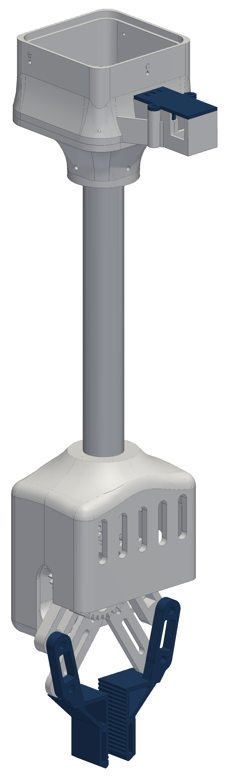
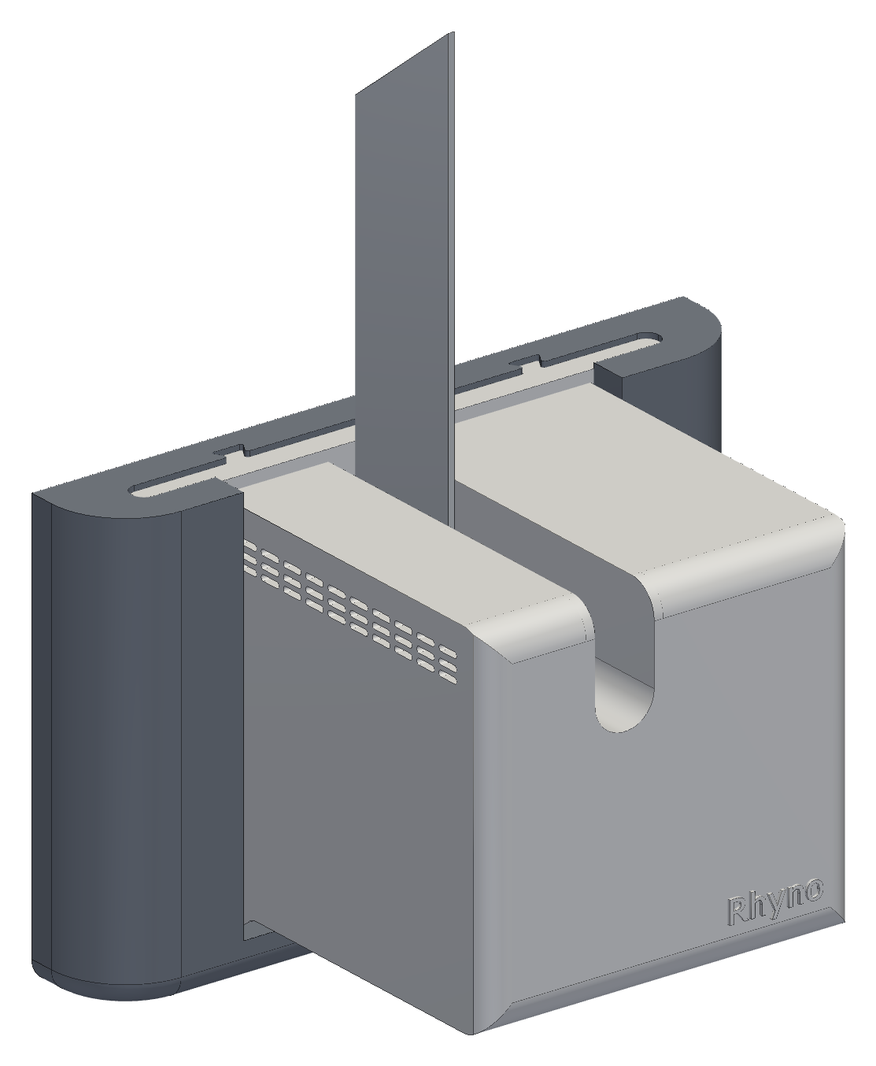
Project Goal
Pick up laundry anywhere in an 11 × 9 ft room and drop it in a hamper
Four ceiling-mounted winches suspend one claw on cables
Design load: jeans, 0.9 kg, at 2 m/s² acceleration; first test load is 1 lb
3D-printed PETG (polyethylene terephthalate glycol) parts on a hobby budget
Success: one garment delivered to the hamper with no human input
Final design (CAD): wall station, left; claw, right
Notes:
Why a cable robot: it covers the whole floor, nothing stands on the floor, and the moving mass is small. Safety rules: stations anchor into studs, the switched power strip is the one hard stop, nobody stands under the robot. 0.9 kg is a screening figure for jeans; the first physical test is 1 lb. The claw tube is 10.5 in. Milestones: one station running repeatably (passed on the bench), three stations holding and moving 1 lb (this week's test), one garment into the hamper.

Slide 5
Scope and Timeline
Phase
Dates
July
August
September
October
Concept and requirements
Jul 16 – Aug 5
Generation 1: build and bench test
Aug 6 – Sep 2
Redesign: sensors and wiring
Sep 3 – Oct 6
Generation 2 and final design
Oct 7 – Oct 21
Build and first system test
Oct 22 – Oct 27
My work (solo project)
Purchased or external
Requirements, calculations and test plans
All CAD (computer-aided design) in SolidWorks
3D printing, fit testing and machining the heat fin
Wiring, soldering and electronics bring-up
Control software: [confirm the parts you wrote]
Stepper motors, drivers and controller boards
Servo, camera, battery and encoder boards
Garment detection: YOLO-World, an open-source model
Shop access or mentors: [if any]
Notes:
About 15 weeks, alone. Generation 1 (August) worked on the bench: corner plates, one central controller board, a finger claw. September to early October was the redesign that drove generation 2: sensors at every winch, the wiring that caused, and the line outlets. Generation 2 in October went through three station and three spool versions to the final design on Oct 21. This week: build and the first test. Say plainly what is mine and what is bought. [Confirm the start date (git shows Jul 16) and what happened in September.]

Slide 6
How It Works
Four wall stations, each with its own winch, encoder and controller
One claw with a gripper, camera and battery, hung on four cables
Laptop plans each move and checks every cable tension before it runs
Phone app starts, pauses and approves each move
Software simulated end to end; hardware test this week
Phone app
Start, pause, and approval before every move
Supervisor (laptop)
Holds one robot state; rejects commands that do not fit it
Startup and tasks (laptop)
Calibrates, then scans, grips, checks and delivers
Claw
Sends camera images; grips only when approved
Motion planner (laptop)
Checks every point of a path, then sends timed moves
Wall stations (one controller each)
Step the motor, read the encoder, hold if the link drops
Commands flow down; status and camera images flow up.
Notes:
Zoomed out: only the bottom layer turns a motor. The phone asks the supervisor; the supervisor holds one robot state; the planner checks every point of a path before anything moves; the stations run the motion on their own clocks and hold if the laptop goes quiet. The claw is a camera plus a gripper that obeys. Details are in the appendix (operating sequence, obstacles, the phone app).

Slide 7
Design Targets
Parameter | Target | Current value | Status
Lift capacity | 1.76 kg: claw, battery and jeans | 1.56 kg (calculated) | Not met
Claw mass | 0.45 kg | 0.86 kg with battery (estimated); [weighed] | Not met
Motor temperature | Below 60 °C (PETG limit) | 58 °C prototype fin; 45–49 °C with 1/8 in fin | Marginal
Working area | Full 11 × 9 ft floor | All but 0.2 m along the walls | Met in design
Wiring | One cable per station | One 12 V pair; 0.51 V drop on the longest run | Met
Positioning accuracy | 2 mm per cable | 0.7 mm (calculated) | To be tested
Speed | 50 mm/s at 2 m/s² | Not yet run | To be tested
Cost | Hobby budget | [total cost] | [fill in]
Safety is a fixed constraint and is not traded against any of these targets.
Notes:
Eight targets, each with a number. Two are not met today: lift capacity and claw mass, and they are the same problem seen from two sides. Motor temperature is marginal since the 1.5 A change. Working area and wiring are met by the design. Accuracy, speed and cost wait on the hardware test and the receipts. Safety is a constraint, not a target: I never trade it for any of the others.

Slide 8
Design Trade-offs
Design change | Benefit | Cost | Chosen setting
Higher motor current | 41 % more pull at 1.5 A | Heat rises with current squared: 2.0 W to 4.05 W | 1.5 A, vented shell and heat fin
Stronger claw | Gear safety factor from 0.4 to 2.0 | More claw mass, less payload | Module 1.5 gears
Larger room | More floor covered | Longer wires, more voltage drop | Only 12 V power runs to the stations
Working closer to the ceiling | More working volume | Cable tension rises from 12 N to 32 N | Stay 0.4 m below the anchors
Smaller spool radius | More pull per amp | Slower line speed | 15 mm core: 34 N empty, 25 N full
Larger safety margins | No skipped steps or wall contact | Less usable force and floor area | Force ÷ 1.5; 0.2 m from walls
Key coupling: a heavier claw needs more pull, more pull needs more current, and heat rises with the square of the current.
Notes:
Every change helps one thing and hurts another, and each design slide after this is one of these trades. Current: pull goes with I but heat goes with I squared, so 41 % more pull costs twice the heat. Claw strength: the stall check pushed the gears from module 1 to 1.5, and every gram of claw comes out of the payload. Room size: wire resistance grows with length, R = ρL/A; that is why only power travels, and the longest 32 ft run drops 0.51 V at 2 A on 16-gauge wire. Ceiling: tension doubles each time the depth below the anchors halves. Spool: a smaller radius pulls harder but reels slower, and the radius grows as the line winds on. Margins: they buy safety with force and floor area. The last line is why weight matters so much.

Slide 9
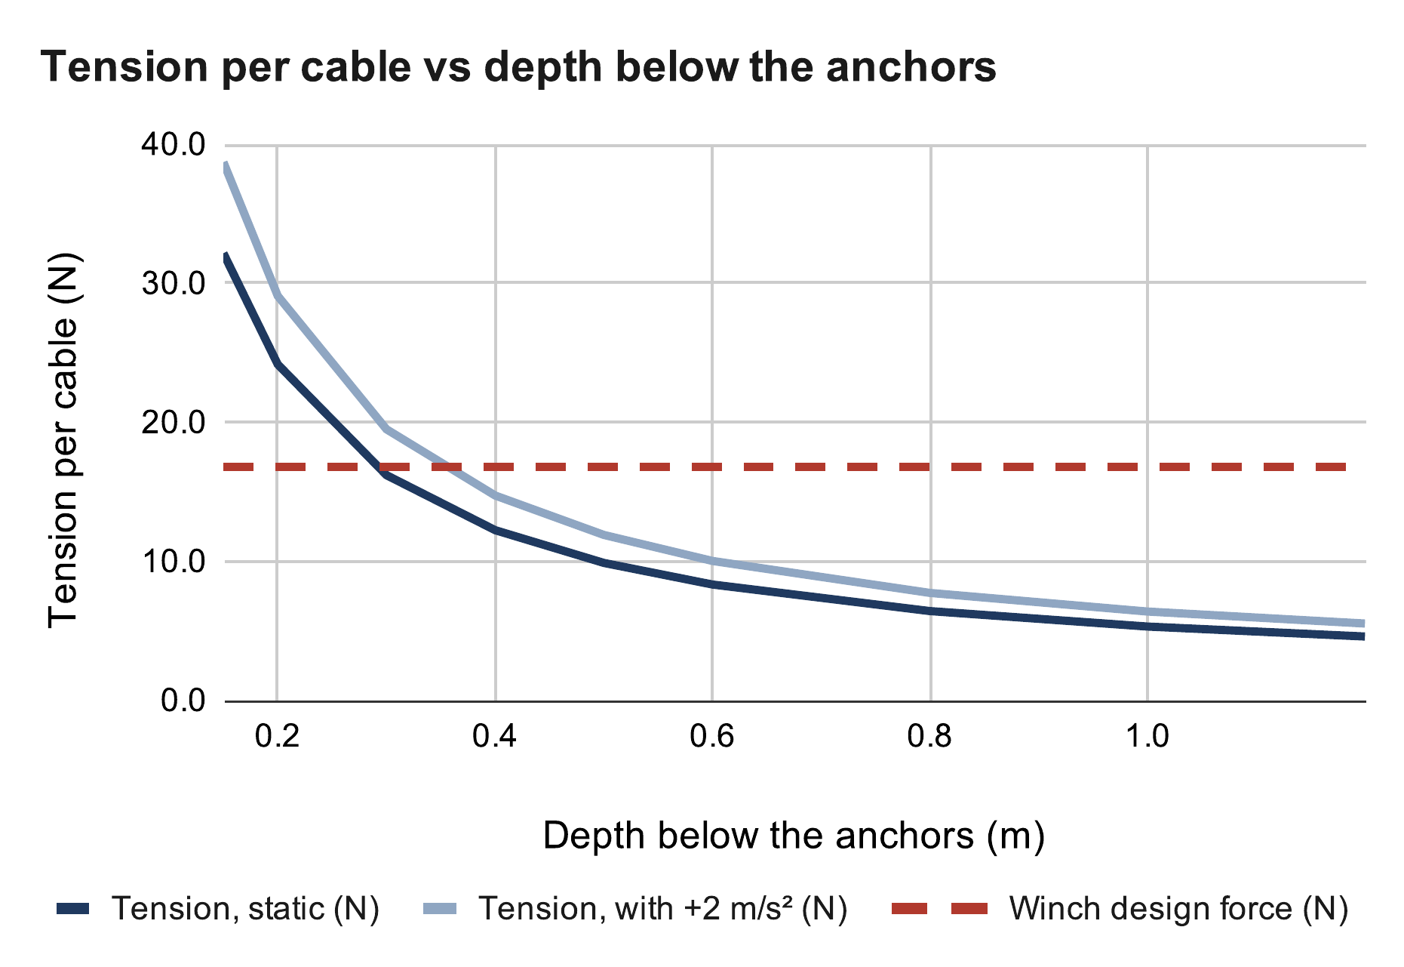
Cable Tension
Cables can only pull, so tension must stay positive
Tension rises sharply near the ceiling
32 N per cable at 0.15 m below the anchors; 8.3 N at 0.6 m
Operating limit: 0.4 m below the anchors
Cable tension at the operating limit
T = W / (4 sin φ), sin φ = d / √(d² + D_{h}²)
sin φ = 0.4 / √(0.4² + 2.17²) = 0.181
T = 8.87 N / (4 × 0.181) = 12.2 N
With 2 m/s²: 12.2 × 1.20 = 14.7 N < 16.8 N
Source: RoomCleaner engineering calculations, “Cable tension” (calculated values)
Where: W = (0.45 + 0.454) kg × 9.81 m/s² = 8.87 N; d = 0.4 m below the anchors; D_{h} = 2.17 m, room center to corner; 16.8 N = winch design force
Notes:
Force balance on the claw: the cable pulls and the weight sum to zero. Centered claw, equal shares. D_h = 2.17 m from the room center to a corner. The tension doubles each time the depth halves near the ceiling, so the ceiling margin is set by tension, not by collision. At 1.06 A the design force was 11.9 N, so 0.4 m was only just enough standing still (12.2 N). At 1.5 A it is 16.8 N, so 0.4 m also covers the 2 m/s² acceleration case (14.7 N). 0.3 m would now hold standing still (16.2 N) but not while accelerating (19.5 N), so I keep 0.4 m. If asked about a corner pick: the far cables go near-horizontal and carry little; the planner checks every cable stays inside its tension limits.

Slide 10
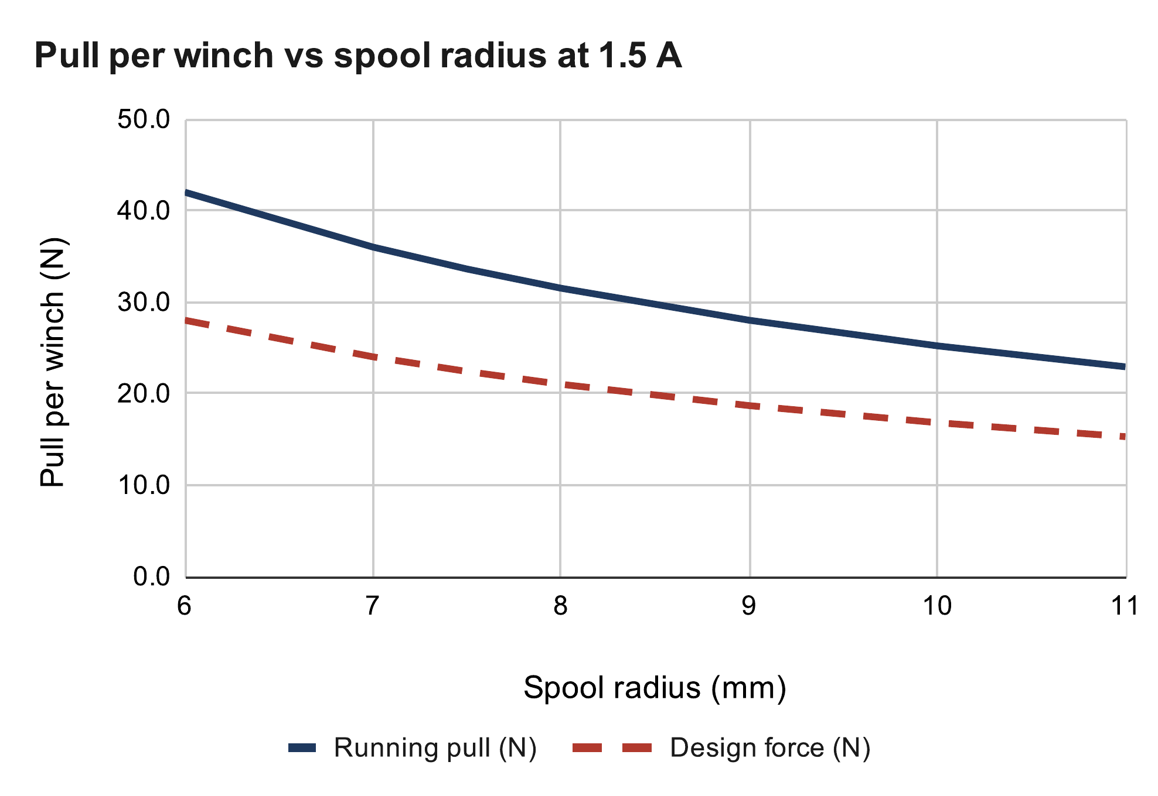
Winch Pull
NEMA 17 (National Electrical Manufacturers Association) stepper with a printed spool
Driver current raised to the rated 1.5 A (was 1.06 A)
Pull: 34 N with an empty spool, 25 N when full
Luggage-scale pull test to confirm the torque
Winch design force at 1.5 A
I = V_{ref} / (8 R_{s}) = 1.2 V / (8 × 0.1 Ω) = 1.5 A
τ_{run} = 0.7 × 0.36 N·m = 0.252 N·m
T = τ / r = 0.252 N·m / 0.010 m = 25.2 N
F_{design} = 25.2 N / 1.5 = 16.8 N
Source: RoomCleaner engineering calculations, “Winch pull” (calculated values)
Where: V_{ref} = driver reference voltage; R_{s} = sense resistor; 0.36 N·m = holding torque at 1.5 A; 0.7 = running/holding ratio (assumed); r = 10 mm full spool; 1.5 = skip margin
Notes:
Current limit from the driver's reference voltage (A4988 datasheet): the first boards topped out at 0.85 V, which is 1.06 A. I got the drivers to 1.5 A, the motor's rated current, so every pull goes up 41 % (1.5 / 1.06). [Fill in: how, and the Vref you read.] The cost is heat: the motor makes twice the heat (next slides). Running torque is lower than holding torque; I assumed 0.7, and the pull test measures it. A smaller spool gives more pull per amp but more turns per meter. The 1.5 margin covers skipped steps.

Slide 11
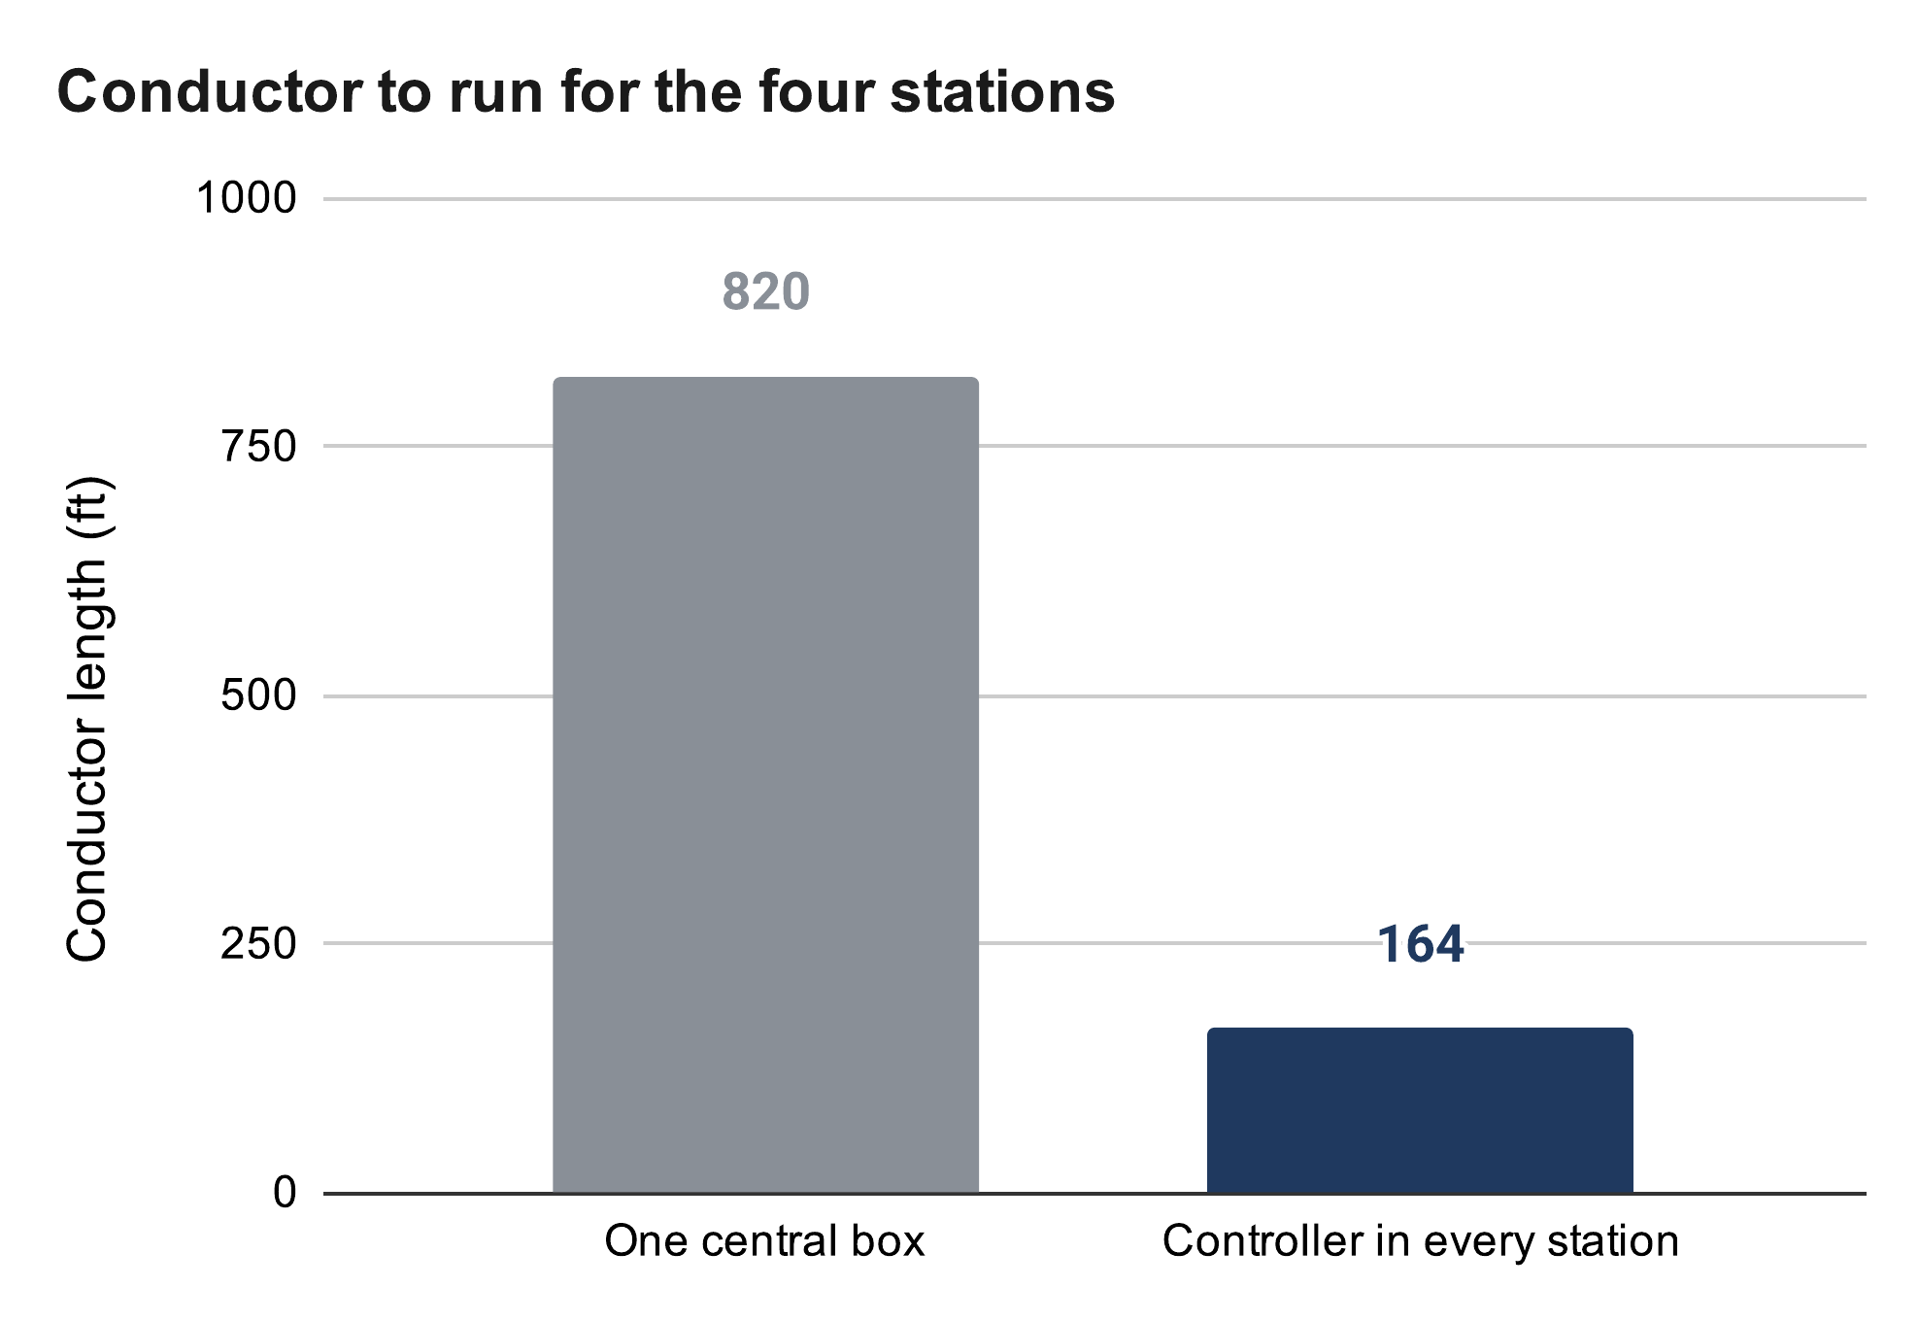
One Controller per Winch
Generation 1 drove all four motors from one central board
Adding sensors at each winch required 10 wires per corner
Moved to a separate controller in each station
Total wire reduced from 820 ft to 164 ft
Wire length and timing error
Wire = n × ΣL
Central board: 10 × 82 ft = 820 ft
Controller per station: 2 × 82 ft = 164 ft
Timing error: Δx = v Δt = 50 mm/s × 50 ms = 2.5 mm
Source: RoomCleaner engineering calculations, “Wiring” (calculated values)
Where: n = conductors per corner (motor 4, switch 2, encoder 4); ΣL = 6 + 21 + 23 + 32 ft of cable routes; v = line speed; Δt = clock offset between stations
Notes:
Real cable routes are 6, 21, 23 and 32 ft (82 ft). 10 conductors × 82 ft = 820 ft against 2 × 82 ft = 164 ft for one power pair. The cost: synchronization moved into software. Each station runs time-stamped segments on its own clock; any lost link means hold. Timing skew becomes cable mismatch: 50 mm/s × 50 ms = 2.5 mm, which is why segments are time-stamped.

Slide 12
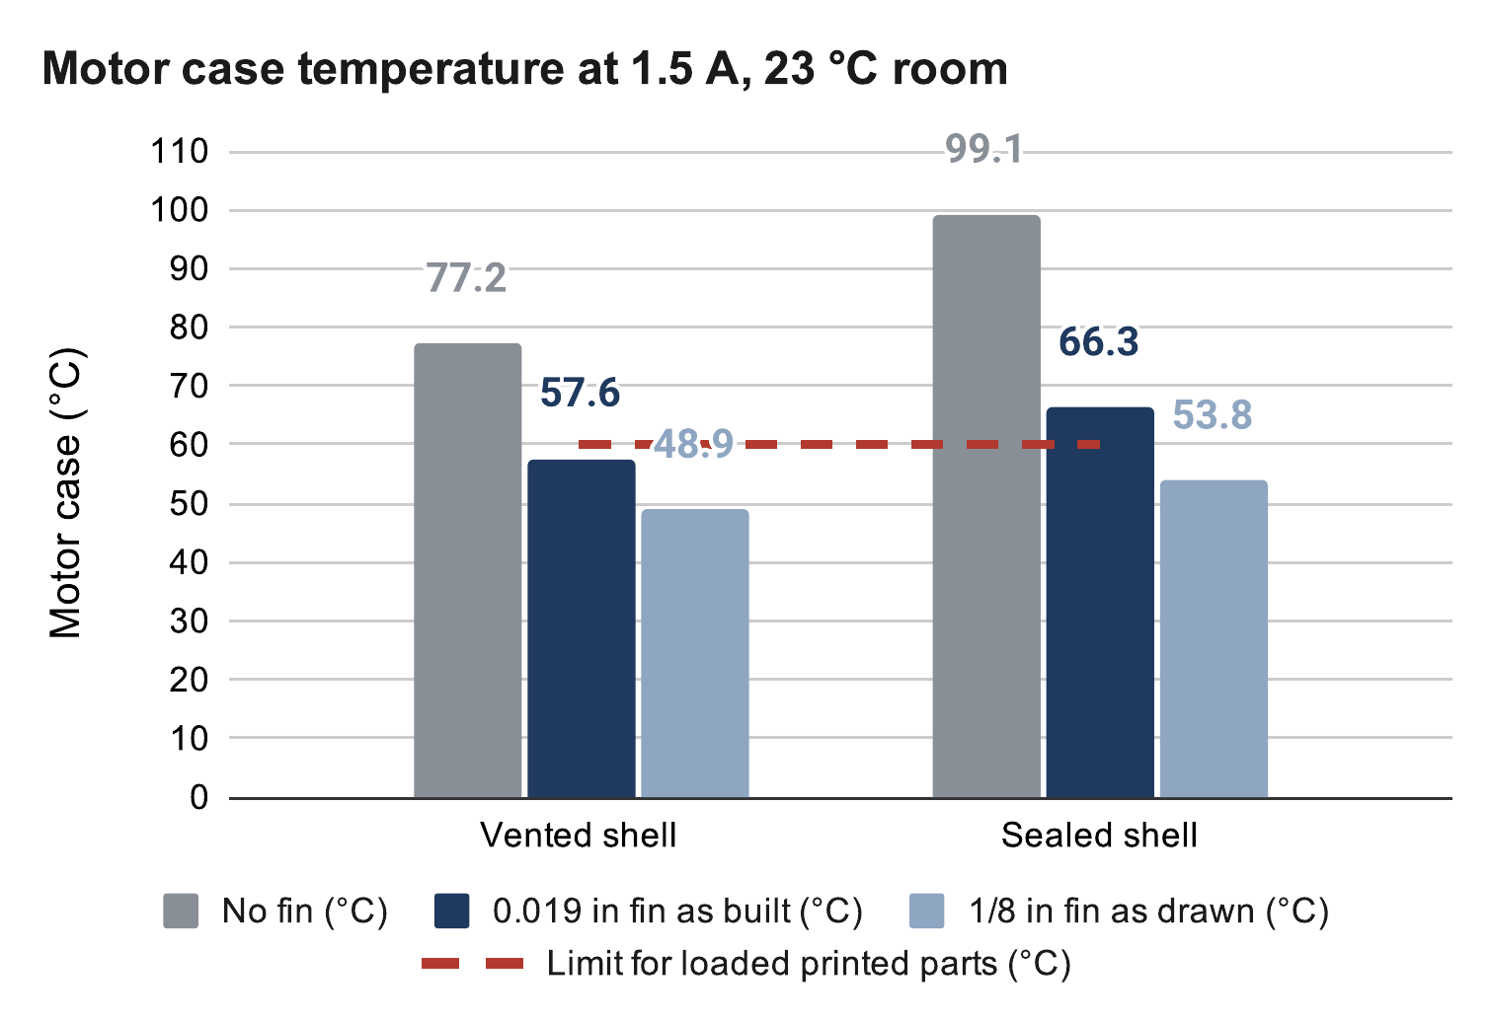
Motor Cooling
Sealed PETG shell traps motor heat
PETG creeps above 60 °C under load
Aluminum fin added through the top of the shell
90-minute hold test at 1.5 A planned
Motor heat and temperature at 1.5 A
P = I² R_{coil} = (1.5 A)² × 1.8 Ω = 4.05 W
1/R_{th} = 1/R_{shell} + 1/R_{fin}, ΔT = P × R_{th}
0.019 in fin: R_{fin} = 23.1 K/W → 57.6 °C
1/8 in fin: R_{fin} = 11.9 K/W → 48.9 °C
Source: RoomCleaner engineering calculations, “Motor temperature” (calculated values)
Where: R_{coil} = 1.8 Ω per phase (assumed); R_{shell} = 12 + 1 K/W, motor to shell air to room; room at 23 °C; 1.5 W of electronics in the shell; limit 60 °C
Notes:
Model: motor to shell air to room, with the fin as a second path out. At 1.5 A the motor makes 4.05 W, double the 2.0 W at 1.06 A. Sheet results, vented shell: no fin 77 °C, 0.019 in fin 57.6 °C, 1/8 in fin 48.9 °C; sealed: 99, 66 and 54 °C, so the shell stays vented. With radiation from the black paint included (refined model) the 1/8 in fin gives about 45 °C. The driver chip also heats more; if it overheats it shuts off and the winch loses torque, so the hold test watches it too. Fallback: 1.35 A. Shape: one tall blade from the heat source.

Slide 13
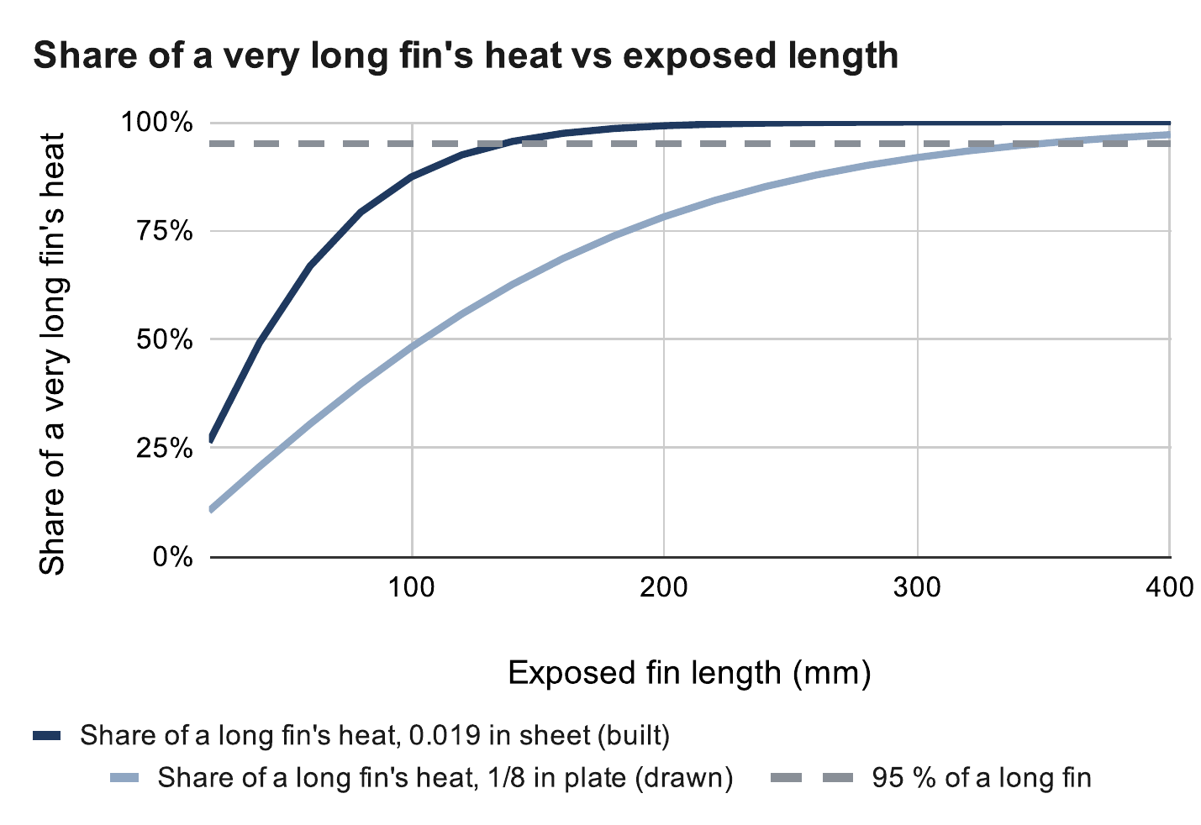
Heat Fin Sizing
0.019 in prototype fin reaches 95 % of its capacity by 136 mm
1/8 in design fin is 74 % efficient at 200 mm
Built length of 200 mm, limited by ceiling clearance
Fin length and efficiency
m = √(2h / (k t)), L₉₅ = 1.83 / m
0.019 in: m = √(2 × 7 / (160 × 0.00048)) = 13.5 /m
L₉₅ = 1.83 / 13.5 = 136 mm
1/8 in: m = 5.25 /m, L₉₅ = 349 mm
η = tanh(mL) / (mL) = tanh(1.05) / 1.05 = 0.74
R_{fin} = 1 / (7 × 0.74 × 0.0176) = 10.9 K/W
Source: RoomCleaner engineering calculations, “Heat fin” (calculated values)
Where: h = 7 W/m²·K, still air; k = 160 W/m·K, aluminum; t = fin thickness; L = 200 mm; A = 2 × 44 mm × 200 mm = 0.0176 m²; R_{fin} = 1 / (h η A)
Notes:
Target length: L95, where a fin gets 95 % of the heat an infinitely long one would. The thin sheet reaches it at 136 mm, so most of its 200 mm does little; the 1/8 in plate keeps gaining to 349 mm, so 200 mm is a compromise with the ceiling (the fin top is 229 mm above the shaft). At 200 mm: sheet 37 % efficient and 22.1 K/W; 1/8 in plate 74 % and 10.9 K/W. Fin equations: Incropera, Fundamentals of Heat and Mass Transfer, ch. 3.

Slide 14

Homing Method
Original plan: a bead on each cable trips a switch at the outlet
Cables could not get shorter than their homing length
Replaced with camera calibration on a printed floor board
Full room now reachable; beads kept as end stops
Reachable area with bead homing
L_{i}(p) ≥ L_{i,home} = ‖a_{i} − p_{home}‖
Home 1 m above the floor: 5 % reachable
Home 2 m above the floor: 29 % reachable
Source: RoomCleaner engineering calculations, “Bead homing” (calculated values)
Where: a_{i} = anchor i; p = claw position; reachable = every cable at or above its home length, inside the 0.2 m wall and 0.4 m ceiling margins
Notes:
This was a poor first plan, caught on paper before it was built. The limit is physical, so software cannot remove it. Replacement: take up slack one cable at a time, lift, look at the floor board from several poses, least-squares fit of anchors and zero lengths, check on held-out poses. Safety comes from margins (0.4 m below the anchors, 0.2 m inside the walls), not precision. Four tags in view: 0.7 mm vs 6.6 mm with one (appendix). Simulated so far; the first hardware run is this week.

Slide 15



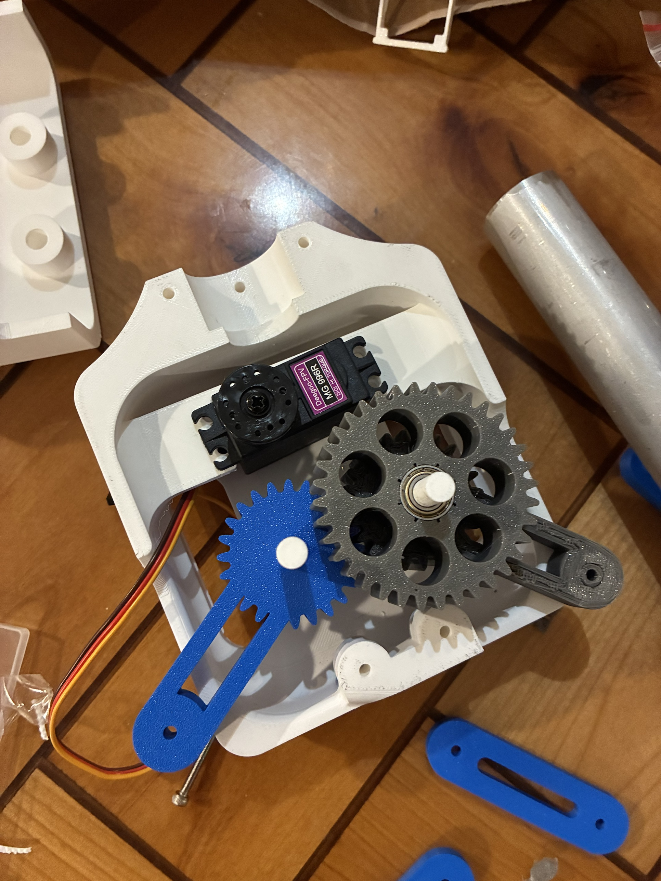
Claw Design
Generation 1 used five TPU (thermoplastic polyurethane) fingers
Fingers could not pinch thin fabric and were 4.6 times over the mass budget
Final design: geared four-bar with parallel jaws and a 53 mm opening
Grip force and gear stress at servo stall
N ≥ W / (2μ) = 4.45 N / 0.6 = 7.4 N
F_{t} = 2τ / d = 2 × 1.078 / 0.027 = 79.9 N
σ = F_{t} / (b m Y) = 79.9 / (15.7 × 1.5 × 0.309)
σ = 11.0 MPa, SF = 22.5 / 11.0 = 2.05
Where: N = grip force per jaw; W = 1 lb test load; μ = 0.3; τ = 1.078 N·m servo stall torque; d = 27 mm pitch diameter; b = 15.7 mm face width; m = 1.5 mm module; Y = 0.309 Lewis factor; SF = safety factor
Left to right, top to bottom: generation 1 fingers, v6 clamp, final four-bar (CAD), printed gear train
Notes:
Each generation fixed a problem found in the one before. Mass drove most changes: every gram of claw is a gram of laundry the winches cannot lift. Four-bar: ground 36.5, crank 53, rocker 50, coupler 34.7 mm; jaws parallel within about 1 degree; closing drops the tips about 38 mm, a scoop. Gear train: servo, 18-tooth pinion, 36/24-tooth compound, 24-tooth sync gear. Lewis check at servo stall: module 1 safety factor 0.35 to 0.41, so the module went up to 1.5. The camera also moved from the ceiling into the claw: it sees the grasp and reads the floor board.

Slide 16
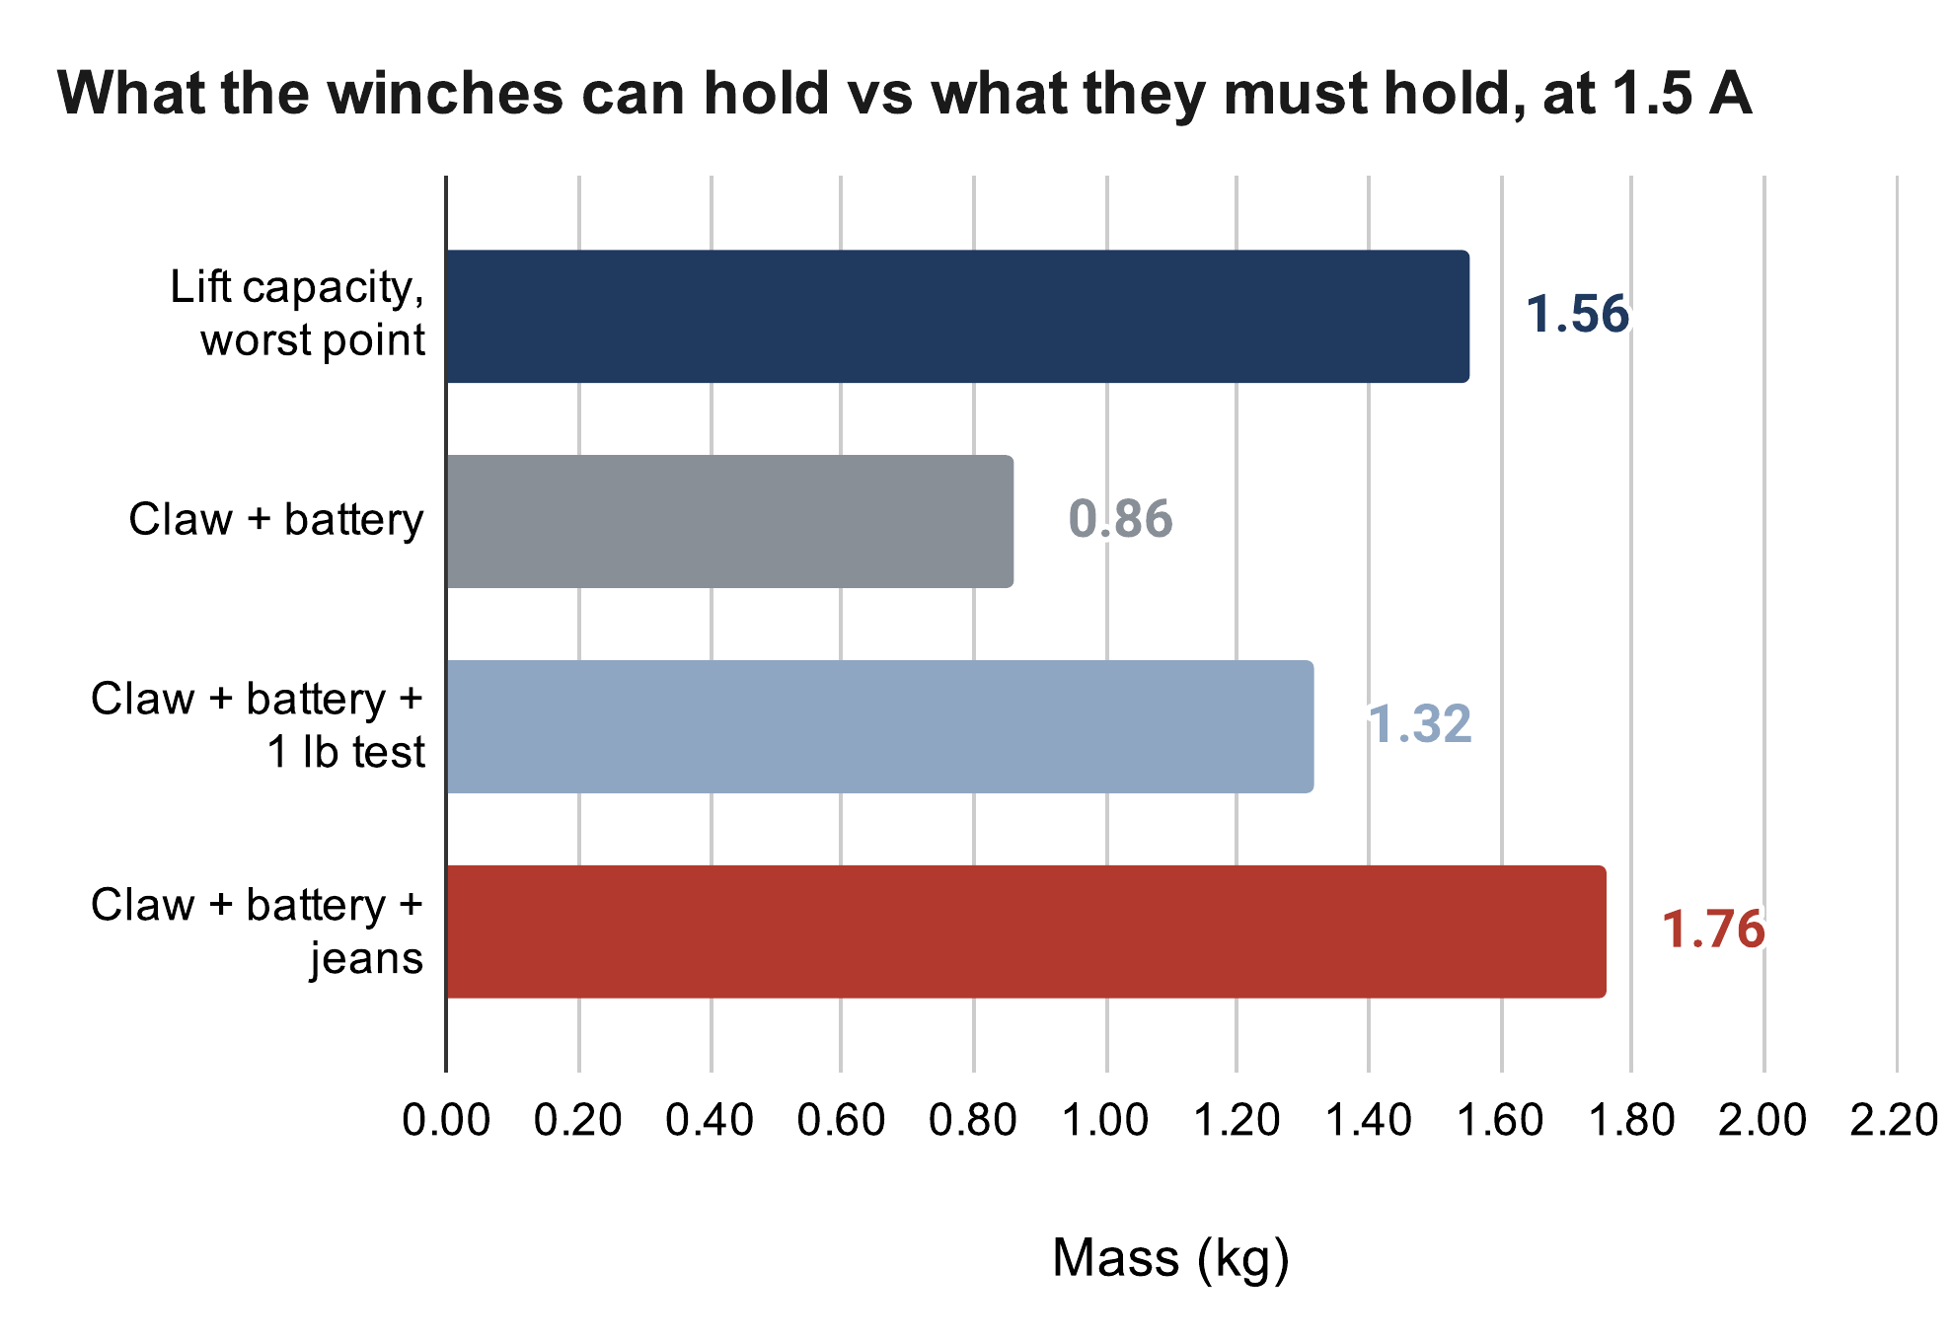
Weight Budget: Open Issue
Lift capacity at 1.5 A is 1.56 kg
Claw with battery estimated at 0.86 kg [weighed mass]
1 lb test load fits; jeans exceed capacity by 0.2 kg
Options: a lighter claw or a 3:1 gear reduction on the winch
Lift capacity against the required mass
m_{max} = F_{design} / (k g)
= 16.8 N / (1.101 × 9.81 m/s²) = 1.56 kg
m_{claw} = 0.55 × 0.927 + 0.198 + 0.055 = 0.76 kg
Required: 0.76 + 0.10 + 0.90 = 1.76 kg > 1.56 kg
Source: RoomCleaner engineering calculations, “Lift budget” (calculated values)
Where: k = worst cable tension per unit weight over the room, with 2 m/s²; 0.55 = print fill; 0.927 kg = solid PETG from CAD; 0.198 kg tube; 0.055 kg servo; 0.10 kg battery; 0.90 kg jeans
Notes:
Be upfront: even at 1.5 A the current claw plus jeans is too heavy, by about 0.2 kg instead of 0.66 kg. Root cause: I set the mass budget late, after the claw grew. Capacity = design force / (worst tension per unit weight × g) = 16.8 / (1.101 × 9.81) = 1.56 kg; the worst point is the middle of a long wall at task height. Claw mass estimate: 0.55 infill fraction × 927 g solid + 198 g tube + 55 g servo ≈ 0.76 kg. The pull test turns the 0.7 running-torque assumption into a measurement, and that number picks the fix.

Slide 17
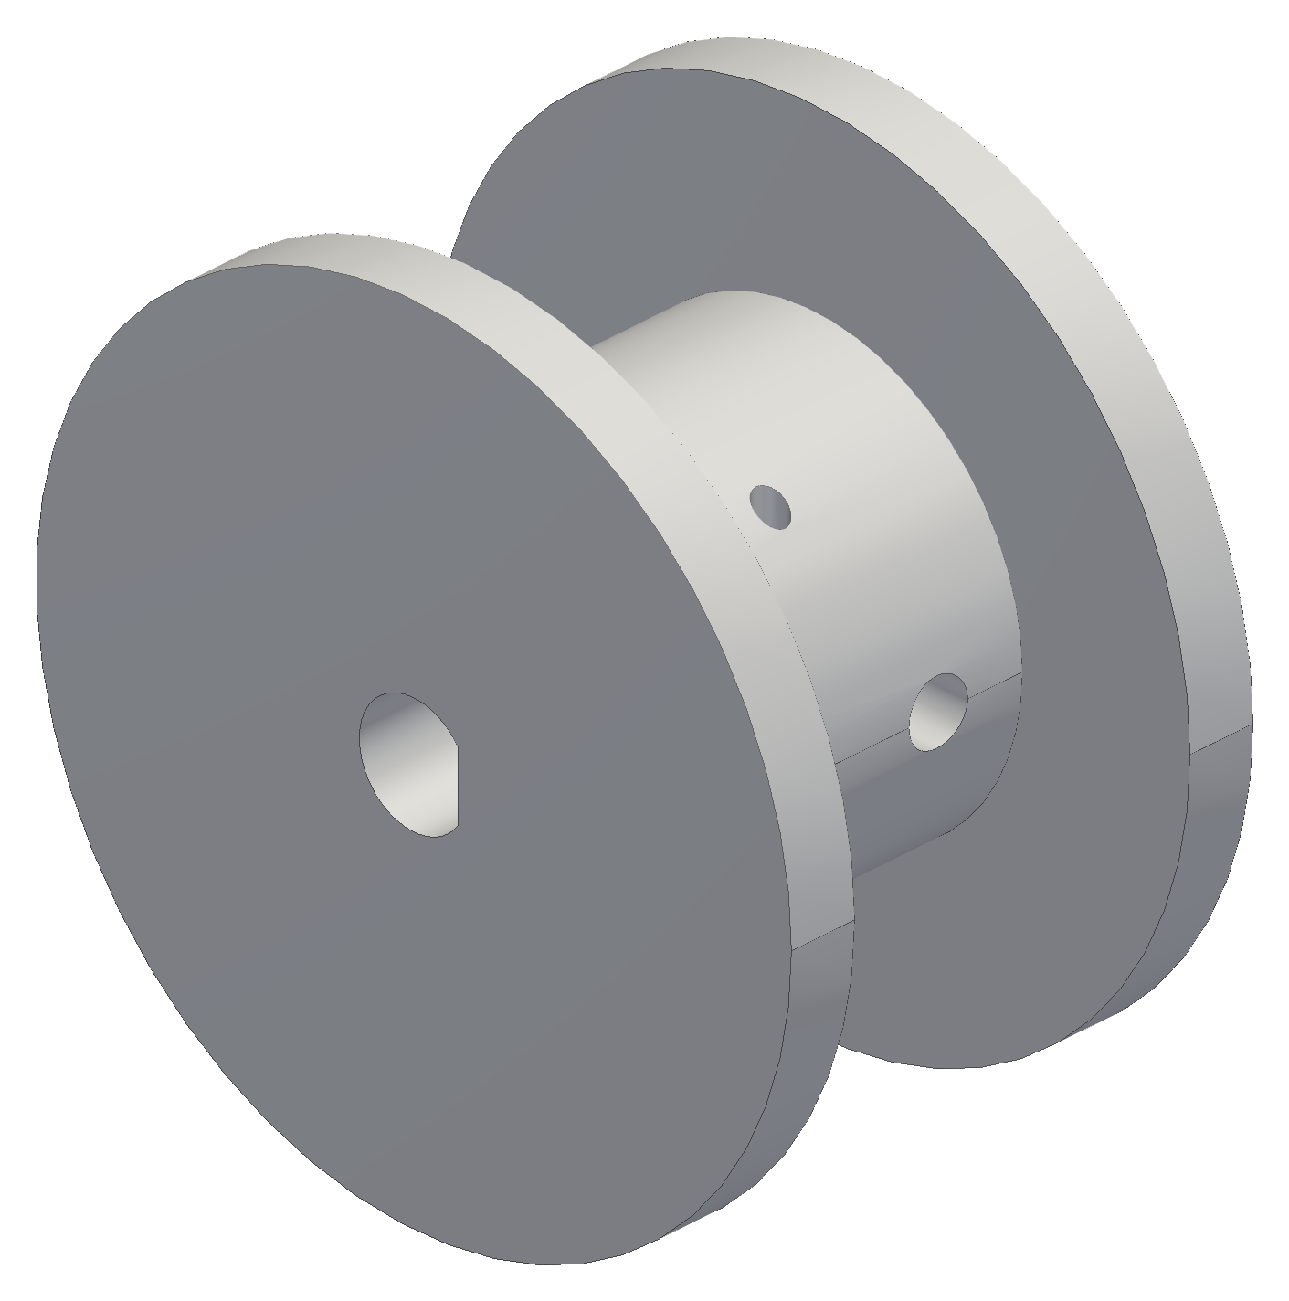


Printed Part Fits
PETG printed on a Creality K1 at 0.2 mm layers
Printed holes come out undersize by at least 0.2 mm
The spool needed three prints to fit the motor shaft
Fit coupons are now printed before full parts
Spool bore clearance
c = (D_{hole} − u) − D_{shaft}
Ø5.2 bore too tight, so u ≥ 0.2 mm
c = (5.45 − 0.2) − 5.00 = 0.25 mm
Where: c = clearance; u = printer undersize; D_{shaft} = 5.00 mm motor shaft; version 3 bore Ø5.45 with a D-flat for the set screw
Spool versions 1, 2 and 3 (CAD)
Notes:
Orientation: flat face on the bed, loads along the layers, no supports on mating faces. Bearing pocket Ø14.075 with a Ø14.000 lead-in lip. Heat-set M3 inserts where screws are reused. Spool v1 was longer than the motor shaft could engage; v2's Ø5.2 bore printed too tight on the 5 mm shaft, so the printer undersize is at least 0.2 mm; v3 opened it to Ø5.45 (about 0.25 mm clearance) with a D-flat. Ø15 core, 16 mm drum: 20 ft of line in 5 layers.

Slide 18


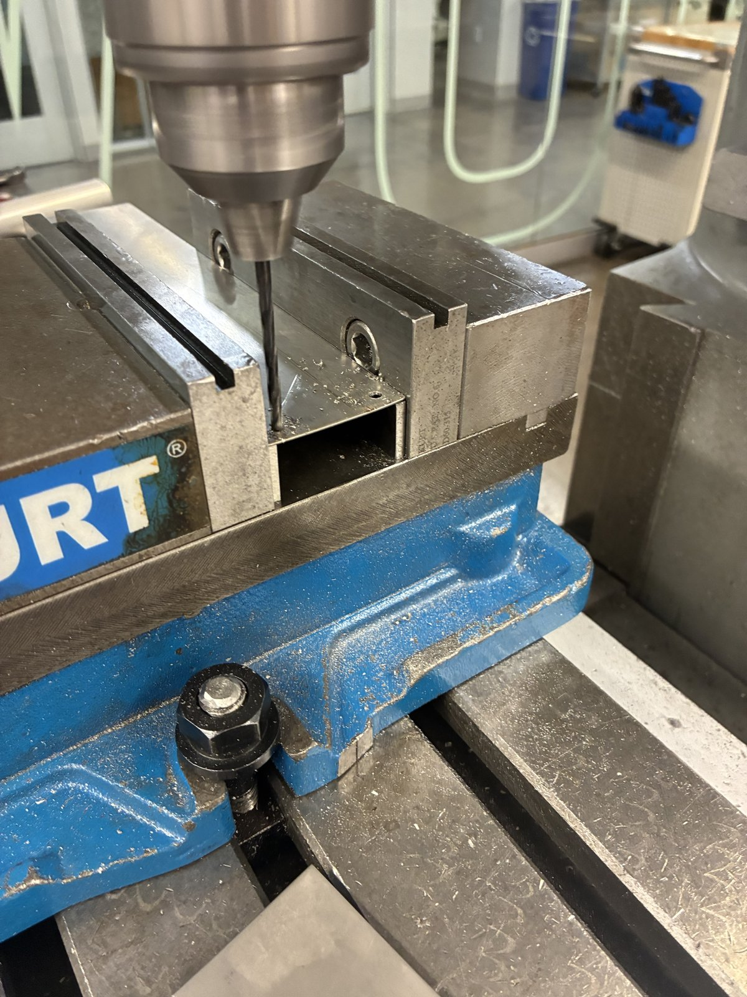

Heat Fin Manufacturing
Shop drawing printed 1:1 and used as a hole template
Prototype cut from 0.019 in aluminum sheet already on hand
All five holes drilled in one mill setup to ±0.1 mm
Fin bolted to the motor without reaming
Shear and blanks, mill setup with the drawing, drilling, and the finished fin
Notes:
One setup from the same two edges means hole-to-hole errors do not stack. Holes: a 7/8 in pilot for the motor boss and 4 × Ø3.4 on the 31 mm motor square. Paint everywhere except the motor contact square, which gets thermal paste. The production fin is 1/8 in plate. [Fill in: time per fin, how many made, any scrap.]

Slide 19


Electronics Bring-Up
Driver stays disabled at boot, so a reset cannot move the motor
Schematic generated from the soldered board, 16 nets
First motor failed to turn: logic rail measured 1.14 V instead of 3.3 V
Supply rails are now checked with a meter before any code is loaded
Soldered station board, left; bench bring-up, right
Notes:
Boot-safe: a 10k pull-up holds the driver's enable pin off until the firmware arms it. USB and the 5 V buck cannot back-feed each other (link jumper plus a Schottky diode). The schematic is generated from the soldered board's net list, so the two cannot disagree. The 1.14 V story: measure the hardware before trusting the software's view of it. Checklist: logic supply, sleep, enable and the buck output on every new board. [Fill in: exact readings, date, what you tried first.]

Slide 20
First System Test
Three stations: the fewest cables that fully constrain the claw
Sequence: self-check, calibration, short move, then pickup
1 lb test load first, then one garment
Pass limits defined before the run
[Photo or video from the three-station test]
Check | Pass limit | Result
Startup self-check | All stations answer; slack taken up | [fill in]
Calibration fit | Held-out poses inside the safety margin | [fill in]
Short move, 1 lb | 300 mm at 50 mm/s, ≤ 2 mm per cable | [fill in]
Pickup | One garment into the hamper | [fill in]
Notes:
Three cables, three unknown tensions, three force equations: statically determinate, so the tensions are solved exactly and slack shows up directly. It is the simplest real test of the calibration and the coordinated motion. Logged: cable lengths, encoder counts, motor temperatures, the fit's error bars. Fill in the results after the test, including any that fail.

Slide 21
Thermal Verification
PETG mount must stay below 60 °C
Hand calculation: 56–59 °C with the prototype fin, 45–49 °C with the 1/8 in fin
SolidWorks thermal study of the motor, fin, screws and mount
90-minute hold test at 1.5 A to confirm
[SolidWorks temperature plot: motor, fin, screws and mount]
Method | 0.019 in fin | 1/8 in fin | PETG mount
Hand calculation | 56–59 °C | 45–49 °C | 2 K below motor
SolidWorks | [fill in] | [fill in] | [fill in]
Hold test | [fill in] | [fill in] | [fill in]
Motor temperature at 1.5 A, 23 °C room, vented shell
Notes:
The 60 °C limit is for the loaded PETG, and that is the one temperature the hand calculation cannot give: it only knows the motor node. The SolidWorks thermal study uses my 10/21 assembly with a detailed NEMA 17 (aluminum end caps, black steel stator, copper windings as the 4.05 W source, plastic connector), the fin, the four M3 screws into the motor, and the PETG slip-in mount; inside the shell 26 to 27 °C, outside 23 °C. Hand calculation: 56 to 59 °C with the prototype fin, 45 to 49 °C with the 1/8 in fin (the range is the simple and the refined model). Then the hold test measures it. If they disagree, I fit h and the coil resistance, not the physics.

Slide 22
Good and Poor Decisions
Good decision | Outcome
One controller per winch | Five times less wire; each station tested on its own
Slide-in wall mount | A station comes off while its anchor stays in place
Camera calibration instead of bead homing | Whole room reachable; no tape measure needed
Gear strength checked at servo stall | Module 1 gears would have failed; fixed in CAD before printing
Poor decision | Outcome
Mass budget set late | Claw and jeans are 0.2 kg over capacity, even at 1.5 A
Bead homing as the first plan | Under a third of the room reachable; redesign needed
Spool printed before a fit test | Three prints to fit the motor shaft
Several stations built before one was proven | Every fix repeated on each station [confirm]
Notes:
Good: each was a trade I priced first. Distributed control cost me software synchronization (2.5 mm per 50 ms of skew) but saved 5× the wire. The slide-in mount came from taking stations down to rework them. Calibration by camera replaced a plan that physically limited the motion. The stall check caught gears that would have sheared before I printed them. Poor: the mass budget came after the claw grew, which is the open issue today. Bead homing looked cheap until I computed what it cost. The spool bore needed a coupon. And building several stations before one was fully proven meant repeating each fix. [Confirm the last one.]

Slide 23
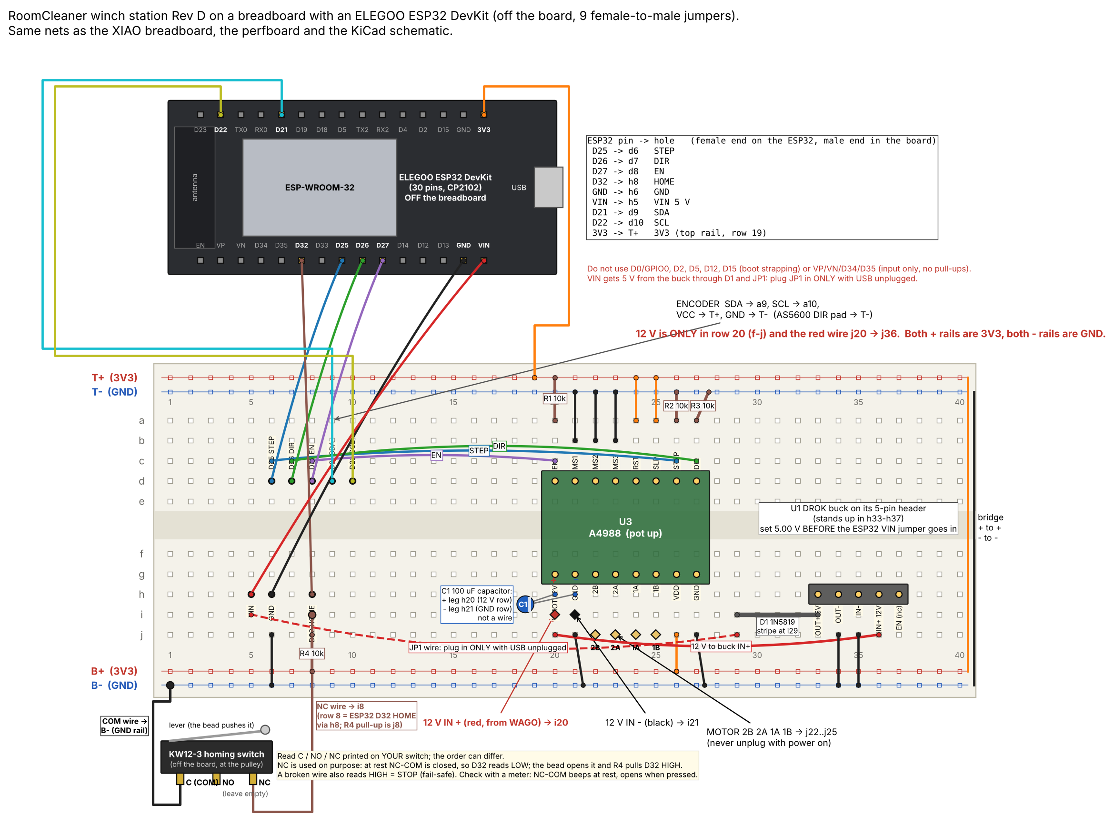
Thorough vs. Scrappy
Thorough
Scrappy
Heat fin sized by calculation and machined in one mill setup to ±0.1 mm
Station schematic checked net by net against the soldered board
Gear strength checked at servo stall before printing
Failed controller replaced by an ESP32 dev board on nine jumpers, same firmware
Floor board made from paper tags on a 250 mm grid
Prototype fin cut from 0.019 in sheet already on hand
Approach: thorough where a mistake is expensive or unsafe, scrappy where it is cheap to undo.
Notes:
Thorough: the fin is machined once, so the hole pattern had to be right before the first cut. The board schematic is generated from the soldered net list so the drawing cannot lie. The gear check happened in CAD because a sheared gear costs a print and a jammed claw. Scrappy: when a controller board died two days before the test, I moved the same circuit to an ESP32 dev board with nine jumpers and a compile-time pin map instead of redesigning the board. The floor board is paper tags because accuracy comes from seeing several tags, not from the board. Three stations now, because three cables already test calibration and coordinated motion while the fourth is built.

Slide 24
Lessons Learned
What I would do differently
Completing it in half the time
Set the mass budget early, from the measured winch pull
Print fit coupons before full parts
Prove one complete station before building the rest
Check supply rails with a meter before debugging code
Freeze requirements in the first week
Order long-lead parts on day one
Start with three stations
Limit each part to one generation, gated by a test
Actual
(15 weeks)
Concept
Generation 1
Redesign
Gen 2 to final
Build, test
Half time
(7 weeks)
Plan
One full station and tests
Copy
Claw, coupons first
Test
Same time scale. Actual schedule: July 16 to October 27.
Notes:
What I would do differently: weigh the claw and set its mass budget from the measured winch pull before designing it; coupons before every new fit; one complete station tested end to end before building more; a meter on every rail before debugging code. Half the time: most of the lost time was the redesign (September to early October) and the generations that a frozen requirement and an early test would have avoided. Order the slow parts on day one. Three stations are statically determinate and need fewer parts for the first test.

Slide 25
Questions
Jasper Buntinx | jasper_buntinx@tamu.edu
Notes:
The appendix follows: project status, fin sizing for 4 W, floor board, calibration, control logic, operating sequence, phone app, obstacles, claw electrical, gear strength, safety, acronyms, calculations and sources.

Slide 26
Appendix
Supporting detail for questions

Slide 27
Project Status
Part | Status | Next test
Wall stations | Built; bench-commissioned [how many] | Three-station test, then the fourth
Station electronics | Built; drivers at 1.5 A [how: Vref reading] | 90-minute hold test at 1.5 A
Heat fin | Prototype 0.019 in built; 1/8 in designed | Machine the 1/8 in fin; hold test
Thermal model of the station | Hand calculation at 1.5 A; SolidWorks model set up | Run it; then the hold test
Claw body: tube, mount, servo, gears | Built | Weigh it
Claw hands, camera housing, encoder casing | Checked in CAD; printing | Fit checks on the first print
Calibration and control software | Simulated end to end | First hardware run
Winch pull | Calculated at 1.5 A: 25–34 N | Luggage-scale pull test
Notes:
Everything calculated or simulated is called that; the next-test column is what turns it into measurements.

Slide 28
Fin Sizing for 4 W
Goal: the fin alone carries all 4.05 W
0.019 in sheet cannot at any length; maximum about 2 W
1/8 in plate needs 145–185 mm
Thickness matters more than length
Painted 6061, 44 mm wide | Mass | Motor at 200 mm, fin alone | Shortest for ≤ 60 °C
0.019 in (prototype) | 14 g | 100–120 °C | None (2.0 W max)
1/16 in | 47 g | 66–72 °C | None (3.6 W max)
0.090 in | 68 g | 60–65 °C | 210 mm or none
1/8 in (design) | 94 g | 56–59 °C | 145–185 mm
3/16 in | 141 g | 53–55 °C | 125–140 mm
1/4 in | 189 g | 51–52 °C | 115–125 mm
Most heat any fin length can carry
q∞ = w √(2 h k t) × θ_{b}
0.019 in: 0.044 × √(2 × 9.3 × 167 × 0.000483) × 37
= 2.0 W < 4.05 W
All 4.05 W through the fin, 23 °C room, paste contact. Calculated.
Where: w = 0.044 m fin width; h = 9.3 W/m²·K, painted; k = 167 W/m·K, 6061 aluminum; t = 0.000483 m; θ_{b} = 60 − 23 = 37 K
Notes:
The built sheet works today only because the motor also sheds about 2.5 W into the vented shell. A thin sheet has a large m = √(2h/kt), so its far end does almost nothing: the most heat any length can carry is w √(2hkt) θ_b, about 2 W for 0.019 in at a 60 °C base. The 1/8 in plate of my first drawing, painted, would carry all of it at the same 200 mm, and with the vented shell the motor would run at about 45 °C. Mass is no problem on a wall station. 1/8 in may be beyond a hand shear: bandsaw and square it on the mill. Ranges: flange at one temperature to heat spread over the patch.

Slide 29

Floor Board Accuracy
Position error equals angle error times camera height
One tag in view: 6.6 mm; four tags: 0.7 mm
Averaging removes noise, but not bias
Position error with one tag in view
δx = σ_{θ} × L = 12.9 mrad × 0.51 m = 6.6 mm
Source: RoomCleaner engineering calculations, “Floor board” (calculated values)
Where: σ_{θ} = pose-angle noise with one tag in view; L = 0.51 m camera height above the board
Notes:
Two tags: 4.85 mrad, 2.5 mm. Noise model: 0.3 px corner noise, 520 px focal length (camera not yet calibrated).

Slide 30
Startup Calibration
No tape measure needed
Fits anchor positions and cable zero lengths
Held-out poses check the fit
Full room allowed only within the fit's error bars
1. Take up slack, one cable at a time
2. Lift the claw off the floor
3. Camera reads the floor board
6. Ready, inside the safety margins
5. Check on held-out poses
4. Fit anchors and cable lengths
Least-squares calibration fit
min Σ_{k} Σ_{i} ( L_{i0} + d_{ik} − ‖a_{i} − p_{k}‖ )²
Full room only if k σ ≤ safety margin
Where: a_{i} = anchor i; p_{k} = claw pose k from the camera; d_{ik} = cable paid out, from the encoder; L_{i0} = cable zero length; σ = fit error; k = confidence multiplier
Notes:
Safety comes from margins, not precision: 0.4 m below the anchors and 0.2 m inside the walls unless the error bars allow more. If the fit is not good enough: more poses, then fit again.

Slide 31
Control Logic: Generation 1 vs. Final
 | Generation 1 | Final
Where is the claw? | Assumed: where the cables were told to put it | Measured: claw camera on the floor board, refit at every startup
Room geometry | Point mass; anchors from a tape measure | Rigid claw; anchors and cable lengths fitted, with error bars
Who runs the motors | One central board steps all four | Each station runs time-stamped moves; the laptop coordinates
Finding laundry | Ceiling camera, pixel to floor map | Claw camera, ray from the claw's pose to the floor
Did the grab work? | Assumed once the claw closed | Camera checks pickup and delivery
Faults | Emergency stop only | Supervisor: a stop keeps torque; nothing restarts by itself
Notes:
Generation 1 trusted its model; the final logic measures before it trusts and checks after it acts. Kept from generation 1: the cable math, the state-machine idea and the YOLO-World detector. All simulated so far.

Slide 32
Operating Sequence
1. Start up
2. Find
3. Pick and deliver
4. Put away
Self-check
Take up slack
Lift a few centimeters
Calibrate
Set the trust level
Rise to scan height
Detector lists the items
Map each to the floor
Choose the nearest
Hover until still
Descend and close
Camera confirms the grip
Move to the hamper and release
Camera confirms the drop
Lower over the floor board
Camera confirms the floor
Disarm after a typed confirmation
After each delivery the robot returns to step 2; three failures in a row pause it for the operator
PAUSE or any fault stops every station at the same point on the path, still holding; nothing restarts by itself
Notes:
Grips wait until the claw stops swinging. A refused release pauses over the hamper. Disarm needs a typed confirmation and a fresh floor check, because releasing torque drops a hanging claw. Simulated end to end.

Slide 33



Phone App
Shows status, the live claw camera and guided setup
Every motion asks for confirmation first
PAUSE holds position immediately
The switched power strip is the hard stop
A reboot never resumes a task
Phone app: home, camera and chat screens
Notes:
Tested against a full simulator of the stations and the claw, so lost messages and reboots were exercised before hardware.

Slide 34
Obstacles
Known obstacles modeled as keep-out cylinders
Every cable checked at every point of the path
Moves that fail the check are refused before any motor turns
People are not detected yet, so nobody stands underneath
1.5 m: clear
Shelf,
0–1.9 m
0.8 m: refused
Side view along a room diagonal: the same floor point at two heights, with an example shelf
Notes:
Next: draw keep-out shapes in the phone app (squares, rectangles, circles with a height), then let the robot build its own room model from the claw camera's scans. Simulated so far.

Slide 35

Claw Electrical
Two-cell lithium-ion pack: 7.4 V with a 5 A fuse
6 V servo rail and a separate 5 V logic rail
Peak draw of 2.8–3.1 A against a 3 A pack rating
Charged with the switch off, attended, at 1 A or less
Notes:
Rules check 0 errors; 9 nets match the specification. Charger: 8.4 V constant current, constant voltage.

Slide 36
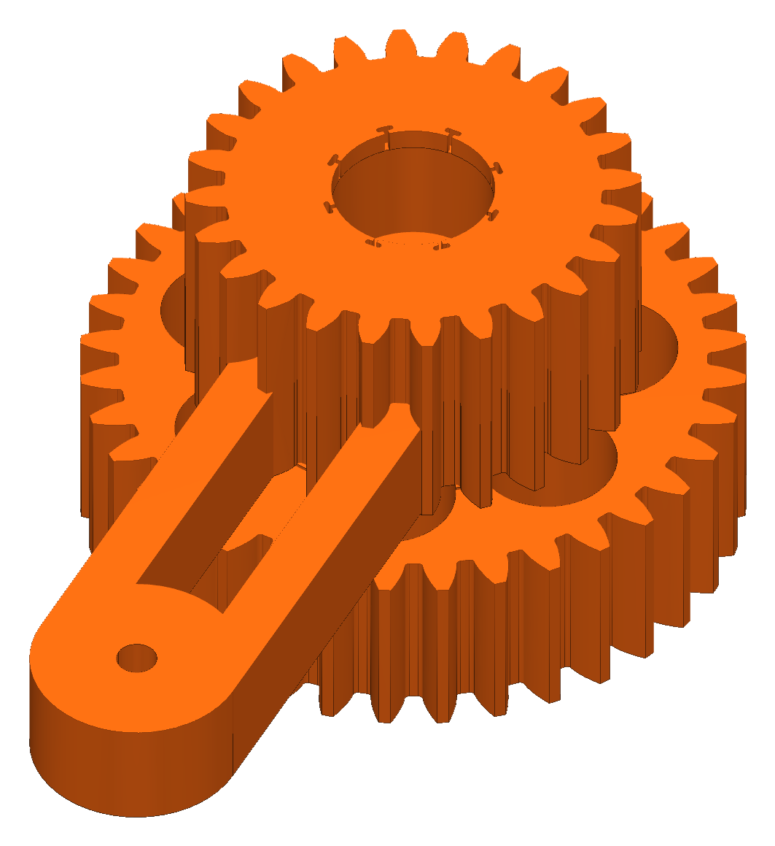
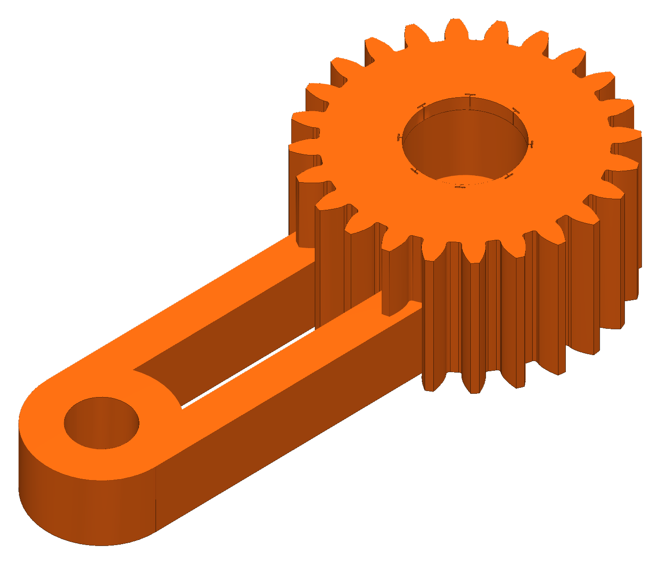
Gear Strength
Module 1.5 gears; PETG allowable stress 22.5 MPa
Safety factors at 6 V stall: 2.05 pinion, 2.50 compound gear, 2.00 sync gear
Module 1 gave safety factors of 0.35–0.41 and was rejected
Lewis bending stress at servo stall
F_{t} = 2τ / d = 2 × 1.078 / 0.027 = 79.9 N
σ = F_{t} / (b m Y) = 79.9 / (15.7 × 1.5 × 0.309) = 11.0 MPa
SF = σ_{allow} / σ = 22.5 / 11.0 = 2.05
Where: τ = servo stall torque; d = pitch diameter (18 teeth × 1.5 mm); b = face width; m = module; Y = Lewis form factor; SF = safety factor
Notes:
Safety factors at the 6 V servo stall: pinion 2.05, 36-tooth gear 2.50, sync gear 2.00 with one jaw taking all the load. Stall torque 1.078 N·m is the servo rating, not measured.

Slide 37
Safety
One hard stop: the switched power strip
Faults and PAUSE hold motor torque
Anchors in wall studs; nobody stands under the robot
Motors are never unplugged under power
Notes:
No safety-rated function is claimed.

Slide 38
Acronyms
Term | Meaning
CAD | Computer-aided design
PETG | Polyethylene terephthalate glycol (the printed plastic)
TPU | Thermoplastic polyurethane (flexible printed plastic)
NEMA 17 | National Electrical Manufacturers Association motor frame, 1.7 in square
I²C | Inter-Integrated Circuit: a short-range two-wire sensor bus
ESP32 | A Wi-Fi microcontroller family (Espressif)
A4988, AS5600 | Stepper-motor driver chip (Allegro); magnetic angle sensor (ams)
YOLO | “You Only Look Once”: an object-detection model family
SF | Safety factor: allowable stress divided by actual stress

Slide 39
Calculations and Sources
All charts come from my engineering calculation sheet
Each result is a formula on labeled inputs
Sources:
  Incropera et al., Fundamentals of Heat and Mass Transfer, ch. 3
  Allegro MicroSystems, A4988 datasheet
Source: RoomCleaner engineering calculations, “Cable tension” (calculated values)
RoomCleaner engineering calculations (Google Sheets)

