Slide 1

RoomCleaner
A four-cable ceiling robot
designed to pick laundry off the floor
Jasper Buntinx · Technical presentation · Oct 27, 2026
Notes:
SAY: I set out to build a ceiling robot that picks laundry off my floor; every time a measurement disagreed with my plan I changed the design, and every change traces back to a first-principles equation.
NUMBERS: Four wall winch stations, one claw on four cables. Target payload 0.9 kg of jeans (provisional screening reference); first test load 1 lb. About 30 minutes of content: 12 decision slides and 7 backups.
LIKELY QUESTION 1: Give me the 30-second version.
ANSWER: Four wall-mounted winch stations hold a claw on four cables. The claw is designed to descend onto laundry, close its jaws with one servo, carry the load and release it over a hamper. I will show twelve decisions where a calculation or a measurement forced me to change the plan, including the ones that did not work out.
LIKELY QUESTION 2: Does it work today?
ANSWER: Not end to end yet. The stations and the claw are designed and partly built; the four-station test has not run and the claw has not been weighed. Slide 16 lists what is measured and what is still planned.

Slide 2
Solo project: a four-winch cable robot, a camera claw, and the control architecture.
WHAT I BUILT · HOW I WORKED
Jul 16
Aug
Oct 7
Oct 20
Oct 27
Concept
Gen-1 bench
SolidWorks gen-2
Gripper v6
Panel
Simulator, BOM, first CAD
Printed plate, test weight
Station v1 to v3
Geared jaws
Today's talk
HOW TO READ THE TAGS
BOUGHT
MADE BY ME
MEASURED
On hardware, with an instrument
Stepper motors, A4988 drivers, ESP32 boards, DROK buck, MG996R servo, bearings, pulleys, line.
Station and claw design in SolidWorks, printed and machined parts, bench wiring, test plan.
CALCULATED
Hand or CAD calculation
SIMULATED
Run in a model or simulator
PLANNED
Not done yet
Notes:
SAY: This is a solo project: I bought the motors, drivers, boards and a few modules, and the station and claw design, the printed and machined parts, the bench wiring and the test plan are mine.
NUMBERS: Jul 16 start (simulator, BOM, first CAD); Aug gen-1 printed plate and bench; Oct 7 SolidWorks gen-2 station; Oct 20 gripper v6; Oct 27 panel. Purchased: stepper motors, A4988 drivers, ESP32 boards, DROK buck, MG996R servo, bearings, pulleys, line. Tags: MEASURED = instrument on hardware, CALCULATED = hand or CAD calculation, SIMULATED = ran in a model, PLANNED = not done yet.
LIKELY QUESTION: What did you actually do yourself?
ANSWER: I designed the stations and the claw in SolidWorks, printed and machined the parts (PETG for the structural parts, the fins sheared and drilled on a manual mill), wired the bench and perfboard electronics and wrote the test plan. I made the architecture decisions: margins instead of precision, no IMU. The motors, drivers, boards, buck, servo, bearings, pulleys and line are purchased.
If you did this yourself, you can say it in the first person: "I designed the stations and the claw in SolidWorks, printed and machined the parts, wired the bench electronics and wrote the test plan." Say that you wrote or specified the control software only if it is true.

Slide 3
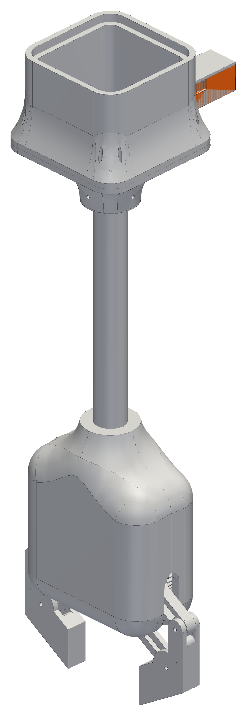
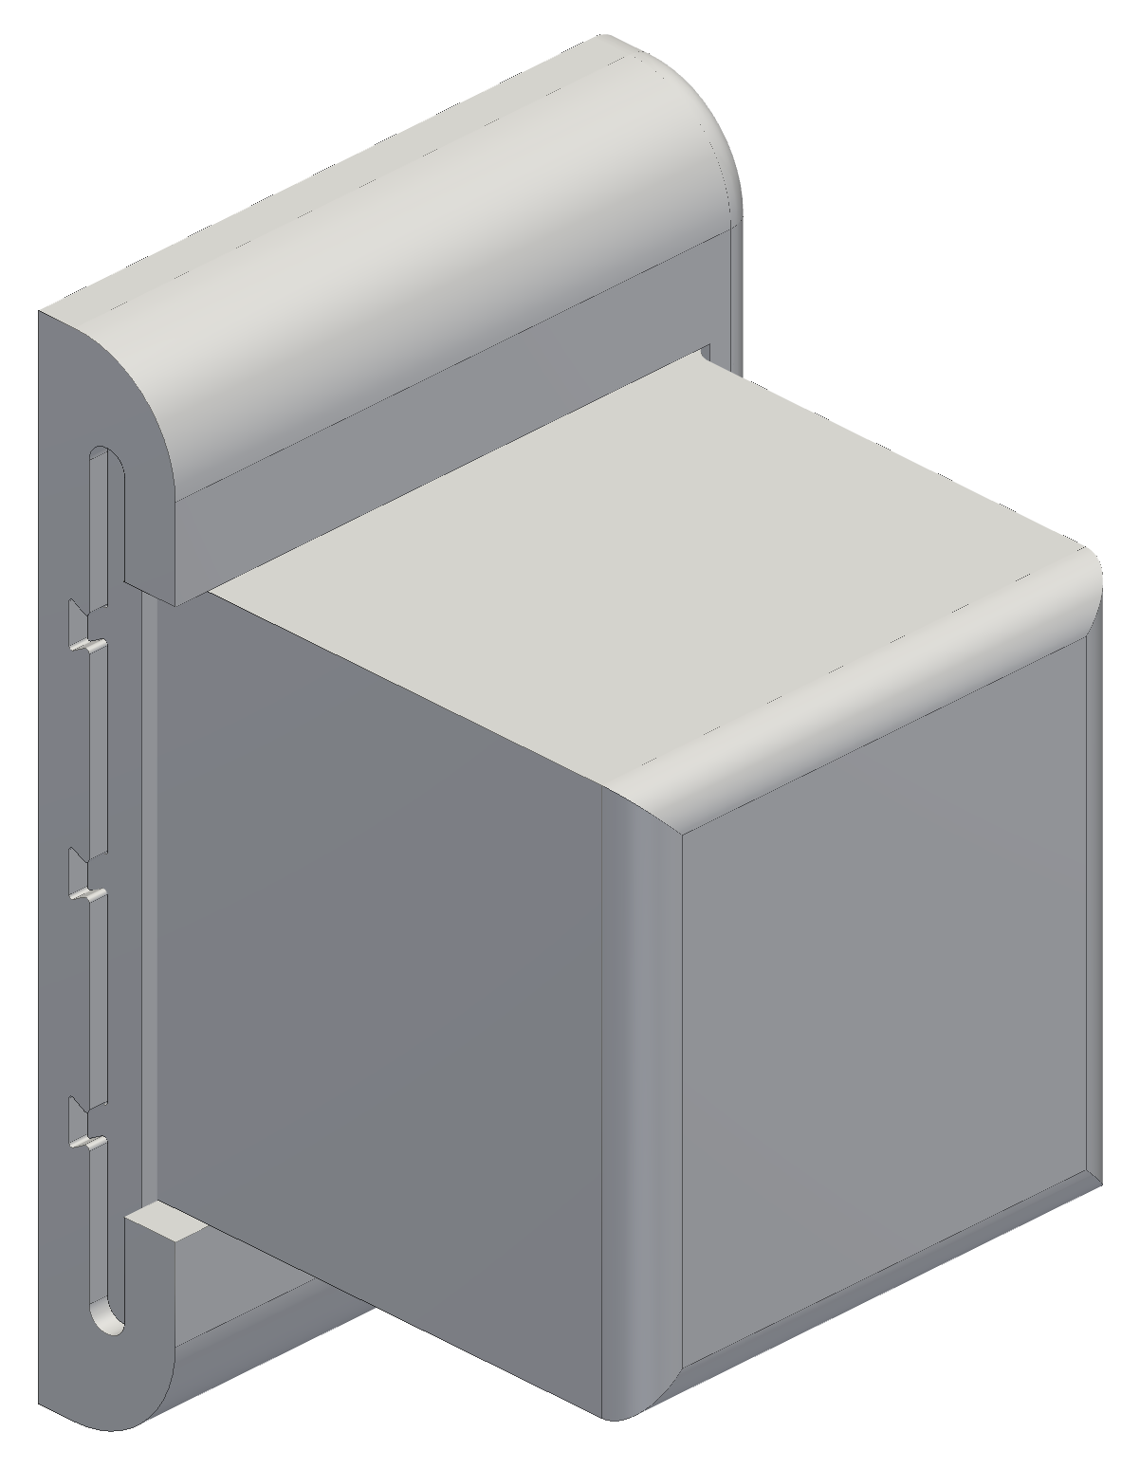
Done means jeans from anywhere on the floor into the hamper.
THE PROBLEM · WHAT DONE MEANS
0.9 kg
Provisional jeans payload plus 2 m/s²; first gate 1 lb
≤ 450 g
Claw mass budget
4 × studs
Stations designed to screw into wall studs
1 switch
The switched power strip is the only kill switch
Winch station v3
0 people
Nobody under the robot while it moves
Claw v6 with camera bay
Notes:
SAY: Done means a pair of jeans goes from anywhere on the floor into the hamper with nobody touching it.
NUMBERS: Payload 0.9 kg is a provisional screening reference for jeans (the first gate is 1 lb, 0.454 kg), plus 2 m/s² vertical acceleration. Claw mass budget 0.45 kg; the printed claw is estimated at 1.05 to 1.25 kg and has not been weighed. Four stations designed to screw into wall studs. The switched power strip is the only stop. Nobody under the robot.
LIKELY QUESTION 1: Why 0.9 kg?
ANSWER: It is a provisional screening reference for a pair of jeans, not a measured garment; the first physical test load is 1 lb. Weighing a representative pair is on my list.
LIKELY QUESTION 2: Your only stop is a power strip and cutting power drops the claw. What is the safety case, and what happens if a stepper skips?
ANSWER: It is a deliberate category-0 stop with no brake: cutting 12 V removes holding torque and the claw falls. The accepted mitigation is that nobody stands under the robot while it moves, with a 1 lb first gate and a slow final approach. In software a stop never disables: every fault and pause holds torque, only a disarm confirmed with the claw supported releases it, and nothing resumes after a reboot. No safety-rated function is claimed (ISO 13849 and IEC 61508 are not claimed); a controlled stop or a self-locking drive is a gen-3 item. Steppers can lose steps silently on a snag or shock; the four-station test requires no step loss and at most 2 mm per cable, and the station board has an encoder port, but none of this has run on four stations and the control behaviour is simulated only.

Slide 4
Cable angle sets the limits: walls bind at task height, ceiling above.
DECISION 04 · CABLE STATICS
CALCULATED
WANTED
Use the whole room.
1
REALIZED
32 N at 0.15 m depth, 8.3 N at 0.6 m.
2
DECIDED
Ceiling margin 0.4 m, plus a wall margin.
3
RESULT
Max 0.5 kg at 0.4 m, 1.1 kg at task height.
Winch design force 8.4–11.9 N
4
BUT
Claw mass counts like payload; 0.45 kg is a budget.
5
FUNDAMENTALS
T = W / (4 sin φ) (claw centred, equal share)
sin φ = d / √(d² + D_{h}²), D_{h} = 2.17 m, W = 8.86 N: T = 32.1 N at 0.15 m, 8.3 N at 0.60 m. Off-centre needs a linear program.
Notes:
SAY: Cable tension scales as one over the sine of the cable angle, so the limits come from cable geometry and the claw's own weight, not the payload: walls bind at task height and the ceiling binds above it.
NUMBERS: Centred claw, four equal shares: W = (0.454 + 0.45) kg x 9.81 = 8.86 N; D_h = 2.17 m (centre to corner of an 11 x 9 ft room). T = 32.1 / 16.2 / 8.3 / 4.6 N per cable at 0.15 / 0.30 / 0.60 / 1.20 m below the anchors; with +2 m/s² 38.6 / 19.4 / 10.0 / 5.5 N. Winch design force: 11.9 N if the 0.36 N·m rating is a one-phase figure (17.9 N running at a full spool, divided by a 1.5 skip margin) or 8.4 N if it is a two-phase rating; both are drawn on the chart. Whole-room worst case by linear program (best split, 0.2 m wall margin, one-phase basis, 1.5 margin): at the 0.4 m ceiling limit the largest tension is 2.42 x weight and the total the winches hold is 0.50 kg; at the highest task pose (0.99 m below the anchors) 1.10 x weight and 1.10 kg. On the two-phase basis those capacities are about 0.71 times lower (about 0.35 kg and 0.78 kg). The 0.45 kg claw is a budget; a printed claw of 1.05 to 1.25 kg would raise every tension (centred, 0.6 m: 13.8 to 15.7 N instead of 8.3 N).
LIKELY QUESTION 1: What about off-centre?
ANSWER: The four-cable split is statically indeterminate (four cables, three force equations), so I find the best split by a linear program that minimises the largest tension. The worst spot is high against the middle of a long wall; the equal-share table is a lower bound for any pose off the centre.
LIKELY QUESTION 2: Why a 0.4 m ceiling margin?
ANSWER: Tension doubles each time the depth halves, so the planner never lets the claw closer than 0.4 m to the anchors. At that limit the same linear program only allows 0.50 kg total (2.42 x weight) against 1.10 kg at task height, so the ceiling is the harder case and the margin is a floor, not a comfortable value.

Slide 5
The driver, not the motor, capped my pull; the fix is open.
DECISION 05 · DRIVE
MEASURED
CALCULATED
0.79–0.85 V → 0.99–1.06 A
WANTED
Raise current from 1.0 to 1.35 A.
1
Vref pot maximum (two readings) and the current it allows
REALIZED
Vref pot maxes at 0.85 V: 1.06 A cap.
2
Printed claw estimate 1,050–1,250 g (unweighed)
DECIDED
Run at the cap; open: core +25 %, or 3:1 gearing.
3
450 g budget
RESULT
Winches hold ≤ ~1.1 kg; claw plus jeans ~2 kg.
4
BUT
Full-spool pull 12.6–17.9 N; pull test decides.
5
FUNDAMENTALS
I = Vref / (8·R_{s}) = 0.85 V / 0.8 Ω = 1.06 A
PLANNED — not yet run
Luggage-scale pull at 1.06 A, empty and full spool; settles the 0.7 factor and one- vs two-phase torque.
τ_{run} = 0.7 τ_{hold}, with τ_{hold} = 0.255 N·m (one-phase) or 0.18 N·m (two-phase). T = τ / r: at r = 10 mm 17.9 or 12.6 N; at the core 23.8 or 16.8 N.
Notes:
SAY: My own numbers told me my claw outgrew my winches: the driver board caps the current at 1.06 A, and the fix, a smaller core, 3:1 gearing or a lighter payload, stays open until a pull test gives a real number.
NUMBERS: Vref pot maximum 0.85 V on the red R100 boards with 3.3 V logic (measured); a second reading on Oct 21 was 0.79 V, which gives 0.99 A and lowers every pull by 7 %. I = Vref / (8 Rs) = 0.85 / 0.8 = 1.06 A. Torque basis: the 0.36 N·m rating is for two coils at 1.5 A; scaled linearly it gives 0.255 N·m holding at 1.06 A. The driver limits the combined current, so if the rating is a two-phase figure the holding torque is 0.18 N·m. Running torque = 0.7 x holding (the 0.7 is assumed). Pull T = tau / r: 23.8 N at the 7.5 mm core and 17.9 N at a full 10 mm spool (one-phase); 16.8 N and 12.6 N (two-phase). Design force (divided by 1.5): 15.9 / 11.9 N one-phase, 11.2 / 8.4 N two-phase. Snag case (holding torque over core radius) 34 N, or 24 N two-phase. On the line centre rather than the outer surface the lever arms are 7.75 and 9.75 mm (23.0 and 18.3 N). Line diameter is assumed 0.5 mm and not yet measured (0.6 mm gives 17.0 N and 1.0 mm gives 12.3 N at a full spool). Largest claw that still lifts 0.9 kg of jeans at the highest task pose, one-phase upper bounds: 202 g (Ø15 core, 1.10 kg held), 397 g (Ø12), 478 g (Ø10, +25 %, but it needs a spool redesign for the set screw and tie-off), 570 g (Ø8, which fails the 20:1 bend ratio). Needed: 0.45 kg claw + 0.9 kg = 1.35 kg, which is 1.22 x what the Ø15 spool can hold. A printed claw of 1.05 to 1.25 kg gives 2.0 to 2.2 kg with jeans. A 3:1 reduction at each winch buys about 2.7 x (2.98 to 3.09 kg held at a 0.2 m wall margin).
LIKELY QUESTION 1: Your own numbers say the winches can't lift your claw plus jeans. Does the robot work, and why is 450 g still the requirement?
ANSWER: Not yet, and the deck says so. At 1.06 A direct drive the four winches hold about 1.1 kg total in the worst case at the highest task pose and 0.50 kg at the 0.4 m ceiling limit, and about 0.71 times less if the motor rating is a two-phase figure. The 1 lb test load plus the 0.45 kg budget claw is 0.9 kg. The printed claw is estimated at 1.05 to 1.25 kg and has not been weighed, so claw plus 1 lb is about 1.5 to 1.7 kg and claw plus jeans 2.0 to 2.2 kg. The options on record: a Ø10 core, +25 % (1.38 kg held); a 3:1 reduction at each winch, about 2.7 times (about 3 kg held); or a 0.3 to 0.5 kg payload for the demo. The first step is a 15-minute luggage-scale pull test, because the 0.7 running-torque factor is assumed and the true torque could be up to 1.4 times lower (two-phase rating); its result decides between these options. 450 g is the number the analysis assumed, not a weighed claw: the v6 gripper was 2.06 kg in CAD, the v7 head is 481 g in CAD, and weighing it is the next step.
LIKELY QUESTION 2: Why not raise Vref or run 5 V logic?
ANSWER: I do not want to modify the driver, and a 3.3 V GPIO cannot guarantee a HIGH into a 5 V-logic input. So I run at the board maximum and look for the pull in geometry or gearing: T = tau / r.
LIKELY QUESTION 3: How will the pull test settle it?
ANSWER: A luggage scale on one station at 1.06 A: holding peak by hand, then running pull before the motor skips, at 100, 200 and 400 steps/s, on the core and on a full spool. The test sheet runs full-step while the winches run 1/16 microstep, so that difference is noted. If the running pull at a full spool is about 25 N or more, direct drive might carry a lighter claw; under about 25 N (expected about 18 N) a 3:1 reduction is the way, with a lighter payload for the demo.

Slide 6
A sealed station would heat the motor mount, my most loaded joint.
DECISION 06 · HEAT
CALCULATED
WANTED
A clean, closed printed shell.
60 °C target
1
REALIZED
Holding stepper heats (I²R); PETG conducts 1/800 of aluminium.
2
DECIDED
Vents plus an aluminium fin.
3
RESULT
Sealed 64 to 46 °C with fin; vented 51 to 41 °C.
4
BUT
No thermometer data yet; vented hold test planned.
5
FUNDAMENTALS
P = I²R; R_{cond} = L / (k A); R_{conv} = 1 / (h A)
PLANNED — not yet run
Hold test, vented shell, 1.06 A: model predicts 41 °C (as-built fin); pass below 60 °C.
P = 1.06² × 1.8 Ω = 2.0 W (R assumed). Flange path: 5 mm PETG 14 K/W vs 3.2 mm aluminium 0.011 K/W (1260× = 800× k, 1.6× thickness).
Notes:
SAY: A sealed PETG shell would leave the motor one way out for its heat, through plastic that conducts about one eight-hundredth as well as aluminium, so the mount that carries the cable load would run hot; the shells are vented today, and a fin through the shell adds margin.
NUMBERS: A holding stepper dissipates P = I²R continuously: 1.0625² x 1.8 Ω = 2.0 W (the 1.8 Ω coil resistance is assumed and not yet measured). Conductivity: aluminium 160 vs PETG 0.2 W/m·K (800 x). Conduction resistance through the 42.3 mm square flange contact: 0.011 K/W for 3.2 mm aluminium vs 14.0 K/W for 5 mm PETG, 1260 x, which is 800 x from conductivity times 1.6 x from thickness. Two-node model at 23 °C ceiling air, h = 7 W/m²·K: sealed shell 64 °C with no fin, 46 °C with the as-built fin (carries 50 % of the heat), 40 °C with the drawn 1/8 in fin (68 %); vented 51 / 41 / 36 °C; open 47 / 39 / 35 °C. The sealed as-built case spans 45 to 49 °C over the h and conductivity ranges. Sealed-shell time constant 35 minutes, vented about 21 minutes. The planned hold test is on the vented shell: 60 minutes at 1.06 A, fin flattened, thermocouples on the motor case, fin and PETG tab, read at 60 minutes (about 94 % of the vented rise, about 82 % of a sealed one) against 0.94 x the 41 °C prediction; pass below 60 °C.
LIKELY QUESTION 1: At 1.06 A in a vented shell your chart shows 51 °C with no fin, under your 60 °C limit. Why a fin, and what have you measured?
ANSWER: The fin was sized when the plan was 1.35 A and a sealed shell (the review model gave 67 °C sealed with no fin at 1.0 A and 106 °C at 1.5 A). At the 1.06 A driver cap the thermal margin is large, so the fin now buys margin (vented 51 to 41 °C, sealed 64 to 46 °C) and keeps the loaded PETG tab cooler, which is the creep concern. Every temperature is calculated: coil resistance 1.8 Ω is assumed (1.5 Ω gives 0.83 times the rise), h is 5 to 9 W/m²K, the alloy and finish are unknown, and no thermometer reading exists. The planned test is a 60-minute hold on the vented shell with thermocouples on the motor case, fin and PETG tab, read at 60 minutes against 0.94 times the 41 °C prediction, pass below 60 °C. If the bare motor is already fine, the test says the fin is not earning its place.
LIKELY QUESTION 2: Why a fin and not a TMC2209 or lower current?
ANSWER: A design review listed seven options (vents, aluminium fin, clip-on sink, TMC2209 drivers, ASA shell, thermistor park, lower current); vents plus a fin was the biggest gain with no new electronics, and lower current costs pull, which slide 5 is already short of.
If you did this yourself, you can say it in the first person: "I weighed seven options and chose vents plus a fin because it was the biggest gain with no new electronics."

Slide 7

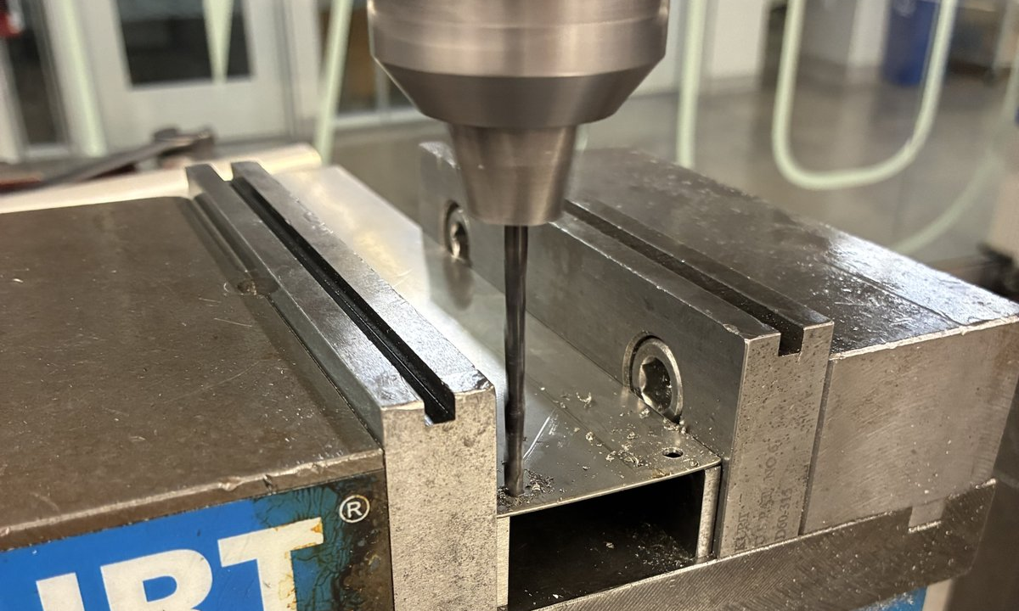
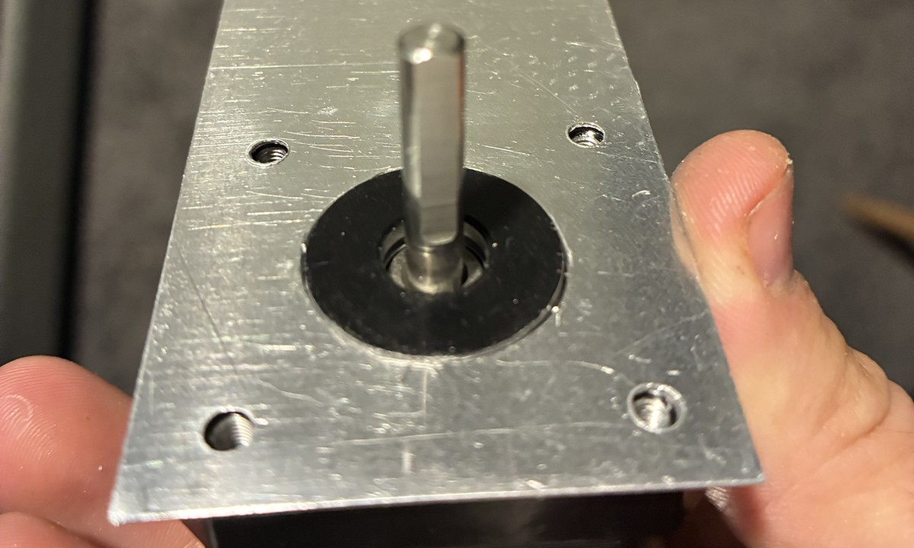
Drawn at 1/8-inch, built at 0.019-inch, then rechecked the physics.
DECISION 07 · BUILDING THE FIN
MEASURED
CALCULATED
WANTED
Drawing: 1/8 in plate, fin efficiency 74 %.
1
REALIZED
As built: 0.019 in (0.48 mm) sheet, not the 1/8 in drawn.
2
DECIDED
Re-ran the fin equation: 74 % falls to 37 %.
1 Sheared blanks, shop drawing
2 Drilling the holes on the mill
3
7/8 in hole
Fin efficiency η, %
RESULT
Still carries about half the heat: 46 °C.
4
BUT
May buzz; screws reach 2.7 mm deeper.
5
3 Fitted: boss centred, 4 holes line up
FUNDAMENTALS
η = tanh(mL) / (mL), m = √(2h / (k t))
PLANNED — not yet run
Hold test: does the thin sheet bow or buzz, and are the screw threads deep enough?
t = 0.483 mm: m = 13.5 /m, mL = 2.69, η = 37 %, R_{fin} = 22 K/W. Drawn 1/8 in: mL = 1.05, η = 74 %, R_{fin} = 10.9 K/W.
Notes:
SAY: The drawing called for 1/8-inch plate but the sheet that could be sheared and drilled on the bench was 0.019 inch, so before accepting it I re-ran the fin equation: efficiency drops from 74 to 37 percent, yet the fin still carries about half of the motor's heat.
NUMBERS: Fin parameter m = sqrt(2h/(k t)) with h = 7 W/m²·K, k = 160, L = 200 mm exposed. As built t = 0.483 mm: m = 13.5 /m, mL = 2.69, efficiency 37 % (33 to 43 % over h = 9 to 5), R_fin 22.1 K/W. Drawn t = 3.175 mm: m = 5.25, mL = 1.05, efficiency 74 % (70 to 80 %), R_fin 10.9 K/W. Sealed shell at 1.06 A: 46 °C (fin share 50 %) vs 40 °C (68 %) for the drawn plate, so the thin fin costs about 6 K. Assumptions: k = 160 W/m·K assumes an aluminium alloy that has not been confirmed (a magnet or file test would settle it), and h = 7 assumes a black fin; the as-built fin is bare metal, which runs hotter (about 41 to 43 °C vented, 46 to 50 °C sealed). Fit: 7/8 in (22.225 mm) centre hole over the 22.0 mm motor pilot boss, about 0.1 mm per side. Screws now reach 3.175 - 0.483 = 2.7 mm deeper into the motor.
LIKELY QUESTION 1: Why does a thinner fin still work?
ANSWER: The exposed area is the same, so the fin still carries about half the heat; the efficiency halves, so the sealed motor runs about 6 K hotter than with the drawn plate. I checked that before accepting the sheet.
LIKELY QUESTION 2: What tolerance did you reach?
ANSWER: The drawing calls for hole positions within 0.1 mm of each other in one setup; the finished part has not been caliper-checked yet.
If you did this yourself, you can say it in the first person: "I drew the 1/8-inch fin and built it from 0.019-inch sheet."

Slide 8
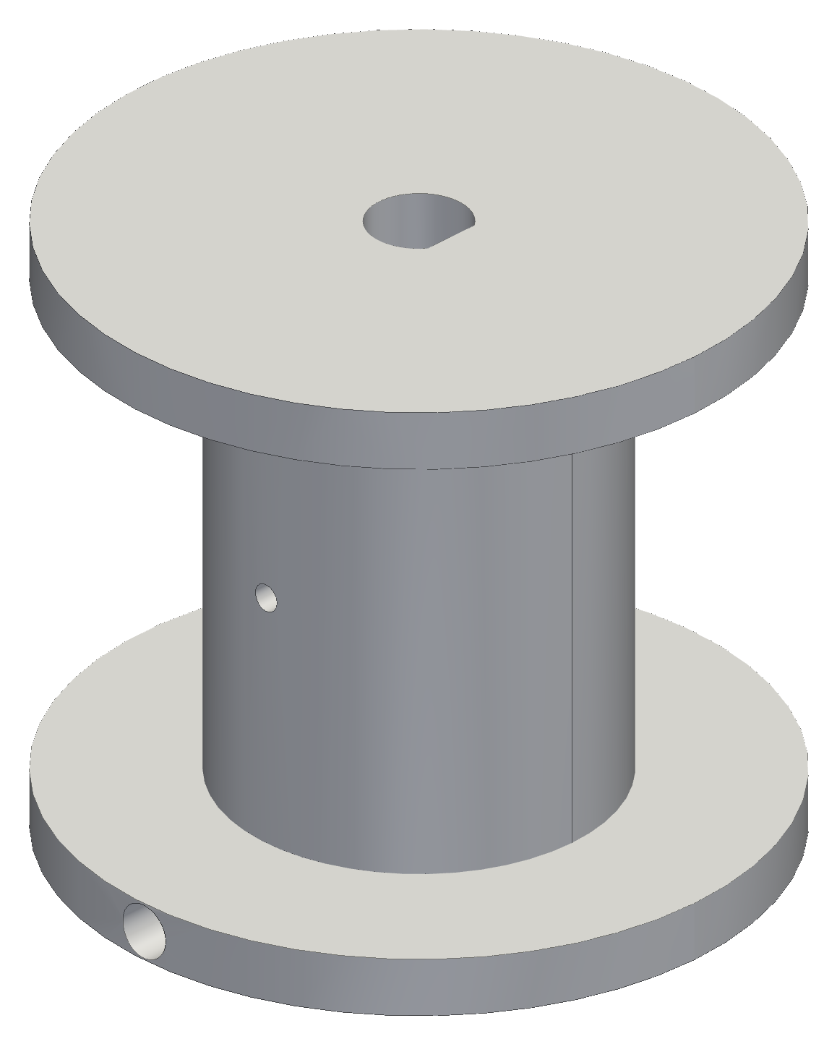


My first spool outran its motor shaft; the fix changed the math.
DECISION 08 · SPOOL
CALCULATED
WANTED
32 mm spool (26 mm drum) on a Ø20 core.
1
REALIZED
About 14.5 mm past the 24 mm shaft (CAD).
2
DECIDED
Ø15 core, 16 mm drum; radius tracks wound length.
3
RESULT
v2 bore too tight: Ø5.2 opened to Ø5.45.
4
Gen-1 spool
v2
v3
Ø20 core, 32 mm long
bore Ø5.2, too tight
Ø15 core, bore Ø5.45
BUT
Printed holes shrink; no caliper reading yet.
5
Ø20 → Ø15
32 → 22
Ø5.2 → Ø5.45
FUNDAMENTALS
core, mm
overall length, mm
bore, mm
r(n) = r₀ + n·d·p; T = τ / r(n); ℓ = 2πr
20 ft of line, diameter assumed 0.5 mm (not measured): 5 layers, r = 7.5 to 10 mm, T = 23.8 to 17.9 N (one-phase), line per rev 47 to 63 mm (+33 %).
Notes:
SAY: In CAD the first spool extended about 14.5 millimetres past the end of the motor shaft, and fixing that changed the layer count, the line force and the line paid out per revolution, so the controller models radius against wound length.
NUMBERS: Gen-1 spool: Ø20 core x 26 mm winding x 32 mm overall. Spool v3 (from the STEP): Ø36 flanges, Ø15 core (r = 7.5 mm), 16 mm drum, 22 mm overall, bore Ø5.45 with a 0.5 mm D-flat on the Ø5 shaft. The 14.5 mm overhang comes from the CAD dimensions (shaft projection 24 mm, winding starting at X = 4.5 for 32 mm overall), not from a caliper. 20 ft (6.096 m) of line, assumed 0.5 mm and not yet measured, at 85 % packing gives 5 layers and a full radius of 10 mm. Line force falls 23.8 to 17.9 N on the one-phase basis (slide 5); line per revolution 47.1 to 62.8 mm (+33 %). v2 bore Ø5.2 printed too tight on the Ø5.0 shaft; v3 opened to Ø5.45. Printed holes print undersize (bead rounding, shrink, elephant foot, mesh chords): Ø5.2 too tight means at least 0.2 mm was lost, so the Ø5.45 bore really leaves about 0.25 mm of clearance, not 0.45 mm. A fit coupon (54 holes from -0.10 to +0.30 mm in 0.05 steps at Ø5, Ø7 and Ø14, vertical and horizontal) is planned; none has been printed.
LIKELY QUESTION 1: How does the controller cope with the changing radius?
ANSWER: It uses radius as a function of wound length, r(n) = r0 + n d p, so the line paid out per step stays right as the spool fills; line per revolution changes by 33 % between the core layer and a full spool.
LIKELY QUESTION 2: Did you measure the printed bore?
ANSWER: Not with calipers yet. The v2 bore printed too tight on the 5 mm shaft, so v3 opened it from Ø5.2 to Ø5.45; a fit coupon is the planned fix for every printed hole.

Slide 9

Bead must not cross the pulley; verification caught rev C.
DECISION 09 · HOMING SWITCH
CALCULATED · CAD
WANTED
Bead on the line trips a home switch.
1
REALIZED
Mid-span, the bead rides over the pulley.
2
DECIDED
A drop arm under the pulley.
3
Bench switch, not rev D
RESULT
Rev C missed in X and Y; rev D overlaps 3.75 mm.
4
BUT
Never trip-tested on real line yet.
5
FUNDAMENTALS
Y overlap = (r_{bead} + r_{roller}) − Y_{roller}
PLANNED — not yet run
Trip test: 5 mm bead on real line against a printed rev D arm.
(2.5 + 2.25) − 1.0 = 3.75 mm, need ≥ 2.0 mm. Rev C: 5.0 mm off in X, 10.5 mm in Y. X error ≤ 1.0 mm across 18 to 22 mm pulleys.
Notes:
SAY: The bead on the line must never ride over the pulley, so the switch moved to a drop arm under it; a geometry check caught that the first drop-arm revision missed the line by 5 millimetres in X and 10.5 in Y, and rev D lands the roller on it.
NUMBERS: Rev C: roller at X = 70.0 against the line at 65.0, so 5.0 mm off in X (0.25 mm gap to the edge of a 5 mm bead, against a 1.5 mm overlap requirement) and 10.5 mm off in Y (no contact). Rev D: X error 0 at the nominal 20 mm pulley, 1.0 mm untuned at 18 and 22 mm (limit 1.0), 0 after the ±2 mm slot tune; Y: roller 1.0 mm, overlap (2.5 + 2.25) - 1.0 = 3.75 mm on a 5 mm bead (limit 2.0 mm). Roller envelope clear of the pulley and of printed material (0.000 mm³ interference). These are probes of the CAD solid, not a physical test; no rev D arm has been printed.
LIKELY QUESTION 1: How do you know it will trip?
ANSWER: I do not yet: rev D passes the geometric checks in CAD, but no bead has been run past a printed arm on real line. That trip test is the open item.
LIKELY QUESTION 2: Why a drop arm?
ANSWER: With the switch mid-span the bead had to ride over the pulley groove on every descent and every homing run. The groove is sized for 0.5 mm line, so a bead climbs the flanges or jams.
If you did this yourself, you can say it in the first person: "I saw that the bead would ride over the groove, and moved the switch to a drop arm under the pulley."

Slide 10
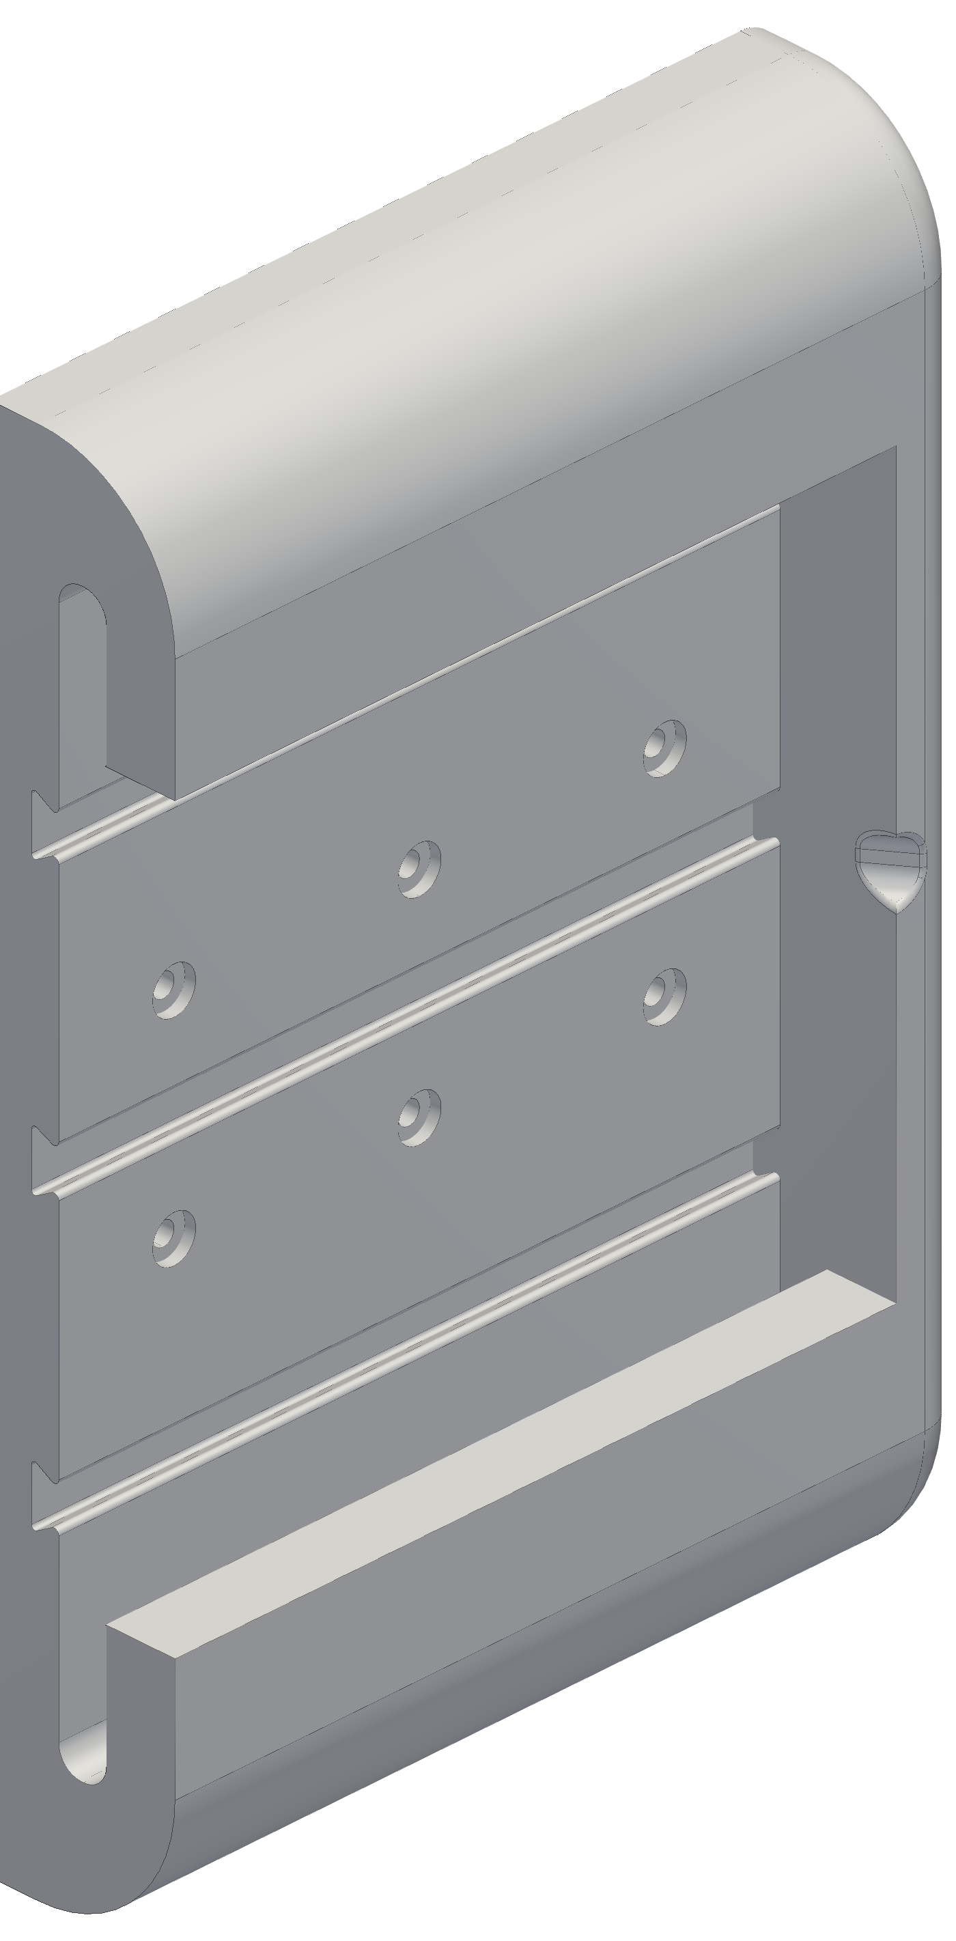
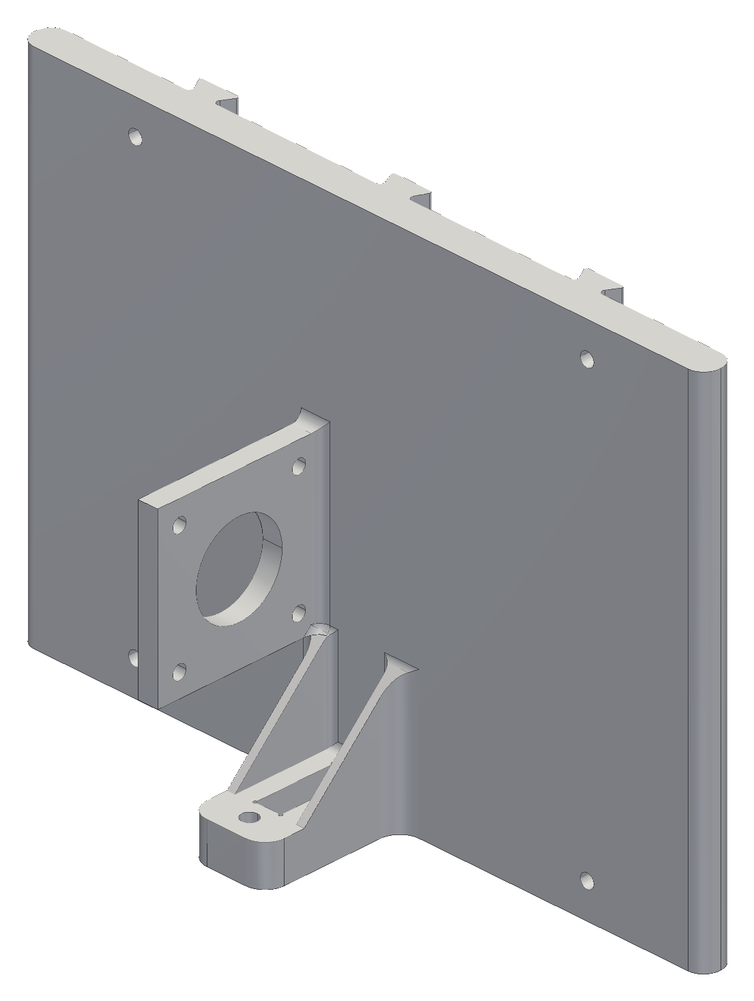
A removable station moves the anchor from a screw to a slide.
DECISION 10 · REMOVABLE STATION
CALCULATED
PLANNED
WANTED
Swap a station without re-calibrating the room.
1
REALIZED
Anchor error maps 1:1; studs see pull-out.
2
DECIDED
Fixed frame plus slide-in; target SF ≥ 3 at 34 N.
3
RESULT
Hand estimate: tab root 8–14 MPa vs 8.33 limit; study pending.
4
BUT
Statics can't see creep; pull test too.
5
Fixed wall frame
Slide-in housing
FUNDAMENTALS
σ = M c / I (rail root); δ = F L³ / (3 E I) (cable exit)
PLANNED — not yet run
SolidWorks linear static study (stress, safety factor, deflection) and a station-mount pull test.
Targets at the 34 N slip load (24 N if two-phase): σ ≤ 8.33 MPa (SF 3 on 25 MPa), ≤ 0.5 mm at the cable exit. Direct drive; 3:1 gearing adds ~2.7×.
Notes:
SAY: Making the station removable moved the anchor from a screw to a slide, and anchor error turns one-to-one into claw position error, so the slide-in is being stress-tested before I trust it.
NUMBERS: PLANNED, no results yet: SolidWorks linear static study of the station mount. Targets at the 34 N slip-limit load (24 N if the motor rating is two-phase, slide 5): peak von Mises at most 8.33 MPa (SF 3 on a 25 MPa derated yield; the same model at 68 N dynamic gives SF 1.5, which is the same check), first principal stress across layers at most 7.5 MPa, cable-exit displacement at most 0.5 mm. A hand estimate puts the motor-tab root at about 8 to 14 MPa with stress concentration, so the study is expected to find a design issue rather than confirm one. This is for direct drive at 1.06 A; with a 3:1 reduction the line load rises about 2.7 times (about 92 N) and the station study is repeated. The line pulls the station away from the wall, so the stud screws see mostly pull-out and prying, plus some shear from the vertical component of the line. Linear statics cannot see creep or layer-adhesion weakness, so a physical pull test closes the gap.
LIKELY QUESTION 1: What retains the slide-in, and what load did you check it against?
ANSWER: Today the slide-in is held by three dovetail ribs and J-lips; a positive lock is still an open item. The 34 N check is the motor-tab stress check, not a retention check.
LIKELY QUESTION 2: Why not keep the screwed-down anchor?
ANSWER: A hook or loose anchor wanders and that error goes 1:1 into claw position, so I bolted the corner down first; service then needs removable stations without re-calibrating the room, so the anchor moved onto a fixed frame and the housing slides in.

Slide 11
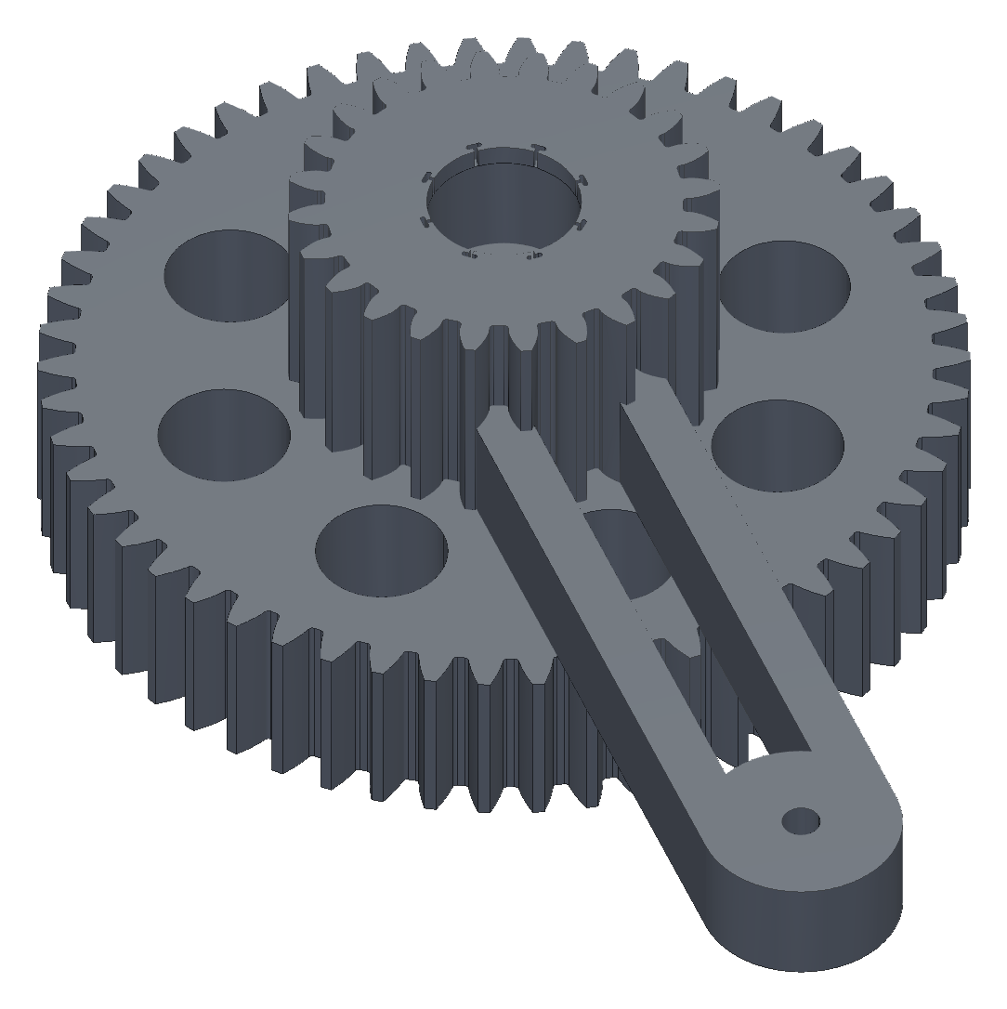
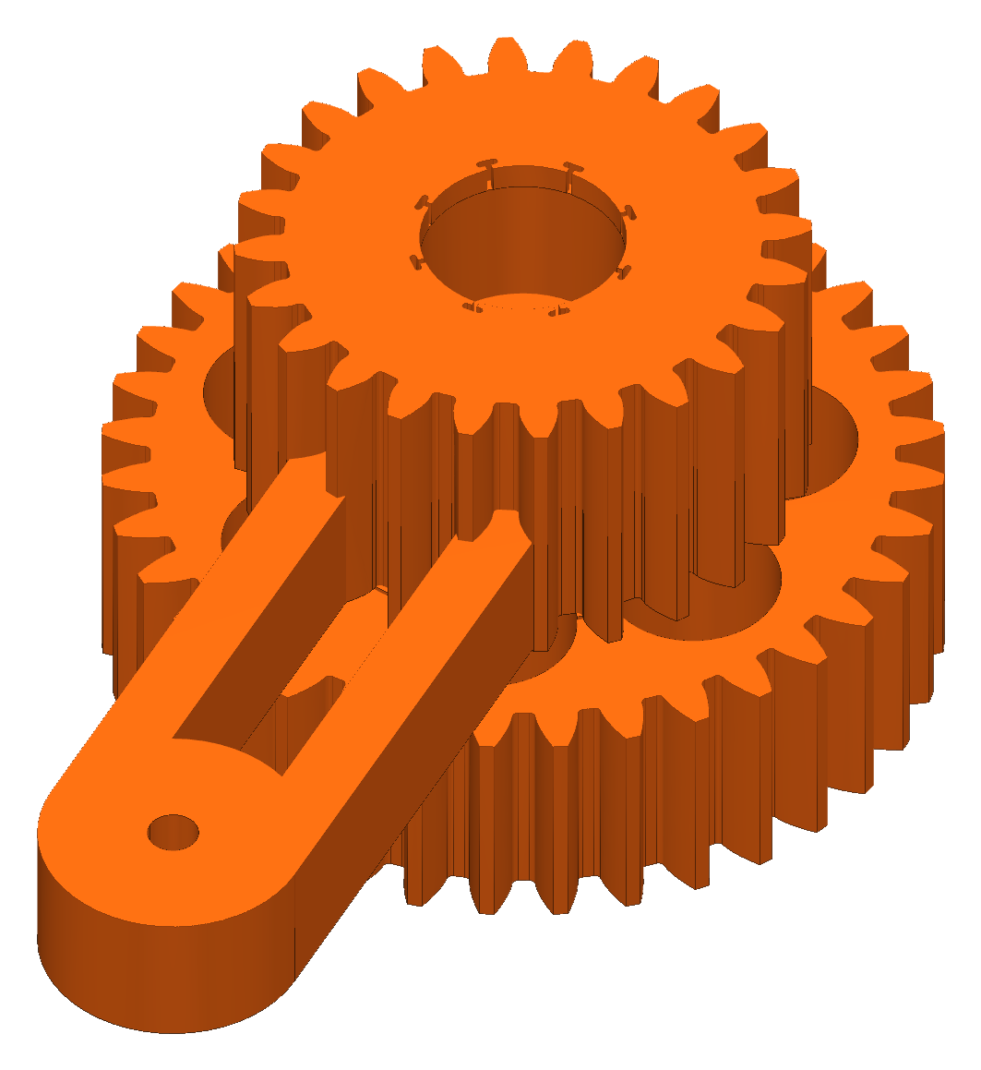
A clamp stalls the servo every grip; teeth are checked at stall.
DECISION 11 · GRIPPER
CALCULATED
SIMULATED
Bars: needed per jaw · Dashed lines: jaw force available
WANTED
Five soft tendon fingers.
1
25.0 N at a 70 mm grab
REALIZED
A clamp is simpler but stalls the servo.
2
13.3 N weakest position
DECIDED
Module 1.5, 2:1 ratio, 36T gear rebuilt from my v6 gears.
3
RESULT
Gears 157 g to 96 g; 257 checks pass with conditions.
4
BUT
Jeans at μ 0.3 need 17.7 N; jaws give 13.3–25 N.
5
My v6 compound, 3:1
Rebuilt v6r, 2:1
FUNDAMENTALS
σ = F_{t} / (b·m·Y); N ≥ m(g + a) / (2μ)
gear set 157 g (CAD)
gear set 96 g (CAD)
Module 1: SF 0.35–0.41 at stall; module 1.5: teeth 2.0–2.5, 36T web 1.7. Jeans: 0.9 × 11.81 / (2 × 0.3) = 17.7 N per jaw.
Notes:
SAY: A clamp does not stop at a position, it stops when the servo stalls, so every grip loads the gear teeth at full stall torque; the teeth are checked at that moment, and the train was rebuilt at 2:1 when the v6 inspection showed the claw far over its mass budget.
NUMBERS: MG996R stall 9.4 kg·cm at 4.8 V (0.922 N·m) and 11.0 kg·cm at 6.0 V (1.079 N·m). Lewis bending: F_t = 2 tau / (m z), sigma = F_t / (b m Y), allowable 22.5 MPa (half of 45 MPa PETG for layer adhesion and fatigue). Module 1, 6 mm face, 18T pinion at 6 V: F_t = 119.9 N, 64.7 MPa, SF 0.35 (0.41 at 4.8 V). Module 1.5, 16 mm face (18 / 36 / 24 / 24 teeth): pinion SF 2.40 / 2.05, 36T gear 2.93 / 2.50, sync gear 2.34 / 2.00 at 4.8 / 6.0 V (the 24T sync gear at 6 V is 1.997, accepted as inside the precision of the assumed stall torque); these are tooth checks only, and the spoked 36T web is SF 1.7 as a conservative bound. Ratio 2:1: jaw torque 0.83 N·m, stroke 76.5 degrees; 3:1 would give 1.25 N·m, 51 degrees and a sync-gear SF of 1.56 (1.33 at 6 V). The v6 inspection found the gripper at about 2.06 kg against the 450 g budget (4.6 x). The 157 g to 96 g comparison is between the original and the rebuilt v6 gear sets (CAD), checked at 257 geometry checks with conditions; the safety factors above are for the v7 gear train in backup B6. Grip: N >= m (g + a) / (2 mu): 1 lb needs 8.9 N per jaw at mu 0.3 (4.5 N at 0.6); jeans need 17.7 N (8.9 N at 0.6). Jaw force at 4.8 V: 13.3 N at the weakest position (gap 0.6 mm) to 25.0 N at a 70 mm grab; 17 % more at 6 V. Margin at the weakest point: 1 lb 1.5 x; jeans at mu 0.3 0.75 x (short); they need a grab of at least 43 mm (22 mm at 6 V).
LIKELY QUESTION 1: Is the jaw force measured?
ANSWER: No. It is simulated from the four-bar model (efficiency 0.95 per mesh, no pivot friction); there is no force-gauge reading and no printed gear has been stalled. Pad-to-cloth friction has never been measured, which is why TPU pads are planned and a pull test is the first thing to run.
LIKELY QUESTION 2: Why 2:1 instead of 3:1?
ANSWER: Mass and the sync gear: 3:1 loads the sync gear to a margin of 1.3 to 1.6, and the v6 gripper was 4.6 x over the mass budget.
If you did this yourself, you can say it in the first person: "I rebuilt my v6 gears at 2:1 with a 36T gear and an R53 crank, and kept my press-fit bearing pockets."

Slide 12
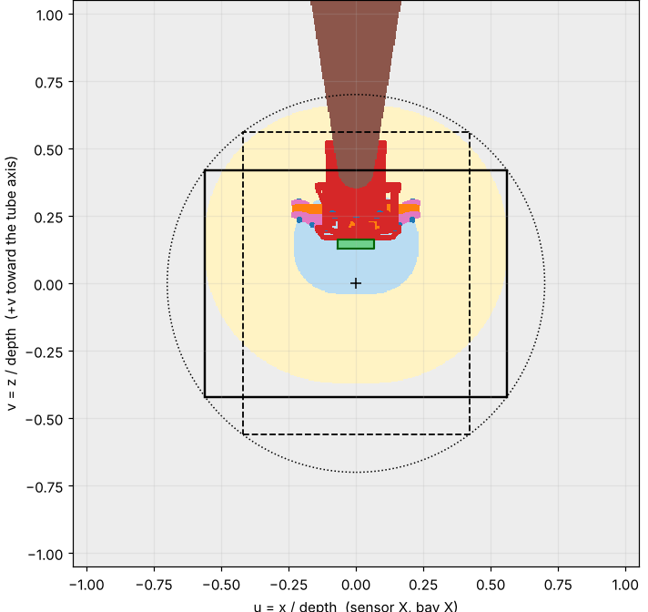
The camera can't see the grasp at contact, and that's fine.
DECISION 12 · CAMERA AND TUBE
CALCULATED
SIMULATED
WANTED
Long aluminium arm; camera sees the jaws.
Camera bay
1
REALIZED
At contact, a plate hides the grasp spot.
2
DECIDED
Cut 50 mm of tube, not 100 mm.
3
RESULT
Visible from 140 mm hover (was 172); saves ~33 g.
4
BUT
Last ~14 cm is blind; add a hover correction.
5
FUNDAMENTALS
D* = (k (H₀ − c) − 93) / (1 − k), k = 1 − 59.5/97
Camera view, 50 mm cut, 140 mm hover; green box = grasp zone. Render: v6 head (superseded).
k = 0.387, H₀ = 512 mm: c = 0 gives D* = 171 mm (ray-cast 172), c = 50 mm gives 140 mm. Saved 33 g assumes a 3 mm wall.
Notes:
SAY: I wanted the camera to see everything, but at the moment of contact the gearbox plate hides the grasp spot, so 50 millimetres of tube were cut and a short visual correction step is added at the hover.
NUMBERS: Similar triangles: a ray from the lens (512.06 mm above the floor with the jaw tips down, 90 mm off the tube axis) to the far edge of the grasp zone (97 mm from the lens) passes the plate face (59.5 mm from the lens) at k = 1 - 59.5/97 = 0.3866 of the lens height. Minimum hover D* = (k (H0 - c) - 93) / (1 - k): 171.1 mm uncut, 139.6 mm with a 50 mm cut (ray-cast scan over the CAD: 172 and 140 mm), 108 mm at 100 mm cut. Each mm of cut lowers D* by 0.63 mm and saves 0.65 g on the assumed 3 mm CAD wall (32.5 g for 50 mm; a 1 mm wall would save about 12 g); the tube can be cut up to 206 mm before the hub meets the head plates. In the 140 mm hover view the grasp zone is 100 % visible and the claw blocks 9.2 % of the 4:3 view with open jaws (7.6 % closed). The render shown is the v6 head, now superseded; the view figure is the current head with the 50 mm cut. Why aluminium: a long printed arm under constant load creeps and would slowly shift the camera against the jaws; same tube, same 10 N tip load: 0.04 mm in aluminium vs 1.32 mm in PETG (33 x). Collars and press fits are a stress-relaxation problem, so the tube joints need a positive cross-bolt lock. The tube wall (3 mm in CAD, 28.54 mm OD) and the alloy are not yet measured.
LIKELY QUESTION 1: Why not cut 100 mm?
ANSWER: We can always cut more; a cut cannot be undone. 50 mm already brings the hover from 171 to 140 mm and saves about 33 g. A shorter tube also shrinks the view and lowers the cable tie-offs toward furniture.
LIKELY QUESTION 2: What about a pile of laundry?
ANSWER: A pile raises the floor, so the required hover rises by the pile height; the model assumes a flat bare floor and a claw hanging still.

Slide 13

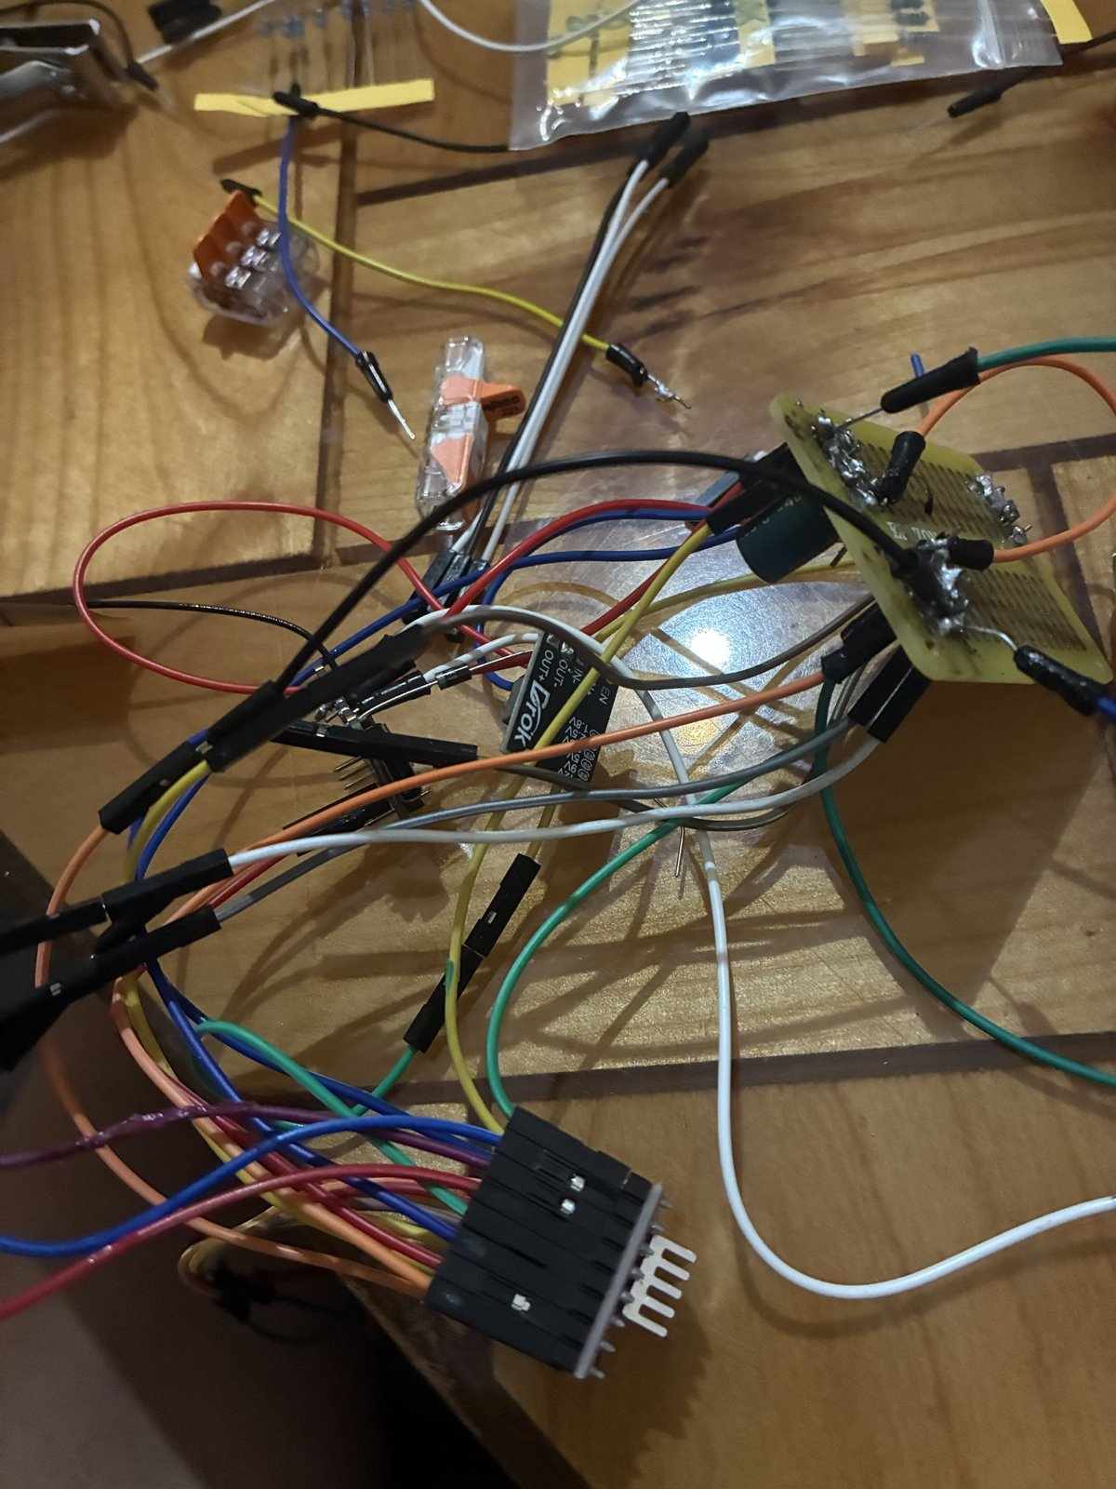
One controller per winch removes long harnesses; a review priced sync.
DECISION 13 · DISTRIBUTED ELECTRONICS
CALCULATED
SIMULATED
WANTED
July: one controller; synchronised motion came free.
1
REALIZED
32 ft harnesses; skew becomes force on four cables.
2
DECIDED
Host plans; stations run timed segments, own clocks.
3
RESULT
Control logic simulated only.
4
BUT
Not yet run on four stations.
5
GEN 1 · central
GEN 2 · per winch
FUNDAMENTALS
Δℓ = v·Δt; F = k·Δℓ; V = I·ρ·2L / A
PLANNED — not yet run
Four stations, 1 lb, 300 mm at 50 mm/s: pass if each cable is within 2 mm.
50 mm/s × 50 ms = 2.5 mm; assumed 3 N/mm gives 7.5 N (upper bound). 16 AWG, 32 ft, 2 A (illustrative): 0.51 V drop (18 AWG: 0.82 V).
Notes:
SAY: In July the plan was one controller so synchronised motion came for free; in October long harnesses argued for one controller per winch, and a design review priced the cost: every millisecond of skew becomes force on four over-constrained cables.
NUMBERS: Skew: 50 mm/s x 50 ms = 2.5 mm of length error (the 50 ms Wi-Fi skew is assumed); with an assumed line stiffness of 3 N/mm (E A / L over a 3 m run, an effective modulus of about 46 GPa), F = 7.5 N, an upper bound because the error would redistribute over the other three cables; about 90 % of the static tension at 0.6 m depth (8.3 N). The 2 mm pass criterion is 6 N, which a 40 ms skew at full speed produces. Wire: 32 ft (9.75 m) one way, 12 V label, 2 A (illustrative): 18 AWG drops 0.82 V (6.8 %), 16 AWG 0.51 V (4.3 %); 16 AWG is preferred for the long run and is not yet purchased. Architecture (simulated): the host plans; stations execute Hermite segments on their own clocks with path-time feed-hold and leases; stop never disables; no automatic resume. Simulated: lease-aligned stop spread about 18 ms; 10/10 lossy motions completed at 2 to 5 % packet loss. The photos show the gen-1 central controller (CNC shield with four A4988 drivers) and the gen-2 per-winch wiring.
LIKELY QUESTION 1: What is feed-hold?
ANSWER: A coordinated stop in path time: all four stations ramp their path rate to zero along the same geometric path, so the claw decelerates along the path instead of one winch stopping first.
LIKELY QUESTION 2: Has it run on four stations?
ANSWER: No. The control logic is simulated only; the four-station test (1 lb, 300 mm at 50 mm/s, within 2 mm per cable) is planned and its pass criteria are written first.
If you did this yourself, you can say it in the first person: "I priced the cost of timing skew and chose one controller per winch."

Slide 14
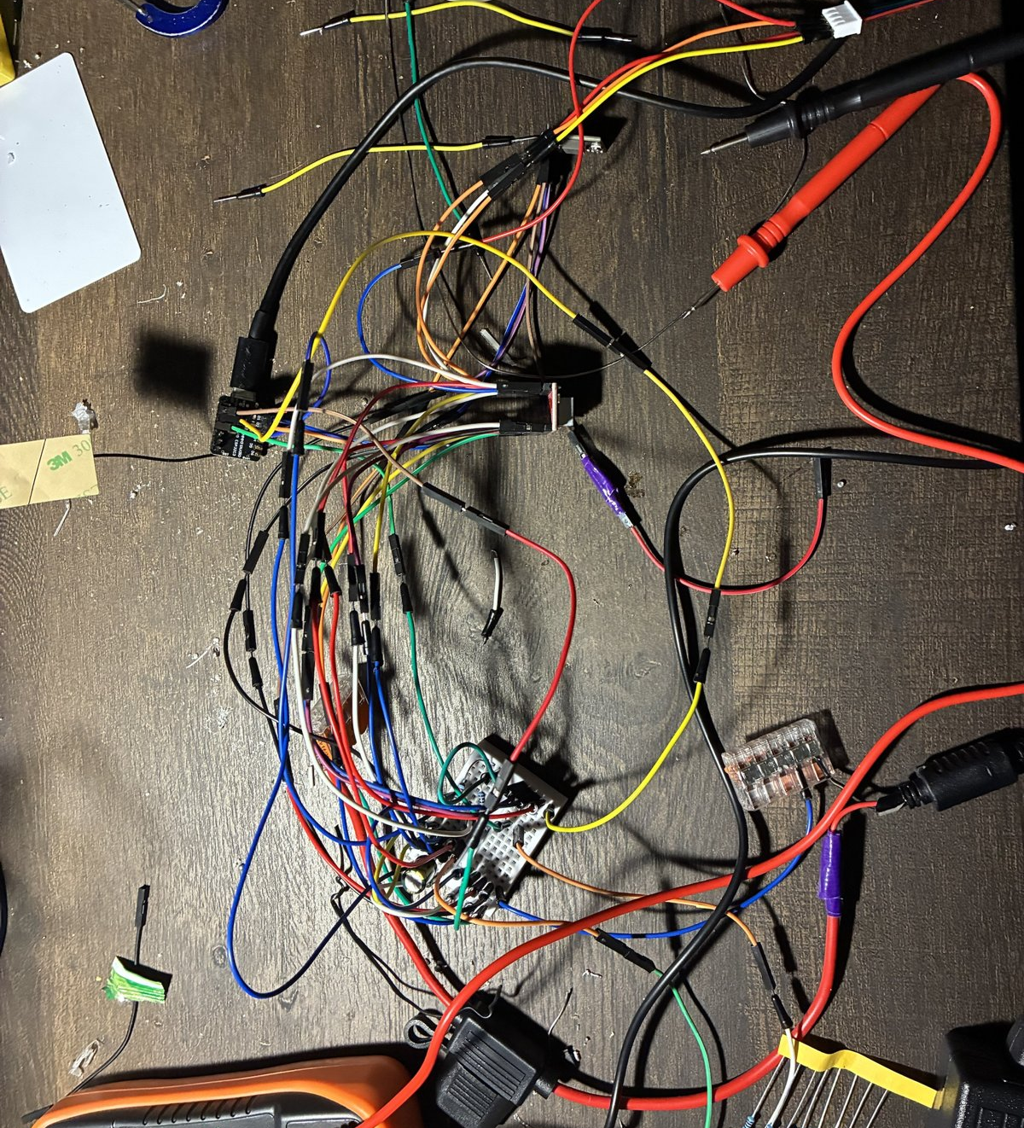
A motor that wouldn't move taught me to measure before coding.
DECISION 14 · BRING-UP
MEASURED
WANTED
First motion on the new station board.
1
3.3 V
REALIZED
Pulses sent, shaft still; logic rail read 1.14 V.
expected on the logic rail
2
DECIDED
Solder 3.3 V; pull resistors; JP1; measure VDD.
3
1.14 V
RESULT
Motor moved after repair; Rev D layout net-checked, not built.
4
read on my meter (not logged)
BUT
As-built board still needs its meter checklist.
5
FUNDAMENTALS
I = Vref / (8·R_{s}) = 0.85 V / 0.8 Ω = 1.06 A
PLANNED — not yet run
Meter checklist on the as-built board: VDD, SLEEP, ENABLE and the buck output.
Meter first: logic rail 1.14 V read against 3.3 V expected. The same habit on Oct 21 found the Vref pot topping out at 0.85 V.
Notes:
SAY: The log said the driver was stepping, but the meter said the 3.3 volt logic rail was 1.14 volts; since then I measure the supply before I touch the code.
NUMBERS: Command log: pulses sent, ENABLE toggled 3.3 to 0 to 3.3 V; shaft did not move; logic rail 1.14 V (expected 3.3 V) from a poor 3.3 V connection; the reading was taken on the bench meter and not logged or photographed. After the 3.3 V connection was repaired on the earlier board the motor moved. Oct 21: the same habit caught a second limit, the Vref pot maxing at 0.85 V (1.06 A). Rev D fixes (layout only, not yet built): 3.3 V soldered rather than jumpered; 10 k pull resistors (R1 EN pull-up so the A4988 boots disabled; R2 and R3 STEP and DIR pull-downs); JP1 link with diode D1 (1N5819) so USB and the buck never fight; a measure-VDD step in the bring-up procedure; 100 µF bulk capacitor on VMOT. The layout is net-checked by script: every hole has exactly one net and every net is connected. Buck output to be checked at 5.00 V before connecting loads.
LIKELY QUESTION 1: Did the motor move after the repair?
ANSWER: Yes, on the earlier board once the 3.3 V connection was repaired. The Rev D board is a net-checked layout and has not been built yet, so its meter checklist is still planned.
LIKELY QUESTION 2: Is the supply safe for the buck?
ANSWER: The bench reading was 18 V while the brick label says 12 V and the DROK input limit is 20 V; whether that was an open-circuit reading is still to be re-measured under load.

Slide 15
I stopped buying precision and moved the safety into margins.
DECISION 15 · CALIBRATION
CALCULATED
SIMULATED
WANTED
Absolute cable lengths from vision alone.
1
250 mm pitch
REALIZED
One tag errs 6.6 mm/frame; cable σ stays above 12 mm.
2
DECIDED
Margins carry safety; probe slack; drop the IMU.
3
RESULT
Simulated: 6/6 startups; 3 of 6 reach full trust.
4
BUT
Claw tilts 13–21° near corners; all simulated.
5
2 tags in view: 4.9 mrad; 4 tags: 1.3 mrad
6.6 mm → 0.7 mm
FUNDAMENTALS
δx = σ_{θ}·L; σ_{N} = σ / √N
per-frame lever-arm error at 0.51 m: one tag vs four tags in view (two tags: 2.5 mm)
One tag: 12.9 mrad × 0.51 m = 6.6 mm. Four tags in view: 1.32 mrad × 0.51 m = 0.68 mm; two tags: 4.85 mrad = 2.5 mm.
Notes:
SAY: I stopped trying to buy precision and moved the safety into margins: ceiling and wall margins carry it, and a floor board plus a one-cable-at-a-time slack probe makes the calibration honest.
NUMBERS: Lever-arm error dx = sigma_theta x L. One 152.4 mm tag at 0.51 m with 0.3 px corner noise: 12.9 mrad, 6.6 mm per frame; tilt noise 10.5 / 17.9 / 31.8 / 49.7 mrad at 0.46 / 0.6 / 0.8 / 1.0 m. A floor board of 150 mm tags on a 0.25 m pitch: with four tags in view 1.32 mrad, 0.68 mm (about 10 x better, the best case); with two tags in view 4.85 mrad, 2.5 mm (about 2.7 x better). Simulated: 6/6 startups, 91 to 97 % of slack readings resolved, predicted sigma 12 to 16 mm, 3 of 6 runs reach full-room trust. The 0.7 mm is the per-frame attitude lever-arm error; the absolute cable-length uncertainty is a different quantity and stays at 12 to 16 mm in simulation, above the 12 mm bead overtravel. Decisions: margins carry the safety, reel each cable in turn (no motion means slack), no IMU on the claw. A converged optimiser is not acceptance: in the one-cable toy both fits had a whitened residual near 1.0, yet the anchor range and length offset were 9 x less identifiable in the small excitation box.
LIKELY QUESTION 1: Why is calibration sigma above the overtravel if the board is 0.7 mm?
ANSWER: 0.7 mm is the per-frame attitude lever-arm error with four tags in view; the absolute cable-length uncertainty is a different quantity, predicted at 12 to 16 mm in simulation. That is why the safety rides on ceiling and wall margins rather than on precision.
LIKELY QUESTION 2: Why does tilt matter?
ANSWER: The claw hangs tilted near the corners: 12.9 degrees at the largest with the recorded centre-of-mass depth of 0.196 m (stale) and 20.7 degrees with the lumped estimate for the current head (0.116 m); 83 to 92 % of grid points exceed 5 degrees. So the grip-tilt rule needs a decision before tilt gates grips across the room.

Slide 16
Measured, calculated, simulated, planned: the test that decides the rest.
EVIDENCE SO FAR
MEASURED | CALCULATED | SIMULATED | PLANNED, with pass limits
Vref pot maximum 0.79–0.85 V One motor on all four driver channels Buck output 5.00 V Logic rail 1.14 V (the fault) Observed, not instrument-measured Fin test-fits on the motor (visual) 18 V read at the supply vs 12 V label (re-measure) | Cable statics, 32 to 4.6 N Gear stress (Lewis) Fin efficiency, 74 % to 37 % Wire drop, 0.51 V Grip force required per jaw | Control system and sync Startup calibration Camera view vs tube length Jaw force, four-bar model | Hold test, vented shell: motor case below 60 °C Winch pull test (luggage scale), empty and full spool Station-mount pull test SolidWorks station study: SF ≥ 3 at 34 N, ≤ 0.5 mm 1 lb, four stations, 300 mm at 50 mm/s: ≤ 2 mm per cable
FIRST TEST
Luggage-scale pull at 1.06 A, empty and full spool; under about 25 N points to a 3:1 reduction (decision open).
Also: confirm VDD = 3.3 V at the driver and measure the line diameter.
Notes:
SAY: Here is what I have actually measured, what is calculated, what is simulated, and the specific tests that decide the rest, each with its pass limit.
NUMBERS: Measured: Vref pot maximum 0.79 to 0.85 V; one motor turned on all four driver channels; buck 5.00 V; logic rail 1.14 V (the fault). Observed, not instrument-measured: the fin test-fits on the motor; 18 V read at the supply against a 12 V label (to re-measure under load). Calculated: statics, Lewis, fin, wire drop, grip force required. Simulated: control system, calibration, camera view, four-bar jaw force. Planned: hold test (60 minutes, vented shell, motor case below 60 °C); winch pull test (luggage scale, empty and full spool); station-mount pull test; SolidWorks station study (SF at least 3, deflection at most 0.5 mm); 1 lb on four stations, 300 mm at 50 mm/s, within 2 mm per cable. Also to confirm: VDD = 3.3 V at the driver, and the line diameter.
LIKELY QUESTION 1: What is the first test you would run?
ANSWER: The 15-minute luggage-scale pull test at 1.06 A, empty and full spool, because it replaces the assumed 0.7 running-torque factor: a running pull of about 25 N or more at a full spool means the direct drive might carry a lighter claw, under about 25 N (expected about 18 N) points to the 3:1 reduction; then the hold test.
LIKELY QUESTION 2: Which number are you least sure of?
ANSWER: The claw mass: the budget is 0.45 kg but the printed claw is estimated at 1.05 to 1.25 kg and has not been weighed, and every capacity number rests on it.

Slide 17
My best decisions were deletions.
WHAT I DELETED, WHAT I LEARNED
DELETED
THREE LESSONS
−
The IMU
01
Measure before you trust a margin
−
Five fingers, now two jaws
The 0.85 V Vref cap and the 1.14 V rail
−
50 mm of tube
02
Print the coupon before the part
−
The housing block, now an open frame (−560 g, CAD)
The spool bore: Ø5.2 became Ø5.45
−
The 5 lb reserve: a 1 lb gate first
03
Stall is the design case
Gear stall and motor holding heat, not the average
With half the time again: buy pulleys and couplers sooner, and build one station to test before four.
jasper_buntinx@tamu.edu
Notes:
SAY: My best decisions were deletions: every part I removed was a part that could not fail, so I measured, deleted, and then simplified.
NUMBERS: Deleted: the IMU; five fingers became two jaws; 50 mm of tube (32.5 g, assuming the 3 mm CAD wall); the housing block replaced by an open frame (head 1,044 g to 481 g, about -560 g in CAD); the 5 lb reserve target, with a 1 lb gate first. Lessons: measure before you trust a margin (Vref 0.85 V, the 1.14 V rail); print the coupon before the part (spool bore Ø5.2 to Ø5.45; a 54-hole coupon is planned); stall and steady state are the design cases (gear stall; motor holding heat). With half the time again: buy pulleys and couplers sooner; build one station to test before four.
LIKELY QUESTION: What would you do differently?
ANSWER: Buy standard pulleys and couplers instead of designing them, and build and test one complete station before building four.

Slide 18
Jaw force is lowest closed and over 3× higher near full open.
BACKUP B1 · JAW KINEMATICS
SIMULATED
CALCULATED
76.5°
jaw stroke from a 153° servo (2:1)
91.6 mm
17.7 N: jeans, μ 0.3
open gap, closed gap 0.000 mm
8.9 N: 1 lb, μ 0.3
0.83 N·m
jaw torque at 4.8 V stall
Near full open the four-bar nears toggle: the effective lever arm shrinks (59 mm at a 10 mm gap, 33 mm at 70 mm) and force rises. No toggle inside the stroke.
FUNDAMENTALS
F_{jaw} = τ_{jaw} / r_{eff}; τ_{jaw} = N·τ_{in}·η² / 2
τ_{jaw} = 2 × 0.922 N·m × 0.95² / 2 = 0.83 N·m. r_{eff} = 59, 48, 33 mm at 10, 40, 70 mm gap, so F = 14.1, 17.2, 25.0 N.
Notes:
SAY: The four-bar jaw gives the least force when it is closed and more than three times as much near full open, because the effective lever arm shrinks as the gap widens.
NUMBERS: Jaw force per jaw at 4.8 V from the four-bar model: 13.3 N at 0.6 mm gap, 14.1 @ 10, 15.0 @ 20, 17.2 @ 40, 21.1 @ 60, 25.0 @ 70, 33.4 @ 80, 43.6 @ 85 mm. Effective lever arm 59 / 48 / 33 mm at 10 / 40 / 70 mm gap. Jaw torque 0.83 N·m at 4.8 V (N = 2, 0.95 efficiency per mesh); stroke 76.5° from a 153° servo; open gap 91.6 mm; closed gap 0.000 mm; max jaw tilt 2.59°. Requirements: 8.9 N for 1 lb at mu 0.3, 17.7 N for 0.9 kg jeans at mu 0.3 (8.9 N at 0.6).
LIKELY QUESTION 1: Is there a toggle in the stroke?
ANSWER: No: the gap is monotonic over the whole 76.5° stroke. Near full open the linkage approaches toggle, which is why force rises steeply there (43.6 N at an 85 mm gap).
LIKELY QUESTION 2: Is this measured?
ANSWER: No. It is simulated from the model (no pivot friction, 0.95 efficiency per mesh); there is no force-gauge reading yet.

Slide 19
The host plans; each station executes, and stop never disables.
BACKUP B2 · CONTROL ARCHITECTURE
SIMULATED
HOST
STATION 1
STATION 2
≈ 18 ms
Planner
Own clock
Own clock
timed
segments
feed-hold · lease
feed-hold · lease
stop spread across stations (simulated)
Plans the path and sends timed segments
STATION 3
STATION 4
10 / 10
Own clock
Own clock
feed-hold · lease
feed-hold · lease
lossy motions completed at 2–5 % packet loss (sim)
Feed-hold in path time
Lease
Stop never disables
All four stations ramp to zero along the same geometric path.
No valid host message in time: the station holds and tells its peers.
Faults and pause hold torque. Only a confirmed disarm releases the load.
Notes:
SAY: The host plans the path and sends timed segments; each station executes them on its own clock, holds on any fault or lost host, and a stop never disables a motor.
NUMBERS: Segments are Hermite segments executed in each station's own clock; the host estimates each station's clock offset and refuses motion unless the clock uncertainty is within its limit. Feed-hold names a path time and the host resends it every 20 ms to any station still running, so one lost datagram cannot leave a winch running while three hold. Lease: no valid host message within the lease time and the station holds itself and broadcasts the hold to its peers. Simulated: lease-aligned stop spread about 18 ms; 10/10 lossy motions complete at 2 to 5 % packet loss. Skew pricing: 2.5 mm per 50 ms at 50 mm/s is about 7.5 N (assumed stiffness). Pass test (planned): 1 lb on four stations, 300 mm at 50 mm/s, within 2 mm per cable.
LIKELY QUESTION: Why not disable the drivers on a fault?
ANSWER: There is no brake, so disabling a driver drops the load. Every fault and pause holds torque; only a disarm confirmed with the claw supported removes it. The power strip is the only category-0 stop and no safety-rated function is claimed.

Slide 20
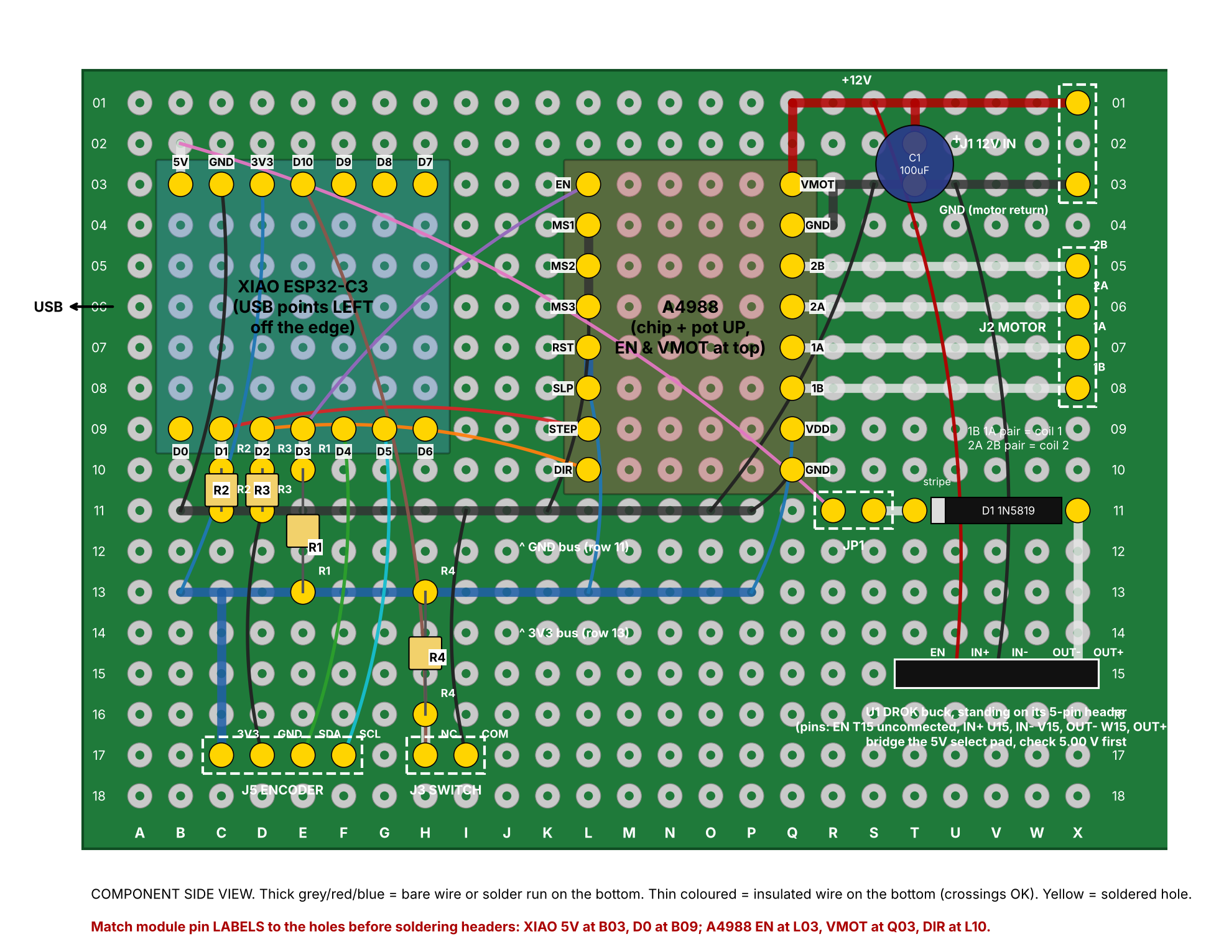
Rev D: soldered 3.3 V, driver boots disabled, no USB-buck fight.
BACKUP B3 · REV D STATION BOARD
PLANNED
WHAT REV D CHANGED
3.3 V soldered, not jumpered.
10 k pull resistors: the driver boots disabled.
JP1 and diode D1: USB and the buck never fight.
Net-checked: every hole has one net, every net is connected.
JP1 link
R1 pull-up
3V3 bus
PLANNED — not yet run
Meter checklist on the as-built board: VDD, SLEEP, ENABLE, buck output.
Notes:
SAY: Rev D fixes the failure from decision 14 on the board itself: the 3.3 volt rail is soldered, the driver boots disabled through a pull-up, and a link and diode keep USB and the buck from fighting.
NUMBERS: 5 x 7 cm perfboard, component-side view, holes named column letter + row number. R1 10 k EN pull-up so the A4988 boots disabled; R2 10 k STEP pull-down; R3 10 k DIR pull-down; R4 10 k switch pull-up. JP1 with D1 1N5819 between the XIAO 5 V side and the buck output. DROK buck standing on its 5-pin header: select 5 V by bridging its 5V pad and check 5.00 V before connecting loads. 3V3 bus row 13, GND bus row 11. C1 100 µF/50 V across VMOT. J1 12 V in, J2 motor, J3 switch, J5 encoder. The layout drawing is net-checked by a script; the as-built board has not been built or metered yet.
LIKELY QUESTION: How do you know the board is right?
ANSWER: The layout is net-checked by a script: every hole has exactly one net and every net is connected. That is a drawing check, not a measurement; the as-built board still needs its meter checklist (VDD, SLEEP, ENABLE, buck output).

Slide 21
Floor board cuts tilt noise up to 10×; hanging tilt still 13–21°.
BACKUP B4 · FLOOR-BOARD ATTITUDE STUDY
CALCULATED
SIMULATED
HANGING TILT AT GRID POINTS (°)
TILT NOISE, ONE TAG, VS RANGE (mrad)
Board: 2 tags 4.9, 4 tags 1.3 mrad
FUNDAMENTALS
θ ≈ M_{v} / (W·L); δx = σ_{θ}·L
Corner tilt grows 1.61× when L falls from 0.196 to 0.116 m; 83 % then 92 % of grid points exceed 5°. Four tags in view: 0.68 mm vs 6.6 mm for one tag.
Notes:
SAY: A multi-tag floor board cuts the tilt noise by up to ten times, but the hanging claw still tilts between 13 and 21 degrees near the corners because of where its centre of mass sits.
NUMBERS: Tilt noise for one 152.4 mm tag at 0.46 / 0.6 / 0.8 / 1.0 m: 10.5 / 17.9 / 31.8 / 49.7 mrad (matches the project's Monte Carlo). Floor board with the camera centred over it: four tags in view 1.32 mrad, 0.68 mm lever-arm error at 0.51 m (9.8 x better than 12.9 mrad, 6.6 mm); two tags in view 4.85 mrad, 2.5 mm. Mean of 1 / 4 / 10 / 30 frames (one tag): 12.9 / 6.5 / 4.1 / 2.4 mrad; a static 1 mrad bias still leaves 0.5 mm. Hanging tilt (force and moment balance on four straight lines, 9 x 7 grid): centre-of-mass depth 0.196 m (recorded, stale): centre 0.0°, median 8.7°, largest 12.9°, 83 % of points above 5°; 0.116 m (lumped estimate for the current head, range 0.09 to 0.14 m): median 13.8°, largest 20.7°, 92 % above 5°. Agrees with the project's attitude predictor to numerical precision at five poses.
LIKELY QUESTION 1: Which depth should I quote?
ANSWER: Neither as final: the recorded 0.196 m belongs to the superseded v6 head; the 0.116 m estimate is a rough lumped figure. The centre of mass needs re-extracting from the CAD and the study rerunning.
LIKELY QUESTION 2: How good is the noise model?
ANSWER: It assumes independent Gaussian corner noise (0.3 px), fronto-parallel tags and a 520 px focal length (a camera guess); real corner noise is unmeasured.

Slide 22
The fin is a parallel heat path; PETG alone can't carry it.
BACKUP B5 · THERMAL NETWORK
CALCULATED
PLANNED
MOTOR CASE
12 K/W
SHELL INTERIOR
3.5 K/W sealed
ROOM AIR
PETG VS ALUMINIUM
2.0 W of coil heat
+ 1.5 W electronics
23 °C near the ceiling
 | Aluminium | PETG
k, W/m·K | 160 | 0.2
Flange path, K/W | 0.011 | 14.0
Spread, mm | 74 | 2.6
Aluminium fin: 22.1 K/W as built, 10.9 K/W as drawn
PLANNED — not yet run
Sealed shell, 1.06 A: 64 °C with no fin, 46 °C with the as-built fin, 40 °C with the drawn 1/8 in fin.
Fin FEA after the SolidWorks study; the hold test replaces the lumped model.
FUNDAMENTALS
P_{m} = (T_{m} − T_{room}) / R_{fin} + (T_{m} − T_{shell}) / R_{ma}
Equal geometry: √(160 / 0.2) = 28×; spreading lengths are for a 0.48 mm sheet. Flange path, 5 mm PETG vs 3.2 mm aluminium: 1260× = 800× from k × 1.6× from thickness.
Notes:
SAY: The motor has two ways out: through the printed shell, which is slow, and through the aluminium fin straight to room air; the fin is the parallel path that keeps the case cooler.
NUMBERS: Two-node network: motor case to shell interior 12 K/W; shell interior to room 0 / 1 / 3.5 K/W for open / vented / sealed; fin as a second path from the motor case to the room, with 1 K/W contact resistance at the flange. P = 1.0625² x 1.8 = 2.03 W (R assumed); 1.5 W of electronics also heat the shell. Fin as built (0.483 mm): m = 13.5 /m, efficiency 37 %, R_fin 22.1 K/W (19.4 to 26.4 over h = 9 to 5). Drawn (3.175 mm): 74 %, 10.9 K/W. Temperatures (h = 7, 23 °C room): open 47 / 39 / 35; vented 51 / 41 / 36; sealed 64 / 46 / 40 for no fin / as built / drawn. Spreading length 74 mm in 0.48 mm aluminium vs 2.6 mm in 0.48 mm PETG; long-fin resistance 22 K/W (0.48 mm Al) vs 182 K/W (5 mm PETG). A 60-minute hold covers about 94 % of the vented rise (about 82 % sealed); read it against 0.94 x the prediction.
LIKELY QUESTION: Why not let the PETG mount sink the heat?
ANSWER: At equal geometry aluminium conducts 28 x better (the square root of 160 / 0.2), and through the flange contact the PETG path is 14.0 K/W against 0.011 K/W (1260 x, which includes the 5 mm vs 3.2 mm thickness). Heat in PETG dies out within a few millimetres of the motor, so the PETG around the motor bolts climbs toward the motor temperature while it carries the cable load.

Slide 23
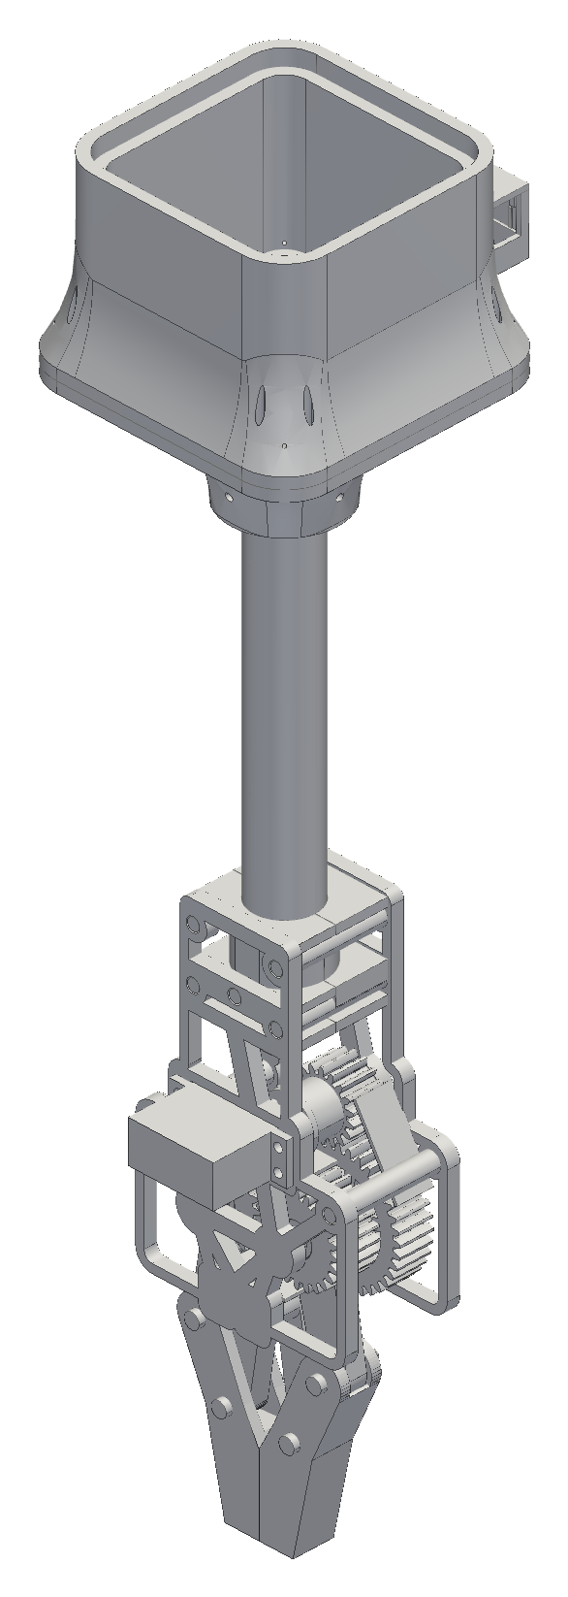
Open-frame v7 gearbox holds SF of about 2 or better at stall.
BACKUP B6 · V7 OPEN-FRAME GEARBOX
CALCULATED
SIMULATED
VERIFIED (REV 2)
Frame 143.5 g (limit 150 g).
Printed total 333 g; head 481 g.
72 checks pass; no interference over the sweep.
Open: servo ear pitch 47.0 vs 48.3 mm.
FUNDAMENTALS
SF = σ_{allow} / σ; σ = F_{t} / (b·m·Y)
σ_{allow} = 22.5 MPa. At 6 V stall F_{t} = 79.9 N: pinion 11.0 MPa, SF 2.05. Sync gear, one jaw takes all: F_{t} = 113.9 N, SF 1.997.
Notes:
SAY: The open-frame v7 gearbox is the alternative that replaced the housing block; at stall every gear sits at a safety factor of about two or better.
NUMBERS: Module 1.5; teeth 18 / 36 / 24 / 24; face widths 15.7 and 20 mm; PETG allowable 22.5 MPa. Safety factor at 4.8 / 6.0 V: pinion 2.40 / 2.05; 36T gear 2.93 / 2.50; 24T sync gear (one jaw takes all) 2.34 / 2.00 (1.997 at 6 V, accepted as inside the precision of the stall torque). Frame 143.5 g (78.7 + 64.8; limit 150 g); printed total 332.8 g; head 481 g with purchased parts. Re-verification: 72 tests pass; interference over the full sweep 0.000 mm³; jaw travel 76.5°. The verdict is pass with conditions.
LIKELY QUESTION: What is still open?
ANSWER: The servo ear pitch (47.0 mm in the plate vs 48.3 mm in the interface definition) must be measured on hardware; the Ø9.7 race ring and the Ø3.3 insert hole cannot be checked from CAD; purchased fastener masses are assumed; flank clearance 0.1994 / 0.1997 mm and the 1.997 sync SF are accepted conditions.

Slide 24


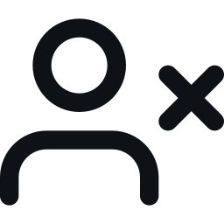
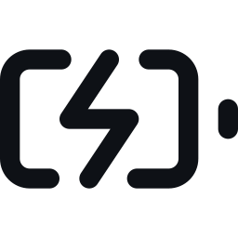
Safety: one hard stop, anchors in studs, nobody underneath.
BACKUP B7 · SAFETY
One hard stop
Stud anchors
Nobody under it
Balance charging
The switched power strip is the only stop. Faults and pause hold torque.
Designed to screw into wall studs; screw pattern vs stud width and slide-in retention are still open. Line load is mostly pull-out and prying, plus some shear.
Nobody stands under the robot while it moves.
Charge the 2S LiPo with a matched balance charger, pack off the robot.
No safety-rated function is claimed (ISO 13849 and IEC 61508 are not claimed).
Notes:
SAY: There is one hard stop, the switched power strip; the stations are designed to anchor into studs; nobody stands under the robot; and the LiPo is balance-charged off the robot.
NUMBERS: Stop never disables: every fault and pause holds torque; only a disarm confirmed with the claw supported removes it; the power strip is the only category-0 stop; no safety-rated function is claimed (ISO 13849 and IEC 61508 are not claimed). Stations: the line pulls the station away from the wall, so the stud screws see mostly pull-out and prying plus some shear from the vertical component of the line; the screw pattern against the stud width and a positive lock on the slide-in are still open; the SolidWorks study and the pull test are planned (slide 10). No AC mains inside printed housings. Claw battery: 2S LiPo, charged with a matched external 2S balance charger with the pack removed from the robot; a protection board is not a charger.
LIKELY QUESTION 1: Is this a safety-rated system?
ANSWER: No. It is a hobby prototype with a single hard stop (the strip) and a rule that nobody is under it; load-bearing, high-speed or energy-storage parts need qualified supervision and controlled testing before use.
LIKELY QUESTION 2: Your only stop is a power strip and cutting power drops the claw. What is the safety case, and what happens if a stepper skips?
ANSWER: It is a deliberate category-0 stop with no brake: cutting 12 V removes holding torque and the claw falls. The accepted mitigation is that nobody stands under the robot while it moves, with a 1 lb first gate and a slow final approach. In software a stop never disables: every fault and pause holds torque, only a disarm confirmed with the claw supported releases it, and nothing resumes after a reboot. No safety-rated function is claimed (ISO 13849 and IEC 61508 are not claimed); a controlled stop or a self-locking drive is a gen-3 item. Steppers can lose steps silently on a snag or shock; the four-station test requires no step loss and at most 2 mm per cable, and the station board has an encoder port, but none of this has run on four stations and the control behaviour is simulated only.

