Slide 1

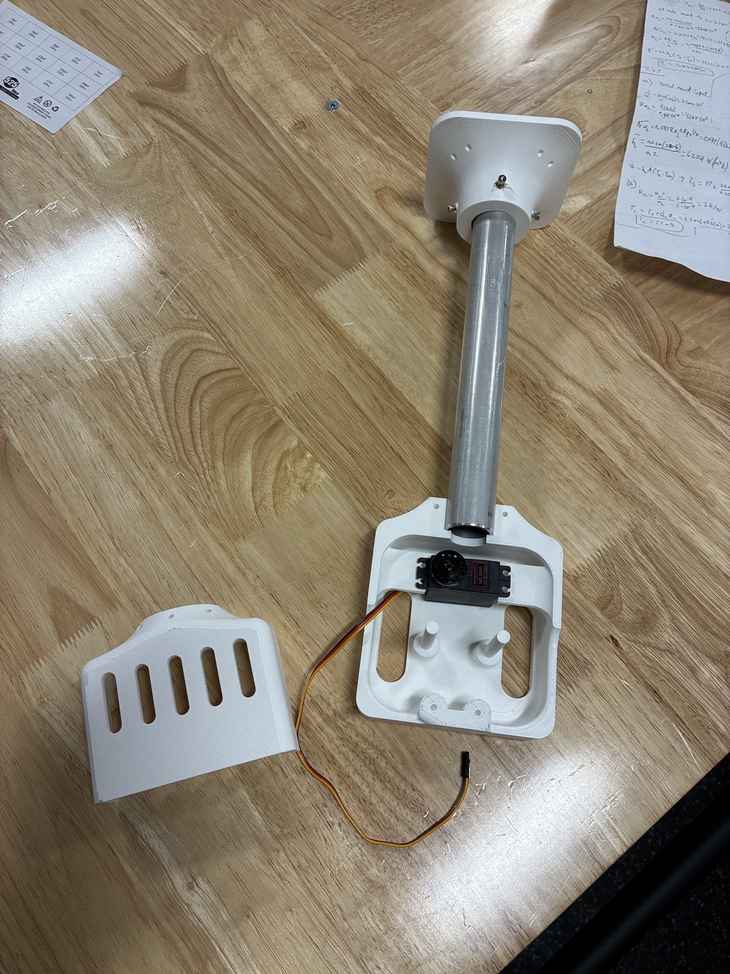
RoomCleaner
A cable robot that picks laundry off the floor
Jasper Buntinx
Mechanical Engineering, Texas A&M University
October 27, 2026
Notes:
One sentence: four winches near the ceiling corners hold one claw on cables; it picks clothes off the floor and drops them in a hamper. Then straight to who I am.

Slide 2
INTRO › DESIGN › BUILD › TEST › LESSONS
About Me
Education: Mechanical Engineering, Texas A&M · [graduation: Month 20XX]
EcoFil: filament recycler (shredder, dryer, extruder)
Sculpture: Austin Creek Show · fiber laser, welding
Outside class: [hobbies, interests]
Why this project: [one line]
[Photo of you building: EcoFil, a sculpture, or the workshop]
Notes:
One minute. Degree and graduation date, EcoFil (what each stage does, what you learned), the sculptures (fiber laser and welding: real fabrication), one hobby. Close with why a laundry robot: a problem you have, and a machine you could build end to end yourself.

Slide 3
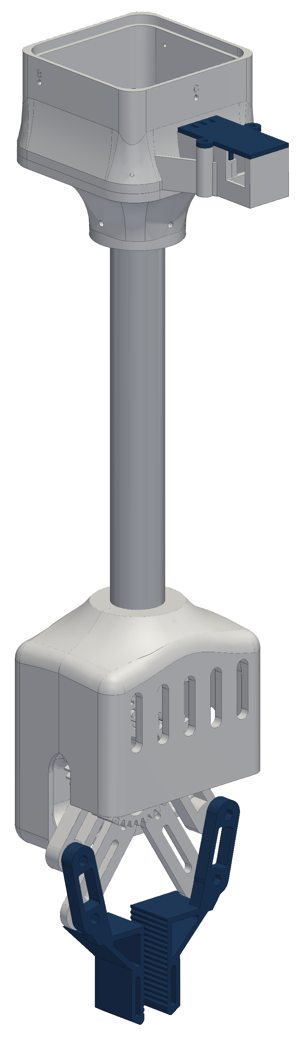
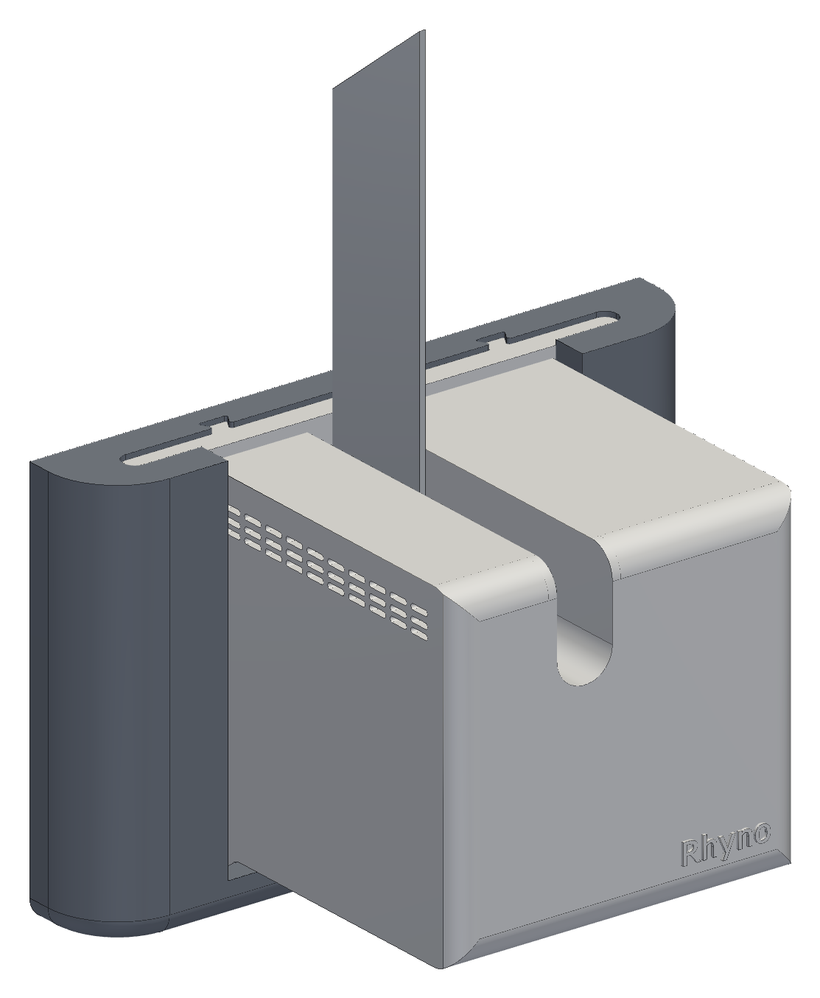
INTRO › DESIGN › BUILD › TEST › LESSONS
The Goal
Task: floor → hamper, 11 × 9 ft room
How: 4 ceiling winches, 1 claw on cables
Load: jeans 0.9 kg at 2 m/s² · test 1 lb
Build: printed PETG (polyethylene terephthalate glycol), hobby budget
What “done” means
Gate 1
One station runs repeatably
Gate 2
Stations hold and move 1 lb
Gate 3
One garment into the hamper
Now: gate 1 passed on the bench, gate 2 is this week’s test
Final design (CAD): a wall station and the claw
Notes:
Why a cable robot: it covers the whole floor, nothing stands on the floor, and the moving mass is small. Safety rules: stations anchor into studs, the switched power strip is the one hard stop, nobody stands under the robot. 0.9 kg is a screening figure for jeans; the first physical test is 1 lb. The claw tube is 10.5 in.

Slide 4
INTRO › DESIGN › BUILD › TEST › LESSONS
Scope and Timeline
Jul 16
Aug 6 – Sep 2
Sep – Oct 6
Oct 7 – 21
Oct 22 – 27
Concept
Requirements, simulator, parts list
Gen 1
Corner plates, one central controller, finger claw
Rethink
Sensors per winch, wiring, line outlets
Gen 2 → final
SolidWorks: station v1→v3, spool v1→v3, claw → four-bar
Build and test
Print, wire, three-station test
Design
Design
Build
Test
Design
Design
Build
Test
Build
Test
Me: a solo project (team of one)
Bought or outside
Requirements, calculations and test plans
All CAD (computer-aided design) in SolidWorks: stations, spool, claw, fin
3D printing and fits; the heat fin on the shear and manual mill
Wiring, soldering, electronics bring-up and debugging
Control software: [confirm the parts you wrote]
Stepper motors, drivers, controller boards
Servo, camera, battery, encoder boards
Garment detector: YOLO-World, an open-source model
Help: [shop access or mentors, if any]
Notes:
About 15 weeks, alone. Gen 1 (August) worked on the bench: corner plates, one central controller board, a finger claw. September to early October was the rethink that drove gen 2: sensors at every winch, the wiring that caused, and the line outlets. Gen 2 in October went through three station and three spool versions to the final design on Oct 21. This week: build and the first test. Say plainly what is mine and what is bought. [Confirm the start date (git shows Jul 16) and what happened in September.]

Slide 5
INTRO › DESIGN › BUILD › TEST › LESSONS
How It Works
Simulated end to end
4 wall stations: winch, encoder, fin, controller
1 claw: gripper, camera, battery
Laptop: plans + checks every move
Phone: start · PAUSE · approve
Phone app
Start, PAUSE, and a “yes” before every move
Supervisor · laptop
One robot state; refuses commands that do not fit it
Startup and tasks · laptop
Calibrate; then scan, grip, check, deliver
Claw
sends camera frames; grips only when approved
Planner · laptop
Checks every path point, then streams time-stamped moves
Wall stations · a controller in each
Step the motor, watch the encoder, hold if the link drops
Commands flow down; status and camera frames flow back up.
Notes:
Zoomed out: only the bottom layer turns a motor. The phone asks the supervisor; the supervisor holds one robot state; the planner checks every point of a path before anything moves; the stations run the motion on their own clocks and hold if the laptop goes quiet. The claw is a camera plus a gripper that obeys. Details are in the backup slides (one run end to end, obstacles, the phone app).

Slide 6
INTRO › DESIGN › BUILD › TEST › LESSONS
What I’m Optimizing
NOT MET
NOT MET
TIGHT
MET IN DESIGN
Lift capacity
Claw mass
Motor temperature
Working area
Maximize
Minimize
Limit
Maximize
Target: Claw + jeans: 1.76 kg
Target: 0.45 kg budget
Target: Under 60 °C (PETG)
Target: Whole 11 × 9 ft floor
Now: 1.56 kg (calculated)
Now: ≈ 0.86 kg (CAD) · [weighed]
Now: 58 °C prototype · 45–49 °C 1/8 in fin
Now: All but 0.2 m at walls (simulated)
MET IN DESIGN
TEST PENDING
TEST PENDING
TEST PENDING
Wiring
Accuracy
Speed
Cost
Minimize
Maximize
Maximize
Minimize
Target: One plug per station
Target: ≤ 2 mm per cable
Target: 50 mm/s · 2 m/s²
Target: Hobby budget
Now: One 12 V pair · 0.51 V drop
Now: 0.7 mm floor board (calculated)
Now: Designed for; not yet run
Now: [total: $___]
Not traded: safety. Anchors in studs, one hard stop, holds on any fault, nobody under the robot
Notes:
Eight things I optimize, each with a number. Two are not met today: lift capacity and claw mass, and they are the same problem seen from two sides. Motor temperature is tight since the 1.5 A change. Working area and wiring are met by the design. Accuracy, speed and cost wait on the hardware test and the receipts. Safety is a constraint, not an objective: I never trade it for any of the others.

Slide 7
INTRO › DESIGN › BUILD › TEST › LESSONS
Trade-offs
Motor current ↑
Claw strength ↑
Room size ↑
Gain: pull, T ∝ I (+41 % at 1.5 A)
Cost: heat, P = I²R (2.0 → 4.1 W)
Set: 1.5 A, vented shell + fin
Gain: gear safety factor 0.4 → 2
Cost: mass; payload = capacity − claw
Set: module 1.5 gears; mass budget open
Gain: more floor covered
Cost: longer wire, more resistance: R = ρL/A
Set: only 12 V travels, on 16-gauge wire
Reach toward the ceiling ↑
Spool radius ↓
Safety margins ↑
Gain: more working volume
Cost: tension, T = W / (4 sin φ): 12 → 32 N
Set: stop 0.4 m below the anchors
Gain: pull, T = τ / r
Cost: line speed, v = ω r; less line per layer
Set: Ø15 core: 34 N empty, 25 N full
Gain: no skipped steps, no wall contact
Cost: usable force (÷ 1.5) and floor area
Set: ÷ 1.5; 0.2 m walls, 0.4 m ceiling
How they chain:
Claw mass ↑
Pull needed ↑
Motor current ↑
Heat ↑ as I²
Fin and vents
Notes:
Every lever helps one thing and hurts another, and each design slide after this is one of these trades. Current: pull goes with I but heat goes with I squared, so 41 % more pull costs twice the heat. Claw strength: the stall check pushed the gears from module 1 to 1.5, and every gram of claw comes out of the payload. Room size: wire resistance grows with length, R = ρL/A; that is why only power travels, and the longest 32 ft run drops 0.51 V at 2 A on 16 AWG. Reach: tension doubles each time the depth below the anchors halves. Spool: a smaller radius pulls harder but reels slower, and the radius grows as the line winds on. Margins: they buy safety with force and floor area. The chain at the bottom is why weight matters so much: a heavier claw needs more pull, more pull needs more current, and the heat grows with the square of the current.

Slide 8
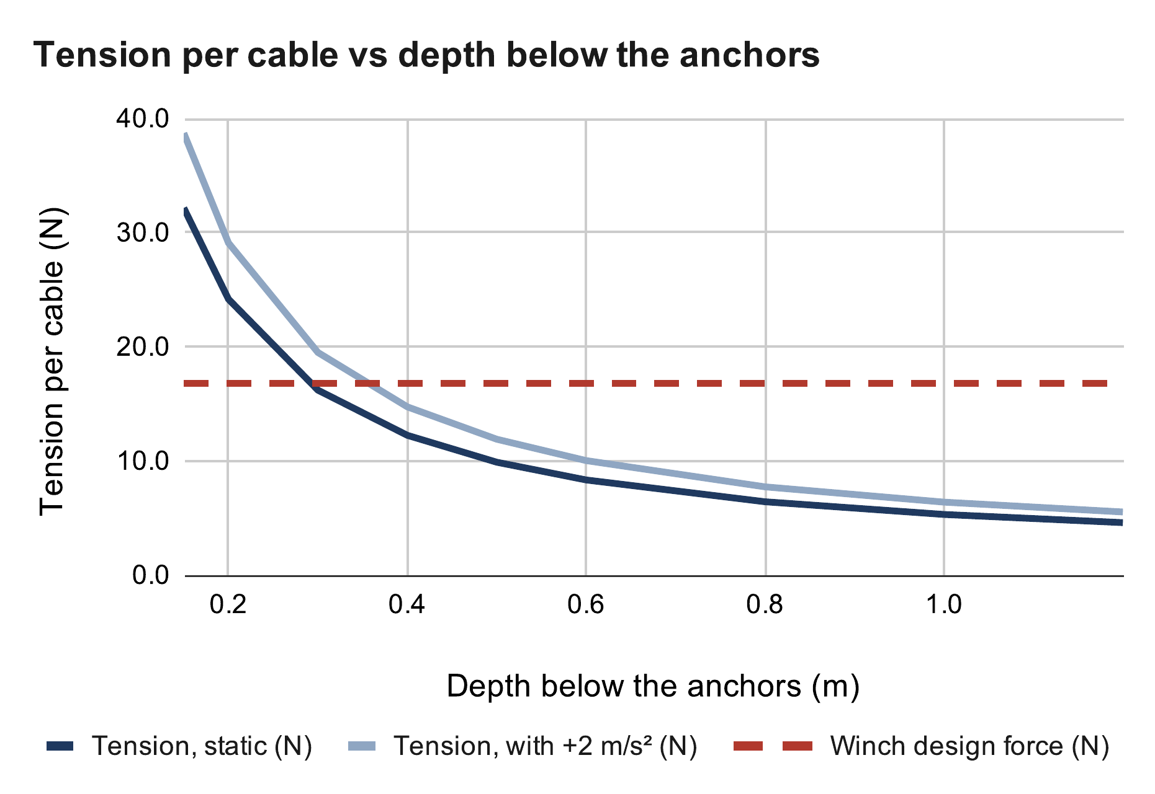
INTRO › DESIGN › BUILD › TEST › LESSONS
Cable Tension
Calculated
Cables only pull: T > 0
Tension climbs near the ceiling
32 N at 0.15 m · 8.3 N at 0.6 m
Decision: stay 0.4 m below anchors
Equation
T = W / (4 sin φ), sin φ = d / √(d² + D_{h}²)
sin φ = 0.4 / √(0.4² + 2.17²) = 0.181
T = 8.87 N / (4 × 0.181) = 12.2 N
× (1 + a/g) = 12.2 × 1.20 = 14.7 N < 16.8 N
where W = (0.45 + 0.454) kg × 9.81 m/s² = 8.87 N · d = 0.4 m below the anchors · D_{h} = 2.17 m centre to corner · a = 2 m/s² · 16.8 N = winch design force
My calculation sheet (Google Sheets), “Cable tension” tab. Calculated, not measured.
Notes:
Force balance on the claw: the cable pulls and the weight sum to zero. Centred claw, equal shares. D_h = 2.17 m from the room centre to a corner. The tension doubles each time the depth halves near the ceiling, so the ceiling margin is set by tension, not by collision. At 1.06 A the design force was 11.9 N, so 0.4 m was only just enough standing still (12.2 N). At 1.5 A it is 16.8 N, so 0.4 m also covers the 2 m/s² acceleration case (14.7 N). 0.3 m would now hold standing still (16.2 N) but not while accelerating (19.5 N), so I keep 0.4 m. If asked about a corner pick: the far cables go near-horizontal and carry little; the planner checks every cable stays inside its tension limits.

Slide 9
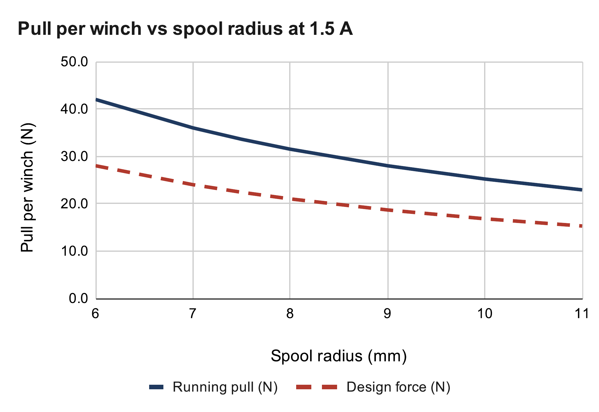
INTRO › DESIGN › BUILD › TEST › LESSONS
Winch Pull
1.5 A set · pull calculated
NEMA 17 stepper (1.7 in frame)
Current: 1.06 → 1.5 A
Pull: 34 N empty · 25 N full spool
Next: luggage-scale pull test
Equation
I = V_{ref} / (8 R_{s}) = 1.2 V / (8 × 0.1 Ω) = 1.5 A
τ_{run} = 0.7 × 0.36 N·m × 1.5 / 1.5 = 0.252 N·m
T = τ / r = 0.252 / 0.010 m = 25.2 N
F_{design} = 25.2 N / 1.5 = 16.8 N
where V_{ref} = driver reference voltage · R_{s} = 0.1 Ω sense resistor · 0.36 N·m holding torque at 1.5 A rated · 0.7 = running / holding (assumed) · r = 10 mm full spool · 1.5 = skip margin
My calculation sheet (Google Sheets), “Winch pull” tab. Calculated, not measured.
Notes:
Current limit from the driver's reference voltage (A4988 datasheet): the first boards topped out at 0.85 V, which is 1.06 A. I got the drivers to 1.5 A, the motor's rated current, so every pull goes up 41 % (1.5 / 1.06). [Fill in: how, and the Vref you read.] The cost is heat: the motor makes twice the heat (next slides). Running torque is lower than holding torque; I assumed 0.7, and the pull test measures it. A smaller spool gives more pull per amp but more turns per metre. The 1.5 margin covers skipped steps.

Slide 10
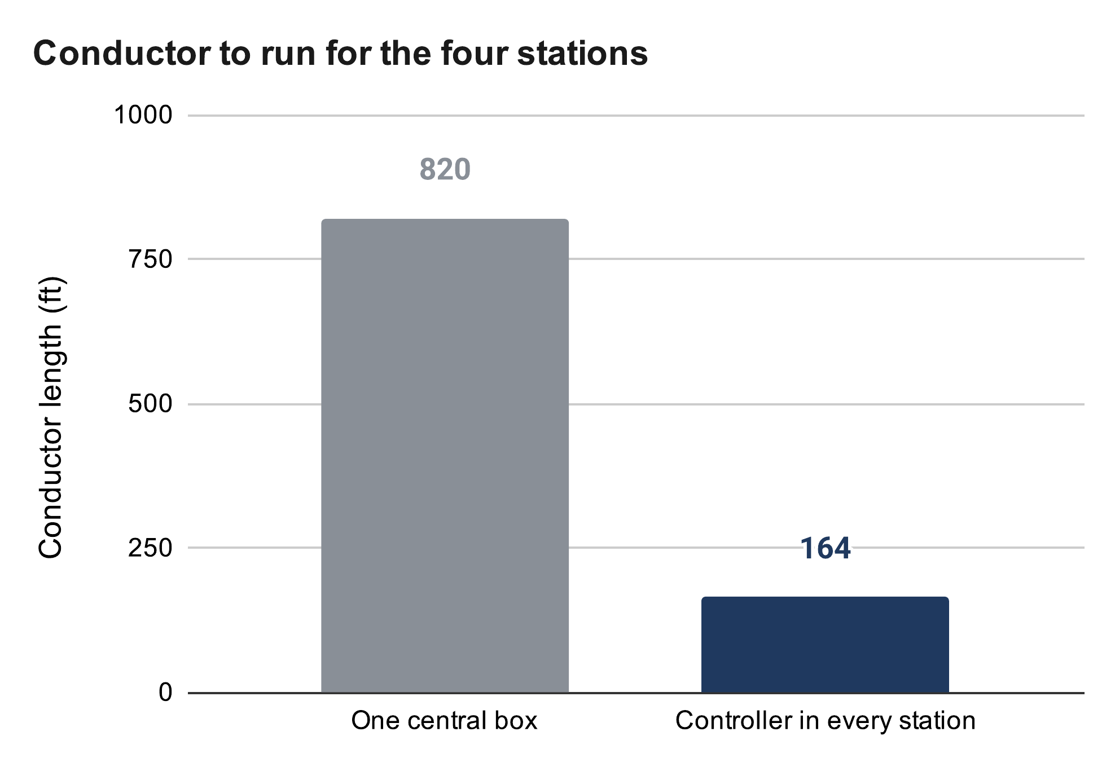
INTRO › DESIGN › BUILD › TEST › LESSONS
One Controller per Winch
Built
Gen 1: one board, four motors
Sensors per winch: 10 wires per corner
Decision: controller in every station
Result: 5× less wire
Equation
Wire = n × ΣL
Central box: 10 × 82 ft = 820 ft
Controller per station: 2 × 82 ft = 164 ft
Sync error: Δx = v Δt = 50 mm/s × 50 ms = 2.5 mm
where n = conductors per corner (motor 4, switch 2, encoder 4) · ΣL = 6 + 21 + 23 + 32 ft of routes · v = line speed · Δt = clock skew between stations
My calculation sheet (Google Sheets), “Wiring” tab. Calculated, not measured.
Notes:
Real cable routes are 6, 21, 23 and 32 ft (82 ft). 10 conductors × 82 ft = 820 ft against 2 × 82 ft = 164 ft for one power pair. The cost: sync moved into software. Each station runs time-stamped segments on its own clock; any lost link means hold. Timing skew becomes cable mismatch: 50 mm/s × 50 ms = 2.5 mm, which is why segments are time-stamped.

Slide 11
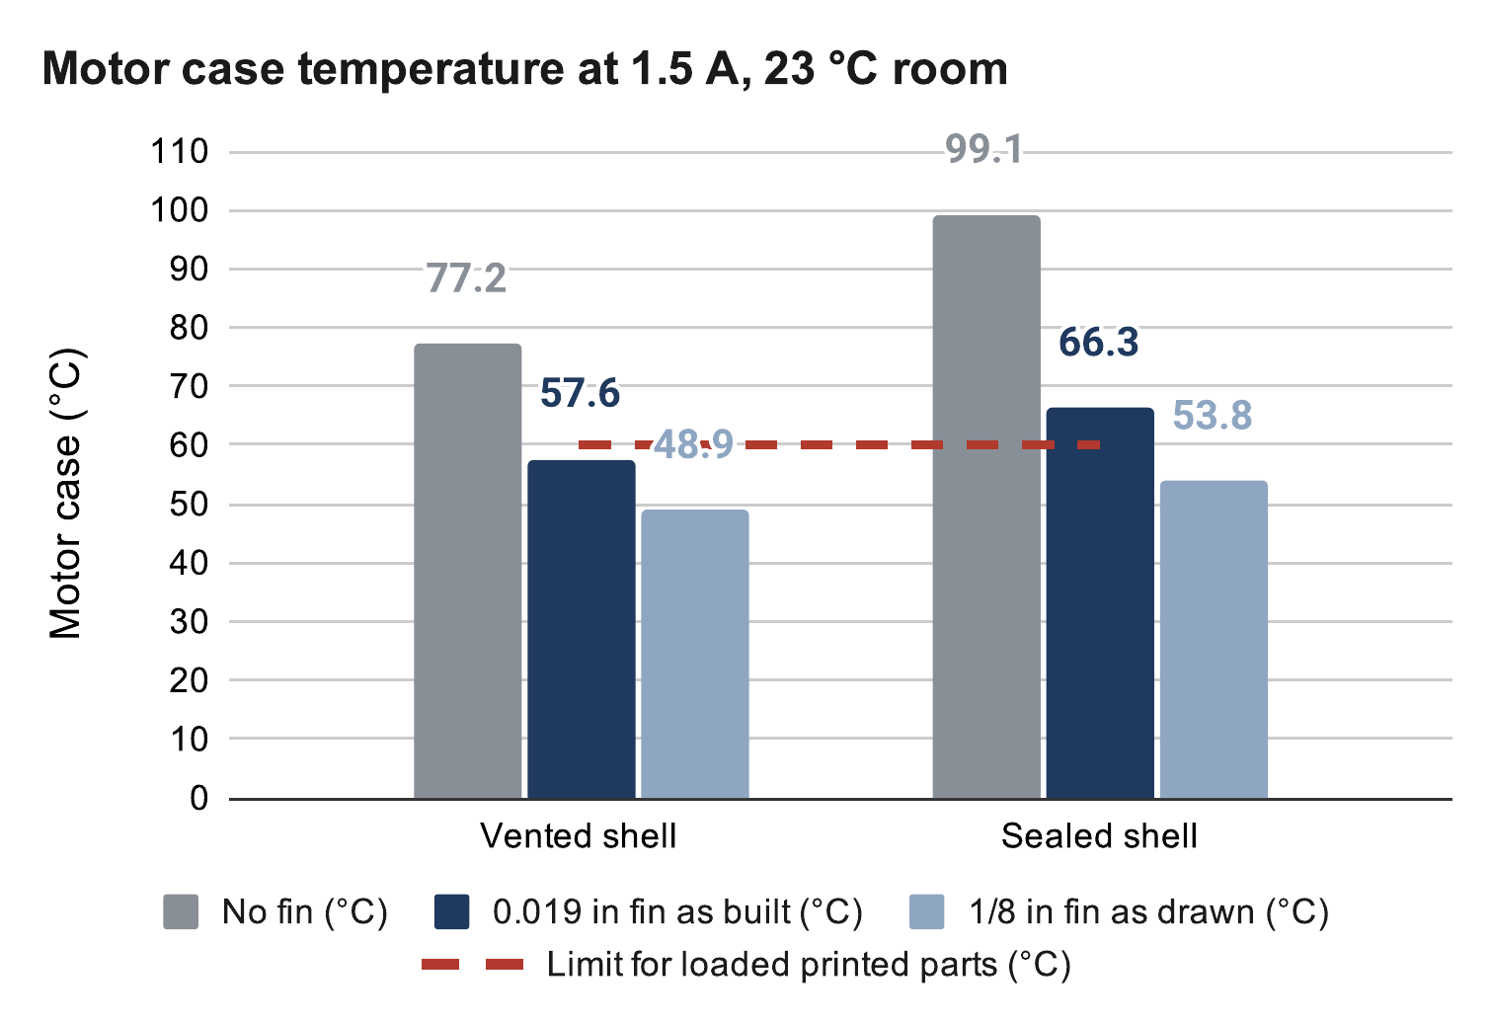
INTRO › DESIGN › BUILD › TEST › LESSONS
Cooling the Motor
Fin built · temperature calculated
Sealed PETG shell traps motor heat
Limit: PETG creeps above 60 °C
Decision: aluminium fin through the shell
Next: 90-min hold test at 1.5 A
Equation
P = I² R_{coil} = (1.5 A)² × 1.8 Ω = 4.05 W
1/R_{th} = 1/R_{shell} + 1/R_{fin}, ΔT = P × R_{th}
0.019 in fin: R_{fin} = 23.1 K/W → 57.6 °C
1/8 in fin: R_{fin} = 11.9 K/W → 48.9 °C
where R_{coil} = 1.8 Ω per phase (assumed) · R_{shell} = 12 + 1 K/W (motor → shell air → room) · room 23 °C · 1.5 W of electronics in the shell · limit 60 °C
My calculation sheet (Google Sheets), “Motor temperature” tab. Calculated, not measured.
Notes:
Model: motor to shell air to room, with the fin as a second path out. At 1.5 A the motor makes 4.05 W, double the 2.0 W at 1.06 A. Sheet results, vented shell: no fin 77 °C, 0.019 in fin 57.6 °C, 1/8 in fin 48.9 °C; sealed: 99, 66 and 54 °C, so the shell stays vented. With radiation from the black paint included (refined model) the 1/8 in fin gives about 45 °C. The driver chip also heats more; if it overheats it shuts off and the winch loses torque, so the hold test watches it too. Fallback: 1.35 A. Shape: one tall blade from the heat source, like an antelope horn.

Slide 12
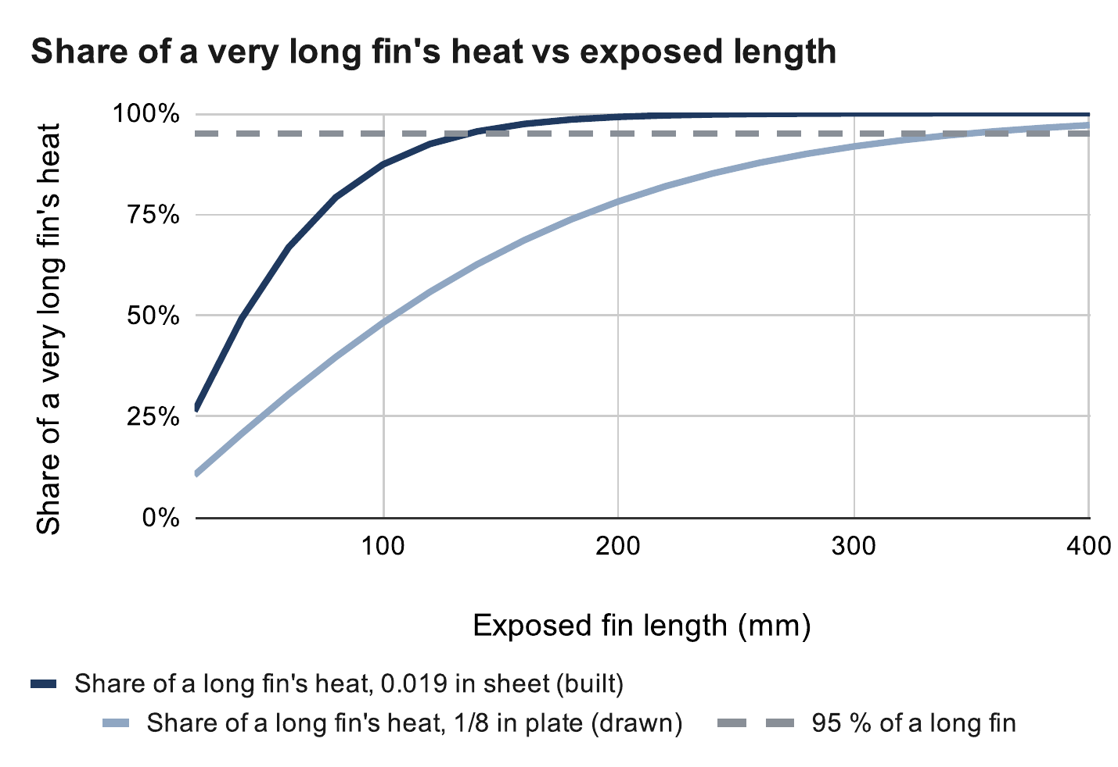
INTRO › DESIGN › BUILD › TEST › LESSONS
Heat Fin Sizing
Calculated
Prototype 0.019 in: done by 136 mm
Design 1/8 in: 74 % efficient at 200 mm
Built length: 200 mm
Equation
m = √(2h / (k t)), L₉₅ = 1.83 / m
0.019 in: m = √(2 × 7 / (160 × 0.00048)) = 13.5 /m
→ L₉₅ = 1.83 / 13.5 = 136 mm
1/8 in: m = 5.25 /m → L₉₅ = 349 mm
η = tanh(mL) / (mL) = tanh(1.05) / 1.05 = 0.74
R_{fin} = 1 / (7 × 0.74 × 0.0176) = 10.9 K/W
where R_{fin} = 1 / (h η A) · h = 7 W/m²·K still air · k = 160 W/m·K aluminium · t = thickness · L = 200 mm · A = 2 × 44 mm × 200 mm = 0.0176 m² · L₉₅ = 95 % of a long fin's heat
My calculation sheet (Google Sheets), “Heat fin” tab. Calculated, not measured.
Notes:
Target length: L95, where a fin gets 95 % of the heat an infinitely long one would. The thin sheet reaches it at 136 mm, so most of its 200 mm does little; the 1/8 in plate keeps gaining to 349 mm, so 200 mm is a compromise with the ceiling (the fin top is 229 mm above the shaft). At 200 mm: sheet 37 % efficient and 22.1 K/W; 1/8 in plate 74 % and 10.9 K/W. Fin equations: Incropera, Fundamentals of Heat and Mass Transfer, ch. 3.

Slide 13

INTRO › DESIGN › BUILD › TEST › LESSONS
Homing
Calculated · simulated
Plan A: bead trips a switch at the outlet
Cables can't get shorter than at home
Decision: camera + floor board calibration
Result: whole room · beads = end stops
Equation
L_{i}(p) ≥ L_{i,home} = ‖a_{i} − p_{home}‖
Home 1 m up (room centre) → 5 % reachable
Home 2 m up → 29 % reachable
where a_{i} = anchor i · p = claw position · reachable = every cable at or above its home length, inside 0.2 m wall and 0.4 m ceiling margins
My calculation sheet (Google Sheets), “Bead homing” tab. Calculated, not measured.
Notes:
This was a poor first plan, caught on paper before it was built. The trade-off is physical, so software cannot remove it. Replacement: take up slack one cable at a time, lift, look at the floor board from several poses, least-squares fit of anchors and zero lengths, check on held-out poses. Safety comes from margins (0.4 m below the anchors, 0.2 m inside the walls), not precision. Four tags in view: 0.7 mm vs 6.6 mm with one (backup slide). Simulated so far; tonight is the first hardware run.

Slide 14



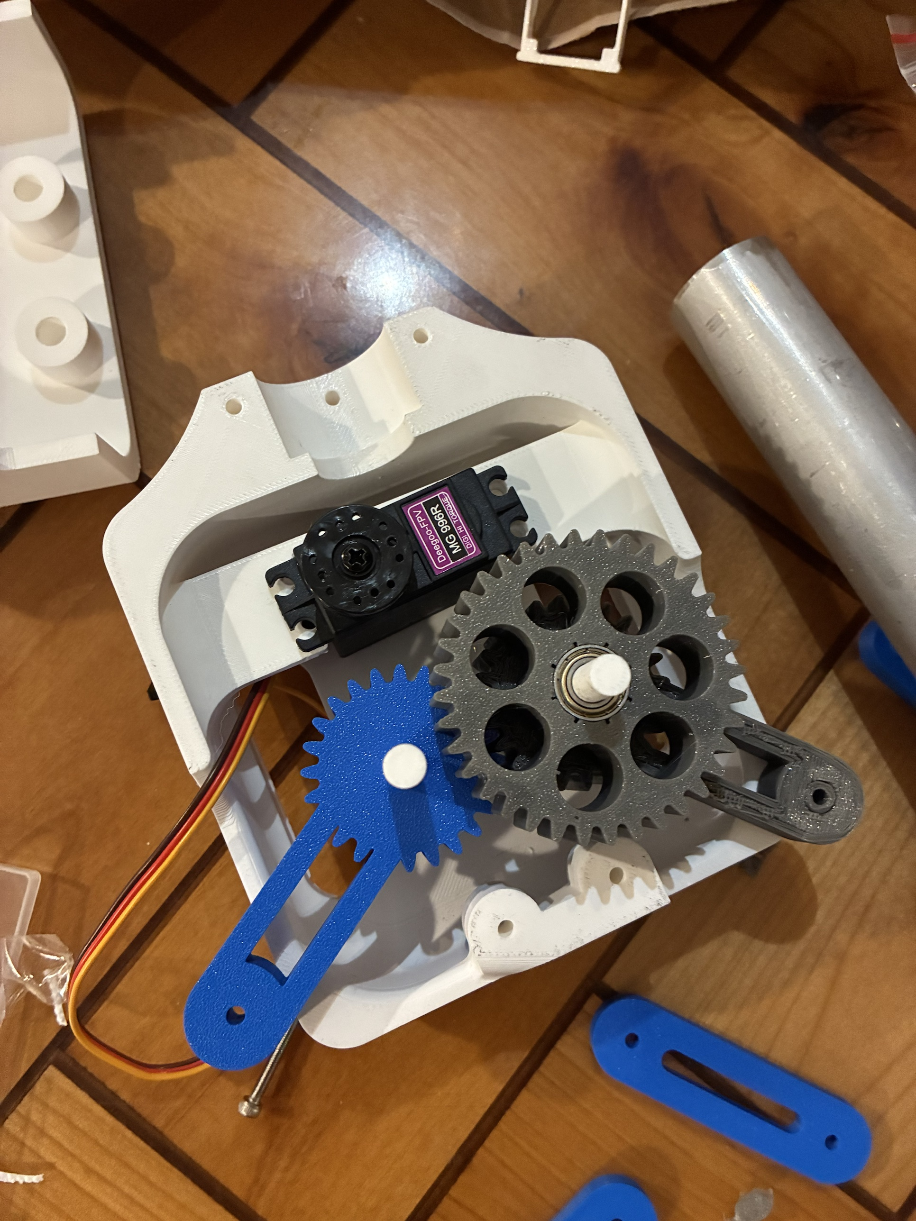
INTRO › DESIGN › BUILD › TEST › LESSONS
The Claw
Body built · hands in CAD
Gen 1: 5 TPU (thermoplastic polyurethane) fingers
Couldn't pinch fabric · 4.6× over mass
Final: geared four-bar, 53 mm opening
Equation
N ≥ m g / 2μ = 0.454 × 9.81 / 0.6 = 7.4 N
F_{t} = 2τ / d = 2 × 1.078 / 0.027 = 79.9 N
σ = F_{t} / (b m Y) = 79.9 / (15.7 × 1.5 × 0.309)
σ = 11.0 MPa → SF = 22.5 / 11.0 = 2.05
where N = grip per jaw · μ = 0.3 · τ = 1.078 N·m stall · d = 27 mm · b = 15.7 mm · m = 1.5 mm · Y = 0.309 · allowable 22.5 MPa · module 1: SF 0.4
Fingers → v6 clamp → final geared four-bar (CAD) → printed gear train with the servo
Notes:
Each generation fixed a problem found in the one before. Mass drove most changes: every gram of claw is a gram of laundry the winches cannot lift. Four-bar: ground 36.5, crank 53, rocker 50, coupler 34.7 mm; jaws parallel within about 1 degree; closing drops the tips about 38 mm, a scoop. Gear train: servo, 18T pinion, 36T/24T compound, 24T sync gear. Lewis check at servo stall: module 1 safety factor 0.35 to 0.41, so the module went up. The camera also moved from the ceiling into the claw: it sees the grasp and reads the floor board.

Slide 15
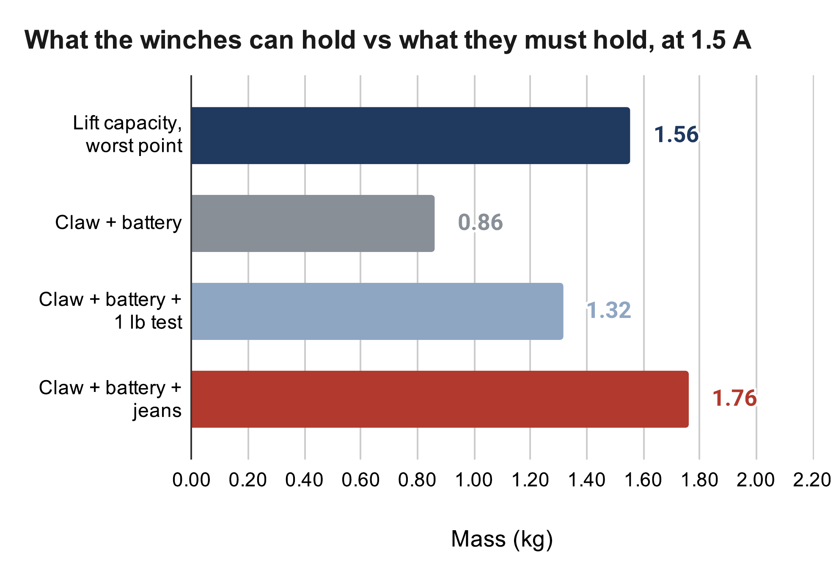
INTRO › DESIGN › BUILD › TEST › LESSONS
Weight: the Open Problem
Open problem
Capacity at 1.5 A: 1.56 kg
Claw: ≈ 0.86 kg · [weighed: ___ g]
1 lb test fits · jeans 0.2 kg over
Fix: lighter claw or 3:1 winch
Equation
m_{max} = F_{design} / (k g)
= 16.8 N / (1.101 × 9.81 m/s²) = 1.56 kg
m_{claw} = 0.55 × 0.927 + 0.198 + 0.055 = 0.76 kg
Need: 0.76 + 0.10 + 0.90 = 1.76 kg > 1.56 kg
where k = worst cable tension per unit weight (+2 m/s²), linear program over the room · 0.55 = print fill · 0.927 kg solid PETG (CAD) · tube 0.198 · servo 0.055 · battery 0.10 · jeans 0.90 kg
My calculation sheet (Google Sheets), “Lift budget” tab. Calculated, not measured.
Notes:
Be upfront: even at 1.5 A the current claw plus jeans is too heavy, by about 0.2 kg instead of 0.66 kg. Root cause: I set the mass budget late, after the claw grew. Capacity = design force / (worst tension per unit weight × g) = 16.8 / (1.101 × 9.81) = 1.56 kg; the worst point is the middle of a long wall at task height. Claw mass estimate: 0.55 infill fraction × 927 g solid + 198 g tube + 55 g servo ≈ 0.76 kg. The pull test turns the 0.7 running-torque assumption into a measurement, and that number picks the fix.

Slide 16
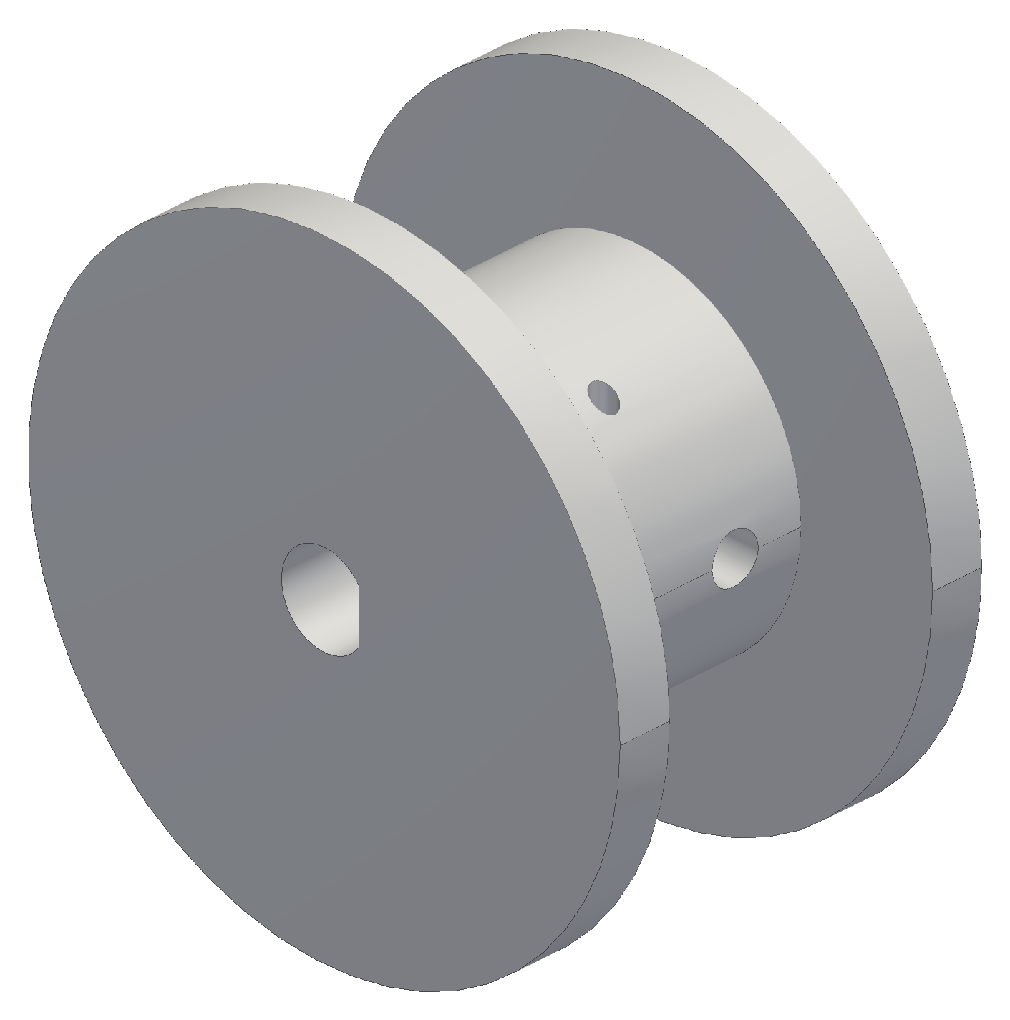


INTRO › DESIGN › BUILD › TEST › LESSONS
Printed Fits
Built
PETG · Creality K1 · 0.2 mm layers
Printed holes come out small
Spool: 3 prints to fit the shaft
Lesson: fit coupon first
Equation
c = (D_{hole} − u) − D_{shaft}
Ø5.2 too tight → u ≥ 0.2 mm
c = (5.45 − 0.2) − 5.00 = 0.25 mm
where c = clearance · u = printer undersize · D_{shaft} = 5.00 mm motor shaft · v3 bore Ø5.45 with a D-flat; the set screw on the flat carries the torque
Spool v1, v2, v3 (CAD)
Notes:
Orientation: flat face on the bed, loads along the layers, no supports on mating faces. Bearing pocket Ø14.075 with a Ø14.000 lead-in lip. Heat-set M3 inserts where screws are reused. Spool v1 was longer than the motor shaft could engage; v2's Ø5.2 bore printed too tight on the 5 mm shaft, so the printer undersize is at least 0.2 mm; v3 opened it to Ø5.45 (about 0.25 mm clearance) with a D-flat. Ø15 core, 16 mm drum: 20 ft of line in 5 layers.

Slide 17


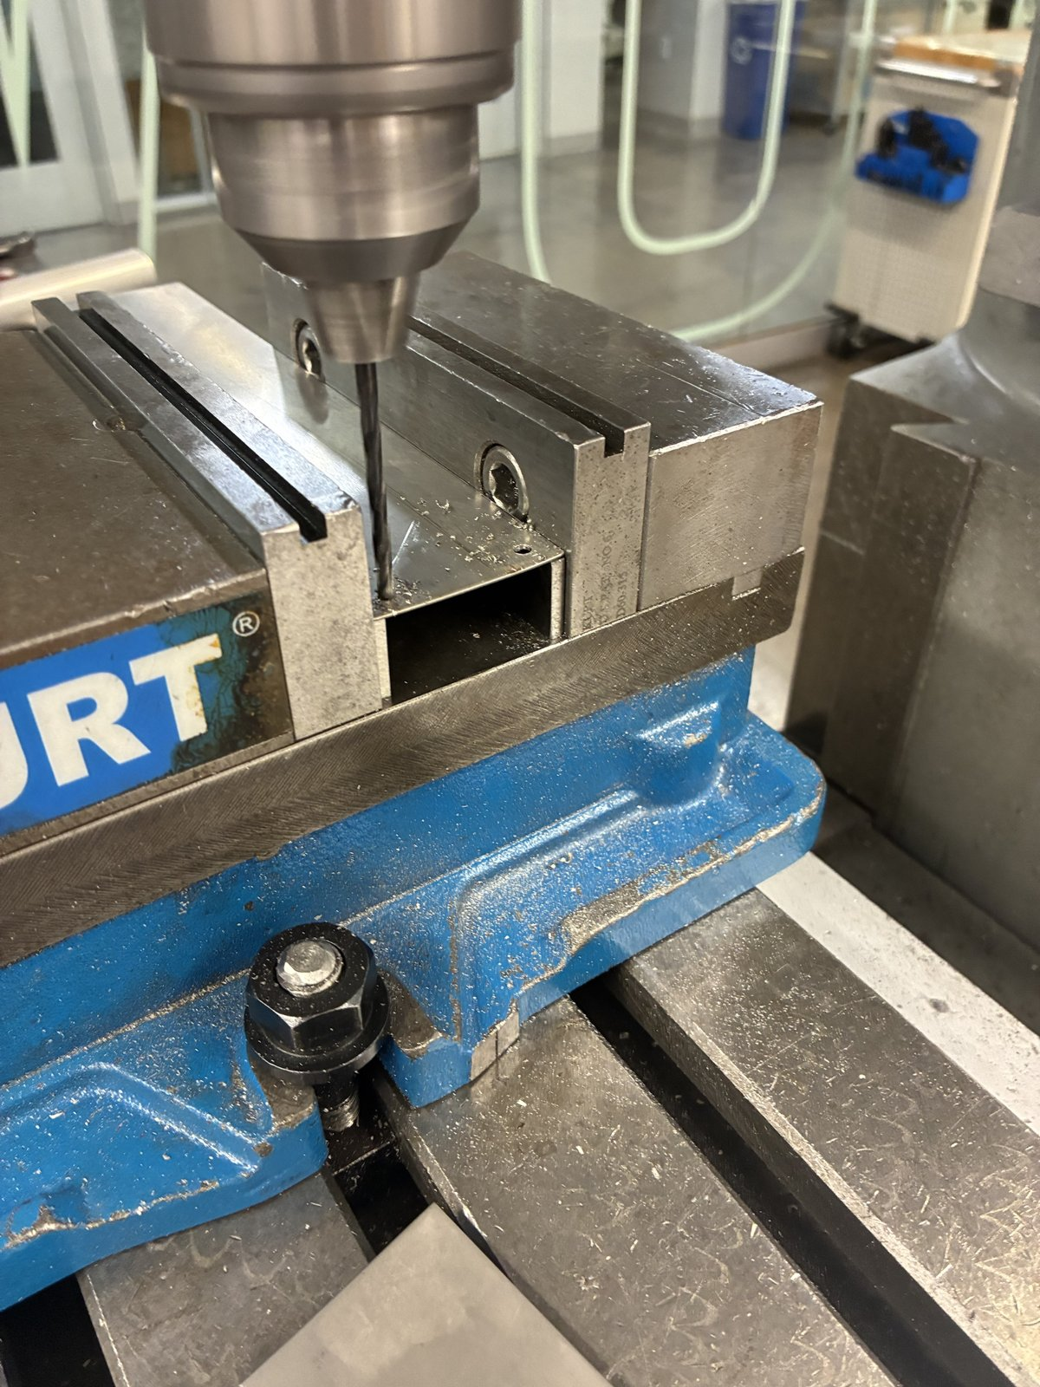

INTRO › DESIGN › BUILD › TEST › LESSONS
Machining the Fin
Built
Shop drawing first: 1:1 template
Prototype: 0.019 in sheet on hand
One mill setup: 5 holes, ±0.1 mm
Bolted on, no reaming
Shear and blanks · mill setup with the drawing · drilling · the finished fin
Notes:
One setup from the same two edges means hole-to-hole errors do not stack. Holes: a 7/8 in pilot for the motor boss and 4 × Ø3.4 on the 31 mm motor square. Paint everywhere except the motor contact square, which gets thermal paste. [Fill in: time per fin, how many made, any scrap.]

Slide 18


INTRO › DESIGN › BUILD › TEST › LESSONS
Electronics Bring-Up
Measured
Boots safe: driver off until armed
Schematic = soldered board: 16 nets
Failure: logic rail 1.14 V, not 3.3 V
Now: meter before code
Soldered station board (left); bench bring-up (right)
Notes:
Boot-safe: a 10k pull-up holds the driver's enable pin off until the firmware arms it. USB and the 5 V buck cannot back-feed each other (link jumper plus a Schottky diode). The schematic is generated from the soldered board's net list, so the two cannot disagree. The 1.14 V story: measure the hardware before trusting the software's view of it. Checklist: logic supply, sleep, enable and the buck output on every new board. [Fill in: exact readings, date, what you tried first.]

Slide 19
INTRO › DESIGN › BUILD › TEST › LESSONS
First Test
Planned · this week
3 stations: fewest cables that hold a point
Self-check → calibrate → move → pickup
Load: 1 lb, then one garment
Pass limits written first
[Photo or video from the three-station test]
Check | Pass limit | Result
Startup self-check | All stations answer; slack taken up | [fill in]
Calibration fit | Held-out poses inside the safety margin | [fill in]
Short move, 1 lb | 300 mm at 50 mm/s, ≤ 2 mm per cable | [fill in]
Pickup | One garment into the hamper | [fill in]
Notes:
Three cables, three unknown tensions, three force equations: statically determinate, so the tensions are solved exactly and slack shows up directly. It is the simplest real test of the calibration and the coordinated motion. Logged: cable lengths, encoder counts, motor temperatures, the fit's error bars. Fill in the results after the test, including any that fail.

Slide 20
INTRO › DESIGN › BUILD › TEST › LESSONS
Thermal Check
Calculated · simulation next
Limit: PETG mount < 60 °C
Hand calc: 56–59 °C (0.019 in) · 45–49 °C (1/8 in)
SolidWorks: motor, fin, screws, mount
Hold test: 90 min at 1.5 A
[SolidWorks temperature plot: motor, fin, screws and mount]
Method | 0.019 in fin | 1/8 in fin | PETG mount
Hand calc | 56–59 °C | 45–49 °C | ≈ motor − 2 K
SolidWorks | [fill in] | [fill in] | [fill in]
Hold test | [fill in] | [fill in] | [fill in]
Three ways to know one temperature: calculate it, simulate it, measure it
Notes:
The 60 °C limit is for the loaded PETG, and that is the one temperature the hand calculation cannot give: it only knows the motor node. The SolidWorks thermal study uses my 10/21 assembly with a detailed NEMA 17 (aluminium end caps, black steel stator, copper windings as the 4.05 W source, plastic connector), the fin, the four M3 screws into the motor, and the PETG slip-in mount; inside the shell 26 to 27 °C, outside 23 °C. Hand calc: 56 to 59 °C with the prototype fin, 45 to 49 °C with the 1/8 in fin (the range is the simple and the refined model). Then the hold test measures it. If they disagree, I fit h and the coil resistance, not the physics.

Slide 21
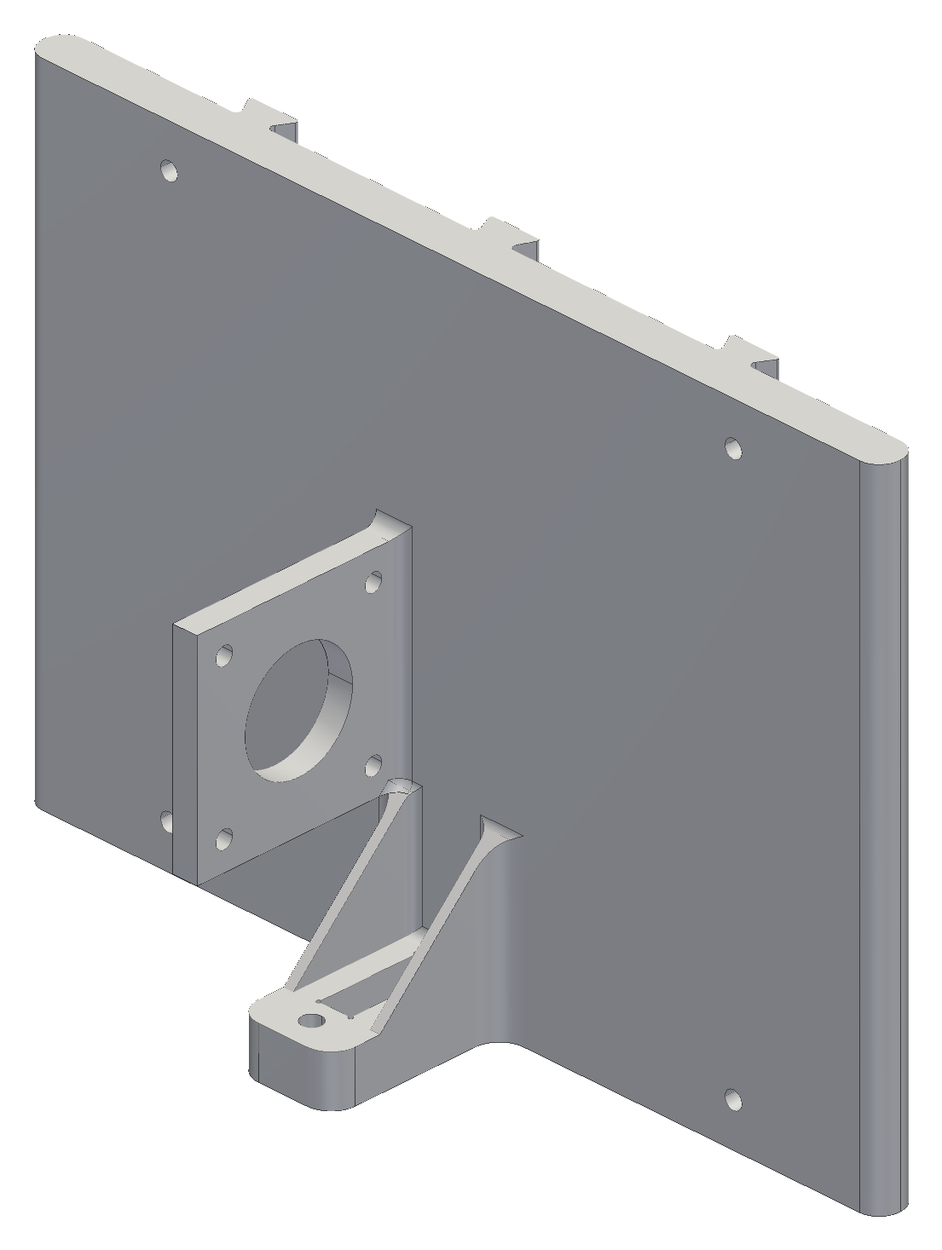

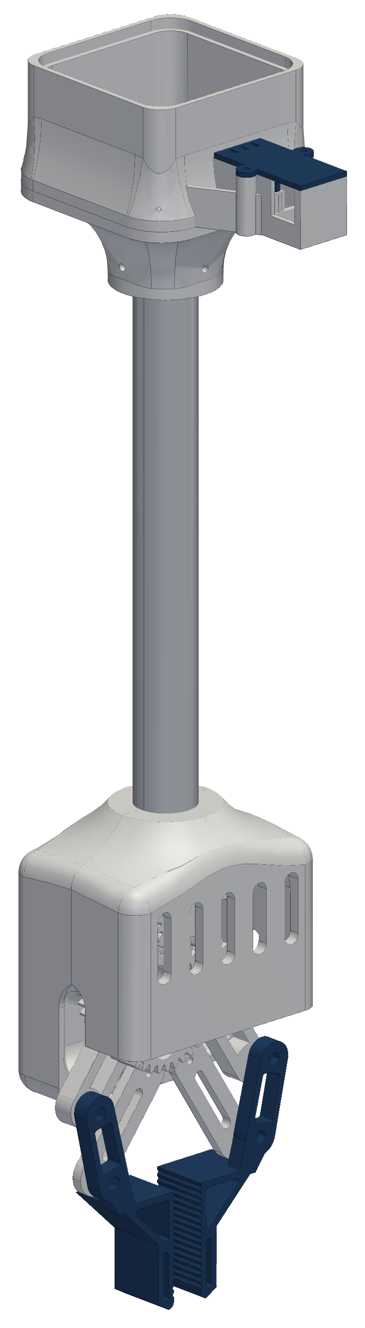
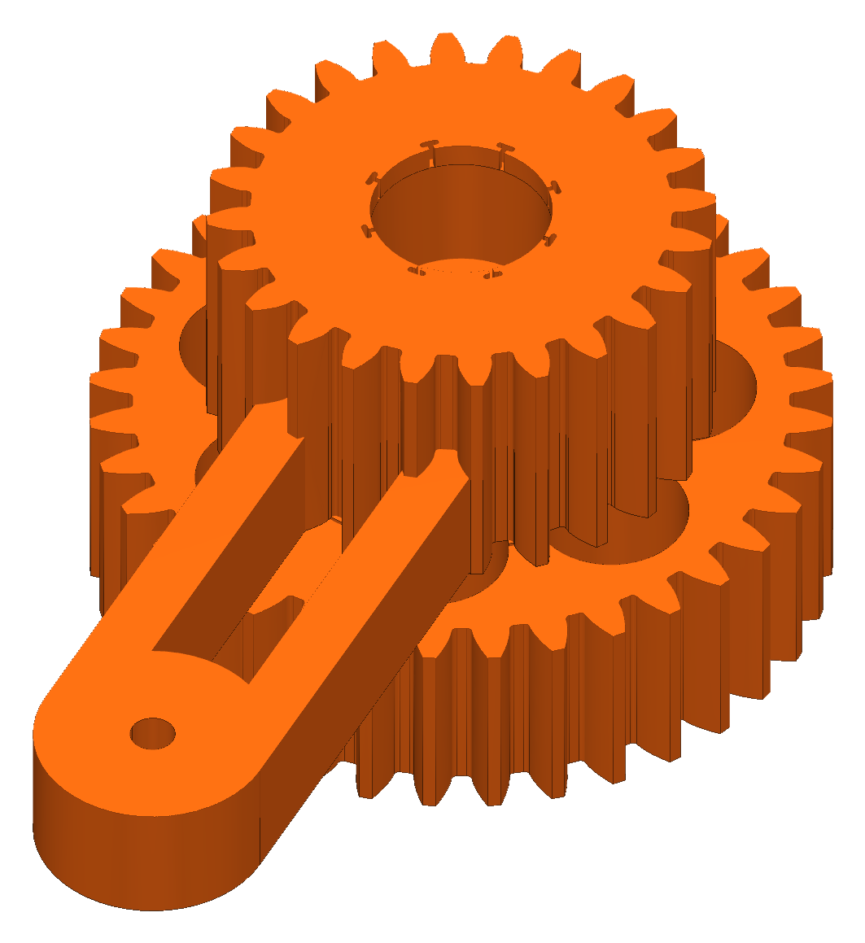
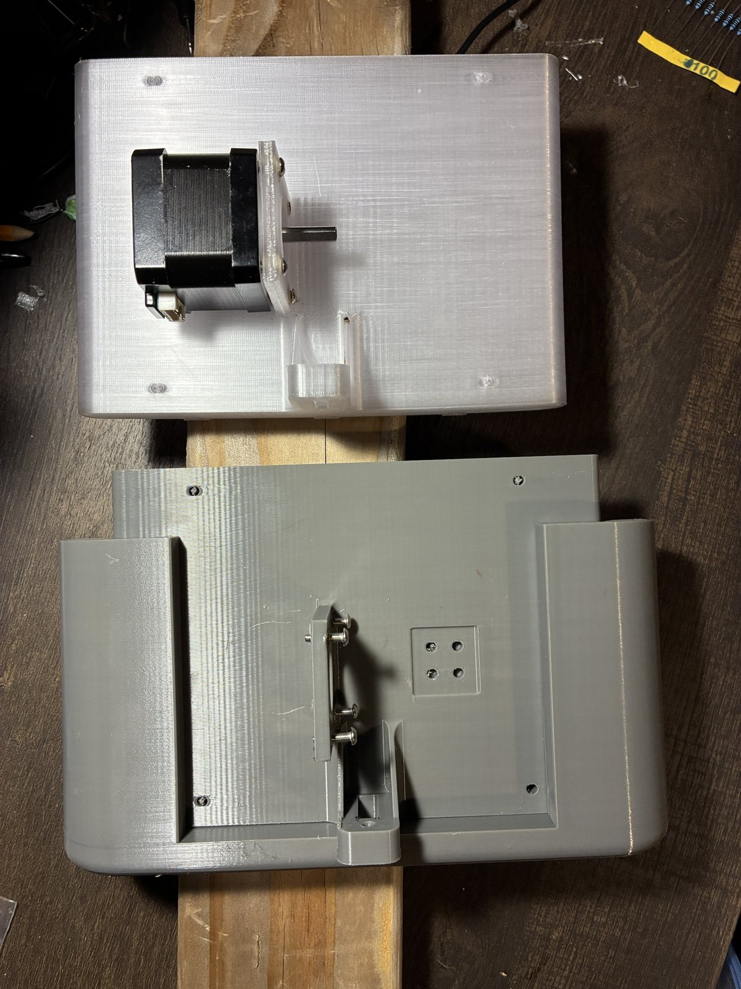
INTRO › DESIGN › BUILD › TEST › LESSONS
Good and Poor Decisions
Good decisions
Poor decisions
One controller per winch
5× less wire; each station tested alone
Mass budget set late
Claw + jeans is 0.2 kg over, even at 1.5 A
Slide-in wall mount
A station comes off; the anchor stays put
Bead homing as plan A
Under a third of the room; a redesign
Camera calibration over bead homing
Whole room reachable; no tape measure
Spool printed before a fit coupon
Three prints to fit the shaft
Gear strength checked at stall
Module 1 would have failed; fixed in CAD
Several stations before one was proven
Every fix repeated on each station
Notes:
Good: each was a trade I priced first. Distributed control cost me software sync (2.5 mm per 50 ms of skew) but saved 5× the wire. The slide-in mount came from taking stations down to rework them. Calibration by camera replaced a plan that physically limited the motion. The stall check caught gears that would have sheared before I printed them. Poor: the mass budget came after the claw grew, which is the open problem today. Bead homing looked cheap until I computed what it cost. The spool bore needed a coupon. And building several stations before one was fully proven meant repeating each fix. [Confirm the last one.]

Slide 22
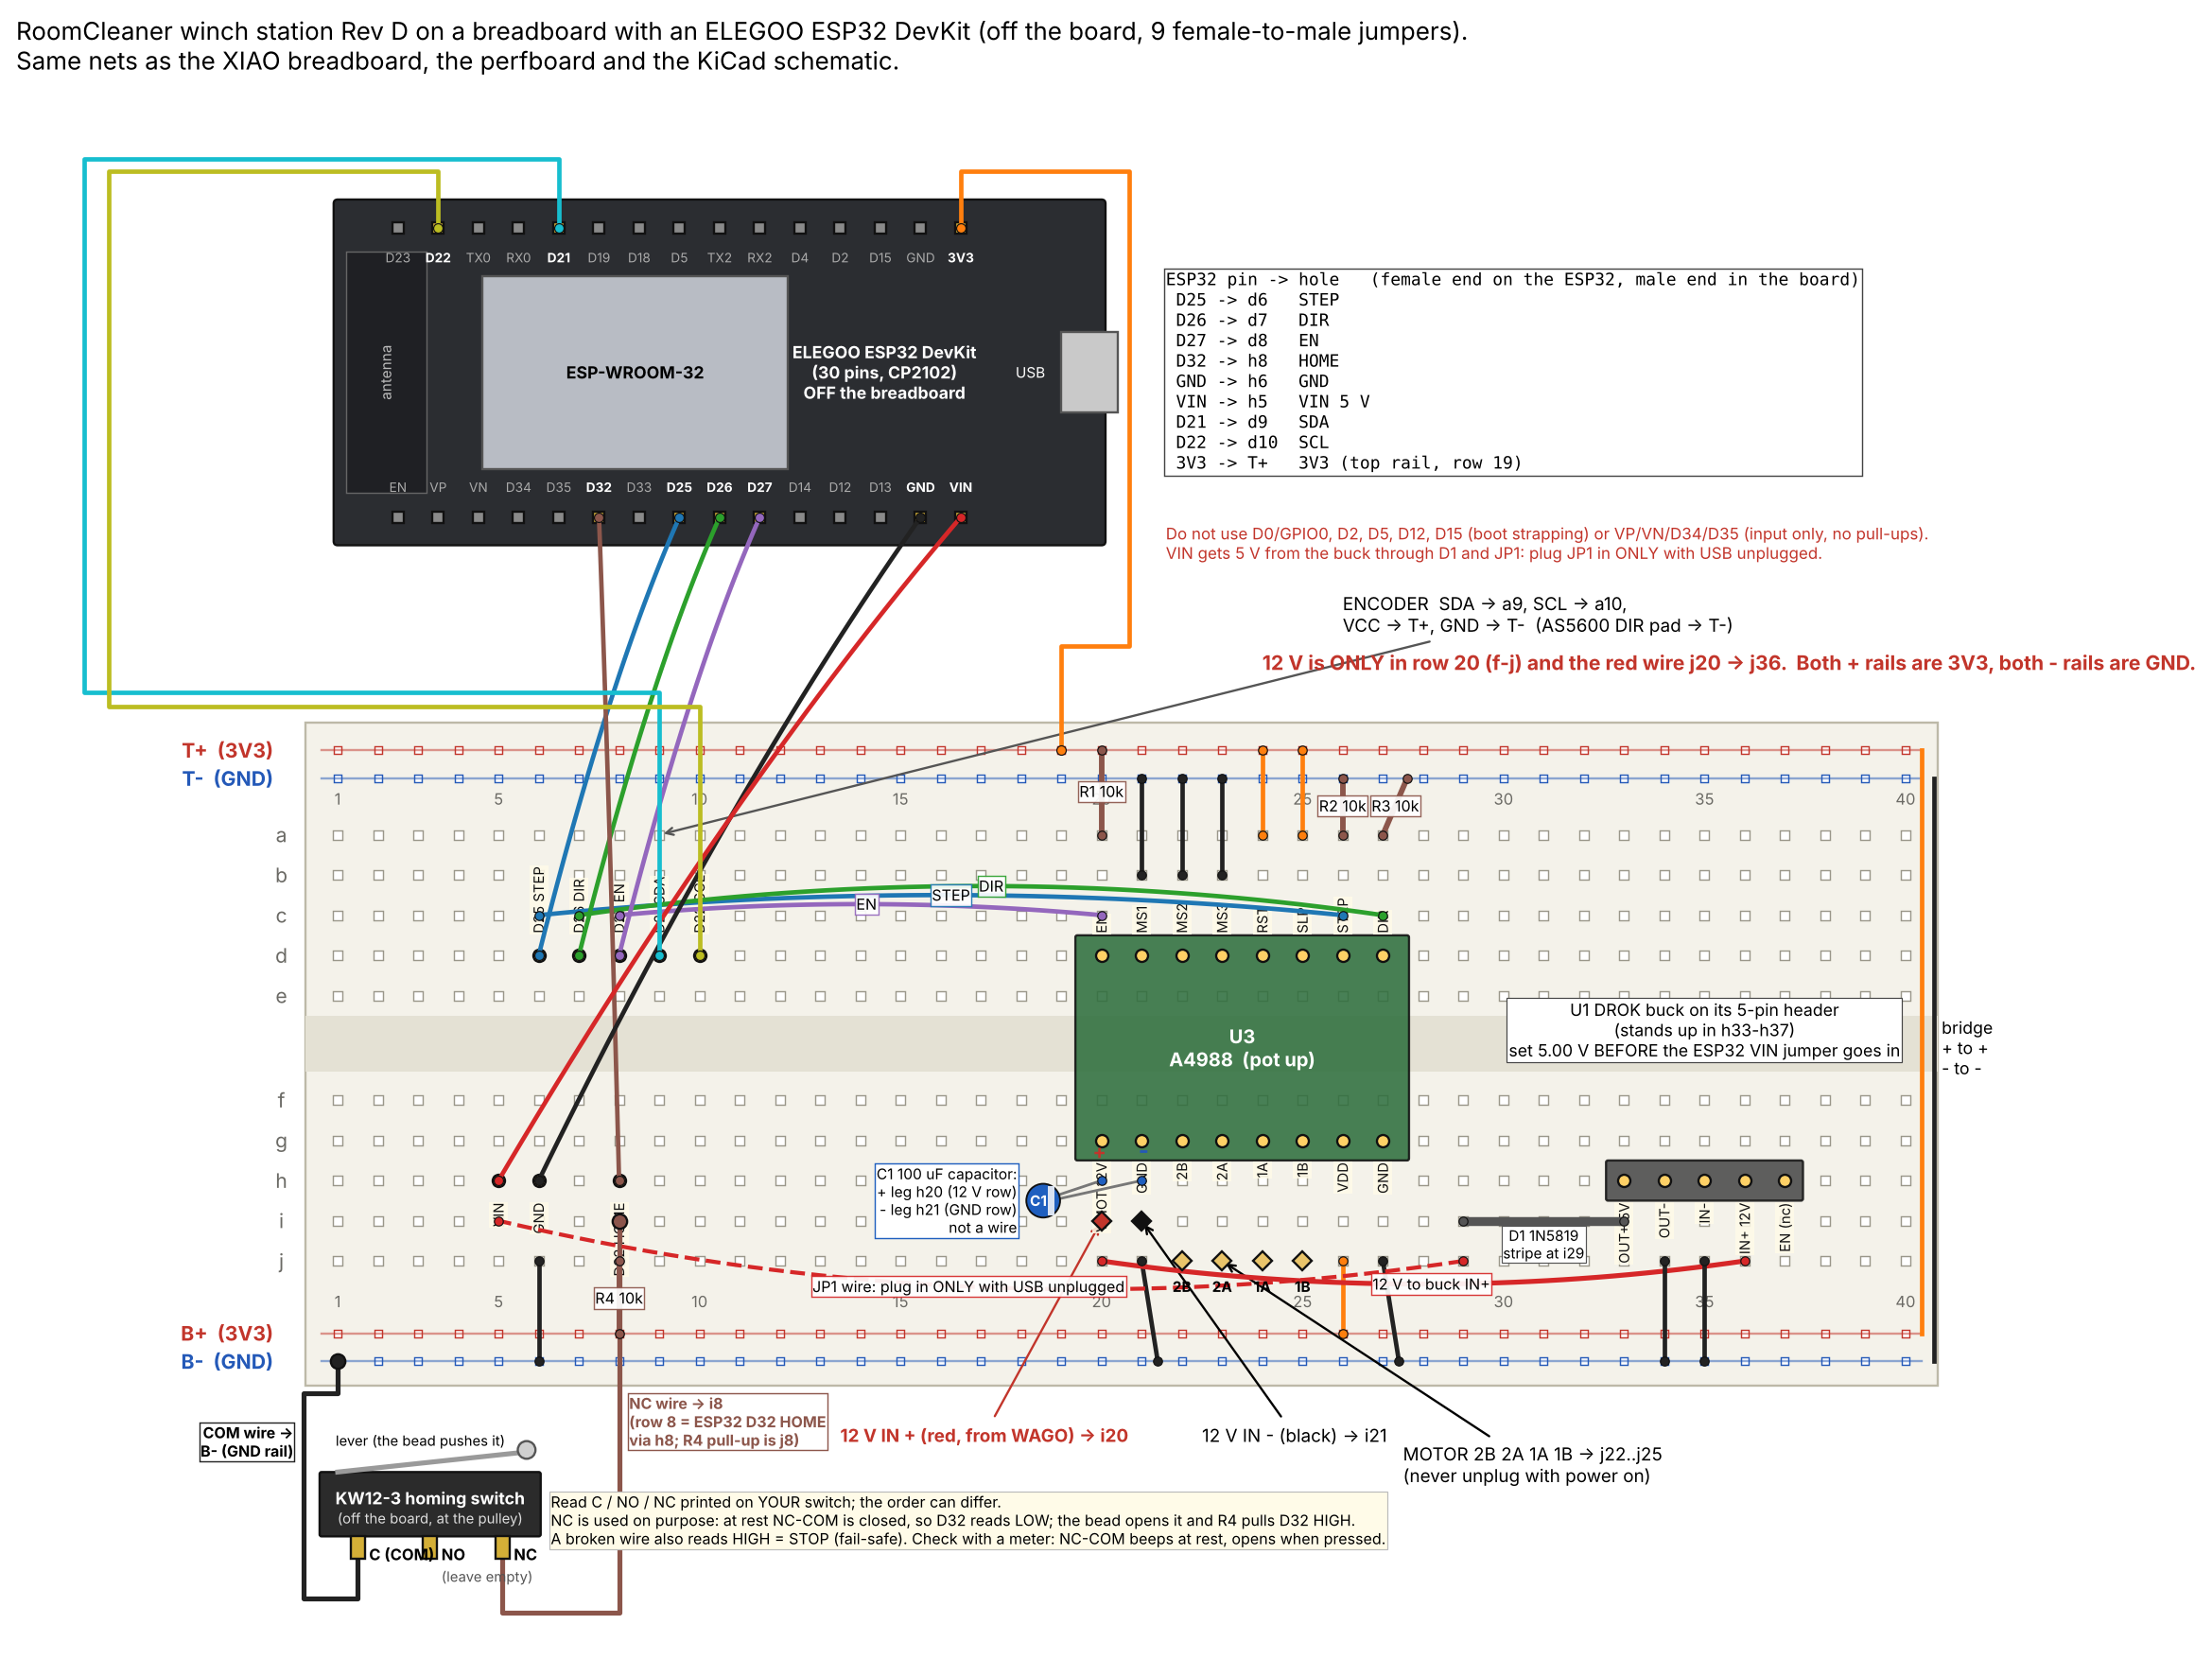
INTRO › DESIGN › BUILD › TEST › LESSONS
Thorough vs Scrappy
Thorough
Scrappy
Heat fin: equations → shop drawing → one mill setup, ±0.1 mm
Station board: schematic checked net by net against the solder
Gears: strength checked at servo stall before printing
Fried a controller: ESP32 on nine jumpers, same firmware
Floor board: paper tags, 250 mm grid
Prototype fin: 0.019 in sheet on hand; design is 1/8 in
Three stations tested while the fourth is built
My rule: thorough where a mistake is expensive or unsafe; scrappy where it is cheap to undo
Notes:
Thorough: the fin is machined once, so the hole pattern had to be right before the first cut. The board schematic is generated from the soldered net list so the drawing cannot lie. The gear check happened in CAD because a sheared gear costs a print and a jammed claw. Scrappy: when a controller board died two days before the test, I moved the same circuit to an ESP32 dev board with nine jumpers and a compile-time pin map instead of redesigning the board. The floor board is paper tags because accuracy comes from seeing several tags, not from the board. Three stations now, because three cables already test calibration and coordinated motion.

Slide 23
INTRO › DESIGN › BUILD › TEST › LESSONS
Lessons Learned
Do differently
In half the time
Weigh early: budget from winch pull
Coupons first: fit before part
One station first: prove, then copy
Meter before code
Freeze requirements in week 1
Order long-lead parts on day 1
Start with 3 stations
One generation per part, test-gated
Actual:
15 weeks
Concept
Gen 1
Rethink
Gen 2 → final
Build, test
Half:
7 weeks
Plan
One full station + tests
Copy
Claw, coupons first
Test
Same scale. Actual: Jul 16 to Oct 27. The half-time plan proves one station before copying it.
Notes:
What I would do differently: weigh the claw and set its mass budget from the measured winch pull before designing it; coupons before every new fit; one complete station tested end to end before building more; a meter on every rail before debugging code. Half the time: most of the lost time was the rethink (September to early October) and the generations that a frozen requirement and an early test would have avoided. Order the slow parts on day one. Three stations are statically determinate and need fewer parts for the first test.

Slide 24
Questions
Jasper Buntinx · jasper_buntinx@tamu.edu
Notes:
Backups follow: status by part, fin sizing for 4 W, floor board, calibration, control logic, one run, phone app, obstacles, claw electrical, gear strength, safety, acronyms, calculations and sources.

Slide 25
BACKUP
Where It Stands
Part | Status | Next test
Wall stations | Built; bench-commissioned [how many] | Three-station test, then the fourth
Station electronics | Built; drivers at 1.5 A [how: Vref reading] | 90-minute hold test at 1.5 A
Heat fin | Prototype 0.019 in built; 1/8 in designed (D38) | Machine the 1/8 in fin; hold test
Thermal model of the station | Hand calc at 1.5 A; SolidWorks model set up | Run it; then the hold test
Claw body: tube, mount, servo, gears | Built | Weigh it
Claw hands, camera housing, encoder casing | Checked in CAD; printing | Fit checks on the first print
Calibration and control software | Simulated end to end | First hardware run
Winch pull | Calculated at 1.5 A: 25–34 N | Luggage-scale pull test
Notes:
Everything calculated or simulated is called that; the next-test column is what turns it into measurements.

Slide 26
BACKUP
Fin Sizing for 4 W
Calculated
Fin alone carries all 4.05 W
0.019 in: never (max ≈ 2 W)
1/8 in: 145–185 mm
Thickness beats length
Painted 6061, 44 mm wide | Mass | Motor, 200 mm, fin alone | Shortest for ≤ 60 °C
0.019 in (prototype) | 14 g | 100–120 °C | never (max ≈ 2.0 W)
1/16 in | 47 g | 66–72 °C | never (max ≈ 3.6 W)
0.090 in | 68 g | 60–65 °C | 210 mm or never
1/8 in (design, D38) | 94 g | 56–59 °C | 145–185 mm
3/16 in | 141 g | 53–55 °C | 125–140 mm
1/4 in | 189 g | 51–52 °C | 115–125 mm
Equation
q∞ = w √(2 h k t) × θ_{b}
0.019 in: 0.044 √(2 · 9.3 · 167 · 0.000483) × 37
= 2.0 W < 4.05 W
All 4.05 W through the fin, 23 °C room, paste contact; ranges: flange at one temperature to heat spread over the patch. Calculated.
where q∞ = most heat any length can carry · w = 0.044 m · h ≈ 9.3 W/m²·K painted · k = 167 W/m·K (6061) · t = 0.000483 m · θ_{b} = 60 − 23 = 37 K
Notes:
The built sheet works today only because the motor also sheds about 2.5 W into the vented shell. A thin sheet has a large m = √(2h/kt), so its far end does almost nothing: the most heat any length can carry is w √(2hkt) θ_b, about 2 W for 0.019 in at a 60 °C base. The 1/8 in plate of my first drawing, painted, would carry all of it at the same 200 mm, and with the vented shell the motor would run at about 45 °C. Mass is no problem on a wall station. 1/8 in may be beyond a hand shear: bandsaw and square it on the mill. Details: calculations/fin_sizing_4w.md.

Slide 27

BACKUP
Floor Board Accuracy
Calculated
Angle error × lever arm
1 tag: 6.6 mm · 4 tags: 0.7 mm
Averaging removes noise, not bias
Equation
δx = σ_{θ} × L = 12.9 mrad × 0.51 m = 6.6 mm
My calculation sheet (Google Sheets), “Floor board” tab. Calculated, not measured.
where σ_{θ} = pose-angle noise with one tag in view · L = 0.51 m camera height above the board
Notes:
Two tags: 4.85 mrad, 2.5 mm. Noise model: 0.3 px corner noise, 520 px focal length (camera not yet calibrated).

Slide 28
BACKUP
Startup Calibration
Simulated
No tape measure
Fit: anchors + cable zero lengths
Held-out poses check the fit
Full room only inside error bars
1 Take up slack, one cable at a time
2 Lift the claw off the floor
3 Camera reads the floor board
6 Ready, inside the safe margins
5 Check on held-out poses
4 Fit anchors and cable lengths
Equation
min Σ_{k} Σ_{i} ( L_{i0} + d_{ik} − ‖a_{i} − p_{k}‖ )²
Full room only if k · σ ≤ margin
where a_{i} = anchor · p_{k} = claw pose k (camera) · d_{ik} = cable paid out (encoder) · L_{i0} = cable zero length · σ = fit error
Notes:
Safety comes from margins, not precision: 0.4 m below the anchors and 0.2 m inside the walls unless the error bars allow more. If the fit is not good enough: more poses, then fit again.

Slide 29
BACKUP
Logic: Gen 1 vs Final
Simulated
 | Gen 1 | Final
Where is the claw? | Assumed: where the cables were told to put it | Measured: claw camera on the floor board, refit at every startup
Room geometry | Point mass; anchors from a tape measure | Rigid claw; anchors and cable lengths fitted, with error bars
Who runs the motors | One central board steps all four | Each station runs time-stamped moves; the laptop coordinates
Finding laundry | Ceiling camera, pixel to floor map | Claw camera, ray from the claw's pose to the floor
Did the grab work? | Assumed once the claw closed | Camera checks pickup and delivery
Faults | Emergency stop only | Supervisor: a stop keeps torque; nothing restarts by itself
Notes:
Gen 1 trusted its model; the final logic measures before it trusts and checks after it acts. Kept from gen 1: the cable maths, the state-machine idea and the YOLO-World detector.

Slide 30
BACKUP
One Run
Simulated
1 Start up
2 Find
3 Pick and deliver
4 Put away
Self-check
Take up slack
Lift a few centimetres
Calibrate
Set the trust level
Rise to scan height
Detector lists the items
Map each to the floor
Choose the nearest
Hover until still
Descend, close
Camera: is it held?
Fly to the hamper, release
Camera: is it in?
Lower over the floor board
Camera confirms the floor
Disarm after a typed confirm
next item; 3 failures in a row → pause for the operator
At any point: PAUSE or a fault stops every station on the same point of the path, still holding. Nothing restarts by itself.
Notes:
Grips wait until the claw stops swinging. A refused release pauses over the hamper. Disarm needs a typed confirmation and a fresh floor check, because releasing torque drops a hanging claw.

Slide 31



BACKUP
Phone App
Simulated
Status, live claw camera, guided setup
Anything that moves asks “yes” first
PAUSE holds position at once
The switched power strip is the hard stop
A reboot never resumes a task
Phone app: home, camera, chat
Notes:
Tested against a full simulator of the stations and the claw, so lost messages and reboots were exercised before hardware.

Slide 32
BACKUP
Obstacles
Simulated
Known obstacles = keep-out cylinders
Every cable checked at every path point
Fails → refused before moving
Can't see people yet: nobody underneath
1.5 m: clear
shelf,
0–1.9 m
0.8 m: refused
Side view along a room diagonal: same floor spot, two heights; an example shelf
Notes:
Next: draw keep-out shapes in the phone app (squares, rectangles, circles with a height), then let the robot build its own room model from the claw camera's scans.

Slide 33

BACKUP
Claw Electrical
2-cell lithium-ion pack: 7.4 V, 5 A fuse
6 V servo rail · separate 5 V logic
Peak 2.8–3.1 A vs 3 A pack
Charge: switch off, attended, ≤ 1 A
Notes:
Rules check 0 errors; 9 nets match the specification. Charger: 8.4 V constant current, constant voltage.

Slide 34
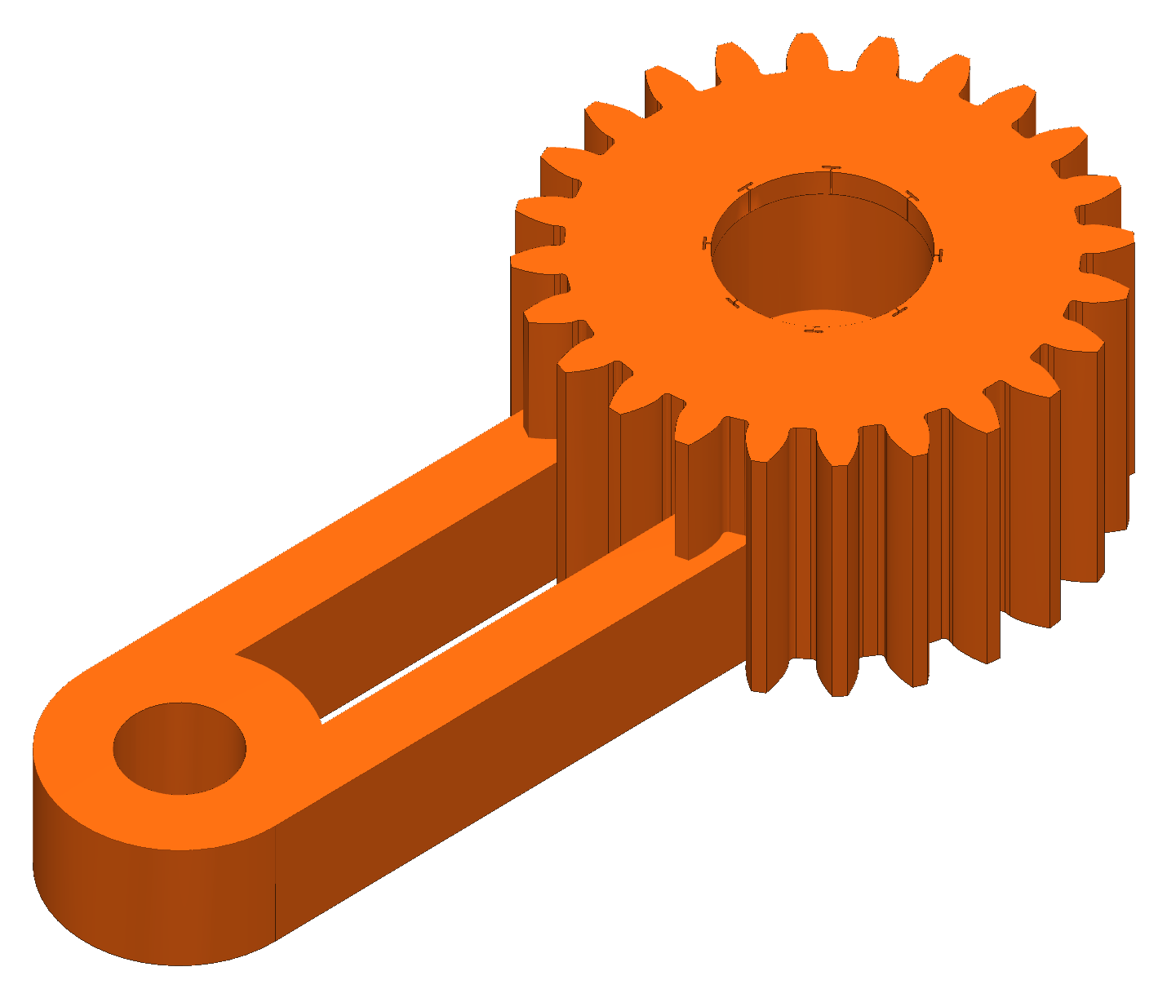
BACKUP
Gear Strength
Calculated
Module 1.5 · PETG allowable 22.5 MPa
6 V stall: SF 2.05 / 2.50 / 2.00
Module 1: SF 0.35–0.41 → rejected
Equation
F_{t} = 2τ / d = 2 × 1.078 / 0.027 = 79.9 N
σ = F_{t} / (b m Y) = 79.9 / (15.7 × 1.5 × 0.309) = 11.0 MPa
SF = σ_{allow} / σ = 22.5 / 11.0 = 2.05
where SF = safety factor · τ = servo stall torque · d = pitch diameter (18 teeth × 1.5 mm) · b = face width · m = module · Y = Lewis form factor
Notes:
Safety factors at the 6 V servo stall: pinion 2.05, 36-tooth gear 2.50, sync gear 2.00 with one jaw taking all the load. Stall torque 1.078 N·m is the servo rating, not measured.

Slide 35
BACKUP
Safety
One hard stop: switched power strip
Faults and PAUSE hold torque
Anchors in studs · nobody underneath
Never unplug a motor under power
Notes:
No safety-rated function is claimed.

Slide 36
BACKUP
Acronyms
Term | Meaning
CAD | Computer-aided design
PETG | Polyethylene terephthalate glycol (the printed plastic)
TPU | Thermoplastic polyurethane (flexible printed plastic)
NEMA 17 | National Electrical Manufacturers Association motor frame, 1.7 in square
I²C | Inter-Integrated Circuit: a short-range two-wire sensor bus
ESP32 | A Wi-Fi microcontroller family (Espressif)
A4988 · AS5600 | Stepper-motor driver chip (Allegro) · magnetic angle sensor (ams)
YOLO | “You Only Look Once”: an object-detection model family
SF | Safety factor: allowable stress ÷ actual stress

Slide 37
BACKUP
Calculations and Sources
Every chart: my calculation sheet
Every result: a formula on marked inputs
Sources:
  Incropera et al., Fundamentals of Heat and Mass Transfer, ch. 3
  Allegro MicroSystems, A4988 datasheet
My calculation sheet (Google Sheets), “Cable tension” tab. Calculated, not measured.
RoomCleaner engineering calculations (Google Sheets)

