Slide 1
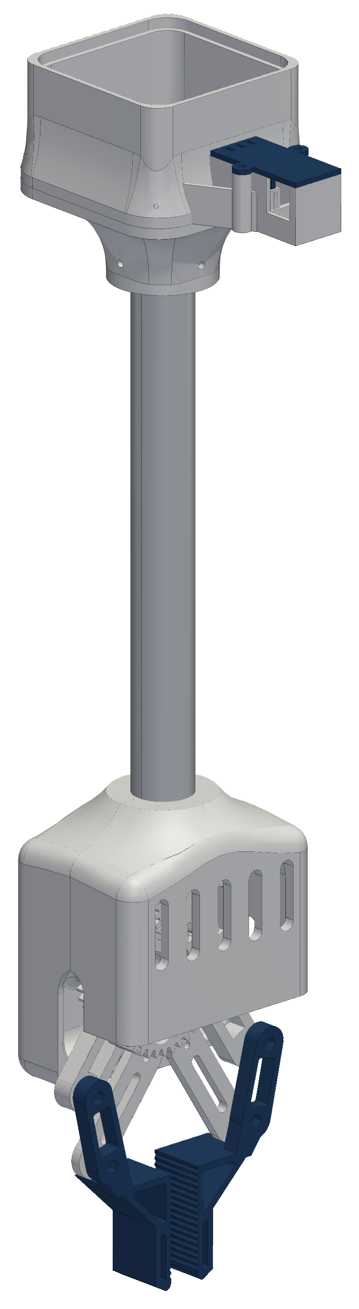

RoomCleaner
A four-cable ceiling robot that picks laundry off the floor
Jasper Buntinx
Technical presentation · October 27, 2026
Notes:
One sentence: a cable robot whose four winches sit in the ceiling corners and move one claw anywhere over the floor.

Slide 2
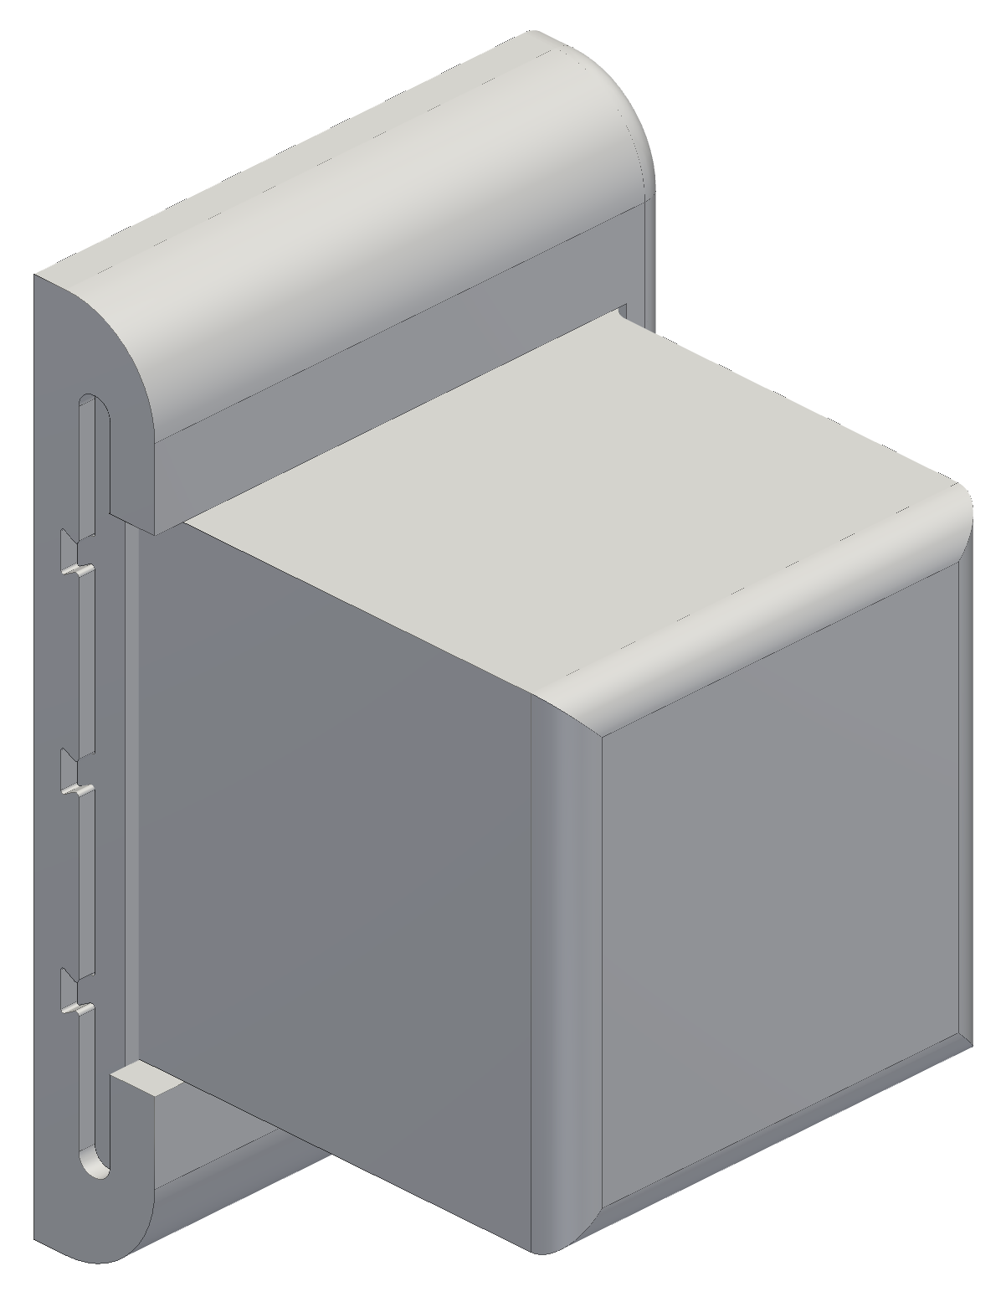
Goal: pick laundry off the floor anywhere in an 11 × 9 ft room
Pick clothes off the floor and drop them in a hamper, from anywhere in the room
Four winches near the ceiling corners hold one claw on four cables
Room 11 × 9 ft with a 9 ft ceiling
Working load: a pair of jeans (0.9 kg) with 2 m/s² of acceleration; first test load 1 lb
3D-printed in PETG on a hobby budget, from parts I can buy and fix myself
Safety: anchors in studs, one hard stop (the switched power strip), nobody under the robot
One of the four winch stations (CAD)
Notes:
Requirements first: where it works, what it lifts, what it costs, and how it stays safe.

Slide 3
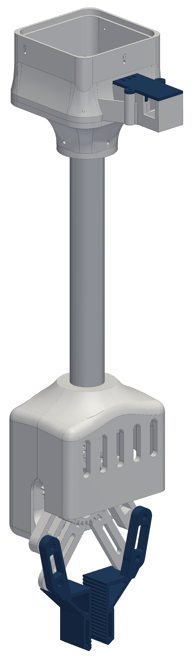
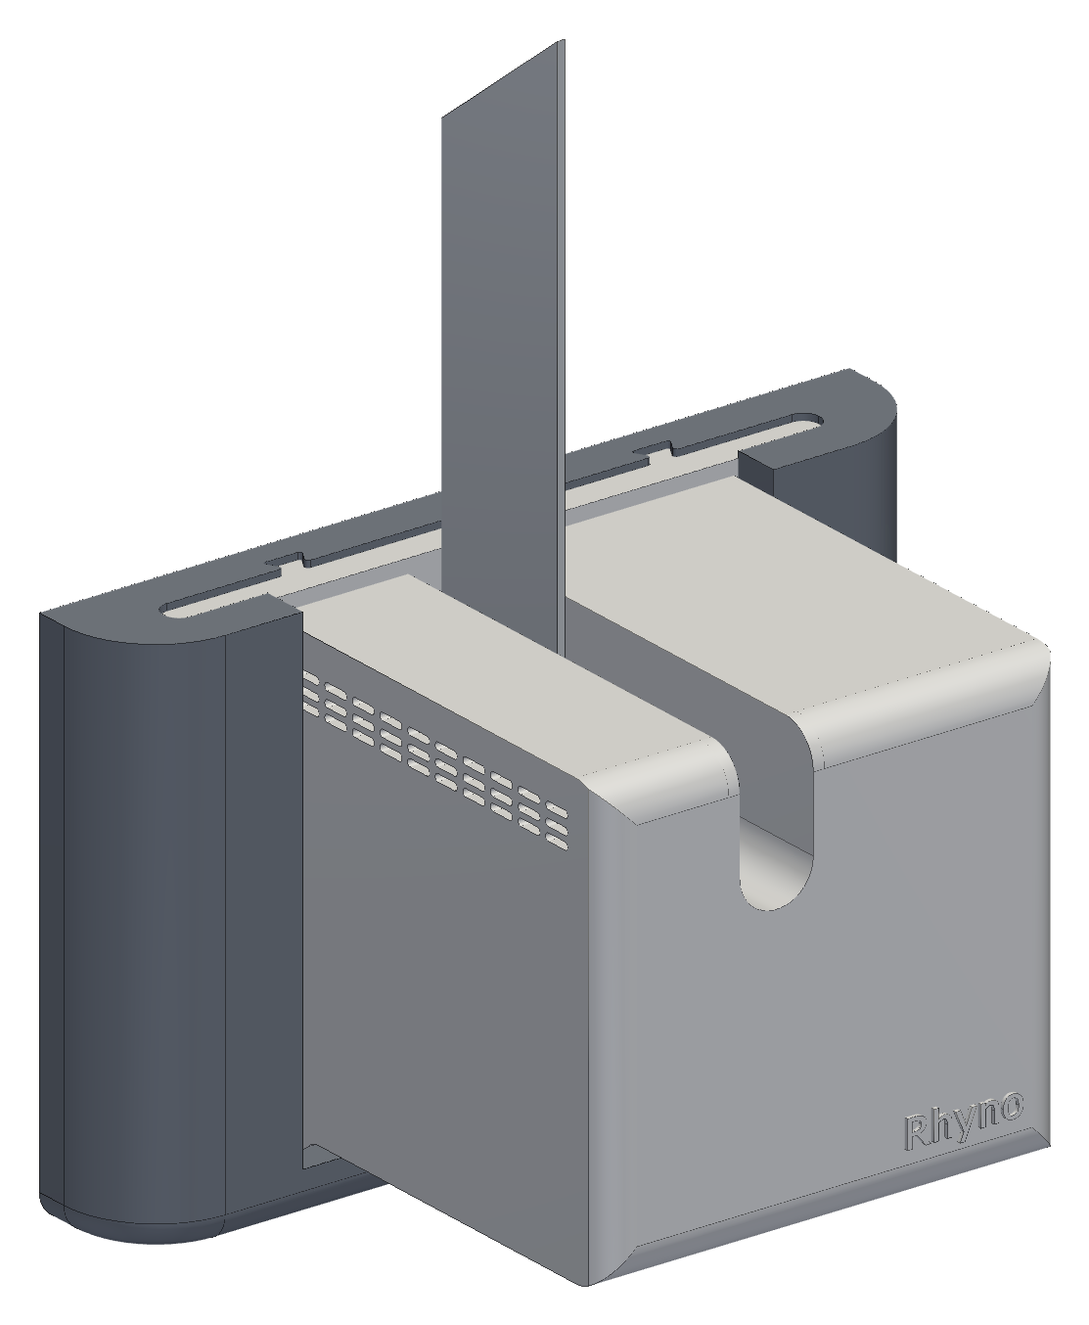
The final design: four wall stations hold one claw on four lines
Four identical wall stations, one near each ceiling corner
  NEMA 17 winch and printed spool, its own ESP32 controller, a spool encoder, and the horn-inspired heat fin
  Each slides onto a wall frame screwed into a stud; one 12 V cable each
One claw on four Dyneema lines
  Geared four-bar gripper, camera in the housing, 10.5 in aluminium tube, 2S LiPo
Controlled from a laptop and a phone app over Wi-Fi
The rest of this talk is how each part got to this point
Final CAD: a wall station (Oct 21 assembly, with the heat fin) and the claw as built
Notes:
The finished design first, so every later decision has a place to land. Station: wall frame, slide-in mount, shell, motor, spool, heat fin, encoder. Claw: housing with the camera bay, 10.5 in tube, geared head, four-bar hands.

Slide 4
Outline
1
How a cable robot works
Position vectors, statics, the winch
2
From one box to modular stations
Wiring, a controller per winch, the slide-in housing, plug-in power, cooling and the horn-inspired fin
3
Homing and calibration
Bead homing, why it limited the motion, the camera-based method
4
The claw
Gripper evolution, the four-bar hands, overhead camera to claw camera, weight vs lift
5
Manufacturing
Printed PETG parts, and a heat fin cut and drilled on a manual mill
6
Electronics
Station board and a bring-up lesson
7
Control logic
First logic vs final logic, one run end to end, the phone app, obstacles
8
Status and next steps
First test, what is built, what I learned
Notes:
The talk follows the order the problems appeared in.

Slide 5
01
How a cable robot works
Four cables, one point, and the vectors that connect them
Notes:
Four cables, one point, and the vectors that connect them

Slide 6

Each cable length is the distance from its anchor to the claw
Room frame at a floor corner: anchor i (the pulley exit) at a_{i}, the claw at p
Each cable is the vector from the claw to its anchor
Its length is the distance between those two points
To move, compute the four lengths at every point on the path
Each spool turns by the change in length over its radius
Closed form: no iteration is needed to command a move
Key equations
l_{i} = a_{i} − p, u_{i} = l_{i} / L_{i}
L_{i} = ‖a_{i} − p‖ = √((a_{ix} − p_{x})² + (a_{iy} − p_{y})² + (a_{iz} − p_{z})²)
Δθ_{i} = ΔL_{i} / r (r = spool radius with the wound line)
Notes:
Inverse kinematics of a cable robot is vector subtraction and a norm, done for each cable at every step.

Slide 7
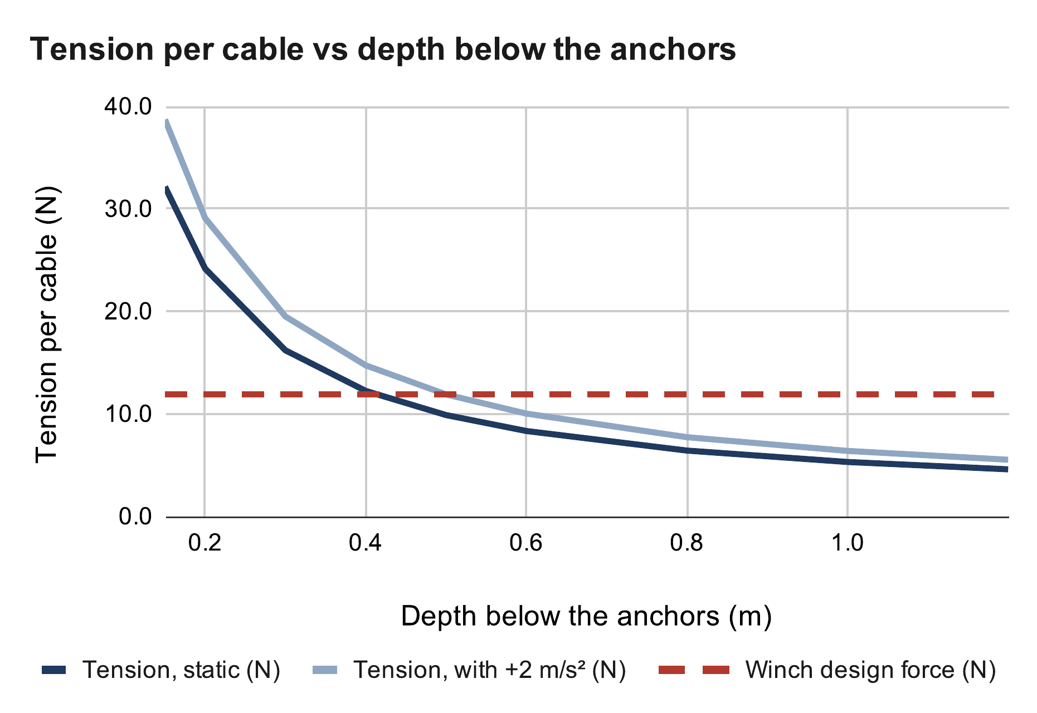
Cables only pull, so tension climbs as they flatten near the ceiling
Force balance: the cable pulls and the weight sum to zero
Cables only pull: every tension must stay positive
Centred claw, equal shares: tension rises as the cables flatten
32 N per cable 0.15 m below the anchors; 8.3 N at 0.6 m
At 0.4 m: 12.2 N, right at the 11.9 N design force
So the robot keeps 0.4 m below the anchors, 0.2 m from the walls
Key equations
Source: calculation sheet (Google Sheets), “Cable tension” tab. Calculated, not measured.
Σ T_{i} u_{i} + m(g + a) = 0, T_{i} > 0
T = W / (4 sin φ), sin φ = d / √(d² + D_{h}²)
W = (0.45 + 0.454) kg × 9.81 m/s² = 8.87 N
Notes:
D_h = 2.17 m from the room centre to a corner. The tension doubles each time the depth halves near the ceiling; the ceiling margin is set by tension, not by collision.

Slide 8
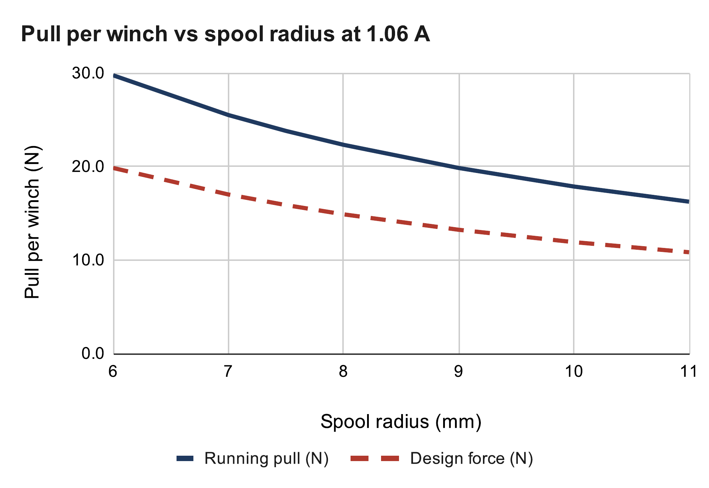
At the driver's 1.06 A limit, each winch pulls 18 to 24 N
NEMA 17 stepper, printed spool, outlet pulley
Current limit set by the driver's reference voltage: 0.85 V → 1.06 A
Running torque < holding torque: 0.7 assumed, the pull test measures it
Smaller spool: more pull per amp, more turns per metre
v3 spool: 24 N empty, 18 N full → 11.9 N design (÷ 1.5)
Key equations
I = V_{ref} / (8 R_{s}) = 0.85 V / (8 × 0.1 Ω) = 1.06 A
τ_{run} = 0.7 · τ_{hold} · I / I_{rated} = 0.7 × 0.36 × 1.06 / 1.5 = 0.18 N·m
T = τ_{run} / r: 23.8 N at r = 7.5 mm, 17.9 N at r = 10 mm
Source: calculation sheet (Google Sheets), “Winch pull” tab. Calculated, not measured.
Current limit: Allegro MicroSystems, A4988 datasheet
Notes:
Design force = full-spool pull / 1.5 skip margin. The pull test turns the 0.7 ratio into a measurement.

Slide 9
02
From one box to modular stations
How adding safety features changed the whole architecture
Notes:
How adding safety features changed the whole architecture

Slide 10

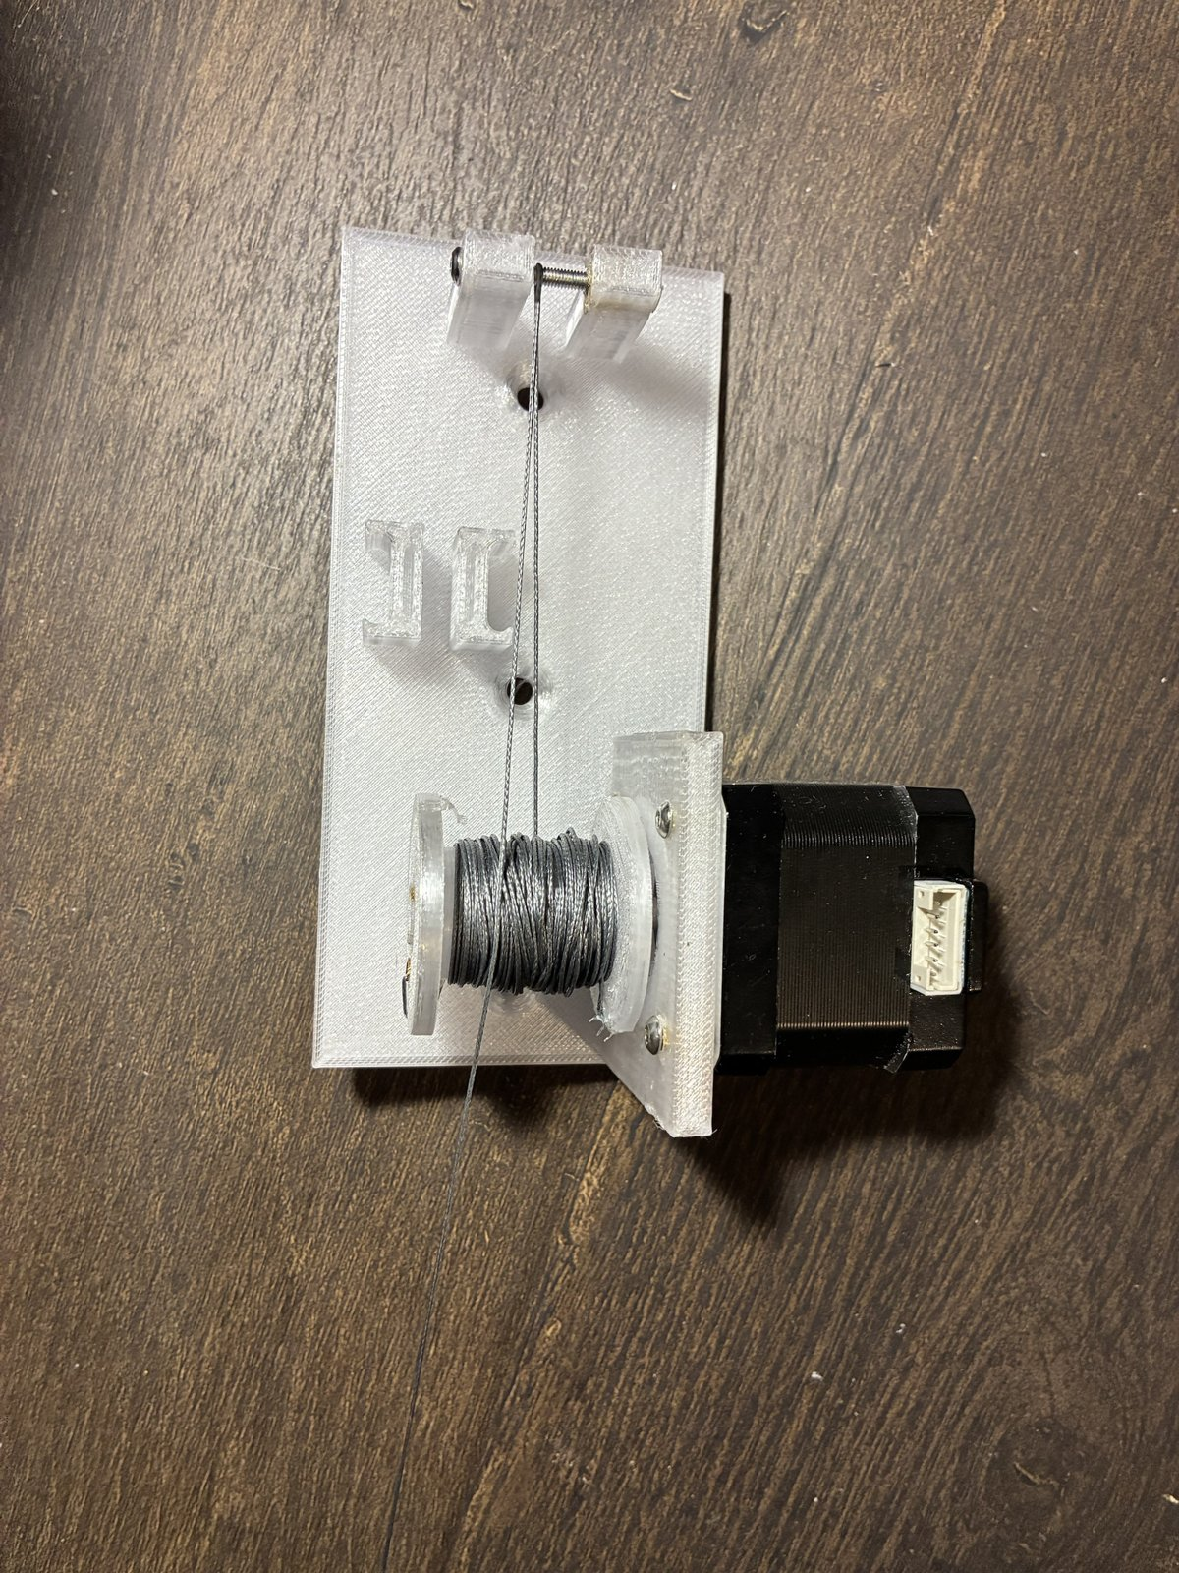
The first design drove all four motors from one central controller
One Arduino Uno and a CNC shield with four A4988 drivers, in a single box
The computer sends moves; the shield steps all four motors from one clock, so sync is free
Each motor gets a long 4-wire cable from the box to its corner
It worked on the bench: a gen-1 station lifted a test weight
Gen 1: central shield with four drivers; spool plate on the wall
Notes:
Simple and synchronised by design. It only stopped working once I wanted more than a motor at each corner.

Slide 11
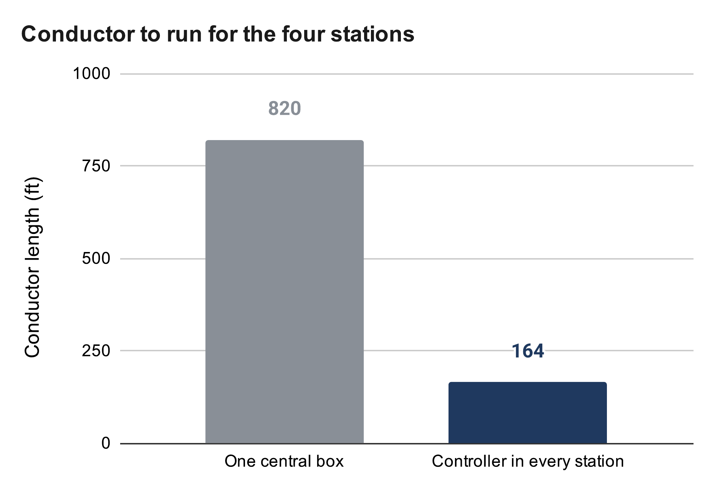
Sensors at every winch made central wiring five times longer
I wanted more safety: a homing switch and an encoder at every winch, plus fault detection
Per corner: motor 4 + switch 2 + encoder 4 = 10 conductors, not 4
Real cable routes are 6, 21, 23 and 32 ft (82 ft)
The encoder's I²C bus is meant for centimetres, not 10 m runs
Motor phase currents in long cables also radiate noise into the sensor lines
Key equations
Source: calculation sheet (Google Sheets), “Wiring” tab. Calculated, not measured.
Conductor = n · ΣL: 10 × 82 ft = 820 ft vs 2 × 82 ft = 164 ft
ΔV = I · R′ · 2L = 2 A × 4.016 mΩ/ft × 64 ft = 0.51 V
16 AWG on the longest run (32 ft); 2 A is illustrative
Notes:
The wire count, not the motors, was the problem. 18 AWG on the same run drops 0.82 V.

Slide 12


A controller in every winch cut the wiring to one power pair
Each station: XIAO ESP32-C3 + A4988 driver + 5 V buck; only 12 V power travels, on 2 wires
Switch and encoder wires stay inside the station, a few centimetres long
The host computer plans the path and sends each station timed segments over Wi-Fi
Each station runs its segments on its own clock; any lost link → hold position
Cost: timing skew between stations becomes cable mismatch, so segments are time-stamped
Benefit: about 5× less wire, and every station can be built and tested alone
Key equations
Δx = v · Δt = 50 mm/s × 50 ms = 2.5 mm of cable mismatch
Gen 2: the station carries its own controller, driver and buck
Notes:
Sync moved from wiring into software: time-stamped segments and a host that keeps every station's clock.

Slide 13
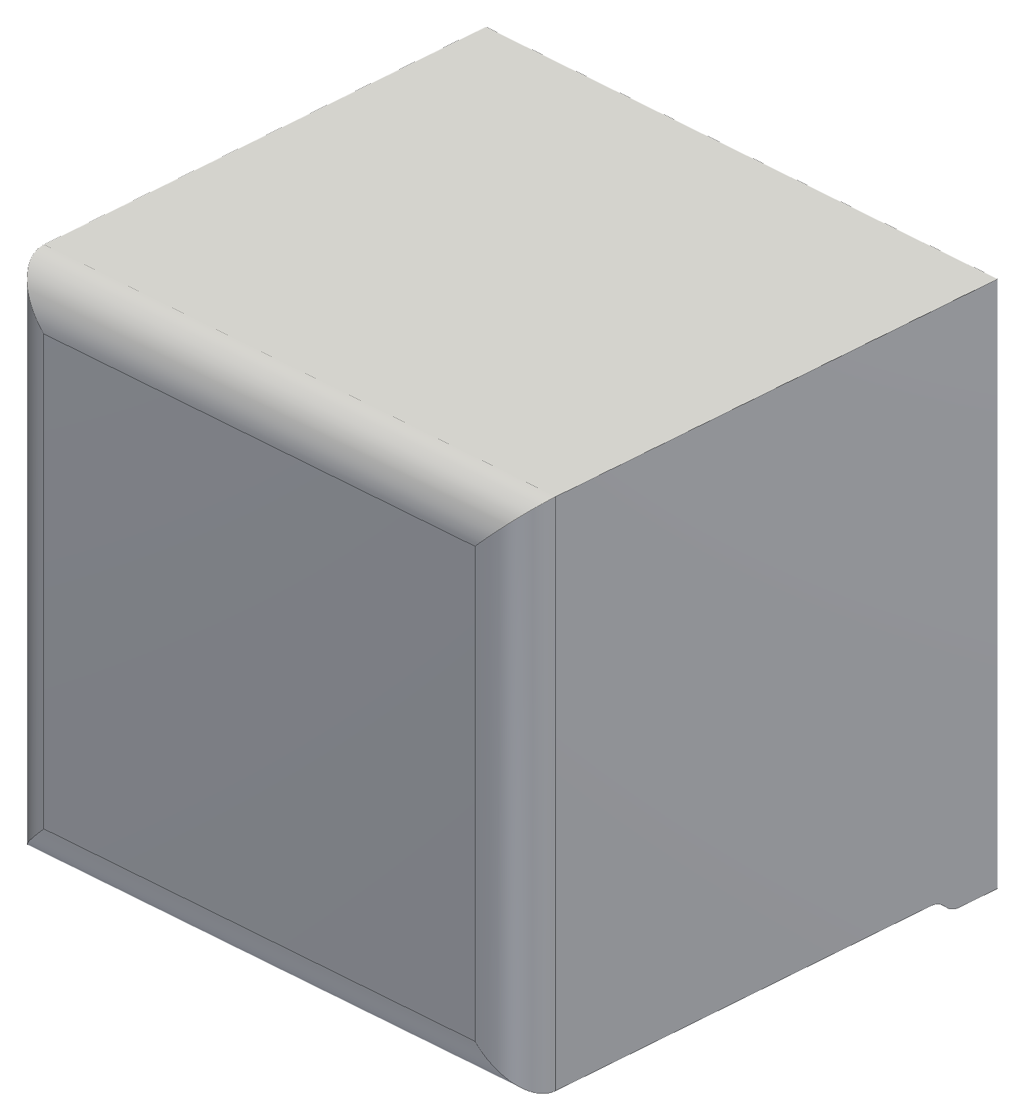
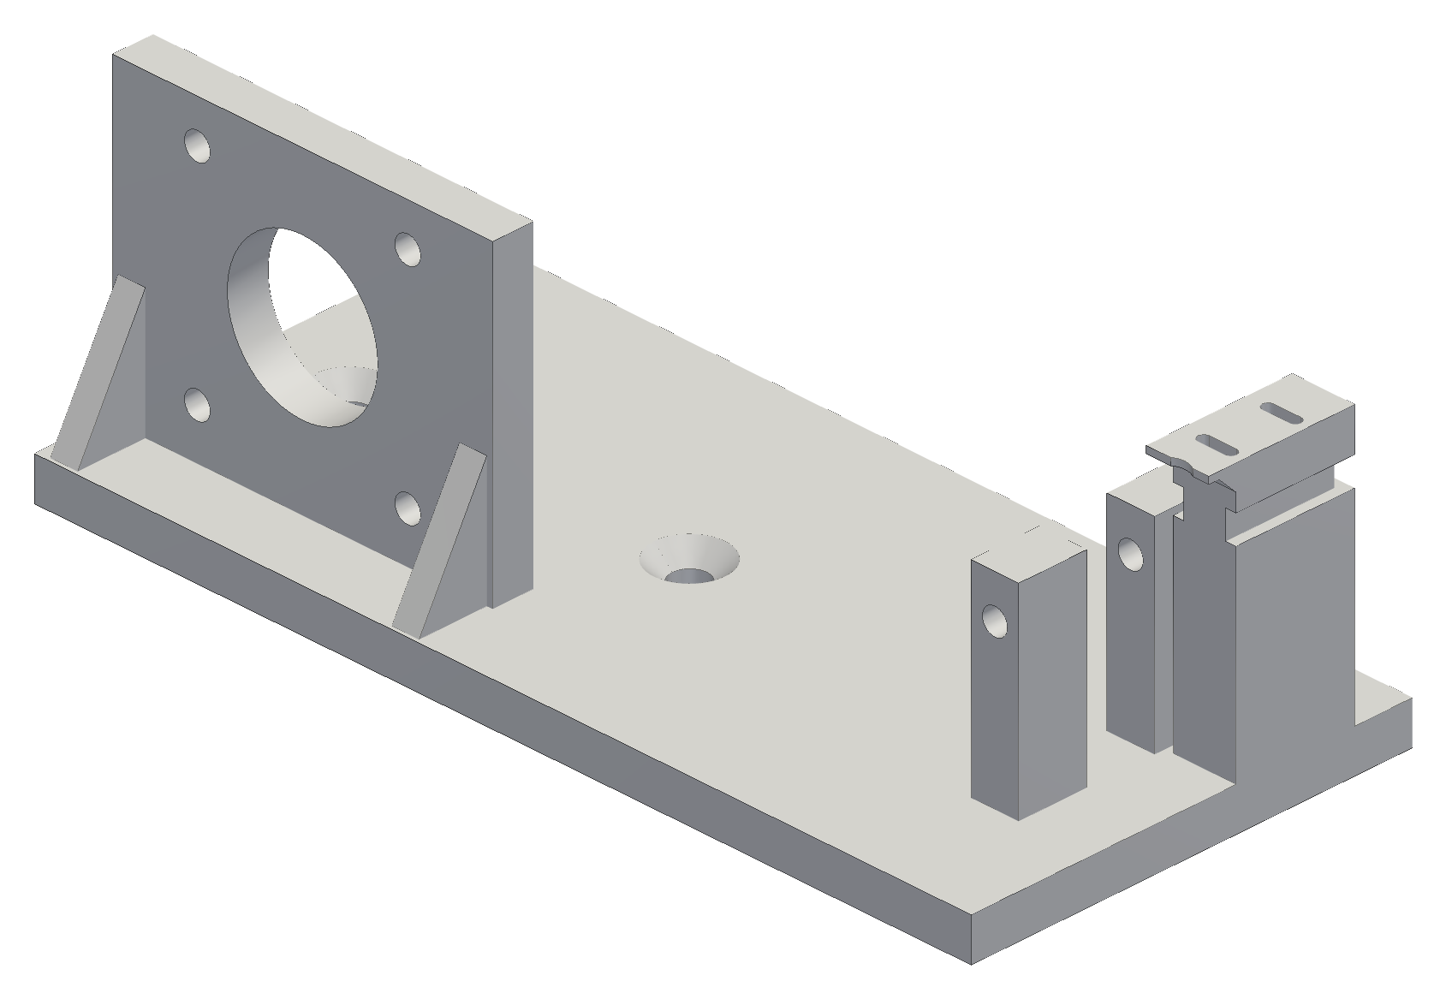
Electronics at every corner turned the wall plate into a housing
Gen 1 was a plate screwed into the wall: fine for a bare motor
Each corner now carries a controller, driver, buck, switch and encoder
  they need protection, a clean look and a path for heat
So each station became a housing: motor, spool, pulley and electronics in one unit
Same unit in all four corners: build one, test one, copy it
Gen-1 corner plate (left) vs the gen-2 station housing (right)
Notes:
Once there are electronics in every corner, the wall plate becomes a product housing.

Slide 14
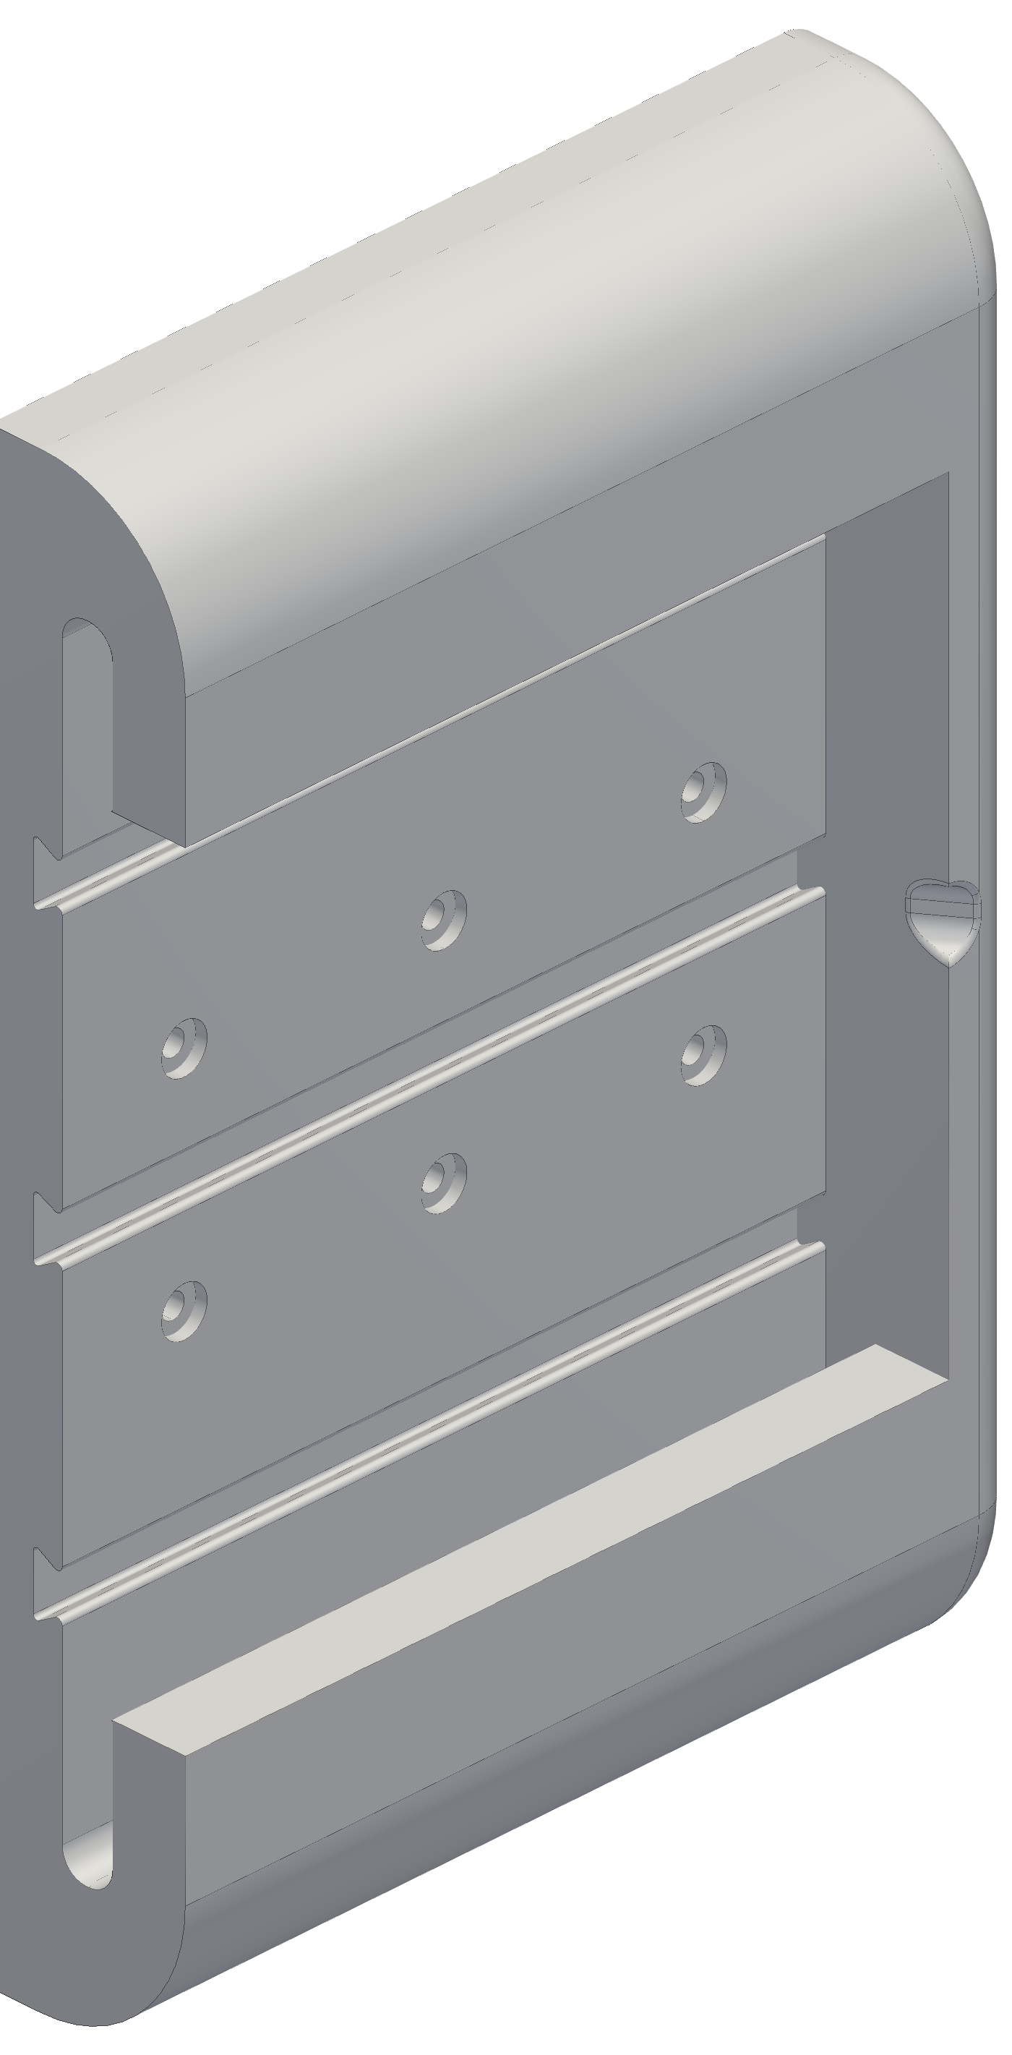
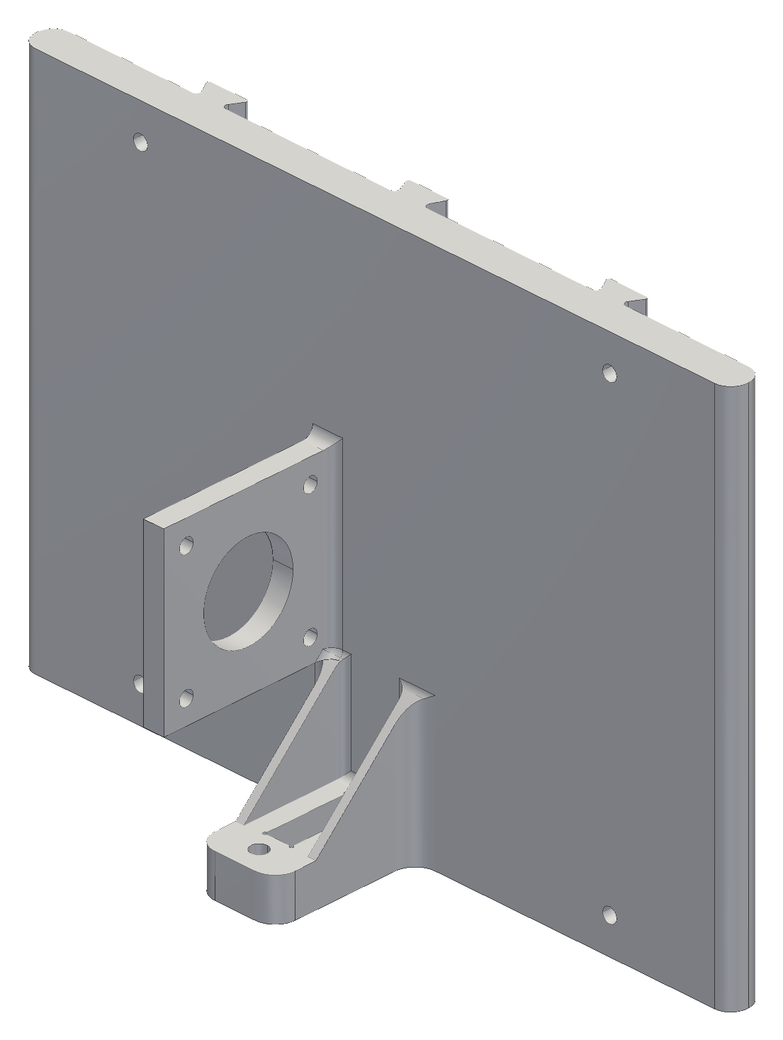
A slide-in mount lets a station come off without moving its anchor
I take stations down often: to test, rework, repair or modify them
Drilling in and out each time damages the wall and moves the anchor point
A fixed wall frame goes into a stud once; the station slides in and locks
Pull it out, rework it, slide it back: the frame keeps the anchor position
Load: the line pulls the station away from the wall (pull-out and prying)
  design target: SF 3 at 34 N; SolidWorks study planned
Key equations
SF = σ_{allow} / σ_{max} ≥ 3 → σ_{max} ≤ 25 MPa / 3 = 8.3 MPa
Allowable: derated PETG yield, 25 MPa
Fixed wall frame (left) and the slide-in piece (right)
Notes:
34 N is the snag case: holding torque at the empty spool. The study checks stress below 8.3 MPa (derated PETG / 3) and deflection at the cable exit.

Slide 15
The robot measures its own geometry every time it is set up
Every time the stations go back up, the robot measures its own geometry
  no tape measure, no numbers typed in, nothing for a user to get wrong
The claw camera reads a printed floor board (a grid of tags) to get the claw's pose
The robot moves through a set of poses and fits the anchor positions and cable lengths by least squares
Works in any room the cables can reach, so it can become a consumer product
1 Take up slack, one cable at a time
2 Lift the claw off the floor
3 Camera reads the floor board
6 Ready, inside the safe margins
5 Check on held-out poses
4 Fit anchors and cable lengths
Startup calibration; the claw camera looks straight down at the board
Notes:
Simulated so far; the hardware run is the first test.

Slide 16
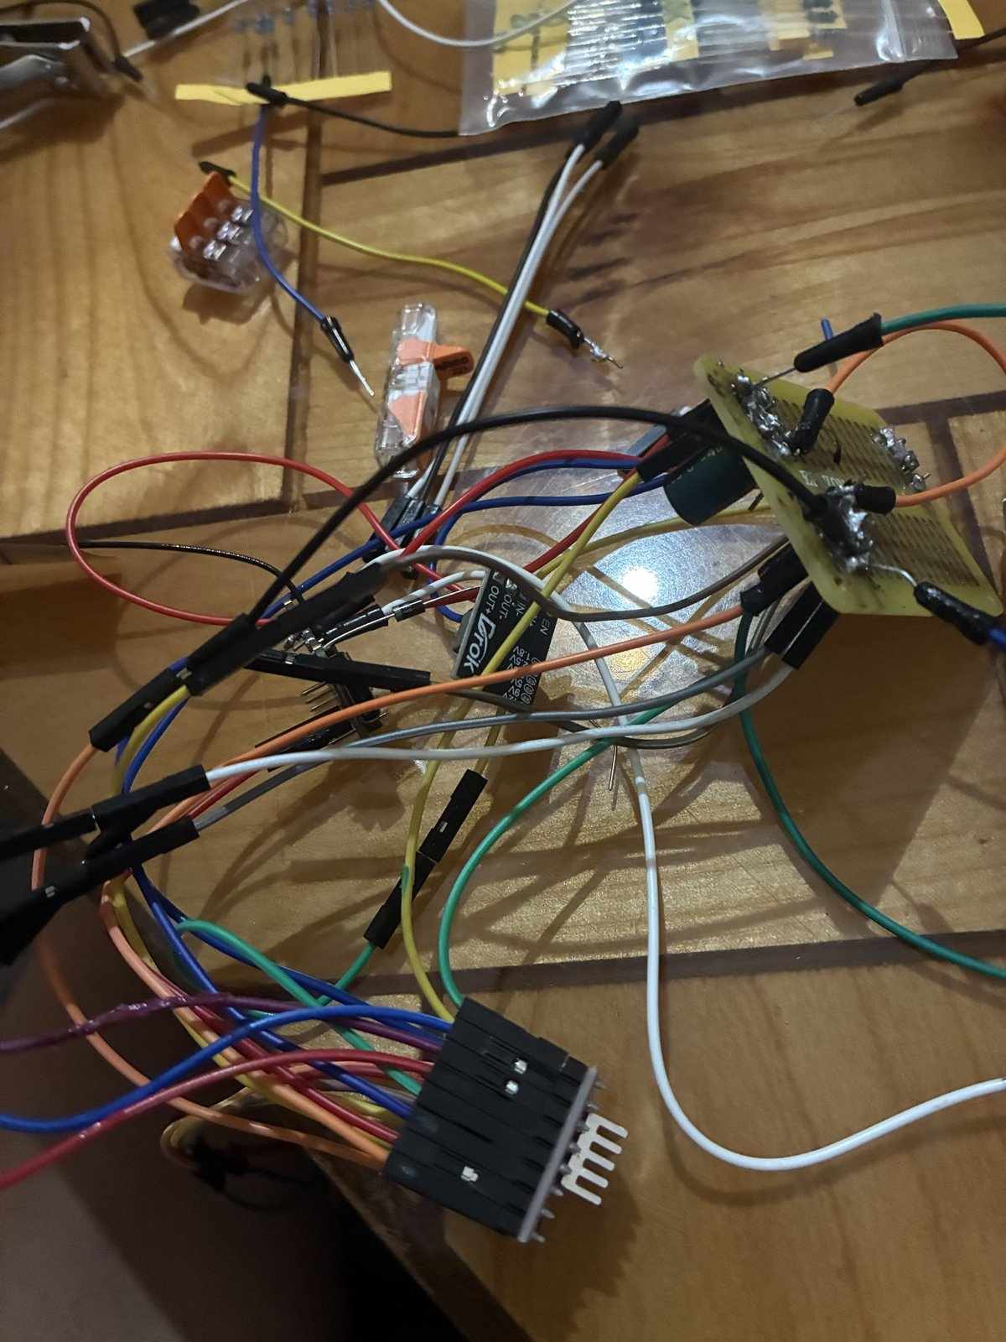
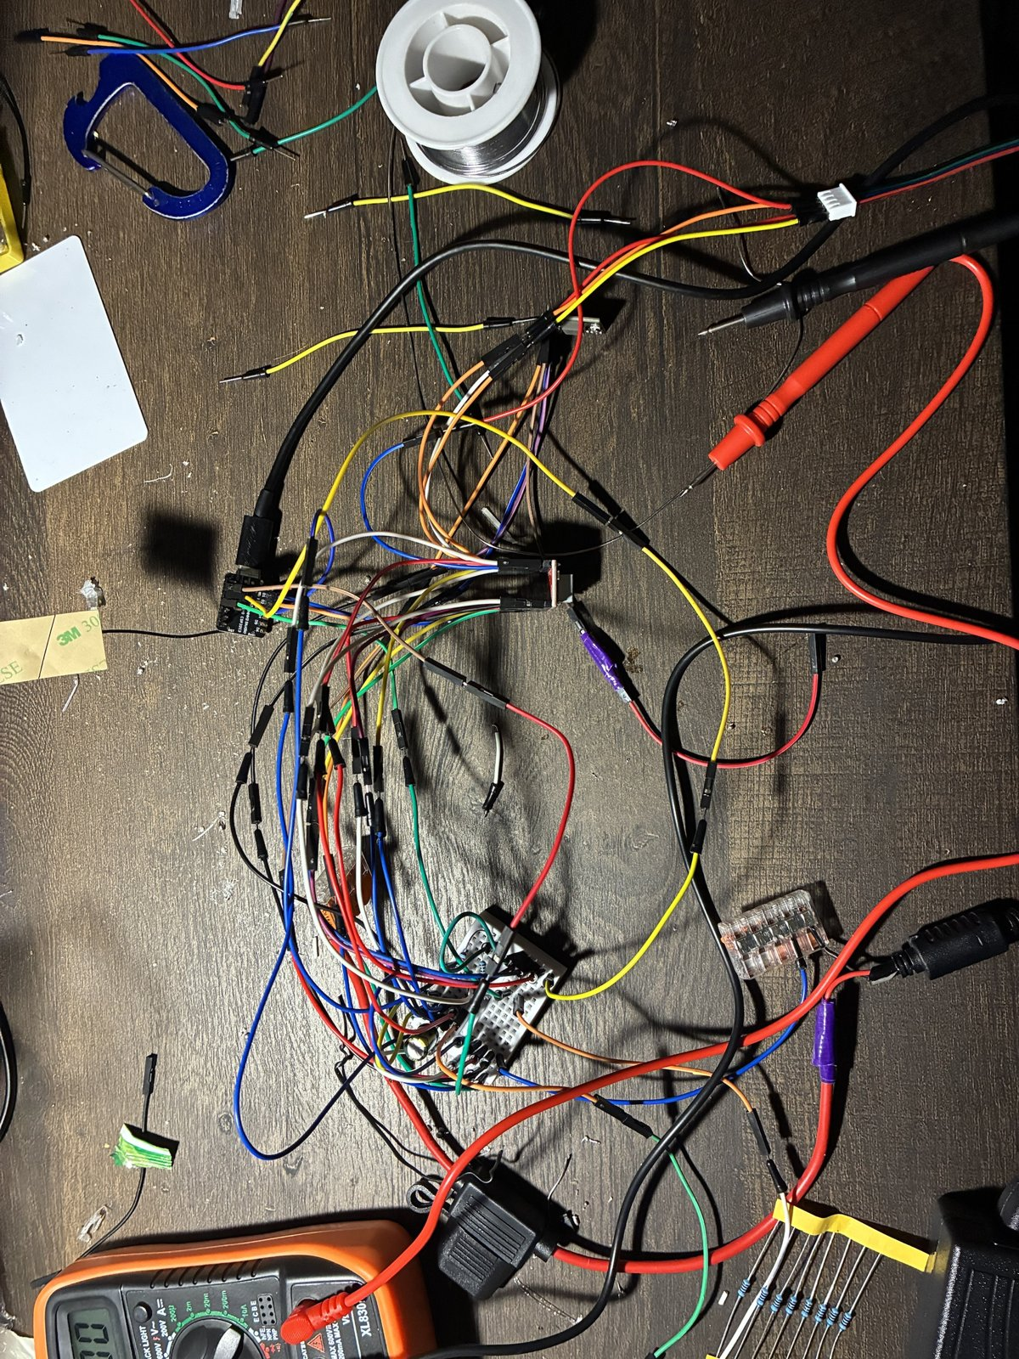
Each station needs only one 12 V cable, so it unplugs cleanly
Each station has one cable: a 16 AWG pair from a fused 12 V supply
Plug in to use; unplug and store the cables when the robot is not needed
Stations slide off the wall frames if wanted
Runs cut at 9, 24, 26 and 35 ft (94 ft of a 100 ft roll), a fuse per branch at the supply
The motor stays wired inside the station, so it is never unplugged under power
The switched power strip is the one hard stop
Inside a station: the buck converter and its wiring; only 12 V comes in
Notes:
Unplugging a motor from an energised A4988 can kill the driver, so the plug carries only 12 V.

Slide 17
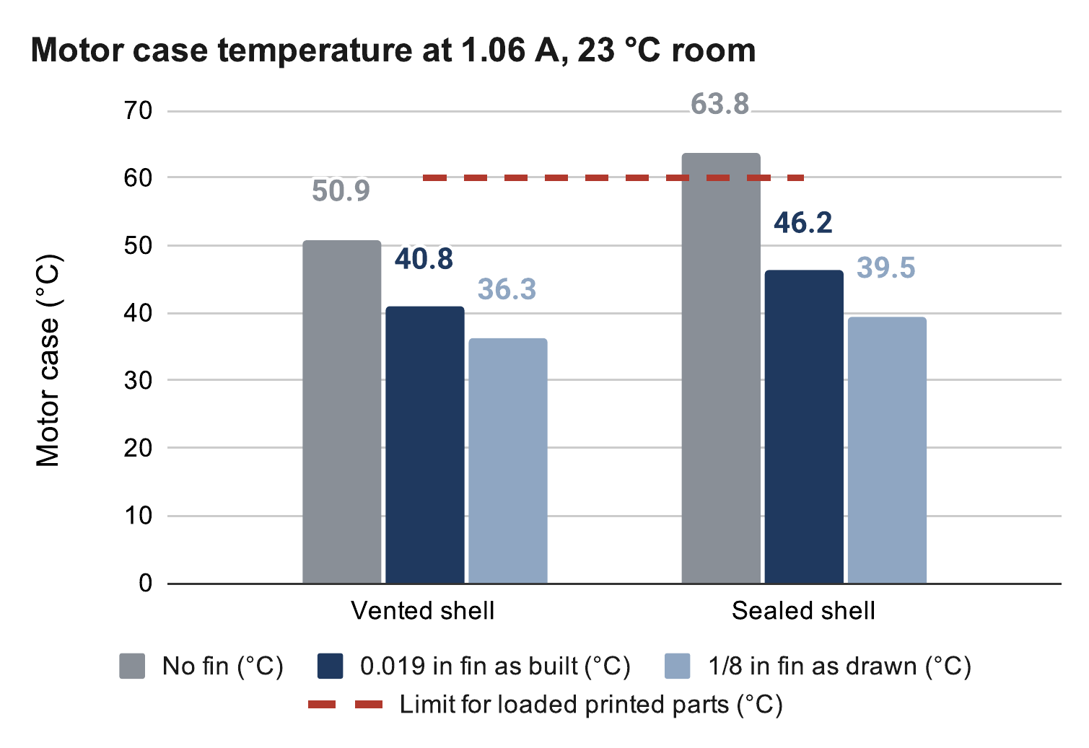
Without the fin, a sealed housing would push the motor past 60 °C
A sealed printed housing traps the motor's heat
  PETG at the loaded motor mount softens and creeps: 60 °C limit
Fix: vents, plus an aluminium fin straight up through the shell
Model: motor → shell air → room, the fin a second path out
At 1.06 A: sealed 64 °C without the fin, 46 °C with it
A 90-min hold test will measure it
Key equations
Source: calculation sheet (Google Sheets), “Motor temperature” tab. Calculated, not measured.
P_{m} = I² R = (1.06 A)² × 1.8 Ω = 2.0 W
ΔT = q · R_{th} (heat flow × thermal resistance)
Fin in parallel with the shell: 1/R = 1/R_{shell} + 1/R_{fin}
Notes:
The fin carries about half the heat in the sealed case. PETG softens near 80 °C. Inputs are assumptions until the hold test: 1.8 Ω per phase, 1.5 W of electronics.

Slide 18
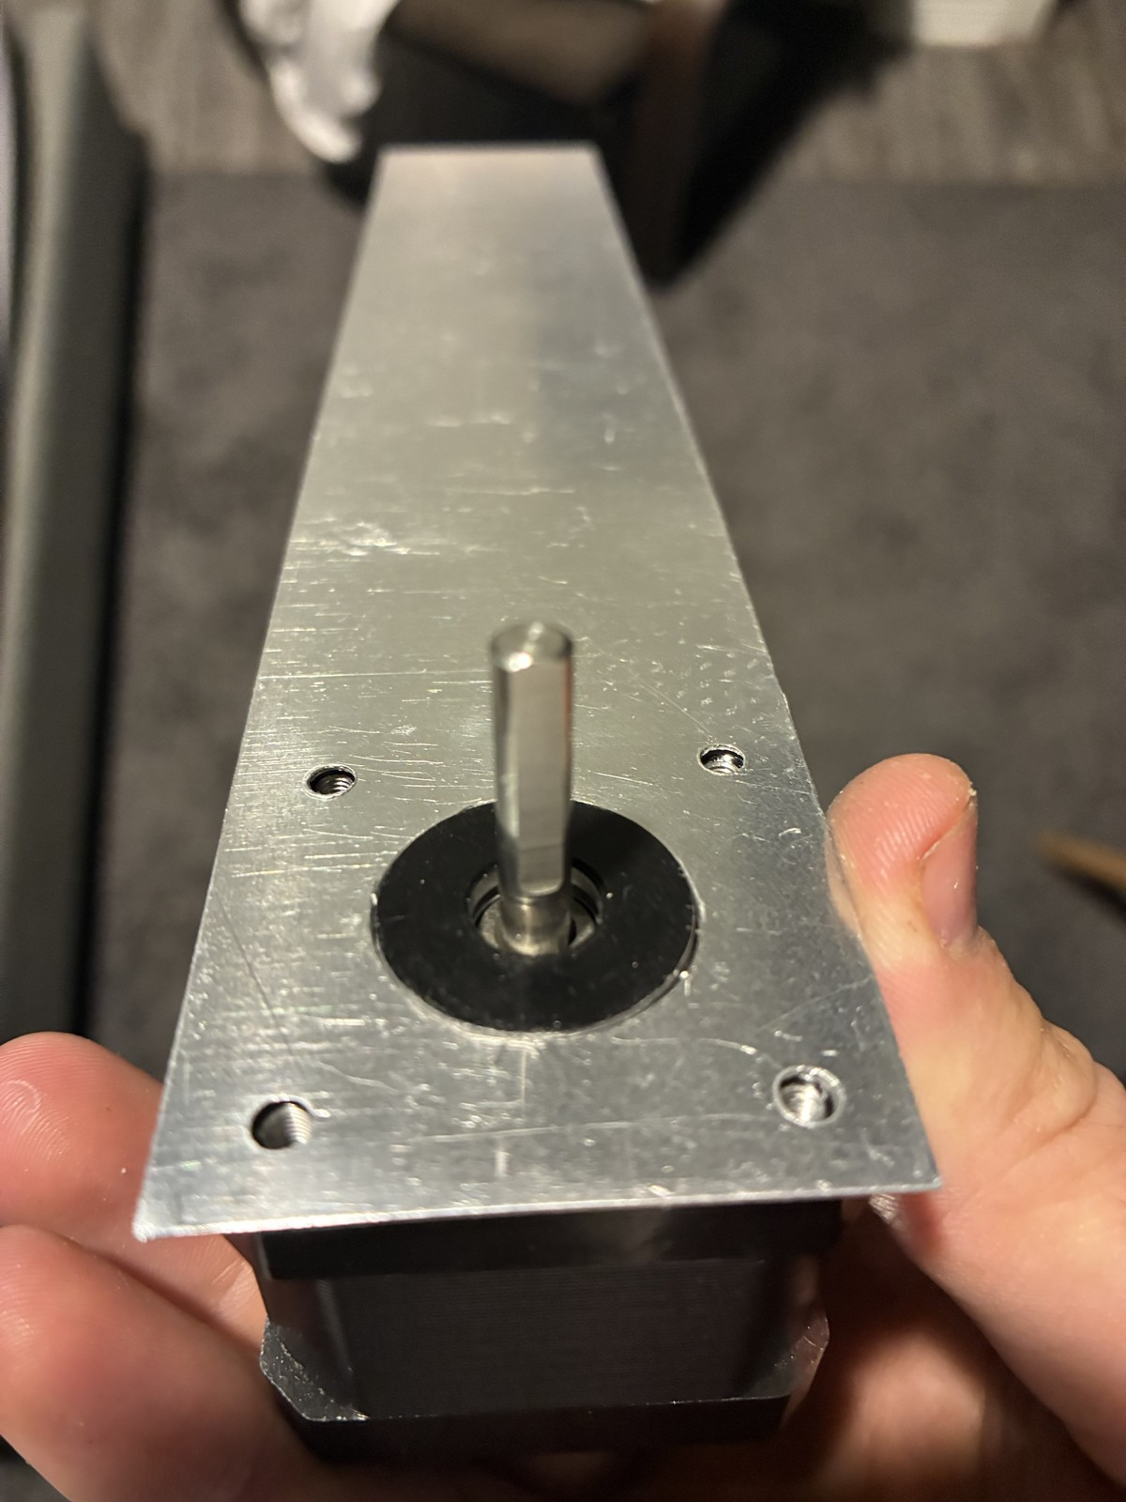
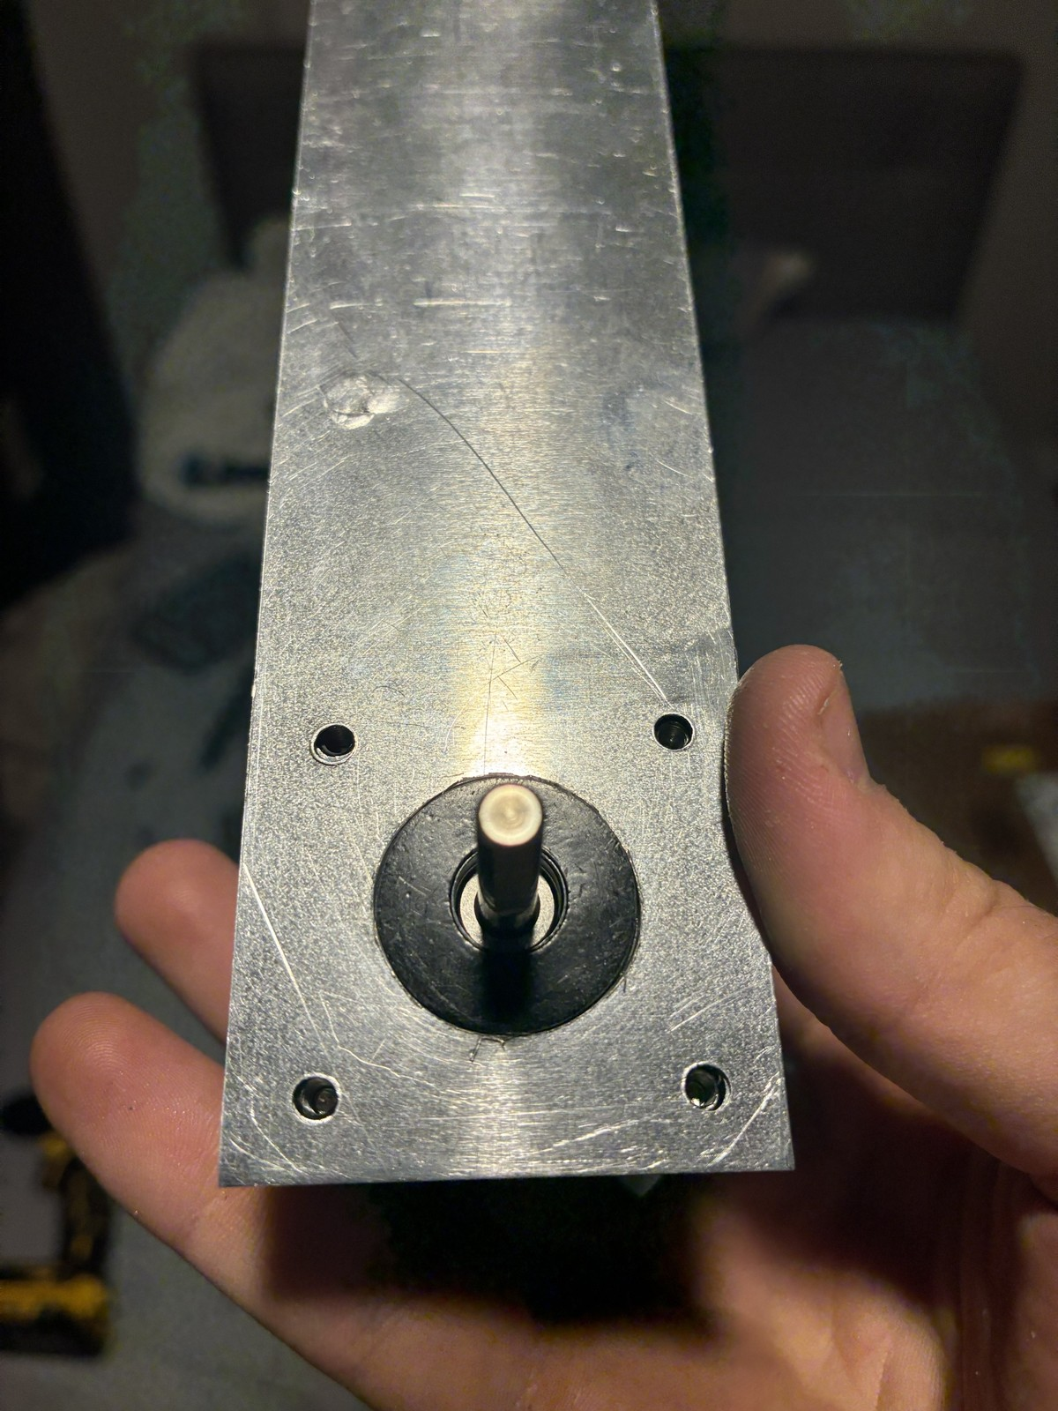
The fin copies an antelope horn: a thin blade that sheds heat
Idea from my bio-inspired design class: antelope horns
A horn is a heat exchanger: warm blood flows into its core, heat leaves through the surface
The fin copies that: one tall, thin blade rising straight up from the heat source
  heat conducts up from the motor and leaves along the length; the tip runs cooler, like a horn's
Vertical, so warm air rises freely off both faces
Motor width (44 mm): adds height, not width, to the station
Key equations
Horn and fin both shed heat by convection: q = h · A · (T_{s} − T∞)
Tall and thin: large area for little mass, A = 2 w L
The fin on the motor: one tall blade rising from the heat source
Notes:
Background (not on the slide): Taylor's goat experiments found a dense blood supply under the horn sheath and estimated horns carry 1-15 % of the animal's heat loss; Picard et al. found climate-dependent horn structure in bovids. The next slide sizes the length.

Slide 19
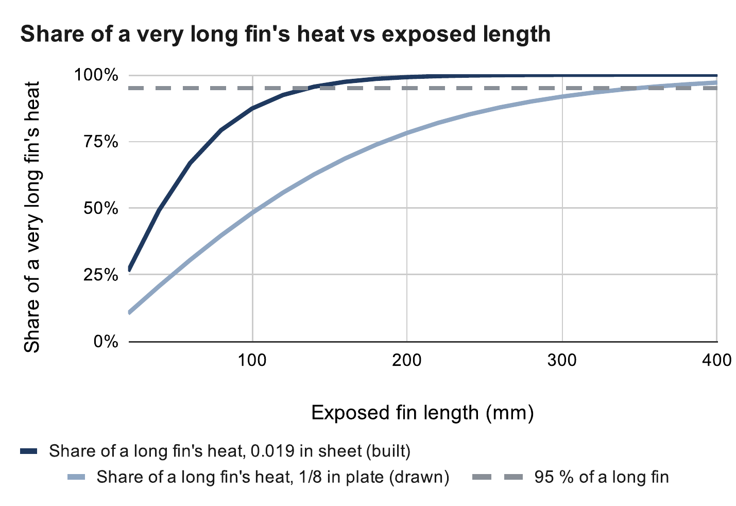
Past 136 mm, the thin fin adds less than 5 % more cooling
The far end runs cooler, so each extra mm does less
0.019 in sheet (built): 95 % of a long fin's heat by 136 mm
1/8 in plate (drawn): 95 % by 349 mm
Built 200 mm above the cover: past 136 mm the sheet adds < 5 %
Looks: horn-like, motor width (44 mm), matte black to radiate more
Key equations
m = √(2h / (k t)), η = tanh(mL) / (mL)
95 % length: tanh(mL) = 0.95 → L = 1.83 / m
k = 160 W/m·K, h = 7 W/m²·K, t = 0.48 mm → 136 mm
Source: calculation sheet (Google Sheets), “Heat fin” tab. Calculated, not measured.
Fin equations: Incropera et al., Fundamentals of Heat and Mass Transfer, ch. 3
Notes:
Efficiency at the built length: 37 % (sheet) vs 74 % (plate); fin resistance 22.1 vs 10.9 K/W. The 200 mm length was sized for the 1/8 in plate; the thin sheet would do the same job at about 140 mm.

Slide 20
03
Homing and calibration
Why the first homing plan limited the robot, and what replaced it
Notes:
Why the first homing plan limited the robot, and what replaced it

Slide 21
The first plan homed each cable with a bead and a switch
A bead on each cable trips a switch at the outlet → a known cable length
The robot zeroes itself from that: set it up anywhere
I expected that to be enough, possibly even without encoders
Detail fixed early: the switch moved below the pulley, so the bead never rides over the pulley groove
KW12-3 homing switch on the bench
Notes:
The idea was a cheap absolute reference per cable.

Slide 22

Bead homing at one point leaves under a third of the room reachable
A bead cannot pass the outlet, so a cable can never be shorter than its homing length
To home all four at one point, each bead sits at that point's length
  then the claw can never get closer to any anchor than from that point
Homing at the room centre 1 m up → about 5 % of the working volume reachable; 2 m up → about 29 %
And vision alone knows cable length to ~20–25 mm, while a bead allows ~12 mm of overtravel: a bead search was not safe either
Source: calculation sheet (Google Sheets), “Bead homing” tab. Calculated, not measured.
Key equations
L_{i}(p) ≥ L_{i,home} = ‖a_{i} − p_{home}‖ for every cable i
Reachable: every cable at or above its homing length
Notes:
Calculated over the working volume with 0.2 m wall and 0.4 m ceiling margins. This tradeoff is physical: software cannot remove it.

Slide 23
Camera poses fit the geometry, and safety margins cover the error
Startup: take up slack one cable at a time, lift, then look at the floor board from several poses
Least-squares fit of the anchor positions and cable zero lengths; held-out poses check the fit
Safety comes from margins, not precision
  0.4 m below the anchors and 0.2 m inside the walls unless the error bars allow more
Beads stay as end-of-travel safety switches; encoders watch for lost steps
1 Take up slack, one cable at a time
2 Lift the claw off the floor
3 Camera reads the floor board
6 Ready, inside the safe margins
5 Check on held-out poses
4 Fit anchors and cable lengths
If the fit is not good enough: more poses, then fit again
Key equations
min over a_{i}, L_{i0}: Σ_{k} Σ_{i} ( L_{i0} + d_{ik} − ‖a_{i} − p_{k}‖ )²
Full workspace only if k · σ ≤ margin
d: cable paid out at pose k (encoder); p: claw position from the camera
Notes:
The robot only unlocks the full workspace when k × σ fits inside the margin; otherwise it stays local. Simulated so far.

Slide 24

Seeing four tags instead of one cuts position error from 6.6 to 0.7 mm
Angle error becomes position error through the lever arm
One tag: 12.9 mrad × 0.51 m ≈ 6.6 mm per frame
Four tags in view: about 0.7 mm
The board is a printed grid at 250 mm pitch: cheap, and it works in any room
Averaging frames helps only with random noise, not with a fixed bias
Source: calculation sheet (Google Sheets), “Floor board” tab. Calculated, not measured.
Key equations
δx = σ_{θ} · L = 12.9 mrad × 0.51 m = 6.6 mm
Notes:
Two tags: 4.85 mrad → 2.5 mm. Noise model: 0.3 px corner noise, 520 px focal length (camera not yet calibrated).

Slide 25
04
The claw
From fingers to a parallel-jaw gripper
Notes:
From fingers to a parallel-jaw gripper

Slide 26

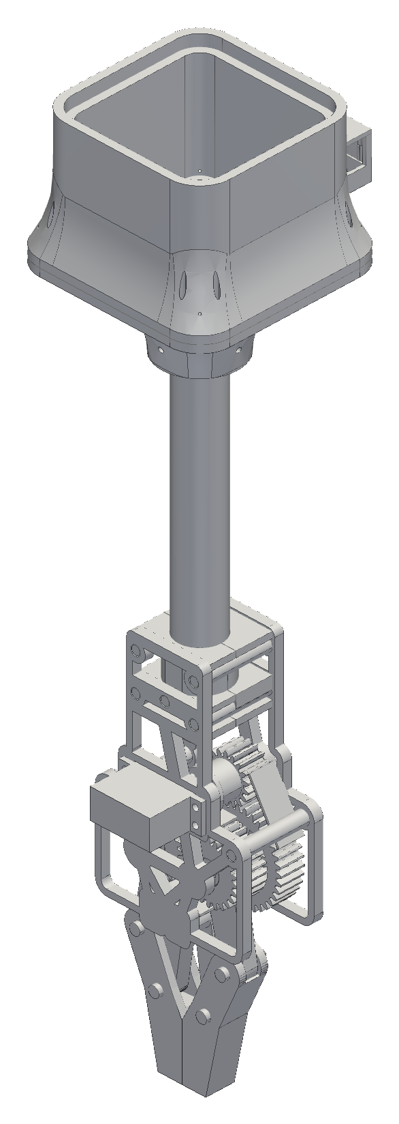


Each claw generation fixed a problem found in the one before
Five tendon-driven TPU fingers → a geared clamp → a lighter open frame → the final parallel-jaw gripper
Each step fixed a problem I found:
  the first clamp's jaws could not pinch thin fabric
  the v6 clamp was about 4.6× its mass budget
  v7 cut the gearbox frame to 143 g
Final: my gear housing and arms, with hands designed to fit them
Fingers, v6 clamp, v7 open frame, final gripper
Notes:
Mass drove most of the changes; every gram of claw is a gram of laundry the winches cannot lift.

Slide 27
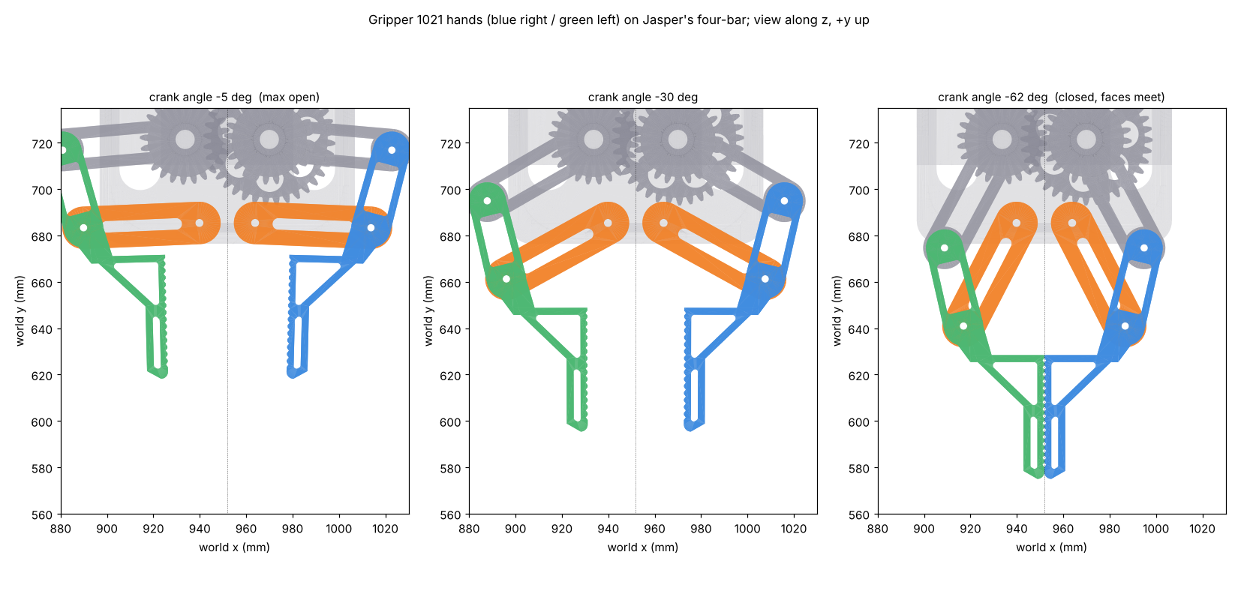
A geared four-bar keeps the jaws parallel through a 53 mm stroke
Servo → 18T pinion → 36T/24T compound → 24T sync gear: mirror-image jaws
Each hand: gear crank (53 mm) + swing arm (50 mm), a near-parallelogram four-bar
  jaws stay parallel within about 1° over the stroke
53 mm opening; closing drops the tips ~38 mm: a scoop
Gear teeth at servo stall: safety factor about 2
Swept in CAD: no collisions from open to closed
Key equations
Gear ratio i = 36 / 18 = 2 (servo → crank)
Grip: 2 μ N ≥ m g → N ≥ 7.4 N per jaw (1 lb, μ = 0.3)
Lewis: σ = F_{t} / (b m Y), F_{t} = 2τ / d
Hands on the linkage: open, mid, closed
Notes:
Four-bar: ground 36.5, crank 53, rocker 50, coupler 34.7 mm. Lewis: module 1.5, PETG allowable 22.5 MPa.

Slide 28
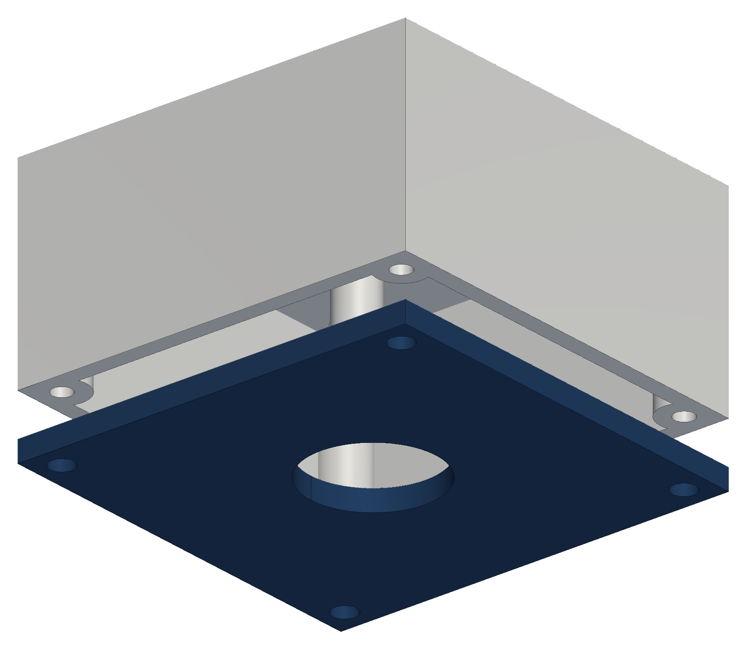
The first setup found laundry with one camera on the ceiling
One camera on the ceiling, looking straight down and framing the whole floor
A detector that works from words (YOLO-World) finds “sock”, “towel”, “t-shirt” with no training
Each item's bottom-centre pixel, where it meets the floor, becomes a floor position
  straight-down camera: scale by the room size; tilted camera: a homography from four taped floor points
The claw then flies to that point and grabs
The camera board sat in a printed ceiling case: shell plus a screw-on lens bezel
Key equations
Straight down: x = u · W / w_{img}, y = v · D / h_{img}
Tilted: (x, y, 1) ∝ H · (u, v, 1), H fitted from 4 floor points
u, v: pixel; W × D: floor size; w × h: image size in pixels
Gen-1 ceiling camera case: shell and lens bezel (45 g PETG)
Notes:
Gen 1 found laundry from above and mapped it to the floor; the claw only had to go there.

Slide 29
The camera moved from the ceiling to the claw, right at the grasp
The overhead camera was one more device to mount, wire and calibrate in every room
The claw and cables hide the spot right where it grasps: it cannot see the grip
Its floor map assumes a flat floor, but a pile of clothes has height
Now: a XIAO ESP32-S3 Sense camera in a bay in the claw's housing, looking straight down the tube
One camera, two jobs: it guides the grasp up close and reads the floor board for calibration
Cost: it sees less of the room at once, so the robot scans by moving
Camera bay on the electronics housing (cover in navy)
Notes:
Sees the grasp spot from about 17 cm; at contact the jaws hide it, so the last view guides the final approach. The gen-1 camera case and its software are kept in the repository.

Slide 30
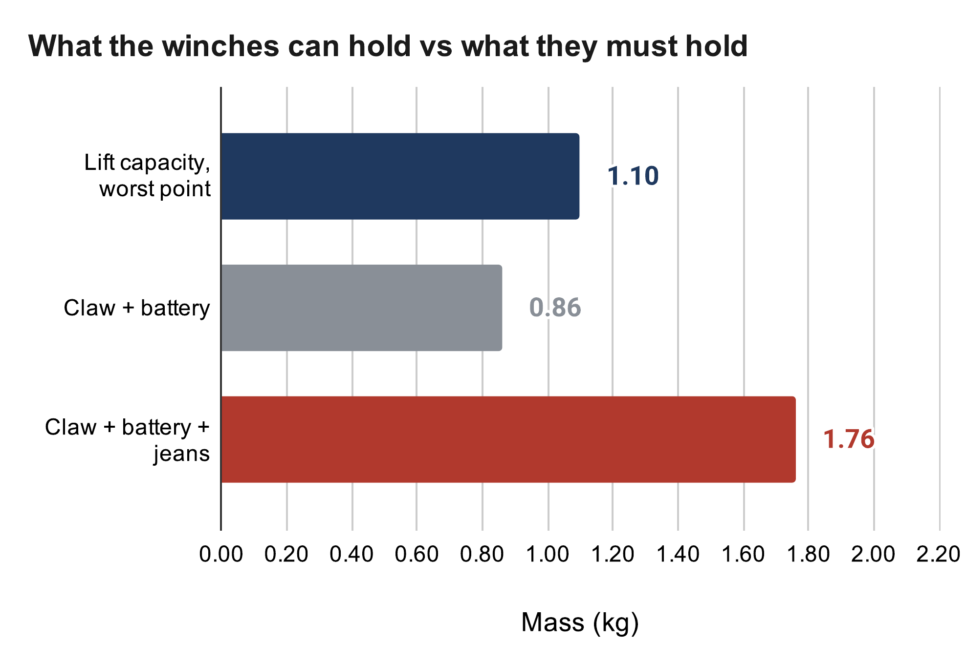
Today the claw plus jeans is heavier than the winches can lift
Driver limit 1.06 A → running pull ≈ 18–24 N per winch (full vs empty spool)
  about 1.1 kg total lift at the worst point in the room
The claw is not weighed yet: CAD says ~0.76 kg printed, plus a 0.1 kg battery
With jeans that is above the capacity today: this is the open problem
Options: lighten the claw, a 3:1 winch reduction (~2.7× pull), or a lighter demo load
  next step: a luggage-scale pull test on one station decides
Source: calculation sheet (Google Sheets), “Lift budget” tab. Calculated, not measured.
Key equations
Σ T_{i} u_{iz} = m (g + a), 0 < T_{i} ≤ 11.9 N (worst point in the room)
m_{claw} ≈ f ρ V + m_{tube} + m_{servo} = 0.55 × 927 g + 198 g + 55 g ≈ 0.76 kg
Notes:
Honest status: the numbers say the current claw plus jeans is too heavy. The pull test turns the 0.7 running-torque assumption into a measurement.

Slide 31
05
Manufacturing
Printed PETG parts, and a heat fin cut and drilled on a manual mill
Notes:
Printed PETG parts, and a heat fin cut and drilled on a manual mill

Slide 32
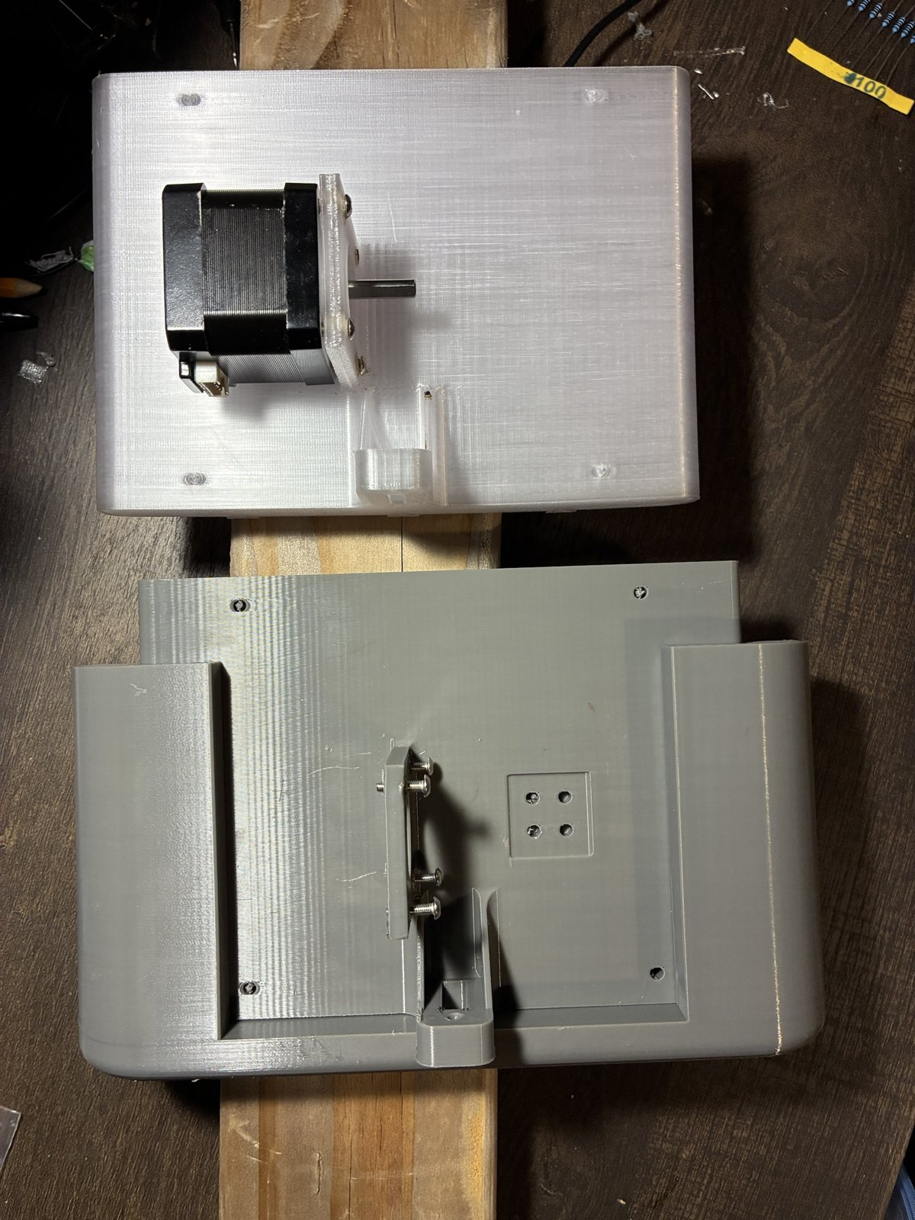
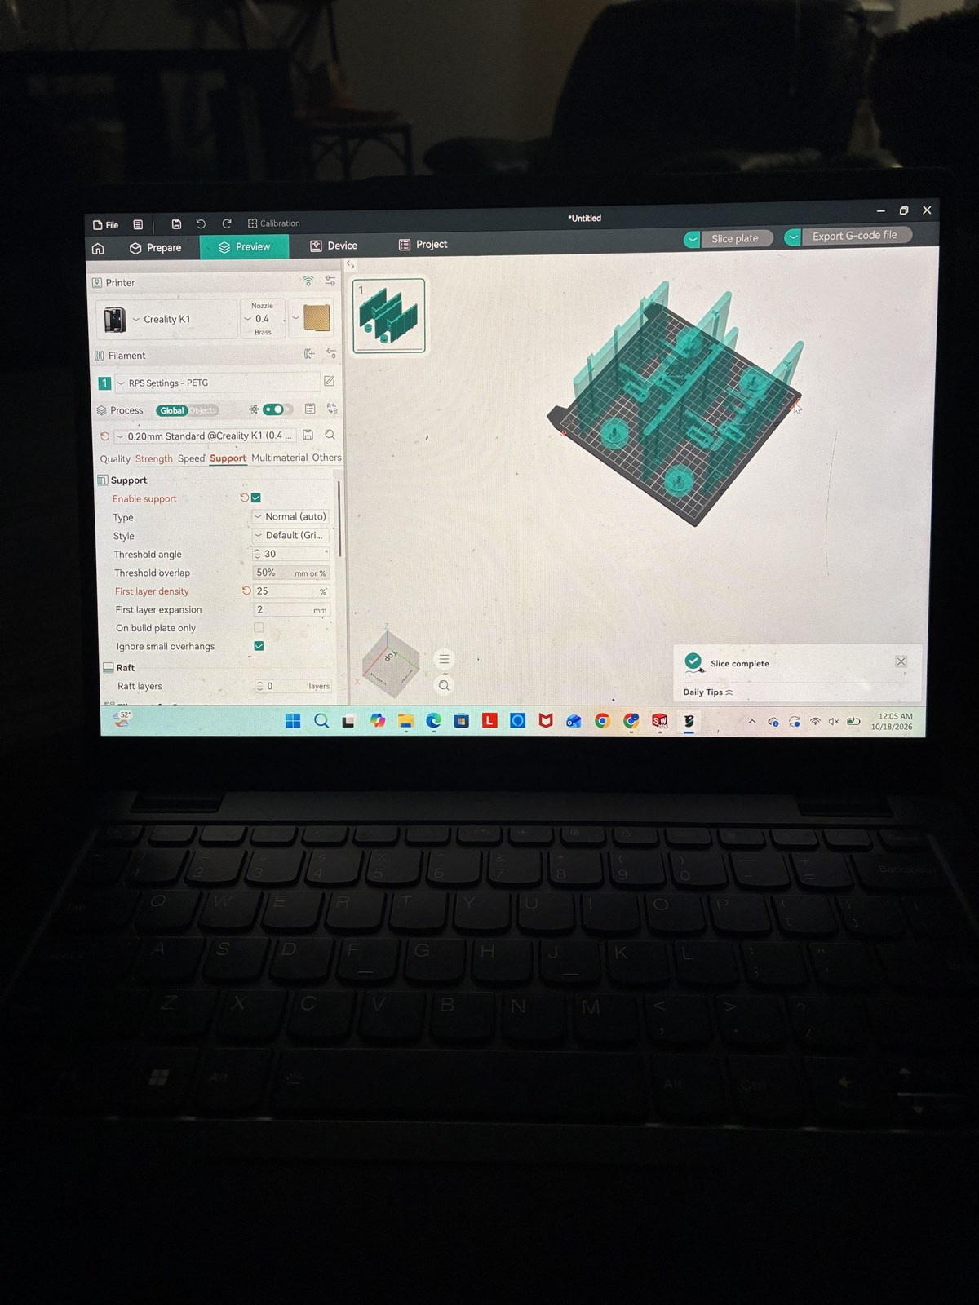
Every printed fit is designed for how FDM prints, then measured
PETG on a Creality K1 (0.4 mm nozzle, 0.2 mm layers); PLA creeps under load
Orientation: flat face on the bed, loads along the layers, no supports on mating faces
Printed holes come out undersize (bead rounding, shrink, first-layer squash)
  so fits get a lead-in: 687 bearing pocket Ø14.075 with a Ø14.000 entry lip
Heat-set M3 inserts where screws are reused
Fewer parts: camera bay printed into the housing
Key equations
Clearance c = (D_{hole} − u) − D_{shaft}, u = printer undersize
Spool: Ø5.2 too tight → u ≥ 0.2 mm, so Ø5.45 gives c ≈ 0.25 mm
Printed PETG station shells; slicing the plate for the K1
Notes:
Every printed interface is chosen for how it prints and how I can measure it, not just how it looks in CAD.

Slide 33
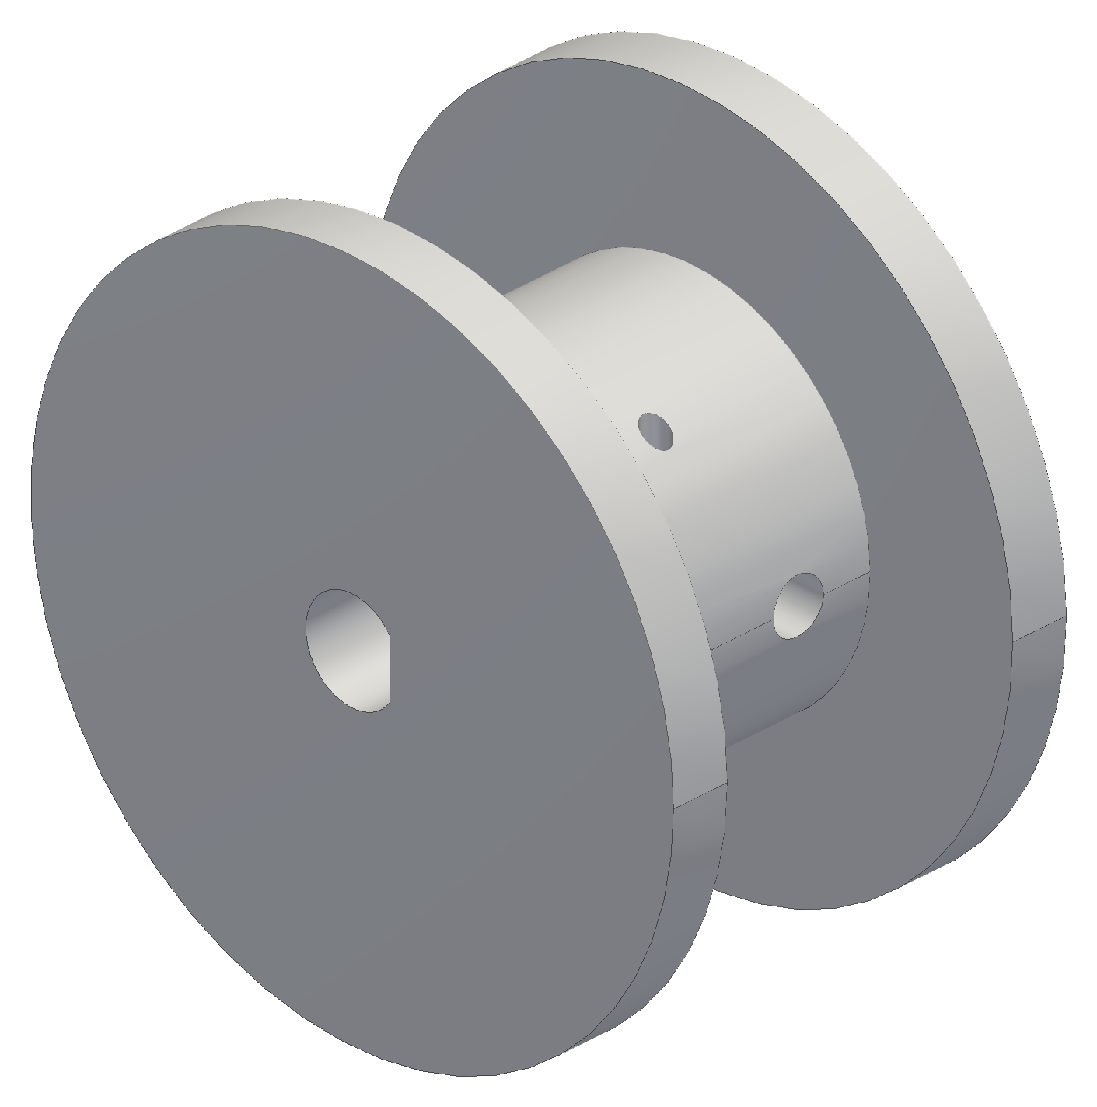


The spool took three prints to fit the shaft and carry the torque
v1: longer than the motor shaft could engage, so it was shortened
v2: the Ø5.2 bore printed too tight on the 5 mm shaft
v3: bore opened to Ø5.45 with a D-flat; the set screw on the flat carries the torque
Ø15 core and 16 mm drum: 20 ft of line in 5 layers with 8 mm of flange margin
Next: a fit coupon before every new interface, measured with calipers
Spool v1, v2, v3 (CAD)
Notes:
The bore fit only locates the spool; torque goes through the set screw on the flat.

Slide 34


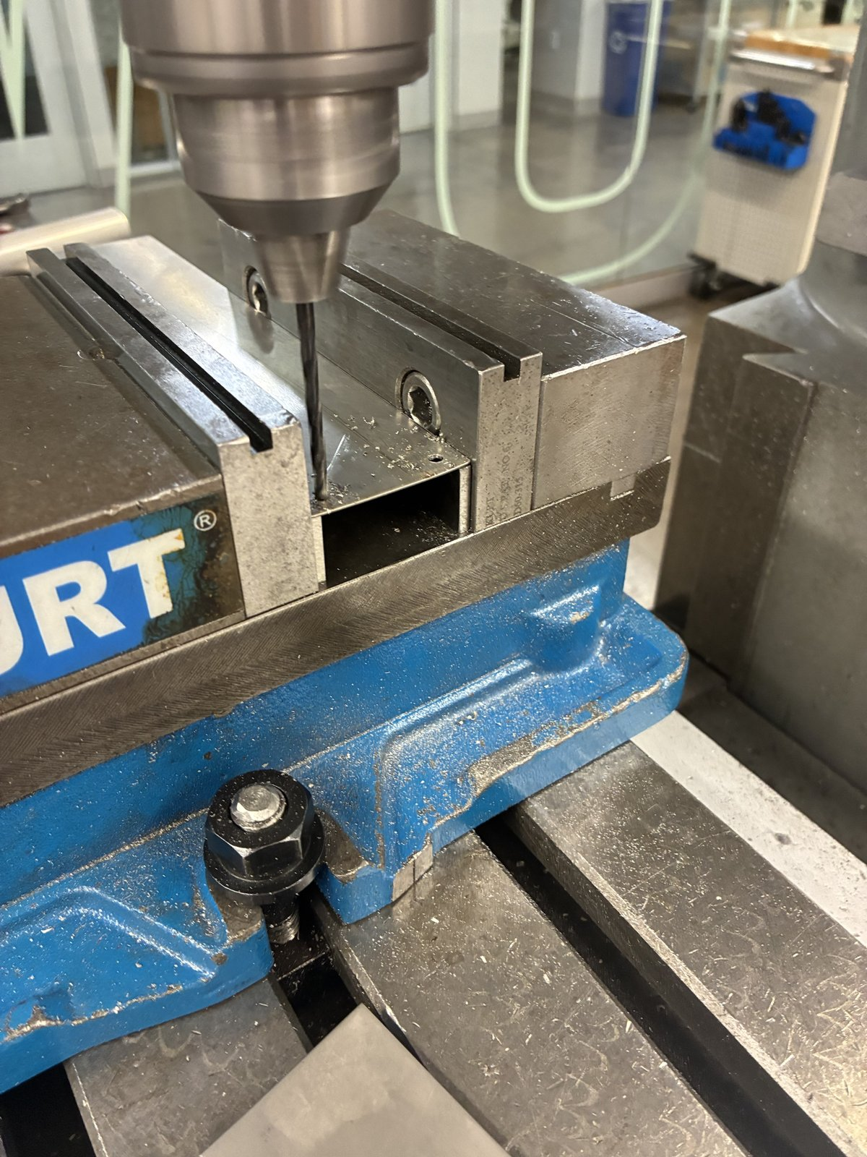

The fin was sheared and drilled in one mill setup to hold ±0.1 mm
Shop drawing first: a 1:1 US Letter print with a hole template and inch dimensions
Sheared the blank from 0.019 in aluminium sheet: 44 × 250 mm (±0.5)
Manual mill, one setup: all five holes located from the bottom and left edges
  7/8 in pilot for the motor boss and 4 × Ø3.4 on the 31 mm motor square, ±0.1 mm to each other
Deburred, then matte black paint except the motor contact square; thermal paste there
Test fit on the NEMA 17: boss centred, all four screws lined up
Shear and blanks, mill setup with the drawing, drilling, the finished fin
Notes:
One setup from the same two edges means hole-to-hole errors do not stack, so the fin bolts on without reaming.

Slide 35
06
Electronics
The station board and a bring-up lesson
Notes:
The station board and a bring-up lesson

Slide 36

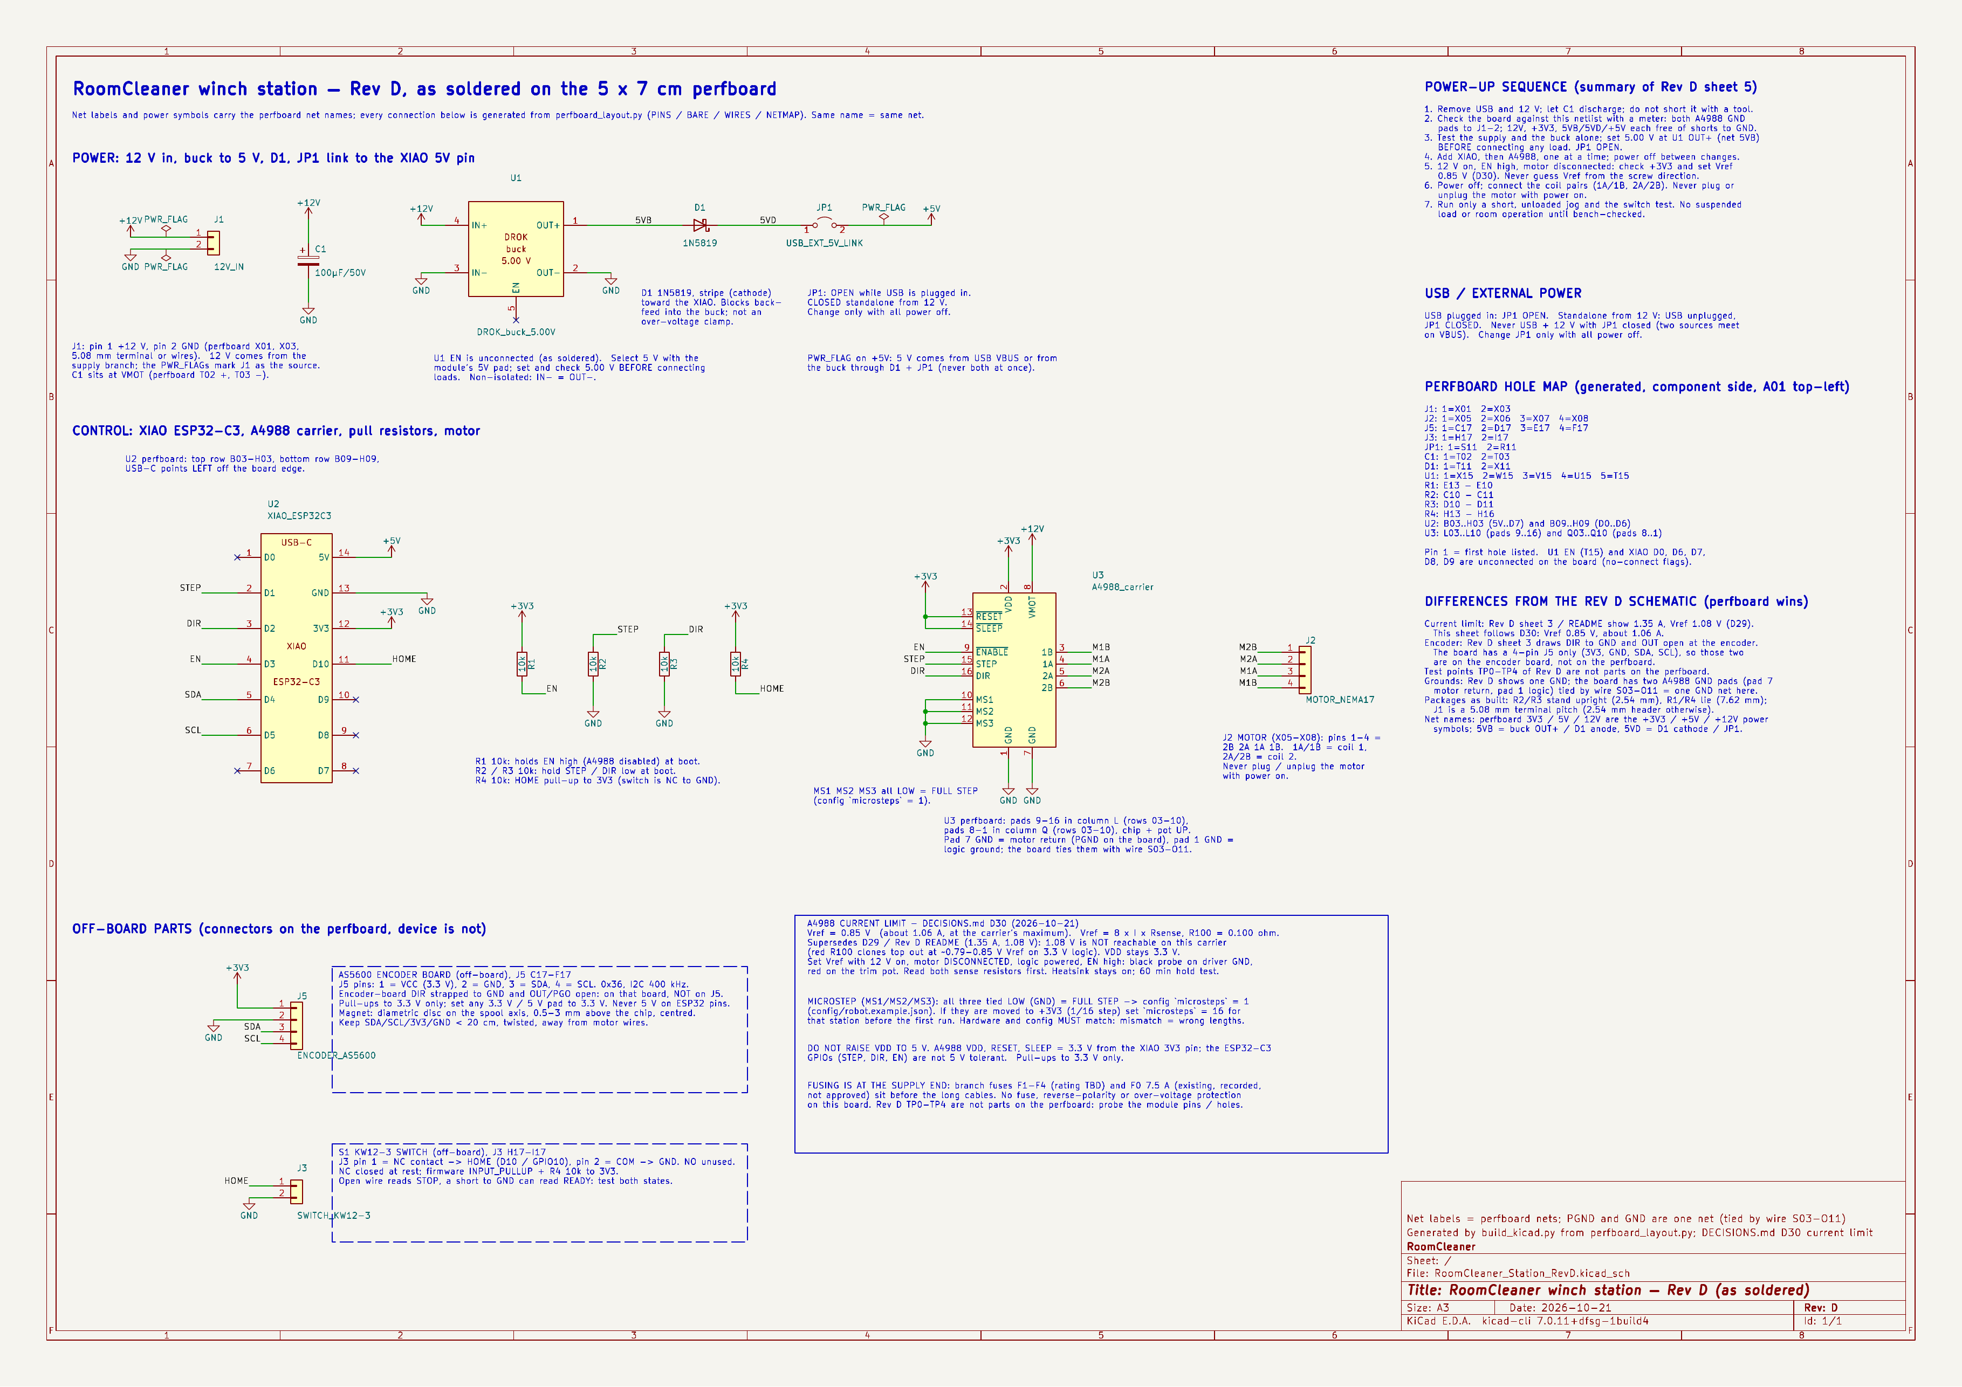
The station board boots safe, and its schematic matches it net for net
The driver boots disabled (EN pull-up): a reset never steps the motor
USB and the 5 V buck cannot back-feed each other: a link jumper plus a Schottky diode
100 µF at the driver's motor supply
Connectors for the motor, homing switch, encoder and 12 V
The KiCad schematic is generated from the soldered board's net list, so the two cannot disagree
KiCad schematic (left), checked net by net against the soldered perfboard (right)
Notes:
Rules check: 0 errors. 16 nets, 55 pins match the perfboard.

Slide 37
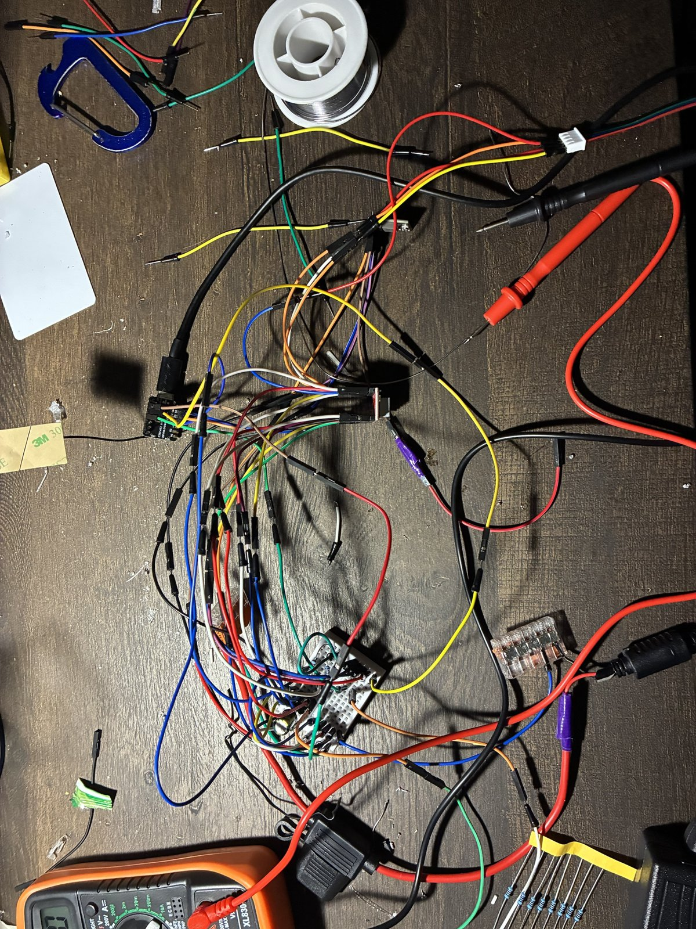

A 1.14 V logic rail, not the code, kept the first motor still
The log said it was stepping; the shaft did not turn
The meter said the logic rail was 1.14 V instead of 3.3 V: a bad connection
After the fix it moved
Since then: a meter checklist before any code
  VDD, SLEEP, ENABLE and the buck output, every new board
Bench wiring and bring-up
Notes:
Lesson: measure before trusting the software's view of the hardware.

Slide 38
07
Control logic
From the first simulator loop to the logic that runs the robot
Notes:
From the first simulator loop to the logic that runs the robot

Slide 39
The first logic trusted its model; the final logic measures, then checks
Gen 1 was written against a simulator: the claw was wherever the cables were told to put it
Real hardware breaks that: lines stretch, pulleys stick, a stepper can skip, anchors are never where the tape says
So the final logic measures before it trusts and checks after it acts
Each row on the right came from a problem earlier in this talk: wiring, homing, the camera
Kept from gen 1: the cable maths, the state-machine idea, the YOLO-World detector
 | First logic (gen 1) | Final logic
Where is the claw? | Assumed: where the cables were told to put it | Measured: claw camera on the floor board, refit at every startup
Room geometry | Point mass; anchors from a tape measure | Rigid claw; anchors and cable lengths fitted, with error bars
Who runs the motors | One central board steps all four | Each station runs time-stamped segments; the host coordinates
Finding laundry | Ceiling camera, pixel to floor map | Claw camera, ray from the claw's pose to the floor
Did the grab work? | Assumed once the claw closed | Camera checks pickup and delivery
Faults | E-stop only; no fault states | Supervisor: stop keeps torque, nothing restarts by itself
Where it may move | Anywhere the cables can hold | Only where the calibration earned trust
Notes:
Same robot, different stance: gen 1 assumed, the final logic verifies. The detector and the kinematics carried over unchanged.

Slide 40
Five layers run the robot, and only the bottom one turns a motor
Each layer talks only to the layers next to it
The phone never moves a motor: it asks the supervisor
The supervisor holds the one robot state and refuses commands that do not fit it
Startup and tasks decide what to do; the planner checks whether it is safe to do it
Stations run the motion on their own clocks and stop together if the host goes quiet
The claw obeys: it grips only when the host approves
Phone app
Start, PAUSE, and a “yes” before every move
Supervisor · host PC
One robot state; refuses commands that do not fit it
Startup and tasks · host PC
Calibrate; then scan, grip, check, deliver
Claw
sends frames; grips only when approved
Planner and coordinator · host PC
Checks every path point, then streams time-stamped segments
Key equations
Stations × 4 · a controller in each
Step the motor, watch the encoder, hold if the link drops
Every path point p_{k}: L_{i} = ‖a_{i} − p_{k}‖, T_{min} ≤ T_{i} ≤ T_{max}
No host message for t > t_{lease} → coordinated hold
Tension includes the claw, the 0.9 kg payload and 2 m/s²; lease 0.3 s in simulation
Commands flow down; status and camera frames flow back up.
Notes:
Zoomed out: phone, supervisor, startup and tasks, planner and coordinator, stations. The claw is a sensor plus a gripper that obeys.

Slide 41
One run: start up and calibrate, then pick, check and deliver each item
1 Start up
2 Find
3 Pick and deliver
4 Put away
Self-check: stations, claw, camera
Take up slack, one cable at a time
Lift a few centimetres
Calibrate from floor-board poses
Set the trust level
Rise to scan height
Claw camera and detector list the items
Map each item to the floor
Choose the nearest
Hover; wait until the claw is still
Descend straight down, close
Lift: camera checks it is held
Fly to the hamper, release
Camera checks it is in
Lower over the floor board
Camera confirms the floor
Disarm only after a typed confirm and a fresh floor check
next item; 3 failures in a row → pause for the operator
At any point: PAUSE or a fault stops every station on the same point of the path, still holding. Nothing restarts by itself; the operator lowers or recovers.
Every step has a limit and a check; a check that fails stops the run instead of guessing
A servo command proves nothing: the camera confirms both the pickup and the delivery
Notes:
The whole operating logic on one slide. Startup is the calibration from section 3. Find and pick-and-deliver repeat per item, nearest first. Grips wait until the claw stops swinging (pendulum dwell). Lowering ends with a vision floor check, and disarm needs both a typed confirmation and a fresh floor check, because releasing torque drops a hanging claw. Simulated end to end; the first hardware test runs the startup and a short move only.

Slide 42



The phone is the operator's only control, and every move asks first
Phone app over home Wi-Fi: robot status, live claw camera, guided setup, chat
Anything that moves the robot asks “yes” first; PAUSE runs at once
PAUSE holds position; the switched power strip is the one hard stop
A reboot never resumes a task: the operator starts again
Tested in a full simulator of the stations and the claw
Phone app: home, camera, chat
Notes:
The software was built against a simulator first, so faults like lost messages and reboots were exercised before hardware.

Slide 43
It plans around known obstacles but cannot yet detect new ones
anchor A
ceiling
anchor C
Known obstacles (shelf, lamp, ceiling fan) are entered as keep-out cylinders
Before any motion, every path point is checked: each cable line against each cylinder
  plus walls 0.2 m, pulleys 0.4 m, task height 1.6 m, cable tension
A path that fails is refused before the robot moves; it is not re-routed yet
While moving it detects a jammed or stalled cable (encoder) and a failed grip (camera)
It cannot yet see a person, a pet or a moved chair: the camera looks down and has no depth
  so: nobody under the robot, PAUSE, and the power strip
1.5 m: clear
keep-out
cylinder:
shelf, 0–1.9 m
0.8 m: refused,
cable A crosses the shelf
Key equations
floor
Cable i: q(s) = a_{i} + s (b_{i} − a_{i}), 0 ≤ s ≤ 1
Hit if z_{low} ≤ q_{z} ≤ z_{high} and (q_{x} − x_{c})² + (q_{y} − y_{c})² ≤ r²
Side view along the A–C diagonal; same floor spot (room centre), two heights. Example obstacle, checked with the planner's own test.
a: pulley exit; b: the cable's hole on the claw; checked at points along each cable
Notes:
Gen 1 had the same idea for the ceiling fan. Next steps: skip an unreachable item instead of stopping, keep-out zones drawn in the app, and furniture footprints mapped from the claw camera's scans.

Slide 44
08
Status and next steps
Notes:
Status and next steps

Slide 45
First test: self-calibration and a short move on the real hardware
Stations up in studs, powered from the switched power strip
Self-calibration on the real hardware: slack take-up, lift, floor-board poses, fit
Then a short lift and a 300 mm move at 50 mm/s with the 1 lb test load
Logged: cable lengths, encoder counts, motor temperatures and the fit's error bars
Pass limits written before the run
Photo / video from the first test
Notes:
Placeholder: replace the box with the first-test photo and the measured numbers (calibration error bars, cable error over the 300 mm move).

Slide 46
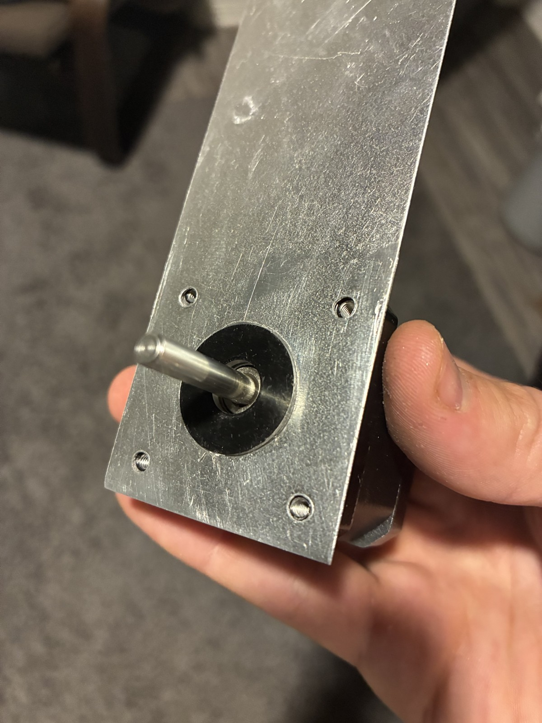
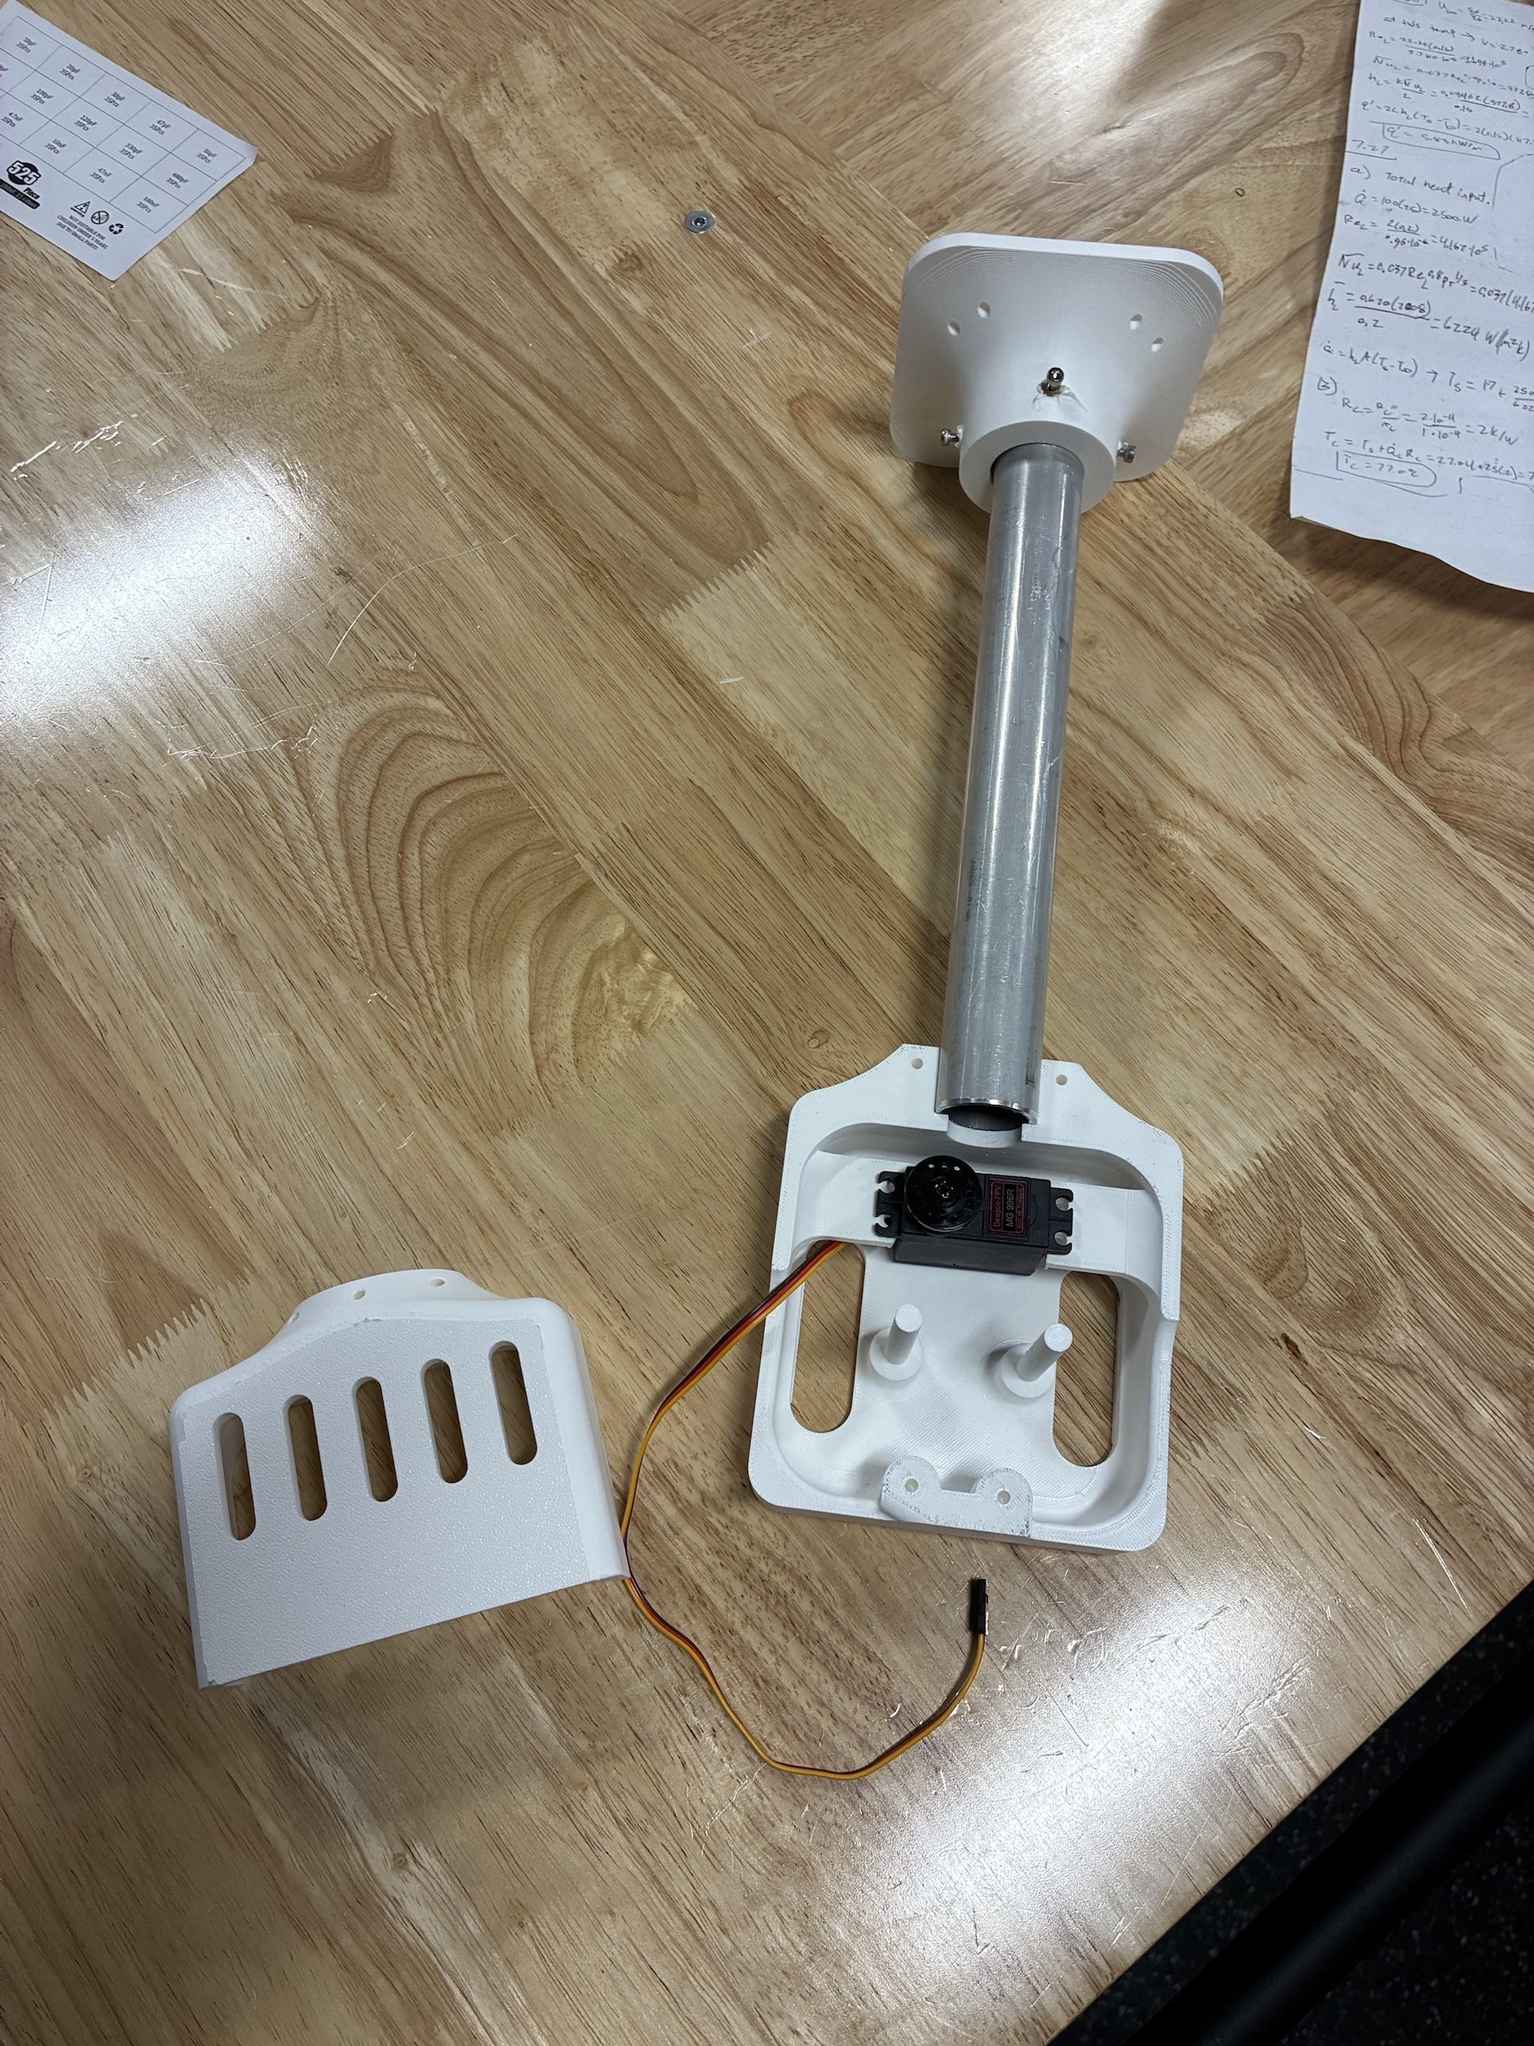
Built and simulated; the next tests turn estimates into measurements
Built: stations, station boards, heat fins, the claw body (tube, mount, servo in its gear housing)
Designed and checked in CAD: the hands, the camera housing, the encoder casing
Calibration and control: simulated, then the first test
Next tests, with pass limits written first:
  winch pull test (decides the capacity fix)
  90-min hold test: motor and printed mount under 60 °C
  SolidWorks static and thermal studies of the station
  four-station lift: 1 lb, 300 mm at 50 mm/s, within 2 mm per cable
Built: the heat fin on the motor (left); the printed claw body with its servo (right)
Notes:
Everything that is calculated or simulated is called that; the test list is what turns it into measurements.

Slide 47
Measure early, print test coupons first, and design for the worst case
Measure before trusting a margin: the driver limit and the 1.14 V rail
Print the test coupon before the part: the spool bore
Hold tolerance where it matters: one mill setup for the fin's holes
Design for the worst case: stall, the corner of the room, the hottest hour
Modularity paid for itself: every station can be pulled, fixed and put back
Question each requirement and delete parts: the IMU, the overhead camera, the five-finger hand, the long motor harnesses
Notes:
If I did it again: buy the pulleys and couplers sooner, and build one complete station to test before building four.

Slide 48
Questions
Jasper Buntinx · jasper_buntinx@tamu.edu
Notes:
Backups follow: schematics, gear strength, safety, calculations and sources.

Slide 49

Backup: claw electrical
One protected 2S pack (7.4 V, 2200 mAh), 5 A fuse, main switch
6 V regulator for the servo only; separate 5 V buck and Schottky diode for the controller
Battery read through 200k / 100k: 8.4 V → 2.80 V at the ADC
Peak ≈ 2.8–3.1 A against a ≈ 3 A pack rating: stalls must stay short
Charged on the claw only with the switch off, attended, at ≤ 1 A
Notes:
Rules check 0 errors; 9 nets match the specification.

Slide 50
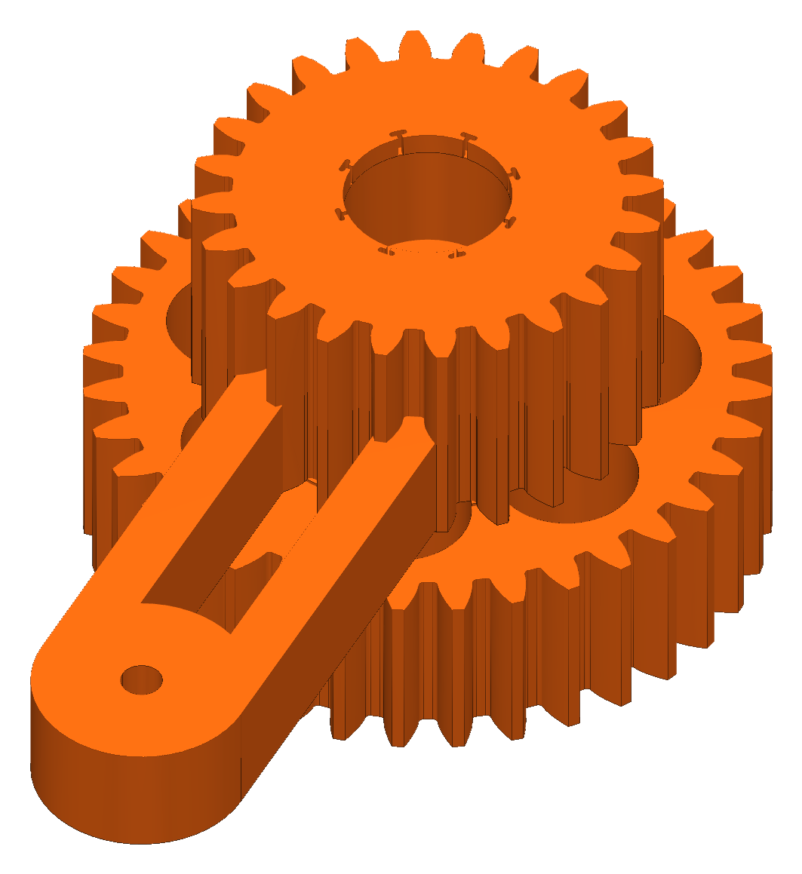
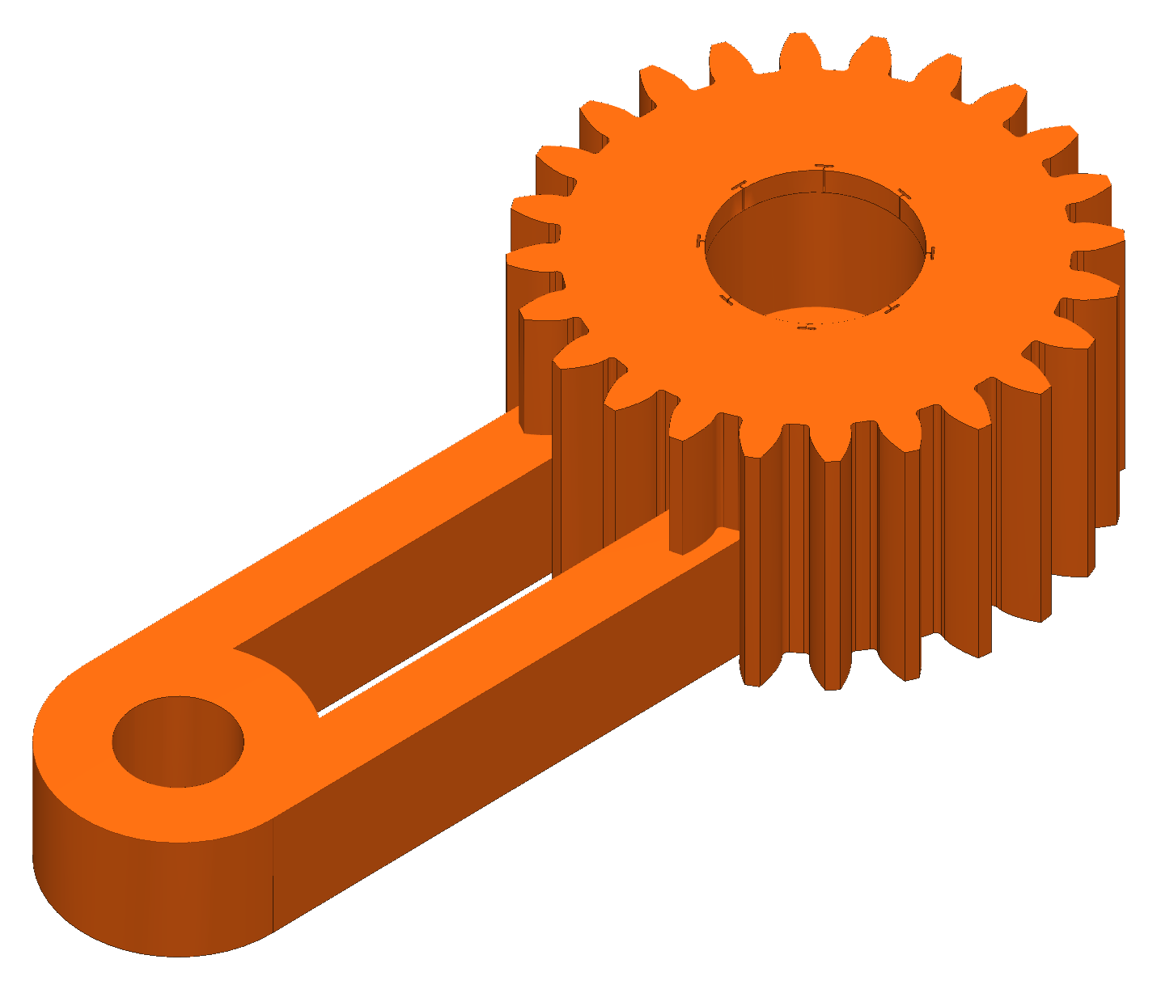
Backup: gear strength (Lewis)
Module 1.5, PETG allowable 22.5 MPa
At 6 V servo stall: pinion SF 2.05, 36T gear 2.50, sync gear 2.00 (one jaw carrying the load)
Module 1 was screened first: SF 0.35–0.41, so the module went up
Key equations
σ = F_{t} / (b m Y), F_{t} = 2τ / d, SF = σ_{allow} / σ
Notes:
Stall torque 1.08 N·m at 6 V (servo rating, not measured).

Slide 51
Backup: safety
One hard stop: the switched power strip; faults and pause hold torque
Stations anchor into studs; the line load is mostly pull-out and prying
Nobody stands under the robot while it moves
Claw battery: protected pack, charged with the switch off and attended
No safety-rated function is claimed

Slide 52
Backup: calculations and sources
Every chart comes from my calculation sheet in Google Sheets, one tab per topic
  cable tension, winch pull, heat fin, motor temperature, wiring, bead homing, floor board, lift budget, gears
Every result is a formula on its inputs; inputs are marked, with their source or assumption
References used:
  Incropera, DeWitt, Bergman, Lavine: Fundamentals of Heat and Mass Transfer, ch. 3 (extended surfaces)
  Allegro MicroSystems: A4988 datasheet (current limit)
RoomCleaner engineering calculations (Google Sheets)

