Slide 1
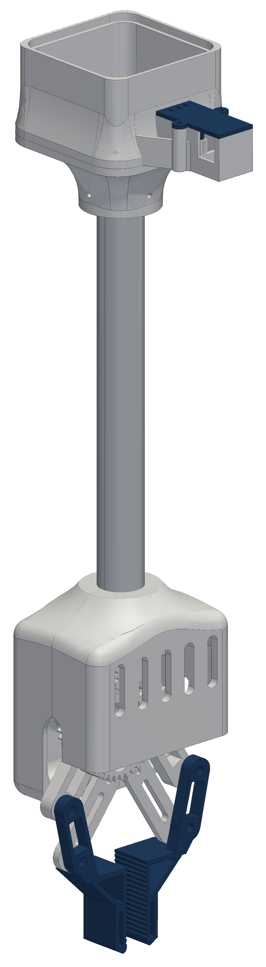

RoomCleaner
A four-cable ceiling robot that picks laundry off the floor
Jasper Buntinx
Technical presentation · October 27, 2026
Notes:
One sentence: a cable robot whose four winches sit in the ceiling corners and move one claw anywhere over the floor.

Slide 2
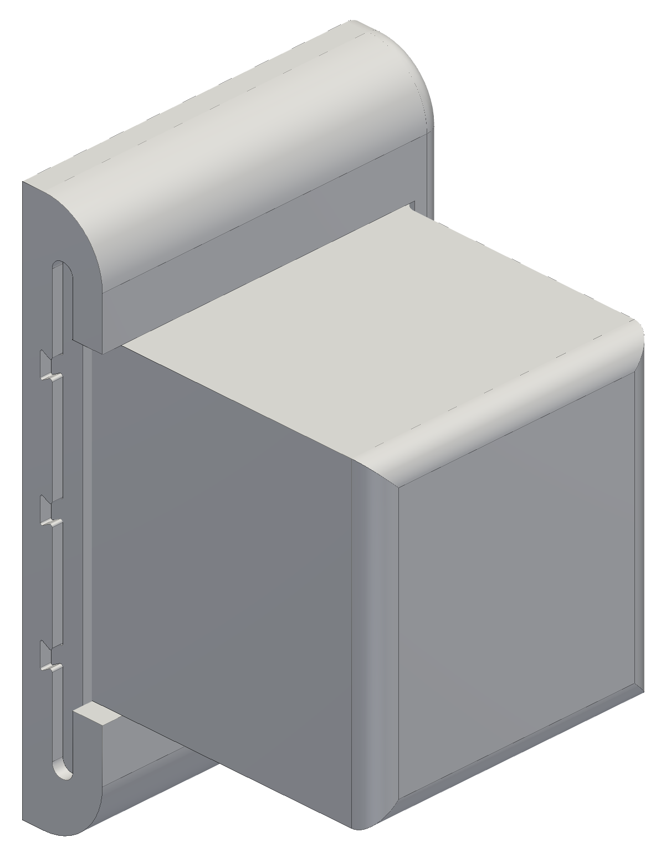
OPENING
Goal and constraints
Pick clothes off the floor and drop them in a hamper, from anywhere in the room
Four winches near the ceiling corners hold one claw on four cables
Room 11 × 9 ft with a 9 ft ceiling
Working load: a pair of jeans (0.9 kg) with 2 m/s² of acceleration; first test load 1 lb
3D-printed in PETG on a hobby budget, from parts I can buy and fix myself
Safety: anchors in studs, one hard stop (the switched power strip), nobody under the robot
One of the four winch stations (CAD)
Notes:
Requirements first: where it works, what it lifts, what it costs, and how it stays safe.

Slide 3
OPENING
Outline
1
How a cable robot works
Position vectors, statics, the winch
2
From one box to modular stations
Wiring, a controller per winch, the slide-in housing, plug-in power, cooling and the horn-inspired fin
3
Homing and calibration
Bead homing, why it limited the motion, the camera-based method
4
The claw
Gripper evolution, the four-bar hands, overhead camera to claw camera, weight vs lift
5
Manufacturing
Printed PETG parts, and a heat fin cut and drilled on a manual mill
6
Electronics and software
Station board, bring-up, control and the phone app
7
Status and next steps
First test, what is built, what I learned
Notes:
The talk follows the order the problems appeared in.

Slide 4
01
How a cable robot works
Four cables, one point, and the vectors that connect them
Notes:
Four cables, one point, and the vectors that connect them

Slide 5

HOW A CABLE ROBOT WORKS
Position vectors
Room frame at a floor corner: anchor i (the pulley exit) at a_{i}, the claw at p
Each cable is the vector from the claw to its anchor
Its length is the distance between those two points
To move, compute the four lengths at every point on the path
Each spool turns by the change in length over its radius
Closed form: no iteration is needed to command a move
EQUATIONS
l_{i} = a_{i} − p, u_{i} = l_{i} / L_{i}
L_{i} = ‖a_{i} − p‖ = √((a_{ix} − p_{x})² + (a_{iy} − p_{y})² + (a_{iz} − p_{z})²)
Δθ_{i} = ΔL_{i} / r (r = spool radius with the wound line)
Notes:
Inverse kinematics of a cable robot is vector subtraction and a norm, done for each cable at every step.

Slide 6
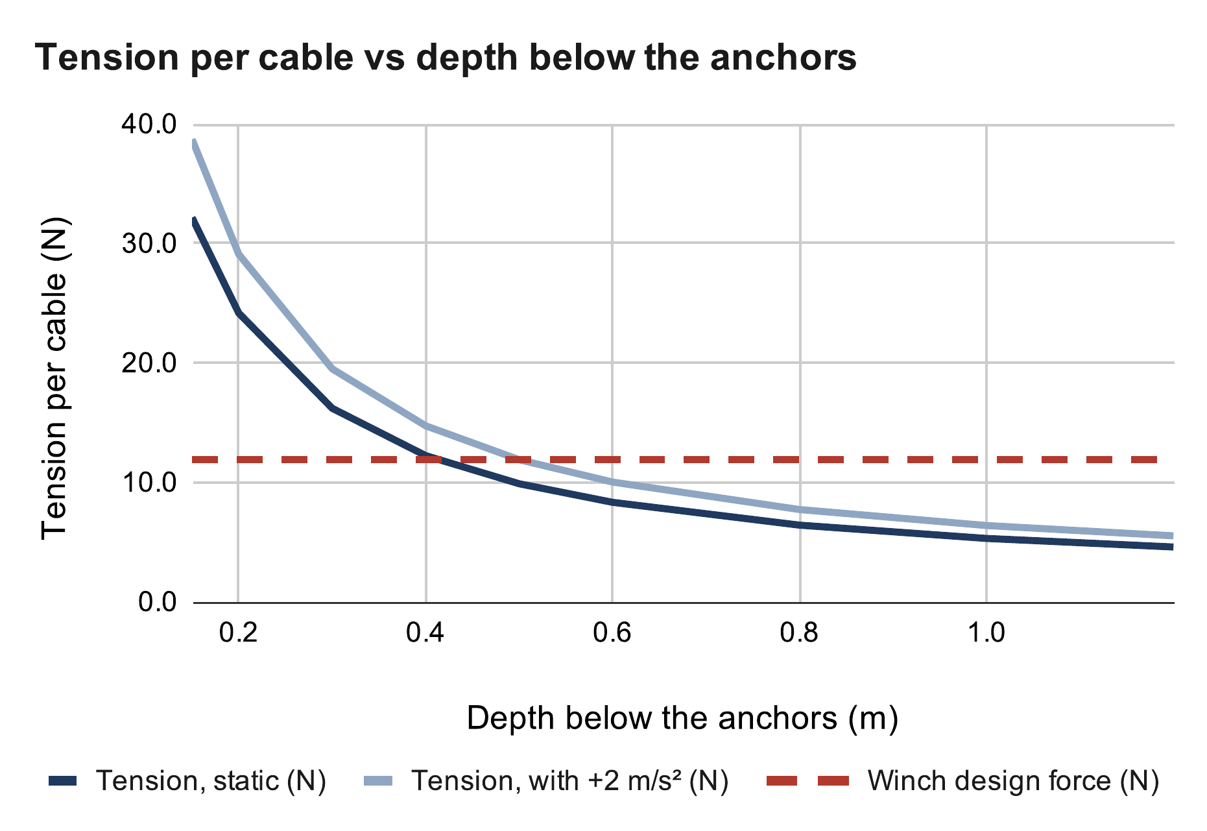
HOW A CABLE ROBOT WORKS
Statics: why cable angle matters
Force balance: the cable pulls and the weight sum to zero
Cables only pull: every tension must stay positive
Centred claw, equal shares: tension rises as the cables flatten
32 N per cable 0.15 m below the anchors; 8.3 N at 0.6 m
At 0.4 m: 12.2 N, right at the 11.9 N design force
So the robot keeps 0.4 m below the anchors, 0.2 m from the walls
EQUATIONS
Expected values: my calculation sheet (Google Sheets), “Cable tension” tab
Σ T_{i} u_{i} + m(g + a) = 0, T_{i} > 0
T = W / (4 sin φ), sin φ = d / √(d² + D_{h}²)
W = (0.45 + 0.454) kg × 9.81 m/s² = 8.87 N
Notes:
D_h = 2.17 m from the room centre to a corner. The tension doubles each time the depth halves near the ceiling; the ceiling margin is set by tension, not by collision.

Slide 7
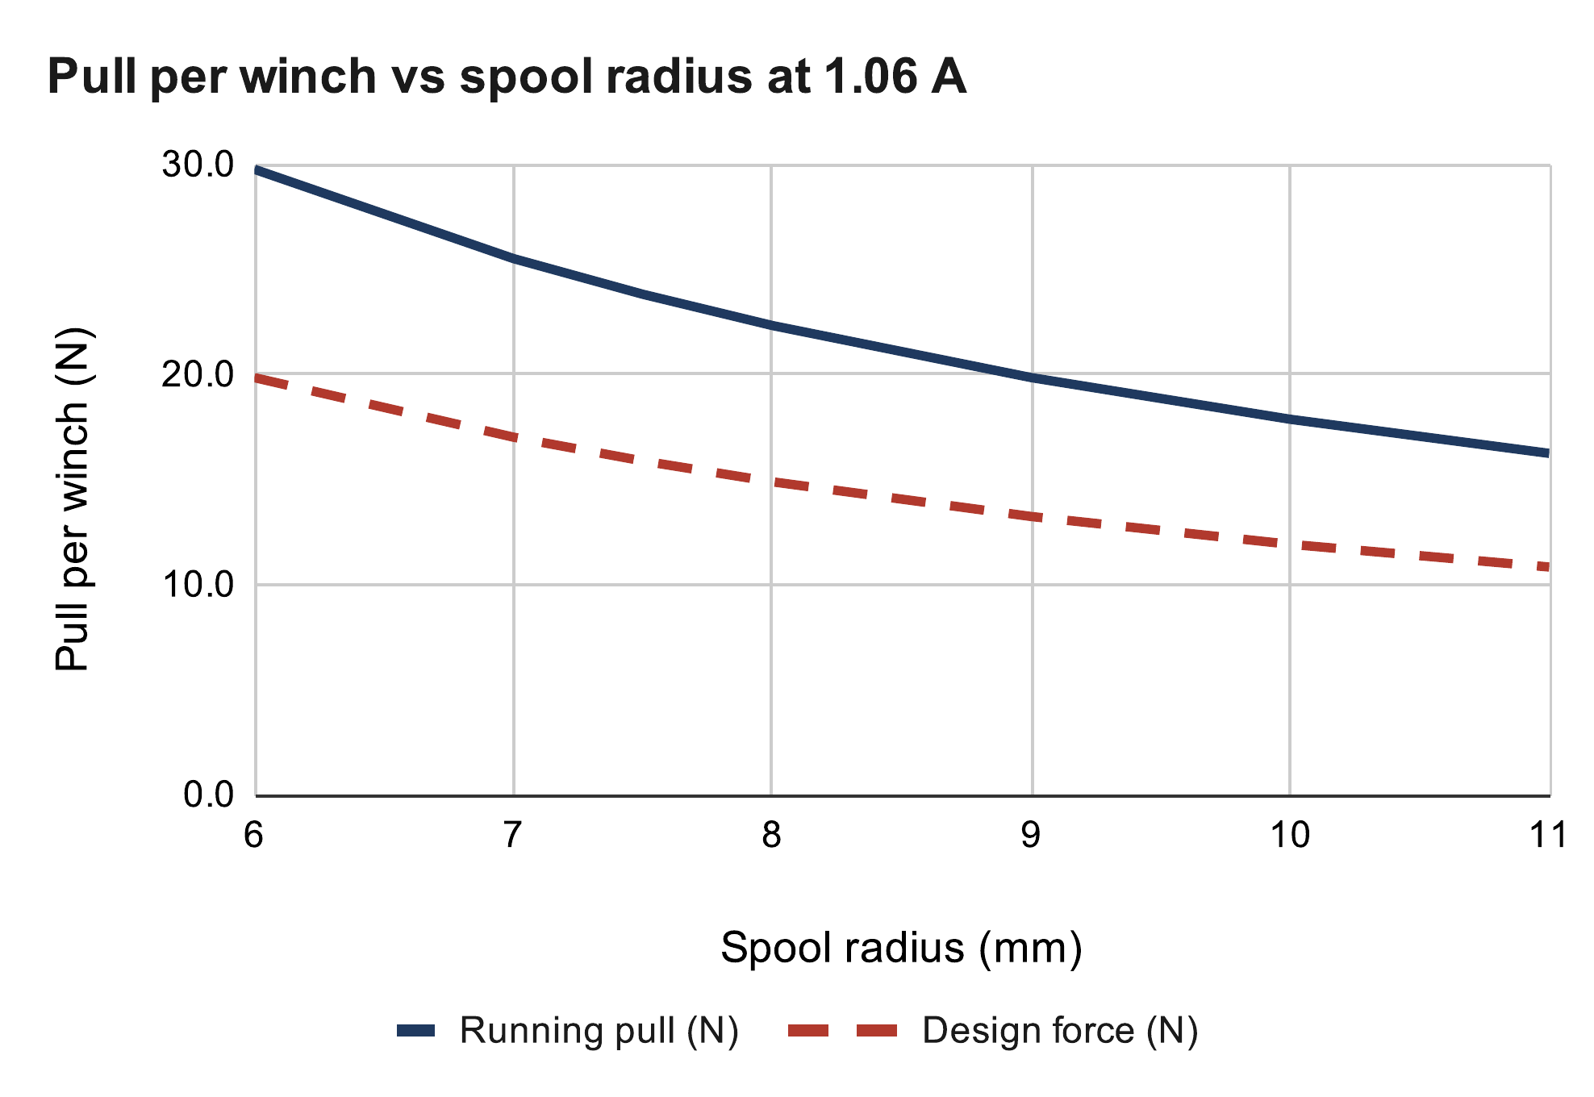
HOW A CABLE ROBOT WORKS
The winch
NEMA 17 stepper, printed spool, outlet pulley
Current limit set by the driver's reference voltage: 0.85 V → 1.06 A
Running torque < holding torque: 0.7 assumed, the pull test measures it
Smaller spool: more pull per amp, more turns per metre
v3 spool: 24 N empty, 18 N full → 11.9 N design (÷ 1.5)
EQUATIONS
I = V_{ref} / (8 R_{s}) = 0.85 V / (8 × 0.1 Ω) = 1.06 A
τ_{run} = 0.7 · τ_{hold} · I / I_{rated} = 0.7 × 0.36 × 1.06 / 1.5 = 0.18 N·m
T = τ_{run} / r: 23.8 N at r = 7.5 mm, 17.9 N at r = 10 mm
Expected values: my calculation sheet (Google Sheets), “Winch pull” tab
Current limit: Allegro MicroSystems, A4988 datasheet
Notes:
Design force = full-spool pull / 1.5 skip margin. The pull test turns the 0.7 ratio into a measurement.

Slide 8
02
From one box to modular stations
How adding safety features changed the whole architecture
Notes:
How adding safety features changed the whole architecture

Slide 9

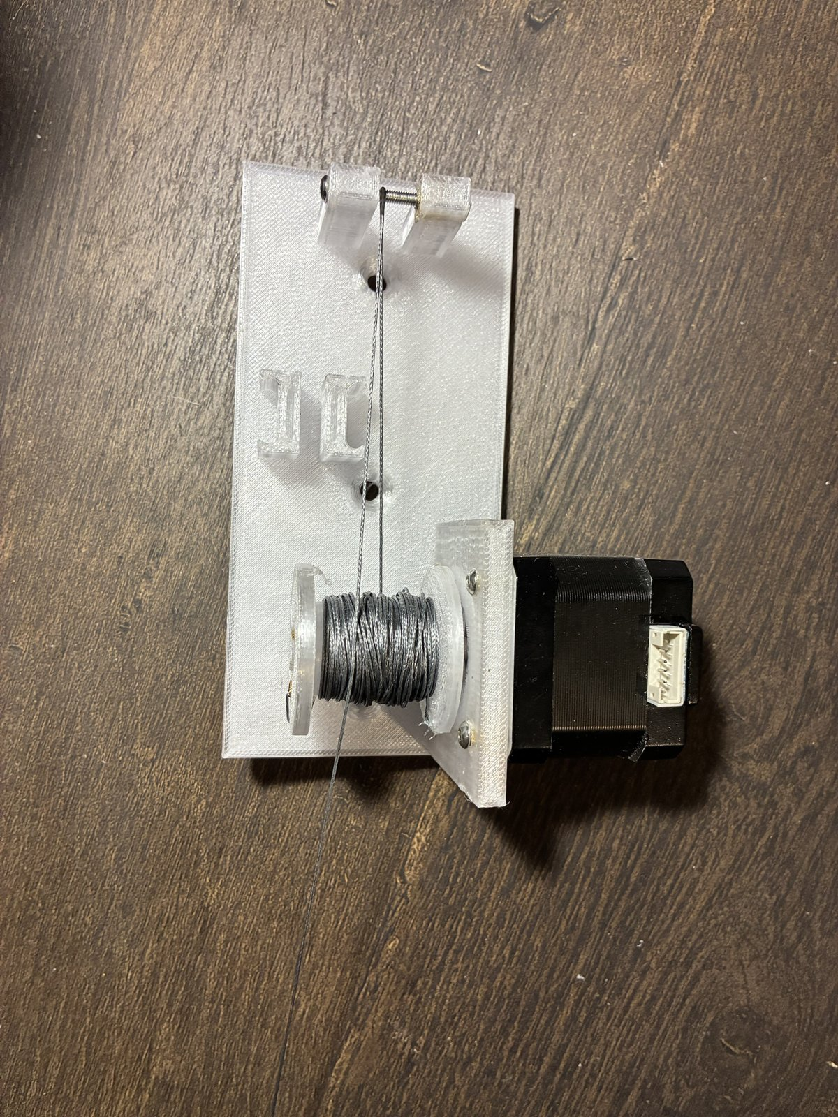
FROM ONE BOX TO MODULAR STATIONS
First idea: one central controller
One Arduino Uno and a CNC shield with four A4988 drivers, in a single box
The computer sends moves; the shield steps all four motors from one clock, so sync is free
Each motor gets a long 4-wire cable from the box to its corner
It worked on the bench: a gen-1 station lifted a test weight
Gen 1: central shield with four drivers; spool plate on the wall
Notes:
Simple and synchronised by design. It only stopped working once I wanted more than a motor at each corner.

Slide 10
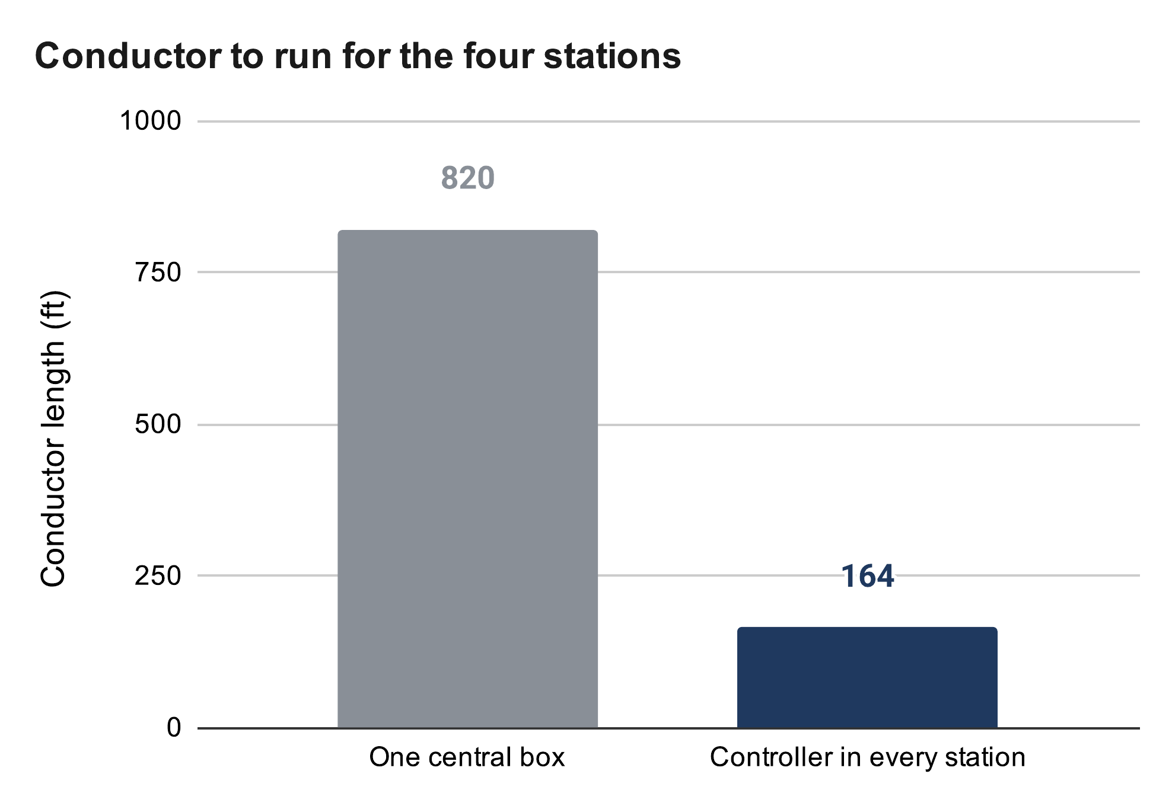
FROM ONE BOX TO MODULAR STATIONS
Why it did not scale: the wiring
I wanted more safety: a homing switch and an encoder at every winch, plus fault detection
Per corner: motor 4 + switch 2 + encoder 4 = 10 conductors, not 4
Real cable routes are 6, 21, 23 and 32 ft (82 ft)
The encoder's I²C bus is meant for centimetres, not 10 m runs
Motor phase currents in long cables also radiate noise into the sensor lines
EQUATIONS
Expected values: my calculation sheet (Google Sheets), “Wiring” tab
Conductor = n · ΣL: 10 × 82 ft = 820 ft vs 2 × 82 ft = 164 ft
ΔV = I · R′ · 2L = 2 A × 4.016 mΩ/ft × 64 ft = 0.51 V
16 AWG on the longest run (32 ft); 2 A is illustrative
Notes:
The wire count, not the motors, was the problem. 18 AWG on the same run drops 0.82 V.

Slide 11


FROM ONE BOX TO MODULAR STATIONS
Decision: a controller in every winch
Each station: XIAO ESP32-C3 + A4988 driver + 5 V buck; only 12 V power travels, on 2 wires
Switch and encoder wires stay inside the station, a few centimetres long
The host computer plans the path and sends each station timed segments over Wi-Fi
Each station runs its segments on its own clock; any lost link → hold position
Cost: timing skew between stations becomes cable mismatch, so segments are time-stamped
Benefit: about 5× less wire, and every station can be built and tested alone
EQUATIONS
Δx = v · Δt = 50 mm/s × 50 ms = 2.5 mm of cable mismatch
Gen 2: the station carries its own controller, driver and buck
Notes:
Sync moved from wiring into software: time-stamped segments and a host that keeps every station's clock.

Slide 12
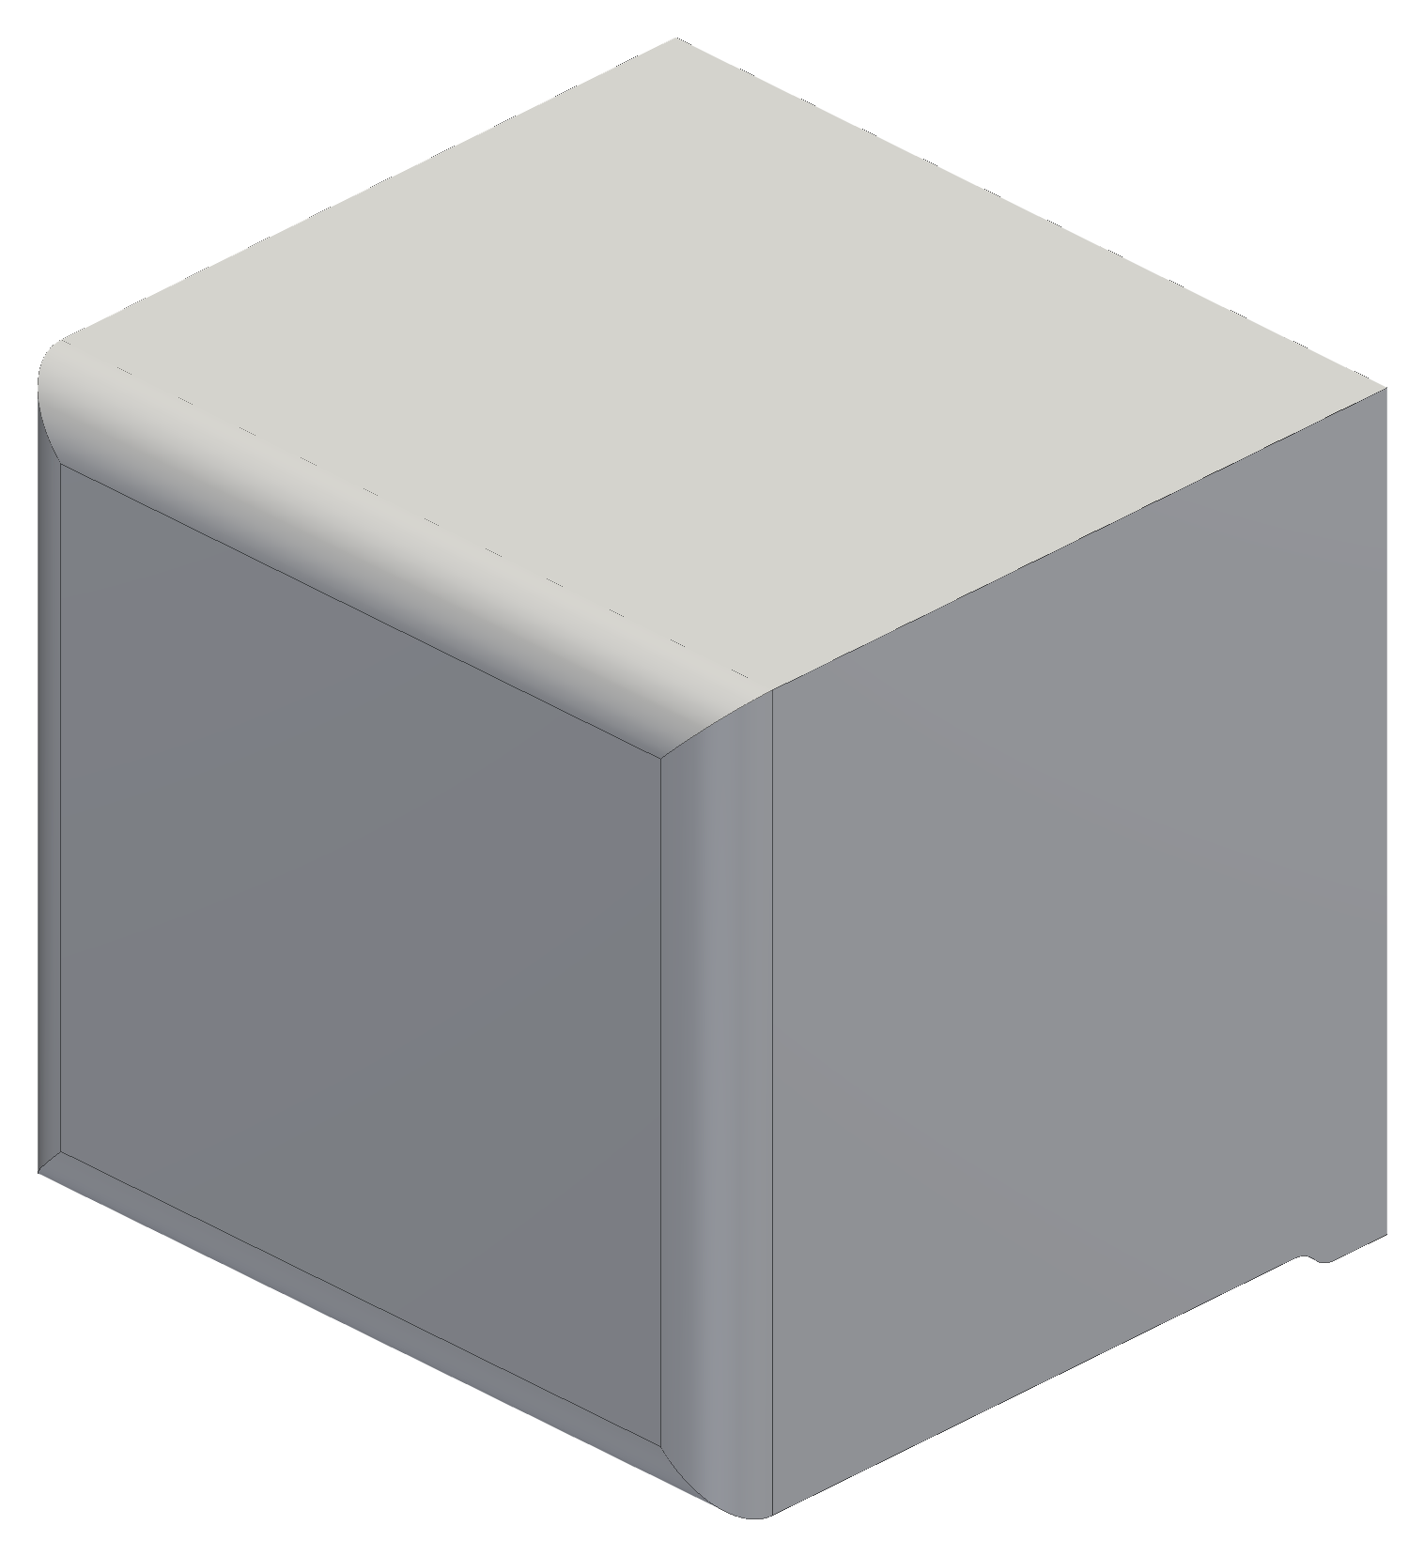
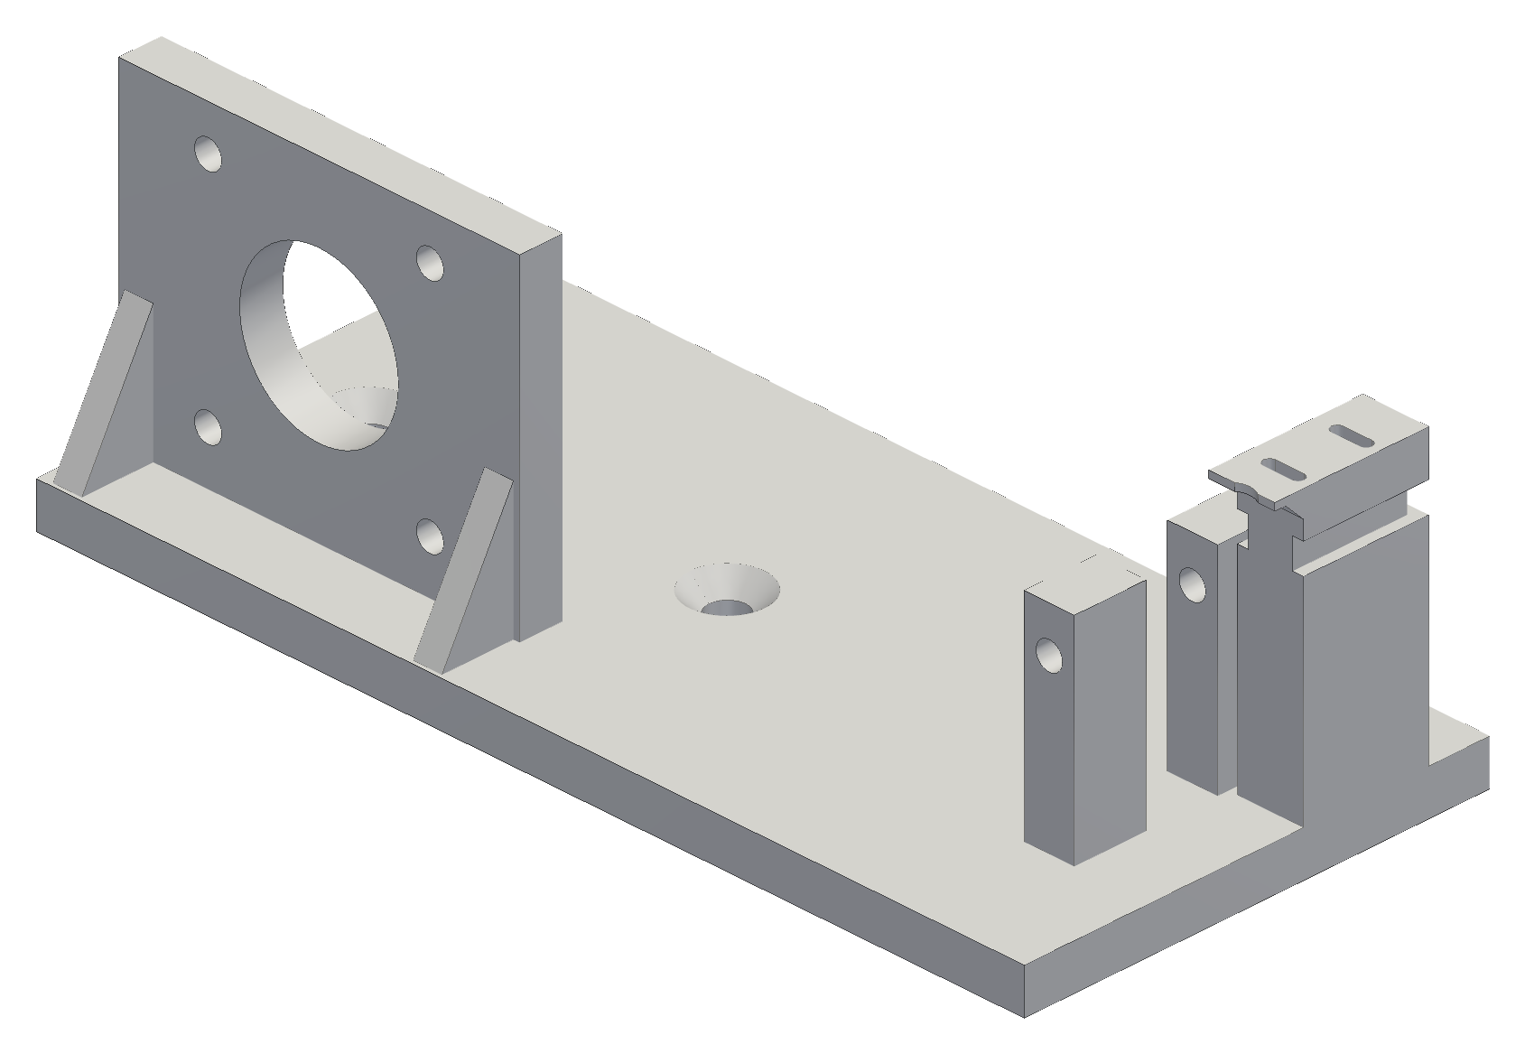
FROM ONE BOX TO MODULAR STATIONS
Making the units modular
Gen 1 was a plate screwed into the wall: fine for a bare motor
Each corner now carries a controller, driver, buck, switch and encoder
  they need protection, a clean look and a path for heat
So each station became a housing: motor, spool, pulley and electronics in one unit
Same unit in all four corners: build one, test one, copy it
Gen-1 corner plate (left) vs the gen-2 station housing (right)
Notes:
Once there are electronics in every corner, the wall plate becomes a product housing.

Slide 13
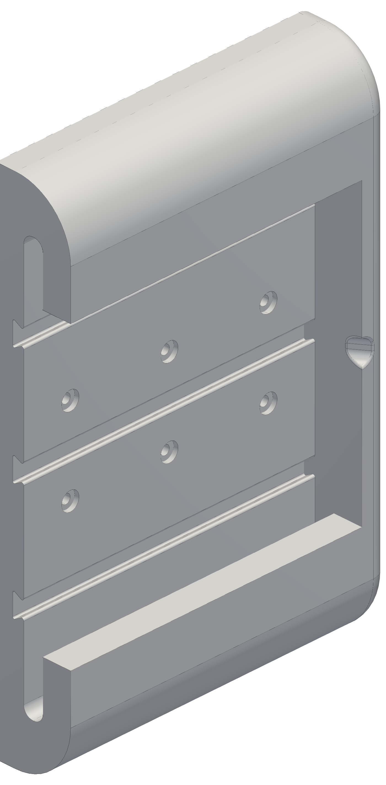
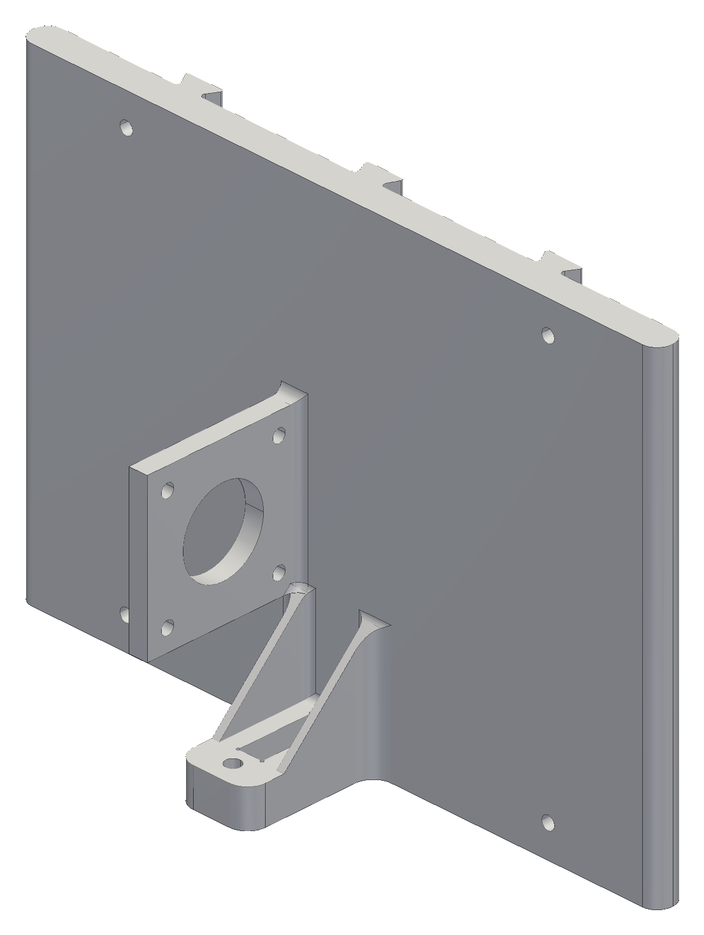
FROM ONE BOX TO MODULAR STATIONS
Slide-in mount
I take stations down often: to test, rework, repair or modify them
Drilling in and out each time damages the wall and moves the anchor point
A fixed wall frame goes into a stud once; the station slides in and locks
Pull it out, rework it, slide it back: the frame keeps the anchor position
Load: the line pulls the station away from the wall (pull-out and prying)
  design target: SF 3 at 34 N; SolidWorks study planned
EQUATIONS
SF = σ_{allow} / σ_{max} ≥ 3 → σ_{max} ≤ 25 MPa / 3 = 8.3 MPa
Allowable: derated PETG yield, 25 MPa
Fixed wall frame (left) and the slide-in piece (right)
Notes:
34 N is the snag case: holding torque at the empty spool. The study checks stress below 8.3 MPa (derated PETG / 3) and deflection at the cable exit.

Slide 14
FROM ONE BOX TO MODULAR STATIONS
Self-calibration: set it up anywhere
Every time the stations go back up, the robot measures its own geometry
  no tape measure, no numbers typed in, nothing for a user to get wrong
The claw camera reads a printed floor board (a grid of tags) to get the claw's pose
The robot moves through a set of poses and fits the anchor positions and cable lengths by least squares
Works in any room the cables can reach, so it can become a consumer product
1 Take up slack, one cable at a time
2 Lift the claw off the floor
3 Camera reads the floor board
6 Ready, inside the safe margins
5 Check on held-out poses
4 Fit anchors and cable lengths
Startup calibration; the claw camera looks straight down at the board
Notes:
Simulated so far; the hardware run is the first test.

Slide 15
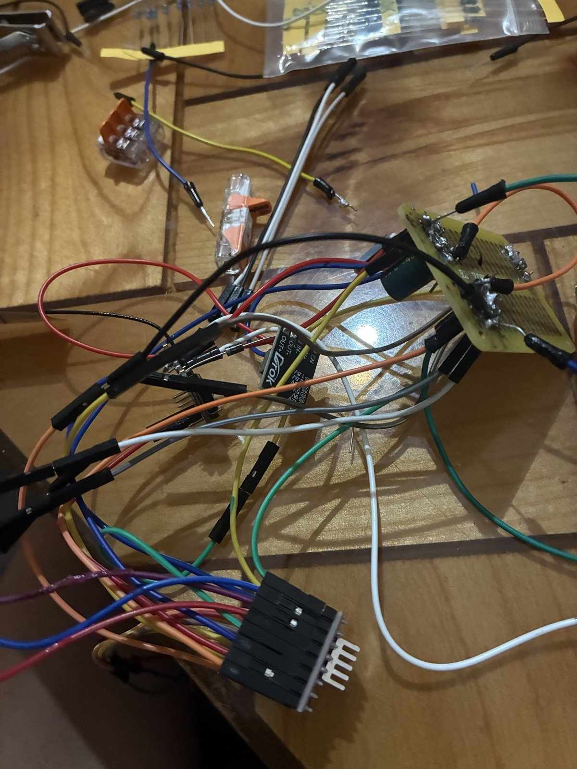
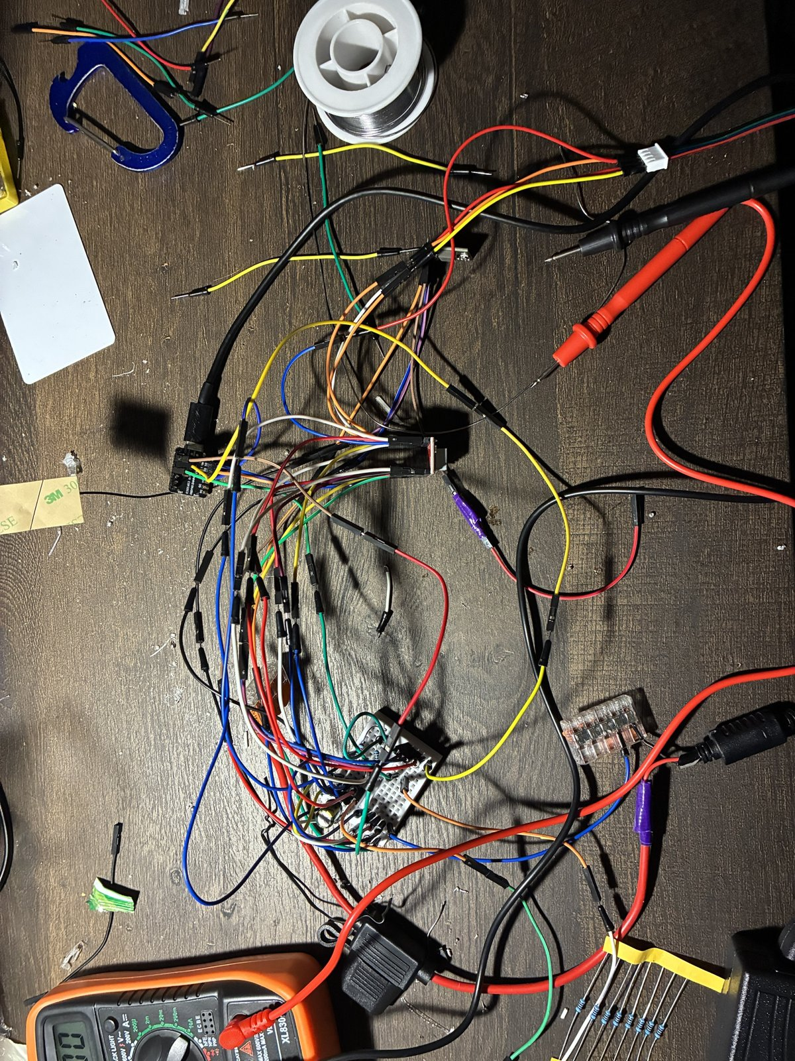
FROM ONE BOX TO MODULAR STATIONS
Plug-in power
Each station has one cable: a 16 AWG pair from a fused 12 V supply
Plug in to use; unplug and store the cables when the robot is not needed
Stations slide off the wall frames if wanted
Runs cut at 9, 24, 26 and 35 ft (94 ft of a 100 ft roll), a fuse per branch at the supply
The motor stays wired inside the station, so it is never unplugged under power
The switched power strip is the one hard stop
Inside a station: the buck converter and its wiring; only 12 V comes in
Notes:
Unplugging a motor from an energised A4988 can kill the driver, so the plug carries only 12 V.

Slide 16
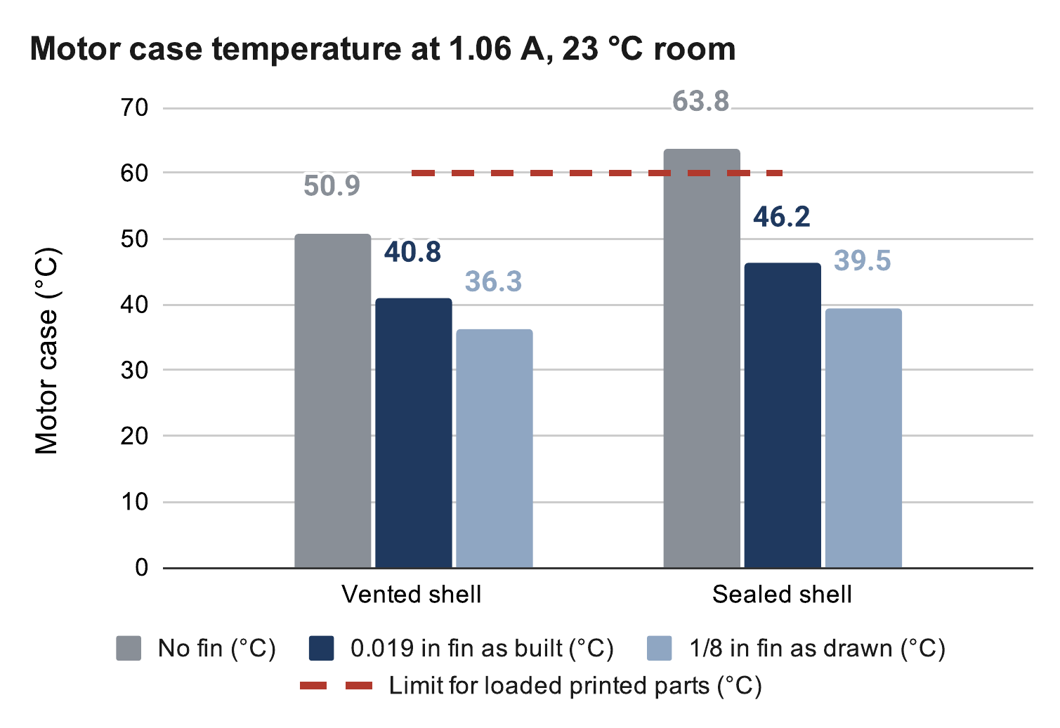
FROM ONE BOX TO MODULAR STATIONS
Cooling
A sealed printed housing traps the motor's heat
  PETG at the loaded motor mount softens and creeps: 60 °C limit
Fix: vents, plus an aluminium fin straight up through the shell
Model: motor → shell air → room, the fin a second path out
At 1.06 A: sealed 64 °C without the fin, 46 °C with it
A 90-min hold test will measure it
EQUATIONS
Expected values: my calculation sheet (Google Sheets), “Motor temperature” tab
P_{m} = I² R = (1.06 A)² × 1.8 Ω = 2.0 W
ΔT = q · R_{th} (heat flow × thermal resistance)
Fin in parallel with the shell: 1/R = 1/R_{shell} + 1/R_{fin}
Notes:
The fin carries about half the heat in the sealed case. PETG softens near 80 °C. Inputs are assumptions until the hold test: 1.8 Ω per phase, 1.5 W of electronics.

Slide 17
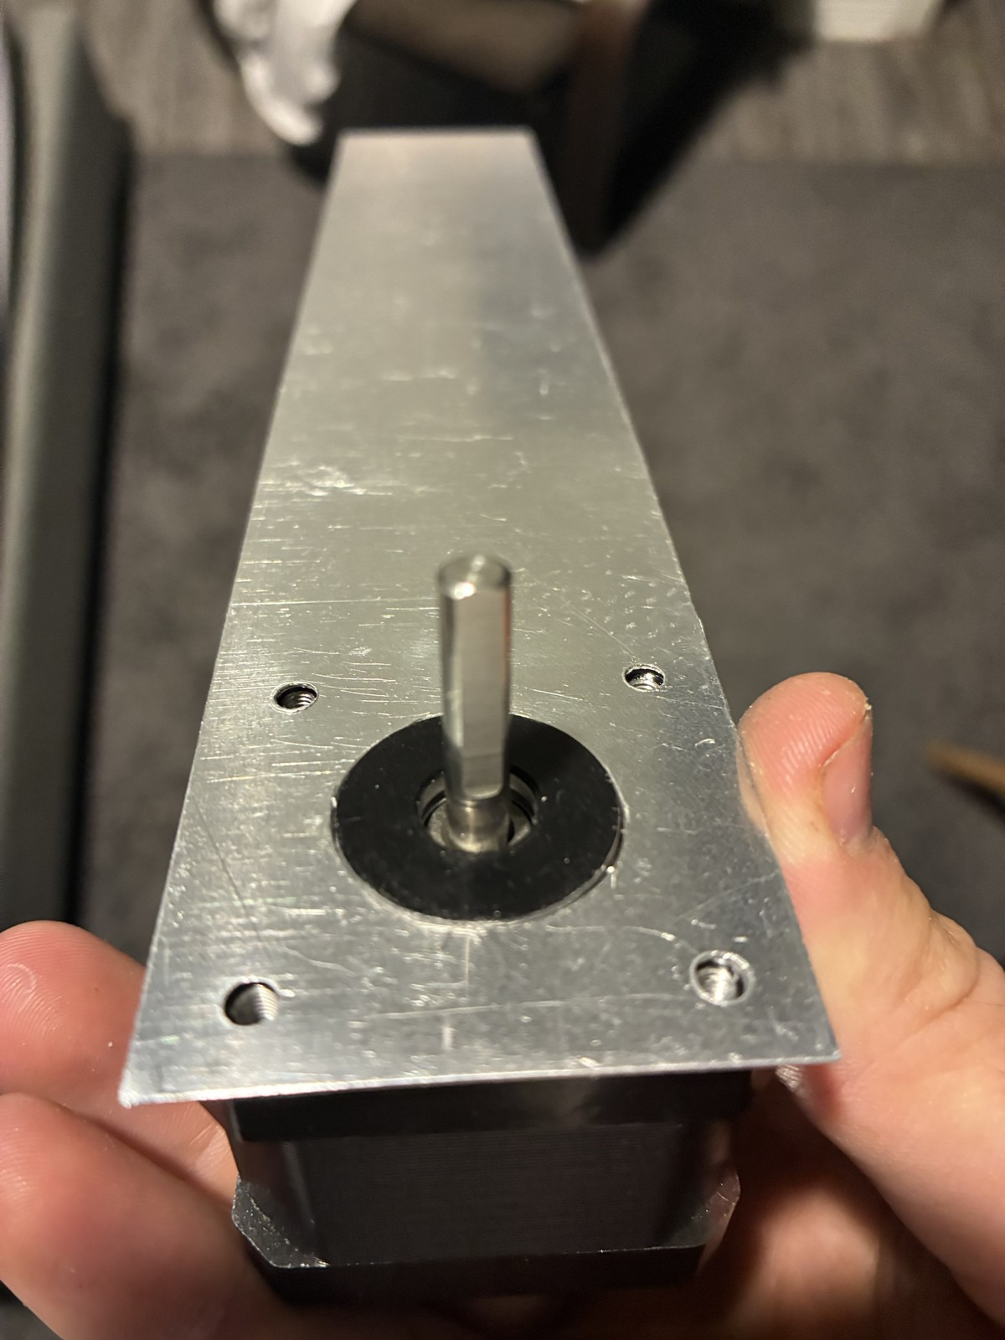
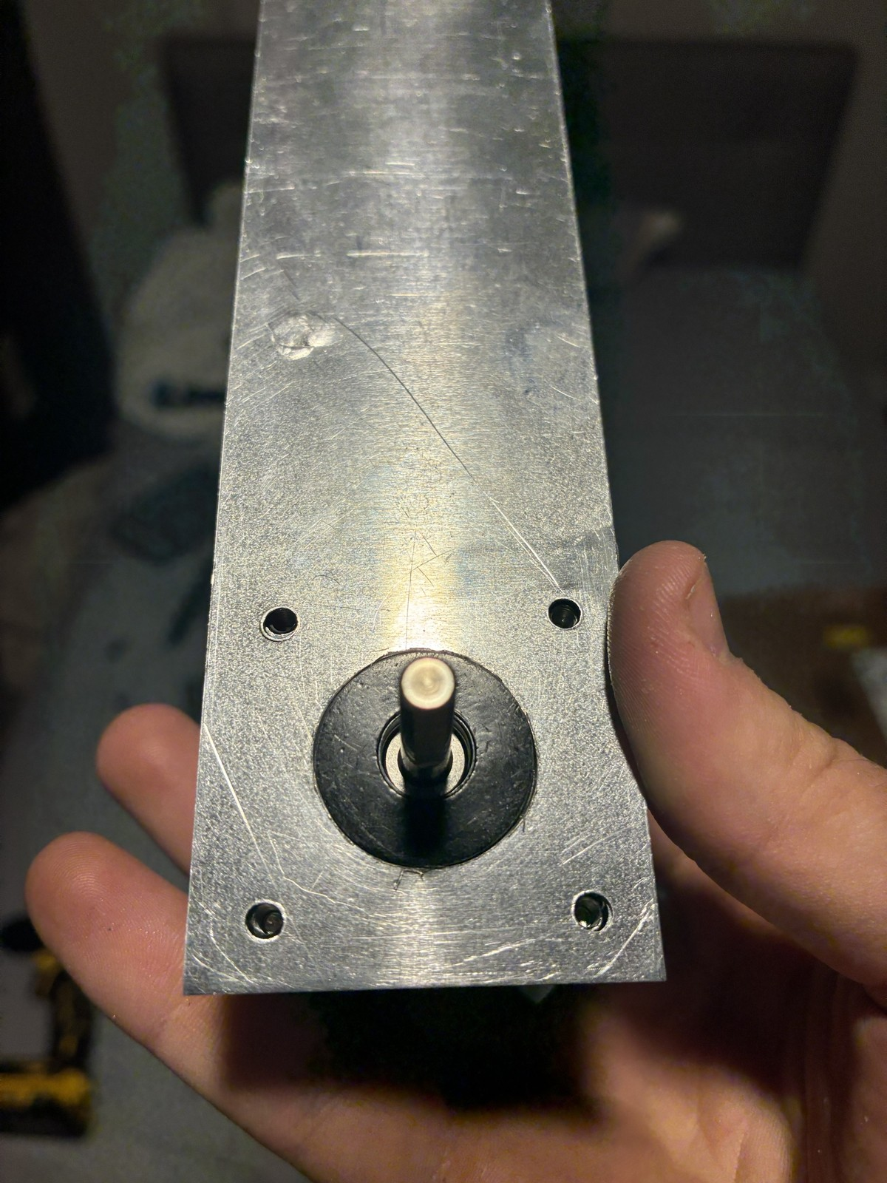
FROM ONE BOX TO MODULAR STATIONS
Bio-inspired fin: antelope horns
Idea from my bio-inspired design class: antelope horns
A horn is a heat exchanger: warm blood flows into its core, heat leaves through the surface
The fin copies that: one tall, thin blade rising straight up from the heat source
  heat conducts up from the motor and leaves along the length; the tip runs cooler, like a horn's
Vertical, so warm air rises freely off both faces
Motor width (44 mm): adds height, not width, to the station
EQUATIONS
Horn and fin both shed heat by convection: q = h · A · (T_{s} − T∞)
Tall and thin: large area for little mass, A = 2 w L
The fin on the motor: one tall blade rising from the heat source
Notes:
Background (not on the slide): Taylor's goat experiments found a dense blood supply under the horn sheath and estimated horns carry 1-15 % of the animal's heat loss; Picard et al. found climate-dependent horn structure in bovids. The next slide sizes the length.

Slide 18
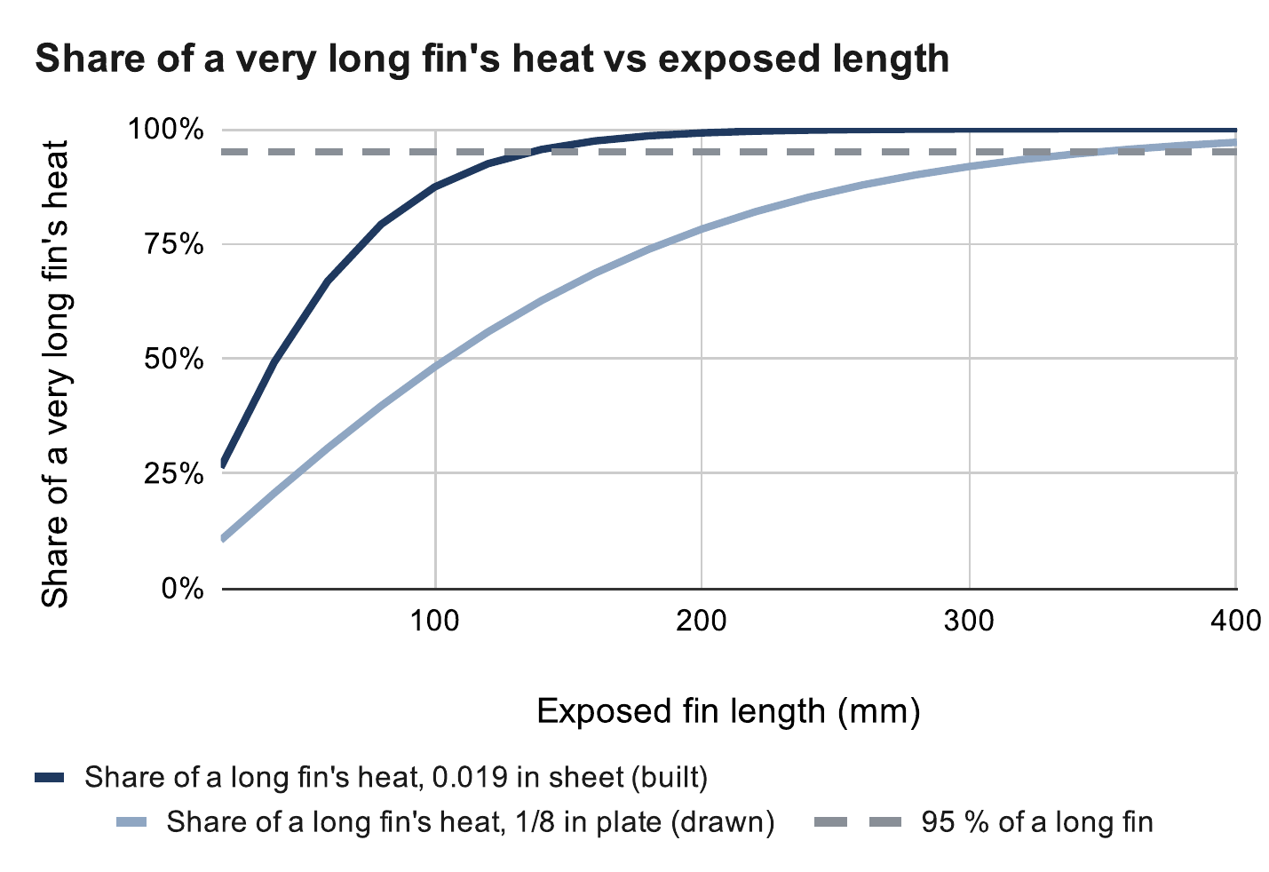
FROM ONE BOX TO MODULAR STATIONS
Heat fin: how much length is useful
The far end runs cooler, so each extra mm does less
0.019 in sheet (built): 95 % of a long fin's heat by 136 mm
1/8 in plate (drawn): 95 % by 349 mm
Built 200 mm above the cover: past 136 mm the sheet adds < 5 %
Looks: horn-like, straight up at motor width (44 mm), matte black
  black radiates more than bare aluminium
EQUATIONS
m = √(2h / (k t)), η = tanh(mL) / (mL)
95 % length: tanh(mL) = 0.95 → L = 1.83 / m
k = 160 W/m·K, h = 7 W/m²·K, t = 0.48 mm → 136 mm
Expected values: my calculation sheet (Google Sheets), “Heat fin” tab
Fin equations: Incropera et al., Fundamentals of Heat and Mass Transfer, ch. 3
Notes:
Efficiency at the built length: 37 % (sheet) vs 74 % (plate); fin resistance 22.1 vs 10.9 K/W. The 200 mm length was sized for the 1/8 in plate; the thin sheet would do the same job at about 140 mm.

Slide 19
03
Homing and calibration
Why the first homing plan limited the robot, and what replaced it
Notes:
Why the first homing plan limited the robot, and what replaced it

Slide 20
HOMING AND CALIBRATION
First plan: bead homing
A bead on each cable trips a switch at the outlet → a known cable length
The robot zeroes itself from that: set it up anywhere
I expected that to be enough, possibly even without encoders
Detail fixed early: the switch moved below the pulley, so the bead never rides over the pulley groove
KW12-3 homing switch on the bench
Notes:
The idea was a cheap absolute reference per cable.

Slide 21

HOMING AND CALIBRATION
The problem: beads limit the motion
A bead cannot pass the outlet, so a cable can never be shorter than its homing length
To home all four at one point, each bead sits at that point's length
  then the claw can never get closer to any anchor than from that point
Homing at the room centre 1 m up → about 5 % of the working volume reachable; 2 m up → about 29 %
And vision alone knows cable length to ~20–25 mm, while a bead allows ~12 mm of overtravel: a bead search was not safe either
Expected values: my calculation sheet (Google Sheets), “Bead homing” tab
EQUATIONS
L_{i}(p) ≥ L_{i,home} = ‖a_{i} − p_{home}‖ for every cable i
Reachable: every cable at or above its homing length
Notes:
Calculated over the working volume with 0.2 m wall and 0.4 m ceiling margins. This tradeoff is physical: software cannot remove it.

Slide 22
HOMING AND CALIBRATION
New calibration: camera, floor board and margins
Startup: take up slack one cable at a time, lift, then look at the floor board from several poses
Least-squares fit of the anchor positions and cable zero lengths; held-out poses check the fit
Safety comes from margins, not precision
  0.4 m below the anchors and 0.2 m inside the walls unless the error bars allow more
Beads stay as end-of-travel safety switches; encoders watch for lost steps
1 Take up slack, one cable at a time
2 Lift the claw off the floor
3 Camera reads the floor board
6 Ready, inside the safe margins
5 Check on held-out poses
4 Fit anchors and cable lengths
If the fit is not good enough: more poses, then fit again
EQUATIONS
min over a_{i}, L_{i0}: Σ_{k} Σ_{i} ( L_{i0} + d_{ik} − ‖a_{i} − p_{k}‖ )²
Full workspace only if k · σ ≤ margin
d: cable paid out at pose k (encoder); p: claw position from the camera
Notes:
The robot only unlocks the full workspace when k × σ fits inside the margin; otherwise it stays local. Simulated so far.

Slide 23

HOMING AND CALIBRATION
Why a floor board
Angle error becomes position error through the lever arm
One tag: 12.9 mrad × 0.51 m ≈ 6.6 mm per frame
Four tags in view: about 0.7 mm
The board is a printed grid at 250 mm pitch: cheap, and it works in any room
Averaging frames helps only with random noise, not with a fixed bias
Expected values: my calculation sheet (Google Sheets), “Floor board” tab
EQUATIONS
δx = σ_{θ} · L = 12.9 mrad × 0.51 m = 6.6 mm
Notes:
Two tags: 4.85 mrad → 2.5 mm. Noise model: 0.3 px corner noise, 520 px focal length (camera not yet calibrated).

Slide 24
04
The claw
From fingers to a parallel-jaw gripper
Notes:
From fingers to a parallel-jaw gripper

Slide 25

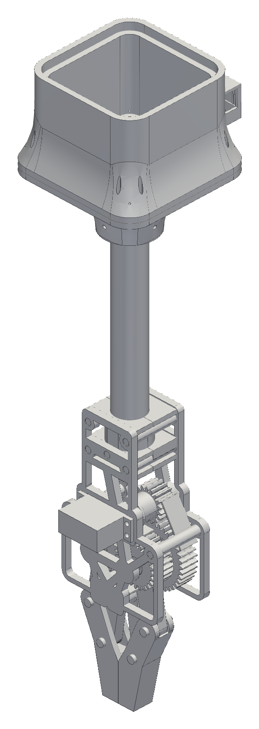


THE CLAW
Claw evolution
Five tendon-driven TPU fingers → a geared clamp → a lighter open frame → the final parallel-jaw gripper
Each step fixed a problem I found:
  the first clamp's jaws could not pinch thin fabric
  the v6 clamp was about 4.6× its mass budget
  v7 cut the gearbox frame to 143 g
Final: my gear housing and arms, with hands designed to fit them
Fingers, v6 clamp, v7 open frame, final gripper
Notes:
Mass drove most of the changes; every gram of claw is a gram of laundry the winches cannot lift.

Slide 26
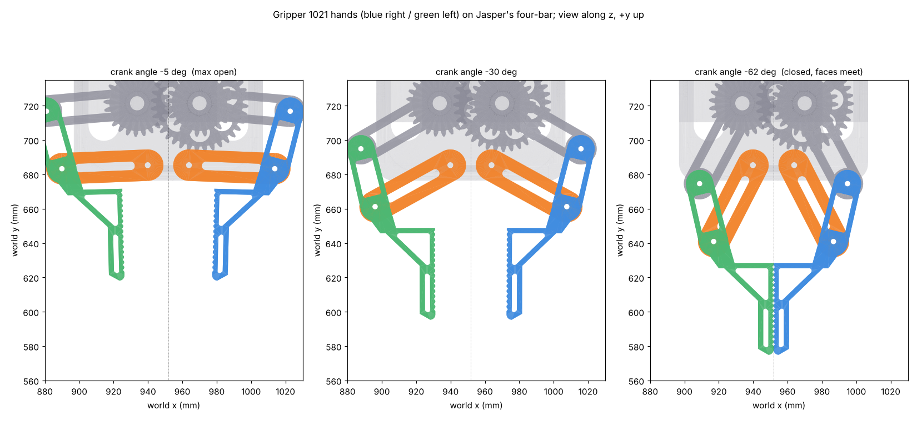
THE CLAW
Final gripper: gears and four-bar hands
Servo → 18T pinion → 36T/24T compound → 24T sync gear: mirror-image jaws
Each hand: gear crank (53 mm) + swing arm (50 mm), a near-parallelogram four-bar
  jaws stay parallel within about 1° over the stroke
53 mm opening; closing drops the tips ~38 mm: a scoop
Gear teeth at servo stall: safety factor about 2
Swept in CAD: no collisions from open to closed
EQUATIONS
Gear ratio i = 36 / 18 = 2 (servo → crank)
Grip: 2 μ N ≥ m g → N ≥ 7.4 N per jaw (1 lb, μ = 0.3)
Lewis: σ = F_{t} / (b m Y), F_{t} = 2τ / d
Hands on the linkage: open, mid, closed
Notes:
Four-bar: ground 36.5, crank 53, rocker 50, coupler 34.7 mm. Lewis: module 1.5, PETG allowable 22.5 MPa.

Slide 27
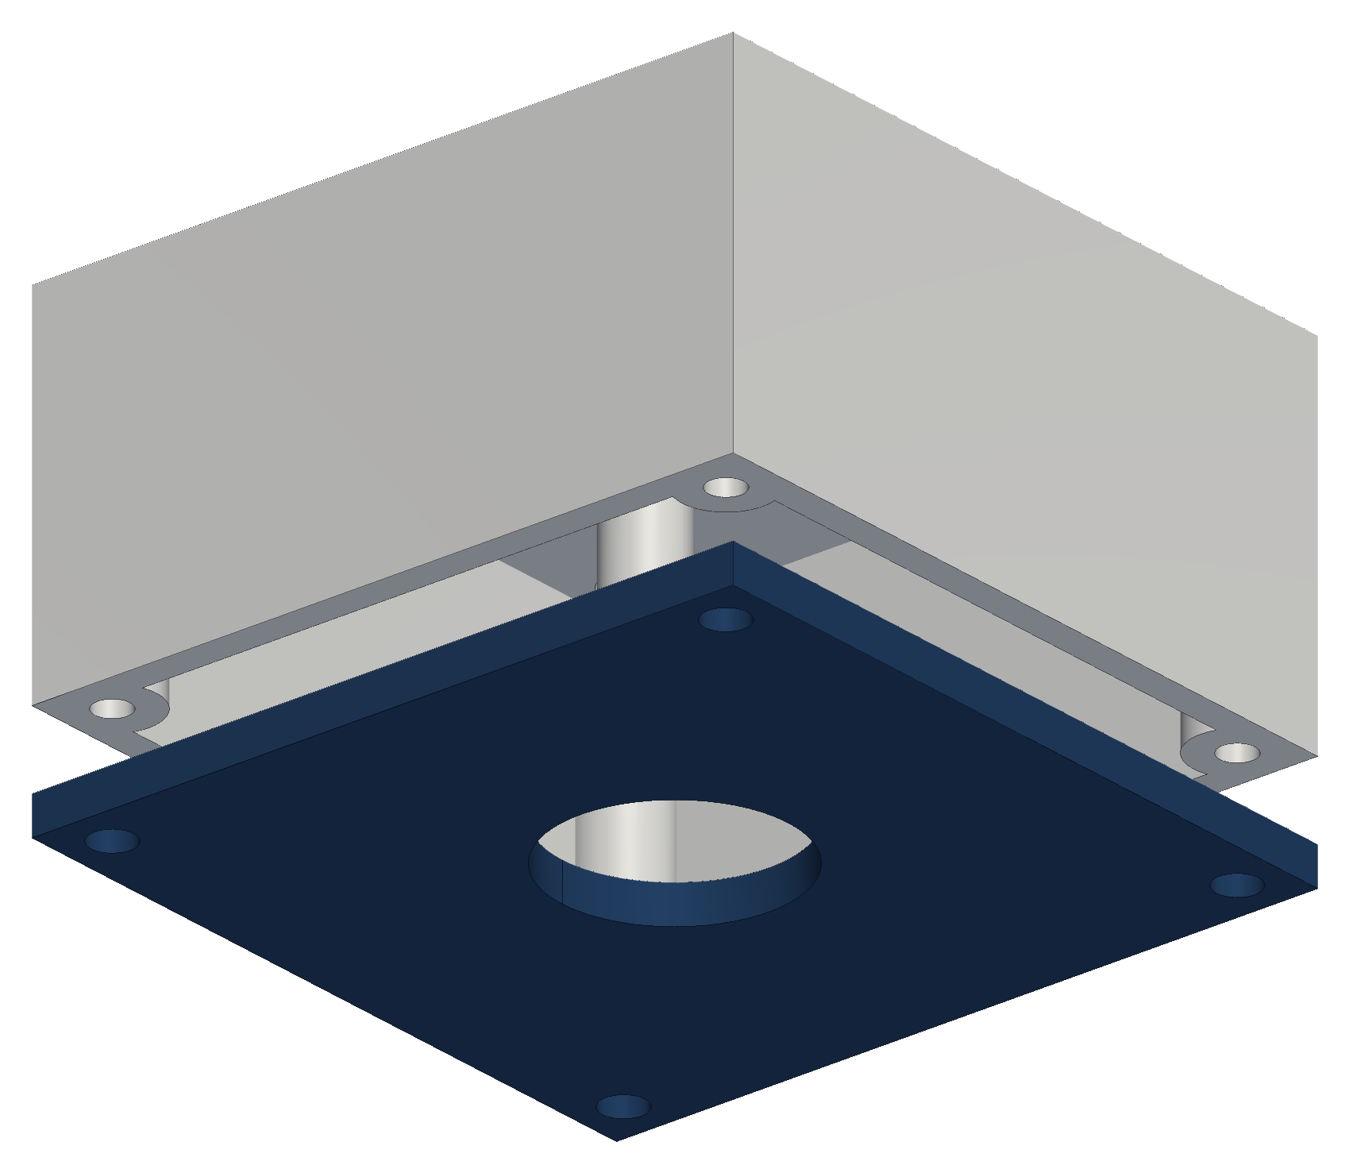
THE CLAW
First setup: an overhead camera
One camera on the ceiling, looking straight down and framing the whole floor
A detector that works from words (YOLO-World) finds “sock”, “towel”, “t-shirt” with no training
Each item's bottom-centre pixel, where it meets the floor, becomes a floor position
  straight-down camera: scale by the room size; tilted camera: a homography from four taped floor points
The claw then flies to that point and grabs
The camera board sat in a printed ceiling case: shell plus a screw-on lens bezel
EQUATIONS
Straight down: x = u · W / w_{img}, y = v · D / h_{img}
Tilted: (x, y, 1) ∝ H · (u, v, 1), H fitted from 4 floor points
u, v: pixel; W × D: floor size; w × h: image size in pixels
Gen-1 ceiling camera case: shell and lens bezel (45 g PETG)
Notes:
Gen 1 found laundry from above and mapped it to the floor; the claw only had to go there.

Slide 28
THE CLAW
Moving the camera to the claw
The overhead camera was one more device to mount, wire and calibrate in every room
The claw and cables hide the spot right where it grasps: it cannot see the grip
Its floor map assumes a flat floor, but a pile of clothes has height
Now: a XIAO ESP32-S3 Sense camera in a bay in the claw's housing, looking straight down the tube
One camera, two jobs: it guides the grasp up close and reads the floor board for calibration
Cost: it sees less of the room at once, so the robot scans by moving
Camera bay on the electronics housing (cover in navy)
Notes:
Sees the grasp spot from about 17 cm; at contact the jaws hide it, so the last view guides the final approach. The gen-1 camera case and its software are kept in the repository.

Slide 29
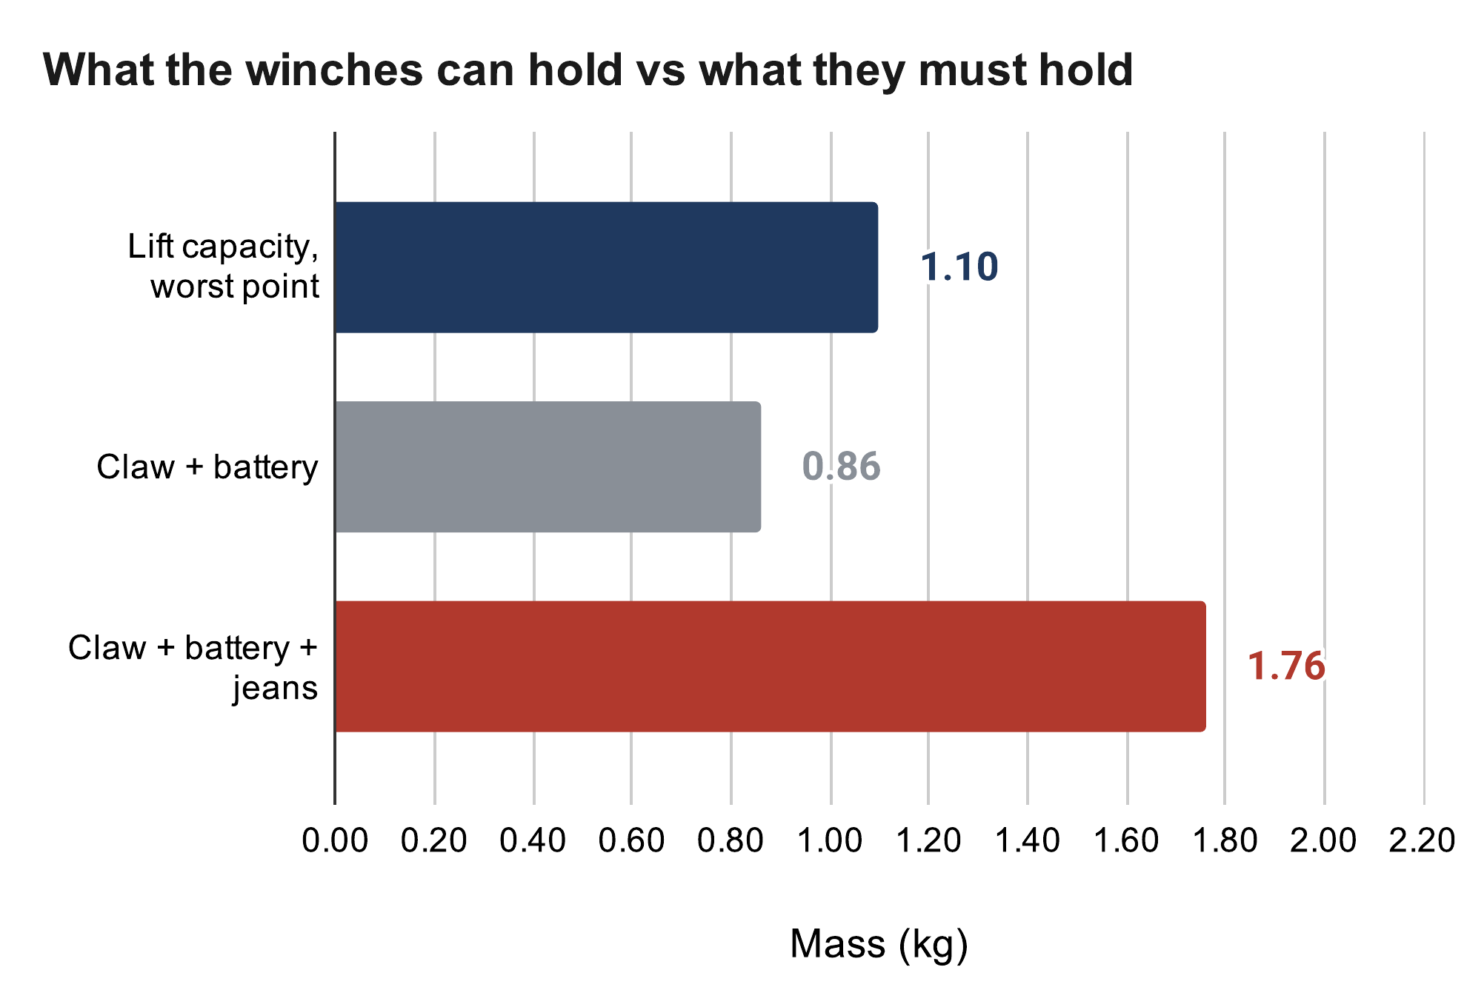
THE CLAW
Weight vs lift: where it stands
Driver limit 1.06 A → running pull ≈ 18–24 N per winch (full vs empty spool)
  about 1.1 kg total lift at the worst point in the room
The claw is not weighed yet: CAD says ~0.76 kg printed, plus a 0.1 kg battery
With jeans that is above the capacity today: this is the open problem
Options: lighten the claw, a 3:1 winch reduction (~2.7× pull), or a lighter demo load
  next step: a luggage-scale pull test on one station decides
Expected values: my calculation sheet (Google Sheets), “Lift budget” tab
EQUATIONS
Σ T_{i} u_{iz} = m (g + a), 0 < T_{i} ≤ 11.9 N (worst point in the room)
m_{claw} ≈ f ρ V + m_{tube} + m_{servo} = 0.55 × 927 g + 198 g + 55 g ≈ 0.76 kg
Notes:
Honest status: the numbers say the current claw plus jeans is too heavy. The pull test turns the 0.7 running-torque assumption into a measurement.

Slide 30
05
Manufacturing
Printed PETG parts, and a heat fin cut and drilled on a manual mill
Notes:
Printed PETG parts, and a heat fin cut and drilled on a manual mill

Slide 31
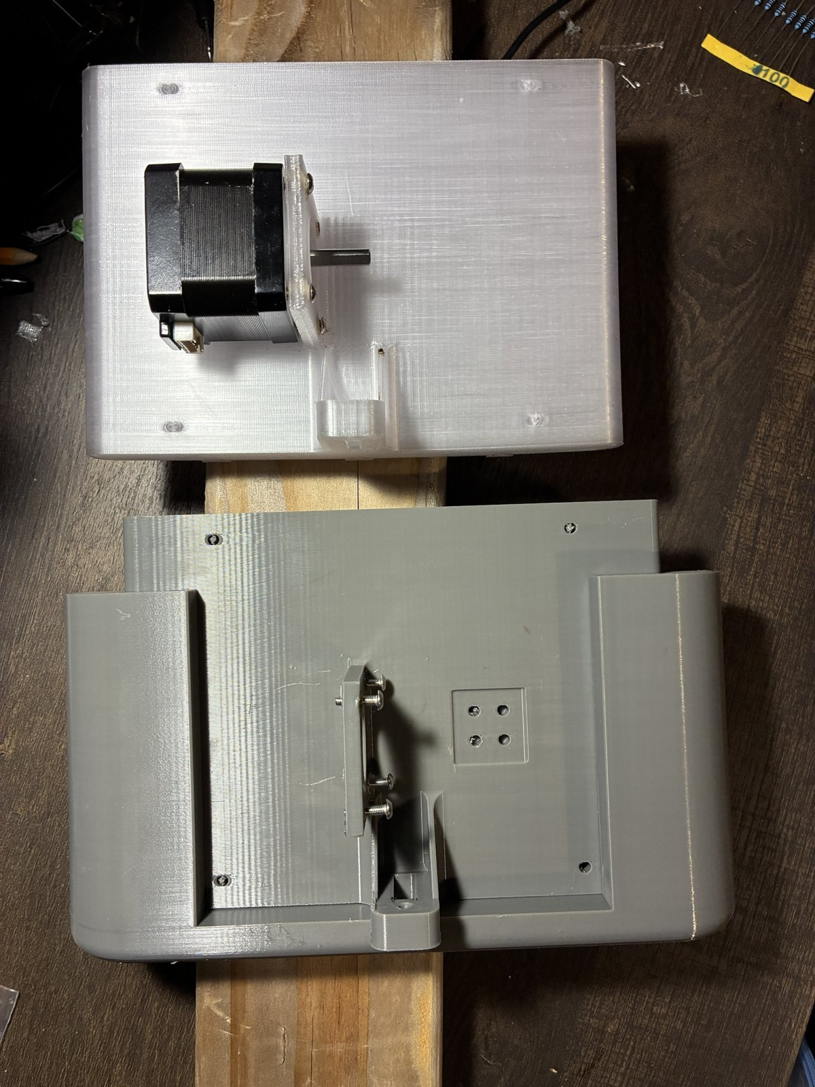
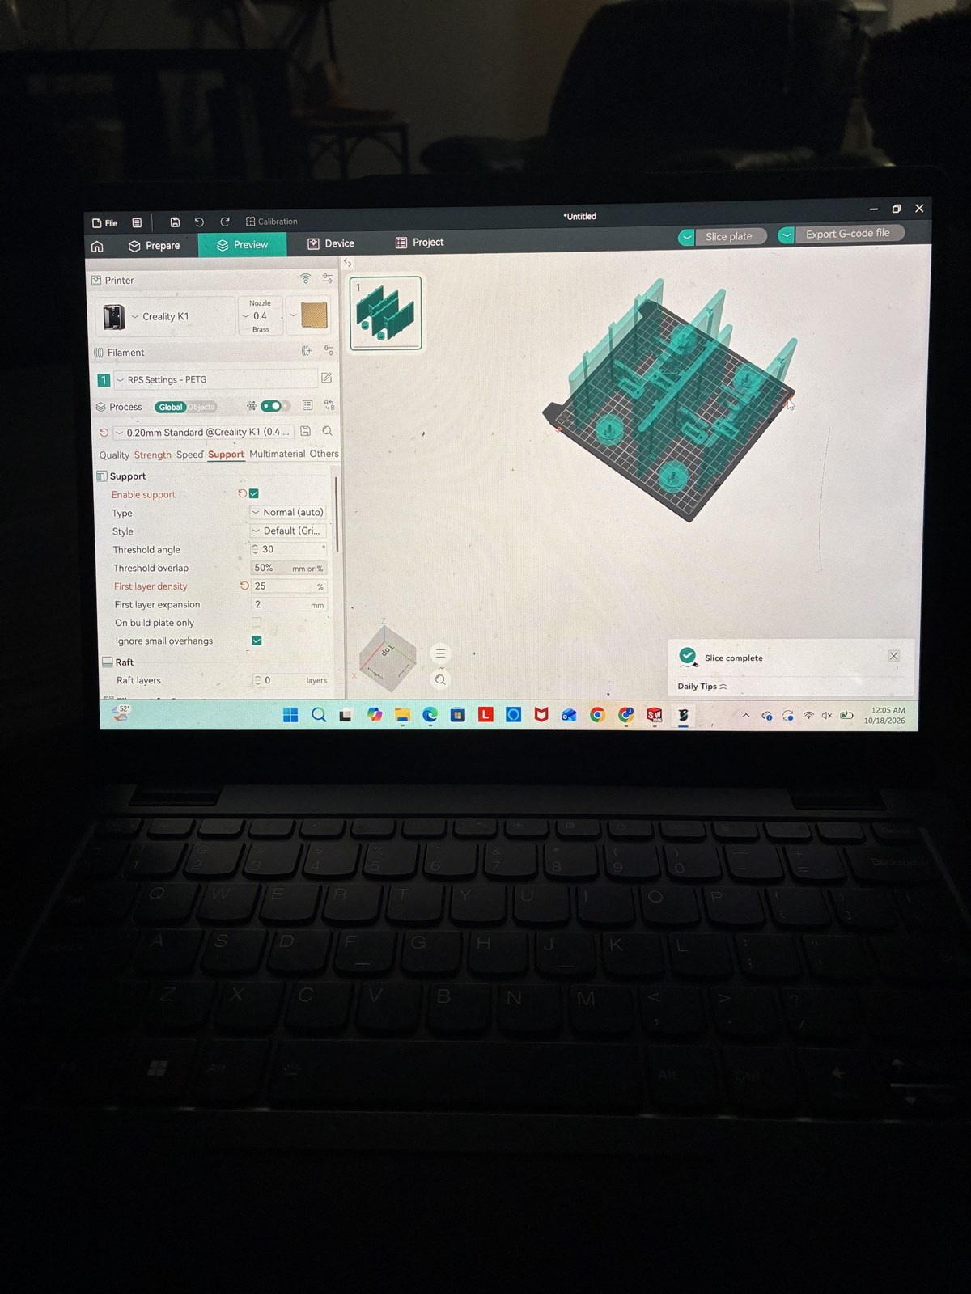
MANUFACTURING
Designing parts to be printed
PETG on a Creality K1 (0.4 mm nozzle, 0.2 mm layers); PLA creeps under load
Orientation: flat face on the bed, loads along the layers, no supports on mating faces
Printed holes come out undersize (bead rounding, shrink, first-layer squash)
  so fits get a lead-in: 687 bearing pocket Ø14.075 with a Ø14.000 entry lip
Heat-set M3 inserts where screws are reused
Fewer parts: camera bay printed into the housing
EQUATIONS
Clearance c = (D_{hole} − u) − D_{shaft}, u = printer undersize
Spool: Ø5.2 too tight → u ≥ 0.2 mm, so Ø5.45 gives c ≈ 0.25 mm
Printed PETG station shells; slicing the plate for the K1
Notes:
Every printed interface is chosen for how it prints and how I can measure it, not just how it looks in CAD.

Slide 32
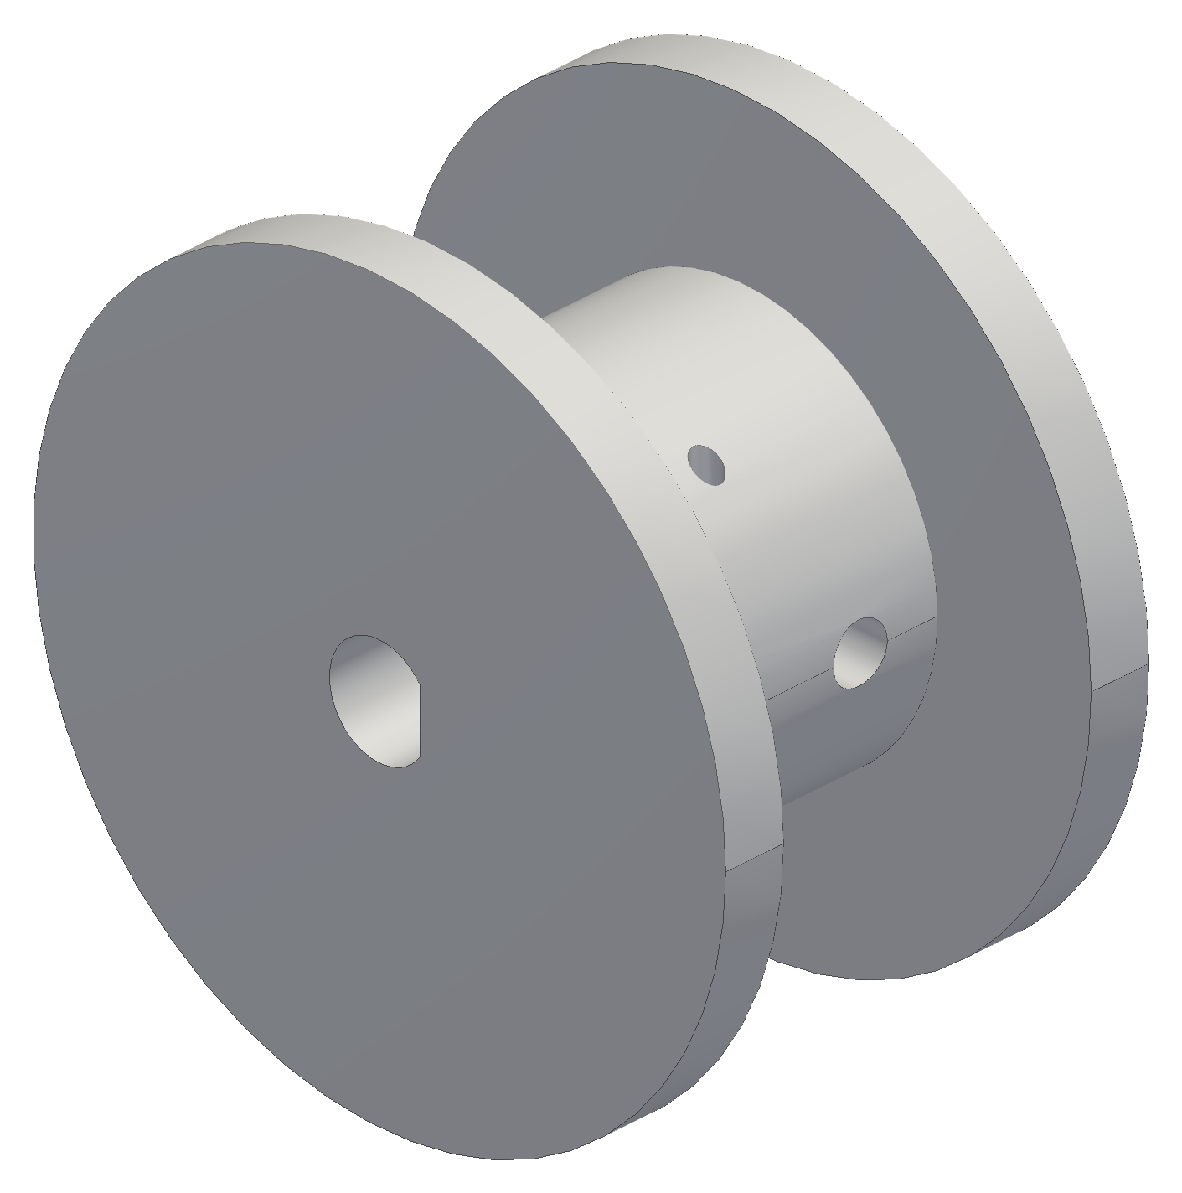


MANUFACTURING
Print, measure, adjust: the spool
v1: longer than the motor shaft could engage, so it was shortened
v2: the Ø5.2 bore printed too tight on the 5 mm shaft
v3: bore opened to Ø5.45 with a D-flat; the set screw on the flat carries the torque
Ø15 core and 16 mm drum: 20 ft of line in 5 layers with 8 mm of flange margin
Next: a fit coupon before every new interface, measured with calipers
Spool v1, v2, v3 (CAD)
Notes:
The bore fit only locates the spool; torque goes through the set screw on the flat.

Slide 33


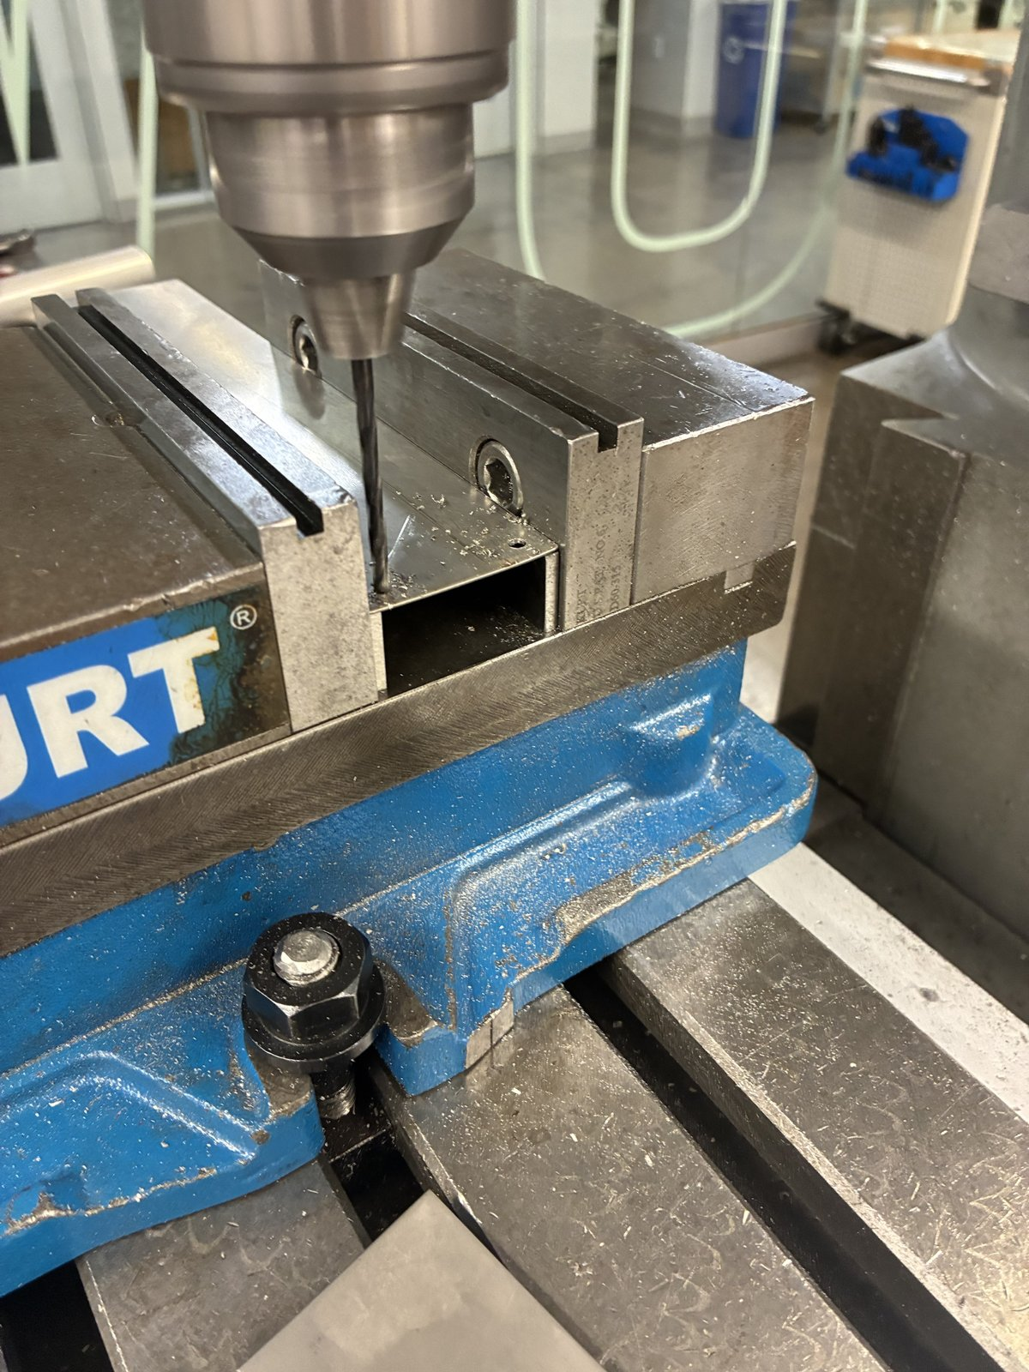

MANUFACTURING
Machining the heat fin
Shop drawing first: a 1:1 US Letter print with a hole template and inch dimensions
Sheared the blank from 0.019 in aluminium sheet: 44 × 250 mm (±0.5)
Manual mill, one setup: all five holes located from the bottom and left edges
  7/8 in pilot for the motor boss and 4 × Ø3.4 on the 31 mm motor square, ±0.1 mm to each other
Deburred, then matte black paint except the motor contact square; thermal paste there
Test fit on the NEMA 17: boss centred, all four screws lined up
Shear and blanks, mill setup with the drawing, drilling, the finished fin
Notes:
One setup from the same two edges means hole-to-hole errors do not stack, so the fin bolts on without reaming.

Slide 34
06
Electronics and software
The station board, a bring-up lesson, and how the robot is controlled
Notes:
The station board, a bring-up lesson, and how the robot is controlled

Slide 35

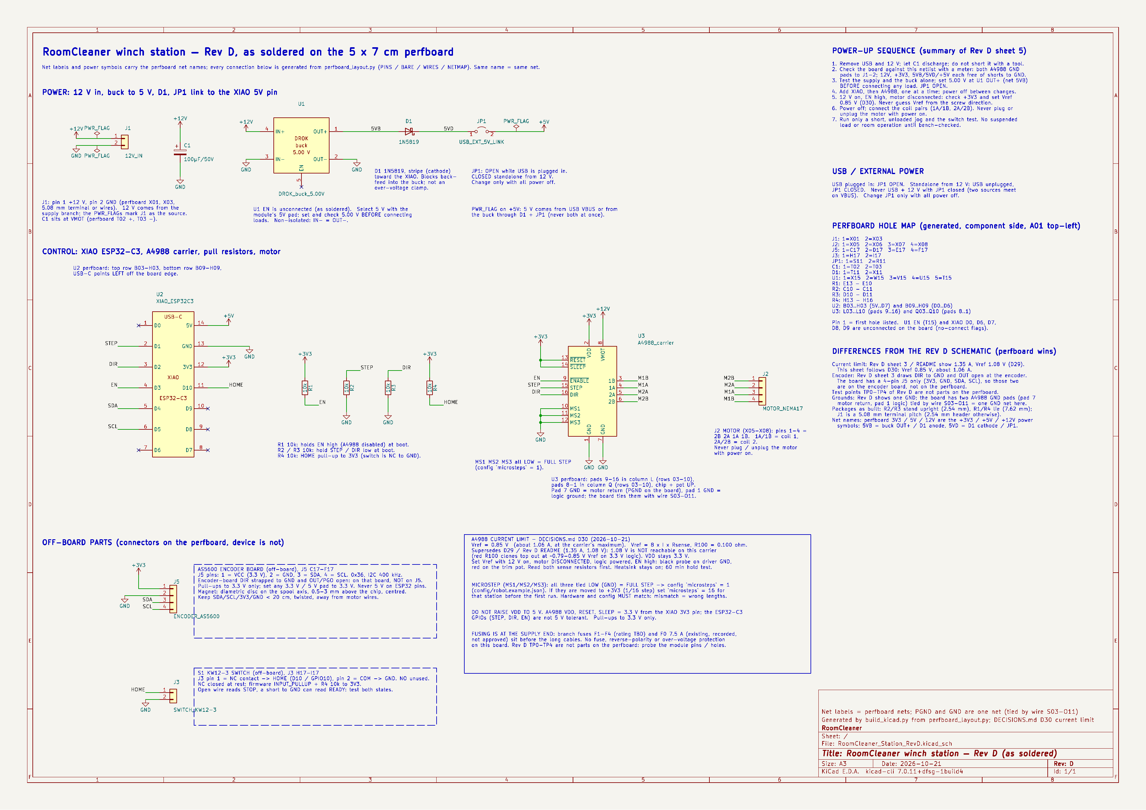
ELECTRONICS AND SOFTWARE
Station board
The driver boots disabled (EN pull-up): a reset never steps the motor
USB and the 5 V buck cannot back-feed each other: a link jumper plus a Schottky diode
100 µF at the driver's motor supply
Connectors for the motor, homing switch, encoder and 12 V
The KiCad schematic is generated from the soldered board's net list, so the two cannot disagree
KiCad schematic (left), checked net by net against the soldered perfboard (right)
Notes:
Rules check: 0 errors. 16 nets, 55 pins match the perfboard.

Slide 36
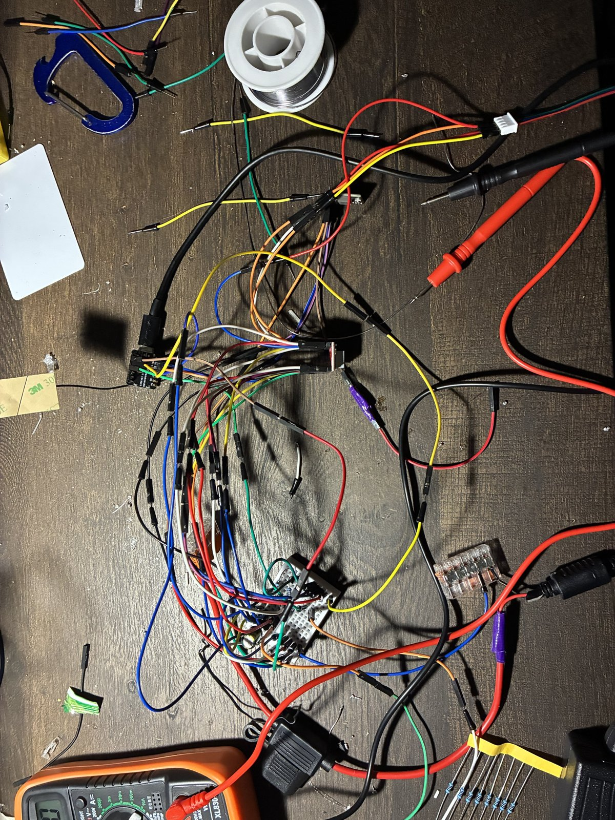

ELECTRONICS AND SOFTWARE
A motor that would not move
The log said it was stepping; the shaft did not turn
The meter said the logic rail was 1.14 V instead of 3.3 V: a bad connection
After the fix it moved
Since then: a meter checklist before any code
  VDD, SLEEP, ENABLE and the buck output, every new board
Bench wiring and bring-up
Notes:
Lesson: measure before trusting the software's view of the hardware.

Slide 37



ELECTRONICS AND SOFTWARE
Control software and phone app
The host plans paths; the stations execute timed segments; a lost link means hold
Stop never disables: there is no brake, so faults and pause keep holding torque
Phone app over home Wi-Fi: robot status, live claw camera, guided setup, chat
  anything that moves the robot asks “yes” first; pause runs at once
Tested in a full simulator of the stations and the claw
Phone app: home, camera, chat
Notes:
The software was built against a simulator first, so faults like lost messages and reboots were exercised before hardware.

Slide 38
07
Status and next steps
Notes:
Status and next steps

Slide 39
STATUS AND NEXT STEPS
First test
Stations up in studs, powered from the switched power strip
Self-calibration on the real hardware: slack take-up, lift, floor-board poses, fit
Then a short lift and a 300 mm move at 50 mm/s with the 1 lb test load
Logged: cable lengths, encoder counts, motor temperatures and the fit's error bars
Pass limits written before the run
Photo / video from the first test
Notes:
Placeholder: replace the box with the first-test photo and the measured numbers (calibration error bars, cable error over the 300 mm move).

Slide 40
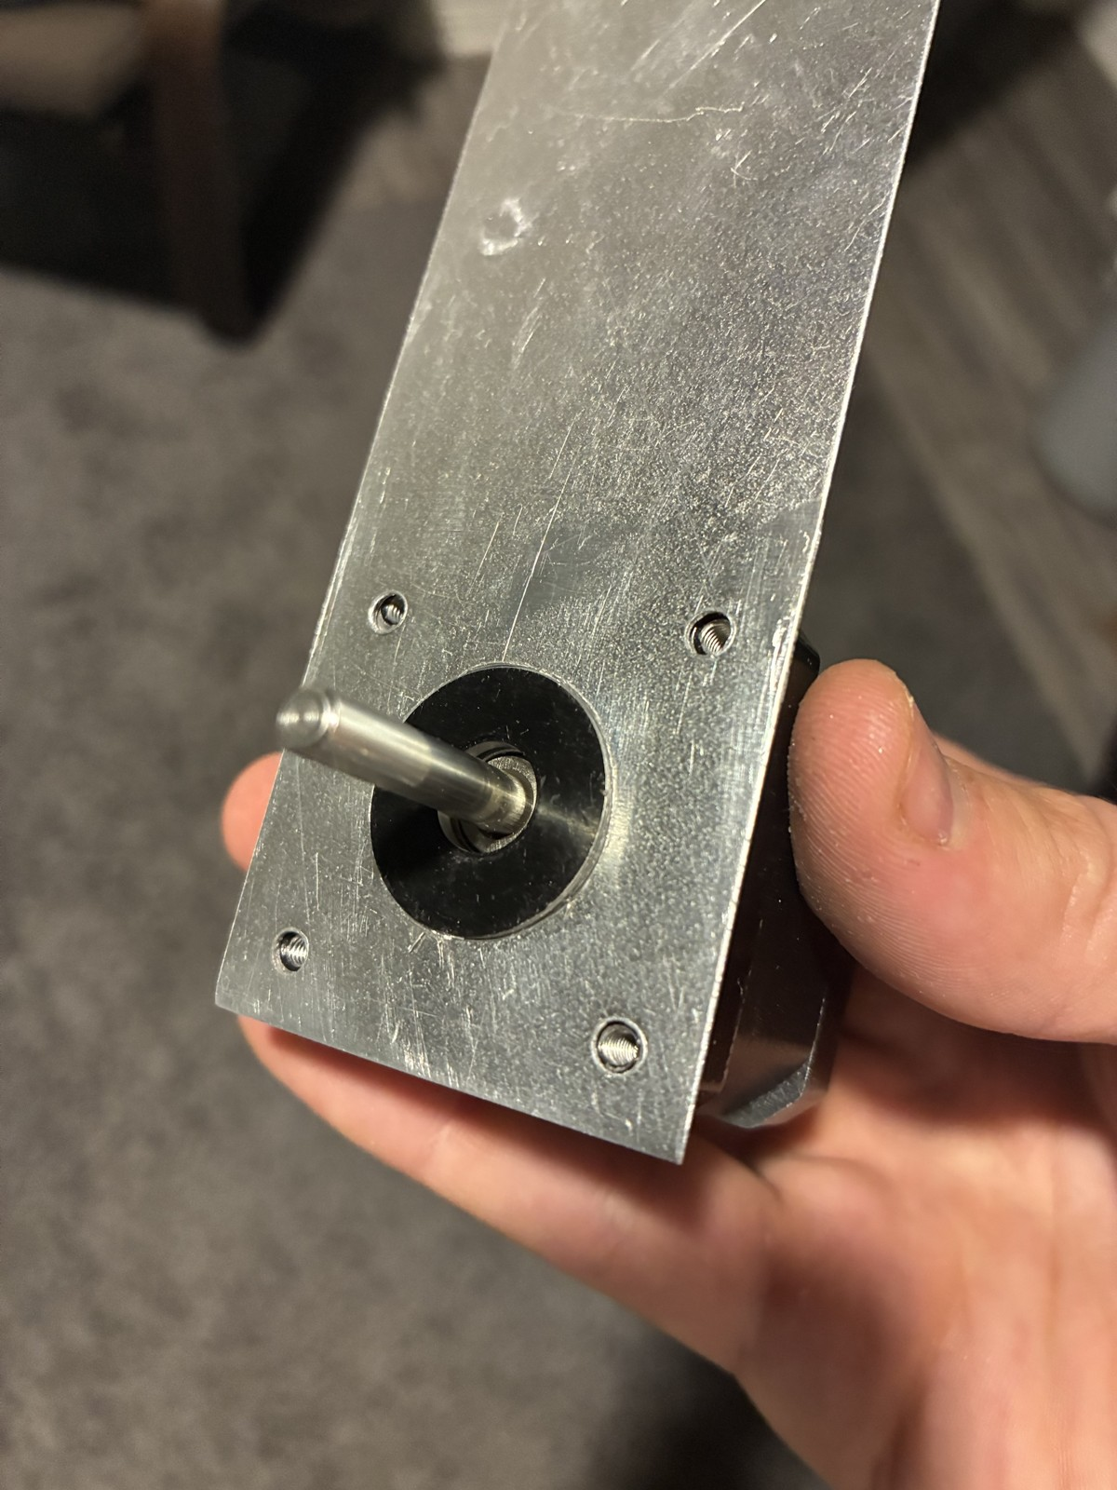
STATUS AND NEXT STEPS
Status and next steps
Built: stations, station boards, heat fins, gripper parts
Designed and checked in CAD: the hands and the camera housing
Calibration and control: simulated, then the first test
Next tests, with pass limits written first:
  winch pull test (decides the capacity fix)
  90-min hold test: motor and printed mount under 60 °C
  SolidWorks static and thermal studies of the station
  four-station lift: 1 lb, 300 mm at 50 mm/s, within 2 mm per cable
Built: the heat fin test-fitted on the motor
Notes:
Everything that is calculated or simulated is called that; the test list is what turns it into measurements.

Slide 41
STATUS AND NEXT STEPS
What I learned
Measure before trusting a margin: the driver limit and the 1.14 V rail
Print the test coupon before the part: the spool bore
Hold tolerance where it matters: one mill setup for the fin's holes
Design for the worst case: stall, the corner of the room, the hottest hour
Modularity paid for itself: every station can be pulled, fixed and put back
Question each requirement and delete parts: the IMU, the overhead camera, the five-finger hand, the long motor harnesses
Notes:
If I did it again: buy the pulleys and couplers sooner, and build one complete station to test before building four.

Slide 42
Questions
Jasper Buntinx · jasper_buntinx@tamu.edu
Notes:
Backups follow: schematics, gear strength, safety, calculations and sources.

Slide 43

BACKUP
Backup: claw electrical
One protected 2S pack (7.4 V, 2200 mAh), 5 A fuse, main switch
6 V regulator for the servo only; separate 5 V buck and Schottky diode for the controller
Battery read through 200k / 100k: 8.4 V → 2.80 V at the ADC
Peak ≈ 2.8–3.1 A against a ≈ 3 A pack rating: stalls must stay short
Charged on the claw only with the switch off, attended, at ≤ 1 A
Notes:
Rules check 0 errors; 9 nets match the specification.

Slide 44
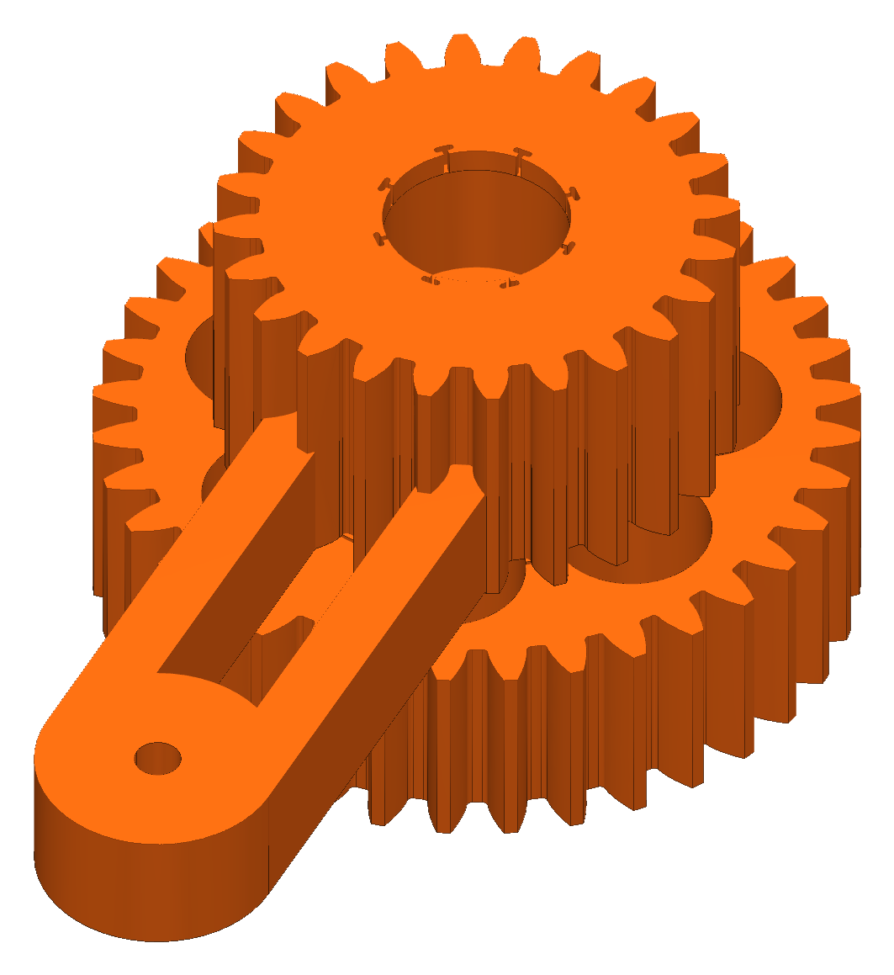
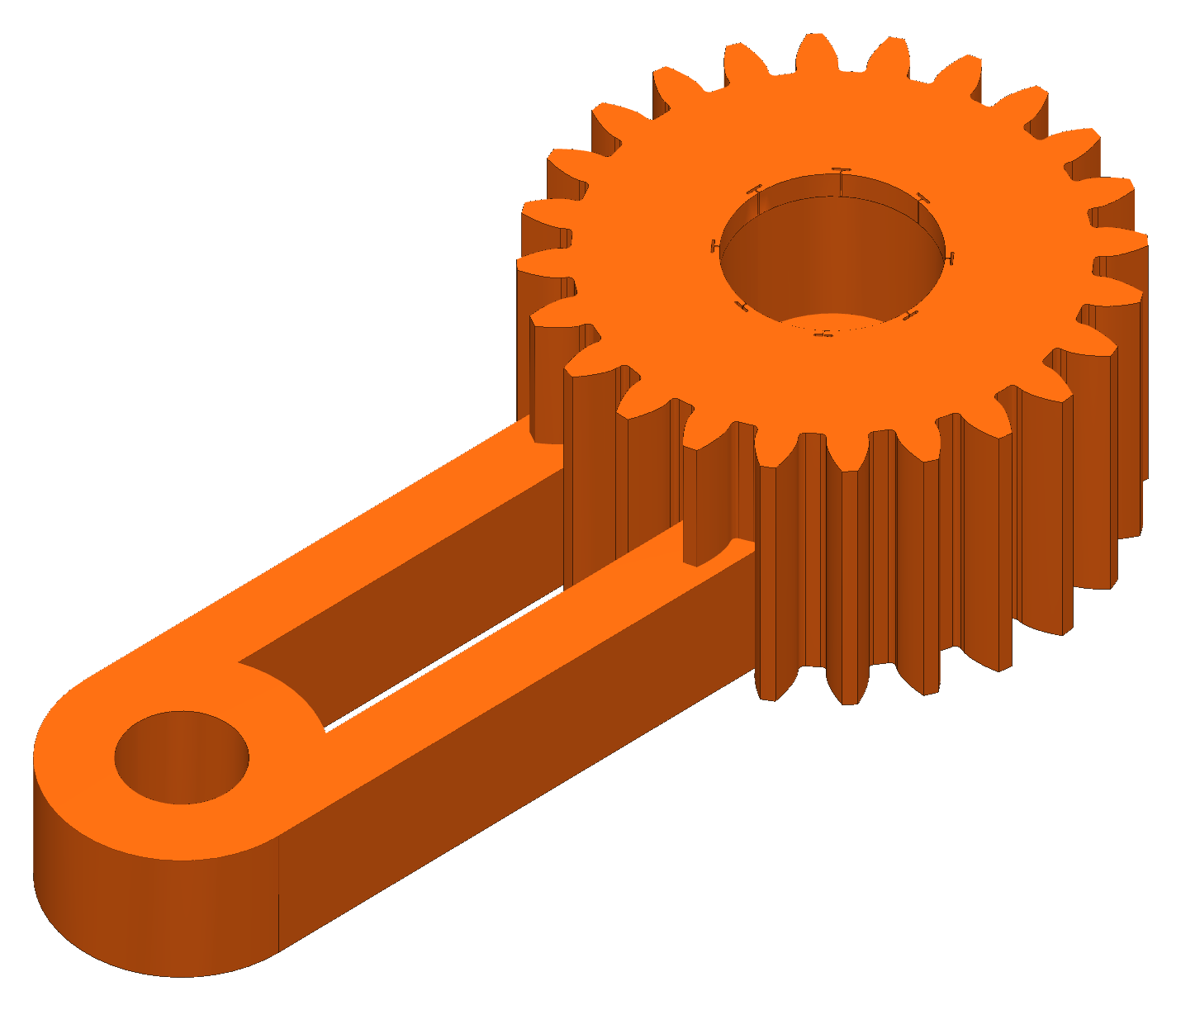
BACKUP
Backup: gear strength (Lewis)
Module 1.5, PETG allowable 22.5 MPa
At 6 V servo stall: pinion SF 2.05, 36T gear 2.50, sync gear 2.00 (one jaw carrying the load)
Module 1 was screened first: SF 0.35–0.41, so the module went up
EQUATIONS
σ = F_{t} / (b m Y), F_{t} = 2τ / d, SF = σ_{allow} / σ
Notes:
Stall torque 1.08 N·m at 6 V (servo rating, not measured).

Slide 45
BACKUP
Backup: safety
One hard stop: the switched power strip; faults and pause hold torque
Stations anchor into studs; the line load is mostly pull-out and prying
Nobody stands under the robot while it moves
Claw battery: protected pack, charged with the switch off and attended
No safety-rated function is claimed

Slide 46
BACKUP
Backup: calculations and sources
Every chart comes from my calculation sheet in Google Sheets, one tab per topic
  cable tension, winch pull, heat fin, motor temperature, wiring, bead homing, floor board, lift budget, gears
Every result is a formula on its inputs; inputs are marked, with their source or assumption
References used:
  Incropera, DeWitt, Bergman, Lavine: Fundamentals of Heat and Mass Transfer, ch. 3 (extended surfaces)
  Allegro MicroSystems: A4988 datasheet (current limit)
RoomCleaner engineering calculations (Google Sheets)

